Slide 1
Introduction to Node.JS (Hands-on )
GESSA ASU Session by Guru Srikar T

Slide 2
Less talk; More code;
Evolution of JavaScript
Why should I learn Node.JS
What is Node.JS anyway
Build something with Node.JS

Slide 3
Evolution of JavaScript
1997 XHR & AJAX
2000-02 JSON
2008 - 13 Frameworks Exploded
2009 - 17 Node.JS
2006 jQuery
1995 Birth
Notes:
Brendan Eich father of javascript in late 1995
1997 Xhr and ajax
Json
Jquery
Server side Node.JS
http://www.harpersbazaar.com/culture/film-tv/news/g7453/game-of-thrones-character-transformations/?slide=6

Slide 4






Evolution of JavaScript
1997 XHR & AJAX
2000-02 JSON
2008 - 13 Frameworks Exploded
2009 - 17 Node.JS
2006 jQuery
1995 Birth
Notes:
Brendan Eich father of javascript in late 1995
1997 Xhr and ajax
Json
Jquery
Server side Node.JS
http://www.harpersbazaar.com/culture/film-tv/news/g7453/game-of-thrones-character-transformations/?slide=6

Slide 5
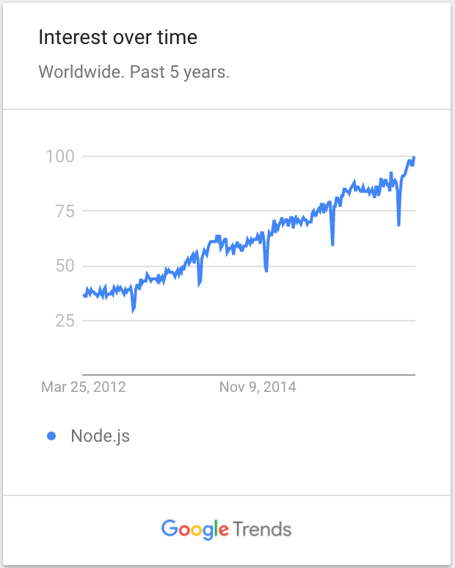
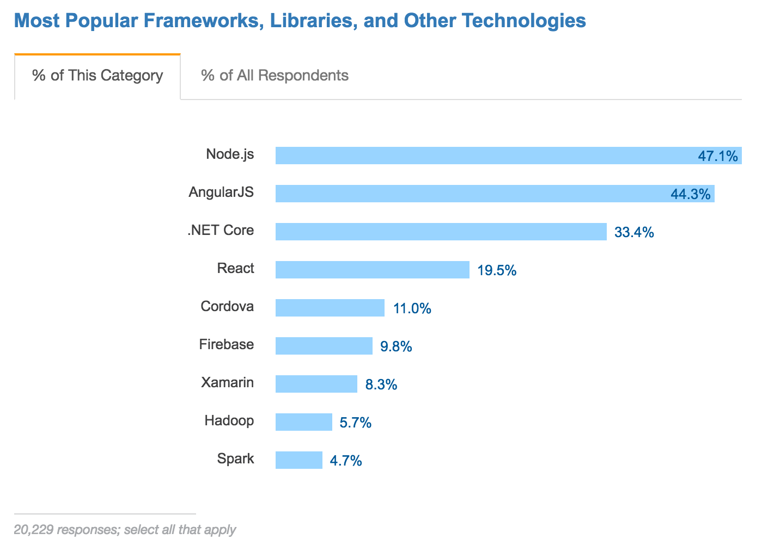
Why should I learn Node.JS
Stackoverflow.com Dev Survey

Slide 6
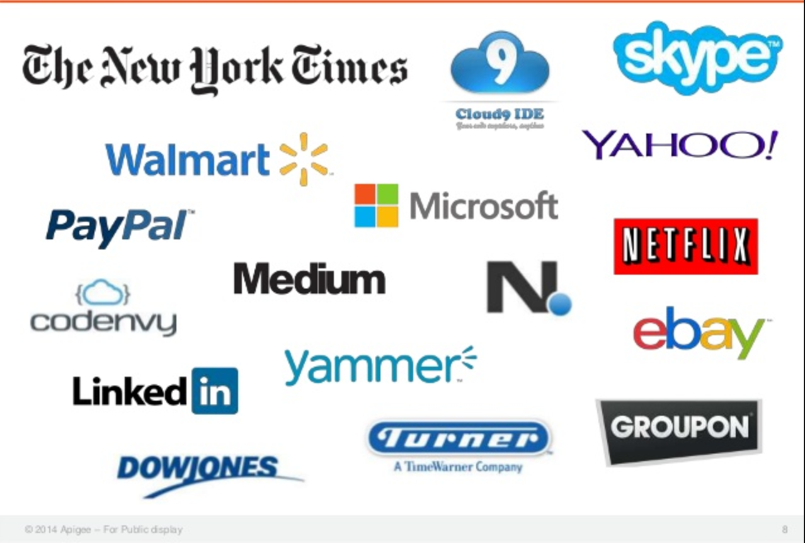
Who is using Node.JS
Notes:
https://www.slideshare.net/apigee/build-apis-in-nodejs-and-swagger-20-with-apigee127

Slide 7
What is Node.JS anyway
Server side JS framework
JS
Node Standard Library
C/C++
V8

Slide 8
What is Node.JS anyway
Server side JS framework
Non-blocking & Event driven
JS
Node Standard Library
Python:
user = db.Select(query)
processUser(user)
doSomethingElseUnrelated();
C/C++
V8
Node:
db.select(query, function (user) { processUser(user); });
doSomethingElseUnrelated();

Slide 9
https://image.slidesharecdn.com/angularjsforbeginners-150207035229-conversion-gate02/95/angular-js-for-beginners-4-638.jpg?cb=1424477649

Slide 10
http://bit.ly/2nN3slp

