Slide 1
COLLEGE OF COMPUTER STUDIES · CMSC 203
Event Registration System
An object-oriented web application for registering students to school events
Final Project: Object-Oriented Application Development
[Group members] · [Instructor name] · October 2026
Notes:
Introduce the group and the project. Replace the placeholders on this slide with the group members and instructor.

Slide 2
The problem we addressed
Sign-ups are collected on paper, group chats and spreadsheets
Organizers cannot tell how many spots are left, so events get overbooked
Students can register twice; records are scattered
Attendance is not recorded in a consistent way
Event details change and are hard to keep updated
Notes:
Explain why manual registration (paper, chat, spreadsheets) fails: overbooking, duplicates, no attendance record.

Slide 3
System overview
Participant (student)
Administrator
Sign up / log in
Browse, search, filter events
Reserve or cancel spots
Profile and attended history
Add, edit, delete events
View participants and registrations
Record attendance
Dashboard statistics
Python · Flask · JSON file storage · HTML/CSS/JavaScript interface
Notes:
Two kinds of users. Walk through what each can do. The web interface was approved by the instructor.

Slide 4
Layered architecture
Presentation
HTML · CSS · JavaScript
Routes
routes.py – thin HTTP wrappers
Services
AuthService · EventService · RegistrationService
Models
Entity · Person · Participant · Admin · Event · Registration · Database
Repository
Repository (abstract) → JsonRepository → data.json
Notes:
Each layer has one job. Routes never touch the file; services never know about HTTP.

Slide 5
OOP concepts applied (30%)
Encapsulation
Inheritance
Private _capacity, _password_hash with validated properties
Entity → Person → Participant / Admin
Polymorphism
Abstraction
describe(), to_dict(), check_password() differ per class
Abstract Entity, Person, Repository (ABC)
Overloading
Constructors
EventService.get(id | Event) with singledispatchmethod
__init__ plus factories: Event.create(), Participant.create()
Notes:
Point to the matching class for each concept during the Q&A. Be ready to open the source file.

Slide 6
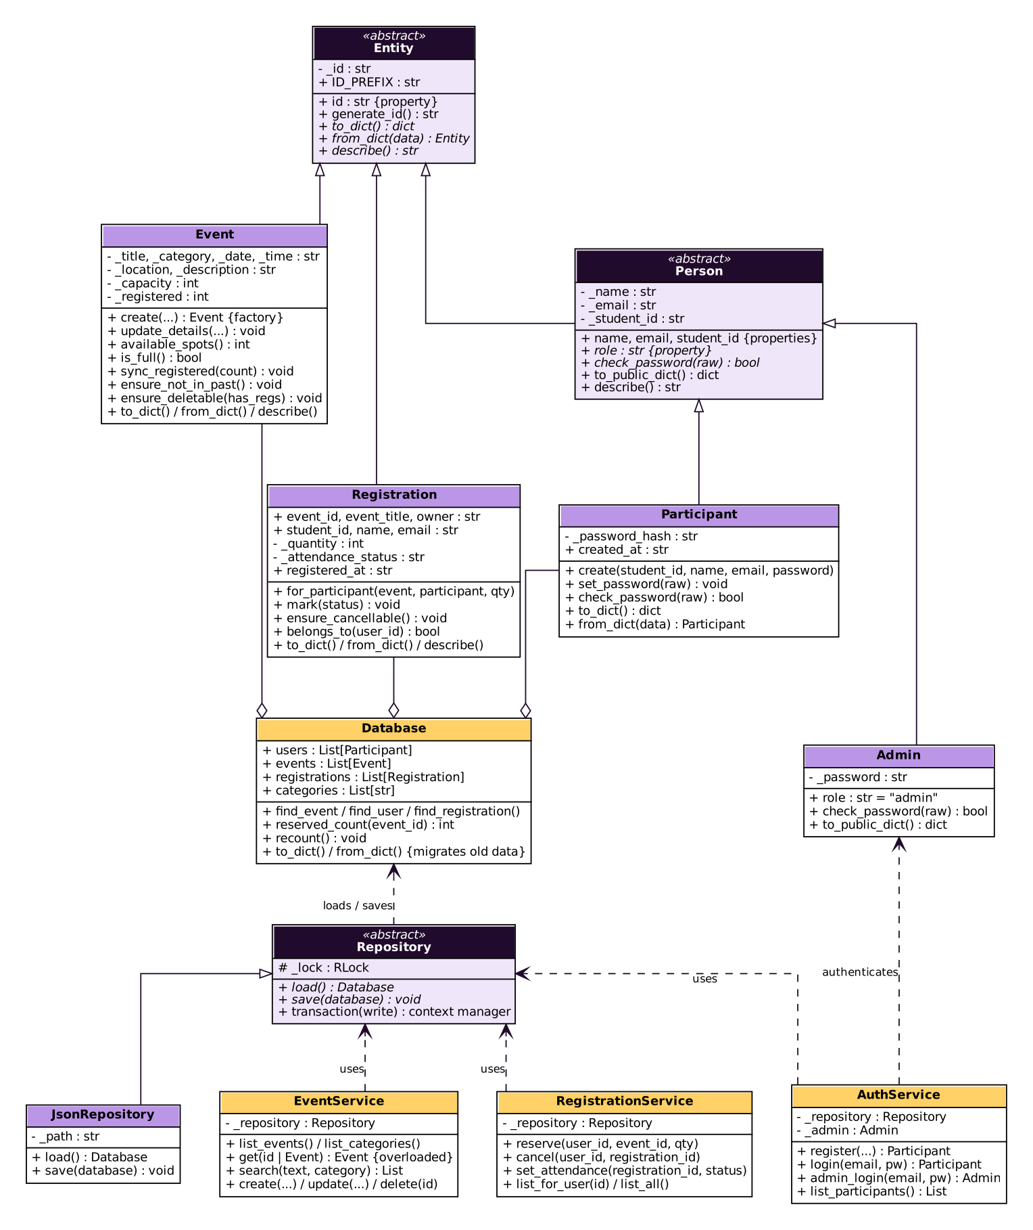
UML class diagram
How to read it
Entity (abstract) is the base of every stored record
Person (abstract) → Participant and Admin
Event and Registration extend Entity
Database aggregates users, events and registrations
Services depend on the abstract Repository, not on the JSON file
Italic = abstract members
Notes:
Walk from the top: Entity is abstract; Person is abstract; Participant and Admin implement role and check_password. Database aggregates the records; services depend on the abstract Repository.

Slide 7
Code highlights
# models/event.py
@property
def capacity(self):
return self._capacity
@capacity.setter
def capacity(self, value):
self._capacity = parse_capacity(value)
# raises ValidationError
# if not a whole number >= 1
# repository.py
class Repository(ABC):
@abstractmethod
def load(self): ...
@abstractmethod
def save(self, db): ...
@contextmanager
def transaction(self, write=False):
with self._lock:
db = self.load()
yield db
if write: self.save(db)
Notes:
Show that invalid values can never be stored because the setter validates.

Slide 8
Exception handling and robustness (10%)
Custom exception hierarchy: EventSystemError → ValidationError, AuthenticationError, PermissionDeniedError, NotFoundError, ConflictError, EventFullError, DuplicateRegistrationError, StorageError
Handles: empty fields, invalid input, wrong data types, file errors
Transactions: if a request fails, nothing is saved
Damaged data.json gives a clear message instead of a crash
Passwords stored as salted hashes; admin and participant permissions checked on every route
Notes:
Mention that errors raised anywhere become clear JSON messages through a single handler in routes.py.

Slide 9
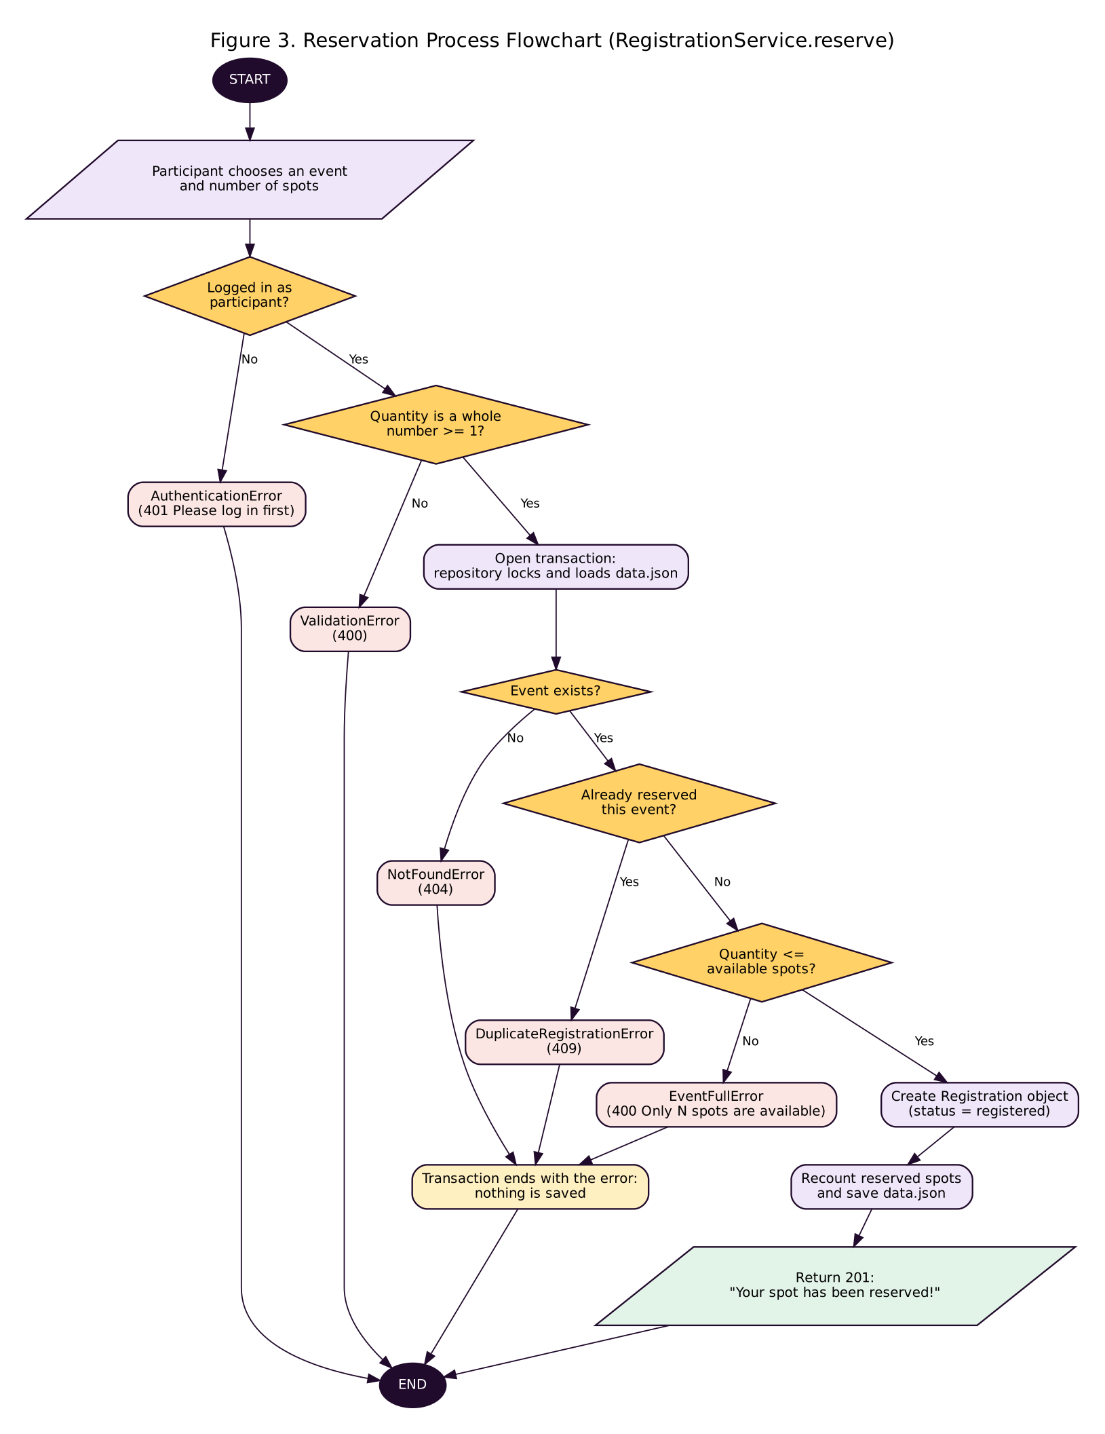
Flowchart: reserving a spot
Checks, in order
Logged in as a participant?
Quantity is a whole number of at least 1?
Event exists?
Not reserved before?
Enough spots left?
Any failed check raises a custom exception and nothing is saved. Only when all pass is the registration created and written to data.json.
Notes:
Follow one request from login check to saved reservation. Every red box is a custom exception.

Slide 10
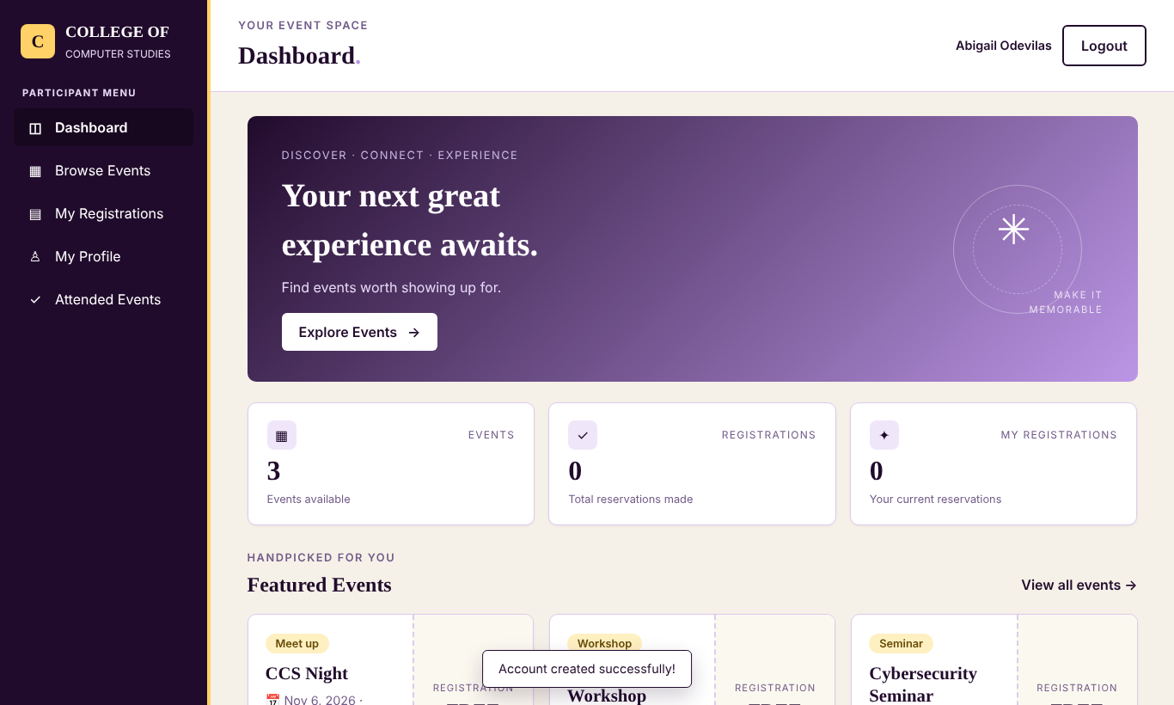
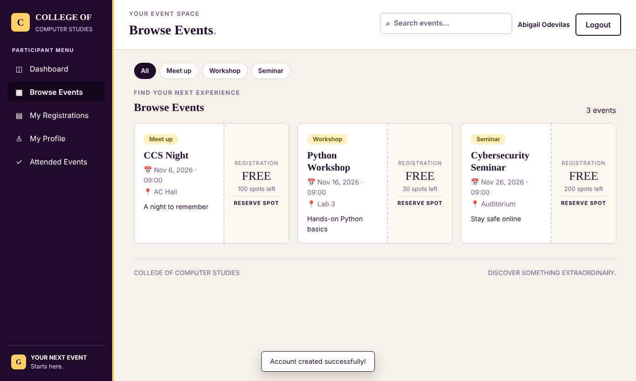
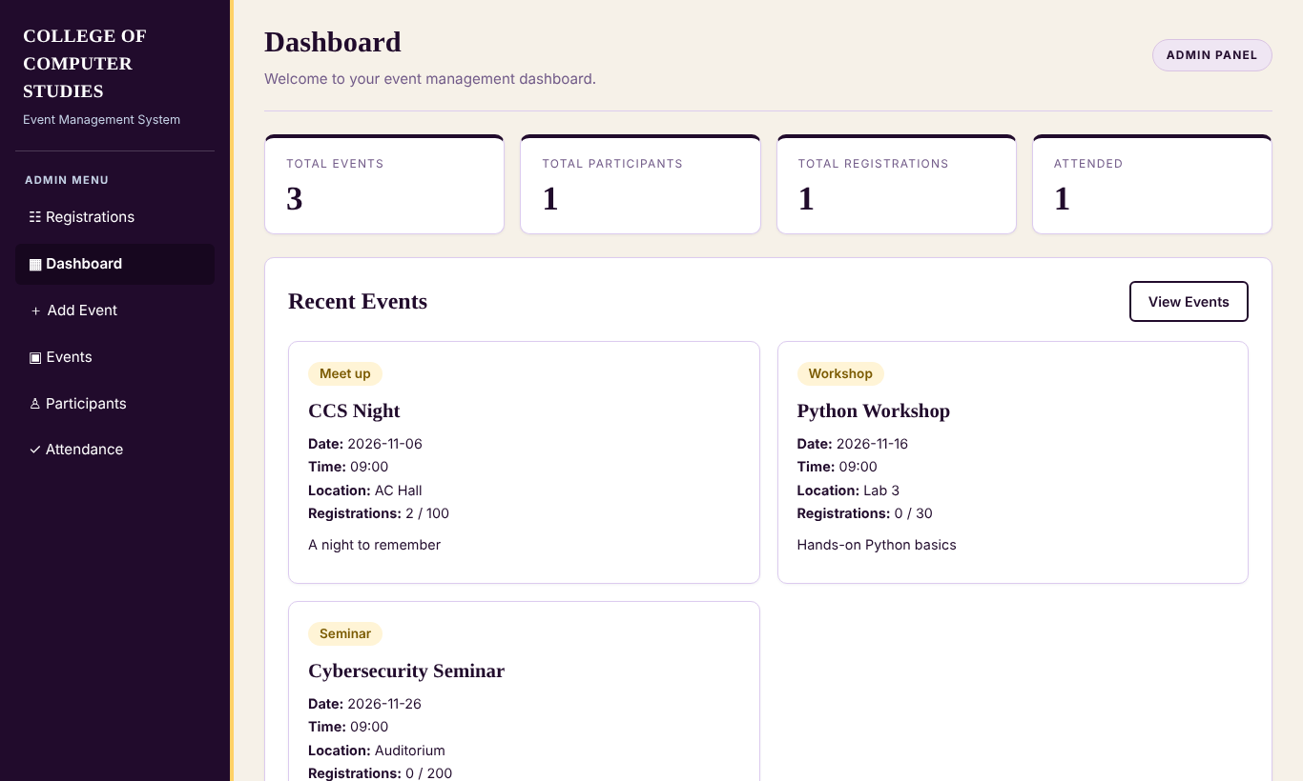
Live demonstration
Participant dashboard
Browse and filter events
Admin dashboard
Demo flow: Admin adds event → Student signs up → Reserves spots → Duplicate / full errors → Admin marks attendance → Student sees Attended Events
Notes:
Suggested demo order: 1) admin logs in and adds an event, 2) student signs up and reserves spots, 3) try a duplicate reservation and an over-capacity request to show the errors, 4) admin marks attendance, 5) student sees the event under Attended Events.

Slide 11
Testing results
25
25
0
tests run
passed
failed
Models: validation, polymorphism, abstract classes
Data file: missing, damaged and old-format files; rollback on failure
Accounts, events and reservations: duplicates, capacity, permissions, attendance
Notes:
25 automated tests all pass. Explain what each group of tests covers.

Slide 12
Challenges encountered
Converting a function-based back end into classes without changing the user interface
Keeping old saved data working (automatic upgrade of old records)
Preventing overbooking when two requests arrive together (file lock + transaction)
Deciding which rules belong in models, services or routes
Notes:
Replace or add to these with your own experiences from building the project.

Slide 13
Lessons learned
Small classes with one job are easier to test and explain
Validation inside the model keeps bad data out of every part of the system
Depending on an abstract Repository lets the storage change later
Automated tests catch mistakes quickly when refactoring
Notes:
Replace or add to these with your own lessons.

Slide 14
Thank you
Questions and answers
Notes:
Every member should be able to explain any part of the code.

