Slide 1


Topic:
HTML (Hyper Text Markup Language) & CSS (Cascading Style Sheets)
Presentation By:
SIDDHI JAIN (0801EC211073)
VAISHNAVEE BELE (IT 92) NAMRATA VASWANI (EI 38)

Slide 2
Introduction to HTML
HTML stands for HyperText Markup Language. It is the standard markup language used to create the structure of web pages. It serves as the backbone of the World Wide Web, allowing content to be displayed on browsers.
Purpose: HTML is a markup language designed to structure content on the web. It provides a standardized way to organize and present information, ensuring consistency across different browsers and platforms.
Its Core Elements include:
<html>: The root element that wraps all content on the page.
<head>: Contains meta-information about the HTML document, such as title, charset, and linked stylesheets.
<title>: Sets the title of the HTML document, visible on the browser's title bar or tab.
<body>: Encloses the main content of the HTML document, including text, images, links,
and more.
Attributes: HTML elements can have attributes that provide additional information. Two basic attributes are:
class: Used to define one or more class names for an HTML element.
id: Assigns a unique identifier to an HTML element.

Slide 3
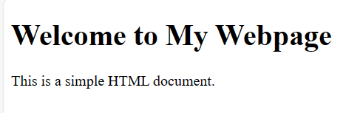
HTML Code Example:
<!DOCTYPE html>
<html lang="en">
<head>
<meta charset="UTF-8">
<meta name="viewport" content="width=device-width, initial-scale=1.0">
<title>My Webpage</title>
</head>
<body>
<h1>Welcome to My Webpage</h1>
<p>This is a simple HTML document.</p>
</body>
</html>

Slide 4
HTML Elements and Tags
Elements: HTML consists of various elements, which are the fundamental building
blocks of a webpage. Elements define the structure and content of a document. Common examples include headings, paragraphs, links, and images.
Tags: HTML uses opening and closing tags to define elements. Tags surround content and provide instructions on how that content should be displayed. They come in pairs, with an opening tag (e.g., <tag>) and a closing tag (e.g., </tag>).
Some HTML Elements:
<h1> to <h6>: Define headings of different levels.
<p>: Represents a paragraph.
<a>: Creates hyperlinks.
<img>: Embeds images.

Slide 5
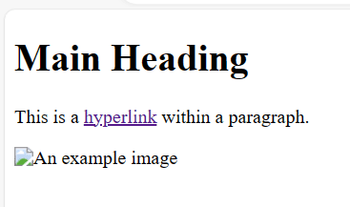
Example:
<!DOCTYPE html>
<html lang="en">
<head>
<meta charset="UTF-8">
<meta name="viewport" content="width=device-width, initial-scale=1.0">
<title>HTML Elements Demo</title>
</head>
<body>
<h1>Main Heading</h1>
<p>This is a <a href="https://example.com">hyperlink</a> within a paragraph.</p>
<img src="example.jpg" alt="An example image">
</body>
</html>

Slide 6
Forms and Multimedia in HTML
Forms: HTML provides interactive elements like forms, allowing users to input data. Key form elements include:
<form>: Wraps the entire form.
<input>: Represents input fields for various types of data.
<button>: Creates buttons for form submission.
Multimedia: Enhance user engagement by embedding multimedia content. Common multimedia elements include:
<img>: Embeds images.
<audio>: Allows audio playback.
<video>: Embeds video content.

Slide 7
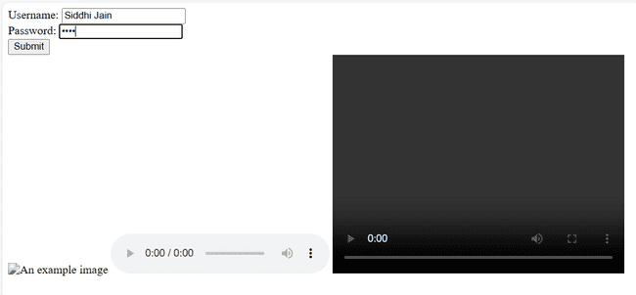
Example
<!DOCTYPE html>
<html lang="en">
<head> <meta charset="UTF-8">
<meta name="viewport" content="width=device-width, initial-scale=1.0">
<title>Interactive Webpage</title>
</head> <body>
<form action="/submit" method="post">
<label for="username">Username:</label>
<input type="text" id="username" name="username"> <br>
<label for="password">Password:</label>
<input type="password" id="password" name="password"> <br>
<button type="submit">Submit</button>
</form>
<img src="example.jpg" alt="An example image" width="300" height="200">
<audio controls>
<source src="audio.mp3" type="audio/mp3">
Your browser does not support the audio element. </audio>
<video width="400" height="300" controls>
<source src="video.mp4" type="video/mp4"> Your browser does not support the video tag.
</video> </body> </html>

Slide 8
Need of CSS
Cascading Style Sheets (CSS) are essential for styling and layout of web pages.
It allows consistent styling across multiple pages.
It allows customization of text color, font type, and spacing etc.
Uses meaningful class and ID names.
It follows a consistent coding style.

Slide 9
Introduction to CSS
Cascading Style Sheets, commonly known as CSS, is a fundamental technology in web development that plays a crucial role in shaping the visual presentation of websites.
It is a language that is used to describe style of a document.
Purpose of CSS: CSS allows web developers to separate the structure (HTML) from the style, providing a clean and modular approach to designing web pages.
CSS Key Functions:
Styling: CSS is used to control the layout, colors, fonts, and overall visual appearance of
HTML elements.
Consistency: It helps maintain consistency across a website by applying a consistent style to multiple pages.
Adaptability: CSS enables web pages to adapt to various devices and screen sizes through responsive design.

Slide 10
History of CSS
Before CSS:
In the early days of the web, styling was embedded within HTML, making it challenging to maintain and update HTML pages multiple times. It was done using some HTML tags as follows:
Inline Styles: Styles are directly applied to individual HTML elements using the style attribute.
<p style="color: blue; font-size: 16px;">This is a paragraph with inline styling.</p>
Font Tag: <font> tag was used to set font-related properties like color and size directly within the HTML markup.
<font color="green" size="4">This text is styled using the font tag.</font>
Background and Text Color Attributes: The bgcolor attribute was used to set the
background color of the entire page.
The text attribute was used to set the text color within specific elements.
<body bgcolor="#FFFF00">
<p text="#000000">This is a paragraph with specified background and text
color.</p>
</body>

Slide 11
Align Attribute: The align attribute was used to align text or elements within a specified direction (e.g., center, left, right).
<h2 align="center">Centered Heading</h2>
But it is limited in functionality as compared to the flexibility offered by CSS.
<b>, <i>, and <u> Tags: Basic formatting options like bold, italic, and underline were
achieved using specific HTML tags.
<p><b>Bold</b>, <i>italic</i>, and <u>underlined</u> text using HTML tags.</p>
These methods lacked the comprehensive styling capabilities provided by CSS.

Slide 12
Emergence of CSS:
CSS emerged in the late 1990s as a solution to separate styling from HTML, providing more flexibility and maintainability.
In 1994, Hakon Wium Lie, a Norwegian web pioneer, and Bert Bos, a Dutch programmer, proposed the first CSS specification. Their vision was to separate content (HTML) from presentation (CSS), thus simplifying web development and making it more flexible.
The difference between HTML and CSS lies in their roles: HTML structures web content, while CSS styles and formats that content.
W3C Standardization: The World Wide Web Consortium (W3C) played a crucial role in standardizing CSS, ensuring a consistent approach across browsers.
🠶 CSS Version History
CSS1 (1996): The first official CSS specification, CSS1, was introduced in 1996. It allowed for basic stylings, such as changing text colors, fonts, and backgrounds, but was limited in terms of layout control.
CSS2 (1998): CSS2, released in 1998, introduced a plethora of new features, including positioning, improved control over layout, and the introduction of media types for different devices.

Slide 13
CSS2.1 (2011): This version focused on clarifying and improving the CSS2 specification, providing greater stability and browser compatibility.
CSS3 (ongoing): CSS3 is not a single monolithic release but a collection of modular specifications introduced gradually. These modules cover various aspects of web design, such as animations, gradients, and flexible box layouts.
CSS4 (in development): CSS4 is the future of CSS, aiming to further enhance web design
capabilities, including responsive design, variable fonts, and improved grid systems.

Slide 14
Linking CSS with HTML file:
🠶<link> Tag: Connects an external CSS file to an HTML document.
🠶<style> Tag: Embeds CSS directly within the HTML document.

Slide 15
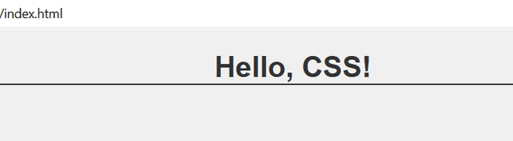
Working with CSS example:
HTML Code:
<!DOCTYPE html>
<html lang="en">
<head>
<meta charset="UTF-8">
<meta name="viewport" content=
"width=device-width, initial-scale=1.0">
<title>Foundation CSS</title>
<link rel="stylesheet" href="styles.css">
</head>
<body>
<h1>Hello, CSS!</h1>
</body>
</html>
/* styles.css */
body {
font-family: 'Arial', sans-serif; background-color: #f0f0f0; text-align: center;
}
h1 {
color: #333;
border-bottom: 2px solid #333;
}

Slide 16
Basic Syntax of CSS
Cascading Style Sheets (CSS) use a simple and straightforward syntax to define styling rules for HTML elements.
CSS Rule Structure:
A CSS rule consists of a selector and a declaration block. selector {
property: value;
/* Additional properties and values */ }
🠶 Selector: Identifies the HTML element(s) you want to style.
🠶 Declaration Block: Contains one or more declarations separated by semicolons, each defining a property and its corresponding value.
/* CSS Rule Example */
h1 {
color: #3498db; font-size: 2em;
margin-bottom: 10px; }

Slide 17
Types of Selectors
Element Selector: Targets HTML elements. p { /* styles for all paragraphs */}
Class Selector: Targets elements with a specific class.
.highlight { /* styles for elements with class "highlight" */}
ID Selector: Targets a specific element with a unique ID. #header { /* styles for the element with ID "header" */}
Properties and Values: CSS properties define the aspects of an element you want to style, specify how to style them.
and values
/* Example */ h2 {
font-family: 'Arial', sans-serif;
font-weight: bold; }
5. Combining Selectors: We can combine multiple selectors in a rule to apply the same styles to different elements.
h3, p, .info {
color: #555; /* common styles for h3, p, and elements with class "info" */ }

Slide 18
6. Universal Selector: The universal selector (*) targets all elements on a page, allowing you to apply styles globally.
* {
margin: 0;
padding: 0;
box-sizing: border-box;
}

Slide 19
Color Systems in CSS:
Named Colors: Use predefined color names, such as "red," "blue," or "green
h1 {color: red; }
Hexadecimal Colors:Specify colors using hexadecimal values. p { color: #336699;}
RGB Colors:Define colors using RGB values.
.background {
background-color: rgb(255, 0, 0);
}

Slide 20
Text Properties in CSS:
Font Family:
Set the font family for text elements.
body {font-family: 'Arial', sans-serif;}
Font Size:Adjust the size of text. p { font-size: 16px; }
Font Weight:Control the thickness of the text.
strong { font-weight: bold;}
Text Alignment:Align text within its container.
.center-text { text-align: center; }
Line Height:Set the spacing between lines of text.
p { line-height: 1.5;
}

Slide 21
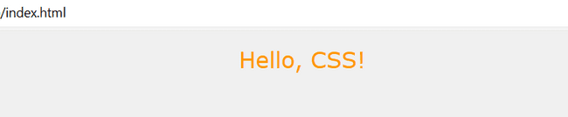
Example demonstrating text and color properties:
h1 {
color: #ff9900;
font-family: 'Verdana', sans-serif; font-size: 24px;
font-weight: normal; text-align: center;
}

Slide 22
Box Model in CSS
🠶 The CSS Box Model is a foundational concept that describes the layout of elements on a webpage. It comprises several components, including width, height, border, padding, and margin.
Width and Height: Width and height properties determine the size of the content area of an element.
Border: Border is the area surrounding the padding and content. It can have a specified width,
style, and color.
Padding: Padding is the space between the content and the border. It contributes to the element's internal spacing.
Margin: Margin is the space outside the border. It provides separation between elements. Visualizing the Box Model:
Content Area: The innermost part containing the actual content.
Padding Area: The space between content and border.
Border Area: The border surrounding the padding.
Margin Area: The outermost space providing separation from other elements.

Slide 23
HTML Code:
<!DOCTYPE html>
<html lang="en">
<head>
<meta charset="UTF-8">
<meta name="viewport" content="width=device-width, initial-scale=1.0">
<title>Box Model Example</title>
<link rel="stylesheet" href="styles.css">
</head>
<body>
<div class="box">
<p>This is the content inside the box.</p>
</div>
</body>
</html>

Slide 24
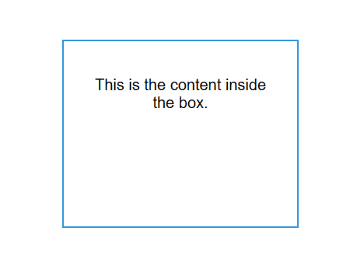
CSS code:
body {
font-family: 'Arial', sans-serif; text-align: center;
margin: 0;
padding: 0; }
.box {
width: 200px;
height: 150px;
padding: 20px;
border: 2px solid #3498db;
margin: 300px; }

Slide 25
Display Property in CSS
🠶 The display property in CSS is used to define how an HTML element should be displayed on the webpage. It controls the layout behavior of an element, determining if it should be treated as a block, inline, inline-block, flex container, grid container, or other display types.
It includes:
display: block;
The element will generate a block-level box. It starts on a new line and stretches the full width of its container.
display: inline;
The element will generate an inline-level box. It does not start on a new line and only takes up as much width as necessary.
display: inline-block;
The element will generate an inline-level box, but it will behave as a block-level box in terms of layout. It allows the element to have a width and height, and it respects top/bottom margins and padding.

Slide 26
display: none;
The element is completely removed from the layout. It's as if the element doesn't exist on the page.
display: flex;
The element becomes a flex container, and its children become flex items. It enables a flex context for its direct children, allowing you to use flex properties for layout.
display: grid;
The element becomes a grid container, and its children become grid items. It enables a grid context for its direct children, allowing you to create complex layouts with rows and columns.
display: inline-flex;
Similar to display: flex; but generates an inline-level flex container. It allows the container to sit inline
with the text and other elements.
display: table;, display: table-row;, display: table-cell;
These values simulate the behavior of a table, table row, and table cell, respectively. They are useful when you want to create table-like structures without using actual table elements.

Slide 27
Bootstrap : CSS Framework
Bootstrap : It is a powerful CSS framework that streamlines the styling process and enhances the visual appeal of web pages.
Its key features are:
Responsive Grid System: Bootstrap provides a responsive grid system, making it easy to create flexible and responsive layouts.
Pre-Styled Components: Bootstrap includes a rich set of pre-designed components such as navigation bars, buttons, forms, and more.
CSS Classes: Bootstrap's extensive set of CSS classes allows developers to apply styles effortlessly without delving deep into custom CSS.
Integration: Bootstrap seamlessly integrates with existing HTML and CSS, making it accessible for developers at any skill level.

Slide 28
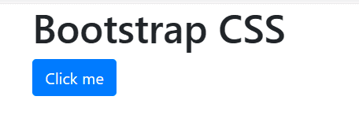
Bootstrap Use:
<!DOCTYPE html>
<html lang="en">
<head>
<meta charset="UTF-8">
<meta name="viewport" content="width=device-width, initial-scale=1.0">
<title>Bootstrap CSS</title>
<link rel="stylesheet" href="https://stackpath.bootstrapcdn.com/bootstrap/4.5.2/css/bootstrap.min.css">
</head>
<body>
<div class="container">
<h1>Bootstrap CSS</h1>
<button class="btn btn-primary">Click me</button>
</div>
</body>
</html>

Slide 29
Materialize CSS:
Materialize CSS is a modern front-end framework that follows Google's Material Design principles, offering a sleek and intuitive design language.
Key Features:
Material Design Components: Materialize provides a comprehensive set of pre-styled Material Design components such as cards, buttons, navigation bars, and more.
Responsive Grid System: Similar to Bootstrap, Materialize includes a responsive grid system for creating flexible and adaptive layouts.
Mobile-First Approach: Materialize is designed with a mobile-first approach, ensuring a seamless experience on various devices.
Integration: Materialize can be easily integrated into existing projects, enhancing the visual appeal without the need for extensive custom styling.

Slide 30
Styling using Materialize CSS
HTML Code:
<!DOCTYPE html>
<html lang="en">
<head>
<meta charset="UTF-8">
<meta name="viewport" content="width=device-width, initial-scale=1.0">
<title>Materialize CSS</title>
<link rel="stylesheet" href="https://cdnjs.cloudflare.com/ajax/libs/materialize/1.0.0/css/materialize.min.css">
</head> <body> <nav>
<div class="nav-wrapper">
<a href="#" class="brand-logo">Logo</a>
<ul id="nav-mobile" class="right hide-on-med-and-down">
<li><a href="#">Home</a></li>
<li><a href="#">About</a></li>
<li><a href="#">Contact</a></li>
</ul>
</div> </nav> </body> </html>

Slide 31
Materialize CSS Components:
Cards and Collections: Materialize offers stylish cards and collections to present content in an organized and visually appealing manner.
Buttons: Materialize provides various button styles, including flat, raised, and floating buttons.
Forms: Form elements are enhanced with Material Design styles, making user interactions intuitive.
Toasts and Modals: Materialize includes components like toasts and modals for displaying notifications and interactive overlays.

Slide 32
Semantic UI:
Semantic UI is a user interface framework that emphasizes clear and human-readable HTML, making the structure of your code more intuitive.
Key Features:
Human-Readable Classes: Semantic UI uses semantic and expressive class names, making it easier to understand the purpose of each element.
Responsive Design: Like other frameworks, Semantic UI supports responsive
design, ensuring your UI looks great on various devices.
Ready-Made Themes: Semantic UI comes with a variety of pre-designed themes, allowing for quick and stylish UI development.
Integration: Semantic UI can be seamlessly integrated into your project,
enhancing the visual appeal with minimal effort.

Slide 33
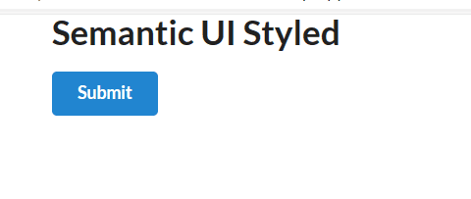
Semantic UI Example:
HTML Code:
<!DOCTYPE html>
<html lang="en">
<head>
<meta charset="UTF-8">
<meta name="viewport" content="width=device-width, initial-scale=1.0">
<title>Semantic UI Example</title>
<link rel="stylesheet" href="https://cdnjs.cloudflare.com/ajax/libs/semantic-ui/2.4.1/semantic.min.css">
</head> <body>
<div class="ui container">
<h1 class="ui header">Semantic UI Styled</h1>
<button class="ui primary button">Submit</button>
</div> </body> </html>

Slide 34
Uses of Semantic UI :
Predefined Classes:
Semantic UI provides a set of classes for various UI elements.
For example, classes like ui button, ui header, and ui container are used to style buttons, headers, and containers, respectively.
Grid System:
Semantic UI includes a responsive grid system that can be utilized by applying specific grid-related classes.
This helps in creating flexible and responsive layouts.
Theming:
Semantic UI supports theming, allowing you to easily change the overall look and feel of your UI. This involves defining custom colors, fonts, and other visual elements using predefined class names or variables.
Customization:
While Semantic UI provides a comprehensive set of styling options, you can still customize and extend styles using additional CSS.
Responsive Design:
CSS is used to implement responsive design principles in Semantic UI. This includes adjusting styles based on the device's screen size using media queries.

Slide 35

Responsive Design in CSS
Responsive design is an approach to web design that ensures websites look and function well on various devices and screen sizes.
Importance: With the diverse range of devices, responsive design is crucial for providing a consistent and optimal user experience.
It is implemented by:
Media queries: These are CSS rules that apply styles based on characteristics of the device, such as screen width, height, or device orientation.
Grid Systems: Responsive grids allow for flexible layouts that adapt to different screen
sizes. Bootstrap and Semantic UI provide responsive grid systems for easy implementation.
Flexbox : CSS Flexbox and Grid layouts provide powerful tools for creating responsive and flexible page structures.
Fluid Images: Set images to have a maximum width of 100% to scale with their parent containers. etc.

Slide 36

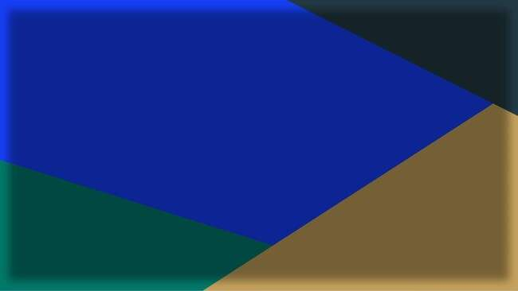






Slide 37









Slide 38
















Slide 39
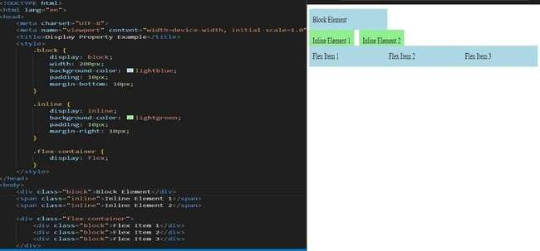

Slide 40











Slide 41
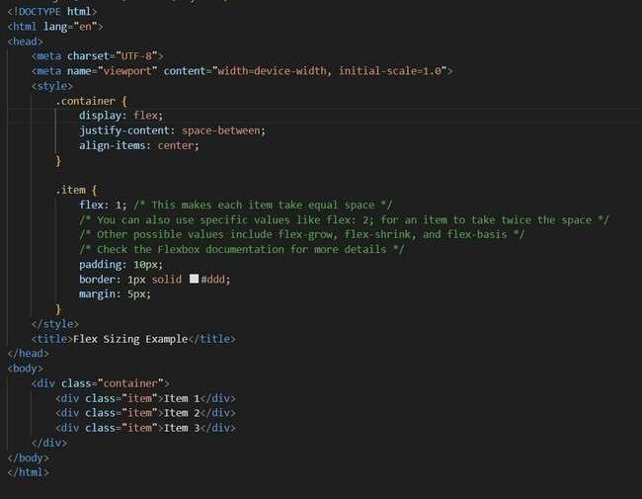
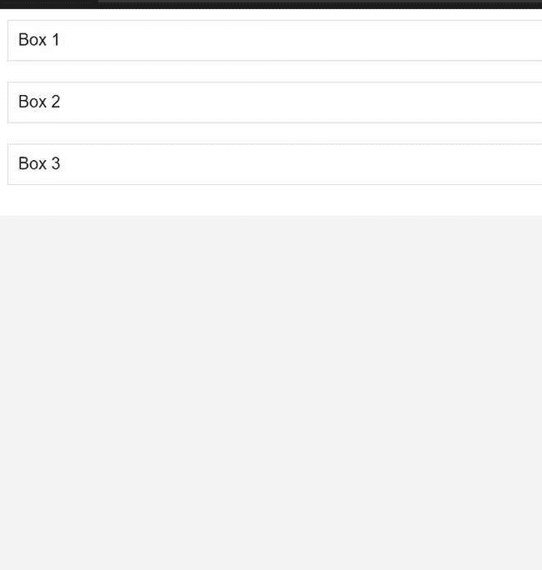

Slide 42




Slide 43















Slide 44







Slide 45
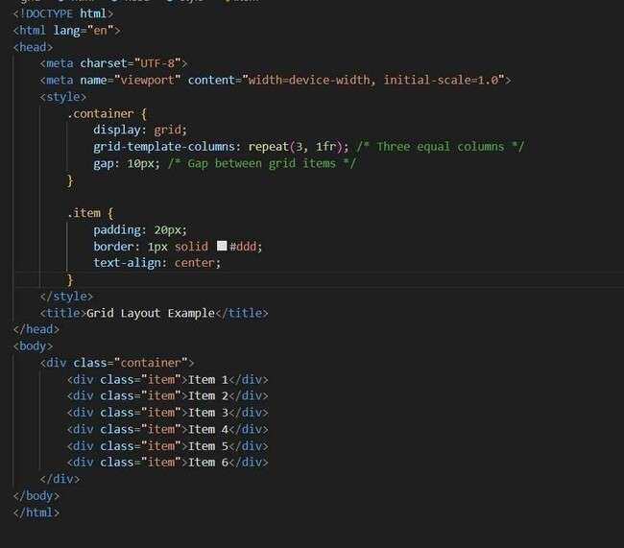
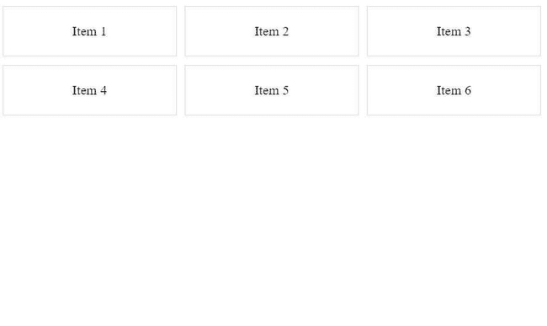

Slide 46






Slide 47









Slide 48













Slide 49
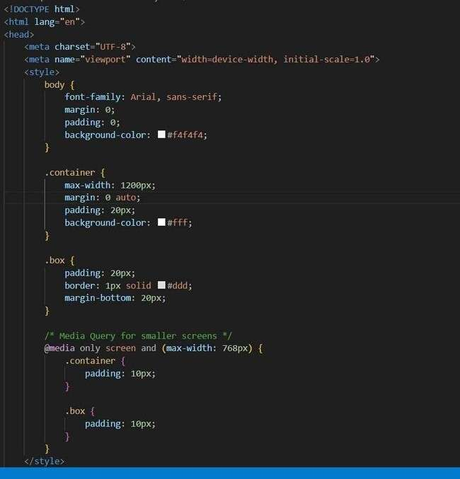
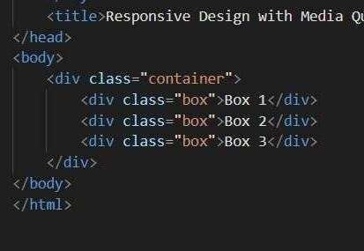

Slide 50
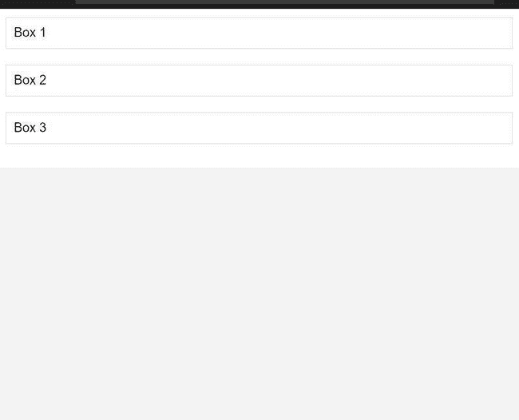

Slide 51













Slide 52













Slide 53

















Slide 54

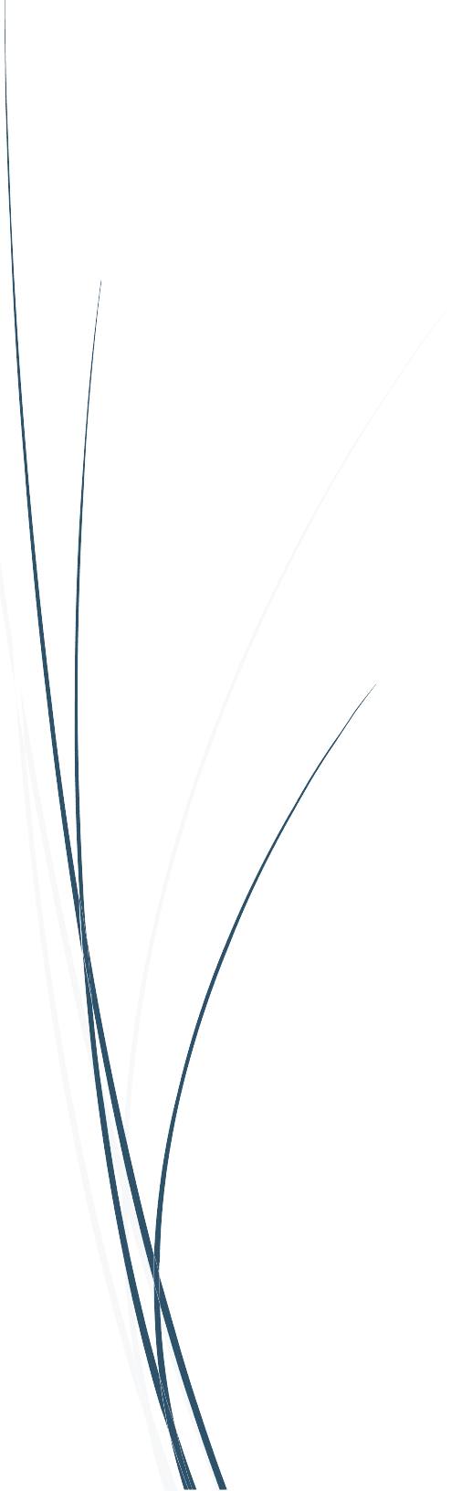







Slide 55
What is Bootstrap?
Bootstrap is a free front-end framework for faster and easier web
development
Bootstrap includes HTML and CSS based design templates for typography, forms, buttons, tables, navigation, modals, image carousels and many other, as well as optional JavaScript plugins
Bootstrap also gives you the ability to easily create responsive designs

Slide 56
FEATURES OF BOOTSTRAP
🠶 Grid System: Bootstrap includes a responsive grid system that allows developers to create flexible and responsive layouts. The grid system helps organize content into rows and columns, making it easy to structure and align elements.
🠶 Component Library: Bootstrap provides a wide range of pre-styled and customizable components, such as buttons, forms, navigation bars, alerts, and more. These components can be easily integrated into projects, saving developers time and effort.
🠶 Customization: While Bootstrap offers a default styling that looks good out of the box, developers can customize the framework to suit the specific design requirements of their projects. Bootstrap can be customized using its Sass variables and mixins.

Slide 57
ADVANTAGES
🠶 Rapid Development: Bootstrap accelerates the development process by providing a set of pre-designed components and styles. This can save developers a significant amount of time when building responsive and visually appealing interfaces.
🠶 Consistency: Bootstrap ensures consistency across different browsers and devices, offering a standardized look and feel. This is particularly useful for projects where maintaining a uniform user experience is important.
🠶 Responsive Design: Bootstrap is built with a mobile-first approach, making it easy to create responsive and mobile-friendly designs without a lot of additional effort.

Slide 58
USES OF BOOTSTRAP
🠶 Cross-Browser Compatibility: Bootstrap takes care of many cross-browser compatibility issues, reducing the need for extensive testing and ensuring a consistent experience for users across various browsers.
🠶 Front-End Development Efficiency: Bootstrap simplifies front-end development by providing a set of ready-to-use components, such as navigation bars, buttons, forms, and more. This can significantly reduce the amount of manual coding and styling required.
🠶 Customization: While Bootstrap comes with default styling, it's highly customizable. Developers can use Bootstrap's Sass variables and mixins to tailor the framework to match the specific design requirements of a project. Startups and Small Projects: Bootstrap is often chosen for startups and small projects where time and resources are limited. Its ease of use and quick setup make it an attractive option for projects with tight deadlines.

Slide 59
🠶 Responsive Web Design: Bootstrap is known for its mobile-first approach, making it a go-to choice for creating responsive websites. It provides a responsive grid system and fluid typography, allowing developers to design interfaces that adapt seamlessly to different screen sizes and devices.
🠶 Rapid Prototyping: Bootstrap's extensive set of pre-designed components and styles allows developers to quickly prototype and build user interfaces. This is particularly useful during the initial stages of a project when a fast turnaround is essential.
🠶 Consistent UI/UX: Bootstrap ensures a consistent look and feel across different browsers and devices. This is advantageous when maintaining a standardized user interface and user experience is a priority.

Slide 60
COMPONENTS OF BOOTSTRAP

Slide 61
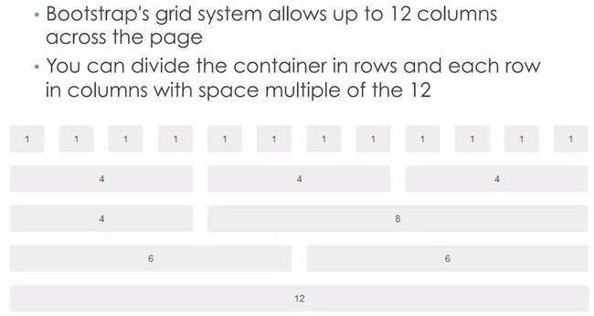
BOOTSTRAP GRIDS

Slide 62
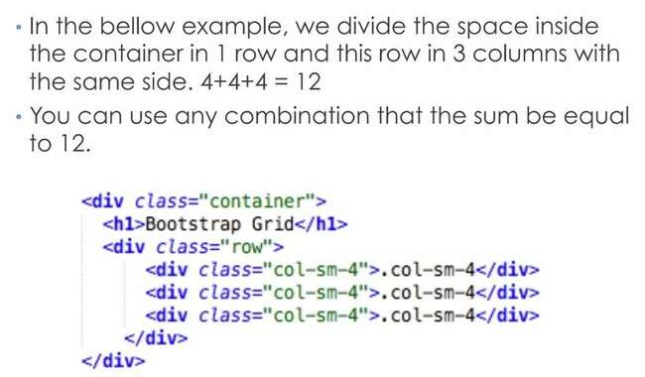
BOOTSTRAP GRIDS

Slide 63
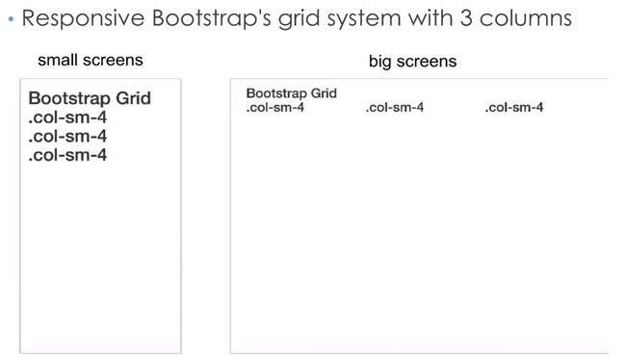
BOOTSTRAP GRIDS

Slide 64
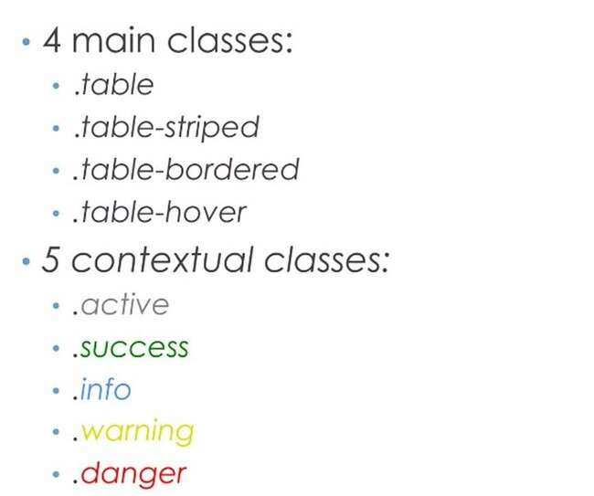
BOOTSTRAP TABLES

Slide 65
BOOTSTRAP TABLES

Slide 66
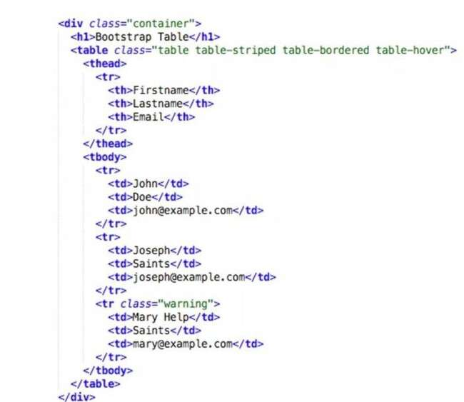
BOOTSTRAP TABLES

Slide 67
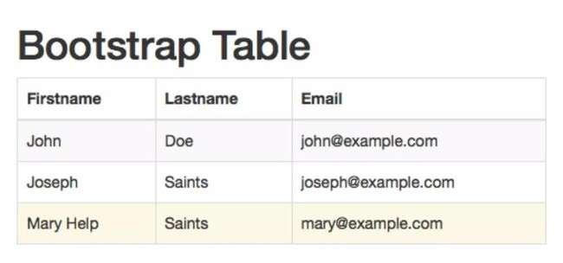
BOOTSTRAP TABLES

Slide 68
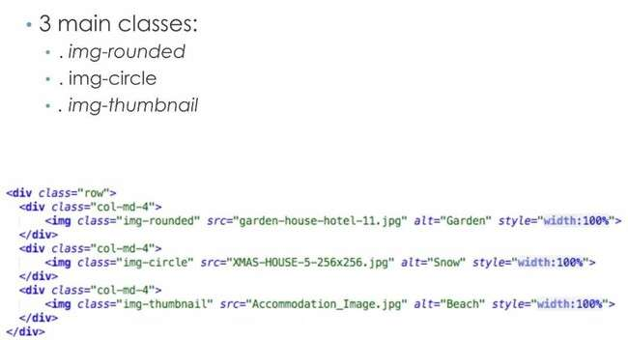
BOOTSTRAP IMAGES

Slide 69
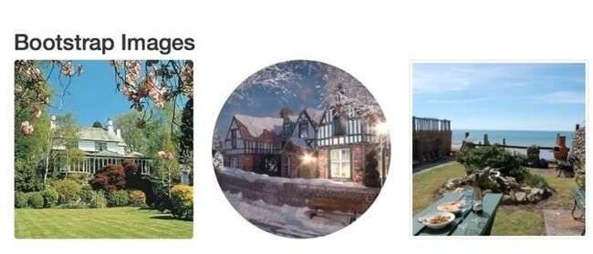
BOOTSTRAP IMAGES

Slide 70
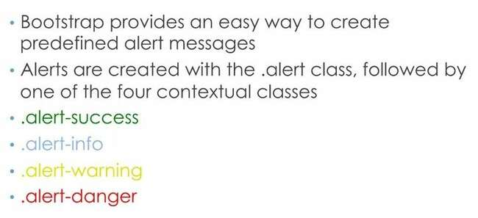
BOOTSTRAP ALERTS

Slide 71
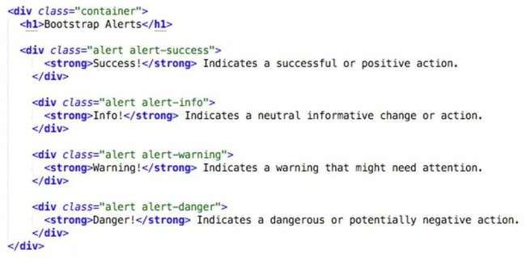
BOOTSTRAP ALERTS

Slide 72
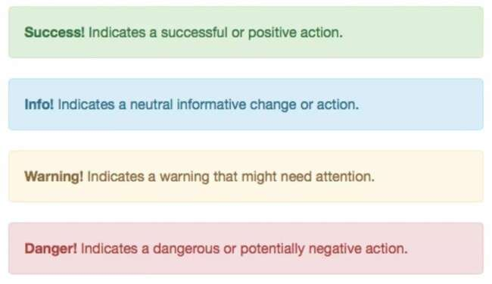
BOOTSTRAP ALERTS

Slide 73
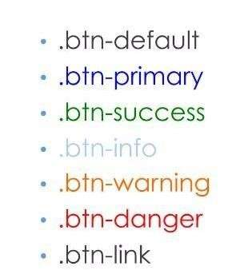
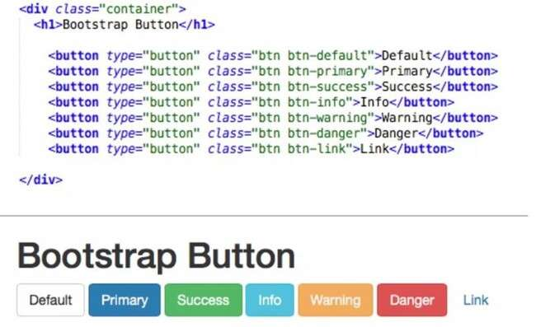
BOOTSTRAP BUTTONS

Slide 74
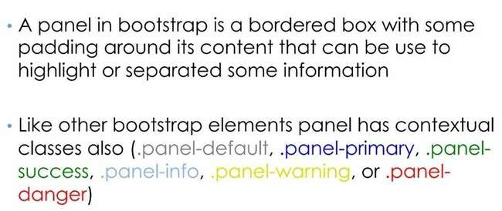
BOOTSTRAP PANELS

Slide 75
BOOTSTRAP PANELS

Slide 76
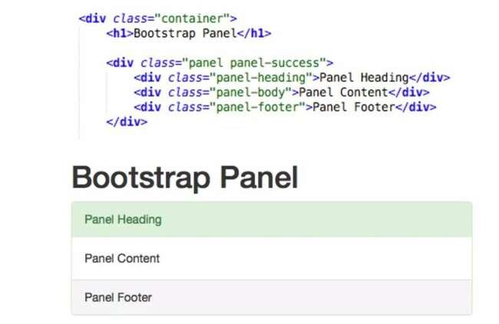
BOOTSTRAP PANELS

Slide 77
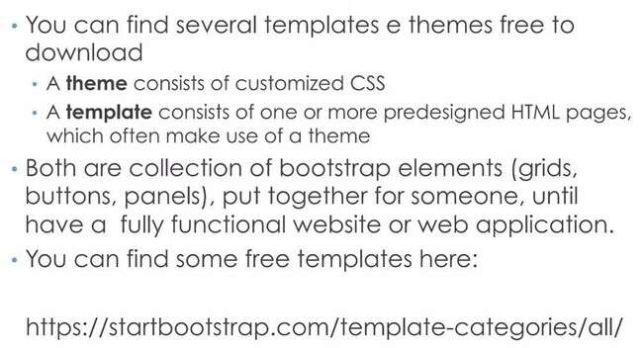
BOOTSTRAP THEMES AND TEMPLATES

Slide 78
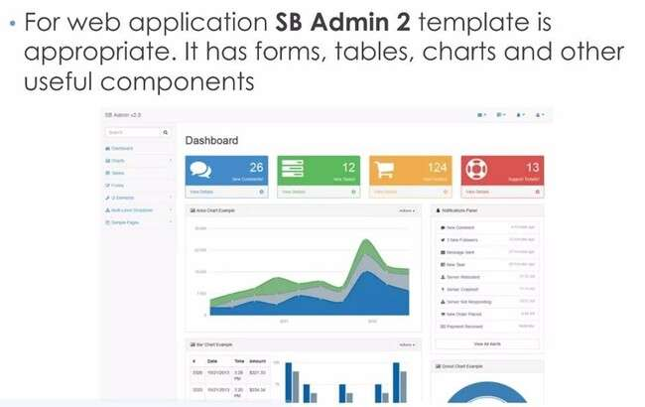
BOOTSTRAP THEMES AND TEMPLATES

