Slide 1

PG Diploma in HPC System Administration
PRESENTATION ON PROJECT REPORT
SECURE CI/CD PIPELINE USING BITBUCKET AND DOCKER REGISTRY

Slide 2
INTRODUCTION:
In this project we have secured our data (data might be in file format or code for development) by using Bitbucket(by creating private projects and repositories) and Docker registry for pull and push image locally.
For automation of task we used CI/CD pipeline with Jenkins.
The architecture and flow diagram will be as follow:

Slide 3
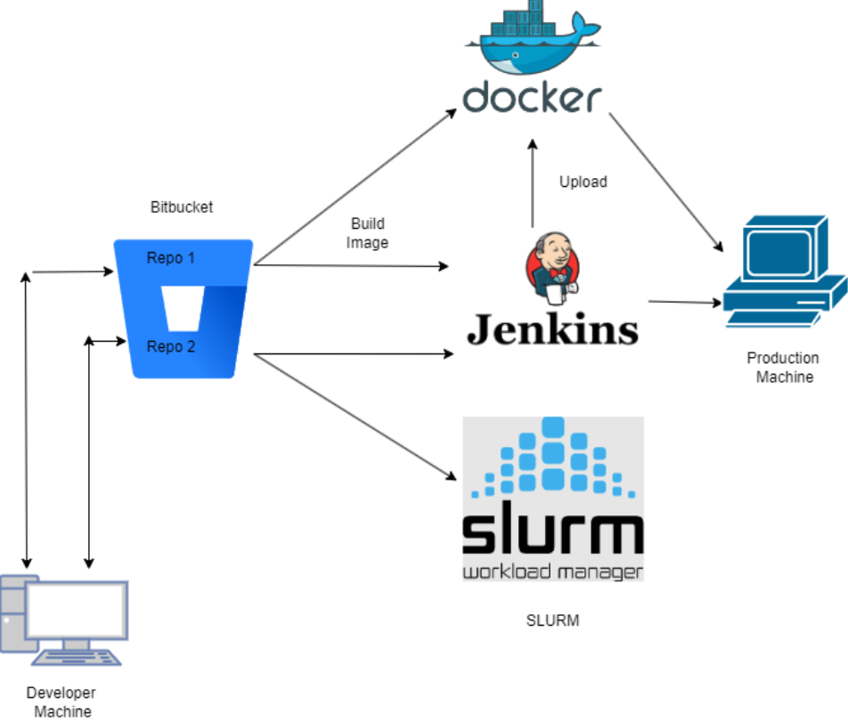
ARCHITECTURE:

Slide 4
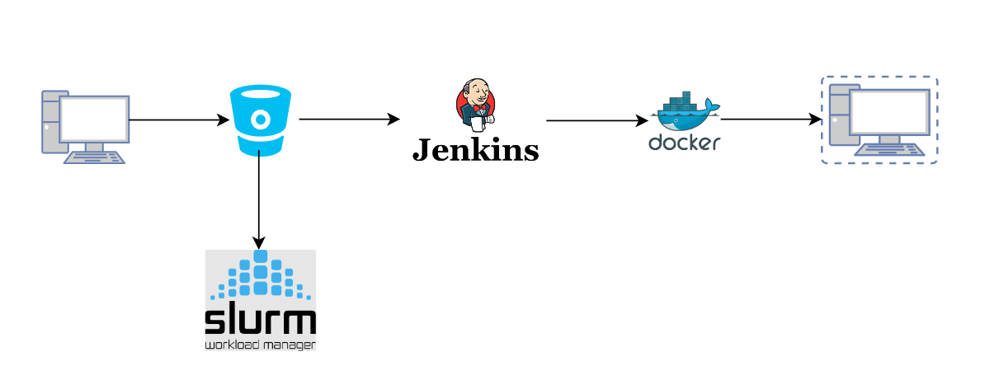
PROCESS FLOW DIAGRAM :

Slide 5
BITBUCKET:
BitBucket is a cloud-based service that helps developers store and manage their code, as well as track and control the changes to their code.
Provide one place for team to collaborate on code from concept to Cloud, build quality code through automated testing, and deploy code with confidence.
To learn BitBucket, we need to have first-hand knowledge of :
1)Version Control:
2)GIT

Slide 6
KEY TERMS OF TO KNOW:
Branch : A branch represents an independent line of development. Branches serve as an abstraction for the edit/stage/commit process. You can think of them as a way to request a brand new working directory, staging area, and project history. New commits are recorded in the history for the current branch, which results in a fork in the history of the project.
Fork : Instead of using a single server-side repository to act as the “central” codebase, forking gives every developer a server-side repository. This means that each contributor has not one, but two Git repositories: a private local one and a public server-side one.
Main : The default development branch. Whenever you create a git repository, a branch named "main" is created, and becomes the active branch.

Slide 7
HEAD : Git’s way of referring to the current snapshot. Internally, the git checkout command simply updates the HEAD to point to either the specified branch or commit. When it points to a branch, Git doesn't complain, but when you check out a commit, it switches into a “detached HEAD” state.
Pipelines : Bitbucket Pipelines is an integrated CI/CD service, built into Bitbucket. It allows you to automatically build, test and even deploy your code, based on a configuration file in your repository.
Pipes : A project is a container for repositories. Projects make it easier for teams to focus on a goal, product, or process by organizing your repositories into projects. Projects can be either visible or hidden from public view.
Working Tree : The tree of actual checked out files, normally containing the contents of the HEAD commit's tree and any local changes you've made but haven't yet committed.

Slide 8
DOCKER REGISTRY:
A Docker registry is a system for versioning, storing and distributing Docker images.
A Docker registry is separated into Docker repositories, each of which holds all image modifications.
The registry may be used by Docker users to fetch images locally and to push new images to the registry (given adequate access permissions when applicable).
Uses of Docker Registry:
1)Our images can be stored in the Docker registry.
2)We can automate the development.
3)With the help of a private docker registry, we can secure our image.

Slide 9
Why do We Use Docker Registry?
Docker Registry aids in development automation. The docker registry allows you to automate building, testing, and deployment. Docker registry may be used to create faster CI/CD pipelines, which helps to reduce build and deployment time.
Docker Registry is useful if you want complete control over where your images are kept. A private Docker registry can be used. You gain total control over your applications by doing so. In addition to controlling who may access your Docker images, you can determine who can view them.
Docker Registry can provide you with information about any issue you may encounter. You may also completely rely on it for container deployment and access it at any moment.

Slide 10
Why is Docker Registry important?
Docker Registry is important because it makes it easy to share and distribute Docker images.
It simplifies the process of managing and deploying Docker containers, which can save time and resources.
Docker Registry is a key component of the Docker ecosystem and is widely used by developers and organizations of all sizes.

Slide 11
JENKINS:
Jenkins is an open source continuous integration/continuous delivery and deployment (CI/CD) automation software DevOps tool written in the Java programming language.
It is used to implement CI/CD workflows, called pipelines.
Pipelines automate testing and reporting on isolated changes in a larger code base in real time and facilitates the integration of disparate branches of the code into a main branch.
They also rapidly detect defects in a code base, build the software, automate testing of their builds, prepare the code base for deployment (delivery), and ultimately deploy code to containers and virtual machines, as well as bare metal and cloud servers.

Slide 12
CI/CD PIPELINE:
A continuous integration and continuous deployment (CI/CD) pipeline is a series of steps that must be performed in order to deliver a new version of software.
CI/CD pipelines are a practice focused on improving software delivery throughout the software development life cycle via automation.
By automating CI/CD throughout development, testing, production, and monitoring phases of the software development lifecycle, organizations are able to develop higher quality code, faster and more securely.
Objective is to minimize human error and maintain a consistent process for how software is released.
CI/CD is the backbone of a DevOps methodology, bringing developers and IT operations teams together to deploy software.

Slide 13
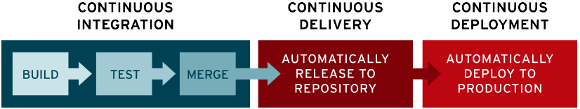

Slide 14
PROCESS:

Slide 16
CODE:

Slide 19
THANK YOU

