Slide 1

SUPPLY CHAIN VISIBILITY & OPTIMISATION
Milestone 2 — Power BI Supply Chain Analytics
Product Movement • Sales • Delivery • Regional Drilldown • Trends & Variance
Team 4 | Mahi . Ramya . Vishal . Abdul Haseeb
Mentor | Mr. Sundar Shakthi
Infosys Springboard Virtual Internship 7.0 - Batch2
Notes:
[Sources]
Final project files: Supply_Chain_Visibility_and_Optimization.pbip; Supply_Chain_Cleaned_Dataset.csv.
Generated asset: original cover_control_tower.png created for this presentation.

Slide 2

SUPPLY CHAIN VISIBILITY & OPTIMISATION
Milestone 2 turns cleaned data into decision-ready analytics
Dashboard requirements were translated into a Power BI control-tower model.
Cleaned Data
KPI Model
Product Movement
Delivery & Region
Trends & Insights
→
→
→
→
66,039 rows prepared for analysis
Sales, movement, delivery and variance measures
Inventory proxy and product intelligence
Reliability, state, city and product drilldown
MoM variance and executive interpretation
Inventory Performance Dashboard • Delivery Performance Dashboard • Region & Product Drilldown
Trends and Variance Analysis • Overall, product, sales, delivery and location analytics
Notes:
[Sources]
Milestone 2 documentation: overview and mentor requirement coverage sections.

Slide 3
SUPPLY CHAIN VISIBILITY & OPTIMISATION
The analytical foundation is built on a duplicate-safe movement grain
The merged Olist dataset is analysed at order, product, delivery, geography and month levels.
66,039
63,089
55,649
18,131
Final dataset rows
Unique movement lines
Distinct orders
Active products
Orders
Products
Sales
Customers
Sellers
Delivery
Geography
Time
Notes:
[Sources]
Dataset validation from Supply_Chain_Cleaned_Dataset.csv and Milestone 2 documentation: 66,039 rows; 63,089 Movement Line Key values; 55,649 distinct orders; 18,131 products.

Slide 4
SUPPLY CHAIN VISIBILITY & OPTIMISATION
Inventory is analysed transparently as product movement
The dataset does not contain actual warehouse balances, so movement is the honest proxy.
“Product movements are used as an inventory proxy; the dataset does not contain actual warehouse stock or on-hand inventory.”
Order Transactions
→
Product Movement
→
Movement Intelligence
Observed historical order-item records
Units and value by movement line
Velocity, ABC, fast/slow and variability
Units Moved • Active Products • Product Velocity • Movement Value
ABC Classification • Fast/Slow Movement • Demand Variability
Notes:
[Sources]
Milestone 2 documentation: inventory-proxy methodology; Power BI report methodology note.

Slide 5
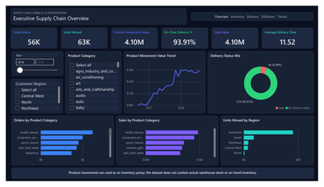
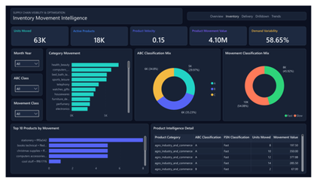
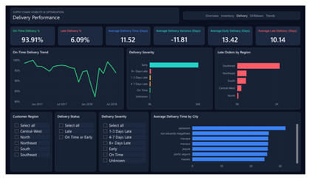
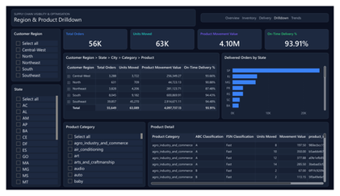
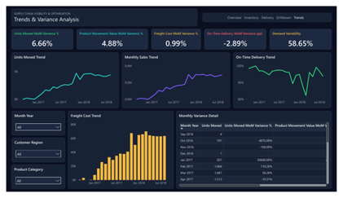
SUPPLY CHAIN VISIBILITY & OPTIMISATION
The final report is a five-page Supply Chain Control Tower
Each page answers a different management question.
1. Executive Overview
2. Inventory Movement
3. Delivery Performance
4. Region Drilldown
5. Trends & Variance
Executive KPIs
Product proxy
Reliability
State to product
MoM change
Notes:
[Sources]
Latest Power BI PDF export: Supply_Chain_Visibility_and_Optimization.pdf, pages 1-5.

Slide 6
SUPPLY CHAIN VISIBILITY & OPTIMISATION
Executive KPIs show scale, value and reliable delivery
Strong overall delivery performance with growing transaction and product-movement activity.
56K
63K
4.10M
Total Orders
Units Moved
Total Sales
4.10M
93.91%
11.52
Movement Value
On-Time Delivery
Avg Delivery Days
Notes:
[Sources]
Final Power BI PDF export page 1; Milestone 2 documentation dashboard 1 section.

Slide 7
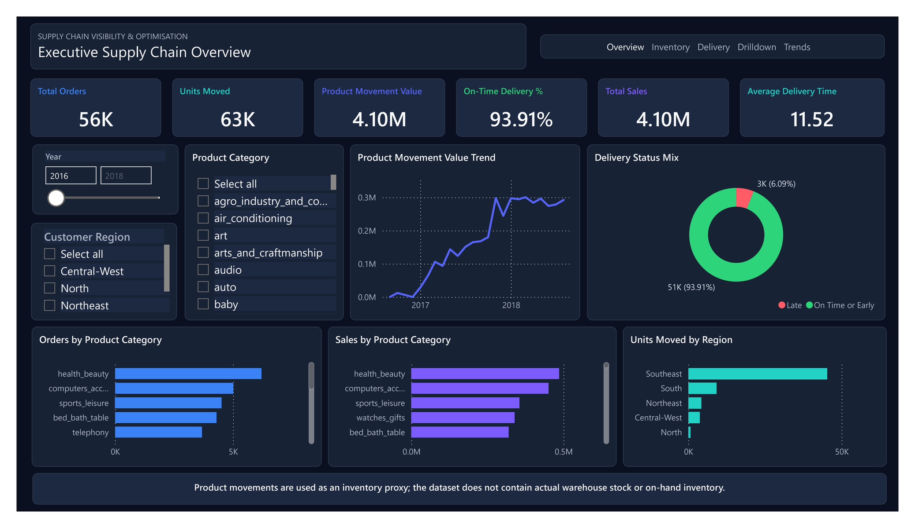
SUPPLY CHAIN VISIBILITY & OPTIMISATION
Notes:
[Sources]
Final Power BI PDF export page 1; Milestone 2 documentation dashboard 1 section.

Slide 8
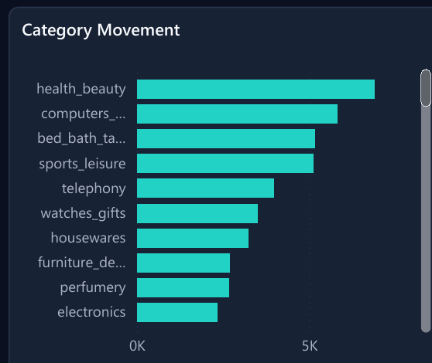
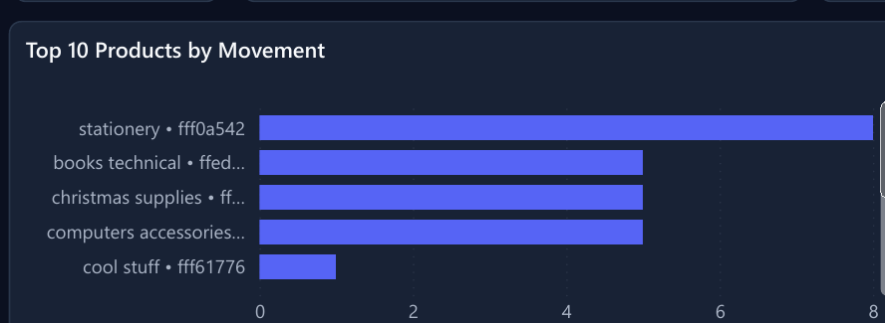
SUPPLY CHAIN VISIBILITY & OPTIMISATION
Product movement becomes the inventory-performance lens
Movement, velocity and variability explain observed product activity without claiming stock-on-hand.
63K
18K
0.15
4.10M
58.65%
Units Moved
Active Products
Product Velocity
Movement Value
Demand Variability
Category Movement identifies high-activity product areas. Top products use category plus shortened product ID because Olist has no commercial product names.
Notes:
[Sources]
Final Power BI PDF export page 2; Milestone 2 documentation dashboard 2 section.

Slide 9
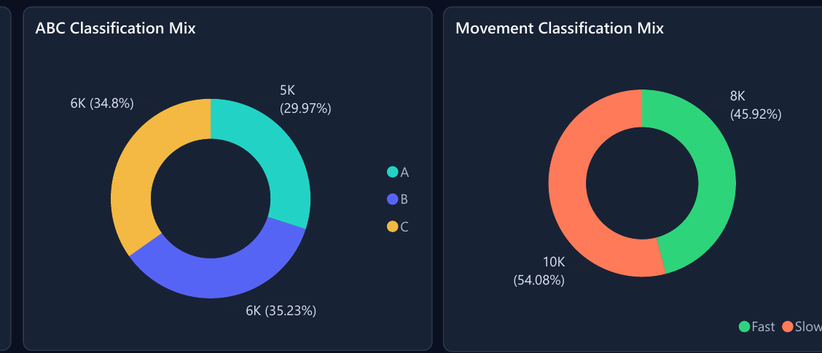
SUPPLY CHAIN VISIBILITY & OPTIMISATION
Classification separates high-value and high-movement product groups
ABC focuses on cumulative movement value; movement class focuses on order-history frequency.
A / B / C
Cumulative movement value
A ≤ 80%, B ≤ 95%, C > 95%
Fast / Slow
Visible movement classes
Based on product units-moved percentiles
Identify high-value product movement concentration.
Prioritize monitoring for fast-moving and slow-moving product groups.
No Non-Moving class is assigned because the data only contains observed order history.
Notes:
[Sources]
Final Power BI PDF export page 2; Product Intelligence table/model definitions; Milestone 2 documentation product movement intelligence section.

Slide 10
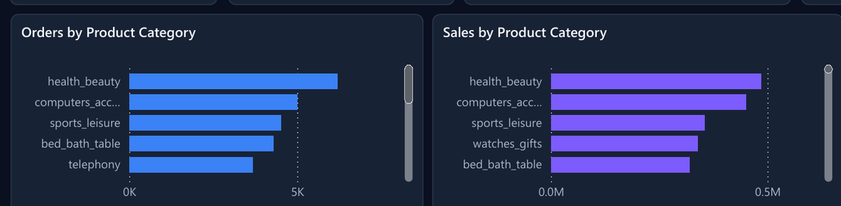
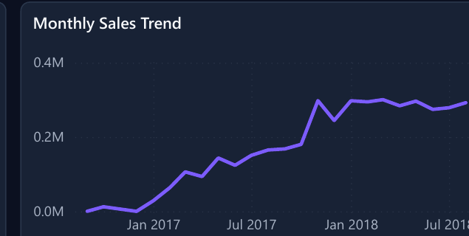
SUPPLY CHAIN VISIBILITY & OPTIMISATION
Sales analysis uses a validated order-item grain
Total Sales is protected from duplicate inflation caused by payment-level joins.
4.10M
1.0446x
63,089
Sales are summed once per Movement Line Key.
Freight is excluded from Total Sales.
Total Sales
Raw price inflation
Unique order-item grain
Raw SUM(price) would overstate sales because the merged dataset contains repeated order-item rows from payment-level joins.
Notes:
[Sources]
Dataset validation from Supply_Chain_Cleaned_Dataset.csv: raw SUM(price) 4,280,314.80; safe Total Sales 4,097,737.13; unique Movement Line Key count 63,089. Final Power BI PDF pages 1 and 5.

Slide 11
SUPPLY CHAIN VISIBILITY & OPTIMISATION
Delivery performance is strong, with late risk concentrated by severity and region
Negative delivery variance means early delivery, not delay.
93.91%
6.09%
11.52
On-Time / Early
Late
Avg Delivery Days
-11.81
10.14
Avg Variance Days
Avg Late Days
Notes:
[Sources]
Final Power BI PDF export page 3; Milestone 2 documentation dashboard 3 section.

Slide 12

SUPPLY CHAIN VISIBILITY & OPTIMISATION
Notes:
[Sources]
Final Power BI PDF export page 3; Milestone 2 documentation dashboard 3 section.

Slide 13
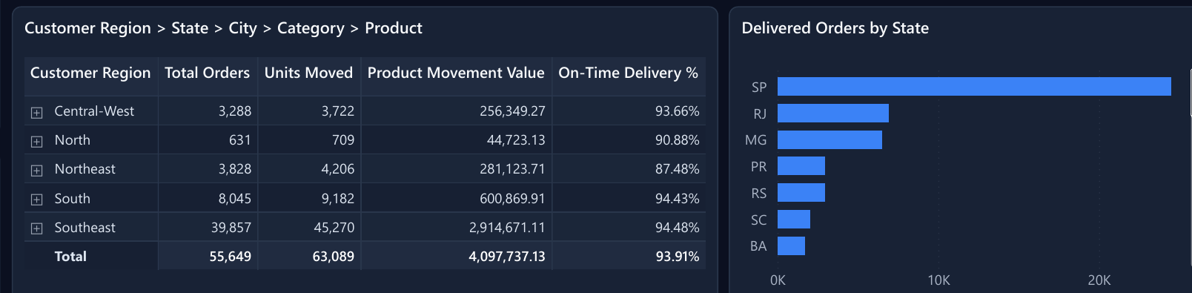
SUPPLY CHAIN VISIBILITY & OPTIMISATION
Drilldown connects geography to product-level performance
Users can move from regional performance into state, city, category and product detail.
Region
→
State
→
City
→
Category
→
Product
Start
Drill level
Drill level
Drill level
Deepest detail
Full hierarchy: Customer Region → State → City → Product Category → Product. Southeast shows the largest movement/order activity in the final dashboard.
Notes:
[Sources]
Final Power BI PDF export page 4; semantic model hierarchy: Customer Region -> State -> City -> Product Category -> Product.

Slide 14
SUPPLY CHAIN VISIBILITY & OPTIMISATION
Trend and variance views surface the latest month’s movement
MoM cards compare the latest visible month with the prior calendar month.
+6.66%
+4.88%
+0.99%
Units MoM
Movement Value MoM
Freight Cost MoM
-2.89 pp
58.65%
On-Time MoM
Demand Variability
Notes:
[Sources]
Final Power BI PDF export page 5; Milestone 2 documentation dashboard 5 and MoM variance sections.

Slide 15

SUPPLY CHAIN VISIBILITY & OPTIMISATION
Notes:
[Sources]
Final Power BI PDF export page 5; Milestone 2 documentation dashboard 5 and MoM variance sections.

Slide 16
SUPPLY CHAIN VISIBILITY & OPTIMISATION
The dashboard gives management an evidence-based supply-chain view
The strongest insights are performance, movement scale, regional concentration and volatility.
93.91%
6.09%
63K
On-time or early delivery
Late delivery rate
Units moved
4.10M
Southeast
58.65%
Validated sales value
Dominant regional activity
Demand variability
ABC classification identifies movement-value concentration; Fast/Slow classification supports product movement monitoring.
Notes:
[Sources]
Final Power BI report KPIs and Milestone 2 documentation key business insights section.

Slide 17
SUPPLY CHAIN VISIBILITY & OPTIMISATION
Milestone 2 — Completed
The cleaned Olist dataset was transformed into an interactive Supply Chain Control Tower.
✓
Executive Performance
✓
Inventory Movement Intelligence
✓
Sales & Product Analysis
✓
Delivery Performance
✓
Region & Product Drilldown
✓
Trends
✓
Variance Analysis
✓
ABC Classification
✓
Movement Classification
“The cleaned Olist dataset was transformed into an interactive Supply Chain Control Tower supporting product movement, sales, delivery, regional and trend-based decision analysis.”
Notes:
[Sources]
Milestone 2 documentation conclusion and mentor checklist coverage; latest Power BI PDF export pages 1-5.

