Slide 1


SUPPLY CHAIN
VISIBILITY & OPTIMISATION
Milestone 3 — Performance Analytics
Supplier Scorecards • Transportation Cost
• Route & Carrier Performance • Advanced KPIs
Infosys Springboard Virtual Internship 7.0 — Batch 2
Team 4 • Mahi • Vishal • Ramya • Abdul Haseeb
Mentor: Sundar Shakthi
From cleaned data to operational decision support
Continue
Notes:
1

Slide 2

PROJECT CONTEXT
Project Overview
A unified view of product movement, delivery reliability, freight, sellers and route performance.
Cleaned Records
Distinct Orders
Movement Lines
On-Time Delivery
66,039
55,649
63,089
93.91%
Final analysis-ready dataset
Validated order grain
Unique order-item movements
Overall service reliability
BUSINESS OBJECTIVE
DATA COVERAGE
Turn transactional e-commerce data into a practical supply-chain control tower that helps management answer:
Orders
lifecycle & status
Products
category & dimensions
How efficiently are products moving through the network?
Sellers
location & performance
Customers
region & city
Where are delays, freight costs and regional bottlenecks concentrated?
Which sellers and routes are strong performers — and which need intervention?
Freight
cost & efficiency
Reviews
experience proxy
How can operational KPIs be combined into decision-ready management views?
Payments
transaction mix
Delivery
estimated vs actual
SUPPLY CHAIN VISIBILITY & OPTIMISATION
MILESTONE 3 • TEAM 4
Notes:
2

Slide 3

PROGRESSION
Project Journey: Milestone 1 → 2 → 3
Each milestone builds on the previous one — from clean data, to visibility, to performance-oriented analytics.
Milestone 1
Milestone 2
Milestone 3
1
Data Preprocessing
2
Power BI Visibility
3
Performance Analytics
Cleaned and validated the merged Olist dataset using Python, missing-value treatment, feature engineering and IQR outlier handling.
Built a five-page Supply Chain Control Tower for product movement, delivery, regional drilldown, trends and variance.
Added seller scorecards, transportation-cost analysis, route performance and advanced cross-KPI management views.
OUTPUT: 66,039 clean rows
OUTPUT: 5 Decision-Ready Pages
OUTPUT: 4 Analytical Workstreams
The analytical grain and data-quality decisions from Milestone 1 remain the foundation for every KPI that follows.
SUPPLY CHAIN VISIBILITY & OPTIMISATION
MILESTONE 3 • TEAM 4
Notes:
3

Slide 4
PREVIOUS MILESTONE
Milestone 1 Recap — Data Preprocessing
Python preprocessing transformed the raw merged Olist data into an analysis-ready dataset.
Raw Records
Exact Duplicates
Before IQR
Cleaned Output
119,143
0
81,170
66,039
40 raw columns
No exact duplicate rows
Rows before outlier filtering
36 final columns
FEATURE ENGINEERING — PYTHON LOGIC
CLEANING WORKFLOW
delivery_delay =
delivered_customer_date
− estimated_delivery_date
01
Profile
shape • dtypes • nulls • duplicates
02
Clean
drop noise • fill categorical/numeric gaps
03
Validate
price • freight • product dimensions
OUTLIER RULE — IQR
04
Engineer
delivery_delay from actual vs estimated date
IQR = Q3 − Q1
Lower = Q1 − 1.5 × IQR
Upper = Q3 + 1.5 × IQR
Result: 66,039 rows retained
05
Treat outliers
IQR-based filtering of extreme values
06
Export
Supply_Chain_Cleaned_Dataset.csv
SUPPLY CHAIN VISIBILITY & OPTIMISATION
MILESTONE 3 • TEAM 4
Notes:
4

Slide 5
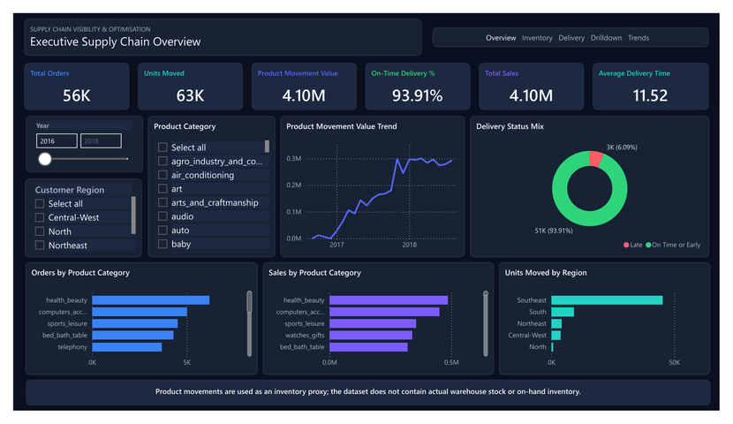
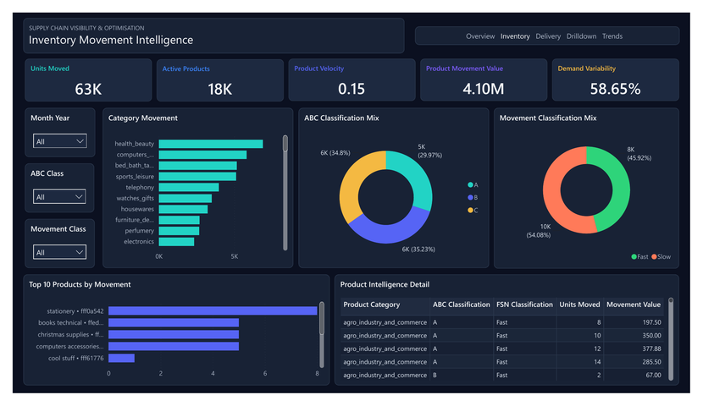
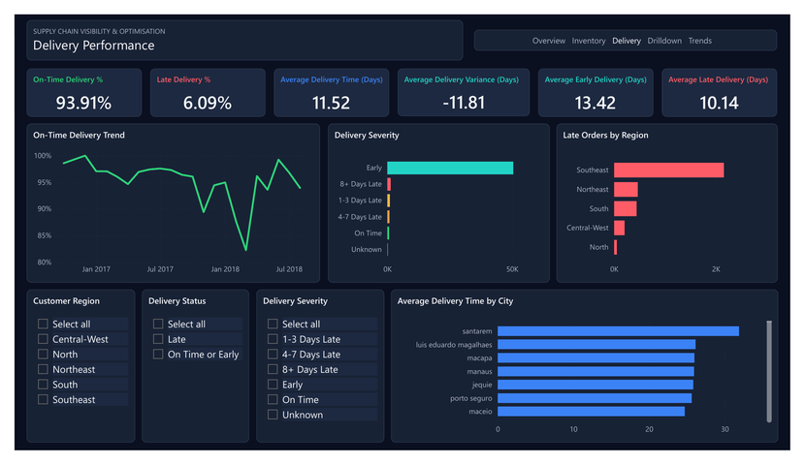
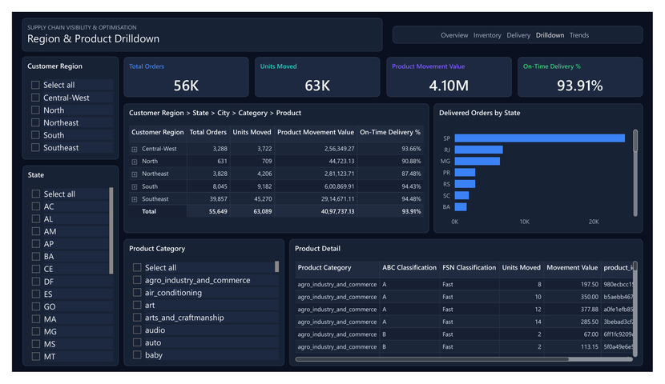
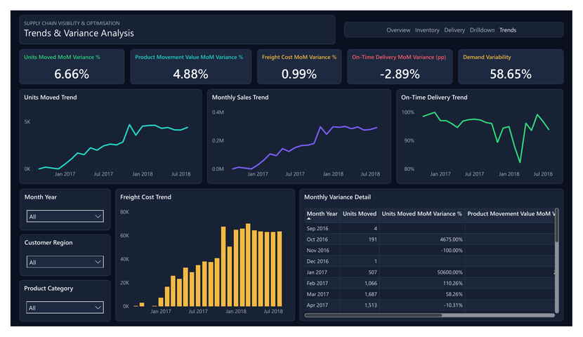
PREVIOUS MILESTONE
Milestone 2 Recap — Supply Chain Control Tower
Five Power BI pages converted the cleaned dataset into interactive visibility and diagnostic analytics.
1. Executive Supply Chain Overview
2. Inventory Movement Intelligence
3. Delivery Performance
4. Region & Product Drilldown
5. Trends & Variance Analysis
SUPPLY CHAIN VISIBILITY & OPTIMISATION
MILESTONE 3 • TEAM 4
Notes:
5

Slide 6
MODEL & DAX
Milestone 2 Analytical Foundation
The dashboard logic was designed around correct grain, transparent inventory assumptions and duplicate-safe measures.
A
Correct analytical grain
B
Inventory proxy — not stock
C
Service reliability
63,089 unique Movement Line Keys prevent repeated payment rows from inflating order-item analysis.
Olist has no warehouse stock or on-hand balance. Product movement is explicitly used as the inventory proxy.
Delivery KPIs compare actual delivery with estimated delivery and distinguish on-time/early from late orders.
DAX — DUPLICATE-SAFE TOTAL SALES
KPI LOGIC — MOVEMENT & DELIVERY
Total Sales =
SUMX(
VALUES([Movement Line Key]),
CALCULATE(MAX([price]))
)
Units Moved = DISTINCTCOUNT([Movement Line Key])
On-Time Delivery % =
On-Time Delivered Orders / Delivered Orders
Demand Variability = STDEV(monthly movement) / AVERAGE(monthly movement)
Why it matters: business insights are only trustworthy when the data grain and measure definitions are correct.
SUPPLY CHAIN VISIBILITY & OPTIMISATION
MILESTONE 3 • TEAM 4
Notes:
6

Slide 7
MILESTONE 3
Performance Analytics
Four analytical workstreams deepen the control tower from visibility into performance evaluation, cost diagnosis and decision support.
01
Supplier Scorecards
02
Transportation Cost
03
Route & Carrier Performance
04
Advanced KPI Visualization
Milestone 3 asks not only “what happened?” — but “where is performance strong, weak, costly or inefficient?”
Notes:
7

Slide 8
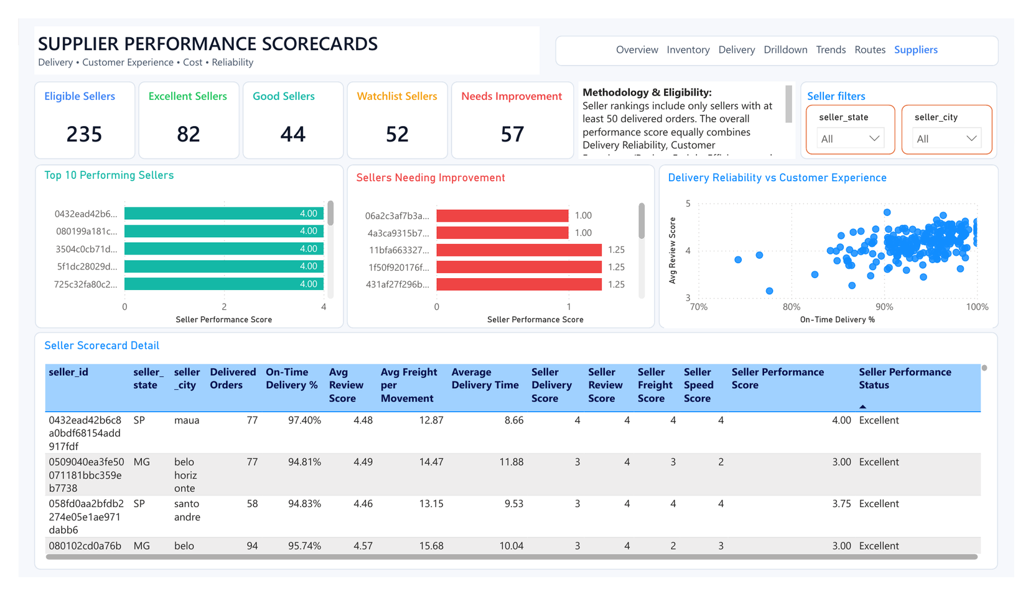
DASHBOARD 1
Supplier / Seller Performance Scorecards
A quartile-based scorecard identifies strong sellers and sellers that require operational attention.
Eligible
Excellent
235
82
50+ delivered orders
Top-performing
Watchlist
Needs Improvement
52
57
Needs monitoring
Priority attention
METHODOLOGY
Formal ranking includes sellers with at least 50 delivered orders.
Four equally weighted dimensions: Delivery, Review, Freight, Speed.
Review score is a customer-experience / quality proxy — not direct product quality.
Performance bands: Excellent • Good • Watchlist • Needs Improvement.
SUPPLY CHAIN VISIBILITY & OPTIMISATION
MILESTONE 3 • TEAM 4
Notes:
8

Slide 9
KEY FINDINGS
Supplier Performance — Findings, Scoring Logic & Interpretation
The scorecard combines service, experience, cost and speed into one defensible seller-level performance view.
Performance distribution — 235 eligible sellers
DAX — OVERALL SELLER PERFORMANCE SCORE
Seller Performance Score =
DIVIDE(
[Seller Delivery Score] + [Seller Review Score] +
[Seller Freight Score] + [Seller Speed Score],
4
)
Eligibility: [Seller Delivered Orders] >= 50
Excellent 82
Good 44
Watchlist 52
Needs Improvement 57
1
A sizeable improvement pool
2
High review alone is not enough
3
Quartiles make the method explainable
109 sellers are either Watchlist or Needs Improvement — 46.4% of the eligible base. Performance governance should focus here first.
The scorecard prevents one strong metric from masking weak freight efficiency or slow delivery by balancing all four dimensions equally.
Scores from 1–4 are based on the eligible-seller distribution, making the ranking relative, transparent and easy to defend in review.
Overall score bands: Excellent ≥ 3.00 • Good ≥ 2.50 • Watchlist ≥ 2.00 • Needs Improvement < 2.00
SUPPLY CHAIN VISIBILITY & OPTIMISATION
MILESTONE 3 • TEAM 4
Notes:
9

Slide 10
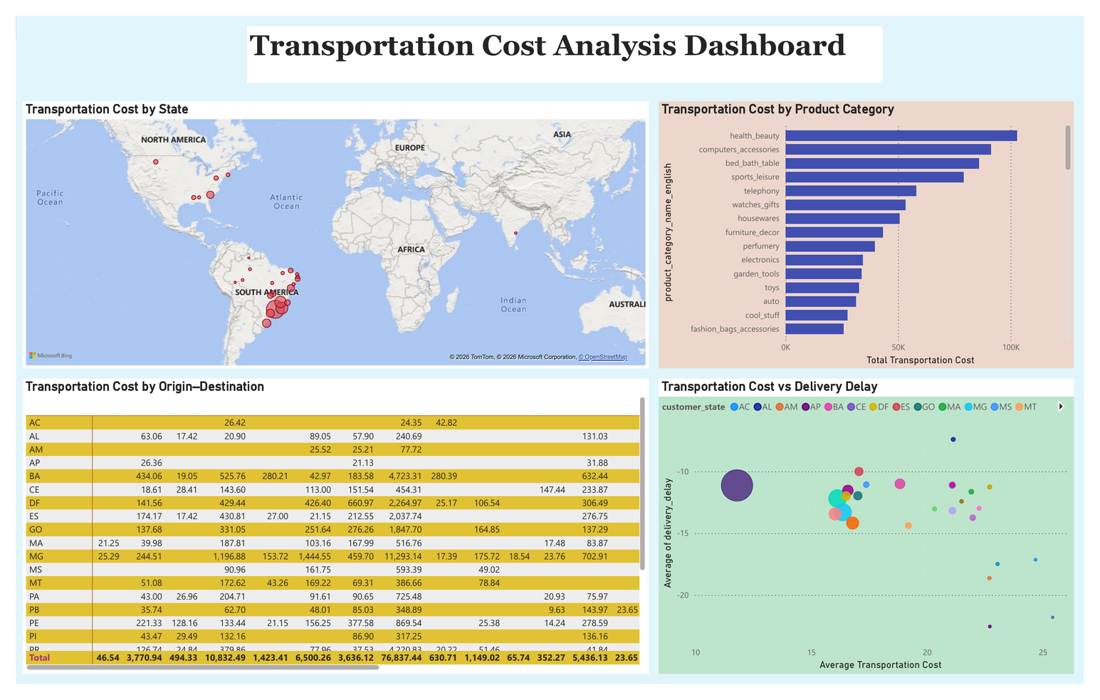
DASHBOARD 2
Transportation Cost Analysis — Where Are We Spending?
Freight expenditure is examined by geography, origin–destination movement, product category and delivery outcome.
Total Transportation Cost
969.23K
Dashboard total
1
Geographic concentration
RJ and MG appear among the largest cost contributors in the state-level view.
2
Category concentration
Health & beauty and computer accessories lead transportation cost by product category.
3
Cost ≠ inefficiency by itself
The scatter compares transportation cost with delivery delay so expensive movements can be judged alongside service outcomes.
CORE CALCULATION LOGIC
SUPPLY CHAIN VISIBILITY & OPTIMISATION
MILESTONE 3 • TEAM 4
Notes:
10

Slide 11
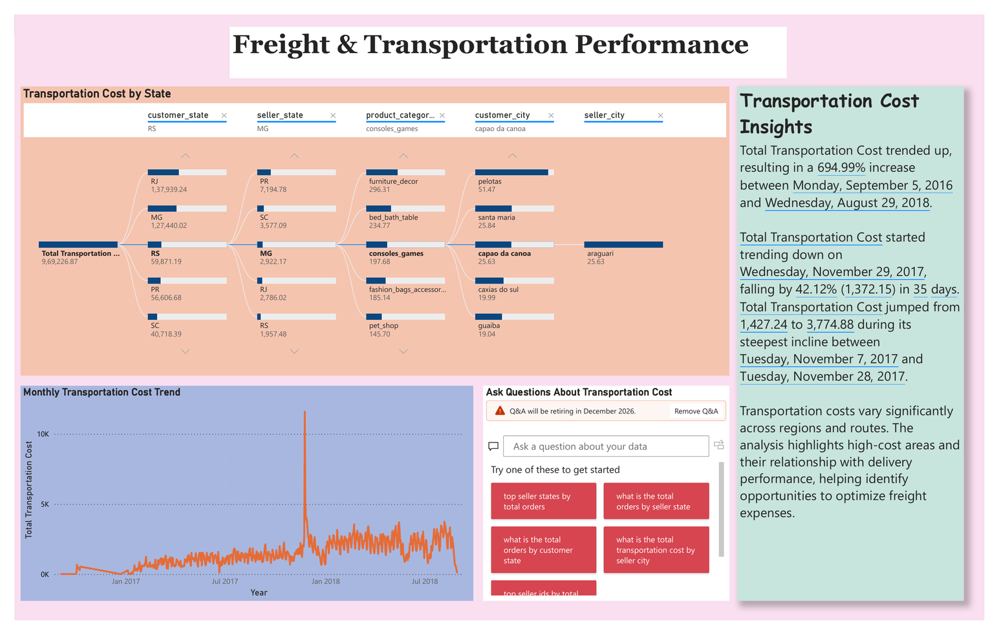
DASHBOARD 2 — DETAIL
Freight & Transportation Performance — Trends & Drilldown
The second transportation view adds monthly trend analysis, hierarchical drilldown and Power BI-generated narrative insights.
POWER BI INSIGHT
Transportation cost trended upward across the dataset period, with the dashboard insight reporting a 694.99% increase from Sep 2016 to Aug 2018.
The steepest incline occurred during Nov 2017 in the automatically generated trend insight.
Cost varies materially across regions, cities and origin–destination combinations.
Filters allow the analyst to isolate specific seller/customer geography and categories.
The monthly trend reveals spikes that deserve root-cause analysis instead of relying on the grand total.
Prioritise high-cost lanes where service does not improve proportionally with spend.
Business interpretation
SUPPLY CHAIN VISIBILITY & OPTIMISATION
MILESTONE 3 • TEAM 4
Notes:
11

Slide 12
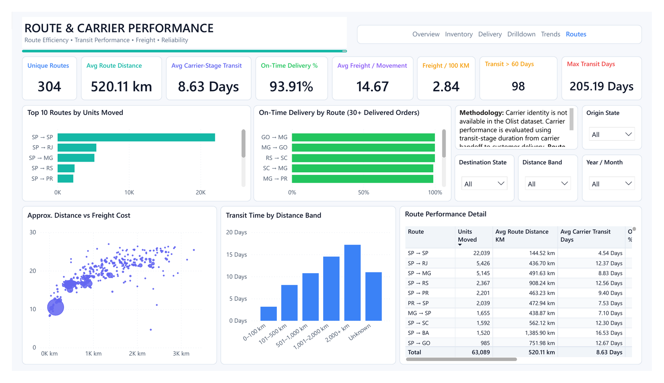
DASHBOARD 3
Route & Carrier-Stage Performance
A consolidated page compares route volume, approximate distance, transit time, freight efficiency, reliability and extreme exceptions.
Unique Routes
Avg Distance
304
520.11 km
Seller → customer state
Approx. geography
Avg Transit
On-Time
8.63 Days
93.91%
Carrier-stage duration
Delivery reliability
Transit > 60 Days
Max Transit
205.19 Days
98
Extreme exceptions
Worst-case outlier
Methodology note
Olist has no carrier identity. “Carrier performance” therefore means transit-stage performance from carrier handoff to customer delivery. Distance is straight-line geography, not road distance.
SUPPLY CHAIN VISIBILITY & OPTIMISATION
MILESTONE 3 • TEAM 4
Notes:
12

Slide 13
KEY FINDINGS
Route & Carrier-Stage Performance — Findings & DAX
High-volume lanes, distance effects and exception monitoring turn route data into operational priorities.
Top route volumes
DAX — FREIGHT & TRANSIT EFFICIENCY
Total Freight Cost = SUMX(VALUES([Movement Line Key]), MAX([freight_value]))
Freight Cost per 100 KM = DIVIDE([Total Freight Cost], [Total Route Distance KM]) * 100
Avg Carrier Transit Days = AVERAGEX(VALUES([order_id]), MAX([Carrier Transit Days]))
SP → SP
22,039
SP → RJ
5,426
SP → MG
5,145
SP → RS
2,367
SP → PR
2,201
1
São Paulo dominates movement
2
Transit generally rises with distance
3
Exceptions deserve separate management
SP → SP alone carries 22,039 units; together with SP → RJ and SP → MG, the top three lanes represent a major share of network movement.
SP → SP averages 4.54 days at ~145 km, while SP → BA averages 16.53 days at ~1,386 km — supporting distance-specific benchmarks.
98 orders exceed 60 carrier-stage days and the maximum reaches 205.19 days. These are not representative averages — they are exception cases.
Calculated column logic: Route = seller_state & " → " & customer_state • Approx. distance uses Haversine coordinates (Earth radius 6,371 km).
SUPPLY CHAIN VISIBILITY & OPTIMISATION
MILESTONE 3 • TEAM 4
Notes:
13

Slide 14
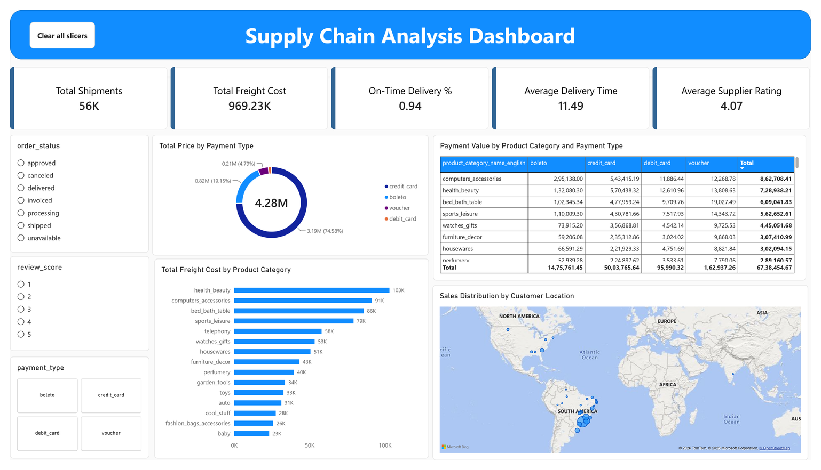
DASHBOARD 4
Advanced KPI Visualization — Management Overview
A consolidated view combines shipment volume, freight, delivery performance, supplier rating, payment mix and geographic distribution.
Shipments
Freight Cost
56K
969.23K
Dashboard total
Total freight
On-Time
Avg Delivery
0.94
11.49
≈ 94%
Days
Supplier Rating
Payment Mix
4.07
Credit card dominates
Average review
CORE KPI LOGIC
On-Time Delivery % =
On-Time Delivered Orders / Delivered Orders
Average Supplier Rating = AVERAGE(review_score)
SUPPLY CHAIN VISIBILITY & OPTIMISATION
MILESTONE 3 • TEAM 4
Notes:
14

Slide 15
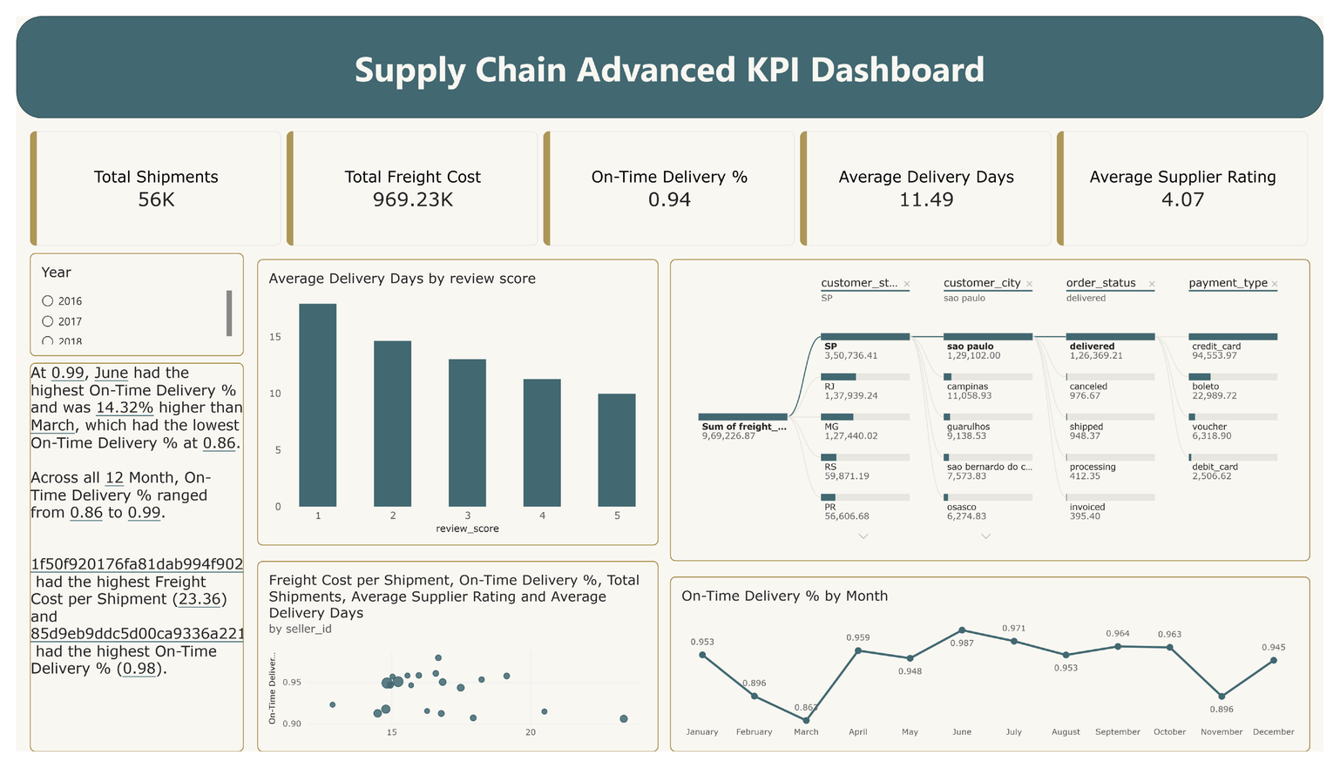
DASHBOARD 4 — DETAIL
Advanced KPI Visualization — Service Pattern Analysis
The second KPI page connects delivery speed, review score, monthly reliability and drillable freight context.
OBSERVED PATTERNS
1
Monthly service varies
The dashboard shows on-time delivery ranging roughly from 0.86 to 0.99 across the twelve displayed months.
2
March vs June
March is the weakest month in the narrative insight, while June is the strongest — a useful target for seasonality/root-cause review.
3
Review & delivery relationship
Average delivery days decline as review score increases in the displayed bar chart — a descriptive association, not proof of causation.
SUPPORTING LOGIC
Average Delivery Days = mean purchase-to-delivery duration
SUPPLY CHAIN VISIBILITY & OPTIMISATION
MILESTONE 3 • TEAM 4
Notes:
15

Slide 16
CROSS-DASHBOARD VIEW
Integrated Milestone 3 Business Insights
Reading the four workstreams together reveals where the network is strong, where it is costly and where targeted action can create value.
1
Service is strong overall
2
Seller improvement is material
93.91% on-time delivery provides a solid network baseline — but aggregate reliability can hide local exceptions.
109 of 235 eligible sellers are Watchlist or Needs Improvement, making seller governance a major opportunity.
3
Cost is geographically concentrated
4
Distance shapes transit behavior
Transportation spend is uneven across states and lanes; high-cost areas deserve cost-to-service comparison.
Transit time generally rises across route-distance bands, so one global transit target is not operationally fair.
5
Exceptions need a dedicated workflow
6
Customer experience connects to operations
98 orders above 60 transit days and a 205-day maximum show why exception monitoring must sit beside average KPIs.
Higher review scores align with shorter delivery durations in the KPI view, reinforcing the business value of reliable fulfilment.
Management takeaway: optimise the combination of COST + SERVICE + SELLER PERFORMANCE + ROUTE RELIABILITY — not any KPI in isolation.
SUPPLY CHAIN VISIBILITY & OPTIMISATION
MILESTONE 3 • TEAM 4
Notes:
16

Slide 17
BUSINESS RECOMMENDATIONS
Recommended Actions
Translate Milestone 3 analytics into a focused operating rhythm for supplier, transport and delivery improvement.
01
Supplier governance
Create monthly scorecard reviews for Watchlist and Needs Improvement sellers; track the weakest component score first.
HIGH
02
Route exception monitoring
Flag carrier-stage transit above route/distance benchmarks and prioritise >60-day exceptions for root-cause investigation.
HIGH
03
Freight optimisation
Investigate high freight-per-distance lanes and categories where additional spend does not translate into better delivery outcomes.
HIGH
04
Service benchmark by distance
Set expected transit ranges by distance band instead of applying a single network-wide target.
MEDIUM
05
KPI operating cadence
Use the Advanced KPI view as a monthly management scorecard linking volume, freight, delivery, reviews and geography.
MEDIUM
Suggested cadence: Weekly exceptions • Monthly seller/route review • Quarterly freight optimisation deep dive
SUPPLY CHAIN VISIBILITY & OPTIMISATION
MILESTONE 3 • TEAM 4
Notes:
17

Slide 18
ACHIEVEMENT
Milestone 3 Outcome — From Visibility to Performance Management
The project now connects clean data, reliable measures and operational dashboards into a coherent decision-support story.
119,143
66,039
5
4
Raw rows
Cleaned rows
Milestone 2 pages
Milestone 3 workstreams
WHAT MILESTONE 3 ADDS
A transparent seller scorecard with minimum-volume eligibility and quartile scoring.
Transportation-cost views that isolate expensive states, lanes, categories and time periods.
Route performance enriched with approximate geographic distance and carrier-stage transit analysis.
Advanced KPI pages that link service, cost, ratings, payments and geography for management review.
Final Message: Milestone 3 transforms the Power BI control tower from descriptive visibility into performance-focused decision support.
SUPPLY CHAIN VISIBILITY & OPTIMISATION
MILESTONE 3 • TEAM 4
Notes:
18

Slide 19
THANK YOU
for your time, guidance and
continuous support
Supply Chain Visibility & Optimisation
Milestone 3 — Performance Analytics
Team 4 • Infosys Springboard Virtual Internship 7.0 — Batch 2
Notes:
19

