Slide 1


SUPPLY CHAIN
VISIBILITY & OPTIMISATION
Milestones 1 to 4 Complete Journey
Infosys Springboard Virtual Internship 7.0 — Batch 2
Team 4 • Mahi • Vishal • Ramya • Abdul Haseeb
Mentor: Sundar Shakthi
Clean Data - Control Tower Visibility - Performance Analytics - Decision Support
Slide 1 of 20
Final Project Presentation | M1-M4 Complete Journey

Slide 2
SUPPLY CHAIN VISIBILITY & OPTIMISATION - MILESTONE 4 - TEAM 4
Project Overview & Business Challenge
Turning transactional e-commerce records into an end-to-end supply chain decision-support system.
Raw Records
Cleaned Records
Distinct Orders
Movement Lines
On-Time Delivery
119,143
66,039
55,649
63,089
93.91%
40 Raw Columns
36 analytical fields
Validated Order Grain
Item movement grain
Network Baseline
BUSINESS PROBLEM
ANALYTICAL CHALLENGE
DECISION SUPPORT OBJECTIVE
Transactional e-commerce data is fragmented across orders, items, payments, sellers, customers, and geolocation. Leadership requires a unified control tower to monitor fulfilment velocity, uncover delay patterns, and curb runaway freight costs.
Olist tables feature one-to-many relationships causing duplicated rows in merged datasets. Simple SUM operations inflate sales and freight. Every KPI must be engineered with duplicate-safe logic at the correct analytical grain.
Deliver four integrated milestones: establishing clean data trustworthiness, creating operational control tower visibility, diagnosing seller/route bottlenecks, and enabling executive decision support.
Data Domain Coverage
- Orders: Lifecycle status & timestamp milestones - Products: Category dimensions & physical weights - Sellers: State/City locations & fulfillment rates
- Freight: Cost & distance-stage transit duration - Reviews: Customer experience proxy (1-5 scale) - Payments: Payment method mix & transaction values
Slide 2 of 20
Final Project Presentation | M1-M4 Complete Journey

Slide 3
SUPPLY CHAIN VISIBILITY & OPTIMISATION - MILESTONE 4 - TEAM 4
PROGRESSION
Project Journey: Milestone 1 -> 2 -> 3 -> 4
Each milestone systematically builds upon the previous foundation to reach executive decision maturity.
Milestone 1:
Data Preparation
MAKE DATA TRUSTWORTHY
Milestone 2:
Control Tower
MAKE OPERATIONS VISIBLE
Milestone 3:
Performance Analytics
DIAGNOSE & EVALUATE
Milestone 4:
Decision Support
EXECUTIVE OPTIMISATION
Key Deliverables
Key Deliverables
Key Deliverables
Key Deliverables
- Ingested 119k raw records
- Python data profiling & type checks
- Handled missing & high-null fields
- IQR outlier filtering (66,039 rows)
- Engineered delivery_delay feature
- 5 Power BI interactive pages
- Product movement as inventory proxy
- ABC & FSN classification
- Delivery variance & severity bands
- Duplicate-safe DAX Total Sales
- Quartile Seller Scorecards (235 eligible)
- Route & carrier-stage transit days
- Haversine distance (304 routes)
- Freight cost concentration in RJ/MG
- Discovered 98 extreme transit outliers
- Executive Overview dashboard
- Delivery Efficiency & seasonal trends
- Transportation cost vs. pricing
- Customer Experience & rating drivers
- Cross-functional operating rhythm
Cumulative Value Creation
The analytical grain, feature engineering, and data-cleaning decisions established in Milestone 1 remain the active, unbroken foundation for every dashboard and recommendation in Milestone 4.
Slide 3 of 20
Final Project Presentation | M1-M4 Complete Journey

Slide 4
SUPPLY CHAIN VISIBILITY & OPTIMISATION - MILESTONE 4 - TEAM 4
MILESTONE 1
Data Preparation & Preprocessing Workflow
Rigorous Python data engineering transformed 119k messy transactional rows into an analysis-ready foundation.
119,143
Raw Records Ingested
40 raw operational attributes
0
Exact Duplicate Rows
Verified distinct primary grain
81,170
Pre-Outlier Retained
After null/noise treatment
66,039
Final Cleaned Output
36 verified analytical fields
6-Stage Preprocessing Pipeline
1. Data Profiling: Evaluated missingness patterns, field cardinality, and data types.
2. Noise Elimination: Removed high-null columns and non-operational attributes.
3. Integrity Checks: Validated numeric bounds on product dimensions, price, and freight.
4. Date Harmonization: Converted raw timestamps into standardized date formats.
5. Feature Engineering: Computed delivery delta (actual vs. estimated date).
6. Outlier Handling: Applied statistical IQR filtering to exclude extreme noise.
PYTHON LOGIC — FEATURE ENGINEERING & OUTLIER RULE
# Feature Engineering: Delivery Delay (Days)
df['delivery_delay'] = (
pd.to_datetime(df['order_delivered_customer_date'])
- pd.to_datetime(df['order_estimated_delivery_date'])
).dt.total_seconds() / (24 * 3600)
# Statistical Outlier Filtering via IQR Method
Q1 = df['delivery_delay'].quantile(0.25)
Q3 = df['delivery_delay'].quantile(0.75)
IQR = Q3 - Q1
lower_bound = Q1 - 1.5 * IQR
upper_bound = Q3 + 1.5 * IQR
cleaned_df = df[(df['delivery_delay'] >= lower_bound) &
(df['delivery_delay'] <= upper_bound)] # 66,039 rows
Analytical Impact of Cleaning
Removing skewed outliers and extreme unfulfilled orders ensured that baseline fulfillment figures (such as 93.91% on-time delivery) reflect genuine operational performance rather than corrupted data logging.
Slide 4 of 20
Final Project Presentation | M1-M4 Complete Journey

Slide 5
SUPPLY CHAIN VISIBILITY & OPTIMISATION - MILESTONE 4 - TEAM 4
MILESTONE 1
Establishing the Correct Analytical Grain & Movement Key
Solving the multi-item order inflation trap through unique movement-grain modeling.
66,039
CSV Cleaned Rows
Raw merged line items
63,089
Movement Lines
order_id + order_item_id
1.0446x
Duplicate Inflation
Unsafe raw sum distortion
R$ 4.10M
Safe Movement Value
Raw SUM was R$ 4.28M
The Data-Grain Duplication Trap
- Root Cause: Merged e-commerce tables have one-to-many relationships (multiple payments or installments per order, multiple items per order).
- The Risk: Blindly running SUM(price) or SUM(freight_value) counts payments and items redundantly, artificially inflating revenue by ~4.46% (R$ 182,577 overstatement).
- Solution: Engineered Movement Line Key (order_id + order_item_id) as the atomic unit of product movement across the supply chain.
DAX IMPLEMENTATION — DUPLICATE-SAFE MEASURES
-- 1. Duplicate-Safe Total Sales / Movement Value
Total Sales =
SUMX(
VALUES('Supply_Chain_Cleaned_Dataset'[Movement Line Key]),
CALCULATE(MAX('Supply_Chain_Cleaned_Dataset'[price]))
)
-- 2. Duplicate-Safe Units Moved
Units Moved =
DISTINCTCOUNT('Supply_Chain_Cleaned_Dataset'[Movement Line Key])
-- 3. Duplicate-Safe Distinct Orders
Total Orders =
DISTINCTCOUNT('Supply_Chain_Cleaned_Dataset'[order_id])
Modelling Principle
Why this matters: Business analytics are only defensible when the mathematical grain matches the physical operational process. All downstream KPIs in Milestones 2, 3, and 4 rely strictly on this grain-safe formulation.
Slide 5 of 20
Final Project Presentation | M1-M4 Complete Journey

Slide 6
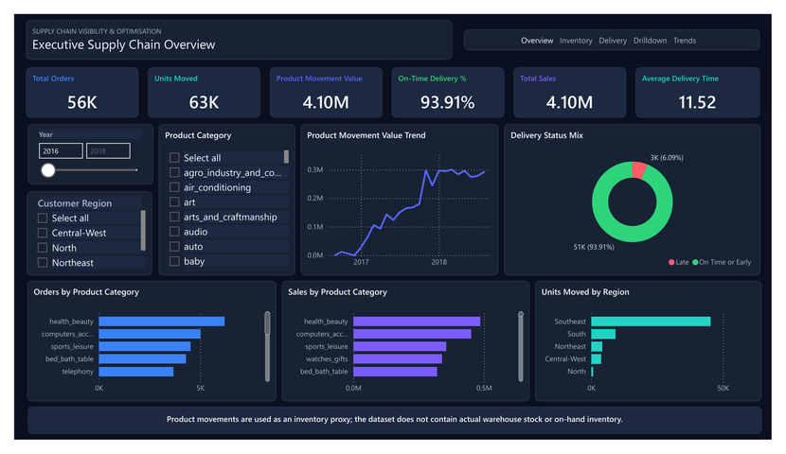
SUPPLY CHAIN VISIBILITY & OPTIMISATION - MILESTONE 4 - TEAM 4
MILESTONE 2
Supply Chain Control Tower Overview
Deploying an interactive 5-page diagnostic intelligence system for full network visibility.
The 5 Core Control Tower Dashboards
1. Executive Supply Chain Overview: High-level KPI pulse tracking orders (56K), units moved (63K), total sales (R$ 4.10M), and on-time delivery (93.91%).
2. Inventory Movement Intelligence: Velocity analytics across 18K active products, demand variability (58.65%), and ABC/FSN movement matrices.
3. Delivery Performance: Delivery variance (-11.81 days), early vs. late breakdown, and severity classification (1-3d, 4-7d, 8+d).
4. Region & Product Drilldown: 5-level operational hierarchies connecting Region -> State -> City -> Category -> Product.
5. Trends & Variance Analysis: Month-over-Month (MoM) performance tracking using robust REMOVEFILTERS date evaluation.
Critical Inventory Proxy Guardrail
The Olist dataset does NOT contain physical warehouse stock balances or bin-level on-hand inventory. All inventory metrics are transparently framed as 'Product Movement Intelligence' acting as an inventory flow proxy.
Slide 6 of 20
Final Project Presentation | M1-M4 Complete Journey

Slide 7
SUPPLY CHAIN VISIBILITY & OPTIMISATION - MILESTONE 4 - TEAM 4
MILESTONE 2
Inventory Movement Intelligence — ABC & FSN Dynamics
Segmenting product movement velocity and revenue contribution without assuming physical stock.
63K
Units Moved
Total items in circulation
18K
Active Products
Catalog items with sales
0.15
Product Velocity
Units / (Products x Months)
58.65%
Demand Variability
STDEV / AVERAGE movement
Movement Categorization Methodology
- ABC Value Analysis (Cumulative Movement Value):
- Class A: Top 80% cumulative value (high-priority revenue drivers).
- Class B: Next 15% cumulative value (80% to 95%).
- Class C: Final 5% cumulative value (tail products, 95% to 100%).
- FSN Velocity Analysis (Order Frequency Percentiles):
- Fast Moving: >= 67th percentile of order frequency.
- Moderate Moving: 33rd to 67th percentile.
- Slow Moving: <= 33rd percentile (NO 'Non-Moving' class exists).
DAX FORMULAS — INVENTORY MOVEMENT & VELOCITY
-- Improved Product Velocity (Normalized by active breadth & time)
Product Velocity =
DIVIDE(
[Units Moved],
[Active Products] * [Active Movement Months]
)
-- Demand Variability (Coefficient of Variation)
Demand Variability =
DIVIDE(
STDEV.S('Monthly_Movement'[Units Moved]),
AVERAGE('Monthly_Movement'[Units Moved])
)
Operational Takeaway
Health & Beauty, Computer Accessories, and Bed/Bath/Table represent the primary Class A / Fast-Moving volume drivers. Supply chain optimization must prioritize lane capacity and supplier SLAs for these high-throughput categories.
Slide 7 of 20
Final Project Presentation | M1-M4 Complete Journey

Slide 8
SUPPLY CHAIN VISIBILITY & OPTIMISATION - MILESTONE 4 - TEAM 4
MILESTONE 2
Delivery Performance & Regional Drilldown
Measuring delivery variance, late-order severity, and multi-tier geographic hierarchies.
93.91%
On-Time Delivery
Orders on or before ETA
6.09%
Late Delivery %
Orders breaching promised ETA
11.52 Days
Avg Delivery Time
Total fulfillment lead time
-11.81 Days
Avg Delivery Variance
Negative indicates early arrival
Delivery Severity & Geographic Hierarchies
- Reframing 'Delay' to 'Delivery Variance': A negative variance represents orders arriving ahead of promised schedule (average -11.81 days early).
- Severity Tiers: Early (majority), On Time, 1-3 Days Late (minor lag), 4-7 Days Late (moderate disruption), 8+ Days Late (critical failure).
- Multi-Level Customer Hierarchy:
Customer Region -> Customer State -> Customer City -> Product Category -> Product ID
- Seller Hierarchy: Seller State -> Seller City -> Seller ID -> Category.
DAX FORMULAS — SERVICE RELIABILITY & SEVERITY
-- 1. On-Time Delivery Percentage
On-Time Delivery % =
DIVIDE(
CALCULATE(DISTINCTCOUNT('Dataset'[order_id]), 'Dataset'[delivery_delay] <= 0),
DISTINCTCOUNT('Dataset'[order_id])
)
-- 2. Average Delivery Variance (Days)
Average Delivery Variance =
AVERAGE('Dataset'[delivery_delay])
-- 3. Average Early Delivery Days
Avg Early Delivery Days =
CALCULATE(ABS(AVERAGE('Dataset'[delivery_delay])), 'Dataset'[delivery_delay] < 0)
Geographic Concentration Insight
Southeast region dominates demand (São Paulo alone generates ~45k movement units). However, remote North and Northeast regions experience longer average lead times and lower on-time delivery percentages.
Slide 8 of 20
Final Project Presentation | M1-M4 Complete Journey

Slide 9
SUPPLY CHAIN VISIBILITY & OPTIMISATION - MILESTONE 4 - TEAM 4
MILESTONE 2
Trends & Month-over-Month (MoM) Dynamics
Uncovering growth trends, seasonality patterns, and time-intelligence variance calculations.
+6.66%
Units MoM Var %
Monthly volume trend
+4.88%
Sales MoM Var %
Monthly value growth
+0.99%
Freight MoM Var %
Freight spend change
-2.89 pp
On-Time MoM Var
Service percentage points
58.65%
Demand Volatility
Monthly CV coefficient
Time-Intelligence Architecture & Findings
- Removing Filter Distortion: Standard PREVIOUSMONTH filters can fail when users slice by specific periods. The improved pattern uses REMOVEFILTERS('Date') to evaluate preceding calendar intervals robustly.
- Seasonal Growth Surge: Observed steady volume ramp from early 2017 to peak levels in mid-2018, accompanied by rapid freight growth.
- Service Tension: Rapid volume growth periods coincide with slight dips in on-time performance (-2.89 percentage points), signaling carrier capacity bottlenecks.
DAX PATTERN — SAFE MONTH-OVER-MONTH (MOM) VARIANCE
-- Robust Time Intelligence using REMOVEFILTERS Pattern
Units Moved Previous Month =
VAR SelectedMonth = MAX('Date'[Month Start])
VAR PrevMonth = EDATE(SelectedMonth, -1)
RETURN
CALCULATE(
[Units Moved],
REMOVEFILTERS('Date'),
'Date'[Month Start] = PrevMonth
)
-- Month-over-Month Variance %
Units Moved MoM Variance % =
DIVIDE([Units Moved] - [Units Moved Previous Month], [Units Moved Previous Month])
Management Takeaway
Static yearly aggregates conceal monthly fulfillment friction. Continuous MoM monitoring is necessary to trigger proactive carrier capacity buffers ahead of high-volume seasonal spikes (e.g., November Black Friday / holiday peak).
Slide 9 of 20
Final Project Presentation | M1-M4 Complete Journey

Slide 10
SUPPLY CHAIN VISIBILITY & OPTIMISATION - MILESTONE 4 - TEAM 4
MILESTONE 3
From Descriptive Visibility to Performance Analytics
Transitioning from 'what happened' into diagnostic evaluation of sellers, routes, costs, and service SLAs.
Supplier / Seller Scorecards
Established a defensible quartile-based evaluation system across 235 eligible sellers (50+ orders) combining delivery reliability, customer reviews, freight efficiency, and speed.
01
Transportation Cost Performance
Diagnosed R$ 969.23K total freight spend, isolating geographic cost hotspots (Rio de Janeiro and Minas Gerais) and disproportionate product category shipping expenses.
02
Route & Carrier-Stage Performance
Enriched model with 19,011 validated ZIP centroids, calculated approximate Haversine straight-line distances across 304 routes, and isolated carrier-stage handoff transit times.
03
Advanced Cross-KPI Visualization
Synthesized service reliability, payment mix, customer rating distributions, and transit duration patterns into unified executive management scorecards.
04
Diagnostic Core Question
Where in our supply chain is performance world-class, where is it acceptable, and where is it costly, inefficient, or vulnerable to failure?
Slide 10 of 20
Final Project Presentation | M1-M4 Complete Journey

Slide 11
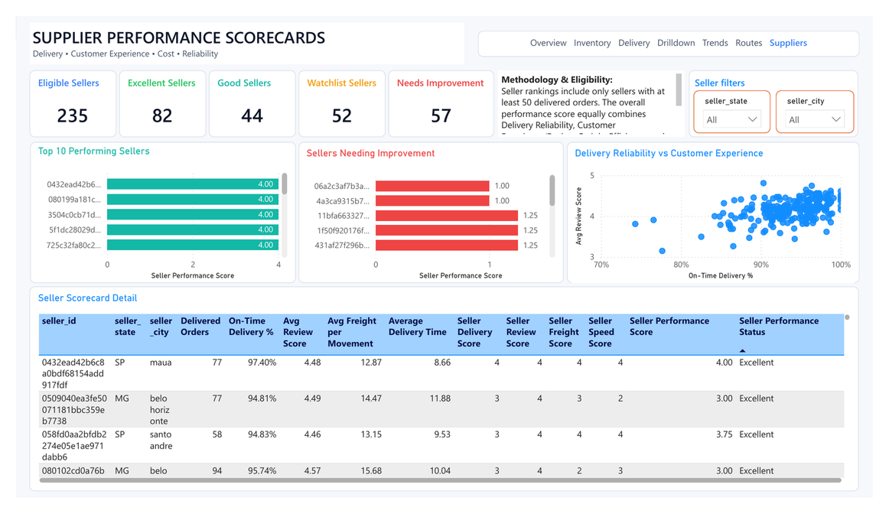
SUPPLY CHAIN VISIBILITY & OPTIMISATION - MILESTONE 4 - TEAM 4
MILESTONE 3
Supplier / Seller Performance Scorecards
Multi-criteria quartile evaluation isolating top performers from vendors requiring operational intervention.
235
Eligible Sellers
50+ delivered orders (70% vol)
82
Excellent (>=3.00)
Top quartile performers
44
Good (2.50–2.99)
Reliable partners
52
Watchlist (2.00–2.49)
Targeted monitoring
DAX — EQUAL-WEIGHTED QUARTILE PERFORMANCE SCORE
-- 4 Dimensions Weighted Equally at 25% each
Seller Performance Score =
DIVIDE(
[Seller Delivery Score] + [Seller Review Score] +
[Seller Freight Score] + [Seller Speed Score],
4
) -- Where individual scores (1-4) reflect eligible-seller quartiles
Key Takeaway: 46.4% Sellers Need Governance
109 out of 235 eligible sellers (46.4%) fall into Watchlist (52) or Needs Improvement (57). High review scores alone do not guarantee operational excellence—the 4-pillar index prevents high product ratings from hiding slow delivery or inefficient freight.
Slide 11 of 20
Final Project Presentation | M1-M4 Complete Journey

Slide 12
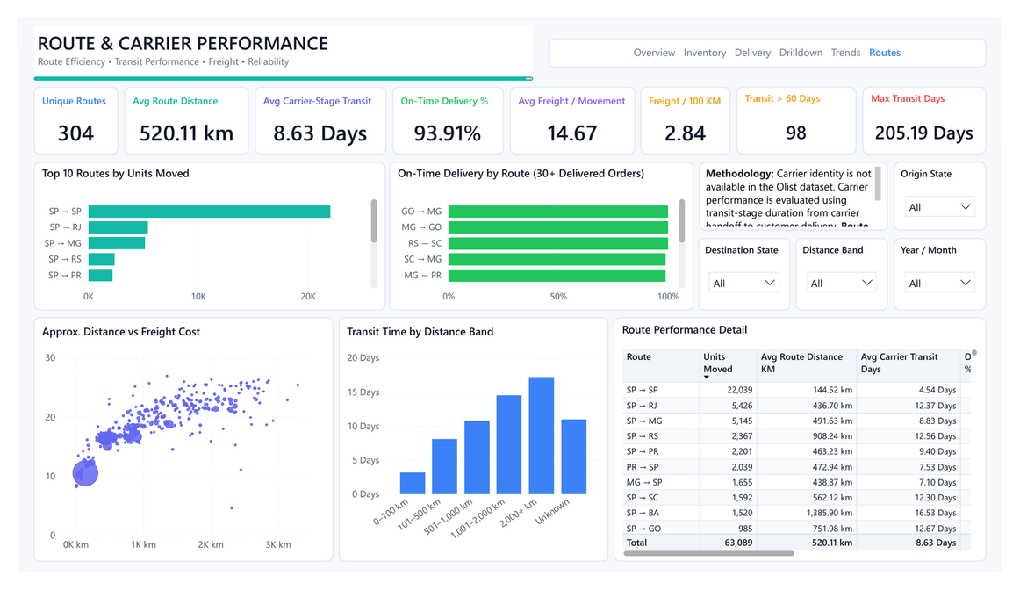
SUPPLY CHAIN VISIBILITY & OPTIMISATION - MILESTONE 4 - TEAM 4
MILESTONE 3
Route & Carrier-Stage Performance Analytics
Geographic route modeling, straight-line Haversine distances, and carrier handoff duration.
304
Unique Routes
Origin State -> Dest State
520.11 km
Avg Distance
Straight-line Haversine
8.63 Days
Avg Carrier Transit
Handoff to delivery
98
Transit >60 Days
Severe outlier shipments
DAX FORMULAS — ROUTE EFFICIENCY & TRANSIT DAYS
-- Carrier-Stage Lead Time (Carrier handoff to customer drop)
Avg Carrier Transit Days =
AVERAGEX(VALUES([order_id]), MAX([Carrier Transit Days]))
-- Normalized Freight Cost per 100 km
Freight Cost per 100 KM =
DIVIDE([Total Freight Cost], [Total Route Distance KM]) * 100
Critical Methodology & Limitations
- Distance is approximate straight-line Haversine (Earth radius 6,371 km) between ZIP centroids, NOT road odometer mileage.
- Olist dataset does NOT contain named carrier companies; metrics evaluate the carrier-stage fulfillment process duration.
Slide 12 of 20
Final Project Presentation | M1-M4 Complete Journey

Slide 13
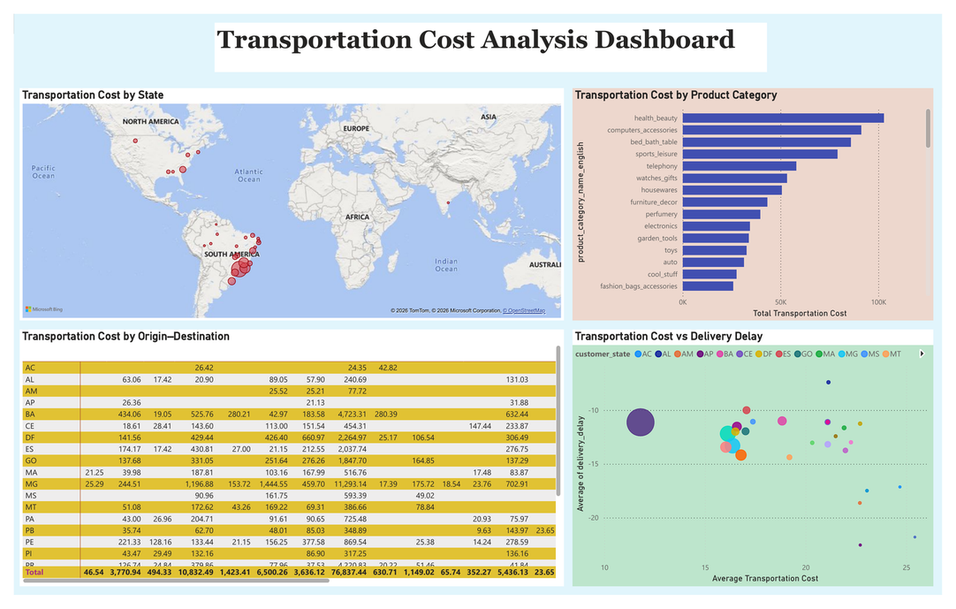
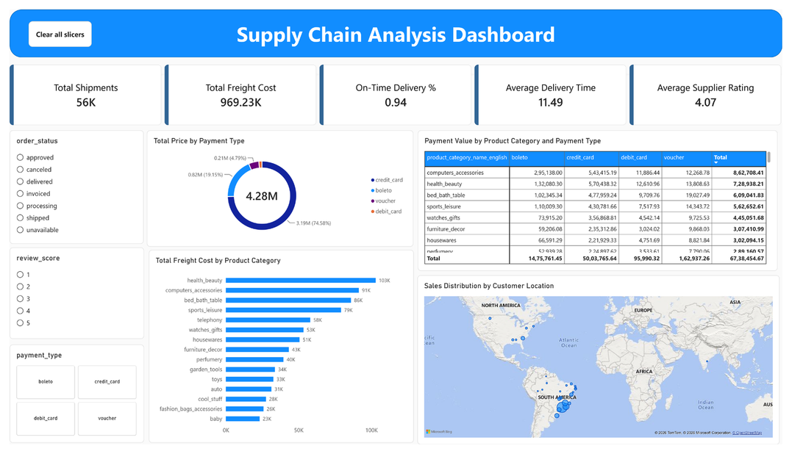
SUPPLY CHAIN VISIBILITY & OPTIMISATION - MILESTONE 4 - TEAM 4
MILESTONE 3
Transportation Cost & Advanced KPI Analytics
Diagnosing freight expenditure concentration, shipment lead times, and customer review relationships.
R$ 969.23K
Total Freight Cost
Dashboard grand total
R$ 137.94K
Rio de Janeiro Spend
High freight state share
56K
Shipments Analyzed
Order shipment volume
4.07 / 5.0
Avg Supplier Rating
Customer experience proxy
Analytical Integration
Freight spending grew dramatically over the operating lifecycle (+694.99% Sep 2016 to Aug 2018). Spend is heavily concentrated in RJ and MG, with Health & Beauty and Computer Accessories demanding the largest logistics budget.
Slide 13 of 20
Final Project Presentation | M1-M4 Complete Journey

Slide 14
SUPPLY CHAIN VISIBILITY & OPTIMISATION - MILESTONE 4 - TEAM 4
MILESTONE 3
Synthesized Key Findings & Analytical Logic
Consolidating 6 core empirical insights across service reliability, vendor tiers, routes, and spend.
1. High Baseline Service (93.91%)
Overall on-time delivery is strong, but aggregate success conceals severe local exceptions in remote lanes.
2. 46.4% Seller Governance Pool
109 out of 235 eligible vendors require performance remediation across delivery speed, reviews, or freight.
3. Geographic Spend Concentration
Freight costs are heavily concentrated in Southeast lanes and inbound shipments to RJ (R$ 137.94K) and MG.
4. Distance Shapes Transit Times
Transit times scale naturally with distance (SP->SP is 4.54d vs. SP->BA at 16.53d); requires tiered SLAs.
5. Critical Outlier Exceptions
98 orders took >60 days in transit, with max transit reaching 205.19 days, requiring dedicated exception workflows.
6. Speed Drives Rating
Strong inverse correlation: average delivery duration drops from ~17.5 days for 1-star reviews to ~10.1 days for 5-star.
Core Management Takeaway
Optimize the holistic equilibrium of COST + SERVICE RELIABILITY + SELLER QUALITY + ROUTE EFFICIENCY. Cutting freight costs blindly destroys delivery speed and damages customer review sentiment.
Slide 14 of 20
Final Project Presentation | M1-M4 Complete Journey

Slide 15
SUPPLY CHAIN VISIBILITY & OPTIMISATION - MILESTONE 4 - TEAM 4
MILESTONE 4
Transitioning from Analysis to Executive Decision Support
Synthesizing operational discoveries into four decision-oriented executive control interfaces.
Executive Overview
COMMERCIAL & FULFILLMENT CONTROL
Delivery Efficiency
SERVICE SPEED & SEASONALITY
Transportation Cost
FREIGHT & MARGIN OPTIMIZATION
Customer Experience
SENTIMENT & RETENTION GOVERNANCE
Executive Capabilities
- Consolidates high-level revenue and order flow.
- Monitors fulfillment pipeline (93.75% delivered, 4.69% shipped).
- Tracks geographic order volume across customer states.
- Surfaces top-performing categories (Telephony, Computers).
Executive Capabilities
- Evaluates shipment lead times (11.49 days average).
- Identifies monthly seasonality dips (March 86.3%, Nov 89.6%).
- Quantifies delivery lead time impact on customer rating.
- Enables interactive slicing by payment type and order status.
Executive Capabilities
- Analyzes R$ 969.23K freight expenditure distribution.
- Diagnoses origin seller state dominance (SP > R$ 0.6M).
- Discovers price vs. freight imbalances across catalog items.
- Pinpoints categories generating disproportionate shipping drain.
Executive Capabilities
- Tracks 55K customer reviews with 4.07 / 5.0 rating average.
- Analyzes rating mix (57.97% 5-star vs. 12.1% 1-star).
- Maps direct correlation between delivery delays and bad reviews.
- Provides category-specific customer sentiment indicators.
The Milestone 4 Mandate
Milestone 4 elevates data analytics into an active management dashboard suite, empowering supply chain leaders to balance customer satisfaction against freight spending and carrier turnaround times.
Slide 15 of 20
Final Project Presentation | M1-M4 Complete Journey

Slide 16
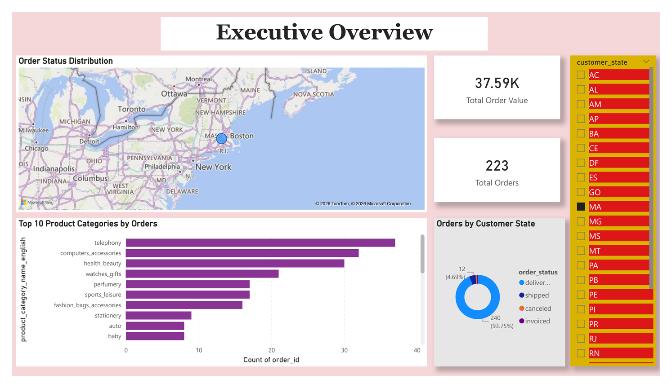
SUPPLY CHAIN VISIBILITY & OPTIMISATION - MILESTONE 4 - TEAM 4
MILESTONE 4
Executive Overview Dashboard
Strategic leadership overview monitoring order volume, fulfillment status mix, and state distribution.
R$ 37.59K
State Order Value
Filtered state view (e.g. MA)
223
State Orders
Customer state volume
93.75%
Delivered Status
240 items completed
4.69%
In-Transit / Shipped
12 items in pipeline
DAX FORMULAS — EXECUTIVE OVERVIEW
-- 1. Total Order Value (Aggregated Payments)
Total Order Value = SUM('Table'[payment_value])
-- 2. Total Order Volume (Distinct Orders)
Total Orders = DISTINCTCOUNT('Table'[order_id])
Operational Analysis & Caution
- The dashboard provides rapid visual slicing by customer state (MA displayed) and top product categories (Telephony, Computer Accessories, Health & Beauty).
- Analytical Note: As shown in Power BI Desktop, KPI cards reflect the active customer state filter context.
Slide 16 of 20
Final Project Presentation | M1-M4 Complete Journey

Slide 17
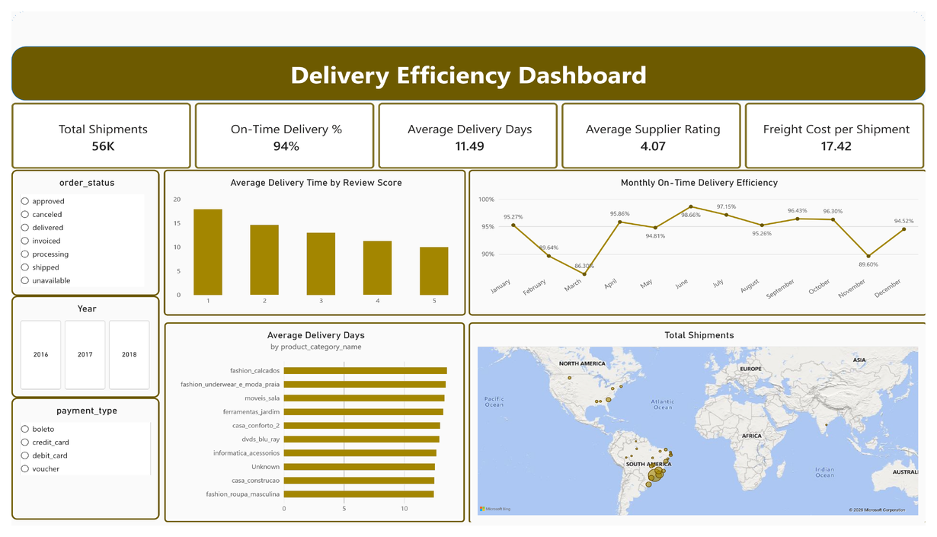
SUPPLY CHAIN VISIBILITY & OPTIMISATION - MILESTONE 4 - TEAM 4
MILESTONE 4
Delivery Efficiency & Seasonality Dashboard
56K
Total Shipments
Distinct orders fulfilled
94%
On-Time Delivery %
Fulfilled on/before ETA
Tracking on-time fulfillment rates, seasonal volume dips, and delivery lead time correlations.
11.49 Days
Avg Delivery Time
Purchase to delivery drop
R$ 17.42
Freight / Shipment
Average shipping charge
DAX FORMULAS — DELIVERY EFFICIENCY & TRANSIT DAYS
-- 1. On-Time Delivery Percentage
On-Time Delivery % =
DIVIDE(
CALCULATE(DISTINCTCOUNT('Dataset'[order_id]), 'Dataset'[delivery_delay] <= 0),
[Total Shipments]
)
-- 2. Average Lead Time Duration (Days)
Average Delivery Time =
AVERAGEX(
FILTER('Dataset', NOT ISBLANK('Dataset'[order_delivered_customer_date])),
DATEDIFF('Dataset'[order_purchase_timestamp], 'Dataset'[order_delivered_customer_date], DAY)
)
Operational Insights: Seasonality & Sentiment Impact
- Seasonal Performance Curve: On-time delivery drops significantly in March (86.30%) and November (89.60%), but peaks in June (98.66%) and July (97.15%).
- Direct Sentiment Impact: Orders with 1-star reviews suffer an average lead time of ~17.5 days, compared to ~10.1 days for 5-star reviews.
Slide 17 of 20
Final Project Presentation | M1-M4 Complete Journey

Slide 18
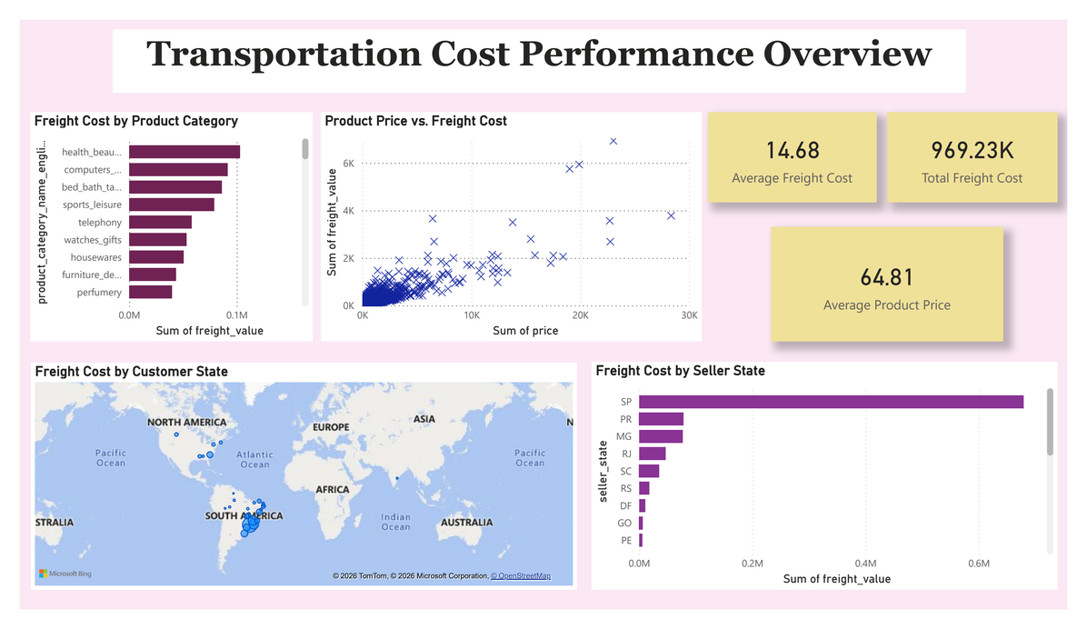
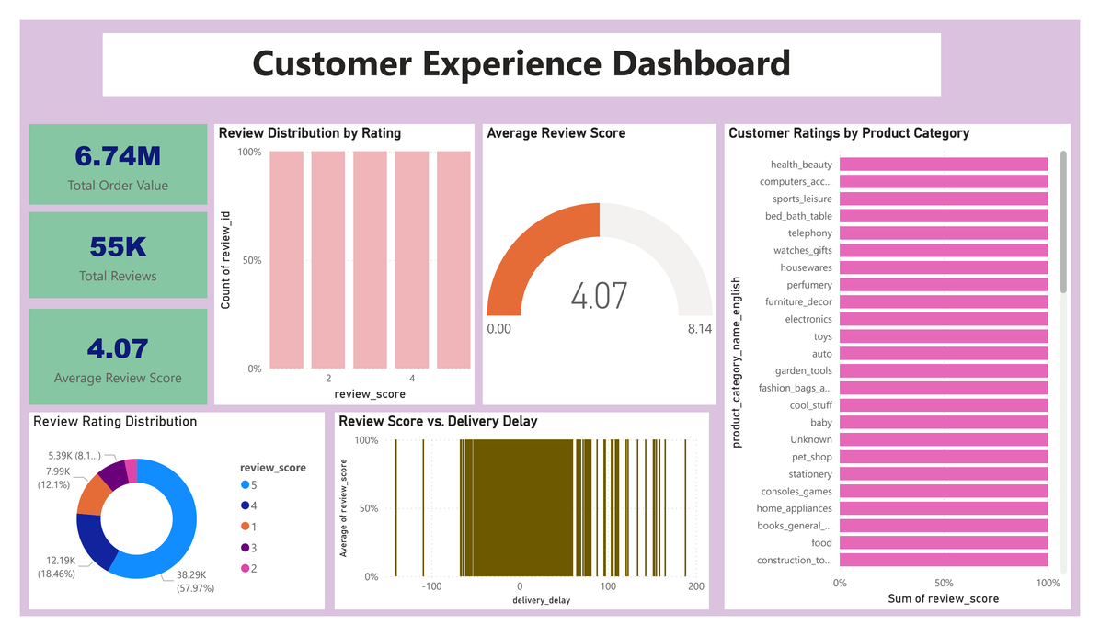
SUPPLY CHAIN VISIBILITY & OPTIMISATION - MILESTONE 4 - TEAM 4
MILESTONE 4
Transportation Cost Performance & Customer Experience
Integrating logistics expenditure diagnostics with customer satisfaction and rating distributions.
R$ 969.23K
Total Freight Cost
Logistics spend pool
R$ 14.68
Avg Freight / Move
Per-movement freight
55K Reviews
Total Customer Reviews
Rating population
4.07 / 5.0
Avg Review Score
57.97% 5-star ratings
TRANSPORTATION DAX
CUSTOMER EXPERIENCE DAX
Total Freight Cost = SUM('Table'[freight_value])
Average Freight Cost = AVERAGE('Table'[freight_value])
Average Product Price = AVERAGE('Table'[price])
Total Reviews = DISTINCTCOUNT('Table'[review_id])
Average Review Score = AVERAGE('Table'[review_score])
Total Order Value = SUM('Table'[payment_value])
Slide 18 of 20
Final Project Presentation | M1-M4 Complete Journey

Slide 19
SUPPLY CHAIN VISIBILITY & OPTIMISATION - MILESTONE 4 - TEAM 4
STRATEGIC GOVERNANCE
End-to-End Strategic Insights & Recommendations
Translating analytical milestones into an executive operating cadence for sustainable supply chain optimization.
Supplier Performance Remediation
Establish monthly governance reviews targeting the 109 sellers in Watchlist (52) and Needs Improvement (57). Enforce corrective action plans on the weakest individual quartile metric (Speed, Freight, or Reliability).
HIGH
Route Exception Management Workflow
Deploy automated trigger alerts for shipments exceeding distance-specific lead time thresholds. Establish dedicated escalation protocols for extreme outlier orders (>60 days in transit).
HIGH
Freight Cost Rationalization
Re-negotiate regional carrier rates in high-spend destination hubs (RJ at R$ 137.94K and MG). Scrutinize catalog items where freight cost represents an excessively high percentage of product retail value.
HIGH
Distance-Tiered Customer Delivery SLAs
Replace monolithic countrywide estimated delivery dates with dynamic distance-band SLAs (e.g., 0-100km, 101-500km, 500-1000km, 1000km+) to prevent false delay alarms and improve customer satisfaction.
MEDIUM
Closed-Loop Customer Experience Loop
Direct customer review feedback into vendor scorecards and carrier SLAs. Prioritize immediate customer service follow-ups whenever actual delivery lags promised date by >3 days.
MEDIUM
Recommended Operating Rhythm
Weekly: Outlier shipment escalations (>60d) - Monthly: Seller scorecard reviews - Quarterly: Regional freight rate & carrier renegotiations
Slide 19 of 20
Final Project Presentation | M1-M4 Complete Journey

Slide 20
PROJECT ACHIEVEMENT & CONCLUSION
From Transactional Data to Strategic Executive Decision Support
The project successfully establishes a complete end-to-end analytics continuum—transforming raw Brazilian e-commerce logs into clean data assets, a 5-page operational control tower, diagnostic supplier scorecards, and executive decision dashboards.
66,039
Cleaned Records
M1 Data Quality Standard
5 Pages
Control Tower Views
M2 Operational Visibility
4 Streams
Performance Diagnostics
M3 Supplier/Route Models
4 Dashboards
Executive Decision Views
M4 Leadership Support
Project Summary & Business Value Delivered
- Trustworthy Data Foundation: Addressed multi-item grain inflation and engineered delivery variance metrics.
- Holistic Control Tower: Unlocked product velocity, ABC/FSN movement intelligence, and multi-tier regional drilldowns.
- Defensible Performance Framework: Scored 235 eligible sellers, mapped 304 routes, and isolated carrier handoff lead times.
- Actionable Decision Support: Directly connected fulfillment delays to customer ratings and identified cost optimization targets.
Slide 20 of 20
Final Project Presentation | M1-M4 Complete Journey

Slide 21

THANK YOU
for your time, guidance and
continuous support
Supply Chain Visibility & Optimisation
Milestone 4 — Completed Successfully
Team 4 • Infosys Springboard Virtual Internship 7.0 — Batch 2

