Slide 1
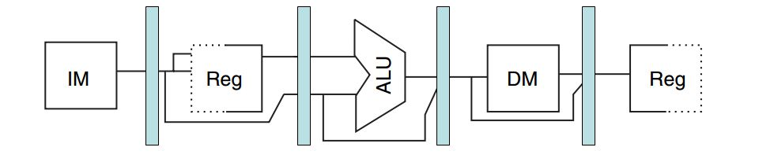
Design Divided into Stages

Slide 2














Fetch Stage
exception
en
EPC
$$PC+1$$
00
$$R[r_{dst}]$$
01
00
PC
$$M[INT]$$
10
$$M\left[3\right] \& M[2]$$
0
01
Instruction Mem
Instruction
$$X[SP]$$
11
$$PC$$
10
add
$$M\left[5\right] \& M[4]$$
1
$$PC$$
11
Entry Point
etype
exception
>
Invalid memory address
Branch
HLT
$$M\left[1\right] \& M[0]$$
set
0xFF00
$$+1$$
00
SP
$$+2$$
01
+
$$−1$$
10
exception
$$−2$$
11
en
step
$$sp[20]$$
Empty stack
type

Slide 3













Decode/Write Back Stages
Instruction
4bits
Reg File (16x8)
16bits
$$R_{scr1}$$
$$R[R_{scr1}]$$
4bits
$$R_{scr2}$$
$$R[R_{scr2}]$$
16bits
4bits
$$R_{dst}$$
$$ALU_{out}$$
0
$$X[SP]$$
1
16bits
$$d_{in}$$
$$Imm<11:0>$$
Sign Extend 16
$$SE(Imm<11:0>)$$
2
$$M[R[R_{scr}] + offset]$$
3
$$PORT.IN$$
4
$$WE$$
$$MOV$$
$$din_{src}$$
write
swap
OUTPUT.PORT
out
en
Write Back Operation

Slide 4











Execute Stage
Decode Stage
flg_reserve
$$<N,Z,C>_{reserved}$$
en
set_c
C
en
flg_restore
$$<N,Z,C>$$
$$R[R_{src1}]$$
$$status :<N,Z,C>$$
0
$$SE(Imm)$$
1
ALU
$$op_{src1}$$
$$ALU_{out} | Memory Address$$
$$R[R_{src2}]$$
0
$$SE(Imm)$$
1
$$op_{src2}$$
$$funct$$

Slide 5


















Memory Stage
Execute Stage
$$ALU_{out}$$
Data Memory
$$Address$$
$$ML{\left[Address\right]}_{15:0}$$
$$R[R_{src1}]$$
$$Data$$
$$M{H\left[Address\right]}_{31:16}$$
$$R[R_{src1}]$$
0
$$Stk Data$$
$$PC$$
1
$$PC+1$$
2
$$XL{\left[Stk Address\right]}_{15:0}$$
$$stk_d_src$$
$$Stk Address$$
$$XH{\left[Stk Address\right]}_{31:16}$$
$$SP$$
$$SWE$$
$$SWE$$
$$WE$$
$$WE$$
0XFFFFF
STACK
0X0FF00
DATA
0X0000F
RESERVED
Exceptions & interrupt table
0X00000

