Slide 1
An Empirical Study of Vulnerability Rewards Programs
Matthew Finifter, Devdatta Akhawe, David Wagner
UC Berkeley

Slide 2
security development lifecycle

Slide 3
Incident Response
Operational Security
Defense in Depth
Vulnerability Remediation
A vulnerability remediation strategy is any systematic approach whose goal is to reduce the number of software vulnerabilities. CERT
Code Reviews
Penetration Testing
Dynamic/Static Analysis Tools
Bug Bounties?

Slide 4
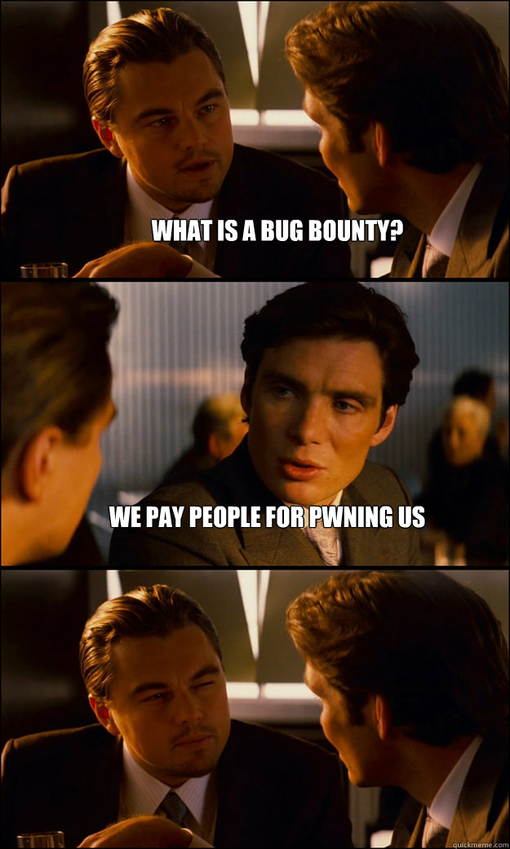

Slide 5
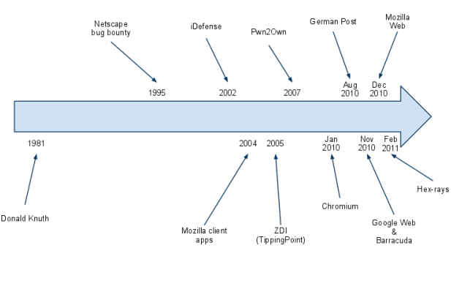
Copyright Adam Mein and Chris Evans, Google Inc.

Slide 6
There is an active debate over the value and effectiveness of VRPs. A number of vendors, notably Microsoft, Adobe, and Oracle, do not maintain a VRP, with Microsoft arguing that VRPs do not represent the best return on investment on a per-bug basis
-- Our paper

Slide 7
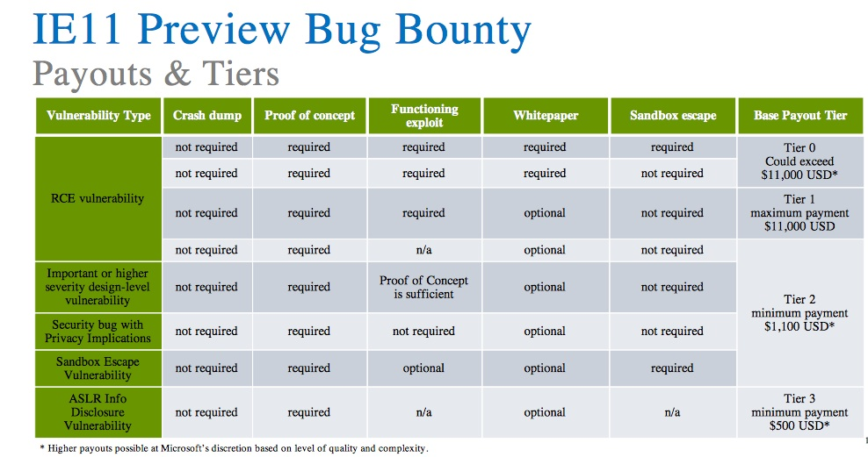


Slide 8
There is an active debate over the value and effectiveness of VRPs. A number of vendors, notably Microsoft, Adobe, and Oracle, do not maintain a VRP, with Microsoft arguing that VRPs do not represent the best return on investment on a per-bug basis

Slide 9
Analysis of Chrome & Firefox VRPs
From 2 viewpoints
Software Vendor
Security Researchers
Other analysis of the data
Lots of hypotheses
We can’t do experiments!
today

Slide 10


Slide 11


Chrome VRP
Firefox VRP
Started in Jan 2010
Rewards ranging from $500 to $1337
Amounts increased over time to $1000--$3133.7
$31,336 for exceptional reports with patches
Started in 1995 by Netscape
Rewards increased to $3000 on July 1, 2010
All high/critical vulns get $3000!

Slide 12
data

Slide 13
Severity, reporter, report date
Bugs found by VRP AND affecting stable releases
Bugs Found using the VRP
Bugs affecting stable releases
For VRP bugs, reward amount (always $3K for Firefox)
For stable bugs, date a patched version available to end-users

Slide 14
Severity
An ordinal measure of “badness” of a security bug
Arbitrary code execution with user’s privilege on the OS considered critical severity by both browsers
Chrome has a privilege separated design and a memory corruption vulnerability in the “renderer” process is only high severity (same origin bypass)
Nearly all memory corruption vulnerabilities in Firefox are critical severity

Slide 15
Severity | Chrome Stable | Chrome Bounty | Firefox Stable | Firefox Bounty
Low | 226 | 1 | 16 | 1
Medium | 288 | 72 | 66 | 9
High | 793 | 395 | 79 | 38
Critical | 32 | 20 | 393 | 142
Unknown | 8 | 13 | 59 | 0
Total | 1347 | 501 | 613 | 190

Slide 16
software vendor perspective

Slide 17
1
Finding Bugs

Slide 18
Bugs found
27.5% of bugs affecting Chrome releases originate from VRP contributions (371 of 1347), and 24.1% of bugs affecting Firefox releases (148 of 613) result from VRP contributions.
Effective!
Note that we are only looking at bugs affecting release versions!
140 high/crit Jan-May ’13 in Chrome, only 40 found by VRP

Slide 19
Bugs found
27.5% of bugs affecting Chrome releases originate from VRP contributions (371 of 1347), and 24.1% of bugs affecting Firefox releases (148 of 613) result from VRP contributions.
Effective!

Slide 20
Bugs found
27.5% of bugs affecting Chrome releases originate from VRP contributions (371 of 1347), and 24.1% of bugs affecting Firefox releases (148 of 613) result from VRP contributions.
Effective!
Total bugs found by Chrome VRP: 371
Max found by best internal researcher: 263
148 found by Firefox VRP (vs 48 by best internal)

Slide 21
Bugs found
27.5% of bugs affecting Chrome releases originate from VRP contributions (371 of 1347), and 24.1% of bugs affecting Firefox releases (148 of 613) result from VRP contributions.
Effective!
But is it cost-effective?

Slide 22
2
Cost

Slide 23
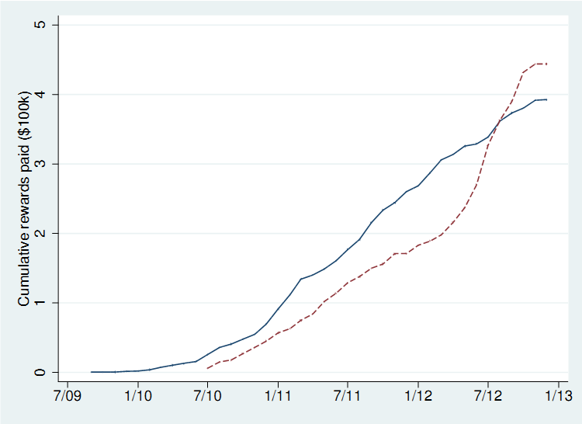
Cost of VRP
Roughly $400,000 over 3 years for bugs affecting stable releases
Chrome
Firefox

Slide 24
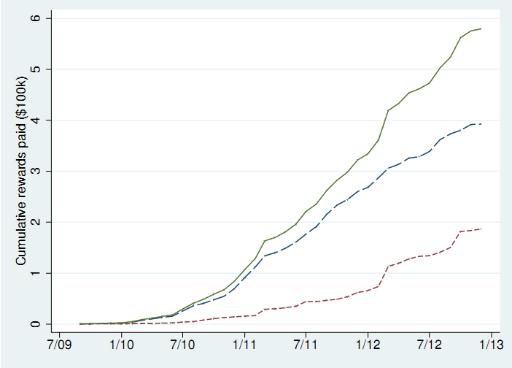
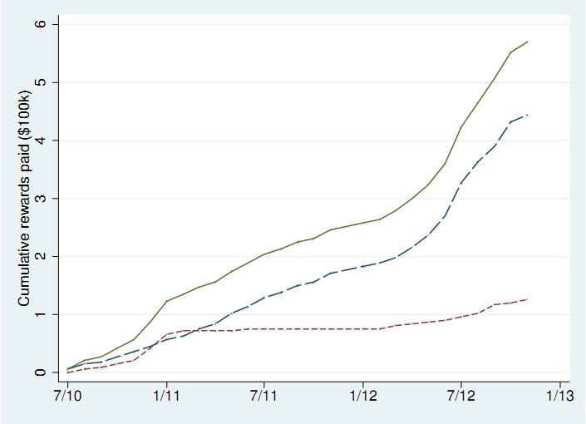
Cost of VRP
Chrome
Firefox
Total Cost
Total Cost
Stable
Stable
pre-release
pre-release

Slide 25
Cost of VRP
Chrome total cost: $579,605 ($485/day)
$186,839 (32%) for non-release bugs
Firefox total cost: $570,000 ($658/day)
$126,000 (22%) for non-release bugs
Roughly, $190,000/year
Comparable to total cost of ONE security engineer
$100,000 + 50% overhead = $500/day
But is it cost-effective? YES

Slide 26
3
Community Engagement

Slide 27
Community Engagement
Get more security bugs from the community

Slide 28
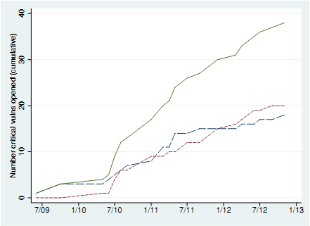
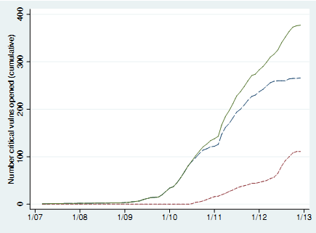
Community Engagement: Critical Bugs
Chrome
Firefox
Increase in reward amounts
internal (blue) vs external (red)

Slide 29
Community Engagement
Get more security bugs from the community
VRP found more critical bugs in Chrome (release) than Internal researchers
For Firefox, internal researchers find the lion’s share of critical vulnerabilities
Although, VRP impact is improving

Slide 30
Given enough eyeballs, all bugs are shallow
Linus’ Law

Slide 31
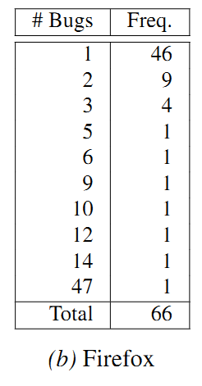
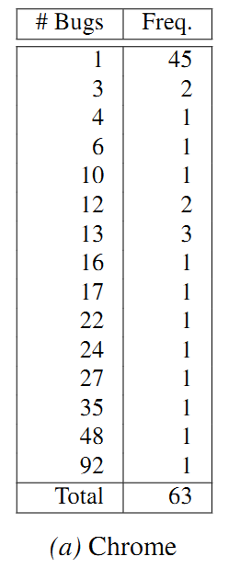
45/46 people only reported 1 high/critical bug

Slide 32
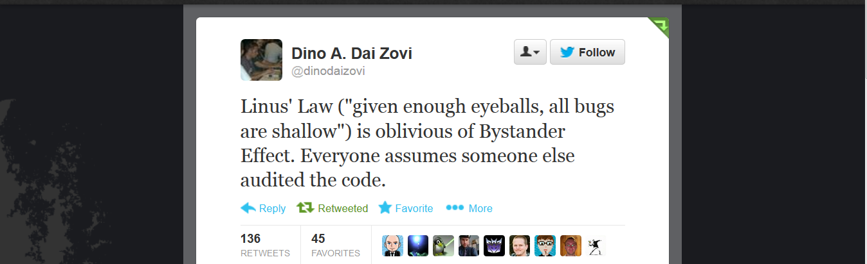
Maybe if we offer money?

Slide 33
Community Engagement
Get more security bugs from the community
Get more eyeballs on code
Get more diverse bugs from the community
Chrome awards amounts ending with 337 for particularly smart/novel vulnerabilities
31 such awards in our dataset
Anecdotal evidence that it can lead to more bugs!
PinkiePie’s exploit => full review of kernel API
a large number of similar issues found

Slide 34
software vendor perspective

Slide 35
From the Software Vendor’s view
Effective: ~25% of bugs affecting release
Cost effective: comparable to ONE developer
Community Engagement
More bugs from community
More eyeballs
Diverse bugs leading to finding more issues

Slide 36
security researcher perspective

Slide 37
1
Reward Amount

Slide 38
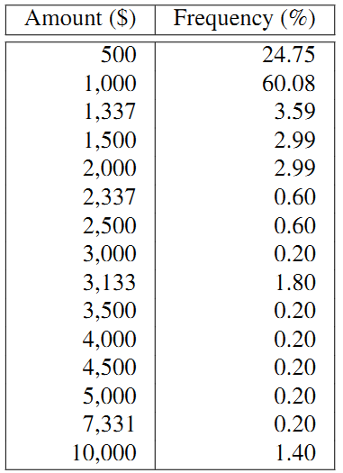
Chrome Reward Amounts
95.8% of awards ≤ $3000 (Firefox)

Slide 39
Reward Amounts
Vast majority of rewards for Chrome under $1000 (median: $1000, mean $1156.9)
Firefox award is $3000 (high/critical) or $0
Lottery?
Low (or possibly negative) expected return on investment of finding bugs
But possibility of very large rewards!

Slide 40
2
Repeat Participation

Slide 41
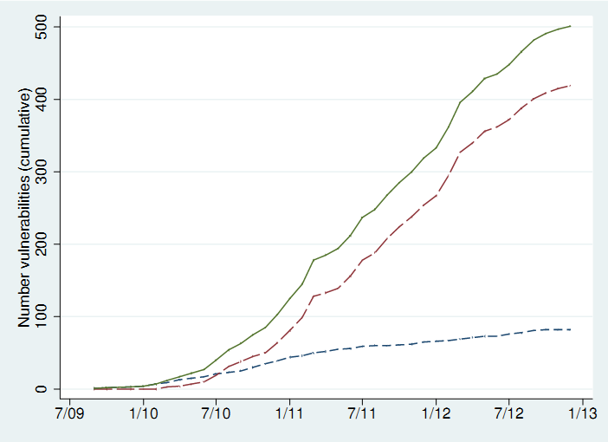
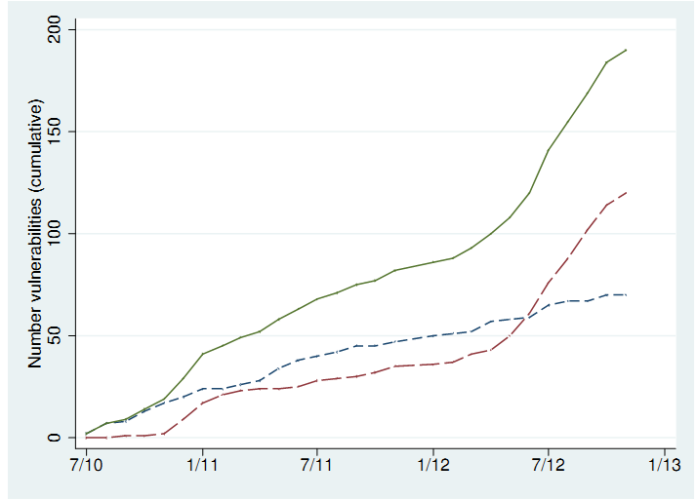
First time vs. Repeat Contribution
Chrome
Firefox
First-time (blue) vs repeat (red)

Slide 42
3
VRP as Employment

Slide 43
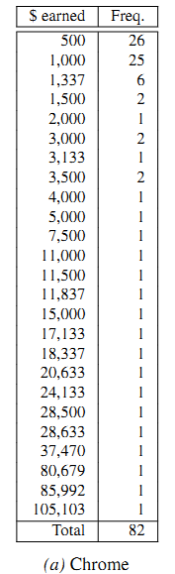
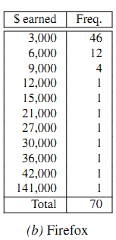
Total Income

Slide 44
VRP as Employment
The very best earn at the most $47,000 per year
Such a person likely to make much more working for Firefox and Chrome
Both Google and Mozilla hired researchers found via VRPs
Hypothesis: The best security researchers bubble to the top, where a full-time job awaits.

Slide 45
security researcher perspective

Slide 46
From the Researcher’s view
Participation in a single VRP program likely not comparable to full-time employment
Although, good performance might lead to a job
Multiple programs could provide significant income
Repeat participation is increasing
Suggests that researchers have a good experience with the programs
Expected reward in Firefox higher than in Chrome
Although, possibility of much higher payoff in Chrome

Slide 47
other analysis

Slide 48
1
Severity

Slide 49
Severity | Chrome Stable | Chrome Bounty | Firefox Stable | Firefox Bounty
Low | 226 | 1 | 16 | 1
Medium | 288 | 72 | 66 | 9
High | 793 | 395 | 79 | 38
Critical | 32 | 20 | 393 | 142
Unknown | 8 | 13 | 59 | 0
Total | 1347 | 501 | 613 | 190

Slide 50
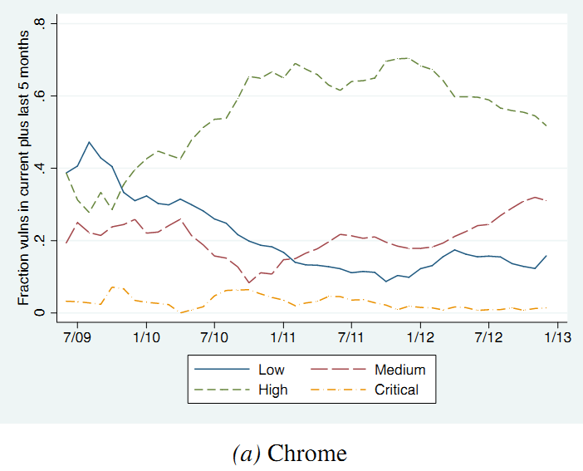
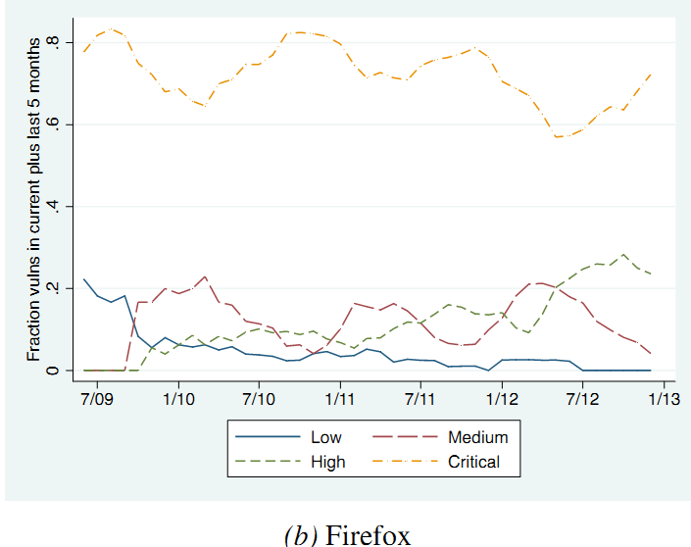
Fraction of Vulns by Severity
High
Critical
High
Critical
Hypothesis: This difference is due to privilege separation

Slide 51
2
Time to Patch

Slide 52
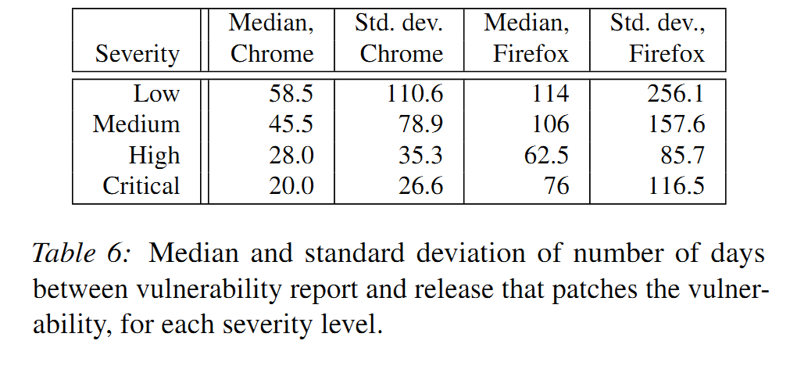


Slide 53
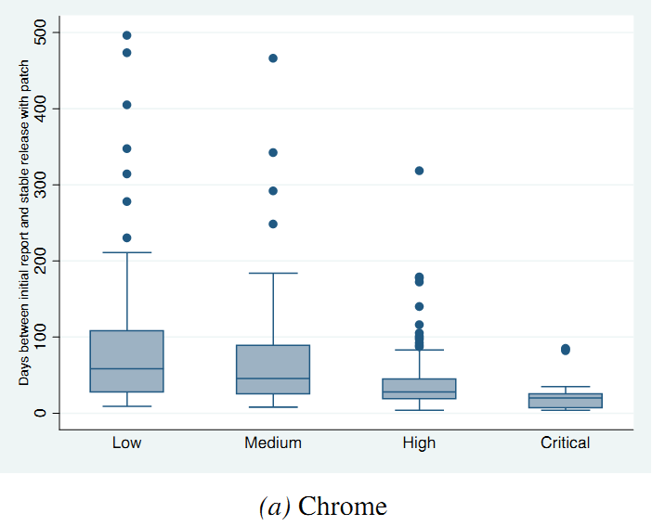

Slide 54
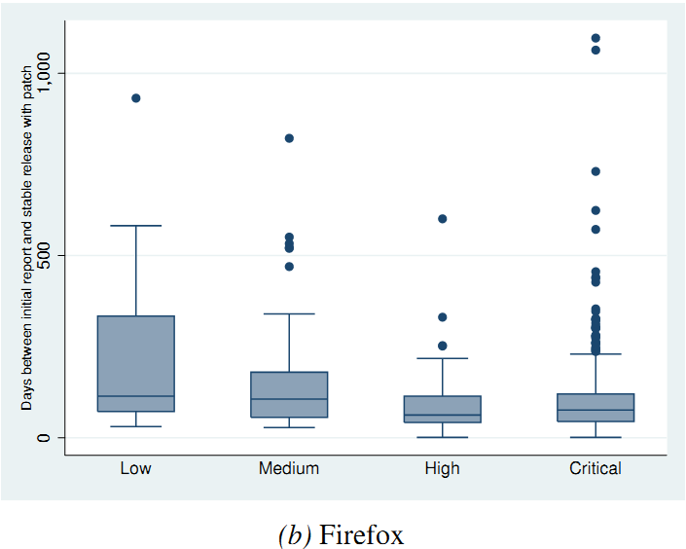

Slide 55
Hypothesis: This difference is due to privilege separation

Slide 56
final thoughts

Slide 57

Notes:
http://www.spoofee.com/forums/off-topic-discussion-general-questions/123568-chrome-vs-firefox.html

Slide 58
Firefox vs Chrome
Despite costing roughly the same, the Chrome VRP
Identified 3x bugs
More popular
Similar participation between repeat and first-time
External Researchers competitive with Internal researchers (for bugs in release versions)
Why?

Slide 59
Possible Reasons
Tiered Reward Structure
Incentivizes participation, keeps cost low
Low variance/mean time to patch
Researchers like when bugs get patched quickly
Higher Profile for Chrome
Pwnium, a high profile event
sudden top-ups for rewards
Such “gamification” leads to more participation

Slide 60
Recommendations for Vendors
VRPs seem cost-effective strategy
Try to reduce time-to-patch
Consider tiered incentives like Chrome
Architecture can have massive impact
See impact of privilege separation for Google Chrome

Slide 61
evil@berkeley.edu
thanks
https://www.cs.berkeley.edu/~devdatta
Thanks to Dan Veditz and Chris Evans for all their help

