Slide 1
Product Labels for Mobile Application Markets
Devdatta Akhawe and Matthew Finifter
University of California, Berkeley
{dev,finifter}@cs.berkeley.edu
Notes:
Good afternoon, my name is Devdatta Akhawe and I will be talking about our position paper on product labels for mobile application markets. This is joint work with Matthew finifter

Slide 2
b.l.u.f. slide
Notes:
I am told the NSA has this b.l.u.f. requirement for all its presentation: the bottom line up front slide. And saw here’s the bottom line for all of our work.

Slide 3
the centralized nature of mobile application markets affords
them a unique opportunity to gather and present information to
eliminate information asymmetry
Notes:
We believe that the centralized nature of mobile application markets afford them a unique opportunity to gather and present information to eliminate information asymmetry. And in this talk, I will expand on what I mean by the unique opportunity and go over a bunch of ideas for product labels to eliminate information asymmetry. This is a position paper, so I would urge you to start thinking for other ideas, and I am really hoping for a great discussion today.

Slide 4
the problem
Notes:
So what is the problem? What is this information asymmetry that I talked about?

Slide 5
Information Asymmetry
Lack of understanding between buyer and seller regarding quality of product
One party has more or better information than the other
Clear asymmetry in mobile application markets
Developer knows quality, security, and privacy profile of the product
The user only has access to noisy indicators like reviews and ratings
Notes:
Information asymmetry is an economic term for transactions in which there is a lack of understanding between buyer and seller. This is an old concept, the classic example being the market for second hand cars: in the absence of a service like CarFax, the market for second hand cars suffers from asymmetry, since one side has more information than the other. There is clear asymmetry in the mobile application markets.
The developer knows the quality security and privacy profile of the product; but the user has no idea. The user only has access to noisy indicators of quality like reviews and ratings.

Slide 6
so what?
Notes:
So what ? Who cares?

Slide 7
Information Asymmetry
Developers can’t differentiate based on quality/security
Differentiation drives innovation
Markets thrive with information symmetry
E.g., CarFax, Nutritional Labels, Safety Certifications
Application markets in a unique position to relieve information asymmetry
Notes:
Well this information asymmetry is a case of market failure: the developer can’t differentiate based on quality/security. A maps application that tracks your location everywhere, and one that respects your privacy looks the same to the user: why should the developer not make money by tracking your location? In general, information asymmetry reduces innovation: if you can’t differentiate your products based on innovation, there is no point in trying.
From previous markets, we know that markets thrive with information symmetry, see the case of carfax, nutritional labels, safety certifications and so on. Our position in this work is that application markets are in a unique position to relieve information asymmetry; something that has never before been possible for software.

Slide 8
Unique position of App Markets
Complete control of installs/uninstalls:
Fantastic position to collect data
Also, to enforce labeling requirements
Punish mislabeling
Often, control the user’s device too
Modify devices for better data and labels
Notes:
Why is the position of application markets so unique? Well, the markets often have complete control over all the installs/uninstalls on the application, a fantastic position to collect all sorts of interesting data as well as enforce labeling requirements. Further more, these markets have the power to punish people who break the rules, something that has never before been true for software markets. Further more, most markets today also control the user’s device: allowing them to modify the devices to collect better data for more powerful labels. For example, Apple controls the AppStore _and_ the iPhone. Google controls Google Play and the OS on Android devices.

Slide 9
Product Labels
Certification
Testing and Standards
Quantitative Analysis
Qualitative Analysis
Notes:
Let me pause here for a moment, and see if there are any questions. We will then go through a bunch of ideas we have had for product labels.

Slide 10
Product Labels
Certification
Testing and Standards
Quantitative Analysis
Qualitative Analysis

Slide 11
Certification
Widely used in the real world:
Product Certification (e.g., fireproofing)
Professional Certification (e.g., Pilot’s license)
Certify products for verifiable properties
E.g., Accelerometer data is used only locally
Encourages developers to participate
Complex certifications fetch higher price
E.g., DoD willing to pay more for certified confidential apps
Notes:
For example, a game that uses accelerometer for controls, doesn’t exfiltrate the data over the network.
For example, it only talks to dod.gov

Slide 12
Product Labels
Certification
Testing and Standards
Quantitative Analysis
Qualitative Analysis

Slide 13
Testing and Standards
Determine suitability for use or compliance to contract
E.g., Tensile strength, PCI
Independent testing providers who test applications
Current comment and reviews are a rudimentary version of this
Mobile markets can formalize testing procedures like real world regulators

Slide 14
Product Labels
Certification
Testing and Standards
Quantitative Analysis
Qualitative Analysis

Slide 15
Quantitative Analysis
Metrics measured via cardinal numbers
Novel metrics possible in application markets
E.g., % of users who uninstalled application after (a) viewing permissions (b) using it for 1 day
Such feedback based metrics have been impossible in classic markets
Control of the end device enables post-hoc metrics for audit of sensor data
Notes:
Quantitative analysis can be used to bring out numbers regarding a software. For example, classic software quality metrics like attack surface can be used. Alternatively, a number to quantify the security/privacy risk for the permissions asked for could be useful. Interestingly, a number of interesting metrics are possible in application markets:

Slide 16
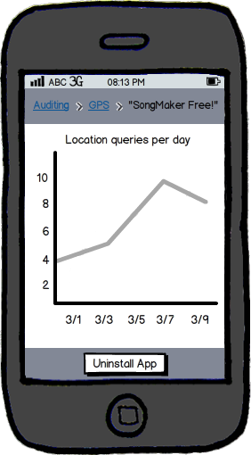
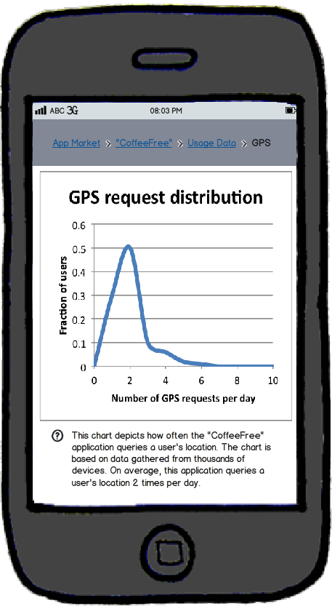

Slide 17
Product Labels
Certification
Testing and Standards
Quantitative Analysis
Qualitative Analysis

Slide 18
Qualitative Analysis
Cardinal numbers as measured by quantitative analysis might not be useful
Quantitative indicators can be bucketed
Low/Med/High attack surface
Similarly, security/privacy risk of permissions
At install point, present other applications with a lower attack surface
Or lower ‘uninstalls’ after sensor data audit

Slide 19
issues

Slide 20
Issues
Sybil Attacks
Already a problem in reviews/ratings
How and How Well can users consume this information?
User studies, A/B tests needed
How to combine labels into 1 actionable number?
Crowdsourced metrics do not work for targeted attacks
Users with such a risk profile should only rely on certifications

Slide 21
conclusion

Slide 22
the centralized nature of mobile application markets affords
them a unique opportunity to gather and present information to
eliminate information asymmetry

Slide 23
thank you

