Slide 1
HPC efficiency considerations
Geert Jan Bex (geertjan.bex@uhasselt.be)
License: this presentation is released under the Creative Commons, see http://creativecommons.org/publicdomain/zero/1.0/

Slide 2
Parallel scaling

Slide 3
Dimensions for scaling
Scaling considered in two dimensions
solve same problem faster by using more resources
solve larger problem by using more resources
Strong scaling
Weak scaling

Slide 4
What you hope/expect for…
strong scaling
weak scaling
execution time
nr. processes
Is this going
to happen?
system size
execution time ∼
nr. processes

Slide 5

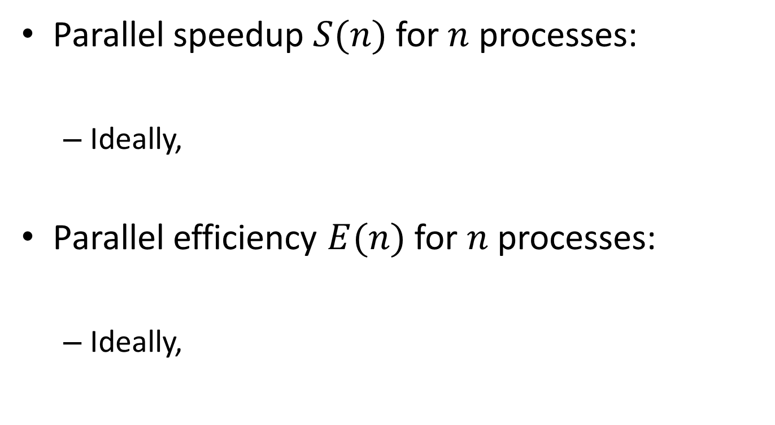



Definitions
Parallel speedup $S(n)$ for $n$ processes:
Ideally,
Parallel efficiency $E(n)$ for $n$ processes:
Ideally,
$$S(n)=\frac{T_{1}}{T_{n}}$$
$$S(n)=n$$
$$E(n)=\frac{T_{1}}{nT_{n}}$$
$$E(n)=1$$

Slide 6
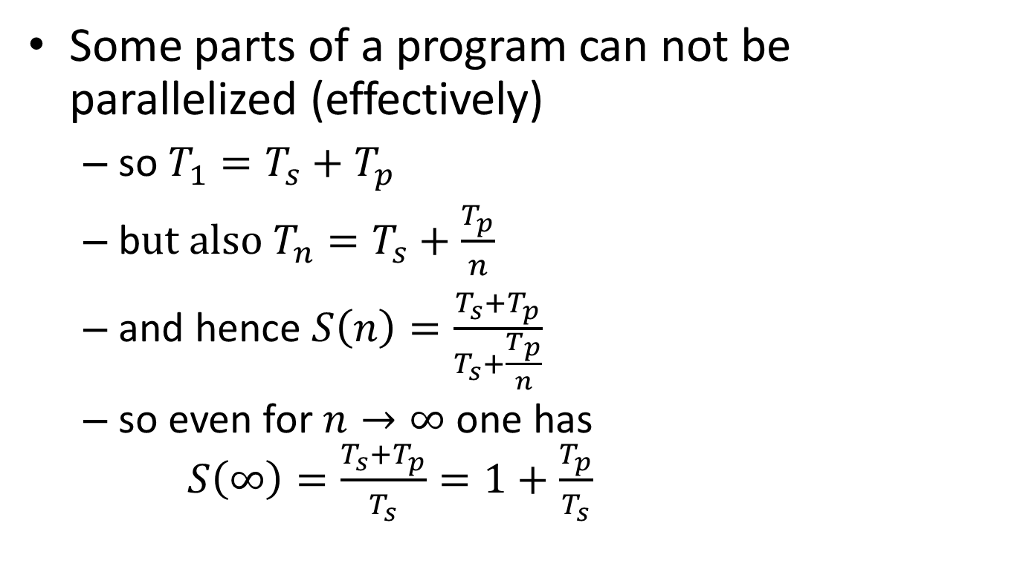
Strong scaling: oops!?!
Some parts of a program can not be parallelized (effectively)
so $T_{1}=T_{s}+T_{p}$
b$ut also T_{n}=T_{s}+\frac{T_{p}}{n}$
and hence $S\left(n\right)=\frac{T_{s}+T_{p}}{T_{s}+\frac{T_{p}}{n}}$
so even for $n→∞$ one has $S\left(∞\right)=\frac{T_{s}+T_{p}}{T_{s}}=1+\frac{T_{p}}{T_{s}}$
Hard limit on speedup due to serial part: Amdahl's law

Slide 7
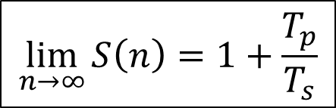

Amdahl's law
speedup
nr. processes
$$\lim_{n→∞}{S\left(n\right)=1+\frac{T_{p}}{T_{s}}}$$
$$\lim_{n→∞}{E\left(n\right)=0}$$

Slide 8
It gets worse…
Overhead!
communication takes time
finite bandwidth
non-zero latency
resource contention
memory subsystem: L3 cache, RAM, QPI
network access
nr. processes
nr. processes

Slide 9
Picking the sweet spot
sweet spot
speedup
sweet spot
nr. processes
efficiency
nr. processes

Slide 10
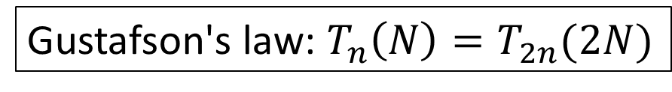
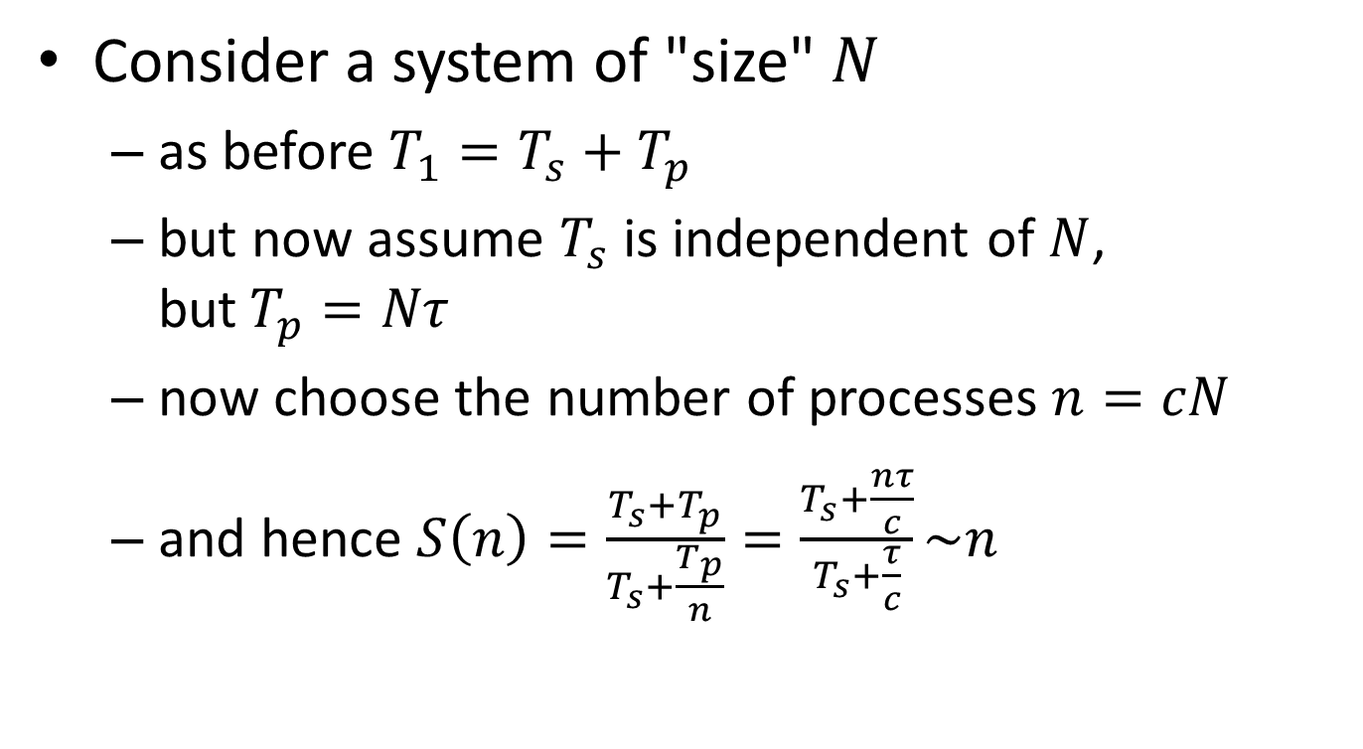
Weak scaling
Consider a system of "size" $N$
as before $T_{1}=T_{s}+T_{p}$
but now assume $T_{s}$ is independent of $N$, but$T_{p}=Nτ$
now choose the number of processes $n=cN$
and hence $S\left(n\right)=\frac{T_{s}+T_{p}}{T_{s}+\frac{T_{p}}{n}}=\frac{T_{s}+\frac{nτ}{c}}{T_{s}+\frac{τ}{c}}\sim n$
Gustafson's law: $T_{n}\left(N\right)=T_{2n}(2N)$
Nice for scientists!

Slide 11
We love Gustafson
Scientist are interested in
studying larger systems/bigger data sets
increasing precision/resolution
…

Slide 12
Throughput computing
N independent tasks
Total number of cores n << N
Execution time single task, 1 thread: t₁
Execution time single task, n threads: t_{n}
Multithreading or not?
However: memory?

