Slide 1
Profiling with Allinea MAP
Geert Jan Bex
(geertjan.bex@uhasselt.be)
License: this presentation is released under the Creative Commons, see http://creativecommons.org/publicdomain/zero/1.0/

Slide 2
Introduction

Slide 3
Introduction
Allinea Forge (https://www.allinea.com/)
Allinea DDT: parallel debugger
Allinea MAP: parallel profiler
Commercial product
Floating licence, token based
64 tokens, e.g.,
2 × 2 MAP sessions of 32 processes
1 × MAP + 1 × DDT session of 32 processes
1 × DDT session of 64 processes
Analyzing a profile offline: half price

Slide 4
Supported programming models
Serial applications
Shared memory programming: OpenMP
GPU programming: CUDA
Distributed programming: MPI, UPC
Weapon of choice for MPI (+ OpenMP)
Debugging/profiling at scale: user interface optimized

Slide 5
Alternatives
Debugging
Commercial: RogueWave TotalView
Open source: Eclipse PTP
Profiling
Open source:
Scalasca
Paraver + Extrae

Slide 6
Profiling

Slide 7
Methodology
MAP uses sampling (call stack)
No instrumentation
Simply compile with -g for details
Overhead is minimal (∼ 5-10 % at most)
Works with many MPI implementations
Intel MPI
OpenMPI
MVAPICH
…

Slide 8
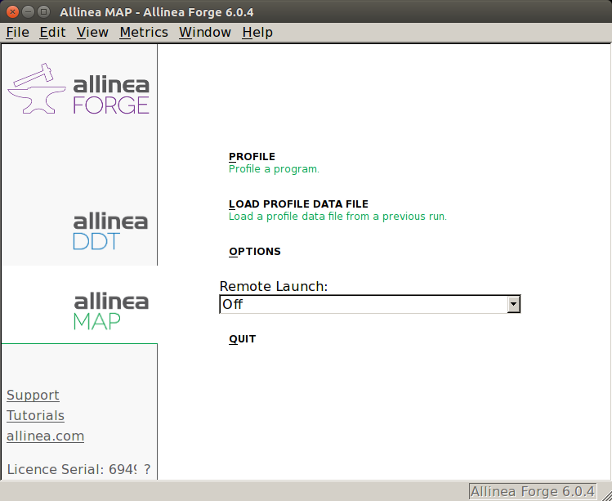
Startup
$ module load AllineaForge
$ map
Start profiling interactively
Load a profile to analyze
```
Start a job to profile interactively

Slide 9
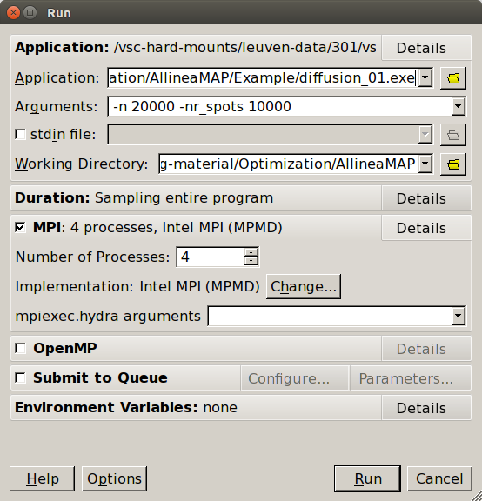
Interactive profiling
Run configuration
Remembers between runs
Choose application
Application arguments
Working directory
Configure MPI/OpenMP
Start run/profiling

Slide 10
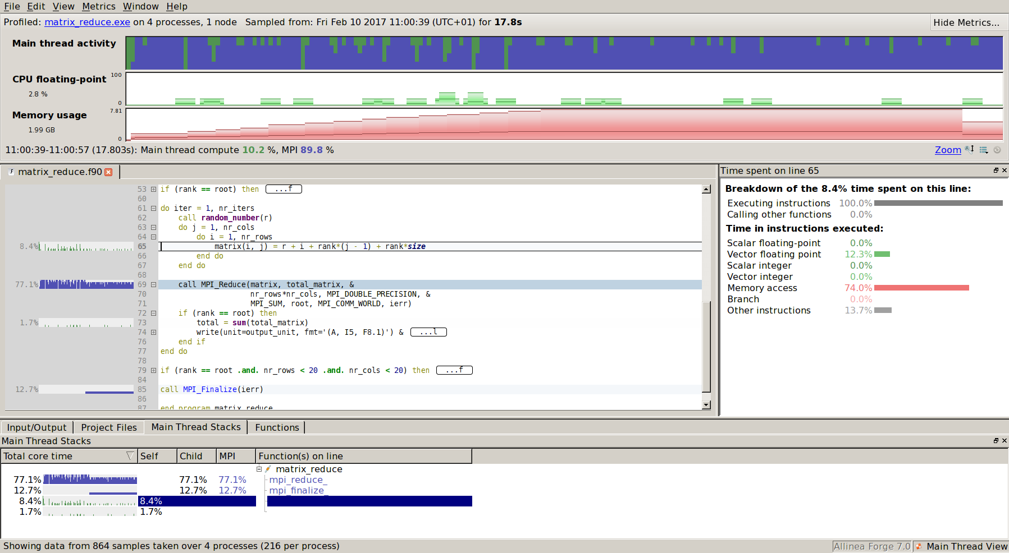

Results
Ask you boss for a large screen

Slide 11
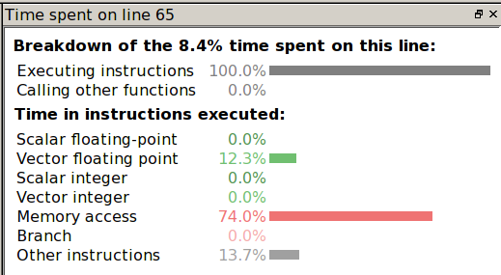


Overview
Vector floating point
Memory access 74 %
No branching

Slide 12
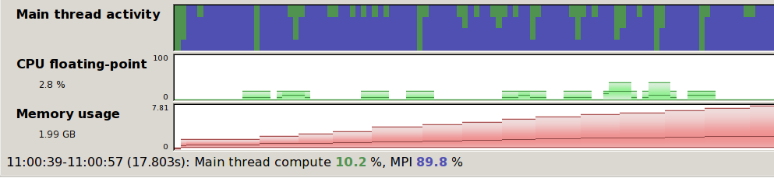
Time line
Zoom by selecting
processes
time
Very useful to identify run
phases
Can display many metrics
CPU instructions
I/O: disk read/write
MPI
Number calls peer-to-peer & collectives/s
Peer-to-peer & collectives bandwidth
Send & receive bandwidth
Any combination

