Slide 1
Debugging techniques
Geert Jan Bex
geertjan.bex@uhasselt.be
License: this presentation is released under the Creative Commons, see http://creativecommons.org/publicdomain/zero/1.0/

Slide 2
Introduction

Slide 3
Motivation
What the most used language in programming?
Profanity!

Slide 4
Motivation
Cambridge University, Undo, RogueWave
Estimated annual economic cost of bugs
Estimate developers' time finding + fixing bugs
System Science Institute (IBM)
relative cost of bugs found in Q&A: × 15
relative cost of bugs found in production: × 100
US$ 312 billion
50 %

Slide 5
Examples
1962: Mariner 1
omitted hyphen → incorrect guidance instructions → self-destruct command
US$ 18 million
2009: Toyota Lexus recall
bug in anti-lock-break software → four people died → 9 million cars recalled
US$ 3 billion
2012: Knight's Capital Group trading violations
one server used old code → 1 million+ stock orders in 1 hour → disturbance of the market
US$ 440 million
https://raygun.com/blog/10-costly-software-errors-history/

Slide 6
Bugs
All (non-trivial) code has bugs!
on average 8/1000 lines of code or worse
First priority: try to avoid them
Some advice & best practices
Some techniques
Find bugs: use the right tools

Slide 7
Avoid bugs
Write sane code!
Document your code, development process
Use tools to detect bugs
Program defensively
Test code
unit testing
integration testing
I’m not a great programmer; I’m just a good programmer with great habits.
— Kent Beck

Slide 8
Coding style

Slide 9
Motivation
Code should be easy to understand
by you
by your colleagues/community
Why?
easier to identify issues
easier to maintain
reduces number of bugs

Slide 10
Code should be as simple
as possible, but not simpler
Everyone knows that debugging
is twice as hard as writing a
program in the first place.
So if you're as clever as you can
be when you write it, how will
you ever debug it?
— Brian Kernighan

Slide 11
Step back: what is programming?
Real world
Model
Implementation
def compute_volume(object):
…
Minimize discrepancies: real world ↔ model ↔ implementation

Slide 12
Code readability
Choose names aptly
Be brief
Respect formatting conventions
Respect coding style standards
Be explicit, express intent
Use language idioms
Always code as if the guy who
ends up maintaining your code
will be a violent psychopath who
knows where you live.
— John F. Woods
Same principles for all programming languages

Slide 13
Naming things
Variables represent things
nouns in natural language
Functions/methods represent
actions
verbs in natural language
property tests
questions in natural language
Principle of
least surprise
with open(file_name, 'r') as data_file:
for line in data_file:
data = parse_line(line)
if is_valid(data):
avg = compute_avg(data)

Slide 14
Brevity
Long functions
hard to follow
too many variables
number of bugs ∼ code length!
Introduce subfunction
enrich vocabulary
raise description level
Top-down versus bottom-up development
matter of taste
no longer than fits on screen

Slide 15
Coding style
Conventions are important
common ground
facilitate efficient communication
shared vocabulary
C
Kernighan & Ritchie, The C programming language, 1988, Prentice Hall, ISBN 978-0131103627
https://cseweb.ucsd.edu/~ricko/CSE30/indhill-cstyle.html
C++
https://google.github.io/styleguide/cppguide.html
http://isocpp.github.io/CppCoreGuidelines/
Fortran
http://www.fortran90.org/src/best-practices.html
Python
https://www.python.org/dev/peps/pep-0008/
Developer documentation
https://developers.google.com/style/
Be consistent!

Slide 16
Style checking tools
C/C++
astyle (https://github.com/xuy/google-astyle)
Python
flake8 (http://flake8.pycqa.org/en/latest/)
pylint (https://www.pylint.org/)

Slide 17
Language standards
For new development, use modern language features, e.g.,
C99
C++14
Fortran 2003+
Python 3.6+
Beware of very latest version
might not be implemented by all compilers (reliably)
Don't use language extensions!

Slide 18
General advice
Maybe "just one little global
variable" isn't too unmanageable,
but that style leads to code that
is useless except to its original
programmer
Global variables are evil!
Fortran: avoid COMMON blocks
in general: minimum scope for variables
If something shouldn't change, be explicit
C/C++: use const
Fortran: use PARAMETER
Be liberal with private
Law of Demeter, principle of least knowledge
Be explicit about intent of function arguments
C/C++: use const
Fortran: use INTENT(IN/OUT/INOUT)
Functions/classes should have single purpose
Initialize variables explicitly
Don't use implicit typing
Fortran: IMPLICIT NONE in program, modules, functions, subroutines
— Bjarne Stroustrup

Slide 19
Unused code
Code commented out → hard to read → bugs
modify/remove
use version control, so nothing "lost"
Unused code → not tested → not updated → bugs
remove
use version control, so nothing "lost"
functions, methods, classes, unused code paths
Use code coverage tool to detect

Slide 20
Language idioms
Program languages have own style
Respect that style!
when, e.g., writing Python, don't write C
Example
don't
do
Be careful when switching programming languages
semantics may subtly differ
for i in range(len(data)):
result = compute_something(data[i])
for data_item in data:
result = compute_something(data_item)

Slide 21

Not-invented-here syndrome
Do not reinvent the wheel
Use standard libraries
Data structures/algorithms
C++: STL
Python: standard library
Linear algebra: BLAS,LAPACK
Communication: MPI
…

Slide 22
References
Clean code: a handbook of agile software craftmanship Robert C. Martin Prentice Hall, 2008
Design patterns: elements of reusable object-oriented software Erich Gamma, Richard Helm, Ralph Johnson, John Vlissides Addison-Wesley, 1994
Refactoring: improving the design of existing code Martin Fowler Addison-Wesley, 1999

Slide 23
Documentation

Slide 24
Comments
Comments
if you had to think about it, comment
never a substitute for clear code!
Comments as to-do lists
follow convention, editors support that, e.g., /* TODO: implement check */
better: issue in version control system
Inaccurate comments → waste of time + bugs
keep comments up to date!
Comments ≠ documentation

Slide 25
Documentation
Things to document
Application Programming Interface (API)
modules: content, overall functionality
classes/user defined types
methods/functions
constants: semantics, units
user interface
Tools
API for (almost) any language: doxygen (http://www.stack.nl/~dimitri/doxygen/)
For Python API in addition: docstring
user interface: mkdocs
Bad documentation worse than no documentation
keep documentation up to date!

Slide 26
Development process documentation
Version Control System, e.g., git
concurrent development
documentation of changes
Online services
issue tracking
"backup"
wiki
e.g.,
on premise?
GitHub (https://github.com/)
GitLab (https://gitlab.com/)

Slide 27
API documentation: doxygen

Slide 28
Class/module documentation
Documentation on
purpose
attributes
semantics, units
expectations, i.e., invariants
methods

Slide 29
Example module documentation
Main entry point
Other module
doxygen format
/*!
\file
\brief Declaration of the tree_2k data structures and functions.
\mainpage tree_2k library
This is a library that implements a tree data structure
to store and query spatial data.
It is similar to a quadtree, but works for any specified rank.
*/
…
tree_2k.h
/*!
\file
\brief Declaration of the node_2k functions.
*/
…
node_2k.h

Slide 30
Function/method documentation
Documentation on
purpose
arguments
semantics, units
expectations, i.e., preconditions
return value
semantics, units
guarantees, i.e., postconditions
error conditions, i.e., exceptions

Slide 31
Example function documentation
/*!
\brief Node constructor, will allocate the node itself, all data
structures required for a node without points inserted into
it, and initialize all members
\param node Double dereferenced pointer to the node to be allocated
and initialized.
\param tree Address of the tree the node is part off.
\param center An array of size rank containing the coordinates of the
new node's center as double precision numbers,
\param extent An array of size rank containing the extent for each
dimension for the new node as double precision numbers,
\return TREE_2K_SUCCESS if the allocation and initialization succeeded,
an error code otherwise.
*/
tree_2k_err_t node_2k_alloc(node_2k_t **node, tree_2k_t *tree,
double *center, double *extent) {
…
}
tree_2k.c
doxygen format

Slide 32
User defined type documentation
Documentation on
purpose
attributes
semantics, units
expectations, i.e., invariants

Slide 33
Example data structure documentation
/*!
\brief Data structure for the nodes in the tree.
This data structure should not be used directly by users of the library.
*/
typedef struct node_2k {
/*! Tree this node is part of. */
struct tree_2k *tree;
/*! Node's bucket, contains the indices of the points stored by
this node, will be NULL is node is split. */
int *bucket;
/*! Number of points in this node, may be zero if the node
has regions. */
int nr_points;
/*! The node's center. */
double *center;
/*! The node's extent. */
double *extent;
/*! Array containing the node's region nodes, NULL if node is not
split. Note that only populated regions are non-NULL. */
struct node_2k **region;
} node_2k_t;
doxygen format
tree_2k.h

Slide 34
Using doxygen
Configuration, start from template, defaults mostly okay
Build documentation
…
PROJECT_NAME = "tree_2k"
…
PROJECT_BRIEF = "Data structure for storing n-dimensional …"
…
OUTPUT_DIRECTORY = ../doc
…
doxygen.cfg
…
docs: $(SRCS)
doxygen doxygen.cfg
…
Makefile

Slide 35
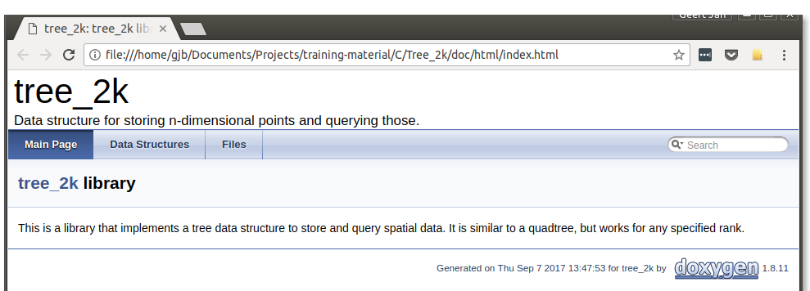
Documentation main page
searchable
Fully hyperlinked

Slide 36
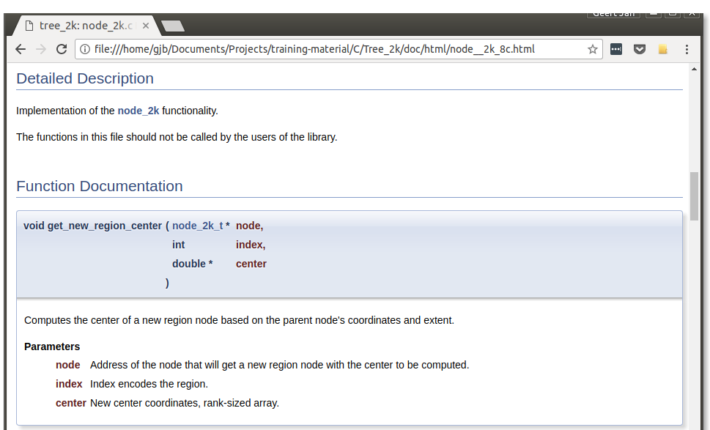
Function documentation

Slide 37
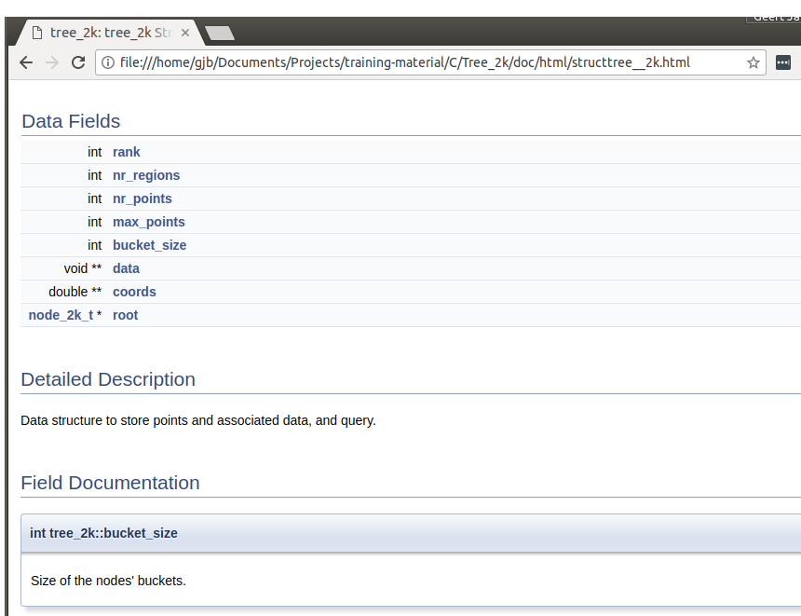
Data structure documentation

Slide 38
Usage examples
Examples help convey semantics
part of good documentation
Can be used as tests
easily check code integrity after changes
Unit testing
Integration testing
If you do anything useful it will
haunt you forever after, and if you
have a major success you get
decades of hard manual labor -
meaning you have to work on the
manual.
— Bjarne Stroustrup

Slide 39
User interface documentation: mkdocs

Slide 40
mkdocs
Documentation written in MarkDown
nice, highlighted rendering of code fragments
Configuration via YAML file
defines structure of documentation
Good preview via local webserver
Easy to deploy on Read the Docs (https://readthedocs.org/)
Alternative: AsciiDoc (http://www.methods.co.nz/asciidoc/)

Slide 41
Example page
level 1 header
# Monitoring jobs and resuming tasks
Keeping track of the tasks already completed, successfully or not, or tasks
still pending can be somewhat annoying. Resuming tasks that were not
completed, or that failed requires a level of bookkeeping you may prefer
to avoid. `arange` is designed to help with both issues.
Note that for this to work, your job should do logging using
[`alog`](alog.md).
## Monitoring a running job
Given either the CSV file or the task identifier range for a job, and its
log file as generated by `alog`, `arange` will provide statistics on the
progress of a running job, or a summary on a completed job.
If the log file's name is `bootstrap.pbs.log10493`, and the job was based
on an CSV data file `data.csv`, a summary can be obtained by
```bash
$ arange --data data.csv --log bootstrap.pbs.log10493 --summary
```
inline code snippet
hyperlink
level 2 header
arrange.md
code snippet with syntax highlighting

Slide 42
Some more formatting elements
numbered/unnumbered lists
Text formatting
italics: _italic text_
bold: *bold text*
External link [the documentation](https://…)
Build steps:
1. run `./configure`
1. run `make`
1. run `make install`
Requirements:
* C compiler, tested with
* GNU gcc
* Intel icc
* MPI library
* BLAS library
indentation per list level

Slide 43
Setup
Site definition file in top directory
MarkDown files in docs subdirectory
site_name: atools (Job array tools) documentation
site_description: atools is a set of utilities…
site_author: Geert Jan Bex
pages:
- Introduction and motivation: 'index.md'
- What are job arrays?: 'job_arrays.md'
- Getting your parameters: 'aenv.md'
…
- Change log: 'changes.md'
- Contact and support: 'contact.md'
site_dir: html_docs/atools
theme: readthedocs
site meta-information
site structure
definition
mkdocs.yml
rendering style
destination directory

Slide 44
Building & deploying documentation
Individual build
mkdocs build
Clean
mkdocs build --clean
During development
mkdocs serve
view in web browser
Deployment
connect Read the Docs to GitHub
GitHub release → Read the Docs build
Online documentation always in sync with releases!

Slide 45
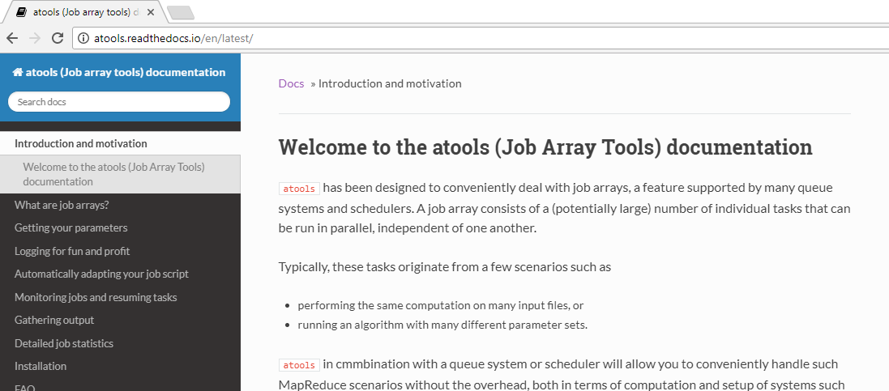
Result
searchable

Slide 46
Compilers & settings, static checkers

Slide 47
Compilers: general
Switch on warnings at compile time
Fix code until no more warnings remain
Switch compilers
Check whether you get warnings/errors with any compiler you have, fix them
Intel icc/icpc more strict than GNU gcc/g++
GNU gfortran more strict than Intel ifort
Compile with debugging information
-g2
No runtime overhead!

Slide 48
Be paranoid, or die!
static double __arg__;
#define SQR(a) ((__arg__ = (a)) == 0.0 ? 0.0 : __arg__*__arg__)
Bad code!!!
icc: -Wall
no warnings, very incorrect results
icc: -Wall -Wremarks -Wchecks -w3
relevant, if cryptic warning, still very incorrect results
$ icc -Wall -Wremarks -Wchecks -w3 …
…
spooky_macro.c(29): remark #981: operands are evaluated in unspecified order
a[i] = SQR(b[i]) + SQR(c[i]);
^

Slide 49
Switching compilers
static double __arg__;
#define SQR(a) ((__arg__ = (a)) == 0.0 ? 0.0 : __arg__*__arg__)
Bad code!!!
Intel icc executable output
GNU gcc executable output
$ ./bad_code_icc.exe
sum = 166581086880546.25
sum = 224904286352835.62
$ ./bad_code_gcc.exe
sum = 166581086880546.25
sum = 166581086880546.25
Do not generalize: Intel compilers are very good!

Slide 50
C/C++ compiler options
At least: -Wall -g
More warnings
gcc/g++: -Wextra
icc/icpc: -Wremarks –Wchecks –w3
Using == or != for floating point, gcc/g++: -Wfloat-equal
Local variable shadows other local: -Wshadow
Undefined preprocessor variable in #if, gcc/g++: -Wundef
Pointer arithmetic depending on sizeof function pointer or void: -Wpointer-arith
Inappropriate function call cast: -Wbad-function-cast
Lost type qualifier in cast: -Wcast-qual
incompatible alignment due to cast, gcc/g++: -Wcast-align

Slide 51
Fortran compiler options
At least
gfortran: -Wall -g
ifort: -warn all -g
More warnings
gfortran: -Wextra
ifort: -diag-enable remark
Compile with no implicits allowed:
gfortran: -fimplicit-none
ifort: -implicitnone
While developing, switch on array bound checking at runtime
gfortran: -fbounds-check
ifort: -check bounds
Check for not explicitly initialized variables
gfortran: -finit-integer=-1000 -finit-real=nan
ifort: -check uninit
incurs performance penalty!
pick value that makes sense

Slide 52
Floating point model
Optimizations may alter numerical results: round off
Compilers
GCC -O2: faithful to source
Intel -O2: optimizations may rearrange expressions
to avoid: -fp-model source (performance impact) or even -fp-model precise
However, revise your algorithm!

Slide 53
Static analysis

Slide 54
Static analysis
Analyze source code
syntax
style
semantics
Will detect runtime problems
not all
Some overlap with compiler checks

Slide 55
Cppcheck
Detects (some!)
memory leaks
function returning stack array variables
inappropriate string formatting codes
variable scope too wide
uninitialized variables
unused variables
unused functions/methods
suspicious arithmetic operations
control flow problems (logical operand order)
missing copy constructor

Slide 56
Tools
CodeSonar: C/C++, commercial
https://www.grammatech.com/products/source-code-analysis
Cppcheck: C++, open source
https://sourceforge.net/projects/cppcheck/files/cppcheck/
Pylint: Python, open source
https://www.pylint.org/
Flake8: Python, open source
http://flake8.pycqa.org/en/latest/
ShellCheck: bash scripts, open source
https://github.com/koalaman/shellcheck

Slide 57
Defensive programming

Slide 58
Report warnings & errors
For C, use err.h
warn(fmt,…)
err(exit_code, fmt,…)
warnx(fmt,…)
errx(exit_code, fmt,…)
Example
append error message associated with ERRNO
exit code for program
$ ./warnErr
warnErr: this is warning nr. 1: start
warnErr: this is error nr. 2:
No such file or directory
$ echo $?
5
#include <err.h>
#include <stdio.h>
#include <stdlib.h>
int main(int argc, char *argv[]) {
warnx("this is warning nr. %d:\n start", 1);
FILE *fp;
if ((fp = fopen("non-existing-file.blabla", "r")) == NULL)
err(5, "this is error nr. %d", 2);
return EXIT_SUCCESS;
}

Slide 59
Check for runtime errors!
Dynamic memory allocation
File operations
open
read
write
MPI calls
if ((a = malloc(n, sizeof(int))) == NULL)
errx(EXIT_FAILURE, "calloc failed");
integer :: status
character(len=1024) :: msg
open(unit=9, file="non-existing.bla", &
status="old", action="read", &
iostat=status, iomsg=msg)
if (status /= 0) then
print *, msg
stop
end if
call MPI_REDUCE(partial_sum, sum, 1, MPI_DOUBLE_PRECISION, &
MPI_SUM, 0, MPI_COMM_WORLD, status)
if (status /= 0) then
…
end if
Don't bother: unrecoverable anyway!

Slide 60
Do not go overboard
Open file for reading
test whether file exists
test whether file can be read
open file, verify success
Reason for failure can be figured out
It's easier to ask forgiveness than it is to get permission.
— Grace Hopper

Slide 61
Assertions
General principles
Run time check of Boolean condition
Sanity check
Pre- and postconditions for functions
Invariants
Can be switched off when compiling for release/production code
Never in production code
Does not replace error handling, input validation
Aid in development, catching bugs
Incurs performance penalty
Not really for testing code: use unit testing
Implemented in
C standard library: assert.h
Python 2.7.x, 3.x: part of language specs

Slide 62
Assertions: example
#include <assert.h>
#include <stdio.h>
#include <stdlib.h>
long fac(long n) {
assert(n >= 0);
long f = 1;
for ( ; n > 1; n--) {
f *= n;
assert(f > 0);
}
return f;
}
int main(int argc, char *argv[]) {
printf("fac(5) = %ld\n", fac(5));
printf("fac(50) = %ld\n", fac(50));
printf("fac(-3) = %ld\n", fac(-3));
return EXIT_SUCCESS;
}
precondition
precondition
invariant
invariant
fac.c

Slide 63
Assertions: running
Compile code
Run program
$ gcc -g2 -o fac fac.c
invariant violated!
$ ./fac
fac(5) = 120
assertion "f > 0" failed: file "fac.c", line 10, function: fac
Aborted (core dumped)

Slide 64
Assertions: release
Compile code to skip assertions
Run program
$ gcc -O2 -DNDEBUG -o fac fac.c
$ ./fac
fac(5) = 120
fac(50) = 0
fac(-3) = 1

Slide 65
References
Arjen Markus (2013) Exception handling in Fortran, Newsletter ACM SIGPLAN Fortran Forum, volume 32, issue 2, p. 7‒13 https://doi.org/10.1145/2502932.2502933

Slide 66
Unit testing

Slide 67
Unit testing: what is it?
Library to write and handle tests
First write test code, then code to be tested
Implementations of framework
CUnit for C
CppUnit for C++
pFUnit for Fortran (http://nasarb.rubyforge.org/)
unittest in Python standard library
Tests are functions
Tests are organized in test suites
Test suites reside in repository
Easy to run, so run often
Invaluable when modifying code
"How to test?" is a question that
cannot be answered in general.
"When to test?" however, does have
a general answer: as early and as
often as possible.
— Bjarne Stroustrup

Slide 68
General concerns
Unit test are
atomic: test a single property
independent: do not assume order
Test for edge cases, corner cases
Test for failure
is exception thrown when it should?
Tests should cover complete code base

Slide 69
CUnit: test code first!
Code to test n!
#include "fac.h"
void test_fac_0(void) {
CU_ASSERT_EQUAL(fac(0), 1);
}
void test_fac_1(void) {
CU_ASSERT_EQUAL(fac(1), 1);
}
void test_fac_4(void) {
CU_ASSERT_EQUAL(fac(4), 24);
}
long fac(long n);
fac.h
tests.c
Test-drive development

Slide 70
CUnit: implementation next!
Code implementing n!
long fac(long n) {
long f = 1;
for ( ; n > 1; n--)
f *= n;
return f;
}
fac.c

Slide 71
CUnit: framework
Setup a registry
Adding a test suite
#include <err.h>
#include <stdlib.h>
#include <CUnit/CUnit.h>
#include "fac.h"
int main(int argc, char *argv[]) {
if (CU_initialize_registry() != CUE_SUCCESS)
errx(EXIT_FAILURE, "can't initialize test registry");
…
CU_cleanup_registry();
return EXIT_SUCCESS;
}
tests.c
CU_pSuite facSuite = CU_add_suite("fac", NULL, NULL);
tests.c
suite's name

Slide 72
CUnit: framework
Adding tests to a suite
Executing the test suite(s)
CU_add_test(facSuite, "fac(0)", test_fac_0);
CU_add_test(facSuite, "fac(1)", test_fac_1);
CU_add_test(facSuite, "fac(4)", test_fac_4);
tests.c
test's name
test's implementation
CU_basic_run_tests();
tests.c

Slide 73
CUnit: compiling & running
Compiling tests
Running the test program
$ gcc -g2 -o tests.exe tests.c fac.c -lcunit
$ ./tests.exe
CUnit - A unit testing framework for C - Version 2.1-2
http://cunit.sourceforge.net/
Run Summary: Type Total Ran Passed Failed Inactive
suites 1 1 n/a 0 0
tests 3 3 3 0 0
asserts 3 3 3 0 n/a
Elapsed time = 0.000 seconds

Slide 74
CUnit: failures
Additional test
Running
void test_fac_too_large(void) {
CU_ASSERT_EQUAL(fac(13), 6227020800);
}
tests.c
$ ./tests.exe
CUnit - A unit testing framework for C - Version 2.1-2
http://cunit.sourceforge.net/
Suite fac, Test fac(13) had failures:
1. units.c:39 - CU_ASSERT_EQUAL(fac(13),6227020800)
Run Summary: Type Total Ran Passed Failed Inactive
suites 1 1 n/a 0 0
tests 4 4 3 1 0
asserts 4 4 3 1 n/a
Elapsed time = 0.000 seconds

Slide 75
CUnit: types of assertions
CU_ASSERT(int expression)
CU_ASSERT_TRUE(value)
CU_ASSERT_FALSE(value)
CU_ASSERT_(NOT_)EQUAL(actual, expected)
CU_ASSERT_PTR_(NOT_)EQUAL(actual, expected)
CU_ASSERT_PTR_(NOT_)NULL(value)
CU_ASSERT_STRING_(NOT_)EQUAL(actual, expected)
CU_ASSERT_NSTRING_(NOT_)EQUAL(actual, expected, count)
CU_ASSERT_DOUBLE_(NOT_)EQUAL(actual, expected, tolerance)
CU_PASS(message)
CU_FAIL(message)
xxx continue after failure in test function
xxx_FATAL returns immediately upon failure from test function

Slide 76
CUnit: setting the stage
Before executing tests from suite, initialize
Open connections
Create temporary file
…
After executing tests from suite, clean up
Close connections
Remove temporary file
…
Create suite
static int suiteInit(void) {
…
return 0;
}
tests.c
static int suiteClean(void) {
…
return 0;
}
tests.c
CU_pSuite facSuite = CU_add_suite("fac", suiteInit, suiteClean);
tests.c

Slide 77
pFUnit: test code first!
Code to test n!
fac_mod.f90
module fac_mod
implicit none
public :: fac
contains
function fac(n) result(r)
implicit none
integer, intent(in) :: n
integer :: r
integer :: i
r = 1_i32
do i = 2, n
r = r*i
end do
end function fac
end module fac_mod
@test
subroutine test_fac_0()
use fac_mod
use pfunit_mod
implicit none
@assertEqual(1, fac(0))
end subroutine test_fac_0
@test
subroutine test_fac_5()
use fac_mod
use pfunit_mod
implicit none
@assertEqual(120, fac(5))
end subroutine test_fac_1
fac_tests.fp

Slide 78
pFUnit: framework
Add test suite
Preprocessing tests
ADD_TEST_SUITE(fac_tests_suite)
testSuites.inc
suite's name: based on module name
…
ifneq ($(BASEMK_INCLUDED),YES)
include $(PFUNIT)/include/base.mk
endif
testSuites.inc: $(SRCS)
%.F90: %.pf
$(PFUNIT)/bin/pFUnitParser.py $< $@
…
Makefile

Slide 79
pFUnit: make file
tests: tests.exe
./$<
ifneq ($(BASEMK_INCLUDED),YES)
include $(PFUNIT)/include/base.mk
endif
FC = gfortran
FFLAGS += -I. -I$(PFUNIT)/mod
LIBS = $(PFUNIT)/lib/libpfunit$(LIB_EXT)
SRCS = $(wildcard *.pf)
OBJS = $(SRCS:.pf=.o)
APPL_OBJS = fac_mod.o
tests.exe: $(APPL_OBJS) $(OBJS)
$(FC) $(FFLAGS) $(FPPFLAGS) -o $@ \
$(PFUNIT)/include/driver.F90 $(OBJS) $(APPL_OBJS) $(LIBS)
testSuites.inc: $(SRCS)
%.F90: %.pf
$(PFUNIT)/bin/pFUnitParser.py $< $@
%.o: %.F90
$(FC) -c $(FFLAGS) $(FPPFLAGS) $<
main program
Makefile

Slide 80
pFUnit: building and running tests
Build
Run
$ make
…
$ ./tests.exe
...
Time: 0.001 seconds
OK
(3 tests)

Slide 81
pFUnit: failing tests
$ ./tests.exe
...F.
Time: 0.000 seconds
Failure
in:
fac_tests_suite.test_fac_4
Location:
[fac_tests.pf:25]
expected 20 but found: 24; difference: |4|.
FAILURES!!!
Tests run: 4, Failures: 1, Errors: 0
ERROR STOP *** Encountered 1 or more failures/errors during testing. ***
Obviously, test
is incorrect

Slide 82
pFUnit: types of assertions
only for real
overloaded for
• real
• complex
• integer
• logical
• string
@assertEqual(expected, actual [, tolerance] )
@assertNotEqual(expected, actual [, tolerance] )
@assertTrue(logical_value), @assertFalse(logical_value)
@assertLessThan(num_value1, num_value2)
@assertLessThanOrEqual(num_value1, num_value2)
@assertGreaterThan(num_value1, num_value2)
@assertGreaterThanOrEqual(value1, value2)
@assertAny(logical_array), @assertNone(logical_array)
@assertAll(logical_array), @assertNotAll(logical_array)
@assertSameShape(shape_array1, shape_array2)
@assertIsNaN(real_value)
@assertIsFinite(real_value)
@assertAssociated(pointer [, target] ), @assertNotAssociated(pointer [, target] )
@assertEquivalent(logical_value1, logical_value2)
@assertExceptionRaised()
@assertFail()
All asserts take optional message argument

Slide 83
pFUnit: setting the stage
User defined type, extend TestCase
override procedure setUp
override procedure tearDown
Before executing tests from suite, initialize
Open connections
Create temporary file
…
After executing tests from suite, clean up
Close connections
Remove temporary file
…

Slide 84
Code coverage

Slide 85
Motivation
Code never executed = dead weight
has to be maintained
discrepancies will creep in
Code not tested doesn’t work
all functions/methods tested?
all code paths tested?
Remove dead code
not lost, version control

Slide 86
Code coverage tool
Keeps track while code executes
Reports by line of code
For C/C++/Fortran: compiler support + tool
instrument code during build
run
report using tool
For Python: coverage
run & report
Generates considerable
run time overhead

Slide 87
GCC
gcc/g++/gfortran compile and link options -g -fprofile-arcs -ftest-coverage
Run application normally
Use gcov <file_name> for report
$ gcov funcs.c
File 'funcs.c'
Lines executed:45.45% of 11
Creating 'funcs.c.gcov'

Slide 88
gcov report
-: 0:Source:funcs.c
-: 0:Graph:funcs.gcno
-: 0:Data:funcs.gcda
-: 0:Runs:1
-: 0:Programs:1
-: 1:#include <err.h>
-: 2:#include "funcs.h"
-: 3:
16: 4:int fac(int n) {
16: 5: if (n < 0) {
#####: 6: errx(1, "### error: …");
16: 7: } else if (n == 0 || n == 1) {
6: 8: return 1;
-: 9: } else {
10: 10: return n*fac(n - 1);
-: 11: }
-: 12:}
not executable
number of times
executed
not executed
funcs.c.gcov

Slide 89
Intel compilers
icc/icpc/ifort compile and link options -g -prof-gen=srcpos \ -prof-dir=./profiles
Run application normally
Merge build & run time info profmerge -prof-dir=./profiles
Generate code coverage report codecov -dpi profiles/pgopti.dpi -spi profiles/pgopti.spi

Slide 90
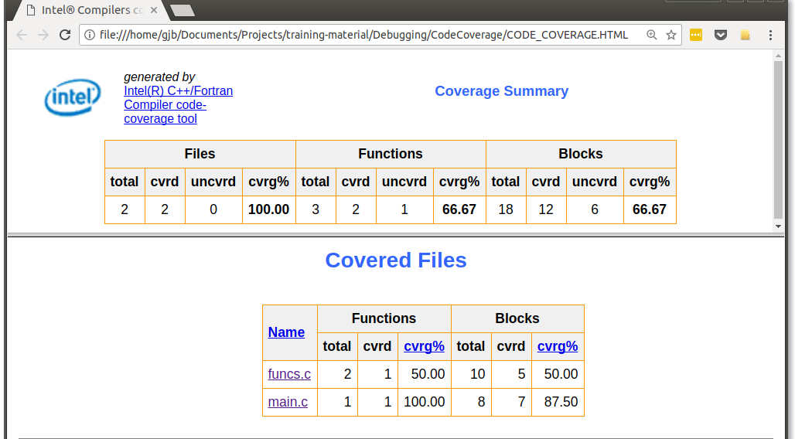
codecov HTML report
overall summary
breakdown per file

Slide 91
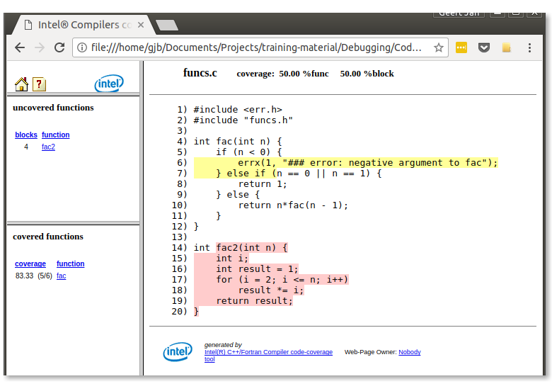
codecov source report
code paths not executed
functions not executed

Slide 92
Integration testing

Slide 93
Integration testing: what is it?
Done after unit testing
Exceeds scope of unit testing
Tests aggregation of several software modules
e.g., command line application
Implementations of framework
shunit2
much better: continuous integration
Tests reside in repository
Easy to run
may take long
Beware of bugs in the above code; I have only proved it correct, not tried it.
— Donald Knuth

Slide 94
Application under test
Computes number of permutations
Example run
$ ./fac.exe -h
usage: fac.exe [-h] n
compute number of permutations
positional arguments:
n number of items
optional arguments:
-h, --help show this help message and exit
$ ./fac.exe 4
24

Slide 95
shunit2: test script
Simple bash script
Run script
#!/usr/bin/env bash
testFac0() {
result=$(./fac.exe 0)
assertEquals 1 ${result}
}
source shunit2
tests = bash functions
capture stdout
test result
test_fac.sh
gather & execute all tests
$ ./test_fac.sh
testFac0
Ran 1 tests.
OK

Slide 96
shunit2: testing for failure
Add test for invalid argument
…
testFacNegative() {
result=$(./fac.exe -333 2> tmp_err.txt)
exit_code=$?
assertEquals 1 ${exit_code}
assertNull "${result}"
assertEquals "### error: argument should be positive" \
"$(cat tmp_err.txt)"
}
…
capture stdout
capture stderr
capture exit code
test_fac.sh
assertNull succeeds if argument is empty string
Note: quoting strings correctly is important!

Slide 97
shunit2: artifacts
Test script leaves file(s)
Use dedicated temporary directory
…
result=$(./fac.exe -333 2> tmp_err.txt)
…
test_fac.sh
…
testFacNegative() {
err_file="${SHUNIT_TMPDIR}/err.txt"
result=$(./fac.exe -333 2> ${err_file})
…
assertEquals "### error: argument should be positive" \
"$(cat ${err_file})"
}
…
test_fac.sh

Slide 98
shunit2: types of assertions
assertEquals [message] expected actual
assertNotEquals [message] expected actual
assertNull [message] value
succeeds if value is empty string
assertNotNull [message] value
assertTrue [message] value
succeeds if value is 0
assertFalse [message] value
fail [message]
only for strings and integers
optional message must be quoted!

Slide 99
shunit2: setting the stage
oneTimeSetUp
shell function run once before tests start
setUp
shell function run before each test
tearDown
shell function run after each test
oneTimeTearDown
shell function run once after all tests done

Slide 100
References
Test-driven development: by example Kent Beck Addison-Wesley, 2002

Slide 101

Harbor no illusions,
code will have bugs!

Slide 102
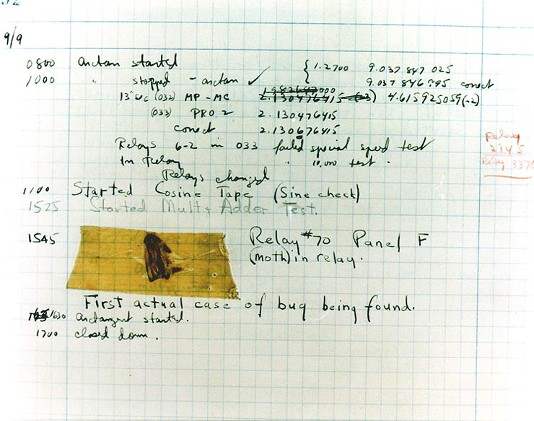
History
Ada Lovelace, analytical engine (1843) … an analysing process must equally have been performed in order to furnish the Analytical Engine with the necessary operative data; and that herein may also lie a possible source of error. Granted that the actual mechanism is unerring in its processes, the cards may give it wrong orders.
Term "bug" coined by Thomas Edison (1873)
Bug report, Computational Laboratory, Harvard (September 9, 1947)

Slide 103
Taxonomy of bugs
Requirements
Structural bugs
Data
Implementation & coding
Integration & interfacing

Slide 104
Requirements
Potential issues
incomplete
inconsistent
ambiguous
Validation
cross-check with colleagues: completeness, consistency
doable?
resource usage?
unnecessary features?

Slide 105
Structural bugs I
Bugs in
control & sequence
forgotten paths
loop termination
duplicate processing
logic
"impossible" cases
improper negation
improper combination of cases
overlap of exclusive cases
misunderstood semantics of logic evaluation

Slide 106
Structural bugs II
Bugs in
processing
arithmetic bugs, function evaluation & algorithm selection
ignoring overflow
floating point comparison
data representation conversion
resource leaks
initialization
using uninitialized variables
bug in first value of loop control
using unallocated memory

Slide 107
Data
wrong format, number of items
dynamic data
garbage in arrays
dangling pointers

Slide 108
Coding & implementation
Typos
l versus I, 0 versus O?
l versus I, 0 versus O
Misinterpretation of statement semantics
Mistakes in documentation → more bugs!

Slide 109
Bugs in parallel code
Extra hard to find: execution is non-deterministic!
Specific types of bugs
deadlocks
race conditions

Slide 110
gdb

Slide 111

gdb: what is it?
Command line debugger, allows to
Step through code while executing
View values of variables
Watch for changes
Works on
Sequential programs
Multithreaded programs (including OpenMP)
Remote processes
Programming languages
C/C++
Fortran
https://www.gnu.org/software/gdb/
Most IDE's have (visual) debuggers: similar approach

Slide 112
gdb: example
#include <math.h>
#include <stdio.h>
#include <stdlib.h>
#include "show.h"
int main(int argc, char *argv[]) {
double a[10], sum;
int i;
for (i = 0; i <= 10; i++)
a[i] = sqrt(i);
for (i = 0; i < 10; i++)
sum += a[i];
printResult("sum", sum);
return EXIT_SUCCESS;
}
#ifndef SHOW_HDR
#define SHOW_HDR
void printResult(char *name,
double r);
#endif
show.h
#include <stdio.h>
void printResult(char *name,
double r) {
printf("%s = %f\n",
name, r);
}
array-bounds.c
show.c
Oops!
$ ./a.out
sum = 22.468278
≠
octave:1> sum(sqrt([0:9]))
ans = 19.306

Slide 113
gdb: compiling code & starting gdb
Compile program for debugging
Running under gdb control: start gdb
$ gcc –g2 array-bounds.c show.c
$ gdb ./a.out
GNU gdb 6.8.0.20080328-cvs (cygwin-special)
Copyright (C) 2008 Free Software Foundation, Inc.
License GPLv3+: GNU GPL version 3 or later <http://gnu.o …
This is free software: you are free to change and redist …
There is NO WARRANTY, to the extent permitted by law. T …
and "show warranty" for details.
This GDB was configured as "i686-pc-cygwin"...
(gdb)

Slide 114
gdb: listing source code
Listing code 10 line window: l(ist)
Listing next 10 lines: l
(gdb) l
1 #include <math.h>
2 #include <stdio.h>
3 #include <stdlib.h>
4
5 #include "show.h"
6
7 int main(int argc, char *argv[]) {
8 double a[10], sum;
9 int i;
10 for (i = 0; i <= 10; i++)
(gdb) l
11 a[i] = sqrt(i);
12 for (i = 0; i < 10; i++)
13 sum += a[i];
14 printf("sum = %lf\n", sum);
15 return EXIT_SUCCESS;
16 }
17

Slide 115
gdb: listing source code
Listing code 10 line window around line 9: l 9
Listing from line 10 to line 13: l 10,13
(gdb) l 9
4
5 #include "show.h"
6
7 int main(int argc, char *argv[]) {
8 double a[10], sum;
9 int i;
10 for (i = 0; i <= 10; i++)
11 a[i] = sqrt(i);
12 for (i = 0; i < 10; i++)
13 sum += a[i];
(gdb) l 10,13
10 for (i = 0; i <= 10; i++)
11 a[i] = sqrt(i);
12 for (i = 0; i < 10; i++)
13 sum += a[i];
(

Slide 116
gdb: listing source code
Listing function: l <func>
Listing function in other file: l <file>:<func>
(gdb) l main
2 #include <stdio.h>
3 #include <stdlib.h>
4
5 #include "show.h"
6
7 int main(int argc, char *argv[]) {
8 double a[10], sum;
9 int i;
10 for (i = 0; i <= 10; i++)
11 a[i] = sqrt(i);
(gdb) l show.c:printResult
1 #include <stdio.h>
2
3 void printResult(char *name, double r) {
4 printf("%s = %f\n", name, r);
}

Slide 117
gdb: running a program
Run the code: r(un)
Not so interesting, but one can
Set breakpoints
Set conditional breakpoints
Watch stuff
add command line arguments here
(gdb) r
Starting program: ./a
[New thread 13704.0x32e0]
[New thread 13704.0x2110]
sum = 22.468278
Program exited normally.

Slide 118
gdb: breakpoints
Set breakpoint at line number: b(reak) <ln>
Set breakpoint at function: b <func>
(gdb) b 10
Breakpoint 1 at 0x401199: file array-bounds.c, line 10.
(gdb) r
8 double a[10], sum;
9 int i;
10 for (i = 0; i <= 10; i++)
11 a[i] = sqrt(i);
12 for (i = 0; i < 10; i++)
array-bounds.c
(gdb) b printResult
Breakpoint 1 at 0x40123a: file show.c, line 4.
(gdb) r
1 #include <stdio.h>
2
3 void printResult(char *name, double r) {
4 printf("%s = %f\n", name, r);
5 }
show.c

Slide 119
gdb: at breakpoints
Inspect value of variables: p(rint) <var>
Proceed execution by
Stepping
With descending into subroutines: s(tep)
Without descending into subroutines: n(ext)
Until next statement: u(until)
Continuing to next breakpoint: c(ontinue)
Step out of function: finish
Handle breakpoints
List: i(nfo) b(reakpoints)
Remove: d(elete) <bn>
Disable/enable: disable <bn>/enable <bn>

Slide 120
gdb: example stepping
(gdb) b main
Breakpoint 1 at 0x401194: file array-bounds.c, line 7.
(gdb) r
Starting program: /cygdrive/c/Users/lucg5005/Documents/My Dropbox/Projects/HPC/Samples/DebuggingProfiling/trunk/Gdb/a
[New thread 11372.0x352c]
[New thread 11372.0x322c]
Breakpoint 1, main () at array-bounds.c:7
7 int main(int argc, char *argv[]) {
(gdb) n
10 for (i = 0; i <= 10; i++)
(gdb)
11 a[i] = sqrt(i);
(gdb) p i
$1 = 0
(gdb) n
10 for (i = 0; i <= 10; i++)
(gdb)
11 a[i] = sqrt(i);
(gdb) p a
$2 = {0, 1, 8.0461413318721078e-315, 0, 4.7233218921966505e+192, 4.7151331558996709e+192, 2.9835385156662606e-314,
4.0742432477169204e-312, 5.0488079539729615e-314, 3.5150220537551154e+159}

Slide 121
gdb: counted steps
(gdb) b 11
Breakpoint 3 at 0x4011a2: file array-bounds.c, line 11.
(gdb) c
Continuing.
Breakpoint 3, main () at array-bounds.c:11
11 a[i] = sqrt(i);
(gdb) p i
$1 = 0
(gdb) c 5
Will ignore next 4 crossings of breakpoint 3. Continuing.
Breakpoint 3, main () at array-bounds.c:11
11 a[i] = sqrt(i);
(gdb) p i
$2 = 5

Slide 122
gdb: example handling breakpoints
(gdb) b 12
Breakpoint 2 at 0x4011e1: file array-bounds.c, line 12.
(gdb) i b
Num Type Disp Enb Address What
1 breakpoint keep y 0x00401194 in main at array-bounds.c:7
breakpoint already hit 1 time
2 breakpoint keep y 0x004011e1 in main at array-bounds.c:12
(gdb) delete 1
(gdb) info breakpoints
Num Type Disp Enb Address What
2 breakpoint keep y 0x004011e1 in main at array-bounds.c:12
(gdb) c
Continuing.
Breakpoint 2, main () at array-bounds.c:12
12 for (i = 0; i < 10; i++)
(gdb) p a
$3 = {0, 1, 1.4142135623730951, 1.7320508075688772, 2, 2.2360679774997898,
2.4494897427831779, 2.6457513110645907, 2.8284271247461903, 3}

Slide 123
gdb: conditional breakpoint
Break conditionally: b <ln> if <cond>
(gdb) b 11 if i == 4
Breakpoint 2 at 0x4011a2: file array-bounds.c, line 11.
(gdb) c
Continuing.
Breakpoint 7, main () at array-bounds.c:11
11 a[i] = sqrt(i);
(gdb) p i
$1 = 4
(gdb) c
Continuing.
sum = 22.468278
Program exited normally.
Only break when condition holds

Slide 124
gdb: dis/enabling breakpoints
Disable breakpoint: disable <bn>
(gdb) b 11
Breakpoint 1 at 0x4011a2: file array-bounds.c, line 11.
(gdb) b 13
Breakpoint 2 at 0x4011ea: file array-bounds.c, line 13.
(gdb) r
Breakpoint 1, main () at array-bounds.c:11
11 a[i] = sqrt(i);
(gdb) c
Continuing.
Breakpoint 1, main () at array-bounds.c:11
11 a[i] = sqrt(i);
(gdb) disable 1
(gdb) c
Continuing.
Breakpoint 2, main () at array-bounds.c:13
13 sum += a[i];
(gdb) i b
Num Type Disp Enb Address What
1 breakpoint keep n 0x004011a2 in main at array-bounds.c:11
breakpoint already hit 2 times
2 breakpoint keep y 0x004011ea in main at array-bounds.c:13
breakpoint already hit 1 time

Slide 125
gdb: issuing commands at break
Commands associated with breakpoint will be executed each time the breakpoint is hit
(gdb) b 11
Breakpoint 2 at 0x4011a2: file array-bounds.c, line 11.
(gdb) commands 2
Type commands for when breakpoint 2 is hit, one per line.
End with a line saying just "end".
>silent
>printf "i = %d\n", i
>continue
>end
(gdb) c
Continuing.
i = 0
i = 1
i = 2
...
i = 8
i = 9
i = 10
don't print breakpoint info
don't stop at breakpoint

Slide 126
gdb: easier tracing
Dynamic printf
Features
Use custom function for printing
Print to "channel"
(gdb) dprintf 11, "i = %d\n", i
Dprintf 2 at 0x4011a2: file array-bounds.c, line 11.
(gdb) c
Continuing.
i = 0
i = 1
i = 2
...
i = 8
i = 9
i = 10

Slide 127
gdb: watch
halt on change: watch <expr>
(gdb) b 10
Breakpoint 1 at 0x401199: file array-bounds.c, line 8.
(gdb) r
Starting program: /cygdrive/c/Users/lucg5005/Documents/My Dropbox/Projects/HPC/Samples/DebuggingProfiling/trunk/Gdb/a
[New thread 4556.0x17ec]
[New thread 4556.0x102c]
Breakpoint 1, main () at array-bounds.c:10
10 for (i = 0; i <= 10; i++)
(gdb) watch a[5]
Hardware watchpoint 2: a[5]
(gdb) c
Continuing.
Hardware watchpoint 2: a[5]
Old value = 4.7151331558996709e+192
New value = 2.2360679774997898
main () at array-bounds.c:10
10 for (i = 0; i <= 10; i++)
(gdb) p i
$1 = 5
a[5] modified

Slide 128
gdb: more watch
Types of watch points:
Halt on write variable: watch <expr>
Halt on read variable: rwatch <expr>
Halt on read/write variable: awatch <expr>
List watchpoints: i(info) watchpoints
Also shows breakpoints
Synonym for i(nfo) b(reakpoints)
Removing, disabling/enabling watchpoints
Same as for breakpoints

Slide 129
gdb: watch example
(gdb) watch sum
Hardware watchpoint 3: sum
(gdb) c
Continuing.
Hardware watchpoint 3: sum
Old value = 5.2844206111867101e+159
New value = 3.1622776601683795
main () at array-bounds.c:10
10 for (i = 0; i <= 10; i++)
int main(int argc, char *argv[]) {
double a[10], sum;
int i;
for (i = 0; i <= 10; i++)
a[i] = sqrt(i);
for (i = 0; i < 10; i++)
sum += a[i];
printResult("sum", sum);
return EXIT_SUCCESS;
}
Oops, not expected!
Note: watch variables
must be in scope!
array-bounds.c

Slide 130
gdb: saving breakpoints
Save breakpoints for next debugging session: save breakpoints bp.txt
Load breakpoints in next session: source bp.txt
However
Adding or removing lines of code doesn't move breakpoints: inconsistencies!
Better to keep debugger open while editing: automatic reload of executable and source

Slide 131
gdb: stack frames
#include <stdio.h>
#include <stdlib.h>
long fib(long n) {
if (n < 2)
return 1;
else {
long a = fib(n-1);
long b = fib(n-2);
return a + b;
}
}
int main(int argc, char *argv[]) {
long n = atol(argv[1]);
printf("fib(%ld) = %ld\n", n, fib(n));
return EXIT_SUCCESS;
}
fib.c

Slide 132
gdb: backtrace
(gdb) b 6
Breakpoint 1 at 0x40118d: file fib.c, line 6.
(gdb) r 5
Starting program: /cygdrive/c/Users/lucg5005/Documents/My Dropbox/Projects/HPC/Samples/DebuggingProfiling/trunk/Gdb/fib 5
[New thread 7548.0x1ee8]
[New thread 7548.0x2534]
Breakpoint 1, fib (n=1) at fib.c:6
6 return 1;
(gdb) bt
#0 fib (n=1) at fib.c:6
#1 0x004011a4 in fib (n=2) at fib.c:8
#2 0x004011a4 in fib (n=3) at fib.c:8
#3 0x004011a4 in fib (n=4) at fib.c:8
#4 0x004011a4 in fib (n=5) at fib.c:8
#5 0x004011f9 in main (argc=2, argv=0xbd49d8) at fib.c:13
(gdb) frame
#0 fib (n=1) at fib.c:6
6 return 1;
(gdb) frame 1
#1 0x004011a4 in fib (n=2) at fib.c:8
8 return fib(n-1) + fib(n-2);
(gdb) frame 5
#5 0x004011f9 in main (argc=2, argv=0xbd49d8) at fib.c:13
13 printf("fib(%ld) = %ld\n", n, fib(n));

Slide 133
gdb: inspecting frames
Getting information
Print local variables: i(nfo) locals
Print all frame info: i(nfo) f(rame)
Moving to other frame
Move to another frame: f(rame) <fn>
Move up a frame: up
Move down a frame: down

Slide 134
gdb: hypothesis testing
Calling a function/subroutine call <func>(<vars>)
Modifying a variable set <var>=<expr>
Nice for testing hypotheses, but… modifies state of program!

Slide 135
gdb: reverse debugging
For gdb ≥ 7.3! (introduced in 7.0)
Allows to "step back in time", i.e., reverse execution (records changes)
Slow, so
Set breakpoint close to (but before) point of interest
Run up to breakpoint, use record
Continue till error
Step back by reverse-next (rn), reverse-step (rs), reverse-continue (rc)
Breakpoints/watch expression should all work
Use with caution!

Slide 136
gdb: multithreaded programs
OpenMP code
program hello_world
integer*4 nthreads, tid, &
& OMP_GET_NUM_THREADS, OMP_GET_THREAD_NUM
! Fork a team of threads giving them their own copies of variables
!$OMP PARALLEL PRIVATE(nthreads, tid)
! Obtain thread number
tid = OMP_GET_THREAD_NUM()
print *, 'Hello World from thread = ', tid
! Only master thread does this
if (tid == 0) then
nthreads = OMP_GET_NUM_THREADS()
print *, 'Number of threads = ', nthreads
end if
! All threads join master thread and disband
!$OMP END PARALLEL
end program hello_world
Hello-world.f90

Slide 137
gdb: switching threads
thread <tn> to switch
Break in specific thread b 13 thread 1
(gdb) b 11
(gdb) r
Starting program: hello
[New thread 0xb7fe7b70 (LWP 1432)]
[Swithing to thread 0xb7fe7b70 (LWP 1432)]
Breakpoint 1, MAIN__.omp_fn.0 (.omp_data_i=0x0) at hello-world.f90:11
print *, 'Hello World from thread = ', tid
(gdb) info threads
2 Thread 0xb7fe7b70 (LWP 1432) MAAIN__.omp_fn.0 (.omp_data_i=0x0)
at hello-world.f90:11
1 Thread 0xb7fe8700 (LWP 1429) MAAIN__.omp_fn.0 (.omp_data_i=0x0)
at hello-world.f90:11
(gdb) p tid
$1 = 1
(gdb) thread 1
[Switching to thread 1 (Thread 0xb7fe8700 (LWP 1429)]#0 MAIN__.omp_fn.0 (.omp_data_i=0x0) at hello-world.f90:11
print *, 'Hello World from thread = ', tid
(gdb) p tid
$2 = 0
breakpoint hit in every thread

Slide 138
gdb: checkpoint
Checkpoints can be used to restart program from previous state
create checkpoint: checkpoint
Restart from that point: restart <checkpoint-id>

Slide 139
gdb: post mortem
Examine state of crashed program $ gdb <executable> <core-file>
Backtrace to see call stack
Switch frames/threads
Inspect values of variables
Requires core file, if necessary, set ulimit $ ulimit -c unlimited
Note: core files can be huge!

Slide 140
Control flow bugs

Slide 141


Fortran logical expressions
Evaluation order in Fortran
…
function accumulate(x, normalize) result(acc)
implicit none
real, dimension(:), intent(in) :: x
real, intent(in), optional :: normalize
real :: acc
acc = sum(x)
if (present(normalize) .and. normalize) then
acc = acc/size(x)
end if
end function accumulate
…
No guarantee on evaluation order!
logical_order.f90
…
if (present(normalize)) then
if (normalize) acc = acc/size(x)
end if
…
logical_order.f90

Slide 142
C/C++ logical expressions
Evaluation order in C/C++
Evaluation order
from left to right!
…
if (strlen(string) > 0 && string != NULL)
printf("hello %s!\n", string);
…
logical_order.c
segmentation fault!
…
if (string != NULL && strlen(string) > 0)
printf("hello %s!\n", string);
…
logical_order.c

Slide 143
Valgrind: finding NULL pointers
$ valgrind ./logical_order_c.exe
…
==41564== Invalid read of size 1
==41564== at 0x400590: main (logical_order.c:15)
==41564== Address 0x0 is not stack'd, malloc'd or (recently) free'd
…
NULL pointer
…
15 if (strlen(string) > 0 && string != NULL)
16 printf("hello %s!\n", string);
…
logical_order.c

Slide 144
Counting ones
Application
generate integer arrays, 0/1 elements
count & print number of 1 elements
$ ./init_proc_vars_f90.exe
1 4/5
2 4/5
3 5/5
4 8/5
5 11/5
More 1 than array
size: unlikely

Slide 145
Code
…
30 function count_one_wrong(a) result(result)
31 implicit none
32 integer, dimension(:), intent(in) :: a
33 integer :: result
34 integer :: count = 0
35 integer :: i
36 do i = 1, size(a)
37 if (a(i) > 0) count = count + 1
38 end do
39 result = count
40 end function count_one_wrong
…
init_proc_vars.f90
Seems pretty innocent, use GDB, set break at line 36

Slide 146
GDB: trace value
(gdb) dprintf 36, "count = %d\n", count
Dprintf 1 at 0x400914: file init_proc_vars.f90, line 36.
(gdb) r
…
count = 0
count = 0
count = 0
count = 0
count = 0
1 4/5
count = 4
count = 4
count = 4
count = 4
count = 4
2 4/5
…
count keeps value
between function
invocations!
…
34 integer :: count = 0
…
init_proc_vars.f90
…
34 integer :: count
35 count = 0
…
init_proc_vars.f90

Slide 147
Computing Fibonacci numbers
Run program
Analyze core
$ ./stack_overflow_f90.exe
Segmentation fault (core dumped)
$ gdb ./stack_overflow_f90.exe core

Slide 148
GDB: figure it out
…
Core was generated by `./stack_overflow_f90.exe'.
Program terminated with signal SIGSEGV, Segmentation fault.
#0 0x00000000004009c2 in fib (n=-261724) at stack_overflow.f90:22
22 r = fib(n-1) + fib(n-2)
(gdb) p n
$1 = -261724
n should not be negative
(gdb) bt
#0 0x00000000004009c2 in fib (n=-261724) at stack_overflow.f90:22
#1 0x00000000004009d9 in fib (n=-261723) at stack_overflow.f90:22
#2 0x00000000004009d9 in fib (n=-261722) at stack_overflow.f90:22
#3 0x00000000004009d9 in fib (n=-261721) at stack_overflow.f90:22
#4 0x00000000004009d9 in fib (n=-261720) at stack_overflow.f90:22
#5 0x00000000004009d9 in fib (n=-261719) at stack_overflow.f90:22
---Type <return> to continue, or q <return> to quit---
Infinite recursion?

Slide 149
Recursion
Oops: no base case
Fix
…
16 recursive function fib(n) result(r)
17 use, intrinsic :: iso_fortran_env, &
only : i64 => INT64
19 implicit none
20 integer(kind=i64), intent(in) :: n
21 integer(kind=i64) :: r
22 r = fib(n-1) + fib(n-2)
23 end function fib
…
stack_overflow.f90
…
21 if (n > 2_i64) then
r = fib(n-1) + fib(n-2)
else
r = 1_i64
end if
…
stack_overflow.f90

Slide 150
Valgrind & stack overflow
$ valgrind ./stack_overflow_f90.exe
==11914== Memcheck, a memory error detector
…
==11914== Command: ./stack_overflow_f90.exe
==11914==
==11914== Stack overflow in thread #1: can't grow stack to 0x1ffe801000
==11914== Stack overflow in thread #1: can't grow stack to 0x1ffe801000
==11914== Can't extend stack to 0x1ffe8010a8 during signal delivery ==11914== for thread 1: no stack segment

Slide 151
Arithmetic bugs

Slide 152
Integer overflow
Count nucleotides in DNA sequence
./dna_generator.py --A 32972 --C 29484 \
--G 33493 --T 30149 |
./overflow.exe
A: -32564
C: 29484
G: -32043
T: 30149
…
std::int16_t nr_A {0};
while (std::cin >> c) {
switch (c) {
case 'A':
nr_A++;
break;
…
32767 + 1 = …
-32768
overflow.cpp

Slide 153
IEEE floating point
sign
bit
exponent
8 bits
fraction
23 bits
…
…
single precision 32 bit
sign
bit
exponent
11 bits
fraction
52 bits
…
…
double precision 64 bit
IEEE 754-2008 standard for floating point arithmetic: http://ieeexplore.ieee.org/document/4610935/

Slide 154
Representation consequences
R
+ ∞
Overflow
≈ 10³⁰⁸
DBL_MAX
1.0 + DBL_EPSILON
1
1.0
2/3
0.666666666666667
Round off
DBL_MIN
≈ 10⁻³⁰⁸
0
0.0
Underflow
≈ -10⁻³⁰⁸
-DBL_MIN
≈ -10³⁰⁸
-DBL_MAX
Overflow
-∞

Slide 155
Floating point versus real numbers
Result ≈ 1.000000005
Actual result = 1.0
Adding floating point numbers is
not associative
not commutative
…
double result = 1.0;
for (i = 0; i < 1000000000; i++)
result += (1.0e-17*rand())/RAND_MAX;
…
addition.c
?

Slide 156
Floating point equality?
Oops?
$ ./equality.exe
1.0*(0.5 - 0.4 - 0.1) != 0.0
-2.775558e-17
…
double result = 1.0*(0.5 - 0.4 - 0.1);
if (result == 0.0)
printf("1.0*(0.5 - 0.4 - 0.1) == 0.0\n");
else
printf("1.0*(0.5 - 0.4 - 0.1) != 0.0\n");
…
replace by
fabs(result) < eps
equality.c
Do not use == or != (== or /=) for floating point comparisons

Slide 157
Floating point overflow & NaN
$ ./float_overflow_nan.exe
exp(1.0e10) = inf
pow(-1.0e10, 51.0) = -inf
1.0/0.0 = inf
-1.0/0.0 = -inf
sqrt(-1.0) = -nan
0.0/0.0 = -nan
inf & nan propagates, use debugger to trace origin(s)

Slide 158
How to tackle?
Trap floating point exceptions
Fortran: easy, compiler flags
gfortran:
ifort: -fpe0
C/C++: function call required
-ffpe-trap=zero,invalid,overflow,underflow
…
#include <fenv.h>
…
feenableexcept(FE_DIVBYZERO |
FE_OVERFLOW |
FE_UNDERFLOW |
FE_INVALID);
…
Note: gcc/g++, compile
with -D_GNU_SOURCE
fpe_trap.c

Slide 159
IEEE floating point exceptions
Divide by zero
zero
FE_DIVBYZERO,
Invalid operation, e.g., sqrt(-1.0), 0.0/0.0, …
invalid
FE_INVALID
Overflow
overflow
FE_OVERFLOW
Underflow
underflow
FE_UNDERFLOW
Loss of precision, e.g., 2.0/3.0
inexact
FE_INEXACT
Note: almost any floating point operation is inexact

Slide 160
Trapped!
$ ./trace_nan_f90.exe
Program received signal SIGFPE: Floating-point exception - erroneous arithmetic operation.
Backtrace for this error:
#0 0x7F3A56A84E08
#1 0x7F3A56A83F90
#2 0x7F3A566D44AF
#3 0x40081A in MAIN__ at trace_nan.f90:11
Floating point exception (core dumped)
However, 5 % runtime overhead

Slide 161
Use GDB to inspect
Start GDB
Run application & explore
$ gdb ./trace_nan_f90.exe
(gdb) r
Program received signal SIGFPE, Arithmetic exception.
0x000000000040081a in trace_nan () at trace_nan.f90:11
11 b(i) = sqrt(a(i))
(gdb) p i
$1 = 3
(gdb) p a(i)
$2 = -3
Note: unreliable when build with -O2,
build with -O0 to debug!

Slide 162
GDB & optimized code
C/C++ application build with -O2
(gdb) r
…
Program received signal SIGFPE, Arithmetic exception.
main () at trace_nan.c:16
16 b[i] = sqrt(a[i]);
(gdb) p a[i]
value has been optimized out

Slide 163
GDB & optimized code
C/C++ application build with -O0
(gdb) r
…
Program received signal SIGFPE, Arithmetic exception.
__kernel_standard (x=-3, y=-3, type=26) at ../sysdeps/ieee754/k_standard.c:597
597 ../sysdeps/ieee754/k_standard.c: No such file or directory.
(gdb) bt
#0 __kernel_standard (x=-3, y=-3, type=26)
at ../sysdeps/ieee754/k_standard.c:597
#1 0x000000000040075c in main () at trace_nan.c:16
(gdb) up
#1 0x000000000040075c in main () at trace_nan.c:16
16 b[i] = sqrt(a[i]);
(gdb) p a[i]
$1 = -3

Slide 164
Floating point underflow
Multiplying numbers > 0
Oops?
1.0e-31f*1.0e-31f → 0.0f
Workaround?
$ ./underflow.exe
1.0e-31f * 1.0e-31f * 5.0f * 1.0e31f * 1.0e31f = 0.0f

Slide 165
References
David Goldberg (1991) What every computer scientist should know about floating-point arithmetic, ACM Computing Surveys, volume 23, issue 1, p. 5‒48 https://doi.org/10.1145%2F103162.103163
Forman Acton (2005) Real computing made real: preventing errors in scientific and engineering calculations, Dover Books

Slide 166
Memory issues

Slide 167
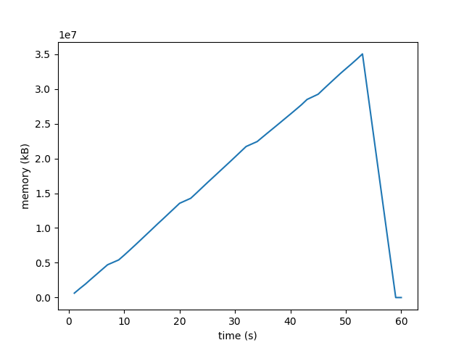
Memory leaks
Run application & monitor memory usage
crash!
Expected?
At least suspicious

Slide 168
Valgrind memcheck
Run with valgrind
$ valgrind ./memory_leak.exe
…
==72184== HEAP SUMMARY:
==72184== in use at exit: 16,000,000 bytes in 2,000 blocks
==72184== total heap usage: 2,001 allocs, 1 frees,
==72184== 16,001,024 bytes allocated
==72184==
==72184== LEAK SUMMARY:
==72184== definitely lost: 16,000,000 bytes in 2,000 blocks
==72184== indirectly lost: 0 bytes in 0 blocks
==72184== possibly lost: 0 bytes in 0 blocks
==72184== still reachable: 0 bytes in 0 blocks
==72184== suppressed: 0 bytes in 0 blocks
…
Not okay!

Slide 169
Valgrind full leak check
Run with valgrind
$ valgrind --leak-check=full ./memory_leak.exe
…
==72215== at 0x4C3A586: malloc (vg_replace_malloc.c:299)
==72215== by 0x400627: create_vector (memory_leak.c:24)
==72215== by 0x4006CF: main (memory_leak.c:14)
=72184== suppressed: 0 bytes in 0 blocks
…
memory_leak.c
…
13 for (i = 0; i < nr_iters; i++) {
14 double *x = create_vector(n);
15 sum += compute_avg(x, n);
16 }
…
21 double *create_vector(int n) {
…
24 if ((x = (double *) malloc(n*sizeof(double))) == NULL)
…

Slide 170
Stack variables
Segmentation fault run with valgrind
$ valgrind ./stack_issue.exe
…
==9807== Invalid read of size 8
==9807== at 0x400699: main (stack_issue.c:13)
==9807== Address 0x0 is not stack'd, malloc'd or (recently) free'd
==9807==
==9807==
==9807== Process terminating with default action of signal 11 (SIGSEGV)
==9807== Access not within mapped region at address 0x0
==9807== at 0x400699: main (stack_issue.c:13)
…
…
4 double sum = 0.0;
…
12 for (i = 0; i < n; i++)
13 sum += x[i];
…
x seems to be NULL
memory_issue.c

Slide 171
Check using GDB
Application core dumped
$ gdb ./stack_issue.exe core
…
Core was generated by `./stack_issue.exe'.
Program terminated with signal SIGSEGV, Segmentation fault.
#0 0x0000000000400619 in main () at stack_issue.c:13
13 sum += x[i];
(gdb) p i
$1 = 0
(gdb) p sum
$3 = 0
(gdb) p x
$2 = (double *) 0x0
first iteration
sum is fine
x is NULL pointer

Slide 172
Actual problem & solution
Culprit
However…
stack_issue.c
…
17 double *init_vector(int n) {
18 double x[n];
…
22 return x;
23 }
…
Solution:
Allocate x on heap
Oops, x stack variable,
goes out of scope
$ gcc -std=c99 -g -O0 -o stack_issue.exe stack_issue.c
stack_issue.c: In function ‘init_vector’:
stack_issue.c:23:12: warning: function returns address of local variable [-Wreturn-local-addr]
return x;
^
Don't ignore compiler warnings!

Slide 173
MUST

Slide 174

MUST
Validator for MPI, checks
constants and integer values
communicator usage
datatype usage
group usage
operation usage
request usage
leak checks (MPI resources not freed)
type mismatches
overlapping buffers passed to MPI
deadlocks due to MPI calls
basic checks for thread-level usage (MPI_Init_thread)
https://doc.itc.rwth-aachen.de/display/CCP/Project+MUST
Note: Intel MPI can catch some of these

Slide 175
Using MUST
MUST uses PMPI interface, so no instrumentation required
Run application with mustrun, not mpirun
HTML report is generated

Slide 176
MUST deadlock run
$ mustrun -np 2 ./deadlock.exe
[MUST] MUST configuration ... centralized checks with fall-back application crash handling (very slow)
[MUST] Using prebuilt infrastructure at …
[MUST] Weaver ... success
[MUST] Generating P^nMPI configuration ... success
[MUST] Search for linked P^nMPI ... not found ... using LD_PRELOAD to load P^nMPI ... success
[MUST] Executing application:
============MUST===============
ERROR: MUST detected a deadlock, detailed information is available in the MUST output file. You should either investigate details with a debugger or abort, the operation of MUST will stop from now.
===============================
^C^C
[MUST] Execution finished, inspect "/MUST_Output.html"!

Slide 177
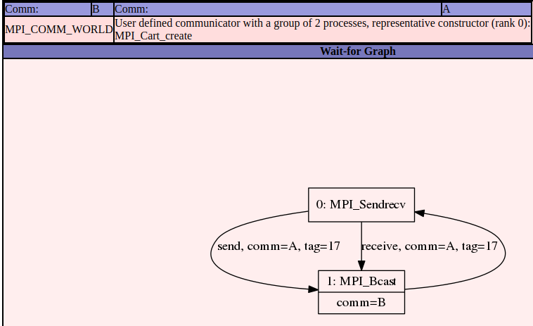
MUST deadlock report
= deadlock!
MPI_Bcast waits
for MPI_Sendrecv
MPI_Sendrecv waits
for MPI_Bcast

Slide 178
Deadlock code
…
if (comm_rank == 0) then
if (command_argument_count() == 1) then
call get_command_argument(1, buffer)
read (buffer, '(I5)') n
else
n = default_n
end if
else
call MPI_Bcast(n, 1, MPI_INTEGER, 0, MPI_COMM_WORLD, ierr)
end if
…
call MPI_Sendrecv(matrix(2, 1), 1, row_type, up, tag, &
matrix(1, 1), 1, row_type, down, tag, &
comm, MPI_STATUS_IGNORE, ierr)
…
rank 0 doesn't
MPI_Bcast!
deadlock.f90
rank 0 starts MPI_Sendrecv all
others stuck in MPI_Bcast!

Slide 179
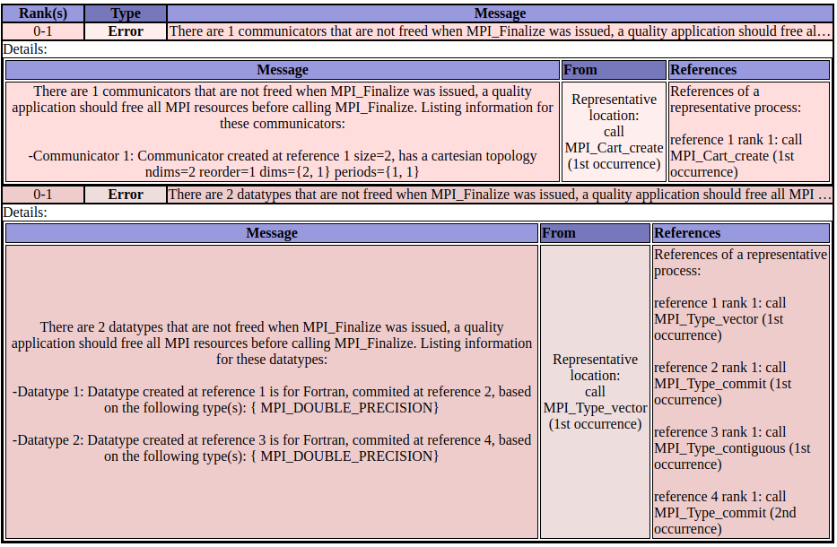
MUST leaked resources report

Slide 180
Leaky code
MPI_Cart_create without
MPI_Comm_free!
…
dims = 0
periodic = .true.
reorder = .true.
call MPI_Dims_create(comm_size, nr_dims, dims, ierr)
call MPI_Cart_create(MPI_COMM_WORLD, nr_dims, dims, periodic, &
reorder, cart_comm, ierr)
…
call MPI_Type_vector(n, 1, n, MPI_DOUBLE_PRECISION, row_type, ierr)
call MPI_Type_commit(row_type, ierr)
call MPI_type_contiguous(n, MPI_DOUBLE_PRECISION, col_type, ierr)
call MPI_Type_commit(col_type, ierr)
…
leak.f90
two MPI_Type_commit,
without MPI_Type_free!

Slide 181
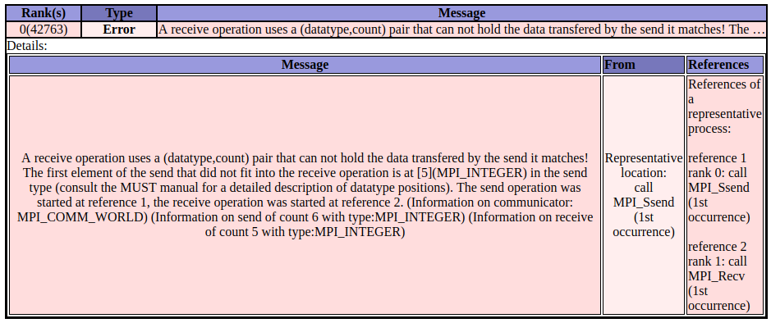
MUST buffer sizes report

Slide 182
Mismatched buffer size code
…
integer, parameter :: send_buff_size = 6
integer, parameter :: recv_buff_size = 5
integer, dimension(send_buff_size) :: send_buff
integer, dimension(recv_buff_size) :: recv_buff
…
if (rank == 0) then
call MPI_Ssend(send_buff, send_buff_size, MPI_INTEGER, 1, tag, &
MPI_COMM_WORLD, ierr)
else if (rank == 1) then
call MPI_Recv(recv_buff, recv_buff_size, MPI_INTEGER, 0, tag, &
MPI_COMM_WORLD, MPI_STATUS_IGNORE, ierr)
end if
…
message_size.f90
send buffer > receive buffer!

Slide 183
Mismatched buffer Intel MPI
$ mustrun -np 2 ./message_size.exe
Fatal error in MPI_Recv: Message truncated, error stack:
MPI_Recv(224).....................: MPI_Recv(buf=0x6b0b80, count=5, MPI_INTEGER, src=0, tag=17, MPI_COMM_WORLD, status=0x1) failed
MPIDI_CH3U_Receive_data_found(131): Message from rank 0 and tag 17 truncated; 24 bytes received but buffer size is 20

Slide 184
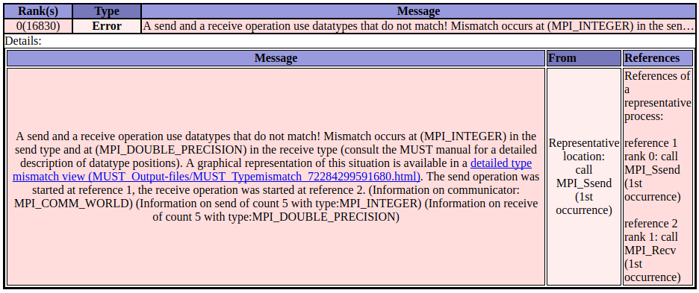
MUST buffer types report

Slide 185
Mismatched buffer type code
…
use, intrinsic :: iso_fortran_env, only : dp => REAL64
…
integer, parameter :: buff_size = 5
integer, dimension(buff_size) :: send_buff
real(kind=dp), dimension(buff_size) :: recv_buff
…
if (rank == 0) then
call MPI_Ssend(send_buff, buff_size, MPI_INTEGER, &
1, tag, MPI_COMM_WORLD, ierr)
else if (rank == 1) then
call MPI_Recv(recv_buff, buff_size, MPI_DOUBLE_PRECISION, &
0, tag, MPI_COMM_WORLD, MPI_STATUS_IGNORE, ierr)
end if
…
message_type.f90
send INTEGER ↔ receive DOUBLE_PRECISION!

Slide 186
However…
…
use, intrinsic :: iso_fortran_env, only : INT64
…
integer, parameter :: buff_size = 5
integer(kind=INT64), dimension(buff_size) :: send_buff, recv_buff
…
if (rank == 0) then
call MPI_Ssend(send_buff, buff_size, MPI_INTEGER, &
1, tag, MPI_COMM_WORLD, ierr)
else if (rank == 1) then
call MPI_Recv(recv_buff, buff_size, MPI_INTEGER, &
0, tag, MPI_COMM_WORLD, MPI_STATUS_IGNORE, ierr)
end if
…
message_type.f90
MPI_INTEGER: 4 byte ↔ INT64: 8 byte
Not caught: PMPI has no clue

Slide 187
Buffer aliasing
…
call MPI_Reduce(buff, buff, buff_size, MPI_INTEGER, MPI_SUM, root, &
MPI_COMM_WORLD, ierr)
…
message_type.f90
MUST 1.5 crashes: no error report
Intel MPI
$ mpirun -np 2 ./buffer_overlap.exe
Fatal error in PMPI_Reduce: Invalid buffer pointer, error stack:
PMPI_Reduce(2334): MPI_Reduce(sbuf=0x6b0a20, rbuf=0x6b0a20, count=5, MPI_INTEGER, MPI_SUM, root=0, MPI_COMM_WORLD) failed
PMPI_Reduce(2255): Buffers must not be aliased

Slide 188
valgrind

Slide 189

Valgrind: what is it?
Memory checker that finds
Memory leaks (memcheck = default)
Illegal accesses to memory locations (memcheck, ptrcheck)
Problems with threads
race conditions (drd)
http://valgrind.org/

Slide 190
Valgrind: example memory leak
…
double *createArray(int n) {
int i;
double *a = (double *) malloc(n, sizeof(double));
…
return a;
}
…
int main(int argc, char *argv[]) {
…
double *a = createArray(N);
…
return EXIT_SUCCESS;
}
memory allocation
no memory deallocation!
leak.c

Slide 191
Valgrind: running
Compile with debug information
Execute program under Valgrind control
$ gcc –g2 -o leak leak.c
$ valgrind ./leak 2> leak.report
sum = 42.0

Slide 192
Valgrind: report
==3085== Memcheck, a memory error detector
==3085== Copyright (C) 2002-2010, and GNU GPL'd, by Julian Seward et …
==3085== Using Valgrind-3.6.1 and LibVEX; rerun with -h for copyright …
==3085== Command: ./leak.exe
==3085==
==3085== HEAP SUMMARY:
==3085== in use at exit: 80 bytes in 1 blocks
==3085== total heap usage: 1 allocs, 0 frees, 80 bytes allocated
==3085==
==3085== LEAK SUMMARY:
==3085== definitely lost: 80 bytes in 1 blocks
==3085== indirectly lost: 0 bytes in 0 blocks
==3085== possibly lost: 0 bytes in 0 blocks
==3085== still reachable: 0 bytes in 0 blocks
==3085== suppressed: 0 bytes in 0 blocks
==3085== Rerun with --leak-check=full to see details of leaked memory
==3085==
==3085== For counts of detected and suppressed errors, rerun with: -v
==3085== ERROR SUMMARY: 0 errors from 0 contexts (suppressed: 11 from 6)
10 double

Slide 193
Valgrind: memory leak fixed
…
double *createArray(int n) {
int i;
double *a = (double *) malloc(n, sizeof(double));
…
return a;
}
…
int main(int argc, char *argv[]) {
…
double *a = createArray(N);
…
free(a);
return EXIT_SUCCESS;
}
memory allocation
corresponding memory deallocation
leak.c

Slide 194
Valgrind: good report!
==3254== Memcheck, a memory error detector
==3254== Copyright (C) 2002-2010, and GNU GPL'd, by Julian Seward et …
==3254== Using Valgrind-3.6.1 and LibVEX; rerun with -h for copyright…
==3254== Command: ./leak.exe
==3254==
==3254==
==3254== HEAP SUMMARY:
==3254== in use at exit: 0 bytes in 0 blocks
==3254== total heap usage: 1 allocs, 1 frees, 80 bytes allocated
==3254==
==3254== All heap blocks were freed -- no leaks are possible
==3254==
==3254== For counts of detected and suppressed errors, rerun with: -v
==3254== ERROR SUMMARY: 0 errors from 0 contexts (suppressed: 11 from 6)

Slide 195
Valgrind: no initialization example
1 #include <stdio.h>
2 #include <stdlib.h>
3
4 int main(int argc, char *argv[]) {
5 int sum, i, result = 10;
6 int *x = (int *) calloc(10, sizeof(int));
7 for (i = 0; i < 10; i++) {
8 x[i] = i;
9 sum += x[i];
}
result += sum;
printf("result = %d\n", result);
free(x);
14 return EXIT_SUCCESS;
15 }
sum used, but not initialized
uninitialized.c

Slide 196
Valgrind: uninitialized use found
==3103== Use of uninitialised value of size 4
==3103== at 0x407A806: _itoa_word (_itoa.c:195)
==3103== by 0x407D33F: vfprintf (vfprintf.c:1619)
==3103== by 0x408589F: printf (printf.c:35)
==3103== by 0x80484A1: main (uninitialized.c:12)
==3103== Uninitialised value was created by a stack allocation
==3103== at 0x804842A: main (uninitialized.c:4)
==3103==
==3103== Conditional jump or move depends on uninitialised value(s)
==3103== at 0x407A80E: _itoa_word (_itoa.c:195)
==3103== by 0x407D33F: vfprintf (vfprintf.c:1619)
==3103== by 0x408589F: printf (printf.c:35)
==3103== by 0x80484A1: main (uninitialized.c:12)
==3103== Uninitialised value was created by a stack allocation
==3103== at 0x804842A: main (uninitialized.c:4)
…
1 #include <stdio.h>
2 #include <stdlib.h>
3
4 int main(int argc, char *argv[]) {
5 int sum, i, result = 10;
6 int *x = (int *) calloc(10, sizeof(int));
7 for (i = 0; i < 10; i++) {
8 x[i] = i;
9 sum += x[i];
}
result += sum;
printf("result = %d\n", result);
free(x);
14 return EXIT_SUCCESS;
15 }
stack allocation for sum
first time sum used for output
uninitialized.c

Slide 197
Valgrind: array bounds overrun
1 #include <stdio.h>
2 #include <stdlib.h>
3
4 int main(int argc, char *argv[]) {
5 int *x = (int *) calloc(10, sizeof(int));
6 x[10] = 12;
7 free(x);
8 return EXIT_SUCCESS;
9 }
a[10] is not allocated
array-overrun.c
==1652==
==1652== Invalid write of size 4
==1652== at 0x804841C: main (array-overrun.c:6)
==1652== Address 0x41a1050 is 0 bytes after a block of size 40 alloc'd
==1652== at 0x4025315: calloc (vg_replace_malloc.c:467)
==1652== by 0x8048410: main (array-overrun.c:5)
==1652==

Slide 198
Intel Inspector

Slide 199
Intel Inspector: what is it?
Tool to detect
thread issues: deadlocks, race conditions
memory issues: leaks
Can be used
GUI
command line
Commercial product

Slide 200
Computing π using OpenMP
$ export OMP_NUM_THREADS=1
$ ./pi
3.14059997
$ export OMP_NUM_THREADS=4
$ ./pi
0.506071389
$ ./pi
0.243729278
$./pi
0.442173123
Not too bad
Not really π, not even deterministic!
May be symptom of race condition

Slide 201
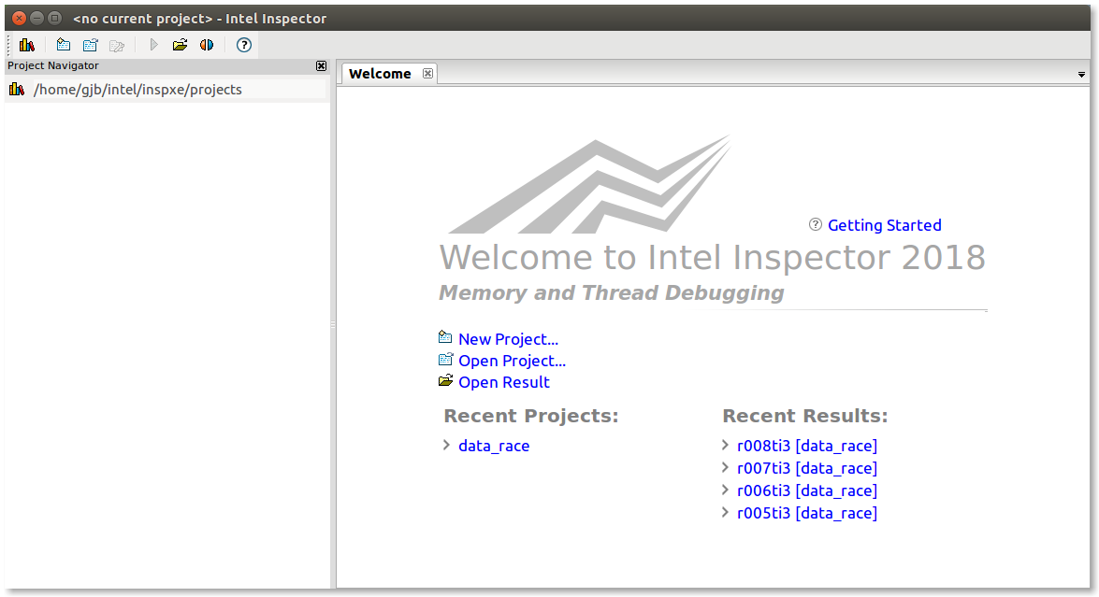
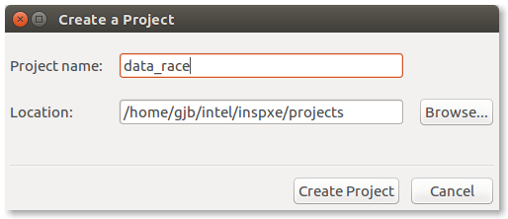
Startup
Inspector is project-based
create new project

Slide 202
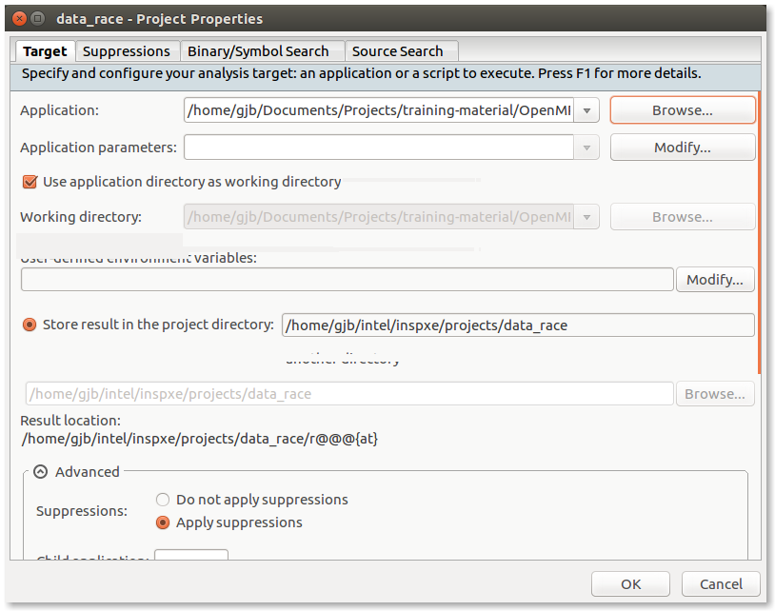
Configure target

Slide 203
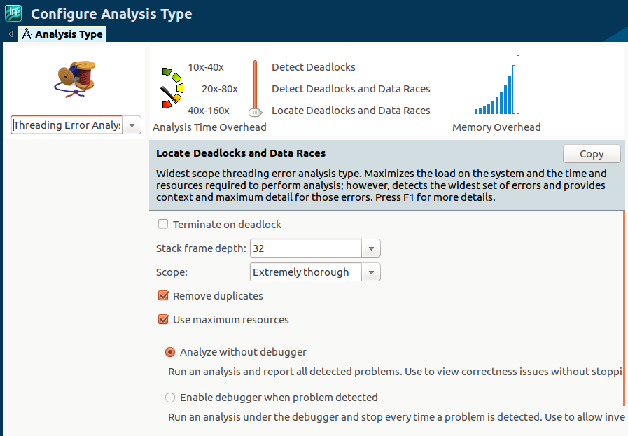
Configure analysis
analysis type
increased from default

Slide 204
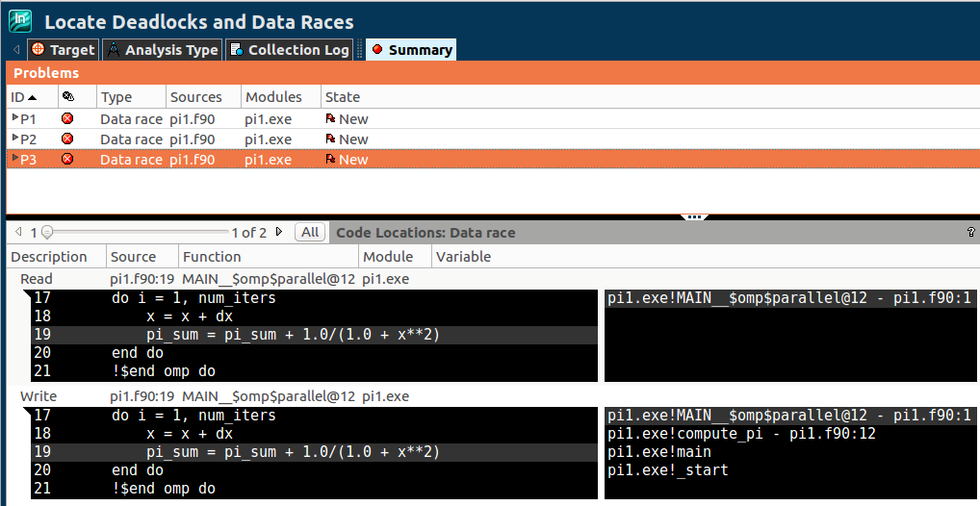
Analysis summary
pi_sum write
pi_sum read

Slide 205

Race condition
memory
register thread 0
register thread 1
0
read
0
+ 1
time
1
write
read
1
+ 1
correctness depends
on execution order
write
2
=
race condition
memory
register thread 0
register thread 1
0
read
0
+ 1
time
1
write
read
0
+ 1
write
1

Slide 206
The mystery of the vanishing bug

Slide 207
Know thy stuff
Crucial to understand
hardware architecture
compiler behavior
programming language semantics
Subtle interplay → "weird" behavior

Slide 208
The code
#include <stdio.h>
#include <stdlib.h>
#define N 8
int main(int argc, char *argv[]) {
const int old_val = 15;
const int new_val = 42;
int i, b, a[N];
long shift = &b - &(a[0]);
b = old_val;
printf("b = %d\n", b);
for (i = 0; i < N; i++)
a[i] = i;
a[shift] = new_val;
printf("setting a[%ld] = %d\n", shift, new_val);
printf("a[%ld] = %d\n", shift, a[shift]);
printf("b = %d\n", b);
return EXIT_SUCCESS;
}
Written to be buggy
array_bounds.c

Slide 209
The bug
a[8]
…
a[0]
a[1]
…
a[6]
a[7]
b
…
a[i]
≡ a[i]
≡ *(a + i)
assignment to a[8]
modifies value of b
≡ *(i + a)
≡ i[a]

Slide 210
To be or not to be…
Now you see it…
and now you don't
$ icc –O1 array_bounds.c
$ ./a.out
b = 15
setting a[8] = 42
a[8] = 42
b = 42
$ icc –O2 array_bounds.c
$ ./a.out
b = 15
setting a[8] = 42
a[8] = 42
b = 15

Slide 211
Explanation
Aggressive optimization (Intel -O2)
a array stored in RAM
b stored only in CPU register for immediate reuse
update of memory location a[8] → no effect on b
Looking at assembly code may help

Slide 212
Debugging tips

Slide 213
A few tips
Typically, compile without optimizations
Consistency between source and debugger state
However, bug may "disappear"
no variable on stack, data in register
different data alignment in memory
timing issues in parallel code (race conditions disappear)
Use a profiler to detect
Unexpected load imbalance between processes/threads
Unexpected communication patterns
Use visualization software
Helps spot anomalies in data structures
Have string representation for objects/data structures

Slide 214
Conclusions

Slide 215
Conclusions
gdb is powerful
Stepping
Watching
Tracing
Valgrind
Memory leaks
Uninitialized variables
Buffer overruns

Slide 216
Other tools
Debuggers
Python: pdb
To visualize data structures: ddd
IDEs, e.g., Eclipse
Parallel debuggers: Allinea DDT, RogueWave TotalView
MPI tracing tools
Intel ITAC
Record MPI events
Add markers in your own code
MPE2
Thread checkers
Intel Inspector
Detects race conditions
Detects memory leaks

Slide 217
References
The art of debugging with gdb, ddd, and Eclipse Norman Matloff & Peter Jay Salzman No Starch Press, 2008
Effective debugging: 66 specific ways to debug software and systems Diomidis Spinellis Addison-Wesley, 2010

Slide 218
Allinea DDT: demo

