Slide 1
Python for data processing & analysis
Geert Jan Bex (geertjan.bex@uhasselt.be)
Acknowledgements: thanks to Stefan Becuwe, Universiteit Antwerpen
for suggestions and corrections
License: this presentation is released under the Creative Commons, see http://creativecommons.org/publicdomain/zero/1.0/

Slide 2
Introduction

Slide 3
Motivation
Why yet another programming language?
Programming languages have strong & weak points
Pick language for task at hand
Why Python?
Useful for data processing
Terse language: express a lot in few lines of code
Short time to solution
Extensive standard library
Cross platform

Slide 4
Python applications
Python is general purpose programming language, but strong for
Data transformation: rewrite data into another format
Preprocessing/postprocessing/aggregating data
Prototyping
Experiment easily in Python, fast implementation later
Explorative programming
Glue/coordination language
Use Python as "scaffolding" for libraries in C/C++/Fortran
In-application scripting language
E.g., Kitware ParaView, Dassault Systèmes Abaqus™, Adobe Photoshop™
Graphical user interfaces
Wrap GUI around C/C++/Fortran code

Slide 5
Python versions
Current 3.x
More clean than 2.x
Almost all Python libraries supported
Version 2.7.x
Last of the 2.x releases
Many Python 3.x features have been retrofitted
All libraries support it
Here, version 3.5
Note: in-application scripting may be stuck at Python 2.7!

Slide 6
Scope
Teach programming in Python
prerequisite: you should know how to program in some other language, if not consider first completing
CodeAcademy http://www.codecademy.com/tracks/python
LearnPython http://www.learnpython.org/
Highlight Python's strong points
Discuss Python's weak points and how to mitigate
These sessions won't teach you how to program, how to find algorithms, that's beyond the scope

Slide 7
Typographical conventions I
Shell commands are rendered as
Do not type $, it represents your shell prompt!
Python shell commands are rendered as
Do not type >>>, it represents the prompt!
iPython interpreter is rendered as
$ python –m doctest data_parsing.py
>>> names = 'bob alice carol'.split()
In[3]: names = 'bob alice carol'.split()

Slide 8
Typographical conventions II
Inline code fragments and file names are rendered as, e.g., hello_world.py
Longer code fragments are rendered as
Data files are rendered as
#!/usr/bin/env python
…
if __name__ == '__main__':
print('hello world!')
case dim temp
1 1 -0.5
2 1 0.0
3 1 0.5
4 2 -0.5
…
fragment not shown

Slide 9
Syntax versus semantics
syntax: form, grammar
correct: The dog is barking.
incorrect: The dog barking.
semantics: meaning, interpretation
correct: The dog barked.
incorrect: The dog spoke.
Except in fairy tales!

Slide 10
What do you want to do today?

Slide 11
Running Python I
Running Python from the command line
goals: run Python scripts in a shell
prerequisites: none
relevant sections: Python fundamentals, Anaconda
Interactive Python
goals: using Python for explorative programming
prerequisites: none
relevant sections: python interpreter/iPython, Anaconda

Slide 12
Running Python II
Managing Python environment
goals: installing, updating packages, creating & sharing environments
prerequisites: none
relevant sections: conda (Linux & MacOS X)
Recommended software

Slide 13
Basic Python programming
Core Python programming
goals: Python syntax & semantics, control flow, data types, functions
prerequisites: experience in some programming language
relevant sections: data types & statements, standard I/O & command line arguments, additional datatypes, file I/O

Slide 14
Intermediate Python programming
Object oriented programming
goals: creating Python classes, inheritance
prerequisites: core Python programming
relevant sections: object oriented programming, data representation (case study)
Functional programming
goals: writing code using functional programming paradigm
prerequisite: core Python programming
relevant sections: list transformations, Iiterators

Slide 15
Software engineering I
Code organization
goals: organizing code of a non-trivial software project
prerequisites: core Python programming
relevant sections: code organization
Documentation
goals: how to document Python code?
prerequisites: core Python programming
relevant sections: docstring & doctest

Slide 16
Software engineering II
Testing
goals: tests are integral part of software development
prerequisites: core Python programming, object oriented programming for unit testing
relevant sections: doctest, unit testing
Error handling
goals: catch & handle runtime errors
prerequisites: core Python programming, object oriented programming to define your own exceptions
relevant sections: error handling

Slide 17
Development I
Debugging
goals: using the Python debugger
prerequisites: core Python programming
relevant sections: debugging
Profiling
goals: using the Python profiler to identify optimization opportunities
prerequisites: core Python programming
relevant sections: profiling

Slide 18
Development II
Python 2 versus Python 3
goals: compare Python versions, porting from Python 2 to 3
prerequisites: core Python programming
relevant sections: Python 2 to 3

Slide 19
Application development I
Command line arguments & configuration files
goals: handling options, flags specified on command line, reading configuration files
prerequisites: core Python programming
relevant sections: argparse, ConfigParser
Logging
goals: writing application events to log files, using log levels
prerequisites: core Python programming
relevant sections: logging

Slide 20
Application development II
Interacting with the operating system
goals: file system operations, executing external commands
prerequisites: core Python programming
relevant sections: file system operations, external commands

Slide 21
File formats
Text-based formats
goals: reading & writing text-based file formats
prerequisites: core Python programming, file I/O
relevant sections: CSV & XML, regular expressions, parsing regular languages, pyparsing for context-free languages, string formatting
Scientific file formats
goals: reading & writing HDF5
prerequisites: core Python programming, numpy
relevant sections: HDF5

Slide 22
Numerical computing
Linear algebra, numerical analysis
goals: various numerical analysis algorithms
prerequisites: core Python programming
relevant sections: numpy & scipy
Scientific visualization
goals: creating 2D and 3D plots from Python
prerequisites: core Python programming, numpy
relevant sections: matplotlib, HoloViews, Bokeh

Slide 23
Symbolic computing
Computer algebra
goals: various symbolic computations
prerequisites: core Python programming
relevant sections: sympy

Slide 24
Data analysis
Relational database interaction
goals: querying relational database systems
prerequisites: core Python programming, object oriented programming for SQLAlchemy
relevant sections: Relational databases
Data analysis
goals: analysis using transforming & filtering tabular data, pivot tables, visulualization
prerequisites: core Python programming
relevant sections: pandas

Slide 25
Other training sessions
Sessions can be organized on demand
Integrating C/C++/Fortran code, wrapping libraries (1.5 hour)
Distributed programming with mpi4py (2 hours)
Cython (2 hours)

Slide 26
Python fundamentals: data types & statements
https://github.com/gjbex/training-material/tree/master/Python/Fundamentals

Slide 27
Hello world!
Minimal code for Python script
“shebang”: tells the shell this is python code
#!/usr/bin/env python
if __name__ == '__main__':
print('hello world!')
Python interpreter executes all code in body
Indentation is relevant!
Code structure
Python Is case-sensitive!

Slide 28
Say hello!
Save script in file hello_world.py
Run script using Python interpreter
Make script executable
Run script directly
$ python hello_world.py
hello world!
$ chmod u+x hello_world.py
$ ./hello_world.py
hello world!
That's what the shebang is for: #!/usr/bin/env python

Slide 29
Hello again!
Encapsulate script in main function
#!/usr/bin/env python
import sys
def main():
print('hello world!')
return 0
if __name__ == '__main__':
status = main()
sys.exit(status)
Simple function, no arguments, return status only
Function call

Slide 30
Generating data
Need some data?
first column, case number: sequential number
second column, dimension number: integer 1, 2, 3
third column, temperature: float value -0.5, 0.0, 0.5
case dim temp
1 1 -0.5
2 1 0.0
3 1 0.5
4 2 -0.5
5 2 0.0
…
def main():
print('case', 'dim', 'temp')
case_nr = 0
for dim_nr in [1, 2, 3]:
for temp in [-0.5, 0.0, 0.5]:
case_nr += 1
print(case_nr, dim_nr, temp)
return 0

Slide 31
for loop
Semantics: for each element in list do…
Actually, not only lists, anything one can iterate over (e.g., sets, dictionaries, I/O streams,…)
variable
list
Note colon!
for dim_nr in [1, 2, 3]:
…
loop body
statement(s)
Note indentation

Slide 32
while loop
Semantics: while boolean condition holds do…
condition
Note colon!
while n > 0:
…
loop body
statement(s)
Note indentation

Slide 33
Skipping and quitting
Skipping loop iterations: continue for n in range(100): if is_prime(n): continue print(n)
Ending loop execution: break n = 100 while n < 1000: if is_prime(n): break n += 1
Works for both for and while loops

Slide 34
Data types
str: sequence of characters, e.g., 'temp'
int: integer, e.g., 2
float: floating point number, e.g., -0.5
complex: complex number, e.g., 1.3 + 4.8j
def main():
print('case', 'dim', 'temp')
case_nr = 0
for dim_nr in [1, 2, 3]:
for temp in [-0.5, 0.0, 0.5]:
case_nr += 1
print(case_nr, dim_nr, temp)

Slide 35
Lists
Very useful data structure
Elements can be of same, or different type
Literal list
[-0.5, 0.0, 0.5]
['alpha', 'beta', 'gamma', 'delta']
Empty list: [] or list()
List constructor
list(range(3)) ≡ [0, 1, 2]
list(range(1, 4)) ≡ [1, 2, 3]
list(range(1, 8, 2)) ≡ [1, 3, 5, 7]
list(range(0, -9, -3)) ≡ [0, -3, -6]
Note: explicit list construction can often be avoided, range(…) returns iterable

Slide 36
More list operations
Example list: l = ['a', 'b']
Number of elements: len(l) == 2
Append to a list: l.append('c'), l ≡ ['a', 'b', 'c']
Remove last element: l.pop() == 'c', l ≡ ['a', 'b']
Insert element at position: l.insert(1, 'c'), l ≡ ['a', 'c', 'b']
Remove element at: l.pop(1) == 'c', l ≡ ['a', 'b']
Extend a list: l.extend(['c', 'd']), l ≡ ['a', 'b', 'c', 'd']

Slide 37
Using list elements
Example list: l = ['a', 'b', 'c']
Use first element: a = l[0], a == 'a'
Use second element: a = l[1], a == 'b'
Use last element: a = l[-1], a == 'c'
One before last: a = l[-2], a == 'b'
Assignment: l[2] = 'de', l ≡ ['a', 'b', 'de']
Note: list index is 0-based!

Slide 38
Slicing & dicing
Example list: l = list(range(1, 6)), l ≡ [1, 2, 3, 4, 5]
Creating sublists:
l_sub = l[2:4], l_sub ≡ [3, 4]
l_sub = l[:4], l_sub ≡ [1, 2, 3, 4]
l_sub = l[2:], l_sub ≡ [3, 4, 5]
l_sub = l[0:4:3], l_sub ≡ [1, 4]
l_sub = l[::2], l_sub ≡ [1, 3, 5]
l_sub = l[4:1:-1], l_sub ≡ [5, 4, 3]
l_r = l[::-1], l_r ≡ [5, 4, 3, 2, 1]
Assigning to slices: l[::2] = ['a', 'b', 'c'], l ≡ ['a', 2, 'b', 4, 'c']

Slide 39
Iterating over lists
Example list: data = list(range(1, 6))
Straightforward iteration for e in data: f(e)
Need index? for i in range(len(data)): g(i, data[i])
Better for i, e in enumerate(data): g(i, e)
√
√

Slide 40
Generating data revisited
Use range(…)
How to do lists of floats?
[0.5*x for x in range(-1, 2)]
list comprehensions: construct list from list
looks a lot like math
def main():
print('case', 'dim', 'temp')
case_nr = 0
for dim_nr in range(1, 4):
for temp in [0.5*x for x in range(-1, 2)]:
case_nr += 1
print(case_nr, dim_nr, temp)
return 0
consider using numpy

Slide 41
Formatting strings
Use tabs as separator
Increase number of digits after decimal point to 4
'{0}\t{1}\t{2:.4f}'.format( case_nr, dim_nr, temp)
tab

Slide 42
Objects & methods
a string is an object (class str), format is a method on that object
object
method
'{0}\t{1}\t{2:.4f}'.format( case_nr, dim_nr, temp)
method parameters
methods on strings produce new strings

Slide 43
Modifying data
Replace negative temperatures by 0.0
case dim temp
1 1 -0.5
2 1 0.0
3 1 0.5
4 2 -0.5
5 2 0.0
…
case dim temp
1 1 0.0000
2 1 0.0000
3 1 0.5000
4 2 0.0000
5 2 0.0000
…
import sys
def main():
print(sys.stdin.readline().rstrip('\r\n'), sep='\t')
for line in sys.stdin:
data = line.rstrip('\r\n').split()
if float(data[2]) < 0.0:
data[2] = '0.0'
print('{0}\t{1}\t{2:.4f}'.format(
data[0], data[1], float(data[2])))

Slide 44
Getting things in and out: I/O & command line arguments

Slide 45
Reading lines from file handles
Standard file handles:
sys.stdin: standard input (keyboard, pipe in)
sys.stdout: standard output (screen, pipe out)
sys.stderr: standard error (screen, pipe out)
Reading a single line:
sys.stdin.readline(): returns str
Reading all lines at once:
sys.stdin.readlines(): returns list of str
Note: line endings,
e.g., \n or \r\n are included
Note: readline(), readlines() are methods on file handles

Slide 46
Reading & memory consumption
Remember, readlines() method reads whole file at once
For large files, creates long list = lots of memory
Avoid:
Use:
… for line in sys.stdin.readlines():
…
Returns iterator, not list Memory friendly!
… for line in sys.stdin:
…

Slide 47
Writing to file handles
print function writes objects to sys.stdout, adds '\n' (or '\r\n') and applies str() conversion function by default
write(…) method writes str to file handle, e.g.,
sys.stderr.write('### error: number is negative\n')
sys.stdout.write(output_str)
flush() method flushes output to disk
At least, tells OS to do so

Slide 48
More on print
print has some useful optional arguments
file: allows to print to any open file handle, e.g., sys.stderr (default: sys.stdout) print("# error: number should be positive", file=sys.stderr)
sep: character to separate multiple objects to print (default: ' '), e.g., print('alpha', 3, 5.7, sep='\t')
end: character to add when all arguments are printed (default: '\n'), e.g., print('next print will be on same line', end='')
flush: whether to combine print with a flush on the file handle (default: False), print('read done', file=sys.stderr, flush=True)

Slide 49
Simple command line arguments
Script name & command line arguments in sys.argv
import sys
if __name__ == '__main__':
print(sys.argv)
Note:
all values are str
$ python cla_printer.py
['cla_printer.py']
$ python cla_printer.py alpha beta 3.5
['cla_printer.py', 'alpha', 'beta', '3.5']
$ python cla_printer.py 'alpha beta' 3.5
['cla_printer.py', 'alpha beta', '3.5']
Okay for very simple cases, better: use argparse

Slide 50
Python fundamentals continued
https://github.com/gjbex/training-material/tree/master/Python/Fundamentals

Slide 51
Some more str methods: strip
Getting rid of line endings: rstrip('\r\n')
method will strip all combinations of \r and \n from right end of string
Similar methods:
lstrip: strips from left end of string
strip: strips from both ends of string
no arguments, strips: space, \t, \r, \n, …
Note that strings are not modified, new string is created!

Slide 52
str method: split
Splitting string: split()returns list of strings
no argument: split on (multiple) whitespace
otherwise, split on provided string
limit number of splits by providing extra argument
E.g., read file, and print only end times
start 1: 2013-03-27 14:20:13
end 1: 2013-03-28 03:05:57
start 2: 2013-03-28 04:30:17
start 3: 2013-03-28 04:30:17
end 2: 2013-03-28 05:45:17
end 3: 2013-03-28 09:15:38
…
Split on ':', but note time format!!!

Slide 53
More str methods: startswith, endswith
startswith(prefix), endswith(suffix) return True if str starts with prefix/ends with suffix respectively, False otherwise
… for line in sys.stdin: event_str = line.strip() if event_str.startswith('end'): event, time_str = event_str.split(':', 1)
print(time_str)
Only single split, otherwise time is split as well

Slide 54
Even more str methods: is<something>
Test str is uppercase/lowercase: s.isupper()/s.islower()
'ABC'.isupper() == True
'A19'.isupper() == True
'Abc'.isupper() == False
'19'.isupper() == False
Test str has only whitespace: s.isspace()
Test str has only digits: s.isdigit()
Test str is alphabethic/alphanumeric: s.isalpha()/s.isalnum()

Slide 55
Searching & replacing in str
Does str contain substring? ('ab' in 'ABabCD') == True
Find position of first occurrence of substring in str: 'ABabCD'.find('ab') == 2
returns -1 when not found
can search between given start and final position
Replace all occurrences of substring by other substring '3.14'.replace('.', ',') == '3,14'
maximum number of replacements can be specified
More methods, but this will do

Slide 56
str operations
Concatenating strings: 'abc' + 'def' == 'abcdef'
Multiplying strings: 'x' * 4 == 'xxxx'
Works for list as well [0.0] * 4 == [0.0, 0.0, 0.0, 0.0]
However, bear in mind that this may not always do what you think

Slide 57
Joining list elements
Often, data contained in list data structure
Needs to be represented as delimited string
Example: [3.1745, 18.14, -6.49043] 3.1745,18.14,-6.49043
Use list comprehension, str function and str's join(…) method
>>> data = [3.1745, 18.14, -6.49043]
>>> print(','.join([str(number) for number in data]))
3.1745,18.14,-6.49043
type

Slide 58
str & list are sequences
characters (elements for list) accessed by position, e.g., s = 'abc': s[0] == 'a', s[2] == 'c', s[-1] == 'c', s[-2] == 'b'
Substrings (slices for list), e.g., s = 'abcde': s[0:3] == 'abc', s[2:4] == 'cd', s[1:] == 'bcde', s[:3] == 'abc' s[::-1] == 'edcba'

Slide 59
str & list length revisited
Function len() computes str length (number of elements for list) len('') == 0, len('abc') == 3 len([]) == 0, len([3, 5, 7]) == 3
Length & truth
Empty string is False, non-empty string True
Empty list is False, non-empty list is True
… if len(line.strip()) > 0: …
… if line.strip(): …
≡

Slide 60
Type conversion
Convert str s to floating point: float(s)
necessary for comparison: float(data[2]) < 0.0
Convert str s to integer: int(s)
Convert number x to str: str(x)
Convert float x to integer: int(x)
takes integer part of float, e.g., int(-3.8) == -3
Determining type of expression e: type(e)
e.g., type(3 + 0.1) == float

Slide 61
if statement
if …: … elif …: … else: …
General form:
Nesting: structure through indentation
Conditional expression:
Note colon!
Note indentation
… n = 10 if r > 1.0 else 0 …

Slide 62
Conditionals
Boolean values: True, False
Boolean operators: not, and, or
Comparison operators: ==, !=, <, <=, >, >=
work on str, float, int,…
List membership: in, e.g.,
'a' in ['c', 'a', 'd'] == True
'e' not in ['c', 'a', 'd'] == True

Slide 63
Which dimension numbers?
Which dimension numbers occur in file?
import sys
def main():
sys.stdin.readline()
dim_nrs = set()
for line in sys.stdin:
dim_nrs.add(int(line.rstrip('\r\n').split()[1])
print(dim_nrs)
return 0

Slide 64
Yuck, what's that?!?
dim_nr = int(line.rstrip('\r\n').split()[1])
≡
line_str = line.rstrip('\r\n')
data = line_str.split()
dim_str = data[1]
dim_nr = int(dim_str)
Python can be terse, but stick to what's comfortable for you!
However, use functions…

Slide 65
Reasonable compromise
One additional variable simplifies code
import sys
def main():
sys.stdin.readline()
dim_nrs = set()
for line in sys.stdin:
data = line.rstrip('\r\n').split()
dim_nrs.add(int(data[1])
print(dim_nrs)
return 0

Slide 66
Sets
set is Python data type, acts like set in math
empty set: s = set()
add element: s.add('a')
check membership: 'b' in s
remove element: s.remove('b')
iterating over elements: for element in s: …
No set of sets, set of lists
Set comprehensions: {i for i in range(3)} ≡ {0, 1, 2}

Slide 67
Set operations
s1 = {3, 5, 7}
s2 = {7, 11}
To modify set, use:
s1.<op>_update(s2)
Intersection: s1.intersection(s2) == {7}
Union: s1.union(s2) == {3, 5, 7, 11}
Difference: s1.difference(s2) == {3, 5}
Symmetric difference: s1.symmetric_difference(s2) == {3, 5, 11}
Is subset of? s1,issubset(s2) == False
Is disjoint from? s1.isdisjoint(s2) == False

Slide 68
More modularity
Same code copied and pasted, modified
Make it generic
…
for line in sys.stdin:
data = line.rstrip('\r\n').split()
dim_nr = int(data[1])
…
def parse_line(line):
data = line.rstrip('\r\n').split()
return (int(data[0]), int(data[1]), float(data[2]))
…
for line in sys.stdin:
case_nr, dim_nr, temp = parse_line(line)
…

Slide 69
Functions
Call by reference
however, remember that str, int, float et al. are immutable
Arguments can have default values
Arguments can be positional, or by keyword
Higher order
functions can have functions as arguments
function can return functions (closures)

Slide 70
Anatomy of function definition
Function definition
return statement to… return results, if any, and return control to caller
function name
argument list
Note colon!
def parse_line(line):
…
function body
statement(s)
Note indentation

Slide 71

Adding flexibility
Optional column separator
default values are created on import, reused for calls: mutable types == surprise!
argument separator
default value
def parse_line(line, sep=None):
data = line.rstrip('\r\n').split(sep)
return (int(data[0]), int(data[1]), float(data[2]))
…
for line in sys.stdin:
(case_nr, dim_nr, temp) = parse_line(line)
…
call with single argument, use default for sep (i.e., None)
…
(case_nr, dim_nr, temp) = parse_line(line, sep=';')
…

Slide 72
Tuples (YADS ☺)
tuple is (kind of) fixed length list, immutable
tuple with two elements: t = ('a', 'b')
first element: t[0] == 'a', second element t[1] == 'b'
def parse_line(line, sep=None):
data = line.rstrip('\r\n').split(sep)
return (int(data[0]), int(data[1]), float(data[2]))
…
for line in sys.stdin:
case_nr, dim_nr, temp = parse_line(line)
…
tuple of int, int, float
1-tuple: ('a', )
3-tuple unpacked into 3 variables

Slide 73
Returning to dimension numbers…
Which dimension numbers occur in file?
…
def main():
_ = sys.stdin.readline()
dim_nrs = set()
for line in sys.stdin:
_, dim_nr, _ = parse_line(line)
dim_nrs.add(dim_nr)
for dim_nr in dim_nrs:
print(dim_nr)
_ is wildcard in tuple unpacking:
tuple elements at those positions are ignored

Slide 74
Named tuples
collections.namedtuple is tuple, but elements have names
type name
from collections import namedtuple
…
Line_Data = namedtuple('Line_Data', 'case_nr dim_nr temp')
def parse_line(line, sep=None):
data = line.rstrip('\r\n').split(sep)
return Line_Data(case_nr=int(data[0]),
dim_nr=int(data[1]),
temp=float(data[2]))
…
for line in sys.stdin:
line_data = parse_line(line)
dim_nrs.add(line_data.dim_nr)
…
element names
constructor
access by name

Slide 75
Counting dimension numbers
How many times does a dimension number occur in file?
maximum & minimum not known a-priori!
…
import sys
def main():
_ = sys.stdin.readline()
counter = {}
for line in sys.stdin:
line_data = parse_line(line)
if line_data.dim_nr not in counter:
counter[line_data.dim_nr] = 0
counter[line_data.dim_nr] += 1
for dim_nr, count in counter.items():
print('{0}: {1}'.format(dim_nr, count))

Slide 76
Dictionaries
Data structure that maps a key onto a value
e.g., map a name to an age
Keys can have any (hashable) type (mixed too)
Values can have any type (mixed too)
Dictionary comprehensions: {k: k**2 for k in range(3)} ≡ {0: 0, 1: 1, 2:4}
ages = {
'alice': 35,
'bob': 32,
}
Curly brackets for dict
key/value pair separated by comma
key
value
key, value separated by colon

Slide 77
Using dictionaries
ages = {
'alice': 35,
'bob': 32,
}
Empty dictionary: {} or dict()
Number of key/value pairs: len(ages)
Storing values ages['caro'] = 45
Retrieving values 35 == ages['alice']
Removing key/value del ages['alice']
Does ages have an age for 'dave'? ages.has_key('dave') ≡ 'dave' in ages

Slide 78
Iterating over dictionaries
Iterate over keys: for name in ages.keys(): … for name in ages: …
Iterate over values: for age in ages.values(): …
Iterate over key/value pairs: for name, age in ages.items(): …
Note: creates views

Slide 79
Counting again…
Using collections.Counter instead of dict: simpler, less error prone
…
import collections
import sys
def main():
_ = sys.stdin.readline()
counter = collections.Counter()
for line in sys.stdin:
line_data = parse_line(line)
counter[line_data.dim_nr] += 1
for dim_nr, count in counter.items():
print('{0}: {1}'.format(dim_nr, count))
bonus method: most_common()

Slide 80
More special data types
collections.namedtuple: tuples with named elements
collections.Counter: count elements
collections.OrderedDict: remembers insertion order
collections.deque: (bounded) double-ended queue
collections.defaultdict: dictionary with computed default values
array.array: faster than lists, however, use numpy

Slide 81
Summary: data types
int
float
complex
bool
str
tuple
list
set
dict
immutable, hashable
simple types
More types in Python
mutable,
not hashable
complex types
Picking the right data type is crucial to produce good code

Slide 82
Summary: control structures
Conditional statement: if …: … elif …: … else: …
Iteration statements:
for-loop: for … in …: …
while-loop: while …: …

Slide 83
Summary: mathematics
Usual operators: +, -, *, /, %
for int, division is floating point division, i.e., 3/5 == 0.6
Raise to power: **
e.g., 2**4 == 16
Floor division: //
e.g., 7.3//5.7 == 1.0, but 6//4 == 1
Mathematical functions in module math
First import module (usually at top of file): import math Use functions, e.g., math.sqrt(3.0)
Or import specific function(s): from math import sqrt Use function(s), e.g., sqrt(3.0)
For complex numbers, functions in cmath
changed from 2.x to 3.x!

Slide 84
Code organization

Slide 85
Python modules & packages
Code organization
Functions common to multiple scripts can be put in separate file = module
Modules can be organized hierarchically in directory structure = packages
Python standard library is organized in packages
Don't forget __init__.py in package directories!

Slide 86
Example module & use
Module file data_parsing.py:
Using the module in script counting.py:
from collections import namedtuple
Line_Data = namedtuple('Line_Data', 'case_nr dim_nr temp')
def parse_line(line, sep=None):
data = line.rstrip('\r\n').split(sep)
return Line_Data(case_nr=int(data[0]),dim_nr=int(data[1]),
temp=float(data[2]))
import data_parsing
def main():
…
for line in sys.stdin:
line_data = data_parsing.parse_line(line)
…

Slide 87
Importing functions directly
Importing function parse_line from module data_parsing in script counting.py:
…
from data_parsing import parse_line
def main():
…
for line in sys.stdin:
data = parse_line(line)
…
More concise, but name clashes can occur! E.g., math.sqrt versus cmath.sqrt
from math import sqrt
from cmath import sqrt as csqrt

Slide 88
Package layout & use example
…
from vsc.parameter_weaver.c.formatter import Formatter
…
weave.py
vsc
__init__.py
util.py
parameter_weaver
__init__.py
artifact.py
base_formatter.py
c
__init__.py
formatter.py
…
fortran
__init__.py
formatter.py
…
…
…
from vsc.parameter_weaver.base_formatter import BaseFormatter
…

Slide 89
Interactive Python
https://github.com/gjbex/training-material/tree/master/Python/Jupyter

Slide 90
Using Python interactively
Useful for experimentation, prototyping
Quit using quit() function or Ctrl-d
$ python
Python 3.4.3 (default, Jun 4 2015, 05:16:07)
[GCC 4.4.7] on linux2
Type "help", "copyright", "credits" or "license"… >>> t = (3, 7)
>>> a, _ = t
>>> a
3

Slide 91
Interactive: iPython & Jupyter
More features than standard python shell
Notebook interface: Jupyter
$ ipython
Python 3.4.3 (default, Jun 4 2015, 15:28:02)
Type "copyright", "credits" or "license" for more information.
IPython 4.0.3 -- An enhanced Interactive Python.
? -> Introduction and overview of IPython's features.
%quickref -> Quick reference.
help -> Python's own help system.
object? -> Details about 'object', use 'object??' for extra details.
In [1]:

Slide 92
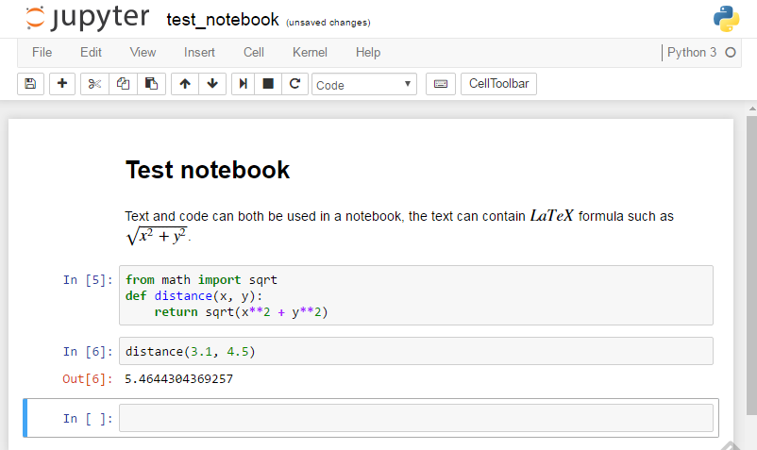
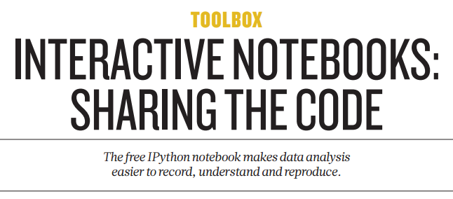
Jupyter notebooks

Slide 93
Jupyter use cases
Excellent for
Explorative programming
Data exploration
Communication, especially across domains
Problems
What was (re-)executed, what not?
Version control?

Slide 94
Python help
Extensive documentation, library documentation is your friend! http://docs.python.org/3/library/
Also built-in help, another friend
>>> import sys
>>> help(sys.exit)
Help on built-in function exit in module sys:
exit(...)
exit([status])
Exit the interpreter by raising SystemExit(status).
If the status is omitted or None, it defaults to ze…

Slide 95
Writing documentation & simple testing
https://github.com/gjbex/training-material/tree/master/Python/CodeTesting

Slide 96
Writing documentation
Documentation is very important!
use DocString
def parse_line(line, sep=None): '''Split a line into its fields, convert to the appropriate types, and return as a tuple.'''
# using \r, \n should work for Windows & *nix
data = line.rstrip('\r\n').split(sep)
return (int(data[0]), int(data[1]), float(data[2]))
>>> import data_parsing >>> help(data_parsing.parse_line) Help on function parse_line in module validator:
parse_line(line)
Split a line into its fields, convert to the appropriate types, and return as a tuple

Slide 97
What to document and how?
DocString for
functions
classes
methods
modules
packages
Comments
particular code fragments you had to think about
see later

Slide 98
Assertions
Testing pre and post conditions
Programming by contract
def fac(n):
assert type(n) == int, 'argument must be integer'
assert n >= 0, 'argument must be positive'
if n == 0 or n == 1:
return n*fac(n - 1)
else:
return 1
Optional
$ python -c 'from fac import fac; print(fac(-1))'
…
assert n >= 0, 'argument must be positive'
AssertionError: argument must be positive

Slide 99
Assert use cases
For development only, not production!
Not a substitute for error handling, i.e., exception handling
Run without assertions, run optimized: -O
$ python -O -c 'from fac import fac; print(fac(-1))'
1
Useful feature, but don't abuse!

Slide 100
Testing: meeting expectations
Tests are important!
unittest: more features, more complex
doctest: simple
Run tests
def parse_line(line): '''Split a line into its fields, convert to the appropriate types, and return as a tuple. >>> parse_line('5 3 3.7') (5, 3, 3.7) ''' data = line.rstrip('\r\n').split() return (int(data[0]), int(data[1]), float(data[2]))
Statement to execute
Expected result
No output: hooray, all tests passed!
$ python -m doctest data_parsing.py
$

Slide 101
Failing tests
def parse_line(line): '''Split a line into its fields, convert to the appropriate types, and return as a tuple. >>> parse_line('5 3 3.7') (5, 3, 3.7) >>> parse_line('5 3 3') (5, 3, 3) ''' data = line.rstrip('\r\n').split() return (int(data[0]), int(data[1]), float(data[2]))
$ python -m doctest data_parsing.py
*********************************************
File "./data_parsing.py", line 9, in __main__.parse_line Failed example: parse_line('5 3 3') Expected: (5, 3, 3) Got: (5, 3, 3.0) ********************************************** 1 items had failures: 1 of 2 in __main__.parse_line ***Test Failed*** 1 failures.$

Slide 102
Object-oriented Python
https://github.com/gjbex/training-material/tree/master/Python/Fundamentals

Slide 103
Object-orientation
Python types are classes
e.g., (14).bit_length() == 4
14 is an object of class int
bit_length is object method defined in class int
Objects of simple Python types are immutable
Operations/methods instantiate new objects
You are using objects all the time!

Slide 104
Value versus object identity
Simple Python types
Value identity: (14 == 14) == True
Object identity: (14 is 14) == True
However, Python version dependent!
Other Python types, general classes
e.g., two set objects: a = {'alpha'}, b = {'alpha'}
Value identity: (a == b) == True
Object identity: (a is b) == False

Slide 105
Defining your own classes
Class definition: class Point(object): …
Objects are instances of classes
instantiated by calling constructor
have
attributes
methods
Classes have
attributes
methods

Slide 106
More to the point…
class Point(object):
def __init__(self, x, y):
self.__x = float(x)
self.__y = float(y)
@property
def x(self):
return self.__x
@property
def y(self):
return self.__y
def __str__(self):
return '({x}, {y})'.format(x=self.x, y=self.y)
constructor for Point objects
getter for object's __x attribute
getter for object's __y attribute
creates string representation for Point object

Slide 107
Making a point… or two
…
def main():
p = Point(3, 4)
q = Point(-2, 5)
print(p.x, p.y)
print(p, q)
…
create Point p at 3, 4
create Point q at -2, 5
access p's x- and y-coordinates
$ python point_driver.py
3.0 4.0
(3.0, 4.0) (-2.0, 5.0)

Slide 108
Object attributes
Make object attributes "private" by hiding them, by convention, use __ prefix self.__x = x
Create getter/setter method to control access to object attributes @property def x(self): return self.__x
Determine object's state
Object attribute can not accidently be modified, i.e., read-only

Slide 109
Object attributes: control
Getter, but no setter
…
def main():
p = Point(3, 4)
print(p.x)
p.x = 4.4
print(p.x)
…
Protects against modification of read-only attributes
$ python point_driver.py
3.0
Traceback (most recent call last):
File "<stdin>", line 1, in <module>
AttributeError: can't set attribute

Slide 110
Object attribute: setter
Implementing setters improves control, assignment to attribute is "intercepted" by setter method
class Point(object):
…
@x.setter
def x(self, value):
self.__x = float(value)
…
E.g., ensures proper type conversion: p.x = 3 results in float, not int for __x attribute

Slide 111
Non-trivial getter/setter
Derived attribute: coordinates as 2-tuple
class Point(object):
…
@property
def coords(self):
return (self.x, self.y)
@coords.setter
def coords(self, value):
self.x = value[0]
self.y = value[1]
…
# Use coords getter/setter
print(p.coords)
p.coords = (3.5, 7.1)
returns a 2-tuple
2-tuple as argument

Slide 112
More object methods I
from math import sqrt
class Point(object):
def __init__(self, x, y):
self.__x = float(x)
self.__y = float(y)
…
def distance(self, p):
return sqrt((self.x - p.x)**2 + (self.y - p.y)**2)
…
# compute distance between p and q
print(p.distance(q))
…
object method Point object as argument
distance method invoked on Point p, with Point q as argument

Slide 113
More object methods II
from math import sqrt, isclose
class Point(object):
…
def on_line(self, p, q, tol=1.0e-6):
if not isclose(p.x, q.x, abs_tol=tol):
a = (q.y - p.y)/(q.x - p.x)
b = p.y - a*p.x
return isclose(self.y, a*self.x + b, abs_tol=tol)
else:
return isclose(self.x, p.x, abs_tol=tol)
…
# check whether r is on line defined by p and q
if r.on_line(p, q):
…
Python 3.5+
on_line method invoked on Point r, with Point p and q as argument

Slide 114
Object methods
Used to
retrieve information on object
modify or manipulate object
derive information from object with respect to other objects
…
Determine what objects can do, or can be done with

Slide 115
Static methods
…
class Point(object):
…
@staticmethod
def all_on_line(p, q, *points):
for r in points:
if not r.on_line(p, q):
return False
return True
…
# check whether p, q, r, v and w are on a line
if Point.all_on_line(p, q, r, v, w):
…
all_on_line method invoked on Point class with Point p, q, r, v, w as arguments, class ignored
Notes:
What about *points?

Slide 116
Variable length argument lists
Arbitrary positional arguments: *argv
Arbitrary keyword arguments: **argv
Available as dictionary
@staticmethod
def all_on_line(p, q, *points):
for r in points:
if not r.on_line(p, q):
return False
return True
arguments
available as tuple
Note: not specific to object oriented programming

Slide 117
More elegant solution
Semantics: True if True for all elements in points
More elegant: all(…)
Similar: any(…)
@staticmethod
def all_on_line(p, q, *points):
for r in points:
if not r.on_line(p, q):
return False
return True
@staticmethod
def all_on_line(p, q, *points):
return all(r.on_line(p, q) for r in points)

Slide 118
Quick interlude
What attributes/methods does a class have?
>>> from point import Point
>>> p = Point(3.7, 5.1)
>>> dir(p) ['__class__', '__delattr__', '__dict__', '__doc__', '__format__', '__getattribute__', '__hash__', '__init__', '__module__', '__new__', '__reduce__', '__reduce_ex__', '__repr__', '__setattr__', '__sizeof__', '__str__', '__subclasshook__', '__weakref__', '__x', '__y', 'all_on_line', 'cords', 'distance', 'on_line', 'x', 'y']

Slide 119
Inheritance
Class can extend other class
Make classes inherit from object, ensure they can be extended later: class Point(object):
New class inherits attributes & methods from parent class
New class can implement new methods, define new attributes
New method can override methods of parent class
New class can inherit from multiple parent classes

Slide 120
Points with mass
class PointMass(Point):
def __init__(self, x, y, mass):
super().__init__(x, y)
self.__mass = float(mass)
@property
def mass(self):
return self.__mass
def __str__(self):
return '{0}: {1}'.format( super().__str__(), self.mass)
constructor of Point overridden
new object method
str method of Point overridden
PointMass objects have x, y, distance, on_line methods as well
PointMass class has all_on_line methods

Slide 121
Base classes & derivation
create Point is base class for PointMass
class PointMass(Point):
def __init__(self, x, y, mass):
super().__init__(x, y)
self.__mass = float(mass)
first call Point's __init__ method
do PointMass-specific initialization

Slide 122
Point with mass is still Point
create PointMass p at 3, 4 and mass 1
def main():
p = PointMass(3, 4, 1)
q = Point(-2, 5)
print(p.x, p.y, p.mass)
print(p.distance(q))
create Point q at -2, 5
p is a Point, so has distance method
$ python point_driver.py
3.0 4.0 1.0
5.09902

Slide 123
Class attributes
class PointMass(Point):
__default_mass = 1.0
def __init__(self, x, y, mass=None):
super().__init__(x, y)
if mass:
self.__mass = float(mass)
else: self.__mass = PointMass.__default_mass
…
@classmethod
def set_default_mass(cls, mass):
cls.__default_mass = float(mass)
class variable __default_mass
setter for class' __defaut_mass attribute
Determine state of class

Slide 124
All those methods
Object methods
work on individual objects
take object as first argument (self)
Class methods
@classmethod
work at class level
take class as first argument (cls)
@staticmethod
work at class level
ignores object or class it is called on

Slide 125
Files: I/O and data formats
https://github.com/gjbex/training-material/tree/master/Python/DataFormats
https://github.com/gjbex/training-material/tree/master/Python/XmlGenerator

Slide 126
Reading from files
Reading from text files, line by line
E.g., read file line by line, convert to uppercase, and print
Reading from a binary file, value by value
E.g., read doubles (8 bytes) and print
1 with open(file_name, 'r') as text_file:
2 for line in text_file:
3 print(line.upper())
with …: context manager
Not portable!!!: data type size? Encoding? little /big endian?
1 from struct import unpack
2 with open(file_name, 'rb') as bin_file:
3 double_bytes = bin_file.read(8)
4 while double_bytes:
5 print(unpack('d', double_bytes)[0])
6 double_bytes = bin_file.read(8)

Slide 127
Libraries & data formats
Standard library (Python 3.x)
Comma separated value files: csv
Configuration files: ConfigParser
Semi-structured data: json, htmllib, sgmllib, xml
Non-standard libraries
Images: scikit-image
HDF5: pytables
pandas
Bioinformatics: Biopython
Use the "batteries" that are included!

Slide 128
Data formats: CSV
Let Sniffer figure out CSV dialect (e.g., Excel)
0 from csv import Sniffer, DictReader
1 with open(file_name, 'rb') as csv_file:
2 dialect = Sniffer().sniff(csv_file.read(1024))
3 csv_file.seek(0)
4 sum = 0.0
5 csv_reader = DictReader(csv_file, fieldnames=None,
6 restkey='rest', restval=None,
7 dialect=dialect)
8 for row in csv_reader:
9 print('{name} --- {weight}'.format(name=row['name'],
10 weight=row['weight']))
11 sum += float(row['weight'])
12 print('sum = {0}'.format(sum))
DictReader uses first row to deduce field names
Access fields by name, thanks to DictReader
Drawback: you still need to know field types

Slide 129
Writing to files
Writing to text files
E.g., compute squares and write to file
Append to text files
E.g., add some more squares to same file
Writing binary files: don't go there
1 with open(file_name, 'w') as text_file:
2 for i in range(0, 10):
text_file.write('{0}: {1}\n'.format(i, i*i))
1 with open(file_name, 'a') as text_file:
2 for i in range(10, 20):
text_file.write('{0}: {1}\n'.format(i, i*i))

Slide 130
Data formats: XML output
<?xml version="1.0" ?>
<blocks>
<block name="block_01">
<item>
0.1
</item>
<item>
1.1
</item>
</block>
<block name="block_02">
<item>
0.2
</item>
<item>
1.2
</item>
</block>
</blocks>

Slide 131
Data formats: creating XML
1 from xml.dom.minidom import Document
2 nr_blocks = 2 3 nr_items = 2
4 doc = Document()
5 blocks = doc.createElement('blocks')
6 doc.appendChild(blocks)
7 for block_nr in range(1, nr_blocks + 1):
8 block = doc.createElement('block')
9 block_name = 'block_{0:02d}'.format(block_nr)
10 block.setAttribute('name', block_name)
11 blocks.appendChild(block)
12 for item_nr in range(0, nr_items):
13 item = doc.createElement('item')
14 text = '{0}.{1}'.format(item_nr, block_nr)
15 text_node = doc.createTextNode(text)
16 item.appendChild(text_node)
17 block.appendChild(item)
18 print(doc.toprettyxml(indent=' '))

Slide 132
Errors: dealing with exceptions
https://github.com/gjbex/training-material/tree/master/Python/CodeTesting

Slide 133
Errors
…
def main():
file_name = sys.argv[1]
with open(file_name) as in_file:
for line in in_file:
print('|{0}|'.format(line.rstrip('\r\n')))
return 0
…
$ python quote.py
Traceback (most recent call last):
File "./quote.0.py", line 13, in <module>
status = main()
File "./quote.py", line 6, in main
file_name = sys.argv[1]
IndexError: list index out of range
exception thrown
Either check length of sys.argv, or deal with error!

Slide 134
Playing catch
…
def main():
try:
file_name = sys.argv[1]
except IndexError as e:
sys.stderr.write('### error: no input file\n')
return 1
with open(file_name) as in_file:
for line in in_file:
print('|{0}|'.format(line.rstrip('\r\n')))
return 0
…
$ python quote.py ### error: no input file

Slide 135
More trouble
$ python quote.py bla
Traceback (most recent call last):
File "./quote.py", line 17, in <module>
status = main()
File "./quote.py", line 11, in main
with open(file_name) as in_file:
IOError: [Errno 2] No such file or directory: 'bla'
exception thrown

Slide 136
Catching more
…
def main():
try:
file_name = sys.argv[1]
in_file = open(file_name)
with in_file:
for line in in_file:
print('|{0}|'.format(line.rstrip('\r\n')))
except IndexError as e:
sys.stderr.write('### error: no input file\n')
return 1
except IOError as e:
msg = "### I/O error on '{0}': {1}".format(e.filename, e.strerror)
sys.stderr.write(msg)
return 2
return 0
…

Slide 137
All handled!
Now all exceptions are handled
Note that code size increased from 5 to 16 lines
Handling errors takes effort
Worthwhile if others are using your software!
One can create own exceptions, derive class from Exception
$ python quote.py bla
### I/O error on 'bla': No such file or directory

Slide 138
Unit testing
https://github.com/gjbex/training-material/tree/master/Python/Unittest
https://github.com/gjbex/training-material/tree/master/Python/PyParsing

Slide 139
Unit testing
Key concepts
Implementation tested through API
Testing should be easy
Tests are independent of one another
Find problems early/fast
Facilitates change
Make small change, run tests
TDD: Test Driven Development
Write tests first, then implement
Programming framework, e.g., Python's unittest

Slide 140
Test case
Subclass of unittest.TestCase
Methods test_<name> are tests
unittest provides driver for running tests
import unittest
from func_lib import fib
class FibTest(unittest.TestCase):
def test_fib4(self):
'''test for fib(4)'''
self.assertEqual(3, fib(4))
if __name__ == '__main__':
unittest.main()
Test case
Individual test
Result to test
Expected result
Test driver
fib_test.py

Slide 141
Running tests
Run Python script
$ python ./fib_test.py
F
================================================
FAIL: test_fib4 (__main__.FibTest)
test a number computations for small arguments
------------------------------------------------
Traceback (most recent call last):
File "./fibber.py", line 13, in test_fib4
self.assertEqual(expected, fib(4))
AssertionError: 3 != 5
------------------------------------------------
Ran 1 test in 0.001s
FAILED (failures=1)

Slide 142
Assert methods
Many methods: provide accurate feedback
assertEqual for int, str
assertAlmostEqual for float, complex
assertTrue, assertFalse for bool
assertListEqual, assertSetEqual, assertDictEqual, assertTupleEqual
assertIn
assertIsNone
assertIsInstance
assertRegex
+ negations, e.g.,
assertNotEqual, …

Slide 143
Checking for expected failure
Exceptions
Also useful: assertRaisesRegex
Warnings: assertWarns
from func_lib import fib, InvalidArgumentException
…
def test_negative_values(self):
'''test for call with negative argument'''
with self.assertRaises(InvalidArgumentException):
fib(-1)
…

Slide 144
Subtests
To check for a series of values
…
def test_low_values(self):
'''test a number computations for small arguments'''
expected = [0, 1, 1, 2, 3, 5, 8, 13]
for n in range(len(expected)):
with self.subTest(i=n):
self.assertEqual(expected[n], fib(n))
…

Slide 145
Fixtures
Prepare for test(s), clean up after test(s), e.g.,
Open/close a file
Open/close a database connection, initialize a cursor
Initialize data structures/objects
Three levels
Before/after any test in module is run
setUpModule()/tearDownModule()
Before/after any test in test case class is run
setUpClass(cls)/tearDownClass(cls) (mark as @classmethod)
Before/after each individual test
setUp(self)/tearDown(self)

Slide 146
Module-level
setUpModule: create and fill database
tearDownModule: remove database
import init_db
…
def setUpModule():
'''create and fill the database'''
conn = sqlite3.connect(master_name)
init_db.execute_file(conn, 'create_db.sql')
init_db.execute_file(conn, 'fill_db.sql')
def tearDownModule():
'''remove database file once testing is done'''
os.remove(master_name)

Slide 147
Test case-level
setUpClass: create copy of database
tearDownClass: remove copy of database
test_name = 'test.db'
@classmethod
def setUpClass(cls):
'''copy original database'''
shutil.copyfile(master_name, cls.test_name)
Test cases must
be independent!
@classmethod
def tearDownClass(cls):
'''remove test database'''
os.remove(cls.test_name)

Slide 148
Test-level
setUp: create connection & cursor
tearDown: close connection
def setUp(self):
'''open connection, create cursor'''
self._conn = sqlite3.connect(self.__class__.test_name)
self._conn.row_factory = sqlite3.Row
self._cursor = self._conn.cursor()
Tests must be independent!
def tearDown(self):
'''close database connection'''
self._conn.close()

Slide 149
Flow for fixtures
Create projects.db
setUpModule for tests
setUpClass for ContentsTest
setUp for test_num_projects
test_num_projects
tearDown for test_num_projects
setUp for test_num_researchers
test_num_researchers
tearDown for test_num_researchers
…
tearDownClass for ContentsTest
setUpClass for ConstraintsTest
setUp for test_project_name_uniqueness
test_project_name_uniqueness
tearDown for test_project_name_uniqueness
…
tearDownClass for ConstraintsTest
tearDownModule for tests
Copy projects.db to test.db
Connect to database
Run test
Disconnect from database
Remove test.db
Remove projects.db

Slide 150
Running all tests
In module
In all modules
…
if __name__ == '__main__':
unittest.main()
fib_test.py
$ python ./fib_test.py
$ python -m unittest discover -p '*_test.py'

Slide 151
Further reading
B. Kernighan & R. Pike (1999) The practice of programming, Addison-Wesley
M. Fowler (1999) Refactoring: improving the design of existing code, Addison-Wesley

Slide 152
Icing on application: Python's argparse, ConfigParser
https://github.com/gjbex/training-material/tree/master/Python/ArgParse
https://github.com/gjbex/training-material/tree/master/Python/ConfigParser

Slide 153
Handling command line arguments
Many tools start out as short script, evolve into applications used by many
Model after Unix tools
Arguments
Flags
Options
Python's argparse benefits
Easy to use
Self-documenting

Slide 154
Defining command line arguments
Use argparse library module
Add positional argument(s)
Add flag(s)
Add option(s)
Parse arguments
from argparse import ArgumentParser
arg_parser = ArgumentParser(description='Gaussian random number generator')
arg_parser.add_argument('nr', metavar='n', type=int, nargs='?', default=1,
help='number of random numbers to generate')
arg_parser.add_argument('-idx', action='store_true', dest='index',
help='print index for random number')
arg_parser.add_argument('-mu', type=float, default=0.0,
help='mean of distribution')
dest='mu' is implicit
args = arg_parser.parse_args()

Slide 155
Using command line arguments
for i in range(args.nr):
if args.index:
prefix = '{0}\t'.format(i + 1)
else:
prefix = ''
print('{0}{1}'.format(prefix, random.gauss(args.mu, args.sigma)))
$ ./generate_gaussians –h
usage: generate_gaussians.py [-h] [-mu MU] [-sigma SIGMA] [-idx] [n]
Gaussian random number generator
positional arguments:
n number of random numbers to generate
optional arguments:
-h, --help show this help message and exit
-mu MU mean of distribution
-sigma SIGMA stddev of distribution
-idx print index for random number
Autogenerated help message
$ ./generate_gaussians –idx 3.0
usage: generate_gaussians.py [-h] [-mu MU] [-sigma SIGMA] [-idx] [n]
generate_gaussians.py: error: argument n: invalid int value: '3.0'

Slide 156
ConfigParser configuration files
Configuration files
save typing of options
Document runs of applications
Easy to use from Python: configparser module
Configuration file (e.g., 'test.conf')
[physics]
# this section lists the physical quantities of interest
T = 273.15
N = 1
[meta-info]
# this section provides some meta-information
author = gjb
version = 1.2.17
section physics
section meta-info
Note: at least one section
key = value
comments

Slide 157
Reading & using configurations
Reading configuration file
Using configuration values
from configparser import ConfigParser
cfg = ConfigParser()
cfg.read('test.conf')
temperature = cfg.getfloat('physics', 'T')
number_of_runs = cfg.getint('physics', 'N')
version_str = cfg.get('meta-info', 'version')
if cfg.has_option('physics', 'g'):
acceleration = cfg.getfloat('physics', 'g')
else:
acceleration = 9.81

Slide 158
Further reading: argparse
Argparse tutorial https://docs.python.org/3.5/howto/argparse.html

Slide 159
Debugging Python

Slide 160
Errors & warnings: pylint, flake8
Static cod analysis, errors, warnings, code quality suggestions
flake8 can be invoked from vim, as git hook
$ pylint add.py
************* Module add
C: 1, 0: Missing module docstring (missing-docstring)
E: 4,10: Undefined variable 'x' (undefined-variable)
Report
======
3 statements analysed.
…
#!/usr/bin/env python
if __name__ == '__main__':
print(x + 3)

Slide 161
Use debugger
Bugs are ubiquitous…
Debugging by print?
easy to do
takes a long time for complex situations
unstructured process
pollutes code
Use debugger (pdb for Python): it can
step through code, statement by statement
inspect variable values
…

Slide 162
Okay, what's this?!?
def main():
n = int(sys.argv[1])
matrix = [[0] * n] * n
for i in range(n):
for j in range(n):
matrix[i][j] = i*n + j + 1
print('\n'.join([' '.join(['{:2d}'.format(e) for e in row]) for row in matrix]))
return 0
In your dreams!
$ python buggy.py 5
1 2 3 4 5
6 7 8 9 10
11 12 13 14 15
16 17 18 19 20
21 22 23 24 25
$ python buggy.py 5
21 22 23 24 25
21 22 23 24 25
21 22 23 24 25
21 22 23 24 25
21 22 23 24 25

Slide 163
Starting & viewing source
Starting the debugger
Listing source code: l [<line-nr>] (list)
$ pdb buggy.py 5
> ./buggy.py(3)<module>()
-> import sys
(Pdb)
Statement about to be executed
debugger prompt
(Pdb) l
1 #!/usr/bin/env python
2
3 -> import sys
4
5 def main():
6 n = int(sys.argv[1])

Slide 164
Stepping
Execute statement: n (next)
Step into function: s (step)
(Pdb) n
> ./buggy.py(5)<module>()
-> def main():
(Pdb)
> ./buggy.py(14)<module>()
-> if __name__ == '__main__':
(Pdb)
> ./buggy.py(15)<module>()
-> status = main()
r (return): run until current function returns
(Pdb) s
> ./buggy.py(5)<module>()
-> def main():

Slide 165
Printing values: variables
Print variable values: p <var> (print)
(Pdb) n
> ./buggy.py(6)main()
-> n = int(sys.argv[1])
(Pdb)
> ./buggy.py(7)main()
-> matrix = [[0] * n] * n
(Pdb) p n
5
(Pdb) n
-> for i in range(n):
(Pdb) p matrix
[[0, 0, 0, 0, 0], [0, 0, 0, 0, 0], [0, 0, 0, 0, 0], [0, 0, 0, 0, 0], [0, 0, 0, 0, 0]]

Slide 166
Using external functions
Create a module print_matrix.py
Import function from module into debugger and use it
def print_matrix(matrix):
print('\n'.join([' '.join(['{:2d}'.format(e) for e in row]) for row in matrix]))
(Pdb) from print_matrix import print_matrix
(Pdb) print_matrix(matrix)
0 0 0 0 0
0 0 0 0 0
0 0 0 0 0
0 0 0 0 0
0 0 0 0 0

Slide 167
And now it gets weird…
Execute some iterations and print matrix
(Pdb) n
> ./buggy.py(9)main()
-> for j in range(n):
(Pdb)
> ./buggy.py(10)main()
-> matrix[i][j] = i*n + j + 1
(Pdb) p i, j
(0, 0)
(Pdb) n
(Pdb) print_matrix(matrix)
1 0 0 0 0
1 0 0 0 0
1 0 0 0 0
1 0 0 0 0
1 0 0 0 0

Slide 168
Alternative: watch for change
display <expr> shows changes on halt
(Pdb) display matrix[-1][0]
display matrix[-1][0]: 0
(Pdb) c
> ./buggy.py(15)init_matrix()
-> matrix[i][j] = i*n + j + 1
(Pdb) c
> ./buggy.py(15)init_matrix()
-> matrix[i][j] = i*n + j + 1
display matrix[-1][0]: 1 [old: 0]
-> matrix[i][j] = i*n + j + 1
(Pdb) p i, j
(0, 1)
(Pdb) print_matrix(matrix)
1 0 0 0 0
…
1 0 0 0 0
Python 3.2+!

Slide 169
Let's see…
It seems that all the rows are the same thing…
Can we fix this, let's restart using restart <argv> and break after matrix initialization using b <line-nr> (break)
(Pdb) matrix[0] is matrix[1]
True
Oops!?!
(Pdb) restart 5
Restarting buggy.py with arguments:
5
> ./buggy.py(3)<module>()
-> import sys
(Pdb) b 8
Breakpoint 1 at ./buggy.py:8

Slide 170
Try a fix
Continue up to the first breakpoint: c (continue)
Reinitialize matrix and check
(Pdb) c
> ./buggy.py(8)main()
-> for i in range(n):
(Pdb) matrix = [[0] * 5 for _ in range(5)]
(Pdb) matrix[0] is matrix[1]
False
Looks good!

Slide 171
Let's check
Only break in loop, when two rows updated: b <line-nr>, <cond> (conditional breakpoint), continue and check
(Pdb) b 10, i == 2
Breakpoint 2 at ./buggy.py:10
(Pdb) c
> ./buggy.py(8)main()
-> for i in range(n):
(Pdb) print_matrix(matrix)
1 2 3 4 5
6 7 8 9 10
0 0 0 0 0
0 0 0 0 0
0 0 0 0 0
Note: we never left debugger!
Looks good!

Slide 172
Managing breakpoints
List breakpoints: b
Ignore breakpoint <n> times: ignore <bp-nr> <n>
Disable breakpoint: disable <bp-nr>
Re-enable breakpoint: enable <bp-nr>
Delete breakpoint: cl <bp-nr> (clear)
Associate debug commands with breakpoint: commands <bp-nr> …
(Pdb) b
Num Type Disp Enb Where
1 breakpoint keep yes at ./buggy.py:8
breakpoint already hit 2 times
3 breakpoint keep yes at ./buggy.py:10
stop only if i == 2
breakpoint already hit 4 times
breakpoint
numbers

Slide 173
In practice
In fact, print_matrix() was not necessary, print data structures with pp (pretty print)
Run until a line number: until <line-nr>
often more convenient than breakpoint
(Pdb) pp matrix
[[1, 0, 0, 0, 0],
[1, 0, 0, 0, 0],
[1, 0, 0, 0, 0],
[1, 0, 0, 0, 0],
[1, 0, 0, 0, 0]]

Slide 174
Last, but not least: call traces
View call stack: bt (back trace)
Moving up or down in stack: up/down
helps to look at context of function call
Very useful workflow: run till crash, do bt, look around, move up,…
(Pdb) bt
/usr/lib/python3.4.3/bdb.py(387)run()
-> exec cmd in globals, locals
<string>(1)<module>()
./buggy.py(15)<module>()
-> status = main()
> ./buggy.py(10)main()
-> matrix[i][j] = i*n + j + 1
calling context
current function
current statement

Slide 175
In closing…
Leave the debugger: q (quit)
Debugger is very useful
Concepts are universal
gdb for C/C++/Fortran
Eclipse debugger for Java/C/C++/Fortran
Allinea DDT parallel debugger for C/C++/Fortran
Worth to invest time to learn to use it

Slide 176
Fixed program
def main():
n = int(sys.argv[1])
matrix = [[0] * n for _ in range(n)]
for i in range(n):
for j in range(n):
matrix[i][j] = i*n + j + 1
print('\n'.join([' '.join(['{:2d}'.format(e) for e in row]) for row in matrix]))
return 0

Slide 177
Further reading
B. Kernighan & R. Pike (1999) The practice of programming, Addison-Wesley

Slide 178
Profiling

Slide 179

If you don't profile…

Slide 180
Profiling approaches
Microbenchmarking, i.e., timing functions
Easy
Can lead to premature optimization = waste of time
Profiling with profiling tool
Slightly more complicated
Identifies true bottlenecks
Both are useful, when used appropriately

Slide 181
Timing functions
ipython: use magic %time or %timeit
Command line: use timeit module
In [1]: from primes import primes
In [2]: %timeit result = primes(1000)
10 loops, best of 3: 172 ms per loop
multiple runs
timing result
module to use
statements to execute, string per line
$ python -m timeit 'from primes import primes' 'primes(1000)'
10 loops, best of 3: 174 msec per loop
Don't forget indentation!

Slide 182
Profiler
Use the cProfile module
module to use
sort order
$ python -m cProfile -s time primes.py 1000
2914 function calls (2878 primitive calls) in 0.261 seconds
Ordered by: internal time
ncalls tottime percall cumtime percall filename:lineno(function)
1 0.250 0.250 0.251 0.251 primes.py:6(primes)
1 0.002 0.002 0.002 0.002 {built-in method loads}
1194 0.001 0.000 0.001 0.000 {'append' of 'list'}
43 0.001 0.000 0.001 0.000 {'join' of 'str'}

Slide 183
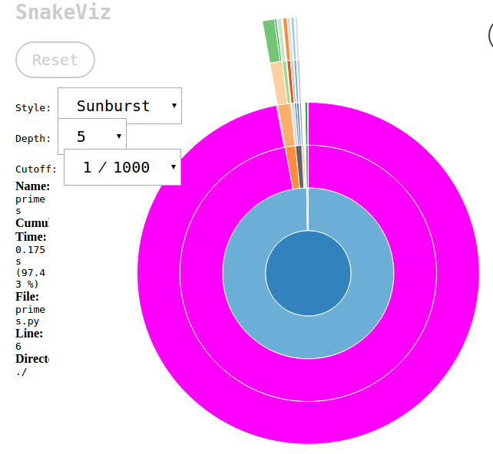
Visual profiles: snakeviz
Use the cProfile module
module to use
sort order
output file
$ python -m cProfile -s time -o primes.prof \ primes.py 1000
$ snakeviz primes.prof

Slide 184
line_profiler
line by line
show profile on screen
decorate function to profile
$ kernprof -l -v primes.py 1000
imer unit: 1e-06 s
Total time: 1.01724 s
File: /home/gjb/Documents/Projects/training-material/Python/Profiling/primes.py
Function: primes at line 4
Line # Hits Time Per Hit % Time Line Contents
==============================================================
4 @profile
5 def primes(kmax):
6 1 2 2.0 0.0 max_size = 1000000
7 1 72903 72903.0 7.2 p = array('i', [0]*max_size)
8 1 4 4.0 0.0 result = []
9 1 2 2.0 0.0 if kmax > max_size:
10 kmax = max_size
11 1 1 1.0 0.0 k = 0
12 1 0 0.0 0.0 n = a2

Slide 185
Logging
https://github.com/gjbex/training-material/tree/master/Python/Logging

Slide 186
Logging: motivation
Useful to verify what an application does
in normal runs
in runs with problems
Helps with debugging
alternative to print statements
Various levels can be turned on or off
see only relevant output
Good practice

Slide 187
Initialize & configure logging
import logging
…
logging.basicConfig(level=level, filename=name, filemode=mode, format=format_str)
…
level: minimal level written to log
filemode
'w': overwrite if log exists
'a': append if log exists
format, e.g., '{asctime}:{levelname:{message}'

Slide 188
Log levels
CRITICAL: non-recoverable errors
ERROR: error, but application can continue
WARNING: potential problems
INFO: feedback, verbose mode
DEBUG: useful for developer
User defined

Slide 189
Selecting log level
CRITICAL
ERROR
WARNING
INFO
DEBUG
level = logging.ERROR
level = logging.INFO

Slide 190
Log messages
Log to DEBUG level
Log to INFO level
Log to CRITICAL level
logging.debug('function xyz called with "{0}"'.format(x))
ignored at level INFO or above
logging.info('application started')
ignored at level WARNING or above
logging.critical('input file not found')

Slide 191
Logging destinations
File
Rotating files
syslog
…

Slide 192
Further reading: logging
Logging how-to https://docs.python.org/3.5/howto/logging.html
Logging Cookbook https://docs.python.org/3.5/howto/logging-cookbook.html

Slide 193
File system operations: Handling files and directories
https://github.com/gjbex/training-material/tree/master/Python/OsFileSystem

Slide 194
Working with files in directories
Directory contains files data_001.txt, data_002.txt,…
data_all.txt
case dim temp
1 1 -0.5
2 1 0.0
3 1 0.5
4 2 -0.5
5 2 0.0
6 2 0.5
7 3 -0.5
8 3 0.0
9 3 0.5
10 4 -0.5
11 4 0.0
12 4 0.5
…
data_001.txt
data_002.txt
case dim temp
1 1 -0.5
2 1 0.0
3 1 0.5
4 2 -0.5
5 2 0.0
6 2 0.5
case dim temp
7 3 -0.5
8 3 0.0
9 3 0.5
10 4 -0.5
11 4 0.0
12 4 0.5
…

Slide 195
Using glob
from argparse import ArgumentParser, FileType from glob import glob
…
def main(): arg_parser = ArgumentParser(description='…') arg_parser.add_argument('-o', dest='output_file', type=FileType('w'), help='…') arg_parser.add_argument('-p', dest='pattern', help='…') options = arg_parser.parse_args() is_header_printed = False for file_name in glob(options.pattern): with open(file_name, 'r') as input_file: header = input_file.readline() if not is_header_printed: options.output_file.write(header) is_header_printed = True for line in input_file: if line.strip(): options.output_file.write(line) return 0
Same as in Bash shell
$ python concat_data.py –o data.txt –p 'data_*.txt'

Slide 196
Path operations
Many operations in os package
Current working directory: os.getcwd()
Create path: path = os.path.join(os.getcwd(), 'data', 'output.txt') path == '/home/gjb/Tests/data/output.txt'
Dissecting paths:
head, tail = os.path.split('/home/gjb/Tests/test.txt') head == '/home/gjb/Tests', tail == 'test.txt'
head, tail = os.path.split('/home/gjb/Tests/') head == '/home/gjb/Tests', tail == ''
root, ext = os.path.splitext ('/home/gjb/Tests/test.txt') root == '/home/gjb/Tests/test', ext == '.txt'
root, ext = os.path.splitext ('/home/gjb/Tests/') root == '/home/gjb/Tests/', ext == ''
Will do the right thing for each OS

Slide 197
File system tests
File tests:
os.path.exists(path): True if path exists
os.path.isfile(path): True if path is a file
os.path.isdir(path): True if path is a directory
os.path.islink(path): True if path is a link
os.access(path, os.R_OK): True if path can be read
os.R_OK: read permission
os.W_OK: write permission
os.X_OK: execute permission

Slide 198
Copying, moving, deleting
Functions in os and shutil modules
copy file: shutil.copy(source, dest)
copy file, preserving ownership, timestamps: shutil.copy2(source, dest)
move file: shutil.move(source, dest)
delete file: os.remove(file)
remove directory: shutil.rmtree(directory)
create directory: os.mkdir(directory)

Slide 199
Temporary files
Standard library tempfile package
Creating file with guaranteed unique name: tempfile.NamedTemporaryFile(…)
import tempfile
…
tmp_file = tempfile.NamedTemporaryFile(mode='w', dir='.',
suffix='.txt', delete=False)
print("created temp file '{0}'".format(tmp_file.name))
with tmp_file.file as tmp:
…
tmp.write(…)
…
File names such as tmpD45x.txt

Slide 200
Walking the tree
Walking a directory tree: os.walk(…), e.g., print name of Python files in (sub)directories
For each directory, tuple:
directory name
list of subdirectories
list of files in directory
import os
…
for directory, _, file_names in os.walk(dir_name):
for file_name in file_names:
_, ext = os.path.splitext(file_name)
if ext == target_ext:
print(os.path.join(directory, file_name))
…

Slide 201
Manipulating strings: Python regular expressions
https://github.com/gjbex/training-material/tree/master/Python/Regexes

Slide 202
Regular expressions: definition
Regular expression = description of a language ≡ set of strings
Language can be
Finite
Infinite
Remember, set of all strings is infinite, countable
Chomsky hierarchy
regular languages ⊂ context-free languages ⊂ context-sensitive languages ⊂ recursively enumerable languages
Python regular expressions can express more than regular languages

Slide 203
Regular expressions: expressive power
Never parse HTML or XML with regular expressions!!!
HTML & XML are context-free languages
Even if you think you can, don't, there be dragons
Can you write a regular expression to match all regular expressions?
No: the language of regular expressions is context-free
Can you parse English using a regular expression
No: English is a little bit context-sensitive

Slide 204
Regular expressions: examples I
DNA: [ACGT]+
[ACGT] = one out of {A, C, G, T}
expr+ = one or more repetitions of expr
DNA containing AAT: [ACGT]*AAT[ACGT]*
expr₁ expr₂ = expr₁ followed by expr₂
expr* = zero or more repetitions of expr
DNA containing AAT or TAT: [ACGT]*(AAT|TAT)[ACGT]*
expr₁ | expr₂ = either expr₁, or expr₂

Slide 205
Regular expressions: examples II
Belgian phone number: 0[1-9]\d?/[1-9]\d{5,6}
[c₁-c₂] = any character from c₁ to c₂
\d = [0-9]
expr? = zero or one occurrence of expr
expr{m,n} = m to n repetitions of expr
All strings, including empty string: .*
. = any character
Email address: \w+(?:\.\w+)?@\w+(?:\.\w+)+
\. = character '.'
\w = [A-Za-z0-9_]
(?: expr) = grouped expr
Don't use this in
practice!!!
Similar to brackets in math expressions

Slide 206
Regular expressions: characters
Characters that have to be escaped
tab : \t
new line : \n
carriage return : \r
\ : \\
brackets : \(, \), \[, \], \{, \}
operators : \+, \-, \*, \?
. (dot) : \.
All other characters literal

Slide 207
Regular expressions: character classes
x = {'x'}
[xyz] = {'x', 'y', 'z'}
[x-z] = {c | 'x' ≤ c ≤ 'z'}
[^xyz] = {any} \ {'x', 'y', 'z'}
\w = {'A',…,'Z', 'a',…,'z', '0',…,'9', '_'}
\W = {any} \ {'A',…,'Z', 'a',…,'z', '0',…,'9', '_'}
\d = {'0',…,'9'}
\D = {any} \ {'0',…,'9'}
\s = {' ', '\t', '\f', '\r', '\n', '\v'} (white space)
\S = {any} \ {' ', '\t', '\f', '\r', '\n', '\v'}
. = {any} \ {'\n'}

Slide 208
Regular expressions: operators
Concatenation: expr₁ expr₂ (implicit)
Choice: expr₁ | expr₂ = either expr₁, or expr₂
Repetition:
expr{n} = exactly n repetitions of expr
expr{m,n} = minimum m, maximum n repetitions of expr where m ≤ n
expr{,n} = minimum zero, maximum n repetitions of expr
expr{m,} = minimum m repetitions of expr
expr? = zero or one occurrence of expr
expr* = zero or more repetitions of expr
expr+ = one or more repetitions of expr
Longest match semantics

Slide 209
Greedy vs. non-greedy operators
Consider string '<var name="x">15</var>'
<.+> will match substring '<var name="x">15</var>'
Use non-greedy operator
<.+?> will match substring '<var name="x">'
expr<op>? = operator <op> with shortest match semantics (i.e., non- greedy) applied to expr
Alternative: <[^>]+>
Longest match semantics!

Slide 210
Why not parse XML with REs?
Task: match start tag in
'<var name="x">15</var>' <.+?> will match substring '<var name="x">'
'<var name="a->b">15</var>' <.+?> will match substring '<var name="a->'
√
Oops!
Use a parser for context free language, or, better still, use Python's xml.dom, xml.sax, …

Slide 211
Regular expressions: matching
Import re module!!!
re.match(pattern, s)
Matches pattern from start of string s
Returns match object, or None if no match
re.search(pattern, s)
Matches pattern anywhere in string s
Returns match object, or None if no match
>>> print(re.match(r'<.+>', '<abc>') is not None)
True
>>> print(re.match(r'<.+>', 'data: <abc>') is not None)
False
Use raw Python strings, i.e., r'…' for regular expressions
>>> print(re.search(r'<.+>', 'data: <abc>') is not None)
True

Slide 212
Raw strings
Yet more strings: raw string, e.g., 'hello\n+world!' versus 'hello\\n+world!' versus r'hello\n+world!'
>>> print('hello\n+world!') hello +world!
>>> print('hello\\n+world!') hello\n+world!
>>> print(r'hello\n+world!') hello\n+world!
'\' is just a regular character in a raw string, very convenient for regular expressions!

Slide 213
Ignoring case
Ignoring case
E.g., match DNA, [AaCcGgTt]+:
cumbersome, error prone, hard to read!
Better: use original pattern [ACGT]+, but match while ignoring case, i.e., using re.IGNORECASE (or re.I) modifier re.match(r'[ACGT]+', s, re.IGNORECASE) or re.match(r'[ACGT]+', s, re.I)

Slide 214
More readable regular expressions
Sophisticated regular expressions are hard to read r'0[1-9]\d?/[1-9]\d{5,6}'
Reformat as r'''0 # area codes always # start with 0 [1-9]\d? # area codes: 1-2 # digits / # separator [1-9]\d{5,6} # 6 or 7 digits for # number'''
Use re.VERBOSE (or re.X) modifier

Slide 215
Regular expression performance
Regular expression may be evaluatedmany times
Don't use for line in sys.stdin: if re.match(r'0[1-9]\d?/[1-9]\d{5,6}', line): …
Do use regex = re.compile(r'0[1-9]\d?/[1-9]\d{5,6}') for line in sys.stdin: if regex.match(line): …
regex is compiled regular expression object, reused many times
Substantial performance benefit!

Slide 216
Regular expressions: extracting I
Part(s) of regular expressions can be captured
Example: regular expression begin (\w+) if matched against
string 'begin data', substring 'data' is captured
String 'begin block', substring 'block' is captured
Use match object returned by re.match or re.search
group 1
group 2
>>> m = re.match(r'(begin|end) (\w+)', 'begin data')
>>> print('{1} {0}s here'.format(m.group(1), m.group(2)))
data begins here

Slide 217
Capturing vs. grouping
Don't confuse grouping and capturing
(?:…): syntactic grouping for operator priority
(…): capturing, use partial match later
Capturing instead of grouping will work, but is slower

Slide 218
Finding repetitions
Match sequences that code for leucine (codons UUA, UUG, CUA, CUC, CUG, CUU): (?:[ACGU]{3})* # any codons (?:UU[AG]|CU[ACGU]) # leucine
Match sequences that code for leucine twice with the exact same codon, at most 5 codons apart (?:[ACGU]{3})* # any codons (UU[AG]|CU[ACGU]) # first leucine (?:[ACGU]{3}){,5}? # codons \1 # second leucine
Repetition of capture 1
Note: non-greedy match operator!

Slide 219
Regular expressions: extracting II
Extract all words from a text 'This is a short text. It has words, but also punctuation, and even numbers like 12 and 7.'
Pattern for word: [A-Za-z]+
re.findall(pattern, s) returns list of all matches of pattern in s
>>> s = 'This is a short text. It has words,...'
>>> m = re.findall(r'[A-Za-z]+', s)
>>> print(m)
['This', 'is', 'a', 'short', 'text', 'It', 'has', 'words']

Slide 220
Regular expressions: extracting III
Splitting a string on a delimiter 'a ; list; of ; words '
Pattern for delimiter: \s*;\s*
re.split(pattern, s) splits string s
>>> s = 'a ; list; of ; words '
>>> parts = re.split(r'\s*;\s*', s.strip())
>>> print(parts)
['a', 'list', 'of', 'words']
or
>>> parts = map(lambda x: x.strip(), s.split(';'))
>>> print(parts)
['a', 'list', 'of', 'words']

Slide 221
Regular expressions: substitution
Values should be quoted 17,13.3,AGCGT,-1.4 '17','13.3','AGCGT','-1.4'
Pattern for values ([^,]+), replace by '\1'
re.sub(pattern, repl, s) replaces all occurrences of pattern in s by repl
Corresponds to
group(1)
>>> s = '17,13.3,AGCGT,-1.4'
>>> result = re.sub(r'([^,])', r"'\1'", s)
>>> print(result)
'17','13.3','AGCGT','-1.4'

Slide 222
Further reading: regular expressions
Regular expression how-to http://docs.python.org/2/howto/regex.html

Slide 223
Formatting data: revisiting string formatting

Slide 224
Formatting: templates
Use template strings
Template consists of text, interspersed with replacement fields 'found {word}: {count}'
Fill out the template using format(…) method
>>> tmpl = 'found {word}: {count}'
>>> print(tmpl.format(word='computer', count=15))
found computer: 15
>>> print(tmpl.format(word='human', count=0))
found human: 0

Slide 225
Formatting: format specifiers
Replacement field can contain format specifiers
Resemble C I/O format specifiers without % 'found {word:>10s}: {freq:.2f}'
alignment
width
type
precision
type
>>> data = {'computer': 0.17, 'human': 0.0084, 'alpha': 0.3}
>>> tmpl = 'found {word:>10s}: {freq:.2f}'
>>> for word in data.keys():
… print(tmpl.format(word=word, freq=data[word]))
computer: 0.17
human: 0.01
alpha: 0.30

Slide 226
Formatting: types
Types
s or none: string
c: character (converts integer to unicode)
d: integer (decimal)
b, o, x: integer (binary, octal, hexadecimal)
e, f, g, E, F, G: floating point numbers
%: percentage
Can have width
Can have precision

Slide 227
Relational databases: Python DB API & SQLAlchemy ORM
https://github.com/gjbex/training-material/tree/master/Python/DbAccess

Slide 228
Accessing relational databases
Relational databases:
great to store structured data, table-oriented
can be accessed easily via command line, programming language, GUI
can be queried using SQL
examples: MySQL, PostgreSQL, Oracle, DB2, SQLite3,…
Using DB from Python via standard interface
Support for sqlite3 built-in, ok for simple applications
For non-trivial stuff, use SQLAlchemy
Object-relational mapping (ORM)
Connectors to many RDBMS

Slide 229
SQL
Create table to store data
Store data
Query data
Modify data
CREATE TABLE IF NOT EXISTS weather (
city_name TEXT NOT NULL,
date TEXT NOT NULL,
temperature REAL NOT NULL);
INSERT INTO weather (city_name, date, emperature
VALUES ('London', '2012-03-14', 13.2);
SELECT city_name, AVG(temperature) FROM weather
WHERE date BETWEEN '2012-01-01' AND '2012-01-31' GROUP BY city_name;
UPDATE weather SET city_name = 'St. Petersburg'
WHERE city_name = 'Leningrad';

Slide 230
Python DB access: inserting data
Connect to a database & create cursor
Insert data tuples
import sqlite3
conn = sqlite3.connect('weather-db')
cursor = conn.cursor()
for data in generate_data(nr_cities, start, end):
cursor.execute('''INSERT INTO weather
(city_name, date, temperature)
VALUES (?, ?, ?)''',
data)
conn.commit()
cursor.close()
tuple

Slide 231
Python DB access: querying
Compute average temperature for period per city
conn = sqlite3.connect('weather-db')
conn.row_factory = sqlite3.Row
cursor = conn.cursor()
cursor.execute(
'''SELECT city_name, AVG(temperature) AS 'temperature'
FROM weather WHERE date BETWEEN ? AND ?
GROUP BY city_namee''',
(start, end))
for row in cursor:
print('{city}\t{tmp}'.format(city=row['city_name'],
tmp=row['temperature']))
cursor.close()

Slide 232
SQLAlchemy: ORM
Define classes/tables
from sqlalchemy import (Column, ForeignKey, UniqueConstraint,
Integer, String, DateTime, Float)
from sqlalchemy.ext.declarative import declarative_base
from sqlalchemy.orm import relationship
Base = declarative_base()
class City(Base):
__tablename__ = 'cities'
city_id = Column(Integer, primary_key=True)
name = Column(String(100), nullable=False, unique=True)
class ≡ table
object attributes
column properties
class attribute ≡ column definition

Slide 233
SQLAlchemy: relationships
Define relationship
table constraint
class Measurement(Base):
__tablename__ = 'measurements'
__table_args__ = (
UniqueConstraint('time', 'city_id'),
)
measurement_id = Column(Integer, primary_key=True)
time = Column(DateTime, nullable=False)
temperature = Column(Float, nullable=False)
city_id = Column(Integer, ForeignKey('cities.city_id'))
city = relationship(City)
column properties
relationship for ORM queries

Slide 234
SQLAlchemy: create tables
To interact, create engine
Creating tables ≡ setting metadata
from sqlalchemy import create_engine
…
engine = create_engine('sqlite:///{0}'.format(db_name))
Base.metadata.create_all(engine)
That's it!

Slide 235
SQLAlchemy: inserts
Create engine, session
Create and add objects
…
from sqlalchemy.orm import sessionmaker
…
engine = create_engine('sqlite:///{0}'.format(db_name))
Base.metadata.bind = engine
DBSession = sessionmaker(bind=engine)
db_session = DBSession()
…
…
for city_name in ['New York', 'Leningrad', 'Paris']:
city = City(name=city_name)
db_session.add(city)
db_session.commit()

Slide 236
SQLAlchemy: inserting relationships
Use objects to express relationships
…
for city in city_list:
temperature = measuree_temperature(city)
date = determine_date()
measurement = Measurement(time=date, temperature=temperature,
city=city)
db_session.add(measurement)
db_session.commit()…
use actual object

Slide 237
SQLAlchemy: queries
Queries as method calls
Natural join query
…
city_list = db_session.query(City).all()
class ≡ table
join on relationship
…
measurements = db_session.query(Measurement) \
.join('city') \
.filter(City.name == city_name,
s_date <= Measurement.time,
Measurement.time <= e_date) \
.all()
Note: class attributes!!!
SELECT * FROM … WHERE …

Slide 238
SQLAlchemy: updates
Modify object attribute(s) ≡ update
…
Leningrad = db_session.query(City) \
.filter(City.name == 'Leningrad') \
.one()
leningrad.name = 'Leningrad'
db_session.commit()
don't forget commit!

Slide 239
SQLAlchemy: just classes
Classes representing tables can have methods
class Measurement(Base):
…
def __str__(self):
fmt_str = '{city:s}: {time:s}\n\tT = {temp:.1f} C'
return fmt_str.format(city=str(self.city),
time=str(self.time),
temp=self.temperature)
…

Slide 240
Pitfalls
ORM "hides" database interaction
Easy to be inefficient
Object creation takes time
Can comsume a lot of memory
Still necessary to understand
Relational model
How RDBMS works

Slide 241
Further reading: relational databases
Introduction to relational database design http://www.ntu.edu.sg/home/ehchua/programming/sql/relational_database_design.html

Slide 242
Transforming list data: Python sorting & list comprehensions
https://github.com/gjbex/training-material/tree/master/Python/OperatorsFunctools

Slide 243
Sorting a simple list
Two ways to sort
Create new list: sorted(…)
In-place sort list.sort() method
Sorts in ascending order, add reverse=True for descending
>>> data = [3.1745, 18.14, -6.49043]
>>> sorted(data)
[-6.49043, 3.1745, 18.14]
>>> data = [3.1745, 18.14, -6.49043]
>>> data.sort()
>>> print(data)
[-6.49043, 3.1745, 18.14]

Slide 244
Sorting a complex list: key function
List of tuples, e.g., word counts
Sort by
Word:
Count:
Simpler using operator
>>> data = [('table', 15), ('chair', 5), ('bed', 19)]
>>> sorted(data, key=lambda x: x[0])
[('bed', 19), ('chair', 5), ('table', 15)]
>>> sorted(data, key=lambda x: x[1])
[('chair', 5), 'table', 15) , (('bed', 19)]
>>> from operator import itemgetter
>>> sorted(data, key=itemgetter(0))
[('bed', 19), ('chair', 5), ('table', 15)]

Slide 245
Reversing a list
Two ways to reverse
Create new list: use slices
In-place reverse list.reverse() method
>>> data = [3.5, 5.7, 7.3]
>>> data[::-1]
[7.3, 5.7, 3.5]
works for str as well!
>>> data = [3.5, 5.7, 7.3]
>>> data.reverse()
>>> data
[7.3, 5.7, 3.5]

Slide 246
Going functional: mapping
list comprehensions: construct list from elements of other list by applying function
E.g., [str(x) for x in [0.15, 3.145]] == ['0.15', '3.145']
>>> data = [3.1745, 18.14, -6.49043]
>>> print(','.join([str(number) for number in data]))
3.1745,18.14,-6.49043
>>> data = [3.1745, 18.14, -6.49043]
>>> print(','.join(map(str, data))
3.1745,18.14,-6.49043
>>> data = [3.1745, 18.14, -6.49043]
>>> print(','.join(['{0:.2f}'.format(f) for f in data]))
3.17,18.14,-6.49

Slide 247
Going functional: filtering
list comprehensions: construct list from elements of other list for elements that pass test
E.g., [x for x in [0.15, -3.45, 1.3] if x >= 0.0] ≡ [0.15, 1.3]
E.g., [sqrt(x) for x in [4.0, -4.0, 9.0] if x >= 0.0] ≡ [2.0, 3.0]
Alternative: map(sqrt, filter(lambda x: x >= 0.0, [4, -4, 9]))
iterators
Don't forget from math import sqrt

Slide 248
Going functional: aggregating
Data in a list should be aggregated, e.g.,
Summation: use sum(…)
Minimum: use min(…)
Maximum: use max(…)
More sophisticated, use reduce(…) and lambda functions
work on str have optional key argument
>>> from functools import reduce
>>> data = [3, 12, 7]
>>> reduce(lambda x, y: x*y, data, 1)
252
lambda function
list
initializer
Lambda functions: very small functions (expression) used once, not worth giving a name

Slide 249
Going functional: zip it
Two (or more) lists should be processed element wise
E.g., [x*y for x, y in zip(a, b)]
As many tuples as length of shortest list
>>> a = [3.5, 7.3, 5.7]
>>> b = [2.0, 1.5]
>>> [x*y for x, y in zip(a, b)]
[7.0, 10.95]
iterator produces tuples

Slide 250
Further reading: functional style
Sorting how-to http://docs.python.org/2/howto/sorting.html
Functional programming how-to http://docs.python.org/2/howto/functional.html

Slide 251
Facing infinity: iterators
https://github.com/gjbex/training-material/tree/master/Python/Iterators

Slide 252
Large data (structures)
Compare
for line in data_file.readlines(): …
for line in data_file: …
How to deal with arbitrary many prime numbers?
Constructs a list of all lines at once = BIG
iterator: line by line

Slide 253
Primes version 1.0: iterator
Function to check whether n is prime
Work with all primes up to 10⁶? Simple…
def is_prime(n):
for i in range(2, int(math.sqrt(n)) + 1):
if n % i == 0:
return False
return n > 1
for n in (i for i in range(1000000) if is_prime(i)):
…

Slide 254
List comprehensions vs. generators
List comprehension [i for i in range(1000000) if is_prime(i)]
all prime numbers up to 1000000 (≈ 78,500)
Generator (i for i in range(1000000) if is_prime(i))
get next prime number when needed, much more memory efficient

Slide 255
Primes version 2.0: yield
What if we want the first 10⁶ prime numbers?
Guess range?
Function that returns next prime at each call?
use yield
Iterator: first call yields 2, second 3, third 5, …
def all_primes():
i = 2
while True:
if is_prime(i):
yield i
i += 1
for n in all_primes():
…

Slide 256
yield statement
Somewhat like return
returns control to the calling function
returns a value
However, callee function state is retained
on next call, continues at the point it was when it yielded
Allows to build your own iterators

Slide 257
Primes version 3.0: itertools
Standard library package itertools provides a lot of useful iterators, check it out!
itertools.count(): iterator over integers
itertools.ifilter(<bool-func>, <iter>): new iterator from <iter> that will yield only items for which <bool-func> is True
import itertools
…
nr_primes = 0
for n in itertools.ifilter(is_prime, itertools.count()): if nr_primes > 1000000: break
nr_primes += 1
…

Slide 258
Other useful functions in itertools
Permutations of an iterable: itertools.permutations(…)
Combinations r out of an iterable:
Without replacement: itertools.combinations(…, r)
With replacement: itertools.combinations_with_replacement(…, r)
Carthesian product of two (or more) iterables: itertools.product(…, …)
Take while boolean predicate pred is true: itertools.takewhile(pred, …)
Cycle through values of iterable: itertools.cycle(…)

Slide 259
Further reading: functional style
Functional programming how-to http://docs.python.org/2/howto/functional.html

Slide 260
Data representation: Python classes case study
https://github.com/gjbex/training-material/tree/master/Python/FiniteStateParser

Slide 261
Going OO: data abstraction
begin block_1
0.322617473156
0.369558068115
0.732467264353
0.584389170786
end block_1
begin block_2
0.0705959106085
0.65856743041
0.526762713499
0.823193820644
end block_2
begin block_3
0.476180897605
0.783168943997
0.0172156882251
0.755582680088
end block_3
block
Data consists of multiple blocks
Blocks have
Name
One or more data values
How to represent?
Python class

Slide 262
Class Block: attributes
Class is abstract definition: attributes represent data
"abstract" Block has attributes
__name: string
__data: list
Block instance block1 has
'my block' as _name
No values (yet) as _data
Store some data, block1 now has two data values: 3.14 and -7.18
Create new block block2
1 class Block():
2 def __init__(self, name):
3 self.__name = name
4 self.__data = []
>>> block1 = Block('my block')
object of type Block
>>> block1.__data.append(3.14)
>>> block1.__data.append(-7.18)
>>> block2 = Block('another')
second object of type Block
Object is container for specific data: attribute values hold data

Slide 263
Class Block: methods
What do we want to do with a block?
Convert it to a string
Retrieve its name
Add data to it
Sort its data
Retrieve its data
How?
Define methods for the class Block
Class is abstract definition: methods represent actions on objects

Slide 264
Class Block: method implementations
1 class Block(object):
2 def __init__(self, name):
3 self.__name = name
4 self.__data = []
5
6 def __str__(self):
7 header = 'begin {0}'.format(self.name())
8 data = '\n\t'.join([str(item) for item in self.data()])
9 footer = 'end {0}'.format(self.name())
10 return '{0}\n\t{1}\n{2}'.format(header, data, footer)
11
12 def name(self):
13 return self.__name
14
15 def add_data(self, data):
16 self._data.append(data)
17
18 def sort_data(self):
19 self._data.sort()
20
21 def data(self):
22 return self.__data
>>> block1.add_data(12.5)
>>> print(block1.name())
my_block
>>> print(block1)
begin my_block
3.14
-7.18
12.5
end my_block

Slide 265
Parsing an (almost) regular language: finite state automata
https://github.com/gjbex/training-material/tree/master/Python/FiniteStateParser

Slide 266
Task: convert data
begin block_1
0.322617473156
0.369558068115
0.732467264353
0.584389170786
end block_1
begin block_2
0.0705959106085
0.65856743041
0.526762713499
0.823193820644
end block_2
begin block_3
0.476180897605
0.783168943997
0.0172156882251
0.755582680088
end block_3
sort!
block_1: "0.322617473156"
block_1: "0.369558068115"
block_1: "0.584389170786"
block_1: "0.732467264353"
block_2: "0.0705959106085"
block_2: "0.526762713499"
block_2: "0.65856743041"
block_2: "0.823193820644"
block_3: "0.0172156882251"
block_3: "0.476180897605"
block_3: "0.755582680088"
block_3: "0.783168943997"

Slide 267
Model the data
begin block_1
0.322617473156
0.369558068115
0.732467264353
0.584389170786
end block_1
begin block_2
0.0705959106085
0.65856743041
0.526762713499
0.823193820644
end block_2
begin block_3
0.476180897605
0.783168943997
0.0172156882251
0.755582680088
end block_3
file := block…
block := begin name
data
…
end name
name := string
data := real

Slide 268
Annotated data
text before first block
This data was produced using SomeSoftware™
begin block_1
0.322617473156
0.369558068115 # this value is suspicious
0.732467264353
0.584389170786
end block_1
There can be anything between blocks,
all kind of useful information or inane chatter.
begin block_2
0.0705959106085
# this is a comment about all values below
0.65856743041
0.526762713499
0.823193820644
end block_2
…
inline comments
blank lines
text between blocks
line comments

Slide 269
Improved model
file := junk* (block junk*)+
block := begin name comment?
(comment | empty line)*
data comment?
(comment | empty line)*
…
end name comment?
Notation: ?: zero or one *: zero or more +: one or more
|: either, or (choice)
name := string
This data was produced using SomeSoftware™
begin block_1
0.322617473156
0.369558068115 # this value is suspicious
0.732467264353
0.584389170786
end block_1
There can be anything between blocks,
all kind of useful information or inane chatter.
begin block_2
0.0705959106085
# this is a comment about all values below
0.65856743041
0.526762713499
0.823193820644
end block_2
…
data := real
comment := # string
junk := string | empty line

Slide 270
Computable model
file := junk* (block junk*)+
Finite state automaton
block := begin name comment?
(comment | empty line)*
data comment?
(comment | empty line)*
…
end name comment?
create block
comment or empty line
begin block
junk
add data to block
name := string
not in block
in block
data
data := real
comment := # string
end block
begin block or end wrong block
or
end of file
junk := string | empty line
end block
return block
error
raise error

Slide 271
Class BlockParser
class BlockParser(object):
1 def __init__(self):
2 self.__states = ['in_block', 'not_in_block', 'error']
3 self.__comment_pattern = re.compile(r'#.*')
4 self.__block_begin_pattern = re.compile(r'begin\s+(\w+)')
5 self.__block_end_pattern = re.compile(r'end\s+(\w+)')
6 self.__state = None
7 self.__current_block = None
8 self.__blocks = None
9 self.__match = None
10 self.__reset()
1 def __reset(self):
2 self.__set_state('not_in_block')
3 self.__current_block = None
4 self.__blocks = []
5 self.__match = None
Must be called before parsing a new file

Slide 272
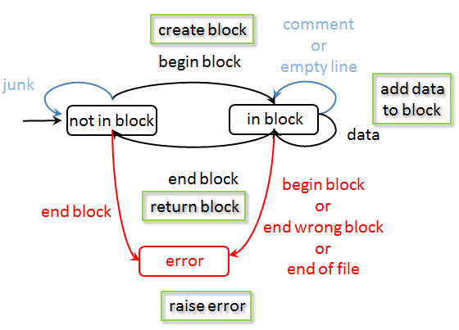
From model to code
1 for line in block_file:
2 line = self.__preprocess(line)
3 if self.__is_in_state('not_in_block'):
4 if self.__is_begin_block(line):
5 self.__init_block()
5 self.__set_state('in_block')
6 elif self.__is_end_block(line):
7 raise DanglingEndBlockError(self)
8 elif self.__is_in_state('in_block'):
9 if self.__is_begin_block(line):
10 raise NestedBlocksError(self)
11 elif self.__is_end_block(line):
12 if self.__end_matches_begin():
13 self.__finish_block()
14 self.__set_state('not_in_block')
15 else:
16 raise NonMatchingBlockDelimitersError(self)
17 elif self.__is_data(line):
18 self.__add_data(line)
19 else:
20 raise UnknownStateError(self.get_state())
21 if self.__s_in_state('in_block'):
22 raise NonClosedBlockError(self)

Slide 273
Parsing a context-free language: pyparsing
https://github.com/gjbex/training-material/tree/master/Python/PyParsing
https://github.com/gjbex/training-material/tree/master/Python/FiniteStateParser

Slide 274
Task: computing branch lengths
(
taxa1: 0.1,
(
(
taxa2: 0.2,
taxa3: 0.3
): 0.11,
taxa4: 0.4
): 0.12
);
0.1
0.12
Branch length to taxa2 = 0.43
taxa1
0.11
0.4
taxa4
0.2
0.3
taxa2
taxa3
Data is tree-structured, structure is significant
Actual data: (taxa1: 0.1, ((taxa2: 0.2, taxa3: 0.3): 0.11, taxa4: 0.4): 0.12);

Slide 275
Model Newick data: nodes
Node attributes
Branch length (0.0 for root node)
Label: taxa name (only leaf nodes)
List of children (empty for leaf nodes)
Node methods
Set/get label
Set/get branch length
Add child node
Get list of children

Slide 276
Attributes: Python decorators
class NewickNode(node.Node):
1 def __init__(self, name=None):
2 super().__init__()
3 self.__label = None
4 self.__length = None
5 self.__children = []
6 @property
7 def label(self):
8 return self.__label
9 @label.setter
10 def label(self, label):
11 self.__label = label
…
12 def add_child(self, child):
13 self.__children.append(child)
14 def children(self):
15 for child in self.__children:
16 yield child
Getter: provide read access to attribute
Setter: provide write access to attribute
Prevent accidental write to attribute, validate values,…

Slide 277
Model Newick data format
(
taxa1: 0.1,
(
(
taxa2: 0.2,
taxa3: 0.3
): 0.11,
taxa4: 0.4
): 0.12
);
tree := ( siblings ) ;
siblings := node ( , node )*
node := leaf | children
leaf := name : length
children := ( siblings ) : length
name := string
length := real
Recursion: siblings → node → children → siblings
Context-free language, not regular: use, e.g., recursive descent parser

Slide 278
pyparsing: parser generator
Advantages
Easy to use
Recursive descent parser grammars are simpler
Lexical definitions are part of grammar
Grammar are Python code
No parser generation phase
Disadvantages
Can only parse strings (files are read to string first)
Issue for large files
Recursive descent parser are slow compared to, e.g., LR parsers
Issue for large files/many files
pyparsing module must be present to use
Alternative: PLY

Slide 279
pyparsing: how to use?
Define the grammar
Expressed in Python, using pyparsing objects
Add actions to various grammar elements
Python functions taking tokens as input, returning tokens or objects (or whatever)
Call parseString(…) method on top-level grammar element
Result is (nested) list of tokens, or objects (depends on actions)

Slide 280
pyparsing: Newick grammar
1 name = Word(alphanums)
2 length = Regex(r'(\d+\.\d+)')
3 lb = Literal('(')
4 rb = Literal(')')
5 end = Literal(';')
6 sep = Literal(':')
7 leaf = name + sep + length
8 node = Forward()
9 siblings = Group(delimitedList(node, ','))
10 children = lb + siblings + rb + sep + length
node << (leaf | children)
tree = lb + siblings + rb + end
name := string
length := real
leaf := name : length
siblings := node ( , node )*
children := ( siblings ) : length
node := leaf | children
tree := ( siblings ) ;

Slide 281
pyparsing: some details
Set a name for use in action functions
1 name = Word(alphanums).setResultsName('taxa_name')
2 length = Regex(r'(\d+\.\d+)').setResultsName('length')
3 lb = Literal('(').suppress()
4 rb = Literal(')').suppress()
5 end = Literal(';').suppress()
6 sep = Literal(':').suppress()
7 leaf = name + sep + length
8 node = Forward()
9 siblings = Group(delimitedList(node, ',')).setResultsName('children')
10 children = lb + siblings + rb + sep + length
node << (leaf | children)
tree = lb + siblings + rb + end
Significant, but uninteresting
This would just produce a list of tokens, we want a tree → add actions

Slide 282
pyparsing: actions
def leaf_action(toks):
'''create a node, and add label, length'''
leaf_node = NewickNode()
leaf_node.label = toks['taxa_name']
leaf_node.length = float(toks['length'])
return leaf_node
def children_action(toks):
'''create a node, add children, length'''
parent_node = NewickNode()
if 'length' in toks.keys():
parent_node.length = float(toks['length'])
for child in toks['children']:
parent_node.add_child(child)
return parent_node
Add actions to relevant grammar elements
leaf.addParseAction(leaf_action)
children.addParseAction(children_action)
tree.addParseAction(children_action)

Slide 283
pyparsing: actual parsing
Call parseString(…) method on top-level grammar element, i.e., tree
result is list of ParseResults objects, here the root node of the tree, i.e., a NewickNode instance
Now branch lengths can be calculated by walking tree, starting from root
results = tree.parseString(str)
root = results[0]

Slide 284
Task solved
Function
Use
def compute_branch_lengths(node, branch_lengths=None, length=0.0):
if branch_lengths is None:
branch_lengths = {}
compute_branch_lengths(node, branch_lengths, length)
return branch_lengths
if node.is_leaf():
branch_lengths[node.label] = length + node.length
else:
if node.length is not None:
length += node.length
for child in node.children():
compute_branch_lengths(child, branch_lengths, length)
branch_lengths = compute_branch_lengths(root)
for taxa, length in branch_lengths.items():
print('{taxa}: {length}'.format(taxa=taxa, length=length))

Slide 285
Using shell commands: Python subprocess
https://github.com/gjbex/training-material/tree/master/Python/Subprocess

Slide 286
Counting words in a file
Using shell utilities: subprocess module
Convenient high-level API
subprocess.call(…) returns exit code of command as integer
subprocess.check_output(…) returns output of command as string
$ wc text.txt
4 12 52 text.txt
from subprocess import check_output
output = check_output(['wc', 'test.txt'])
lines, words, chars, _ = output.strip().split(' ')

Slide 287
Counting words in a string
Low-level API: input & output
$ wc -
This is a single line.
1 5 23 -
from subprocess import Popen, PIPE
text_str = 'This is a single line.\n'
cmd = Popen(['wc', '-'], stdin=PIPE, stdout=PIPE)
cmd.stdin.write(text_str)
cmd.stdin.close()
output = cmd.stdout.readline()
lines, words, chars, _ = output.strip().split(' ')
Make sure wc knows it received all data!!!
Popen(…, stdin=PIPE, stdout=PIPE) creates file objects stdin/stdout for writing/reading, analogous to pipes in Unix

Slide 288
Python for scientific computing: numpy
https://github.com/gjbex/training-material/tree/master/Python/Matrices
https://github.com/gjbex/training-material/tree/master/Python/Numpy

Slide 289
Out of the box
Python is interpreted
Python is slow
Python is really slow
Okay for one-offs, prototypes, short runtimes
Not okay for computationally intensive tasks!
Don't use vanilla Python for computations!!!

Slide 290
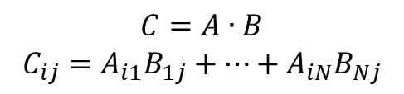
Python performance
def init_matrix(n): m = [] for i in range(n): m.append([]) for j in range(n):
m[i].append(random.random()) return m
def matmul(a, b, c): n = len(a) for i in range(n): for j in range(n):
c[i][j] = 0.0 for k in range(n): c[i][j] += a[i][k]*b[k][j]
500 × 500 matrices
Represent matrix as list of lists
Python: 0.09 s
C: 0.014 s
Naïve!
Fortran: 0.012 s
$$C=A∙B$$
$$C_{ij}=A_{i1}B_{1j}+⋯+A_{iN}B_{Nj}$$
Python: 32 s
C: 0.49 s
Fortran: 0.11 s

Slide 291
Libraries for numeric computation
numpy
Fast arrays
Matrix operations (BLAS-like)
Linear algebra
Fast Fourier Transform
Mathematical functions defined on arrays
Pseudo-random number generation to initialize arrays
Simple statistics
…

Slide 292
Python using numpy
500 × 500 matrices
import numpy as np
def init_matrix(n): return np.random.uniform(0.0, 1.0, (n, n))
def matmul(a, b): return a @ b
numpy: 0.011 s
numpy: 0.077 s
Language/library | Execution time matrix multiplication (s)
Python | 32
C | 0.49
Fortran | 0.11
Python/numpy | 0.077
Fortran/BLAS | 0.060
415 ×

Slide 293
Creating array I
convention
import numpy as np
create 3-element array, all 0.0
v1 = np.zeros(3)
v2 = np.ones(3)
v3 = np.empty(3)
create 3-element array, all 1.0
create 3-element "empty" array initialize elements later
create 2 × 3 array, all elements 0.0
a = np.zeros((2, 3))
b = np.ones((2, 3))
c = np.eye(2)
d = np.empty((2, 3))
create 2 × 3 array, all elements 1.0
create 2 × 2 identity array
create 2 × 3 "empty" array initialize elements later
Default type: np.float ≡ double precision

Slide 294
Creating arrays II
e = np.random.uniform(0.0, 1.0, (2, 3))
create 2 × 3 array, elements x randomly drawn from uniform distribution such that x ∈ [0.0, 1.0[
f = np.array([[3.1, 4.2, -1.1], [-0.3, 1.3, 13.1]])
create 2 × 3 array from a Python list of lists
f = np.genfromtxt('matrix.txt')
create 2 × 3 array from text file
1.2 2.3 3.4
4.5 5.6 6.7

Slide 295
Creating arrays III
e = np.arange(-1.0, 1.0, 0.25)
create 8-element array, first element -1.0,
last element less than 1.0, step 0.25
[ -1. -0.75 -0.5 -0.25 0. 0.25 0.5 0.75 ]
f = np.linspace(-1.0, 1.0, 9)
create 9-element array, first element -1.0,
last element 1.0, determine step
[ -1. -0.75 -0.5 -0.25 0. 0.25 0.5 0.75 1. ]

Slide 296
Numpy data types
Integers np.int8, np.int16, np.int32, np.int64 default for np.int: np.int32 on 32-bit, np.int64 on 64-bit architecture
Floating point numbers np.float32, np.float64, np.float96 default for np.float: np.float64, i.e., double precision
Complex numbers np.complex64, np.complex128, np.complex192 default for np.complex: np.complex128, i.e., double precision
Characters/strings: np.character
v = np.zeros(3, dtype=np.int8)

Slide 297

Accessing array elements
a = np.zeros((2, 3))
nr. bytes to next row
Array dimensions, strides
Assigning to a specific element
Using an element's value
a.shape == (2, 3)
a.strides == (24, 8)
nr. bytes to next column
a[1, 0] = 5.0
$$\left(\begin{matrix}0.0 & 0.0 & 0.0 \\ 5.0 & 0.0 & 0.0\end{matrix}\right)$$
Note:
Implicit conversion of tuple for indexing
0-based indexing
q = a[1, 0] + a[1, 2]

Slide 298
Accessing subarrays: slicing
[[ 1 2 3 4 5 ]
[ 6 7 8 9 10 ]
[ 11 12 13 14 15 ]
[ 16 17 18 19 20 ]]
a = np.arange(1, 21).reshape(4, 5)
Second column
Third row
2D subarray
a[:, 1]
[ 2 7 12 17 ]
result: 1D array
a[2, :]
[ 11 12 13 14 15 ]
[[ 1 2 3 4 5 ]
[ 6 1 0 9 10 ]
[ 11 0 1 14 15 ]
[ 16 17 18 19 20 ]]
a[1:3, 1:3] = np.eye(2)
cfr. list slicing, but…
array slicing does not copy!

Slide 299
Fancy indexing
a = np.arange(1, 10, dtype=np.int).reshape(3, 3)
[[ 1 2 3 ]
[ 4 5 6 ] [ 7 8 9 ]]
Conditional indexing
Conditional assignement
a[a % 2 == 1] = 0
[[ 0 2 0 ]
[ 4 0 6 ] [ 0 8 0 ]]
3 × 3 Boolean array
np.where(a > 0, 1, -1)
[[ -1 1 -1 ]
[ 1 -1 1 ] [ -1 1 -1 ]]
3 × 3 Boolean array

Slide 300
Operations on arrays
Scalar-array operations: +, -, *, /, //, **
Element-wise operations: +, -, *, /, //, **
Matrix product
Python 3.5 style
a = np.array([[1.0, 3.0], [4.0, 5.0]])
print(3.0 + a)
[[ 4. 6. ]
[ 7. 8. ]]
a = np.array([[1.0, 3.0], [4.0, 5.0]])
b = np.array([[2.0, 3.0], [1.0, 0.5]])
print(a*b)
[[ 2. 9. ]
[ 4. 2.5 ]]
print(np.dot(a, b))
[[ 5. 4.5 ]
[ 13. 14.5 ]]
print(a @ b)

Slide 301
Functions operating on arrays
a = np.empty((500, 500))
b = np.random.uniform(0.0, 1.0, (500, 500))
Avoid
Use
Other functions: np.sin, …, np.sinh, …, np.exp, np.trace, np.transpose,…
for i in range(500):
for j in range(500):
a[i, j] = math.sqrt(b[i, j])
140 μs
21 ×
a = np.sqrt(b)
6.5 μs

Slide 302
Some linear algebra
a = np.array([[1.0, 3.0], [4.0, 5.0]])
numpy has some linear algebra operations
matrix power
matrix inverse
determinant
eigen values
[[ 85. 129.]
[ 172. 257.]]
np.linalg.matrix_power(a, 3)
[[-0.71428571 0.42857143]
[ 0.57142857 -0.14285714]]
np.linalg.inv(a)
np.linalg.det(a)
-7.0
np.linalg.eigvals(a)
[-1. 7.]

Slide 303
References versus copies
Reshape: different view on same data
Some operations return copies, check documentation carefully
a = np.array([[1.0, 3.0],
[4.0, 5.0]])
[[ 1. 3.]
[ 4. 5.]]
b = a.reshape((a.size, ))
[ 1. 3. 4. 5.]
a[0, 0] = 13.0
[[ 13. 3.]
[ 4. 5.]]
a
b
[ 13. 3. 4. 5.]

Slide 304
numpy data I/O revisited
Reading text file with 10⁹ 64-bit floats
np.fromtxt(…): 57 minutes, 44 GB RAM
np.fromfile(…, sep='\n'): 4.6 minutes, 8 GB RAM
Reading binary file with 10⁹ 64-bit floats
np.fromfile(…): 8 seconds, 8 GB RAM
12 ×
5 ×
All functions are equal, but…
some are more equal than others
35 ×
Not all data formats are equal: HDF5 to the rescue

Slide 305
Matrices
Matlab-like initialization
Overloaded * and ** operators
Result is always matrix (2D)
a = np.matrix('1.0 3.0; 4.0 5.0')
[[ 1. 3. ]
[ 4. 5. ]]
Don't use,
confusing
a = np.matrix([[1.0, 3.0], [4.0, 5.0]])
b = np.matrix([[2.0, 3.0], [1.0, 0.5]])
print(a*b)
print(a**3)
[[ 5. 4.5 ]
[ 13. 14.5 ]]
[[ 85. 129. ]
[ 172. 257. ]]
a = np.matrix('1.0, 3.0')
b = np.matrix('2.0; 4.0)
print(a*b)
[[ 14. ]]

Slide 306
Python for scientific computing: Scipy
https://github.com/gjbex/training-material/tree/master/Python/Numpy
https://github.com/gjbex/training-material/tree/master/Python/Birdsong

Slide 307
Libraries for numeric computation
…
scipy
Dense/sparse inear algebra
Solving ordinary differential equations
Numerical integration
Optimization
Interpolation
Signal processing
Statistics
Special mathematical functions
Mathematical & physical constants
…
convention
import scipy as sp
import subpackages as needed
import scipy.linalg

Slide 308
Singular Value Decomposition
Should be fast when built against good BLAS/Lapack iibrary
Computing SVD
Note: s is not a 2D-array, it is a 1D-array
Let's check
import scipy.linalg
a = np.array([[7.3, 5.7], [-1.2, 5.3]])
u, s, v = sp.linalg.svd(a)
S = np.diag(s)
A = u @ S @ v
delta = A - a
[[ 8.88178420e-16, 0.00000000e+00],
[ 4.44089210e-16, 0.00000000e+00]]

Slide 309
Linear regression
x,y
0.000e+00,1.206e+00
5.263e-02,1.207e+00
…
Reading data
Linear regression
data.csv
data = np.genfromtxt('data.csv', dtype=[np.float64, np.float64],
delimiter=',', names=True)
import scipy as sp import scipy.stats
slp, intc, r, _, _ = sp.stats.linregress(data['x'],
data['y'])

Slide 310
Optimization: function definitions
Minimize
Define function
Define gradient
$$f\left(x, y\right)={\left(x^{2}+y^{2}\right)}^{2}−{2x}^{2}−{2y}^{2}+0.1x$$
def f(X):
x = X[0]
y = X[1]
return (x**2 + y**2)**2 - 2*x**2 - 2*y**2 + 0.1*x
def grad_f(X):
x = X[0]
y = X[1]
f_x = 4*(x**2 + y**2)*x - 4*x + 0.1
f_y = 4*(x**2 + y**2)*y - 4*y
return np.array([f_x, f_y])

Slide 311
Optimization
Compute minimum
Many methods
Powell
Conjugate gradient
BFGS
Newton conjugate gradient
…
import scipy.optimize
x0 = np.array([1.0, 0.01])
xopt = scipy.optimize.fmin_cg(f, x0, fprime=grad_f, disp=False)

Slide 312
Ordinary differential equations
Rewrite higher order differential equation to set of first order equations
def func(t, y, g, l, q, F_D, Omega_D):
return [
y[1],
-(g/l)*y[0] - q*y[1] + F_D*np.sin(Omega_D*t)
]
y[0] ≡ θ
y[1] ≡ ω

Slide 313

Jacobian for equations
For many methods, convergence improves by specifying Jacobian
$$\left[\begin{matrix}\frac{∂f_{1}}{∂θ} & \frac{∂f_{1}}{∂ω} \\ \frac{∂f_{2}}{∂θ} & \frac{∂f_{2}}{∂ω}\end{matrix}\right]$$
def jac(t, y, g, l, q, F_D, Omega_D):
return [
[0.0, 1.0],
[-g/l, -q]
]

Slide 314
Integrate ODEs
Integrate from t0 to t_max in steps delta_t
integration method RKF(4, 5)
from scipy.integrate import ode
…
ode_sys = ode(func, jac).set_integrator('dopri5')
ode_sys.set_initial_value([theta0, omega0], t0)
ode_sys.set_f_params(g, l, q, F_D, Omega_D)
ode_sys.set_jac_params(g, l, q, F_D, Omega_D)
while ode_sys.successful() and ode_sys.t < t_max:
ode_sys.integrate(ode_sys.t + delta_t)
print(ode_sys.t, ode_sys.y[0], ode_sys.y[1])

Slide 315
Signal processing
Remove noise from sound file (WAV)
Read WAV file
Perform FFT to compute frequency spectrum
…
from scipy.io import wavfile
…
sample_rate, signal = wavfile.read(wav_file_name)
…
n = len(signal)
freq = sample_rate*np.arange(n)/n
Y = sp.fft(signal)/n

Slide 316

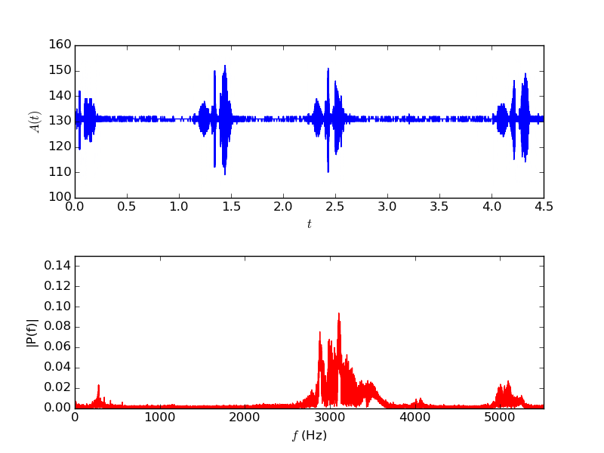
Original signal

Slide 317
Create highpass filter
Import signal processing package
Create IIR digital filter
…
import scipy.signal
…
fraction of Nyquist frequency
order of the filter
minimum attenuation
…
b, a = sp.signal.iirfilter(17, cutoff,
rs=min_attenuation,
btype='highpass',
analog=False,
ftype='cheby2')
…
filter type
IIR filter type
Notes:
The Nyquist frequency is half of the sampling rate of a discrete signal processing system.
Infinite impulse response (IIR) is a property applying to many linear time-invariant systems. Common examples of linear time-invariant systems are most electronic and digital filters. Systems with this property are known as IIR systems or IIR filters, and are distinguished by having an impulse response which does not become exactly zero past a certain point, but continues indefinitely. This is in contrast to a finite impulse response in which the impulse response h(t) does become exactly zero at times t > T for some finite T, thus being of finite duration.

Slide 318
Filter signal
Apply filter
Write signal to WAV file
…
base = np.uint8(np.mean(signal))
filtered_signal = sp.signal.filtfilt(b, a, signal)
wav_signal = base + np.array(filtered_signal, dtype=np.uint8)
…
…
wavfile.write(filtered_wav_file_name, sample_rate, wav_signal)
…

Slide 319
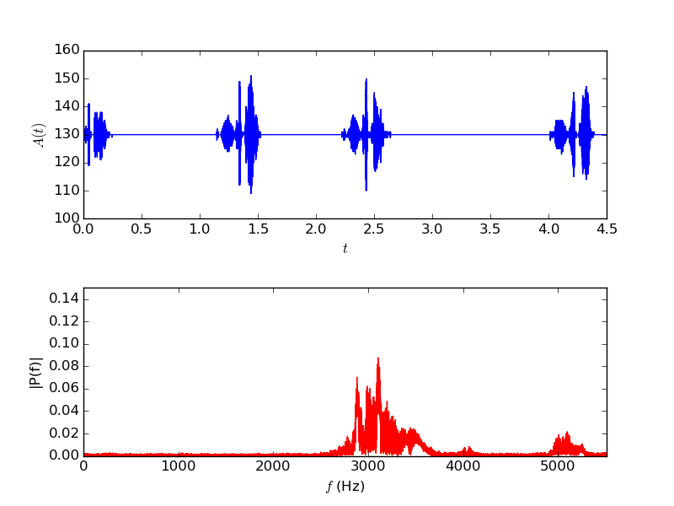
Filtered signal

Slide 320
Matplotlib
https://github.com/gjbex/training-material/tree/master/Python/Matplotlib

Slide 321
And some matplotlib…
Rich Python plotting library
scatter plot
line plot
bar plot/histogram
heatmap
3D surface plot
Highly customizable plots
LaTeX labels/annotation
Plot to screen, various file formats
Lots of features, this barely scratches the surface.
Convention: import matplotlib.pyplot as plt

Slide 322
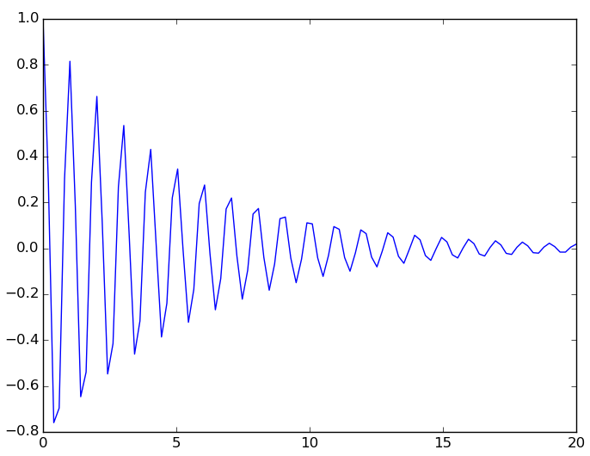
Simple line plot
Data: lists or numpy arrays
Add plot
Show plot
Save plot
x = np.linspace(0.0, 20.0, 500)
y = np.exp(-mu*x)*np.cos(2.0*np.pi*x)
plt.plot(x, y)
plt.show()
plt.savefig(file_name)

Slide 323
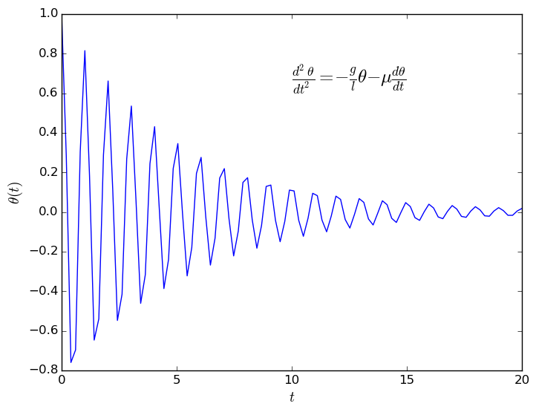
Axis labels, annotation
Add label for x and y axis
Add annotation
plt.xlabel(r'$t$', fontsize=14)
plt.ylabel(r'$\theta(t)$', fontsize=14)
construct plot
≡
gradually enrich plt
eq = (r'$\frac{d^2 \theta}{dt^2} = ' +
r'- \frac{g}{l} \theta ' +
r'- \mu \frac{d\theta}{dt}$')
plt.text(10.0, 0.65, eq, fontsize=18)
LaTeX notation, rendered

Slide 324
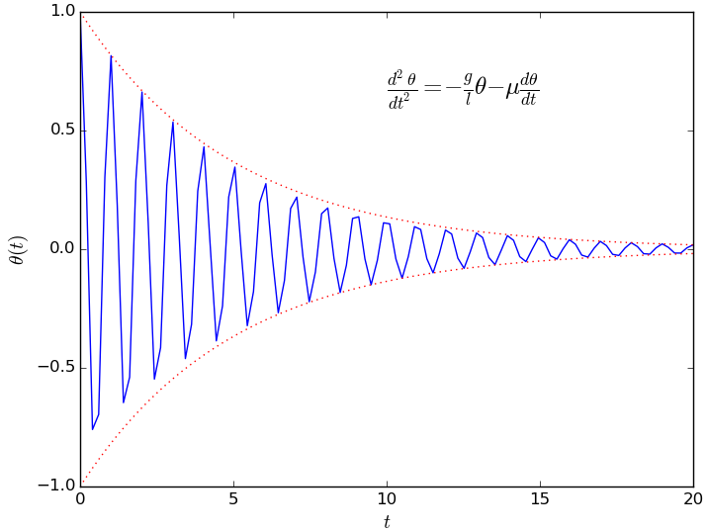
Multiple functions on line plot
Data
Add to plot, line style, color
y_plus = np.exp(-mu*x)
y_min = -np.exp(-mu*x)
plt.plot(x, y_plus,
':', alpha=0.8,
color='red',
linewidth=0.9)
plt.plot(x, y_min,
':', alpha=0.8,
color='red',
linewidth=0.9)
line type

Slide 325
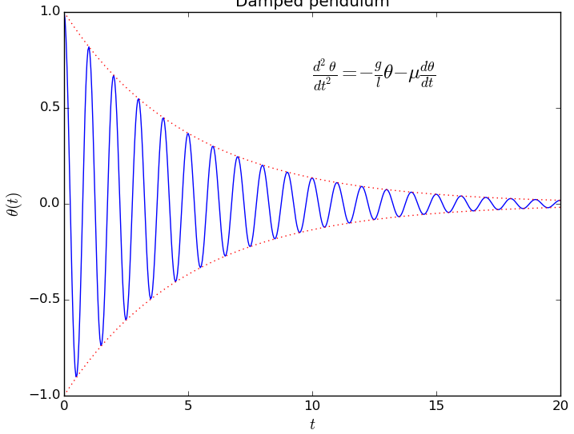
Complete line plot

Slide 326
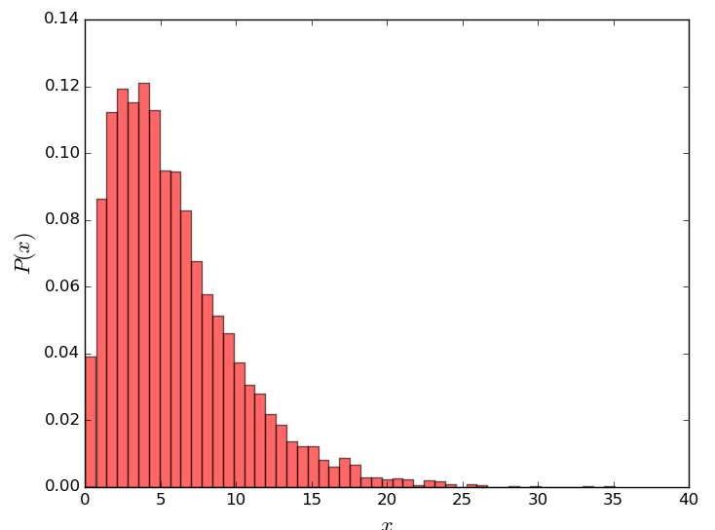
Histogram
13.3146868758
9.66243828428
6.44936354431
2.81183151337
9.55644862073
…
Data:
Plot histogram
values = np.loadtxt('data.txt')
bins = 50
data.txt
plt.hist(values, bins, normed=1,
color='red', alpha=0.6)
plt.xlabel('$x$', fontsize=16)
plt.ylabel('$P(x)$', fontsize=16)

Slide 327
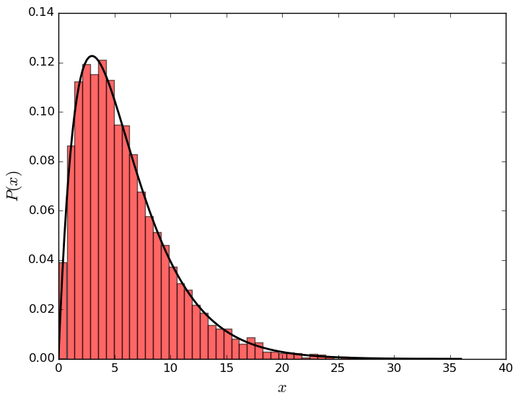
Line plot on histogram
Data:
Reminder
x = np.linspace(floor(np.min(values)), ceil(np.max(values)),
200)
y = sp.stats.gamma.pdf(x, 2, scale=3.0)
plt.plot(x, y, linewidth=2.0,
color='black')
import numpy as np
import scipy as sp
import scipy.stats
import matploblib.pyplot as plt

Slide 328
Heat map data
Function to plot
Data
def f(x, y, x0=0.0, freq=1.0, beta=0.5):
r = np.sqrt((x - x0)**2 + y**2)
return np.exp(-beta*r)*np.cos(2.0*np.pi*freq*r)
x = np.linspace(x_min, x_max, points)
y = np.linspace(y_min, y_max, points)
X, Y = np.meshgrid(x, y)
z = f(X, Y, x0=x0_1, freq=f_1) + f(xx, yy, x0=x0_2, freq=f_2)

Slide 329
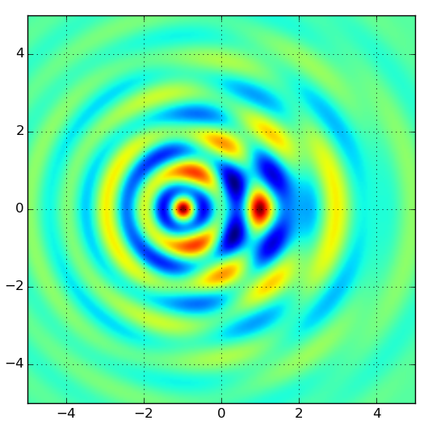
Heat map plot
Plot map
plt.imshow(z, extent=[x_min, x_max, y_min, y_max])
plt.grid(True)
Explore color maps, helps interprete data!
Brewer schemes

Slide 330
3D surface plot I
Importing extra modules
Plot
from mpl_toolkits.mplot3d import Axes3D
from matplotlib import cm
figure = plt.figure()
axes = figure.gca(projection='3d')
axes.set_xlim(x_min, x_max)
axes.set_ylim(y_min, y_max)
axes.set_zlim(z_min, z_max)
surface = axes.plot_surface(X, Y, z,
rstride=4, cstride=4,
cmap=cm.coolwarm,
linewidth=0)
figure.colorbar(surface)

Slide 331
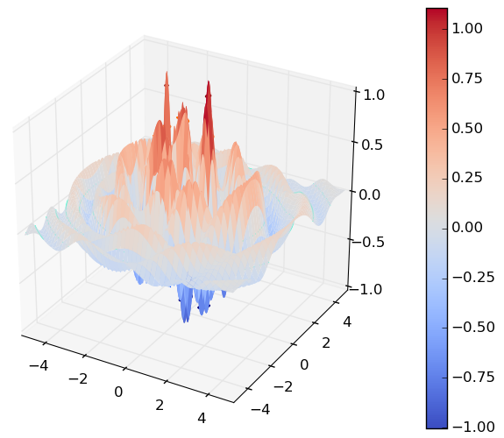
3D surface plot II

Slide 332
References
numpy for MATLAB users http://mathesaurus.sourceforge.net/matlab-numpy.html
ColorBrewer 2.0: advice on choosing appropriate color maps http://colorbrewer2.org/

Slide 333
Sympy

Slide 334
Introduction
sympy: library for computer algebra
symbolic computations
Features
linear algebra
vectors, matrices, tensors
solving linear sets of equations
eigenvalues/eigenvectors, SVD
…
calculus
computing derivatives, series expansions
limits
integrals (indeterminate/determinate)
…

Slide 335
Defining symbols
import sympy
Defining multiple symbols
Symbol with assumptions
real
rational
integer
positive/negative
Matrices
a, b, c, x = sympy.symbols('a b c x')
y = sympy.Symbol('y', positive=True)
A = sympy.Matrix([[x**2, x*y], [-x*y, y**2]])

Slide 336
Solving equations
Solve
Solve
sympy.solve(a*x**2 + b*x + c, x)
[ (-b + sqrt(-4*a*c + b**2))/(2*a),
-(b + sqrt(-4*a*c + b**2))/(2*a) ]
A = sympy.matrix([[a, b], [c, d]])
X = sympy.Matrix([x, y]).reshape(1, 2)
B = sympy.Matrix([1, 0]).reshape(1, 2)
sympy.solve(A*X - B, X)
{ x: d/(a*d - b*c),
y: -c/(a*d - b*c) }

Slide 337
Eigenvalues, eigenvectors
multiplicity
eigen = A.eigenvects()
[(a/2 + d/2 - sqrt(a**2 - 2*a*d + 4*b*c + d**2)/2, 1, [Matrix([
[-b/(a/2 - d/2 + sqrt(a**2 - 2*a*d + 4*b*c + d**2)/2)],
[ 1]])]),
(a/2 + d/2 + sqrt(a**2 - 2*a*d + 4*b*c + d**2)/2, 1, [Matrix([
[-b/(a/2 - d/2 - sqrt(a**2 - 2*a*d + 4*b*c + d**2)/2)],
[ 1]])])]
v1, v2 = eigen[0][2][0], eigen[1][2][0]
sympy.simplify(v1.T*v2)
Matrix([[(-b + c)/c]])
if A is symmetric, eigenvectors are orthogonal

Slide 338
Derivatives
Define function
Derivative with respect to x
Derivative with respect to x and y
def f(x, y):
return a*x**2 + b*x*y + c*y**2 + d
diff(f(x, y), x)
2*a*x + b*y
diff(f(x, y), x, y)
b

Slide 339
Integration
Indefinite integral
Definite integral
Multiple integrals
sympy.integrate(f(x, y), x)
a*x**3/3 + b*x**2*y/2 + x*(c*y**2 + d)
from sympy import exp, sqrt, pi, oo
sympy.integrate(exp(-x**2/2)/sqrt(2*pi),
(x, -oo, oo))
1
sympy.integrate(f(x, y), (x, 0, 1), (y, 0, 2))
2*a/3 + b + 8*c/3 + 2*d

Slide 340
Limits and series expansion
Limit
Series expansion
sympy.limit(sin(x)/x, x, 0)
1
sympy.series(sin(x)/x, x, 0, n=6)
1 - x**2/6 + x**4/120 + O(x**6)
Use .removeO() when not required
Use .taylor_term() to get term of specific order

Slide 341
Expression representation
sympy expression = tree
from sympy import Add, Mul, Pow
Add(Mul(a, Pow(x, 2)), Mul(b, x), c)
Add
Mul
Mul
Symbol('c')
Symbol('a')
Pow
Symbol('b')
Symbol('x')
Symbol('x')
Integer(2)

Slide 342
Parts of expressions
Taking expression apart
Operator
Operands
Pow
expr = 1/(a*x + b)
Add
Integer(-1)
Mul
Symbol('b')
expr.func
sympy.core.power.Pow
Symbol('a')
Symbol('x')
expr.args
expr.args[0].args[0]
(a*x + b, -1)
b

Slide 343
Expression manipulation
Substitution
Factor, expand
Simplify
expr = x**2 + 2*a*x + y**2
expr.subs(y, a)
x**2 + 2*x*y + y**2
(x**2 + 2*x*y + y**2).factor()
((x + y)**2).factor()
(x + y)**2
x**2 + 2*x*y + y**2
x, y = symbols('x y', positive=True)
(log(x) + log(y)).simplify()
log(x*y)

Slide 344
HDF5: PyTables
https://github.com/gjbex/training-material/tree/master/Hdf5/PythonSamples

Slide 345
HDF5: what is it?
System, OS, programming language independent way of storing data
Hierarchical Data Format
Abstract data model
File
Group
Dataset
Data type
Attribute
Storage model
File system
Directory
File
Metadata
Documentation, comments in data file itself, self contained

Slide 346
HDF5 data
Data stored in dataset as n-dimensional arrays
Dataspace describes layout of data (rank,dimensions)
Datatype describes single data element
Atomic
Integer, float
String, time
Opaque
Composite
Compound
Enumeration
Array
Variable length
Partial read/writes, hyperslab selection
Data layout & type description part of HDF5 file:
self-documenting
discovery!

Slide 347
HDF5 storage
Filtering
Compression
Error detection
Datasets can be extended
Storage drivers
Single file
Multiple files
Multiple files on parallel file system
Memory

Slide 348
HDF5: how to use it?
C/C++
Fortran 90
Java
Python
PyTables, h5py
HDF5 file can be read by program in any language
Not so easy in C/C++/Fortran, fairly trivial in Python

Slide 349
Importing modules
To work with HDF5 files
import tables
if necessary (usually not, unless when using compounds), import specific functions, classes
if necessary (almost certainly), import numpy
…
import tables
from tables import Int32Col, Float64Col
import numpy as np
…

Slide 350
Open & close HDF5 file
Create new HDF5 file (w for write)
Open HDF5 file for modification (a for append)
Open HDF5 file for reading (r for read)
Close file
Preferred alternative
h5file = tables.open_file('data.h5', mode='w', 'simulation input and results')
file name
title
h5file = tables.open_file('data.h5', mode='a')
h5file = tables.open_file('data.h5', mode='r')
h5file.close()
with tables.open_file('data.h5', 'w', '…') as h5file:
…

Slide 351
Creating a group
group location in hierarchy
group name
Groups start in root
Creating a subgroup
input_group = h5file.create_group(h5file.root, 'input',
'input data')
≡
comment
input_group = h5file.create_group('/', 'input',
'input data')
field_group = h5file.create_group(input_group, 'fields',
'various fields')
≡
field_group = h5file.create_group('/input', 'fields',
'various fields')

Slide 352
Adding an array
Use numpy arrays
Add it to HDF5 file
magn_field = lambda x, y: x**2 + 2*x*y
X, Y = np.meshgrid(np.linspace(-1.0, 1.0, x_dim), np.linspace(-1.0, 1.0, y_dim))
field = magn_field(X, Y)
array location in hierarchy
array name
h5file.create_array(field_group, 'magnetic', field,
'static magnetic field')
h5file.flush()
comment
array

Slide 353
Adding an 2D array
Create numpy array
Add array
positions = np.random.normal(scale=10.0, size=(20, 2))
h5file.create_array('/coords', 'positions', positions,
'particle positions', createparents=True)
h5file.flush()

Slide 354
Annotations
Adding a unit annotation to array
Adding annotation to a group
attrs, _v_attrs behave mostly like Python dictionaries, to set, get, remove an annotation
list of attributes:
field_group.magnetic.attrs['units'] = 'mT'
field_group._v_attrs['warning'] = 'do not modify'
field_group._f_list('user')

Slide 355
Objects & tables
Define class
Create table
from tables import IsDescription, Int32Col, Float64Col
class Particle(IsDescription):
particle_id = Int32Col()
mass = Float64Col()
x_pos = Float64Col()
y_pos = Float64Col()
x_vel = Float64Col()
y_vel = Float64Col()
initial_state = h5file.create_table( '/', 'particles', Particle, 'initial state of particles' )

Slide 356
Populate table
Add new particles
particle = h5file.root.particles.row
for particle_id in range(100):
particle['particle_id'] = particle_id
particle['mass'] = random.gauss(0.0, 1.0)
particle['x_pos'] = random.gauss(0.0, 1.0)
particle['y_pos'] = random.gauss(0.0, 1.0)
particle['x_vel'] = random.gauss(0.0, 1.0)
particle['y_vel'] = random.gauss(0.0, 1.0)
particle.append()
h5file.flush()
append particles one by one, unlimited (except by disk space)

Slide 357
Reading an array
Read entire dataset, i.e., array
Read slice
Read non-consecutive data
magn_field = h5file.root.input.fields.magnetic print(np.average(magn_field))
pos = h5file.root.coords.positions[3:7, :]
read x- and y-coordinates of 4 particles
indices = [2, 4, 6]
pos = h5file.root.coords.positions[indices, :]
read x- and y-coordinates of 3rd, 5th, and 7th particle
Hyperslabs!

Slide 358
Reading a table
Compute center of mass
x, y = 0.0, 0.0 mass = 0.0
for particle in h5file.root.particles: mass = particle['mass']
x += particle['mass']*particle['x_pos']
y += particle['mass']*particle['y_pos'] x /= mass y /= mass

Slide 359
HDF5 command line utilities
h5dump
Print a textual representation of HDF5 file
h5ls
Explore structure of HDF5 file
h5copy
Copy data set from one HDF5 file to another
h5mkgrp
Create a group in an HDF5 file

Slide 360
Pandas
https://github.com/gjbex/training-material/tree/master/Python/Pandas

Slide 361
What is it?
Library for data science
defines datastructures
Series (1D)
DataFrame (2D)
Panel (3D)
defines algorithms
selection
pivot tables
defines utilities
visualization, e.g., scatter_matrix
Backed by numpy
Nice to experiment with data, jupyter notebooks
convention
import pandas as pd
R dataframes
for Python

Slide 362
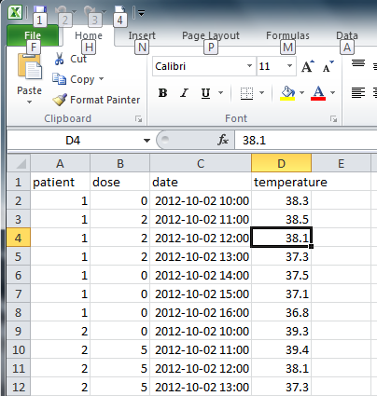
Example data
Microsoft Excel spreadsheet

Slide 363
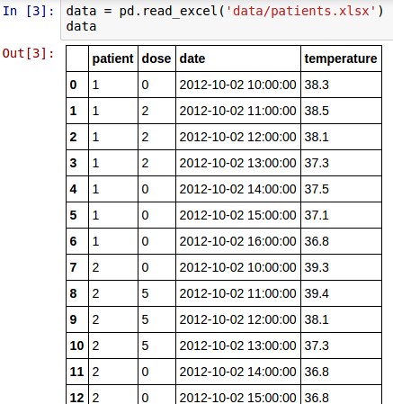
Read dataframe
Create DataFrame from Excel file
Also tabular data, CSV, HDF5, SQL query, HTML page,…
Show in notebook

Slide 364
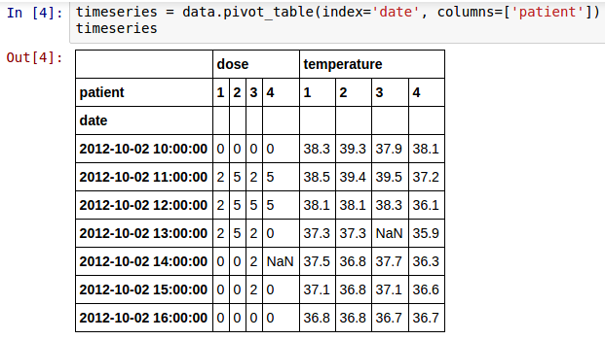
Transform dataframe
Patient data as columns, date as index: pivot table
missing value

Slide 365
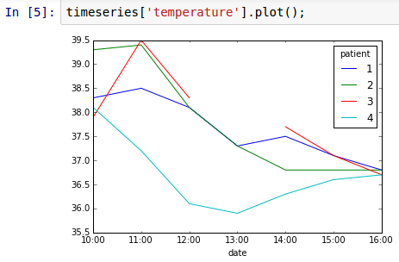
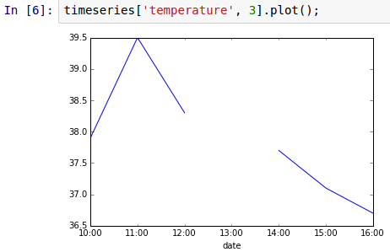
Plot data
missing value

Slide 366
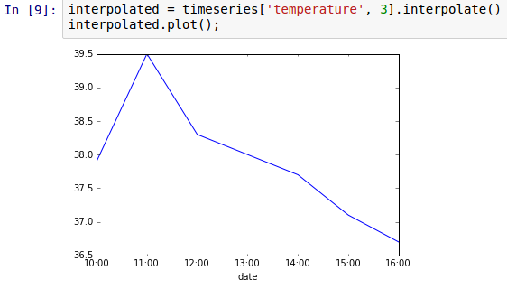
Missing data: NaNs
Can be filled with 0, other value, or interpolated
interpolated value

Slide 367
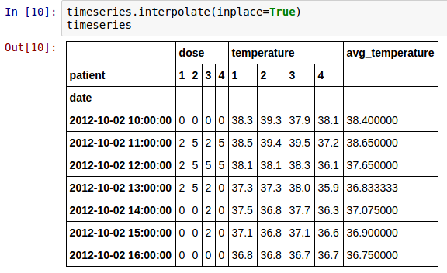
In-place changes
Changes produce new DataFrame
good to experiment
bad for performance/memory usage
Use in place

Slide 368
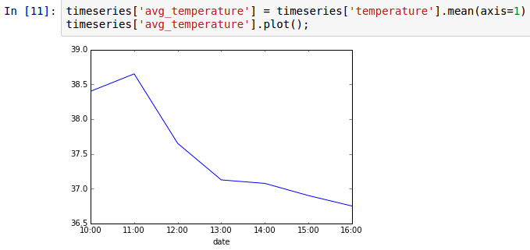
Statistics & adding columns
Compute average temperature and add as column
add column
compute statistics

Slide 369
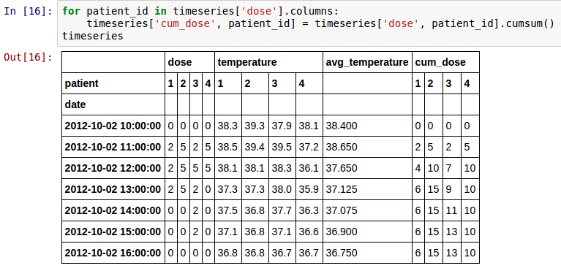
Cumulative sum
compute sums
Dose is better expressed cumulatively
modify column

Slide 370
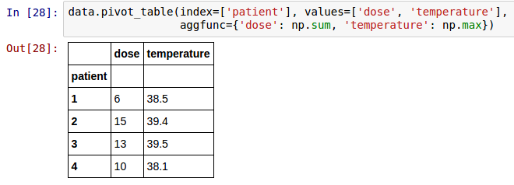
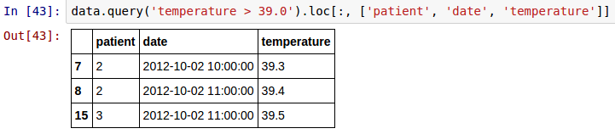
More pivot & query
pivot_table and query are powerful!
What is total dose versus maximum temperature for each patient?
Which patients had temperature > 39, and when?

Slide 371
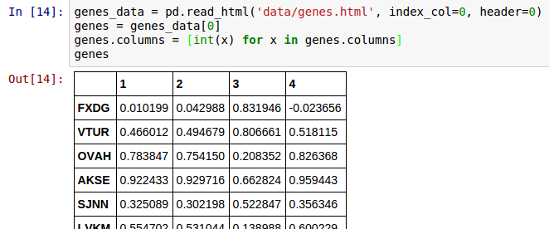
Reading HTML tables
column names
index column
read_html produces list of DataFrame, one per HTML table on page
Column names are str by default, converted to int for consistency with running example

Slide 372
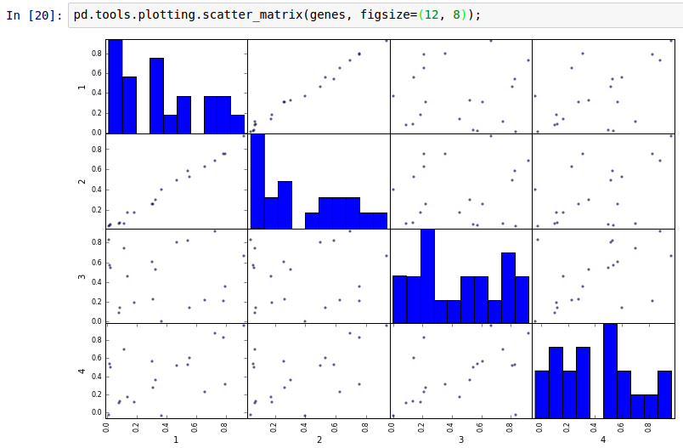
Scatter matrix

Slide 373
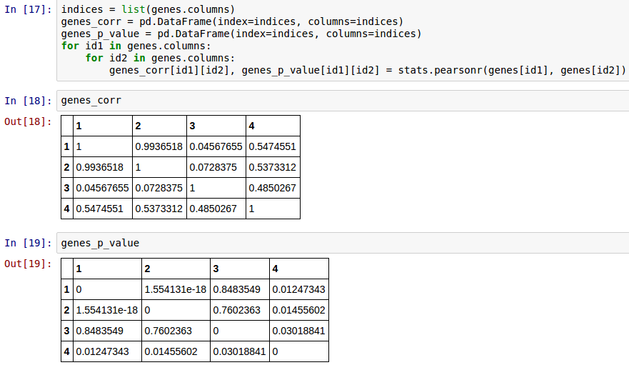
Computing correlations
Creating DataFrames by hand
Note: import scipy.stats as stats

Slide 374
HoloViews
https://github.com/gjbex/training-material/tree/master/Python/HoloViews

Slide 375
What is it?
Library for exploratory data visualization
Easy to create overlays
Parameter exploration
GridSpace
HoloMap
Interfaces with numpy, pandas
Nice to experiment with/explore data, jupyter notebooks
Very simple for complex things
convention
import holoviews as hv

Slide 376

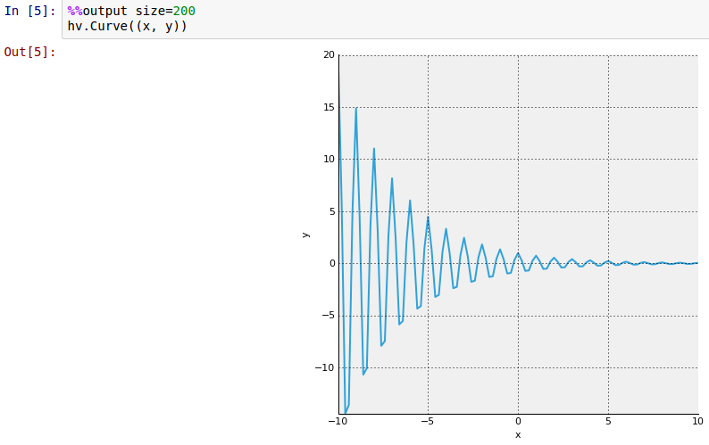
Trivial example
Plotting numpy arrays
plot tuple of x and y values

Slide 377
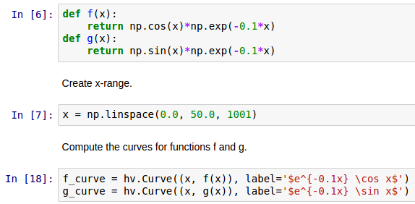
Combining plots
Create data & two plots
create two plots not yet displayed
label plots using LaTeX

Slide 378
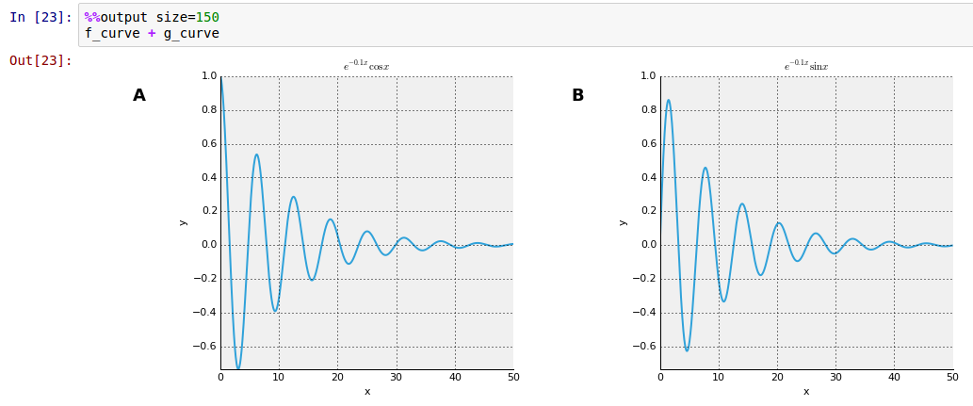
Side by side
combine plots side by side

Slide 379
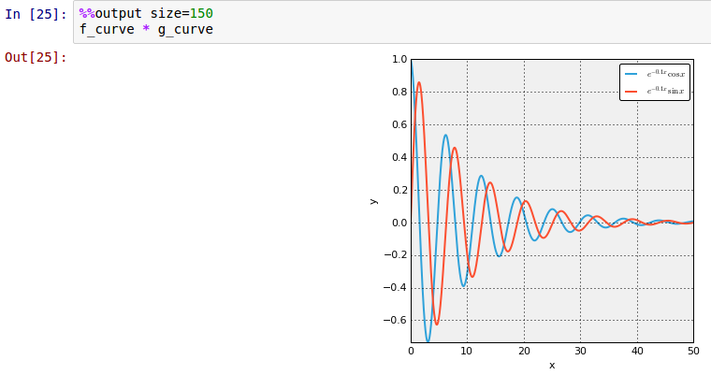
Overlay
combine plots by overlaying

Slide 380
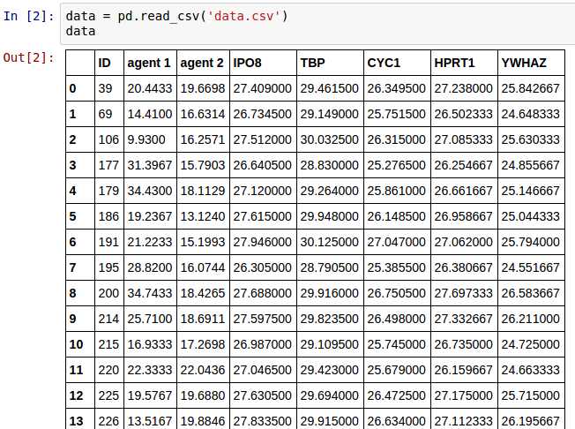
pandas & HoloViews
Read data

Slide 381
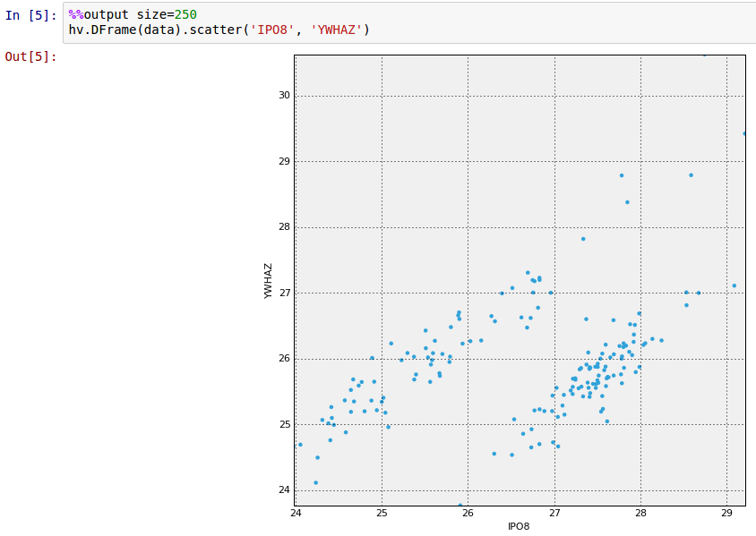
Plotting DataFrame
"bridge" between pandas & HoloViews

Slide 382
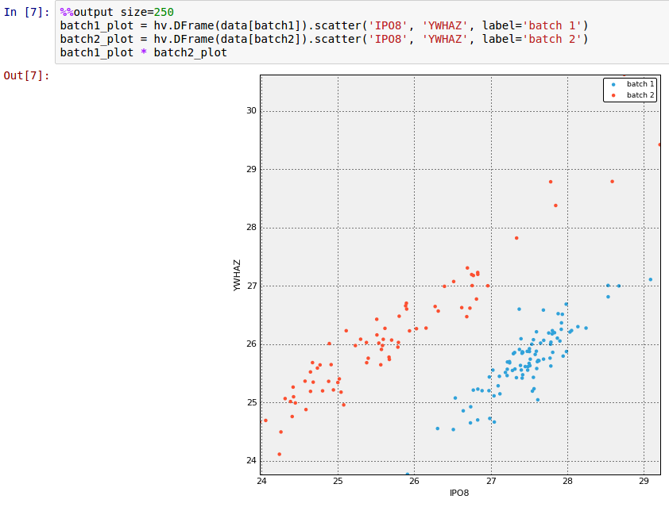
More overlays

Slide 383
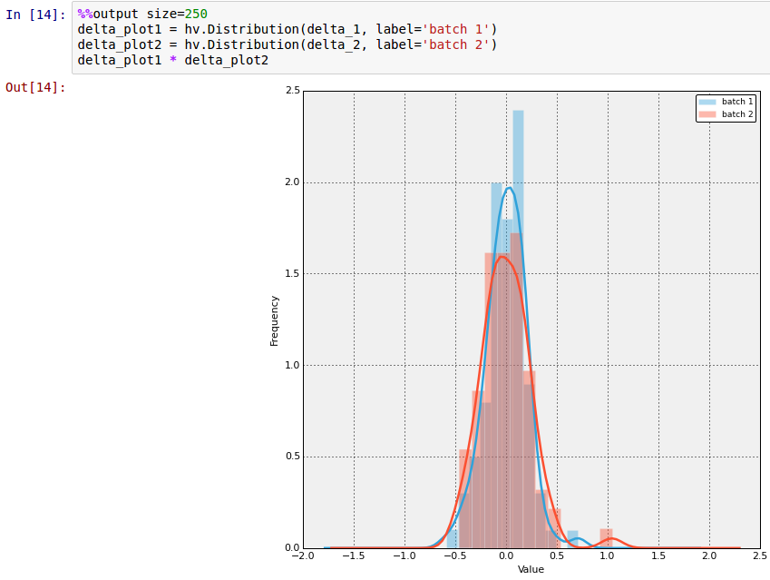
Plotting distributions

Slide 384
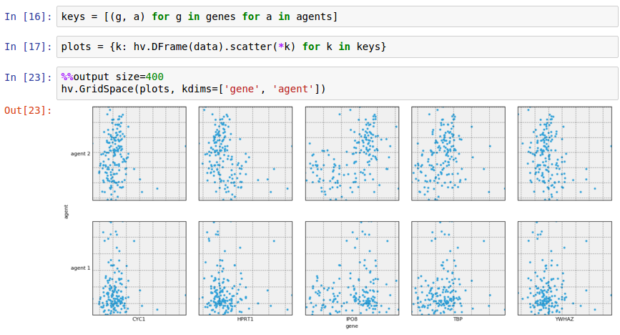
GridSpace
create key pairs,
gene, agent
create plots,
one per key pair

Slide 385
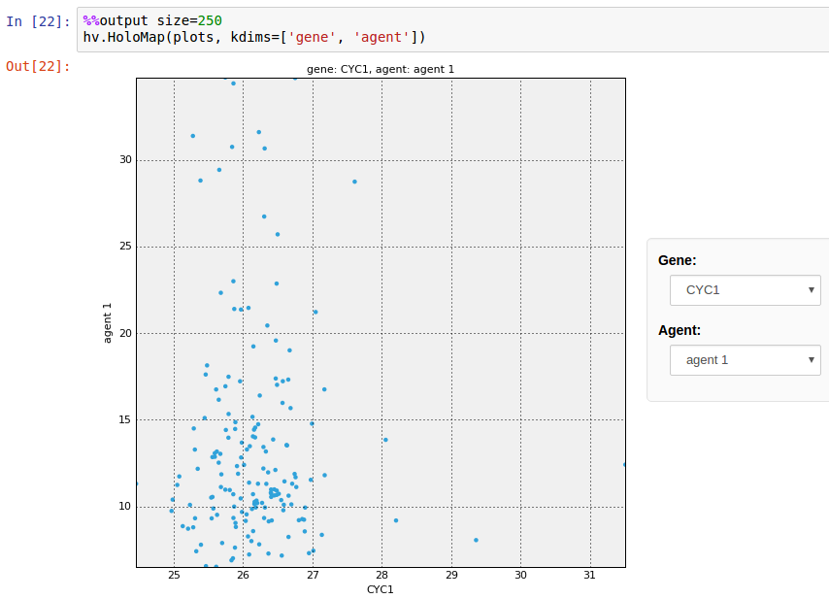
HoloMap
select parameters to plot from menus

Slide 386
Bokeh
https://github.com/gjbex/training-material/tree/master/Python/Bokeh

Slide 387
What is it?
Plot library
Easy to use
Integrates with Pandas
Interactive demos in jupyter notebooks
Export to HTML pages, interactive plots using Javascript
Disadvantages
No (convenient) LaTeX labels
More oriented towards information visualization

Slide 388
Simple plot
import required functions
from bokeh.plotting import figure, output_file, show
…
x = np.linspace(0.0, 20.0, 500)
y = np.exp(-mu*x)*np.cos(2.0*np.pi*x)
y_plus = np.exp(-mu*x)
y_min = -np.exp(-mu*x)
…
output_file('plot.html', title='damped pendulum')
fig = figure(title='damped pendulum',
x_axis_label='t', y_axis_label='theta')
fig.line(x, y)
fig.line(x, y_min, line_color='red', line_width=0.6,
line_dash=(2, 2))
fig.line(x, y_plus, line_color='red', line_width=0.6,
line_dash=(2, 2))
show(fig)
set output file
create figure
plot data
create file

Slide 389
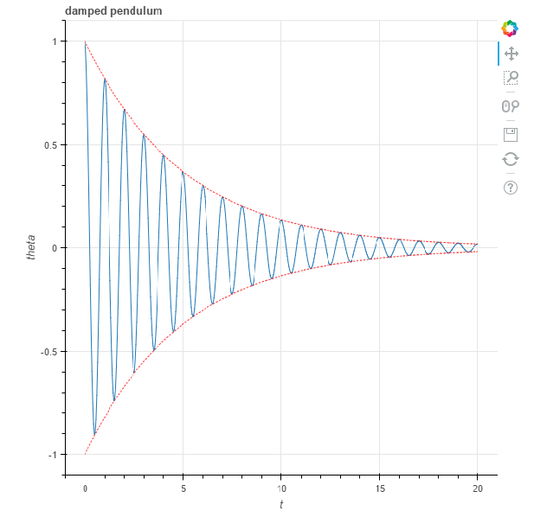
HTML file
pan tool
box zoom
wheel zoom
save image
reset
Interactive in web browser!

Slide 390
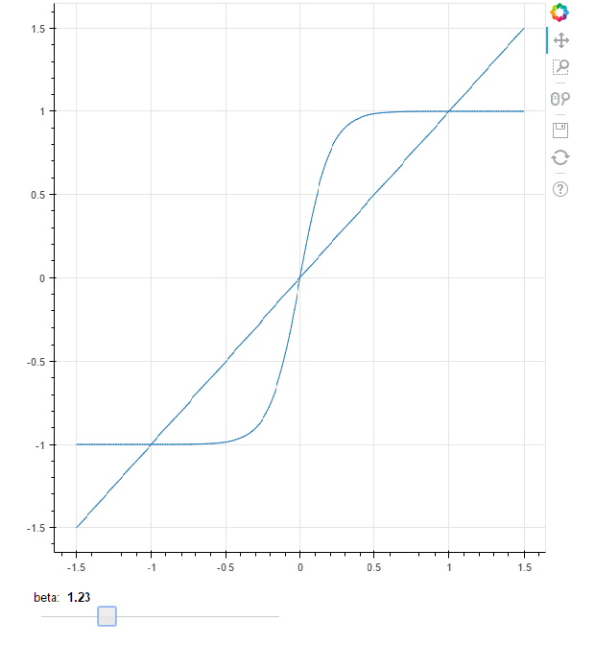
HTML file with widget
Required: callback function
• modifies data
• triggers update
• involves Javascript tinkering
interactive slider

Slide 391
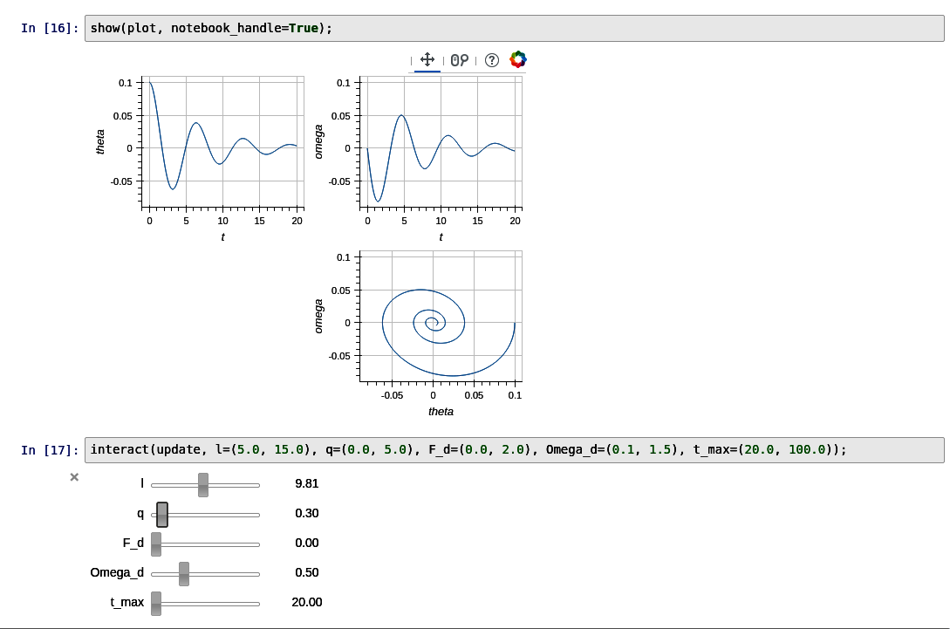
Linked figures
linked figures for
• panning, zooming
• interactive settings

Slide 392
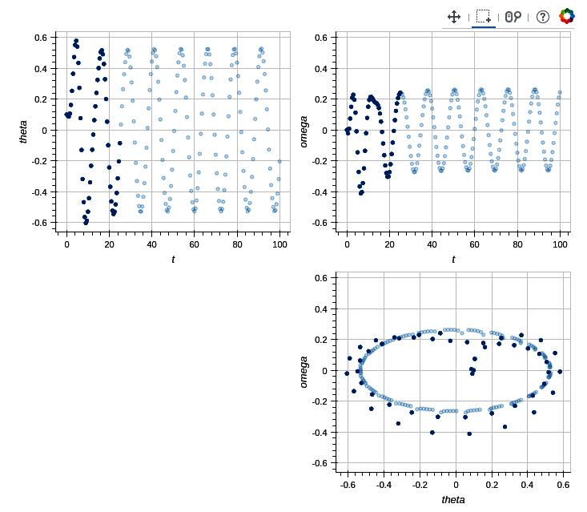
Linked brushing
consistent selection

Slide 393
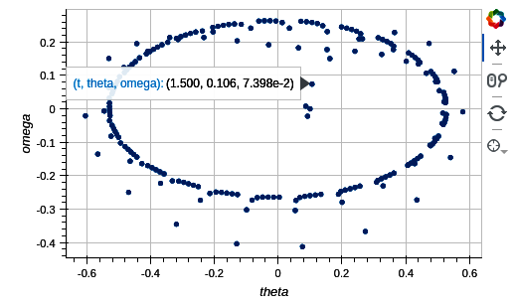
Hover tool
hover for details
Any information can be added

Slide 394
Conclusions

Slide 395
Conclusions
Python pros
Versatile & expressive
Easy to read
Good & extensive standard library
Python cons
Fairly slow
Some weird idiosyncrasies
Python 2 to 3: disruptive changes

Slide 396
Managing Python environment

Slide 397
Installing & upgrading packages
Use pip
Install new package
Upgrade a package
Install a package only for yourself
To check for upgrades, use yolk
$ pip install pandas
$ pip install -U pandas
$ pip install --user -U pandas
$ yolk -U

Slide 398
Conda: environment
Install miniconda (http://conda.pydata.org/miniconda.html)
Create new environment
Use environment
Deactivate environment
environment name
$ conda create -n science python=3 \
numpy scipy matplotlib
packages to install
Python version
$ source activate science
$ source deactivate

Slide 399
Conda: installing & updating
Install new package
Update package
Update environment
Uninstall package
List all installed packages
$ conda install holoviews
Note: will also install dependencies locally, including non-python libraries
$ conda update holoviews
$ conda update --all
$ conda remove holoviews
$ conda list

Slide 400
Conda: multiple environments
Clone environment
List all environments
Remove environment
environment name
$ conda create -n data_science --clone science \
pandas seaborn
additional packages to install
base environment
$ conda env list
$ conda remove --name data_science --all

Slide 401
Conda: sharing environments
Export environment description
Export to YAML file
Create new environment based on description, portable across systems
$ source activate science $ conda env export > science_environment.yml
$ conda env create -f science_environment.yml

Slide 402
Conda: caveats
Conda installs dependencies
Easy & fast
System specific distribution: no compiles
Library dependencies, e.g., zlib, mpich,…
Upgrading Python version: clone first!
Fine on your own machine,
not so fine on HPC cluster!
Performance!

Slide 403
Migrating from 2.x to 3.x

Slide 404
New in Python 3
print and exec are functions
dict.keys(), dict.items() return views, not lists
map(), filter(), zip() return iterators, not lists
xrange() no longer exists, just use range
1/2 → 0.5, 1//2 == 0
nonlocal makes scoping somewhat more sane
a, *rest = [1, 2, 3, 4] → a == 1, rest == [2, 3, 4]
dictionary & set comprehensions
super(…) is more sane
strings: UTF-8, so can't be compared to or written as bytes directly (binary I/O)

Slide 405
Tools to help migration
Create (lots of) tests
doctest, or, better,
unittest
Prepare 2.x code: import from the future
from __future__ import division, print_function
from future_buildins import map, filter, zip
Use 2to3
Shows a diff in patch format
Can convert file in place (-n -w flags)
pylint, flake8 for syntax/semantic checks

Slide 406
Pitfalls
Division of integers return float:
Python 2.x: 3/4
Python 3.x: 3//4
Universal newlines mode for text file reading
Python 2.x: line ending not translated
Python 3.x: line endings translation to '\n'
Binary I/O
Python 2.x: strings and bytes mix easily
Python 3.x: strings are UTF-8, so can't be compared or concatenated to binary reads (bytes)

Slide 407
More pitfalls
List sort
Python 2: cmp keyword
Python 3: use key keyword

Slide 408
Writing for both 2.x and 3.x
Use the future
Use module six
from __future__ import (absolute_import, division,
print_function, unicode_literals)
from builtins import (bytes, dict, int, list, object, range,
str, ascii, chr, hex, input, next, oct,
open, pow, round, super, filter, map,
zip)

Slide 409
Anaconda

Slide 410

Continuum Analytics Anaconda
Spyder development environment
Editor: write scripts/modules
Console, i.e., iPython interpreter: execute code snippets, run scipts
Object inspector: from editor/console
Standalone iPython console
Jupyter
Qt console
Notebook
License: free for academic use

Slide 411
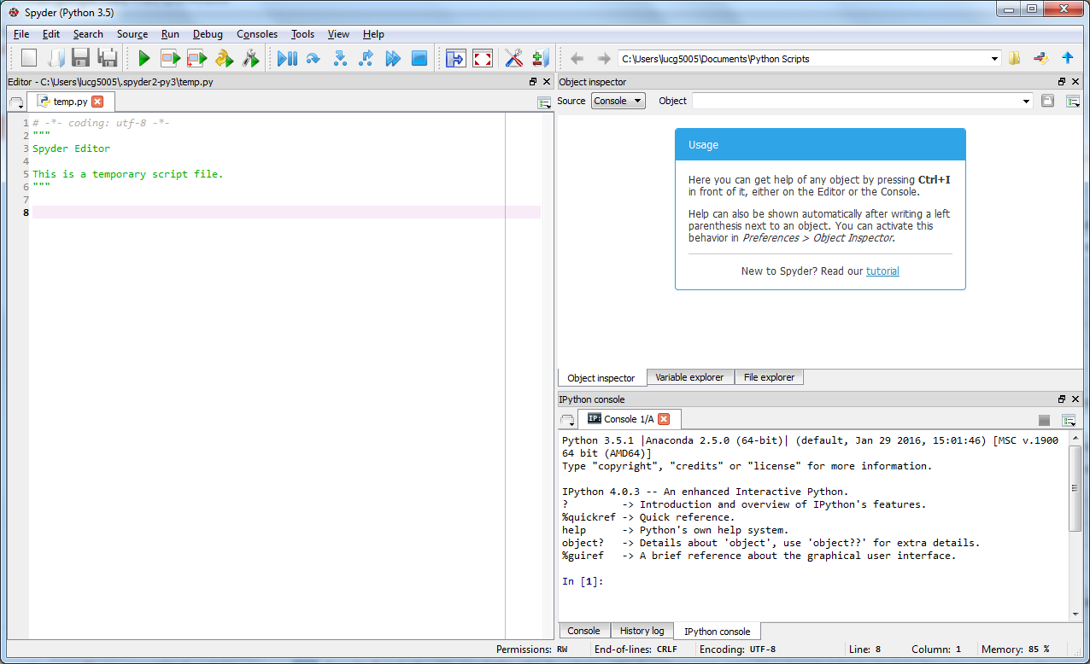
Spyder
object inspector
editor
console

Slide 412
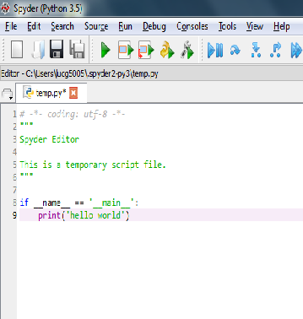
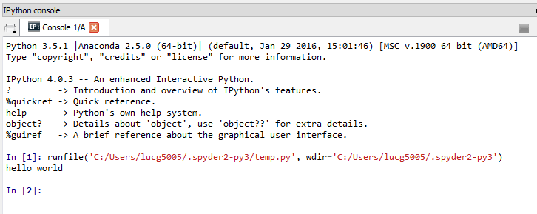
Spyder: work cycle
Repeat until done
Edit code
Safe file
Run file
Check results

Slide 413
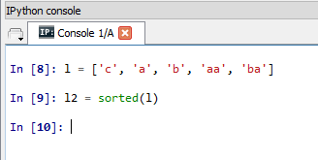
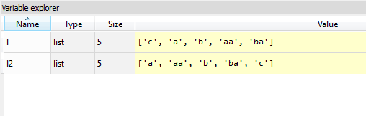
Spyder: object inspector
Executing code snippets
Variable values in inspector

Slide 414


Spyder: getting help
Select function/method/… in editor/console, press ctrl-i
Help in object inspector

Slide 415
Spyder: more features
Project/file manager
Debug code
Profile code

Slide 416
References

Slide 417
Some useful learning references
Python tutorial: https://docs.python.org/3.4/tutorial/
Library reference: https://docs.python.org/3.4/library/
Language reference: https://docs.python.org/3.4/reference/
Think Python: http://www.greenteapress.com/thinkpython/thinkpython.pdf
Python style guides:
Idioms and anti-idioms in Python: http://docs.python.org/2/howto/doanddont.html
PEP 8: http://www.python.org/dev/peps/pep-0008/
Google: http://google-styleguide.googlecode.com/svn/trunk/pyguide.html

Slide 418
Books
How to make mistakes in Python Mike Pirnat, O'Reilly, 2015
Writing idiomatic Python 3.3 Jeff Knupp, 2013
Fluent Python: clear, concise and effective programming Luciano Ramalho, O'Reilly, 2015
Many, many more

Slide 419
Python software
Official Python website: http://www.python.org/
PyPI (Python Package Index): https://pypi.python.org/pypi
Continuum Anaconda (fully loaded Python distribution, free for academic use) : https://store.continuum.io/cshop/anaconda/
Miniconda: http://conda.pydata.org/miniconda.html
PyLint (check syntax before running script): http://www.pylint.org/
Flake8 (another syntax/semantics checker) https://pypi.python.org/pypi/flake8
PyDev (Eclipse plugin for Python development): http://pydev.org/

Slide 420
Useful non-standard Python libraries
Numerical computations, especially linear algebra: numpy, scipy http://www.numpy.org/, http://www.scipy.org/
Image processing: scikit-image http://scikit-image.org/
Parsing context free languages: pyparsing http://pyparsing.wikispaces.com/
HDF5: PyTables http://www.pytables.org/
Data analysis: pandas http://pandas.pydata.org/
Plots: matplotlib, HoloViews http://matplotlib.org/, http://ioam.github.io/holoviews/
Bioinformatics: BioPython http://biopython.org/
Graphs: NetworkX http://networkx.github.io/

