Slide 1
Parallel SVD
Geert Jan Bex
geertjan.bex@uhasselt.be

Slide 2
Singular Value Decomposition
Useful linear algebra technique for, e.g.,
rank reduction
linear fitting
…

Slide 3
Implementations
Lapack: serial + multithreaded, build using BLAS
Intel MKL
netlib Lapack
Scalapack: distributed using BLACS, build using pBLAS
Intel MKL
netlib Scalapack
Fortran, wrappers for C/C++/Python,…
Fortran

Slide 4
Test application
Read matrix from HDF5 file
Perform singular value decomposition
Fortran: Lapack's dgsevd
Fortran + MPI: Scalapack's pdgsevd
Python: scipy's svd
Matlab's svd
Recompute matrix from decompostion
Fortran: BLAS' dgemm
Fortran + MPI: pBLAS' pdgemm
Python: numpy's dot
Matlab's *
Compute error of recomputed matrix versus original

Slide 5
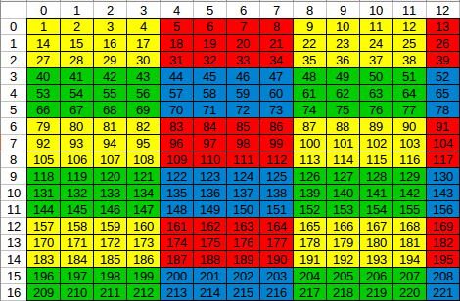
Lines of code & complexity
Implementation | Number of lines
Matlab | 16
Python + numpy + scipy | 37
Fortran + BLAS + Lapack | 200
Fortran + pBLAS + Scalapack | 480
Layout of matrix data for
use with Scalapack routines:
BLACS for communication

Slide 6
Multithreaded execution time
m = n = 32000, i.e., 4 × 8 GB
1 node, 2.8 GHz, 20 cores, 64 GB RAM
dgesvd: 6850 s
2 × dgemm: 296 s
1 node, 2.3 GHz, 10 cores, 128 GB RAM
dgesvd: 7670 s
2 × dgemm: 856 s
thinking
GHz
cerebro
Scaling for SVD, matrix multiplication of n × n matrix is O(n³)

Slide 7
Distributed versus multithreaded
m = n = 64000, i.e., 4 × 32 GB
4 nodes, 2.8 GHz, 16 cores
pdgesvd: 16600 s
2 × pdgemm: 1850 s
1 node, 2.3 GHz, 10 cores
dgesvd: 61300 s
2 × dgemm: 6850 s
8 nodes, 2.3 GHz, 8 cores
dgesvd: 343000 s
2 × dgemm: 51300 s
thinking
data locality!!!
cerebro
cerebro
Data stored on 1 node, needed by 7 others: communication + little cache reuse

Slide 8
Python & Matlab
No Scalapack, only multithreading!
Code runs on cerebro
m = n = 64000, i.e., 4 × 32 GB
linalg.svd: 61300 s
2 × dot: 6850 s

Slide 9
Effect of dplace
m = n = 32000, i.e., 4 × 8 GB
Without dplace
dgesvd: 24200 s
2 × dgemm: 672 s
With dplace
dgesvd: 7670 s
2 × dgemm: 856 s
data locality!!!

Slide 10
Latency
latency
disk I/O
1000000 cycles
Infiniband
5000 cycles
OpenMP barrier
1500 cycles
NUMA
RAM
150 cycles
80 cycles
erf
L3 cache
50 cycles
40 cycles
**
20 cycles
exp
L2 cache
20 cycles
10 cycles
/ or sqrt
5 cycles
+ or *
L1 cache
5 cycles
streaming DP fused multiply/add
Core
1 cycle

Slide 11
Conclusion
Cerebro is effective for
exploration
prototyping
verification
Efficient implementation needs work
careful shared memory implementation, taking into account data placement & locality
distributed implementation, using BLACS and/or MPI

