Slide 1
The singularity is near!
Geert Jan Bex (geertjan.bex@uhasselt.be)
License: this presentation is released under the Creative Commons, see http://creativecommons.org/publicdomain/zero/1.0/

Slide 2
Introduction

Slide 3
Introduction
Singularity developed by Berkeley Lab http://singularity.lbl.gov/
Intended as HPC alternative to
Docker https://www.docker.com/
Shifter https://github.com/NERSC/shifter

Slide 4
Motivation
The good: containers are useful
Some dependency chains are hard to resolve
X11 applications
32-bit applications
Portability of workflow across systems
The bad: containers pose security risks
Escalating privileges
Access to entire file systems
Enter singularity

Slide 5
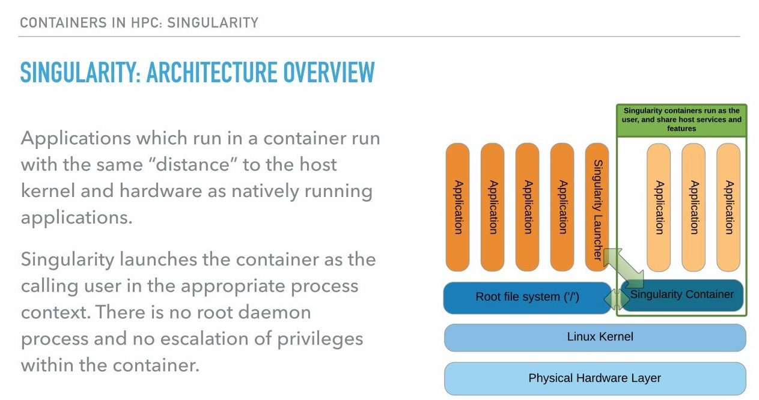
Singularity architecture

Slide 6
Singularity image
Single file, contains
OS components
System libraries
Application libraries
Applications
Data (possibly, but normally not)
Creation
Can be done on any machine, any (Linux) OS
Requires root privileges
Deployment
Runs on any (Linux) machine, singularity installed
No root privileges required

Slide 7
Installing singularity
Clone GitHub repository
Run autogen
Configure
Make
Install
Environment
Set PATH and LD_LIBRARY_PATH if installed in non-standard location
$ git clone https://github.com/singularityware/singularity.git
$ ./autogen.sh
Or other appropriate directory
$ ./configure --prefix=/usr/local
$ make
Must be sudo!
$ sudo make install

Slide 8
Creating images

Slide 9
Create image
Initially, empty image
Creation done with sudo
Maximum size (in MiB) of the image
Can be resized later, if necessary
File system created "inside" image
$ sudo singularity create --size 2048 grace.img
$ sudo singularity expand --size 1024 grace.img

Slide 10
Image definition file: bootstrap
Has to be installed on host
For, e.g., Ubuntu
xenial: 16.04, trusty: 14.04
For, e.g., CentOS
BootStrap: debootstrap
OSVersion: xenial
MirrorURL: http://us.archive.ubuntu.com/ubuntu/
BootStrap: yum
OSVersion: 7
MirrorURL: http://mirror.centos.org/centos-7/7/os/$basearch/
Include: yum

Slide 11
Bootstrap from Docker
For, e.g., Debian
Any public Docker container can be used
Docker containers in private repositories can be used
Specify token
BootStrap: docker
From: debian:jessie

Slide 12
Image definition file: %post
Post bootstrap phase, extra software installation
Through package manager
Download, configure, make, make install
E.g., Ubuntu
E.g., CentOS
%post
sed -i 's/$/ universe/' /etc/apt/sources.list
apt-get update
apt-get -y install grace
%post
yum -y install vim-minimal

Slide 13
Image definition file: %runscript, %test
Action when using run, e.g.,
Optionally, action when using test, e.g.,
%runscript
/usr/bin/grace
%test
/usr/bin/grace -version

Slide 14
Image definition file: complete
BootStrap: debootstrap
OSVersion: xenial
MirrorURL: http://us.archive.ubuntu.com/ubuntu/
%post
sed -i 's/$/ universe/' /etc/apt/sources.list
apt-get update
apt-get -y install grace
%runscript
/usr/bin/grace
%test
/usr/bin/grace -version

Slide 15
Bootstrap image
Installs base OS
Installs software specified in %post
Bootstrap done with sudo
When changing definition file, only modified parts executed
Nice for debugging, fast cycle
Updates/upgrades/security fixes done
$ sudo singularity bootstrap grace.img grace.def

Slide 16
Mount image
To manually modify image
To inspect/test image (read only)
Only to experiment, not as part of final setup!
$ mkdir /tmp/mnt
$ sudo singularity mount --writable grace.img /tmp/mnt
$ mkdir /tmp/mnt
$ sudo singularity mount grace.img /tmp/mnt

Slide 17
Using images

Slide 18
Run image/execute commands
To execute run script
Bound directories
Home directory
Current working directory
/tmp, /var/tmp
To execute arbitrary command
$ singularity run grace.img
Not on RHEL 6.x, 7.x
$ singularity exec grace.img gracebat –data data.dat \ -batch plot.bat
$ singularity exec grace.img xmgrace

Slide 19
Integration in workflow
Integration into PBS job script
Singularity images can be used in any workflow
#!/bin/bash –l
#PBS –l nodes=1:ppn=1
#PBS –l walltime=00:30:00
cd $PBS_O_WORKDIR
singularity exec grace.img gracebat –data data.dat \ -batch plot.bat

Slide 20
Image shell
To execute run shell in image
Defaults to /bin/sh, not /bin/bash!
Take care with .bash_profile/.bashrc, might generated errors
Nice to test software, do development
$ singularity shell grace.img

Slide 21
Directory bindings
Current working directory
where image is executed
Home directory
bound to user's host home directory
Additional bindings
command line option: -B <host-path>:<img-mount-point>
e.g., -B ~/Data:/mnt/data
Note: mount point must exist
as many as required

Slide 22
Multithreaded applications

Slide 23
Example definition file
BootStrap: debootstrap
OSVersion: xenial
MirrorURL: http://us.archive.ubuntu.com/ubuntu/
%post
sed -i 's/$/ universe/' /etc/apt/sources.list
apt-get update
apt-get -y install build-essential apt-get -y install git
cd /tmp
git clone https://github.com/gjbex/training-material.git
cd training-material/Mpi/HybridPi/
make clean pi_openmp.exe
cp pi_openmp.exe /usr/bin/
cd /tmp
rm -rf training-material/
Build tools
Download, build, install own software

Slide 24
Running OpenMP application
PBS job script, e.g., scaling test
#!/bin/bash -l
#PBS -l nodes=1:ppn=28
#PBS -l walltime=00:05:00
cd $PBS_O_WORKDIR
for num_threads in 1 2 4 8 16 24 28; do
export OMP_NUM_THREADS=$num_threads
time singularity exec xenial_openmpi.img \
pi_openmp.exe 100000000
done
Note: compiler version in image need not be same as on host

Slide 25
Distributed applications

Slide 26
Example definition file
BootStrap: debootstrap
OSVersion: xenial
MirrorURL: http://us.archive.ubuntu.com/ubuntu/
%post
sed -i 's/$/ universe/' /etc/apt/sources.list
apt-get update
apt-get -y install libmlx4-dev
apt-get -y install libmlx5-dev
apt-get -y install libibverbs-dev
apt-get -y install ibverbs-utils
apt-get -y install libopenmpi-dev
apt-get -y install openmpi-bin
apt-get -y install openmpi-common
apt-get -y install build-essential apt-get -y install git
cd /tmp
git clone https://github.com/gjbex/training-material.git
cd training-material/Mpi/HybridPi/
make clean pi_mpi.exe
cp pi_mpi.exe /usr/bin/
cd /tmp
rm -rf training-material/
Mellanox drivers, IB verbs
OpemMPI library and tools
Build tools
Download, build, install own software

Slide 27
Running MPI application
PBS job script
#!/bin/bash -l
#PBS -l nodes=2:ppn=28
#PBS -l walltime=00:05:00
cd $PBS_O_WORKDIR
module load foss/2016a
mpirun -mca orte_tmpdir_base /tmp \
singularity exec xenial_openmpi.img pi_mpi.exe 100000000
Note: OpenMPI version in image is same as on host

Slide 28
Performance

Slide 29
Singularity overhead
Startup of image ≈ 0.4 s
Serial code/OpenMP (computing π)
Overhead for walltime ≈ 20 seconds: < 0.85 %
Overhead for walltime ≈ 3 minutes: < 0.70 %
(Almost) independent of number of threads
MPI (computing SVD, matrix product)
PDGESVD: 7 % for 16 processes, 24 % for 64 processes
PDGEMM: < 1 % for 16 processes, 10 % for 64 processes
However, serial GESVD: 10 %
⇒ workflow with many short runtimes: entirely in image

Slide 30
Singularity performance pitfalls
Using non-optimized libraries/applications
Compilation can/should target specific hardware, e.g., -xHost
Performance loss up to 10-40 %
Crucial for BLAS, propagates to other scientific libraries, e.g., LAPACK, PETSc,…

Slide 31
Conclusions

Slide 32
Conclusions
Singularity advantages
Portability
Reproducibility
Easily create images
Integrate images into existing workflows
No privilege escalation
Create as root
Run as user, no sudo possible
Quite reasonable performance/overhead
No excuse to run crappy/suboptimal software!

Slide 33
Bootstrap best practices
Install software in default location, not home directory
Define environment variables in image's /environment
Files should be owned by system account, not user
Don’t mess with /etc/passwd, /etc/group, /etc/shadow
Do installation via definition file, not by hand
Better reproducibility

Slide 34
References
Singularity documentation
User guide http://singularity.lbl.gov/user-guide
Admin guide http://singularity.lbl.gov/admin-guide
Singularity GitHub repository https://github.com/singularityware/singularity
HPCWired article discussing singularity versus Docker/Shifter

