Slide 1
Profiling with Allinea MAP
Geert Jan Bex
(geertjan.bex@uhasselt.be)
License: this presentation is released under the Creative Commons, see http://creativecommons.org/publicdomain/zero/1.0/

Slide 2
Introduction
Allinea Forge (https://www.allinea.com/)
Allinea DDT: parallel debugger
Allinea MAP: parallel profiler
Commercial product
Floating licence, token based
64 tokens, e.g.,
2 × 2 MAP sessions of 32 processes
1 × MAP + 1 × DDT session of 32 processes
1 × DDT session of 64 processes
Analyzing a profile offline: half price

Slide 3
Supported programming models
Serial applications
Shared memory programming: OpenMP
GPU programming: CUDA
Distributed programming: MPI, UPC
Weapon of choice for MPI (+ OpenMP)
Debugging/profiling at scale: user interface optimized

Slide 4
Alternatives
Debugging
Commercial: RogueWave TotalView
Open source: Eclipse PTP
Profiling
Open source:
Scalasca
Paraver + Extrae

Slide 5
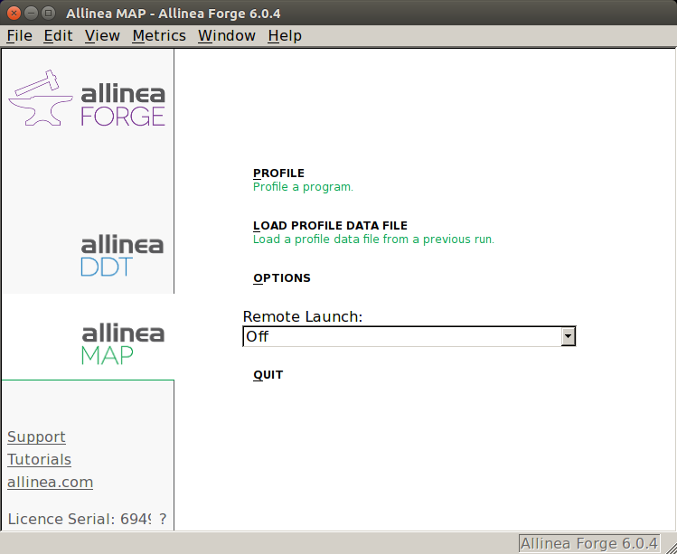
Startup
$ module load AllineaForge
$ map
Start profiling interactively
Load a profile to analyze
```
Start a job to profile interactively

