Slide 1
Graphical Information Systems data
https://github.com/gjbex/training-material/tree/master/Python/Gis

Slide 2
Introduction
Graphical Information System (GIS), e.g.,
ArcGIS
QGIS
Many data formats, e.g.,
shape files
GeoJSON
Python & GIS
I/O library: Fiona
visualization: Folium
data processing/modeling: Shapely
Can be scripted with Python

Slide 3
World Happiness Index
Data
World Happiness information: CSV file
relevant columns: Country, Happiness Score
data on 157 countries
country names, borders,… : GeoJSON
import pandas as pd
happiness_data = pd.read_csv(happiness_filename)

Slide 4
Folium visualization
import folium
Create world map
Add chloropleth
longitude
lattitude
world = folium.Map(
location=[0.0, 0.0],
tiles='Mapbox Bright',
zoom_start=2)
shows entire world
world.choropleth(
name='world happiness',
data=happiness_data,
columns=['Country', 'Happiness Score'],
geo_data=str(country_geo_filename),
key_on='properties.name',
fill_color='YlGn', fill_opacity=0.7,
line_opacity=0.2,
legend_name='Happiness Score')
pandas
GeoJSON

Slide 5
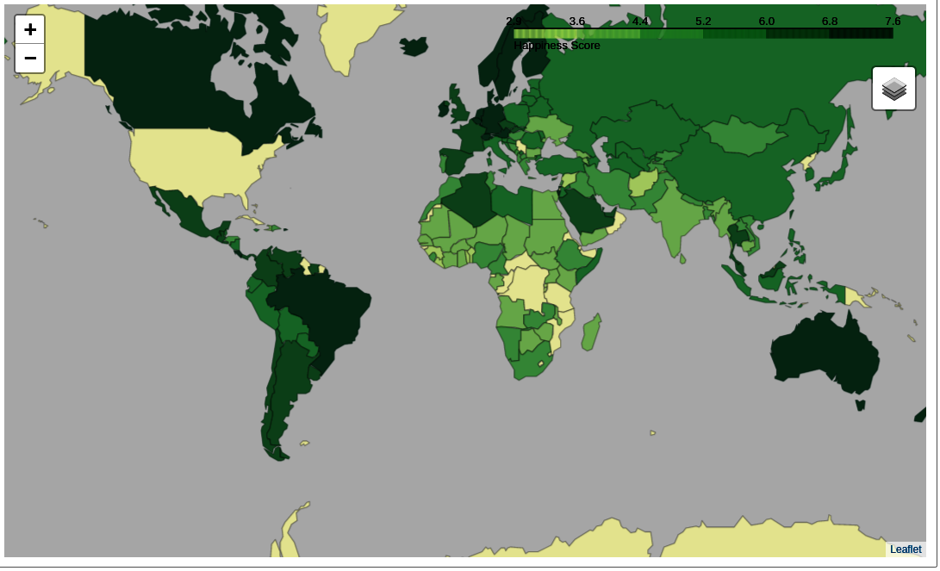
Folium in Jupyter Notebook
Missing data?

Slide 6
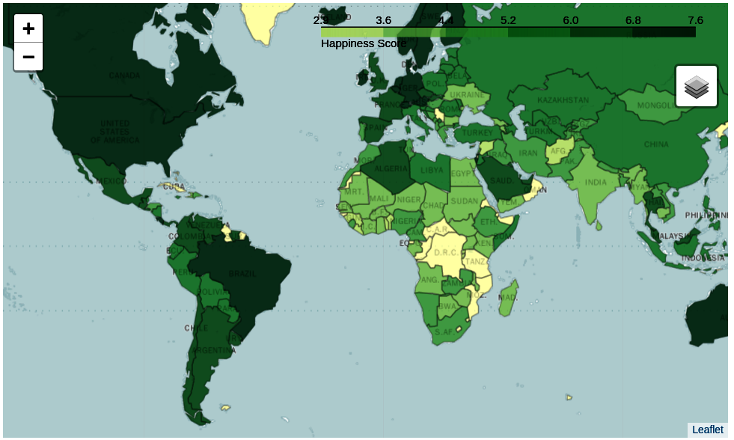
Data linkage issue
In World Happiness Index: United States
In GeoJSON file: United States of America
Fix: change names, e.g.,
happiness_data.at[12, 'Country'] = 'United States of America'

Slide 7




Shapely: geometric objects
Point: 2D or 3D
MultiPoint: collection of Point
LineString: sequence of Point
MultiLineString: multiple LineString
LinearRing: closed LineString
should not cross
Polygon: LinearRing as outer boundary, optionally multiple LinearRing as "holes"
should not touch in more than one point
MultiPolygon: multiple Polygon
should not touch in more than one point

Slide 8
Shapely: object examples
LineString
LinearRing
Polygon
line = LineString([(0.0, 0.0), (1.0, 1.0), (2.0, 0.5)])
outer = LinearRing([(3.0, 2.0), (3.0, 5.0), (6.0, 5.0),
(6.0, 2.0)])
inner1 = LinearRing([(3.5, 2.5), (3.5, 4.5), (4.5, 4.5),
(4.5, 2.5)])
inner2 = LinearRing([(5.0, 2.5), (5.0, 4.5), (5.5, 4.5), (5.5, 2.5)])
polygon = Polygon(outer, [inner1, inner2])

Slide 9
Shapely: predicates
a.within(b) ≡ b.contains(a)
a.intersects(b) ≡ not a.disjoint(b)
a.crosses(b)
a.almostequals(b, decimal=3)
a.is_valid
Shapely lets you create invalid objects
line.is_ring

Slide 10
Shapely: spatial analysis
a.intersection(b)
a.union(b)
a.difference(b)
a.symmetric_difference(b)
a.boundary: one dimension less
a.centroid: "mean" position
Set theoretic operations
a ≡ a.intersection(b).union(a.symmetric_difference(b))
a.symmetric_difference(b) ≡ a.difference(b).union(b.difference(a))
Note: use cascading_union for performance

Slide 11



Shapely: buffer
Point: 0D, LineString: 1D
buffer operation → 2D
line1 = LineString([(0.0, 1.0), (1.0, 0.5), (2.0, 1.5)])
line2 = LineString([(1.0, 0.5), (0.0, 2.0), ((-1.5, 1.0))])
multi_line = MultiLineString([line1, line2]
buff1 = multi_line.buffer(0.1)
buff2 = multi_line.buffer(0.1, cap_style=CAP_STYLE.flat, join_style=JOIN_STYLE.mitre)

Slide 12
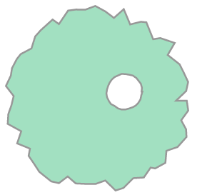
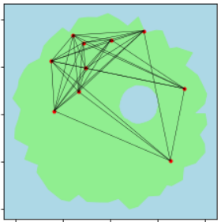
Shapely: example
Create island
create coast as LinearRing
create lake contour as LinearRing
check whether lake.within(coast)
create island as Polygon, coast as boundary, lake as hole
Create cities
create city position as Point
extend proportional to size city = city.buffer(population)
retain if city.within(island)
Create roads
create road as LineString between cities
retain if road.within(island)

Slide 13
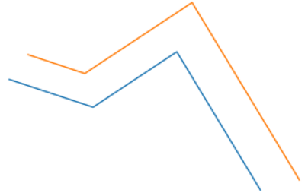
Shapely: other constructions
shape.convex_hull: shape → Polygon
shape.envelope: shape → Polygon
rectangle, sides parallel to axes
shape.minimum_rotated_rectangle: shape → Polygon
line.parallel_offset(…): line → LineString
parallel = line.parallel_offset(0.5, 'left', join_style=JOIN_STYLE.mitre)

Slide 14
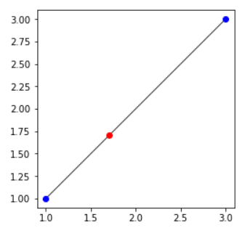
Shapely: interpolation
Compute point at given distance from point along a line
point1 = Point((1.0, 1.0))
point2 = Point((3.0, 3.0))
line = LineString([point1, point2])
point3 = line.interpolate(1.0)
point1.distance(point3)
→ 1.0
d = 1.0

Slide 15
GeoPandas: shape files & GeoJSON
import geopandas as gpd
%matplotlib inline
Read GeoJSON
Coordinate reference system
gdf = gdp.read_file(geo_json_filename)
print(gdf.info())
<class 'geopandas.geodataframe.GeoDataFrame'>
RangeIndex: 180 entries, 0 to 179
Data columns (total 3 columns):
id 180 non-null object
name 180 non-null object
geometry 180 non-null object
dtypes: object(3)
memory usage: 4.3+ KB
gdf.crs

Slide 16
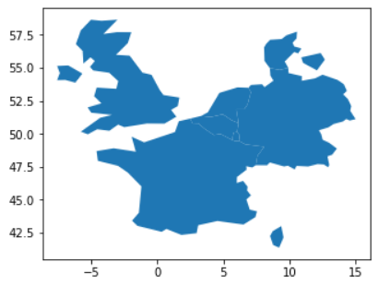
GeoPandas: selection
longitude range
Spatial selection
Visualization
latitude range
western_europe = gdf.cx[0:10, 50:55]
id
BEL Belgium
DEU Germany
DNK Denmark
FRA France
GBR United Kingdom
LUX Luxembourg
NLD Netherlands
Name: name, dtype: object
Based on intersection
print(western_europe['name'])
western_Europe.plot()

Slide 17
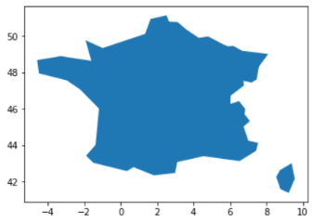
GeoPandas operations
Shapely operations, e.g., buffer(…), boundary, rotate(…)
GeoSeries/GeoDataFrame → GeoSeries
unary_union: GeoDataFrame/GeoSeries → Polygon/MultiPolygon
Overlay operations: overlay(…)
union, intersection, difference, symmetric_difference
southern_europe = gdf.cx[-10:20, 40:45]
intersection = gpd.overlay(western_europe, southern_europe, how='intersection')

Slide 18
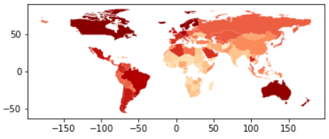
GeoPandas merge
Merging dataframes
consistent column names
df = pd.read_csv(csv_filename)
df.rename(columns={'Country': 'name'})
df_merged = gdf.merge(df, on='name')
df_merged.plot(column='Happiness Score', cmap='OrRd')
merge on country name
Cholopleth plot
by happiness score

Slide 19
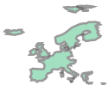
GeoPandas dissolve
Aggregate GIS information based attributes
world = df_merged[['name', 'Region', 'geometry']]
regions = world.dissolve(by='Region')
western_Europe_shape = regions.at['Western Europe', 'geometry']

Slide 20
GeoTIFF
Raster data, e.g., satellite imagery
TIFF image file
1 or more raster bands
meta-data in tags
coordinate reference system
geotransform
I/O: GDAL library with Python wrapper

Slide 21
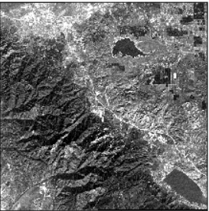
Reading GeoTIFF
Open & read GeoTIFF
Number raster bands: data.RasterCount
Raster band as numpy array
Projection: data.GetProjection()
Geo-transform: data.GetGeoTransform()
import gdal
data = gdal.Open(file_name)
count from 1!
raster_band = data.GetRasterBand(1).ReadAsArray()

Slide 22
Writing GeoTIFF
Create file
Set projection/geo-transform
Write numpy array data
Flush cache
driver = gdal.GetDriverByName('GTIFF')
new_data = driver.Create(new_file_name,
data.RasterXSize, data.RasterYSize,
1, gdal.GDT_Byte)
nr. of bands
many types, e.g.,
GDT_Float32
GDT_Int16
new_data.SetProjection(data.GetProjection())
new_data.SetGeoTransform(data.GetGeoTransform())
new_data.GetRasterBand(1).WriteArray(new_raster_band)
new_data.GetRasterBand(1).WriteArray(new_raster_band)

Slide 23
GeoTIFF geo-transformation
Geo-transformation: pixels → coordinates

Slide 24
Further reading
Folium manual http://python-visualization.github.io/folium/docs-master/
Shapely manual https://shapely.readthedocs.io/en/latest/
GeoPandas manual http://geopandas.org/index.html
GIS & Python introduction https://macwright.org/2012/10/31/gis-with-python-shapely-fiona.html
Fiona manual http://toblerity.org/fiona/index.html
Editing/displaying GeoJSON http://geojson.io/
GIS data sources http://gisgeography.com/best-free-gis-data-sources-raster-vector/

