Slide 1
Essential C++ Numerics
Geert Jan Bex
(geertjan.bex@uhasselt.be)
License: this presentation is released under the Creative Commons, see http://creativecommons.org/publicdomain/zero/1.0/

Slide 2
Presentation based on: A tour of C++ Bjarne Stroustrup
Addison-Wesley, 2014

Slide 3
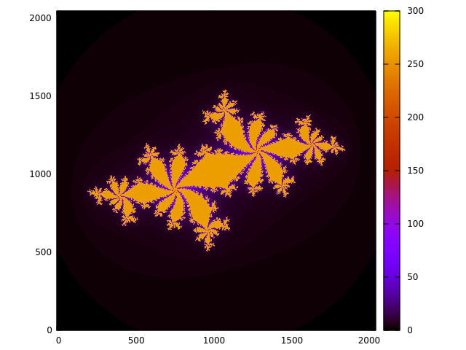
Complex numbers
#include <complex>
…
using namespace std;
…
const complex<double> c(-0.62772, - 0.42193);
for (double x = -1.8; x < 1.8; x += 0.001)
for (double y = -1.8; y < 1.8; y += 0.001) {
complex<double> z(x, y);
while (abs(z) < 2.0 && n++ < max_n)
z = z*z + c;
cout << x << " " << y << " " << n << endl;
}
(Overloaded) math functions
More efficient:
real(z)*real(z) + imag(z)*imag(z) < 4.0

Slide 4
Numerical limits
#include <limits>
Integer: int, long, int8_t, int16_t, int32_t, int64_t
minimum: std::numeric_limits<int>::min()
maximum: std::numeric_limits<int>::max()
Floating point: float, double, long double
smallest number > 0: std::numeric_limits<double>::min()
maximum: std::numeric_limits<double>::max()
1 < 1 + ε: std::numeric_limits<double>::epsilon()
significant digits, base 10: std::numeric_limits<double>digits10
isfinite(…): true if not ±infinity, or NaN

Slide 5
Limit values
usually short
usually int
usually long
 | int8_t | int16_t | int32_t | int64_t
min() | -256 | -32768 | -2147483648 | -9223372036854775808
max() | 255 | 32767 | 2147483647 | 9223372036854775807
∼10⁹
∼ 10¹⁹
 | float | double | long double
digits10 | 6 | 15 | 18
min() | 1.176e-38 | 2.225e-308 | 1.190e+4932
epsilon() | 1.192e-07 | 2.221e-16 | 1.084e-19
max() | 3.403e+38 | 1.798e+308 | 3.362e-4932
performance penalty!
32-bit
64-bit
96-bit

Slide 6
More precision?
Possible, but at high cost
performance
development
Consider other algorithms first
Libraries for arbitrary precision arithmetic
GMP: for integers
MPFR: for floating point numbers
MPC: for complex floating point numbers

Slide 7
Random number generation
Engine: generates random number sequence
std::random_device: non-deterministic
std::ranlux48
std::mt19937_64: Mersenne twister
…
Distributions
uniform_int_distribution<type>(a, b)
uniform_real_distribution<type>(a, b)
normal_distribution<type>(mu, sigma)
…

Slide 8
Typical workflow
Create random device
Create seed distribution
Draw seed from seed distribution using random device
Create engine, seed
Create actual distribution
Draw random number from actual distribution using engine

Slide 9
Example: normal distribution
#include <functional>
#include <random>
…
using seed_dist_t = uniform_int_distribution<size_t>;
…
random_device dev;
seed_dist_t seed_distr(0, numeric_limits<size_t>::max());
auto seed = seed_distr(dev);
cout << seed << endl;
mt19937_64 engine(seed);
auto distr = bind(normal_distribution<int>(0.0, 1.0), engine);
for (int i = 0; i < 5; i++)
cout << distr() << endl;
①
②
③
④
⑤
⑥

Slide 10
Multiple distributions
bind binds by value, i.e., copies, unless wrapped
#include <functional>
#include <random>
…
using seed_dist_t = uniform_int_distribution<size_t>;
…
mt19937_64 engine(seed);
auto x_distr = bind(normal_distribution<int>(0.0, 1.0), ref(engine));
auto y_distr = bind(normal_distribution<int>(0.0, 1.0), ref(engine));
Without ref(…), both x_distr and y_distr produce same numbers!

Slide 11

Linear algebra
Several libraries, don't do your own!
Eigen (http://eigen.tuxfamily.org/)
purely header files
trivial to install
Armadillo (http://arma.sourceforge.net/)
uses BLAS/Lapack
quite convenient
good performance
no distributed algorithms
…
Here: a flavor of Armadillo

Slide 12
Data types
shortcuts: type is double
Vectors
Col<type>, colvec, vec
Row<type>, rowvec
Matrices
dense: Mat<type>, mat
sparse: SpMat<type>, sp_mat
Cubes (3D arrays)
Cube<type>, cube
Fields (2D or 3D arrays, arbitrary objects)
Field<obj_type>
#include <armadillo>
…
using namespace arma;
…
type is scalar
obj_type is arbitrary

Slide 13
Initialization
Literal initialization
Generated vectors
Generated matrices
Generated vector/matrices/cubes
vec v {7.3, 9.1};
mat A {{-1.0, 3.1, 4.3}, {2.1, -2.4, 0.9}};
vec x = linspace<vec>(-1.0, 1.0, 501);
vec y = regspace<vec>(0.0, 0.1, 1.0);
mat A = eye<mat>(5, 5);
Note resemblance to MATLAB, numpy
mat A = randn<mat>(2, 3);
vec x = randu<vec>(5);
vec y = zeros<vec>(10);
mat C = ones<mat>(3, 2);

Slide 14
Matrix arithmetic/functions
mat A {{-1.0, 3.1, 4.3}, {2.1, -2.4, 0.9}};
mat B {{2.1, -2.0, 0.2}, {0.1, 3.1, -1.7}};
vec x {7.3, 9.1};
vec y = (2.0*A + B)*x;
Operator overloading for convenient mathematical expressions
scalar-matrix multiplication
matrix-vector multiplication
matrix-matrix sum
vec x = randn(10);
vec y = randn(10);
double distance = norm_dot(x, y);
Many other math functions: abs, det, norm, dot, min, max, sum,…

Slide 15
Matrix access
…
for (size_t j = 0; j < A.n_cols; j++)
for (size_t i = 0; i < A.n_rows; i++)
A(i, j) = f(i, j);
Note: elements stored columnwise
…
mat B = A.submat(span(min_row, max_row),
span(min_col, max_col));
rowvec x = A.row(row_nr);
vec y = A.col(col_nr);
…
double a, b, c;
…
A.transform([=] (double x) { return a*x*x + b*x + c; });

Slide 16
Linear algebra
Many decomposition methods, e.g., SVD
Matrix transpose: A.t()
Matrix inverse: A.i()
…
mat A(nr_rows, nr_cols);
…
mat U, V;
vec s;
svd(U, s, V, A);
mat S = diagmat(s);
mat A_p = (U*S)*V.t();

Slide 17
ODEs with Boost::odeint
Declarations
Define equations
#include <array>
#include <functional>
#include <boost/numeric/odeint.hpp>
using namespace boost::numeric::odeint;
using state_type = array<double, 3>;
void lorenz_param(const state_type& x, state_type& dxdt, double t,
double sigma, double R, double b) {
dxdt[0] = sigma*(x[1] - x[0]);
dxdt[1] = R*x[0] - x[1] - x[0]*x[2];
dxdt[2] = -b*x[2] + x[0]*x[1];
}
RHS of ODEs

Slide 18
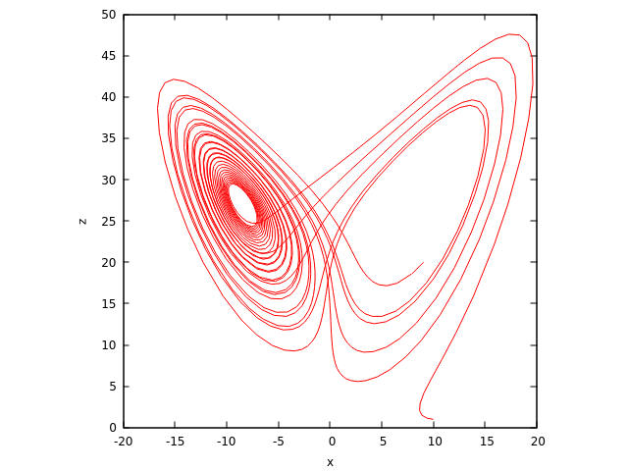
Solving ODEs
Writing steps
Integration
void write_lorenz(const state_type& x, const double t) {
cout << t << '\t' << x[0] << '\t' << x[1] << '\t' << x[2] << endl;
}
const double sigma = 10.0;
const double R = 28.0;
const double b = 8.0/3.0;
using namespace std::placeholders;
auto lorenz = bind(lorenz_param, _1, _2, _3, sigma, R, b);
state_type x = { 10.0, 1.0, 1.0 };
integrate(lorenz, x, 0.0, max_t, delta_t, write_lorenz);
Use bind to set parameters

Slide 19
What was left out/added?
Left out
Value arrays, see section on containers
Added
Linear algebra with Armadillo
ODEs with Boost

