Slide 1
Essential C++ Numerics
Geert Jan Bex
(geertjan.bex@uhasselt.be)
License: this presentation is released under the Creative Commons, see http://creativecommons.org/publicdomain/zero/1.0/

Slide 2
Presentation based on: A tour of C++ Bjarne Stroustrup
Addison-Wesley, 2014

Slide 3
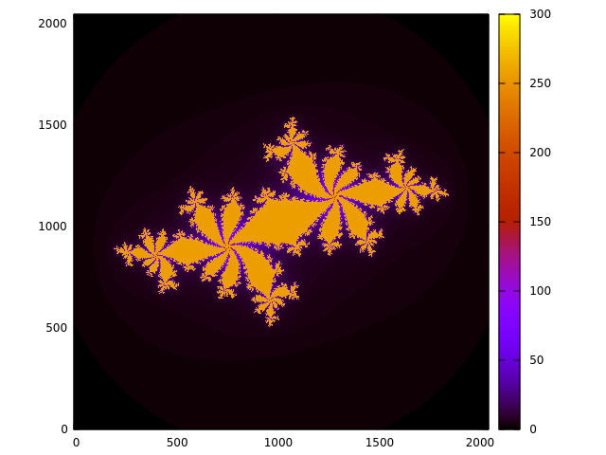
Complex numbers
#include <complex>
…
using namespace std;
…
const complex<double> c(-0.62772, - 0.42193);
for (double x = -1.8; x < 1.8; x += 0.001)
for (double y = -1.8; y < 1.8; y += 0.001) {
complex<double> z(x, y);
while (abs(z) < 2.0 && n++ < max_n)
z = z*z + c;
cout << x << " " << y << " " << n << endl;
}
(Overloaded) math functions
More efficient:
real(z)*real(z) + imag(z)*imag(z) < 4.0

Slide 4
Numerical limits
#include <limits>
Integer: int, long, int8_t, int16_t, int32_t, int64_t
minimum: std::numeric_limits<int>::min()
maximum: std::numeric_limits<int>::max()
Floating point: float, double, long double
smallest number > 0: std::numeric_limits<double>::min()
maximum: std::numeric_limits<double>::max()
1 < 1 + ε: std::numeric_limits<double>::epsilon()
significant digits, base 10: std::numeric_limits<double>digits10
isfinite(…): true if not ±infinity, or NaN

Slide 5
Limit values
usually short
usually int
usually long
 | int8_t | int16_t | int32_t | int64_t
min() | -256 | -32768 | -2147483648 | -9223372036854775808
max() | 255 | 32767 | 2147483647 | 9223372036854775807
∼10⁹
∼ 10¹⁹
 | float | double | long double
digits10 | 6 | 15 | 18
min() | 1.176e-38 | 2.225e-308 | 1.190e+4932
epsilon() | 1.192e-07 | 2.221e-16 | 1.084e-19
max() | 3.403e+38 | 1.798e+308 | 3.362e-4932
performance penalty!
32-bit
64-bit
96-bit

Slide 6
More precision?
Possible, but at high cost
performance
development
Consider other algorithms first
Libraries for arbitrary precision arithmetic
GMP: for integers
MPFR: for floating point numbers
MPC: for complex floating point numbers

Slide 7
Random numbers

Slide 8

Linear algebra
Several libraries, don't do your own!
Eigen (http://eigen.tuxfamily.org/)
purely header files
trivial to install
Armadillo (http://arma.sourceforge.net/)
uses BLAS/Lapack
quite convenient
good performance
no distributed algorithms
…
Here: a flavor of Armadillo

Slide 9
Ordinary differential equations
Straightforward: Boost::odeint

Slide 10
What was left out/added?
Left out
Value arrays, see section on containers
Added
ODEs with Boost
Linear algebra with Armadillo

