Slide 1
Profiling & debugging
Geert Jan Bex
(geertjan.bex@uhasselt.be)
License: this presentation is released under the Creative Commons, see http://creativecommons.org/publicdomain/zero/1.0/

Slide 2
Profiling

Slide 3
Workflow
Concentrate on single node
profile & analyze bottlenecks
memory access?
cache use?
vectorization?
branch prediction?
OpenMP overhead?
Inter-node communication
profile & analyze bottlenecks
granularity of communication/computation?
domain decomposition?
suboptimal MPI calls?
Use version control!
Use unit tests!

Slide 4
Unit testing: what is it?
Library to write and handle tests
First write test code, then code to be tested
Implementations of framework
CUnit for C
CppUnit for C++
JUnit for Java
funit for Fortran (http://nasarb.rubyforge.org/)
unittest in Python standard library
RUnit for R
Tests are functions
Tests are organized in test suites
Test suites reside in repository
Easy to run, so run often
Invaluable when modifying code

Slide 5
Profiling with Allinea MAP

Slide 6
Introduction
Allinea Forge (https://www.allinea.com/)
Allinea DDT: parallel debugger
Allinea MAP: parallel profiler
Commercial product
Floating licence, token based
64 tokens, e.g.,
2 × 2 MAP sessions of 32 processes
1 × MAP + 1 × DDT session of 32 processes
1 × DDT session of 64 processes
Analyzing a profile offline: half price

Slide 7
Supported programming models
Serial applications
Shared memory programming: OpenMP
GPU programming: CUDA
Distributed programming: MPI, UPC
Weapon of choice for MPI (+ OpenMP)
Debugging/profiling at scale: user interface optimized

Slide 8
Methodology
MAP uses sampling (call stack)
No instrumentation
Simply compile with -g for details
Overhead is minimal (∼ 5-10 % at most)
Works with many MPI implementations
Intel MPI
OpenMPI
MVAPICH
…

Slide 9
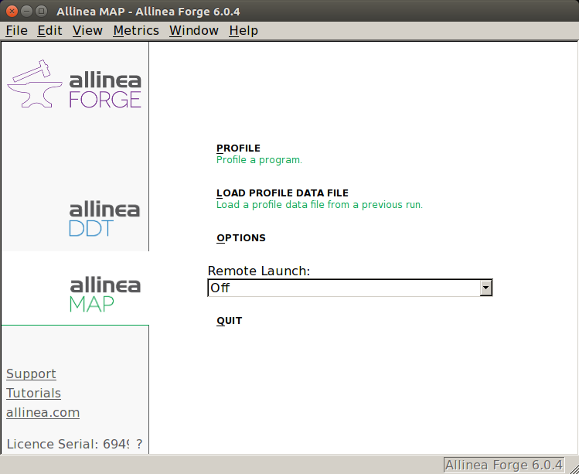
Startup
$ module load AllineaForge
$ map
Start profiling interactively
Load a profile to analyze
```
Start a job to profile interactively

Slide 10
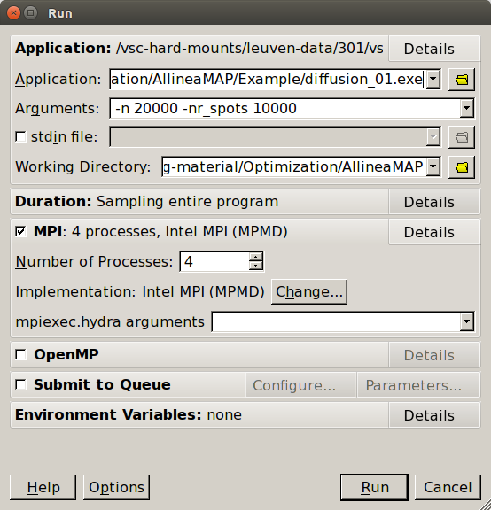
Interactive profiling
Run configuration
Remembers between runs
Choose application
Application arguments
Working directory
Configure MPI/OpenMP
Start run/profiling

Slide 11
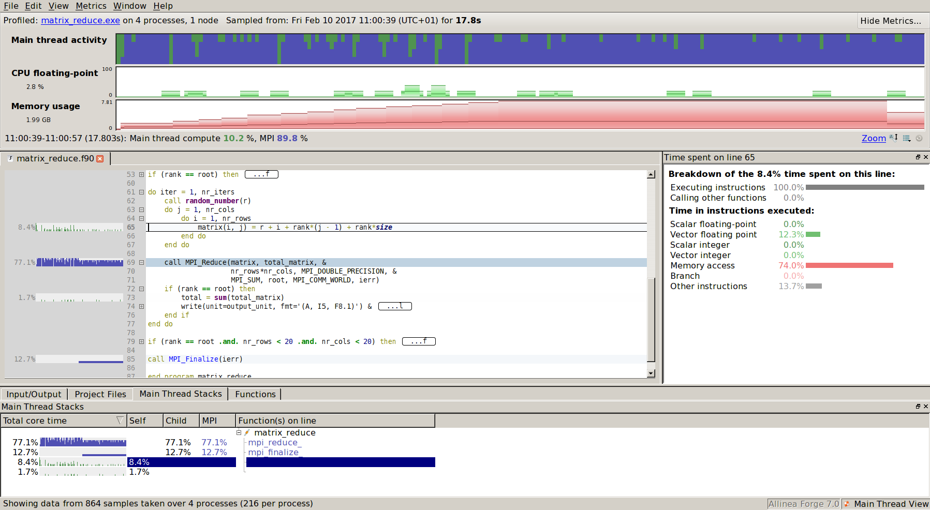

Results
Ask your boss for a large screen

Slide 12
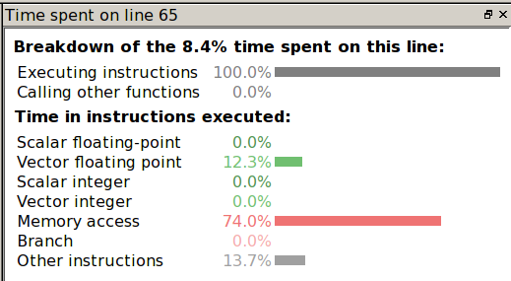


Line breakdown
Vector floating point
Memory access 74 %
No branching

Slide 13
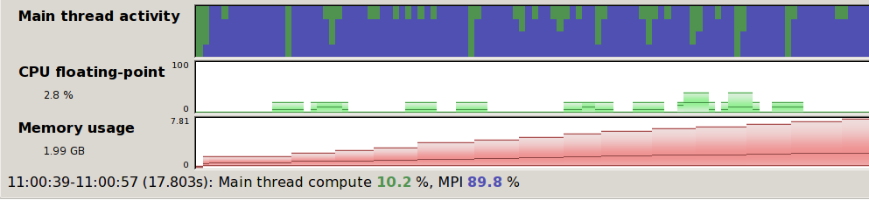
Time line
min, max, mean, s.d. available
Zoom by selecting
All view updated!
processes
time
Very useful to identify run
phases
Can display many metrics
CPU instructions
I/O: disk read/write
MPI
Number calls peer-to-peer & collectives/s
Peer-to-peer & collectives bandwidth
Send & receive bandwidth
Any combination

Slide 14
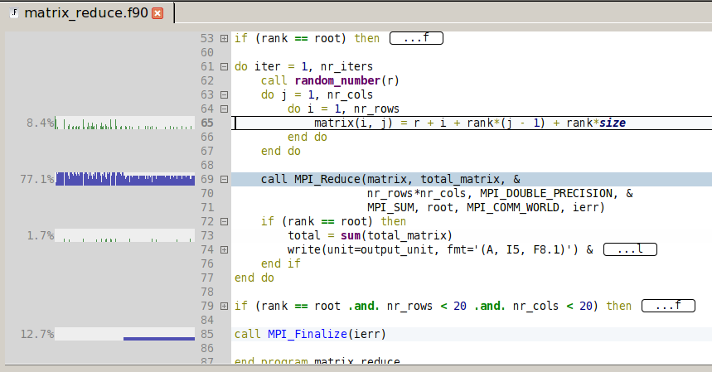
Source code view
Code can be folded
Line based activity
Color coded:
• Communication
• Compute
Easy to navigate through code
Go to function definitions in any file
Requires compile with -g

Slide 15
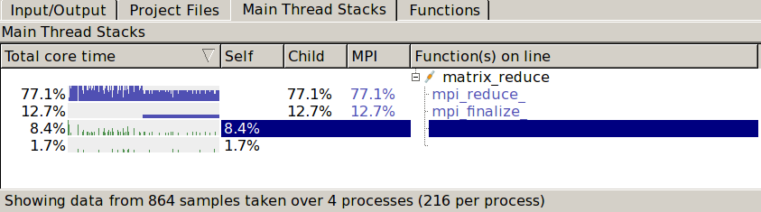
Call stack view
Click to go to code
Ordered by % runtime
Navigate to source code

Slide 16
Round tripping
From within Allinea MAP
Edit code
Rebuild
Profile
Commit in version control system
Switch between MAP and DDT

Slide 17
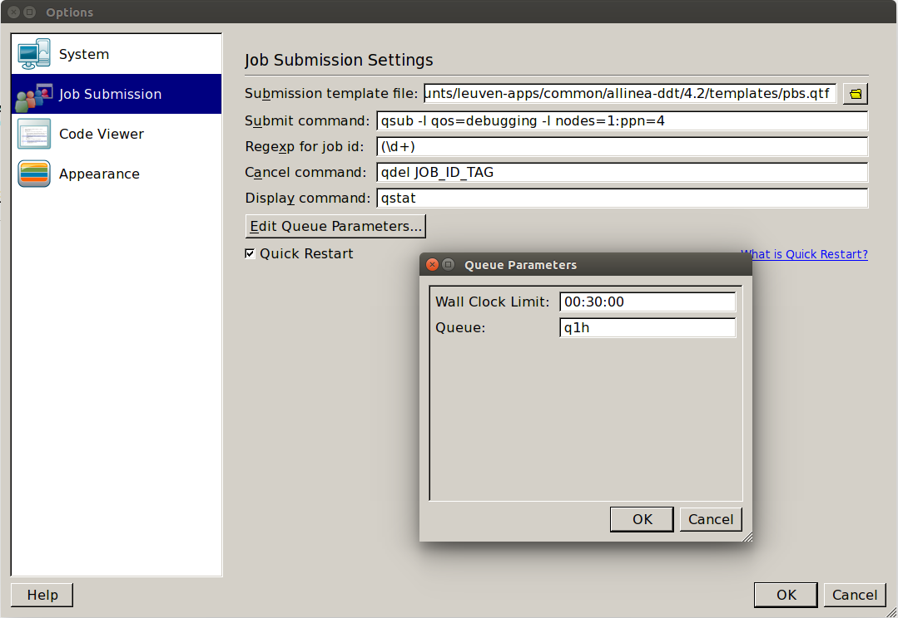
Interactive profiling via job
Job will run on compute nodes

Slide 18
Batch profiling via job
#!/bin/bash –l
#PBS –l nodes=1:ppn=4
#PBS –l walltime=1:00:00
…
map --np 4 --profile --stop-after 3500 \
diffusion.exe 10000 5000 30
Submit job
When done, open profile with MAP

Slide 19
Performance issues

Slide 20
Compute node architecture
Socket 0
NUMA node 0
Socket 1
NUMA node 1
L1
L2
L3
L1
L2
L1
L2
L3
L1
L2
DDR3
core0
core5
core10
core15
DDR3
L1
L2
L1
L2
L1
L2
L1
L2
core1
core6
QPI
core11
core16
DDR3
DDR3
L1
L2
L1
L1
L2
L1
L2
L2
L1
L2
core2
core0
QPI
core17
core7
core12
DDR3
L1
L2
L1
L2
L1
L2
L1
L2
DDR3
core3
core8
core13
core18
DDR3
L1
L2
L1
L2
L1
L2
L1
L2
DDR3
core4
core9
core14
core19
IB
I/O

Slide 21
Memory issues

Slide 22
Memory hierarchy
Bandwidth: 130 GB/s
Data transport takes time!
RAM
size: 64 GB+
latency: 150 cycles
L3 cache
size: 25 MB+
latency: 50 cycles
L2 cache
size: 256 kb
latency: 20 cycles
L1 cache
size: 32 kb data + 32 kb instruction
latency: 5 cycles
QPI incurs 10 % loss
on average: 3 MB/core

Slide 23
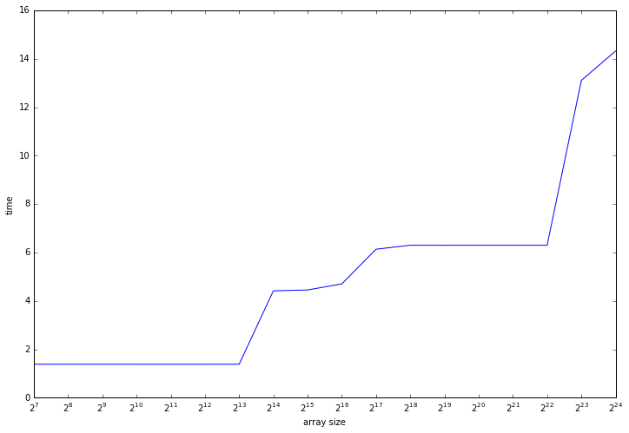
Memory hierarchy timings
L1
L2
L3
16 Mb
256 kb
32 kb

Slide 24
Cache lines
Transport 64 byte at once: RAM → L3 → L2 → L1
cache line
8 double or 16 single precision
Data structure layout is critical!
access to contiguous data
not exploited: effective • memory bandwidth/8 or 16
• cache size/8 or 16
double a[n];
…
for (i = 0; i < n; i++)
f(a[i])
…
a[i-1]
a[i]
a[i+1]
…
a[i+7]
a[i+8]
…
cache line
cache line

Slide 25
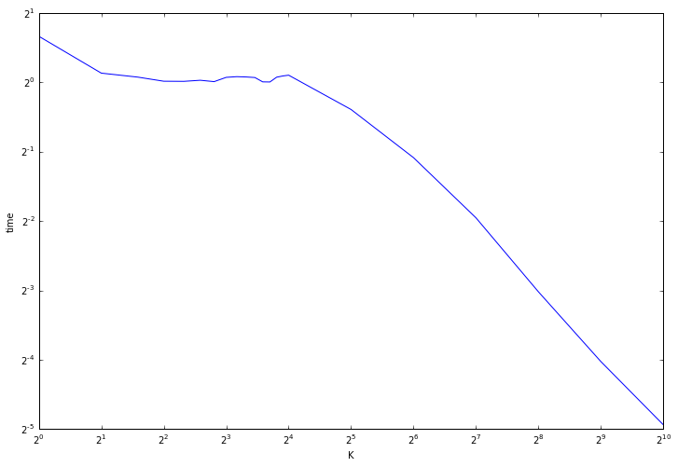
Cache line timings
int a[n];
…
for (i = 0; i < n; i += K)
a[i] *= 3
stride 16
less work, almost equal time!
memory bound,
equal number
of cache lines
to fetch
less work, less cache lines to fetch

Slide 26
Multidimensional arrays
Ordering of 2D/3D/… arrays
by row: C/C++
by column: Fortran, Matlab
…
a_{1,1}
a_{1,2}
a_{1,3}
a_{2,1}
a_{2,2}
a_{2,3}
…
row-major
Access in "wrong" order: performance degradation!
…
a_{1,1}
a_{2,1}
a_{3,1}
a_{1,2}
a_{2,2}
a_{3,2}
…
column-major

Slide 27
AoS versus SoA
Array of Structs versus Struct of Arrays?
struct particle {
double x, y, z, m;
int q;
};
struct particle particles[n];
…
x_{i}
y_{i}
z_{i}
m_{i}
q_{i}
x_{i+1}
…
cache line
May transport useless data: performance degradation
struct particles {
double x[n], y[n], z[n],
m[n];
int q[n];
};
…
x_{i}
x_{i+1}
x_{i+2}
y_{i}
y_{i+1}
…
cache line

Slide 28
CPU & Vectorization issues

Slide 29
Expensive arithmetic operations
Division: 10 cycles
x/2.0 → 0.5*x
sqrt: 10 cycles
sqrt(x**2 + y**2) < d → x**2 + y**2 < d**2
exp: 20 cycles
Power: 40 cycles
x**2 → x*x (compiler may do this)
erf: 80 cycles
Chebyshev approximation?

Slide 30
Vectorization
Arithmetic operation done on registers
Vector registers for floating point operands: 256 bit wide
4 double precision
8 single precision
4 concurrent operations
8 concurrent operations
double precision: 4 registers × 2.5.10⁹ additions × 18 cores × 2 sockets = 360 GFLOPS
Theoretical peak performance!

Slide 31
(Counter) examples
Can be vectorized
Can not be vectorized
double a[N], b[N], c[N];
for (int i = 0; i < N; i++)
a[i] = a[i] + b[i]*c[i];
All iterations are independent
Loop done in chunks of 4
double a[N], b[N], c[N];
for (int i = 1; i < N; i++)
a[i] = a[i-1] + b[i]*c[i];
Iteration i depends on iteration i - 1

Slide 32
Compiler flags & directives
GCC compiler family
gcc –march=corei7-avx –O3 …
gcc –ftree-vectorize \ –march=corei7-avx –O2 …
for feedback, use -ftree-vectorizer-verbose=2
Intel compiler family
icc –xHost –O2 …
for feedback, use -qopt-report-phase=vec \ -qopt-report=3
Help compiler using, e.g., #pragma omp simd …

Slide 33
Timings for double precision
Number of operations | Dependent | Independent
1 | 1.0 | 1.0
2 | 2.0 | 1.0
4 | 4.0 | 1.0
8 | 8.2 | 1.0
Timings are unit-less relative numbers
Intel compilers 16.x are very smart

Slide 34
AVX2
Haswell, Broadwell CPUs: AVX2 instruction set
Fused multiply/add: a*x + b is single operation
Integer vector registers: 256 bit wide
Extra operations for cryptography
Streaming: 1 addition and 1 multiplication/cycle!
Worth to recompile!

Slide 35
Communication vs. computation

Slide 36
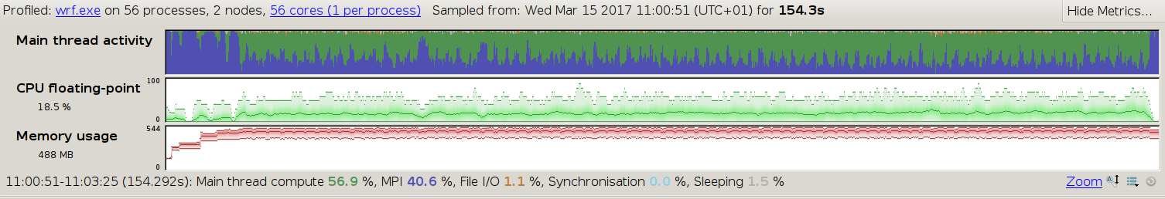
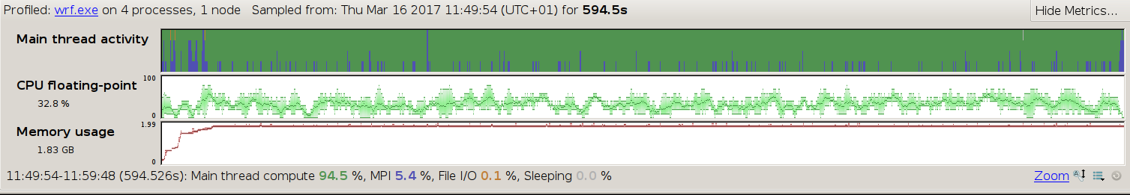
Domain decomposition
resources
walltime
domains too small!
lots of MPI chatter!
load imbalance
resources
walltime

Slide 37
Debugging

Slide 38
Bugs
All (non-trivial) code has bugs!
First priority: try to avoid them
Some advice & best practices
Some techniques
Find bugs: use the right tools

Slide 39
Avoid bugs
Write sane code!
Use descriptive variable/function names
If you needed to think about something, write a comment
Adhere to language-specific code layout conventions
Follow language-specific coding best practices
Stick to the official language specification, don't use extensions
Document your code, especially
Precondition: which assumptions are made about function parameters by the callee?
Postconditions: what can the caller safely assume about return values of functions?
Invariants: which conditions should always be fulfilled?
Program defensively
Check for exceptional conditions, report and/or handle

Slide 40
Compilers: general
Switch compilers
Check whether you get warnings/errors with any compiler you have, fix them
Switch on warnings at compile time
-Wall
For Intel: -Wall -Wremarks –Wchecks –w3
Compile with debugging information
-g2
No runtime overhead!

Slide 41
Floating point model
Optimizations may alter numerical results: round off
Compilers
GCC -O2: faithful to source
Intel -O2: optimizations may rearrange expressions
to avoid: -fp-model source (performance impact) or even -fp-model precise

Slide 42
Fortran language & compiler
GCC's gfortran is more strict than Intel's ifort
eliminate warnings generated by both compilers
Compile with no implicits allowed:
ifort: -implicitnone
gfortran: -fimplicit-none
While developing, switch on array bound checking at runtime
ifort: -check bounds
gfortran: -fbounds-check
Check for not explicitly initialized variables
ifort: -check uninit
gfortran: -finit-integer=-1000 (or whatever) -finit-real=nan
Be careful using latest language features
may not be (reliably) implemented yet
incurs performance penalty!

Slide 43
Fortran 2003+
In subroutines and functions: declare arguments with intent(in/out/inout)
Use parameter attribute for constant variables
Always use statement implicit none
In modules
In subroutines/functions

Slide 44
C/C++ language & compiler
Intel's icc/icpc is more strict than GNU's gcc/g++
Eliminate warnings generated by both compilers
Be careful when using latest C++ language features
May not be (reliably) implemented yet
Always initialize variables!
Be liberal with const for variables, arrays, pointers, references

Slide 45
Debugging with GDB

Slide 46
gdb: what is it?
Command line debugger, allows to
Step through code while executing
View values of variables
Watch for changes
Works on
Sequential programs
Multithreaded programs (including OpenMP)
Remote processes
Programming languages
C/C++
Fortran
Most IDE's have (visual) debuggers: similar principles

Slide 47
Example
#include <math.h>
#include <stdio.h>
#include <stdlib.h>
#include "show.h"
int main(int argc, char *argv[]) {
double a[10], sum;
int i;
for (i = 0; i <= 10; i++)
a[i] = sqrt(i);
for (i = 0; i < 10; i++)
sum += a[i];
printResult("sum", sum);
return EXIT_SUCCESS;
}
#ifndef SHOW_HDR
#define SHOW_HDR
void printResult(char *name,
double r);
#endif
show.h
#include <stdio.h>
void printResult(char *name,
double r) {
printf("%s = %f\n",
name, r);
}
array-bounds.c
show.c
Oops!
$ ./a.out
sum = 22.468278
≠
octave:1> sum(sqrt([0:9]))
ans = 19.306

Slide 48
Compiling code & starting gdb
Compile program for debugging
Running under gdb control: start gdb
$ gcc –g2 array-bounds.c show.c
$ gdb ./a.out
GNU gdb 6.8.0.20080328-cvs (cygwin-special)
Copyright (C) 2008 Free Software Foundation, Inc.
License GPLv3+: GNU GPL version 3 or later <http://gnu.o …
This is free software: you are free to change and redist …
There is NO WARRANTY, to the extent permitted by law. T …
and "show warranty" for details.
This GDB was configured as "i686-pc-cygwin"...
(gdb)

Slide 49
Listing source code
Listing code 10 line window: l(ist)
Listing next 10 lines: l
(gdb) l
1 #include <math.h>
2 #include <stdio.h>
3 #include <stdlib.h>
4
5 #include "show.h"
6
7 int main(int argc, char *argv[]) {
8 double a[10], sum;
9 int i;
10 for (i = 0; i <= 10; i++)
(gdb) l
11 a[i] = sqrt(i);
12 for (i = 0; i < 10; i++)
13 sum += a[i];
14 printf("sum = %lf\n", sum);
15 return EXIT_SUCCESS;
16 }
17

Slide 50
Listing source code
Listing code 10 line window around line 9: l 9
Listing from line 10 to line 13: l 10,13
(gdb) l 9
4
5 #include "show.h"
6
7 int main(int argc, char *argv[]) {
8 double a[10], sum;
9 int i;
10 for (i = 0; i <= 10; i++)
11 a[i] = sqrt(i);
12 for (i = 0; i < 10; i++)
13 sum += a[i];
(gdb) l 10,13
10 for (i = 0; i <= 10; i++)
11 a[i] = sqrt(i);
12 for (i = 0; i < 10; i++)
13 sum += a[i];
(

Slide 51
Listing source code
Listing function: l <func>
Listing function in other file: l <file>:<func>
(gdb) l main
2 #include <stdio.h>
3 #include <stdlib.h>
4
5 #include "show.h"
6
7 int main(int argc, char *argv[]) {
8 double a[10], sum;
9 int i;
10 for (i = 0; i <= 10; i++)
11 a[i] = sqrt(i);
(gdb) l show.c:printResult
1 #include <stdio.h>
2
3 void printResult(char *name, double r) {
4 printf("%s = %f\n", name, r);
}

Slide 52
Running a program
Run the code: r(un)
Not so interesting, but one can
Set breakpoints
Set conditional breakpoints
Watch stuff
add command line arguments here
(gdb) r
Starting program: ./a
[New thread 13704.0x32e0]
[New thread 13704.0x2110]
sum = 22.468278
Program exited normally.

Slide 53
Breakpoints
Set breakpoint at line number: b(reak) <ln>
Set breakpoint at function: b <func>
(gdb) b 10
Breakpoint 1 at 0x401199: file array-bounds.c, line 10.
(gdb) r
8 double a[10], sum;
9 int i;
10 for (i = 0; i <= 10; i++)
11 a[i] = sqrt(i);
12 for (i = 0; i < 10; i++)
array-bounds.c
(gdb) b printResult
Breakpoint 1 at 0x40123a: file show.c, line 4.
(gdb) r
1 #include <stdio.h>
2
3 void printResult(char *name, double r) {
4 printf("%s = %f\n", name, r);
5 }
show.c

Slide 54
At breakpoints
Inspect value of variables: p(rint) <var>
Proceed execution by
Stepping
With descending into subroutines: s(tep)
Without descending into subroutines: n(ext)
Until next statement: u(until)
Continuing to next breakpoint: c(ontinue)
Step out of function: finish
Handle breakpoints
List: i(nfo) b(reakpoints)
Remove: d(elete) <bn>
Disable/enable: disable <bn>/enable <bn>

Slide 55
Example stepping
(gdb) b main
Breakpoint 1 at 0x401194: file array-bounds.c, line 7.
(gdb) r
Starting program: /cygdrive/c/Users/lucg5005/Documents/My Dropbox/Projects/HPC/Samples/DebuggingProfiling/trunk/Gdb/a
[New thread 11372.0x352c]
[New thread 11372.0x322c]
Breakpoint 1, main () at array-bounds.c:7
7 int main(int argc, char *argv[]) {
(gdb) n
10 for (i = 0; i <= 10; i++)
(gdb)
11 a[i] = sqrt(i);
(gdb) p i
$1 = 0
(gdb) n
10 for (i = 0; i <= 10; i++)
(gdb)
11 a[i] = sqrt(i);
(gdb) p a
$2 = {0, 1, 8.0461413318721078e-315, 0, 4.7233218921966505e+192, 4.7151331558996709e+192, 2.9835385156662606e-314,
4.0742432477169204e-312, 5.0488079539729615e-314, 3.5150220537551154e+159}

Slide 56
Counted steps
(gdb) b 11
Breakpoint 3 at 0x4011a2: file array-bounds.c, line 11.
(gdb) c
Continuing.
Breakpoint 3, main () at array-bounds.c:11
11 a[i] = sqrt(i);
(gdb) p i
$1 = 0
(gdb) c 5
Will ignore next 4 crossings of breakpoint 3. Continuing.
Breakpoint 3, main () at array-bounds.c:11
11 a[i] = sqrt(i);
(gdb) p i
$2 = 5

Slide 57
Example handling breakpoints
(gdb) b 12
Breakpoint 2 at 0x4011e1: file array-bounds.c, line 12.
(gdb) i b
Num Type Disp Enb Address What
1 breakpoint keep y 0x00401194 in main at array-bounds.c:7
breakpoint already hit 1 time
2 breakpoint keep y 0x004011e1 in main at array-bounds.c:12
(gdb) delete 1
(gdb) info breakpoints
Num Type Disp Enb Address What
2 breakpoint keep y 0x004011e1 in main at array-bounds.c:12
(gdb) c
Continuing.
Breakpoint 2, main () at array-bounds.c:12
12 for (i = 0; i < 10; i++)
(gdb) p a
$3 = {0, 1, 1.4142135623730951, 1.7320508075688772, 2, 2.2360679774997898,
2.4494897427831779, 2.6457513110645907, 2.8284271247461903, 3}

Slide 58
Conditional breakpoint
Break conditionally: b <ln> if <cond>
(gdb) b 11 if i == 4
Breakpoint 2 at 0x4011a2: file array-bounds.c, line 11.
(gdb) c
Continuing.
Breakpoint 7, main () at array-bounds.c:11
11 a[i] = sqrt(i);
(gdb) p i
$1 = 4
(gdb) c
Continuing.
sum = 22.468278
Program exited normally.
Only break when condition holds

Slide 59
Disabling/enabling breakpoints
Disable breakpoint: disable <bn>
(gdb) b 11
Breakpoint 1 at 0x4011a2: file array-bounds.c, line 11.
(gdb) b 13
Breakpoint 2 at 0x4011ea: file array-bounds.c, line 13.
(gdb) r
Breakpoint 1, main () at array-bounds.c:11
11 a[i] = sqrt(i);
(gdb) c
Continuing.
Breakpoint 1, main () at array-bounds.c:11
11 a[i] = sqrt(i);
(gdb) disable 1
(gdb) c
Continuing.
Breakpoint 2, main () at array-bounds.c:13
13 sum += a[i];
(gdb) i b
Num Type Disp Enb Address What
1 breakpoint keep n 0x004011a2 in main at array-bounds.c:11
breakpoint already hit 2 times
2 breakpoint keep y 0x004011ea in main at array-bounds.c:13
breakpoint already hit 1 time

Slide 60
Issuing commands at breakpoint
Commands associated with breakpoint will be executed each time the breakpoint is hit
(gdb) b 11
Breakpoint 2 at 0x4011a2: file array-bounds.c, line 11.
(gdb) commands 2
Type commands for when breakpoint 2 is hit, one per line.
End with a line saying just "end".
>silent
>printf "i = %d\n", i
>continue
>end
(gdb) c
Continuing.
i = 0
i = 1
i = 2
...
i = 8
i = 9
i = 10
don't print breakpoint info
don't stop at breakpoint

Slide 61
Easier tracing
Dynamic printf
Features
Use custom function for printing
Print to "channel"
(gdb) dprintf 11, "i = %d\n", i
Dprintf 2 at 0x4011a2: file array-bounds.c, line 11.
(gdb) c
Continuing.
i = 0
i = 1
i = 2
...
i = 8
i = 9
i = 10

Slide 62
Watch
halt on change: watch <expr>
(gdb) b 10
Breakpoint 1 at 0x401199: file array-bounds.c, line 8.
(gdb) r
Starting program: /cygdrive/c/Users/lucg5005/Documents/My Dropbox/Projects/HPC/Samples/DebuggingProfiling/trunk/Gdb/a
[New thread 4556.0x17ec]
[New thread 4556.0x102c]
Breakpoint 1, main () at array-bounds.c:10
10 for (i = 0; i <= 10; i++)
(gdb) watch a[5]
Hardware watchpoint 2: a[5]
(gdb) c
Continuing.
Hardware watchpoint 2: a[5]
Old value = 4.7151331558996709e+192
New value = 2.2360679774997898
main () at array-bounds.c:10
10 for (i = 0; i <= 10; i++)
(gdb) p i
$1 = 5
a[5] modified

Slide 63
Wore watch functionality
Types of watch points:
Halt on write variable: watch <expr>
Halt on read variable: rwatch <expr>
Halt on read/write variable: awatch <expr>
List watchpoints: i(info) watchpoints
Also shows breakpoints
Synonym for i(nfo) b(reakpoints)
Removing, disabling/enabling watchpoints
Same as for breakpoints

Slide 64
Watch example
(gdb) watch sum
Hardware watchpoint 3: sum
(gdb) c
Continuing.
Hardware watchpoint 3: sum
Old value = 5.2844206111867101e+159
New value = 3.1622776601683795
main () at array-bounds.c:10
10 for (i = 0; i <= 10; i++)
int main(int argc, char *argv[]) {
double a[10], sum;
int i;
for (i = 0; i <= 10; i++)
a[i] = sqrt(i);
for (i = 0; i < 10; i++)
sum += a[i];
printResult("sum", sum);
return EXIT_SUCCESS;
}
Oops, not expected!
Note: watch variables
must be in scope!
array-bounds.c

Slide 65
Saving breakpoints
Save breakpoints for next debugging session: save breakpoints bp.txt
Load breakpoints in next session: source bp.txt
However
Adding or removing lines of code doesn't move breakpoints: inconsistencies!
Better to keep debugger open while editing: automatic reload of executable and source

Slide 66
Stack frames
#include <stdio.h>
#include <stdlib.h>
long fib(long n) {
if (n < 2)
return 1;
else {
long a = fib(n-1);
long b = fib(n-2);
return a + b;
}
}
int main(int argc, char *argv[]) {
long n = atol(argv[1]);
printf("fib(%ld) = %ld\n", n, fib(n));
return EXIT_SUCCESS;
}
fib.c

Slide 67
Backtrace
(gdb) b 6
Breakpoint 1 at 0x40118d: file fib.c, line 6.
(gdb) r 5
Starting program: /cygdrive/c/Users/lucg5005/Documents/My Dropbox/Projects/HPC/Samples/DebuggingProfiling/trunk/Gdb/fib 5
[New thread 7548.0x1ee8]
[New thread 7548.0x2534]
Breakpoint 1, fib (n=1) at fib.c:6
6 return 1;
(gdb) bt
#0 fib (n=1) at fib.c:6
#1 0x004011a4 in fib (n=2) at fib.c:8
#2 0x004011a4 in fib (n=3) at fib.c:8
#3 0x004011a4 in fib (n=4) at fib.c:8
#4 0x004011a4 in fib (n=5) at fib.c:8
#5 0x004011f9 in main (argc=2, argv=0xbd49d8) at fib.c:13
(gdb) frame
#0 fib (n=1) at fib.c:6
6 return 1;
(gdb) frame 1
#1 0x004011a4 in fib (n=2) at fib.c:8
8 return fib(n-1) + fib(n-2);
(gdb) frame 5
#5 0x004011f9 in main (argc=2, argv=0xbd49d8) at fib.c:13
13 printf("fib(%ld) = %ld\n", n, fib(n));

Slide 68
Inspecting frames
Getting information
Print local variables: i(nfo) locals
Print all frame info: i(nfo) f(rame)
Moving to other frame
Move to another frame: f(rame) <fn>
Move up a frame: up
Move down a frame: down

Slide 69
Hypothesis testing
Calling a function/subroutine call <func>(<vars>)
Modifying a variable set <var>=<expr>
Nice for testing hypotheses, but… modifies state of program!

Slide 70
Reverse debugging
For gdb ≥ 7.3! (introduced in 7.0)
Allows to "step back in time", i.e., reverse execution (records changes)
Slow, so
Set breakpoint close to (but before) point of interest
Run up to breakpoint, use record
Continue till error
Step back by reverse-next (rn), reverse-step (rs), reverse-continue (rc)
Breakpoints/watch expression should all work
Use with caution!

Slide 71
Multithreaded programs
OpenMP code
program hello_world
integer*4 nthreads, tid, &
& OMP_GET_NUM_THREADS, OMP_GET_THREAD_NUM
! Fork a team of threads giving them their own copies of variables
!$OMP PARALLEL PRIVATE(nthreads, tid)
! Obtain thread number
tid = OMP_GET_THREAD_NUM()
print *, 'Hello World from thread = ', tid
! Only master thread does this
if (tid == 0) then
nthreads = OMP_GET_NUM_THREADS()
print *, 'Number of threads = ', nthreads
end if
! All threads join master thread and disband
!$OMP END PARALLEL
end program hello_world
Hello-world.f90

Slide 72
Switching threads
thread <tn> to switch
Break in specific thread b 13 thread 1
(gdb) b 11
(gdb) r
Starting program: hello
[New thread 0xb7fe7b70 (LWP 1432)]
[Swithing to thread 0xb7fe7b70 (LWP 1432)]
Breakpoint 1, MAIN__.omp_fn.0 (.omp_data_i=0x0) at hello-world.f90:11
print *, 'Hello World from thread = ', tid
(gdb) info threads
2 Thread 0xb7fe7b70 (LWP 1432) MAAIN__.omp_fn.0 (.omp_data_i=0x0)
at hello-world.f90:11
1 Thread 0xb7fe8700 (LWP 1429) MAAIN__.omp_fn.0 (.omp_data_i=0x0)
at hello-world.f90:11
(gdb) p tid
$1 = 1
(gdb) thread 1
[Switching to thread 1 (Thread 0xb7fe8700 (LWP 1429)]#0 MAIN__.omp_fn.0 (.omp_data_i=0x0) at hello-world.f90:11
print *, 'Hello World from thread = ', tid
(gdb) p tid
$2 = 0
breakpoint hit in every thread

Slide 73
Checkpoint
Checkpoints can be used to restart program from previous state
create checkpoint: checkpoint
Restart from that point: restart <checkpoint-id>

Slide 74
Post mortem
Examine state of crashed program $ gdb <executable> <core-file>
Backtrace to see call stack
Switch frames/threads
Inspect values of variables
Requires core file, if necessary, set ulimit $ ulimit -c unlimited
Note: core files can be huge!

Slide 75
Debugging with Allinea DDT

Slide 76
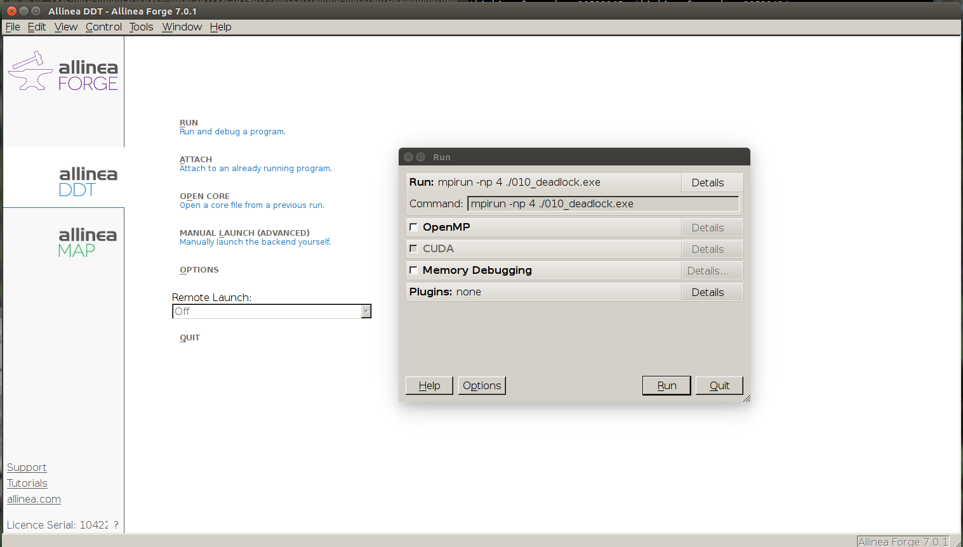
Start DDT

Slide 77
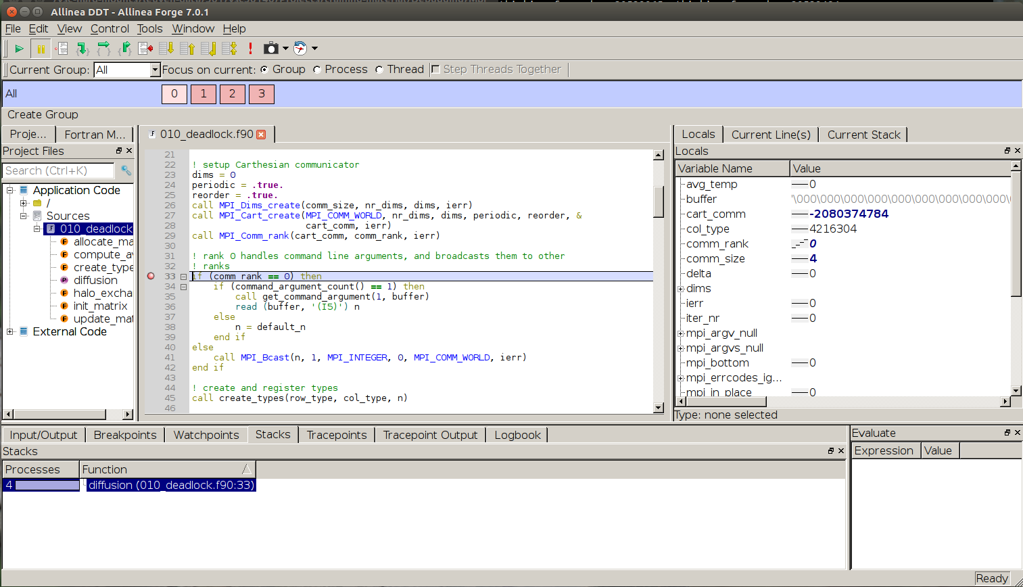
Run program
switch processes
breakpoint

Slide 78
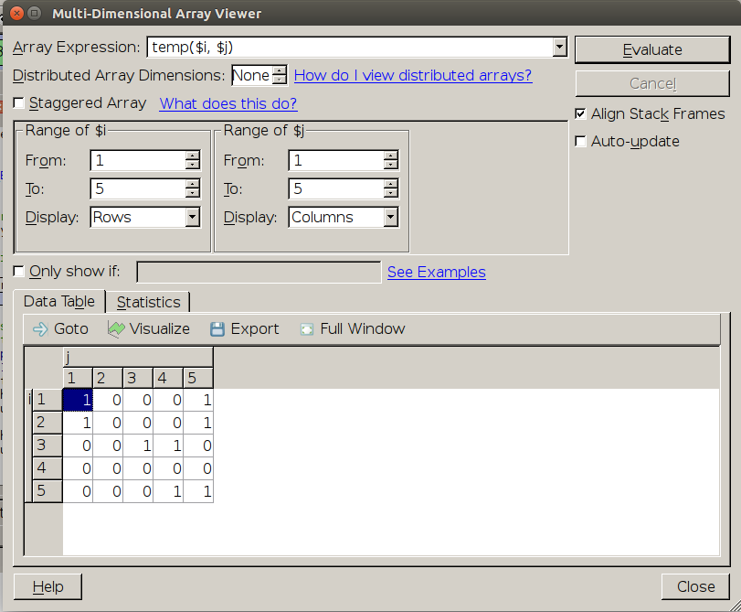
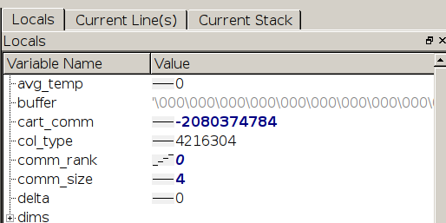
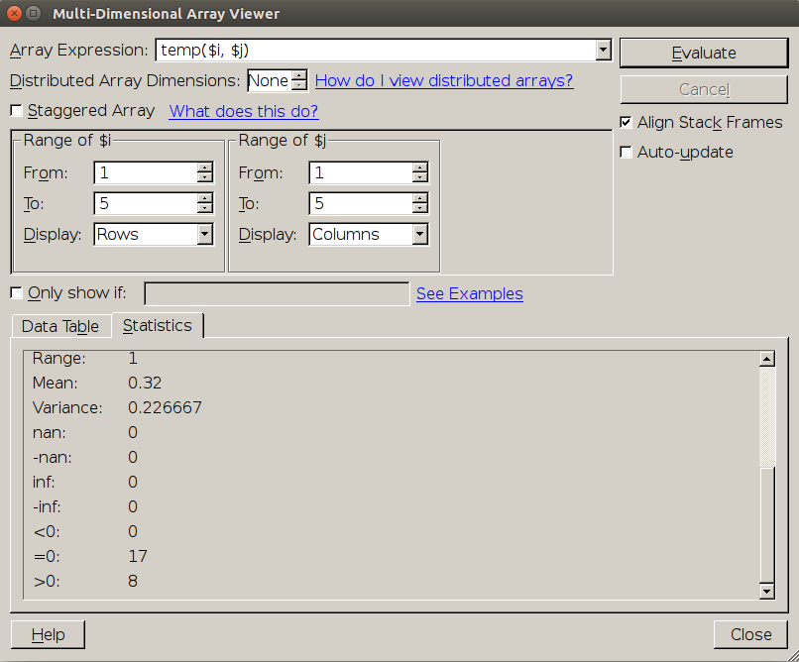
Inspect variables at scale
over processes
spot anomalies

Slide 79
Conclusions

Slide 80
Profiling: conclusions
MAP is excellent for applications with many processes/threads
Easy to get an overview
However, works well for serial code too
Timeline is valuable tool
Very easy to use, but correct interpretation requires insight
Drawback: limited to number of tokens
Number of processes
Concurrent sessions
As any tool, not Swiss army knife
Use in combination with other tools, e.g., Intel

Slide 81
Debugging: conclusions
Avoid bugs!
Learn to work with debugger
huge time saver
For
serial code: GDB
multithreaded code: GDB or Allinea DDT
MPI code: Allinea DDT

Slide 82
Alternatives
Debugging
Commercial: RogueWave TotalView
Open source:
gdb
Eclipse PTP
Profiling
Open source:
gprof
Scalasca
Paraver + Extrae

Slide 83
Reference material

Slide 84
Latency
latency
disk I/O
1000000 cycles
compute time
GPGPU
20000 cycles
Infiniband
5000 cycles
OpenMP barrier
1500 cycles
RAM
150 cycles
80 cycles
erf
L3 cache
50 cycles
40 cycles
**
20 cycles
exp
L2 cache
20 cycles
10 cycles
/ or sqrt
5 cycles
+ or *
L1 cache
5 cycles
streaming DP fused multiply/add
Core
1 cycle

Slide 85
Bandwidth
RAM
ivybridge (dual socket, 10 core): 93 GB/s
haswell (dual socket, 12 core): 110 GB/s
broadwell (dual socket, 14 core): 125 GB/s
QPI
ivybridge: 25 GB/s
haswell: 30 GB/s
broadwell: 30 GB/s
GPGPU RAM (GDDR5@750MHz, K40c): 288.0 GB/s
SATA revision 3: 0.6 GB/s
SATA revision 3.2: 2.0 GB/s
SAS 3: 1.2 GB/s
PCI Express 3.0 (16x): 15.75 GB/s
Infiniband QDR 4x: 4.0 GB/s
Infiniband EDR 4x: 12.5 GB/s
Note: bandwidth depends
on message size!

