Slide 1
Graphical Information Systems data
https://github.com/gjbex/training-material/tree/master/Python/Gis

Slide 2
Introduction
Graphical Information System (GIS), e.g.,
ArcGIS
QGIS
Many data formats, e.g.,
shape files
GeoJSON
Python & GIS
I/O library: Fiona
visualization: Folium
data processing/modeling: Shapely
Can be scripted with Python

Slide 3
World Happiness Index
Data
World Happiness information: CSV file
relevant columns: Country, Happiness Score
data on 157 countries
country names, borders,… : GeoJSON
import pandas as pd
happiness_data = pd.read_csv(happiness_filename)

Slide 4
Folium visualization
import folium
Create world map
Add chloropleth
longitude
lattitude
world = folium.Map(
location=[0.0, 0.0],
tiles='Mapbox Bright',
zoom_start=2)
shows entire world
world.choropleth(
name='world happiness',
data=happiness_data,
columns=['Country', 'Happiness Score'],
geo_data=str(country_geo_filename),
key_on='properties.name',
fill_color='YlGn', fill_opacity=0.7,
line_opacity=0.2,
legend_name='Happiness Score')
pandas
GeoJSON

Slide 5
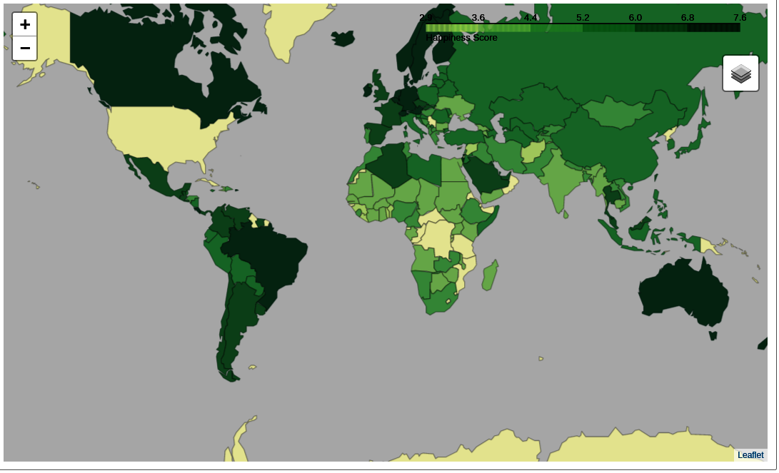
Result in Jupyter Notebook
Missing data?

Slide 6
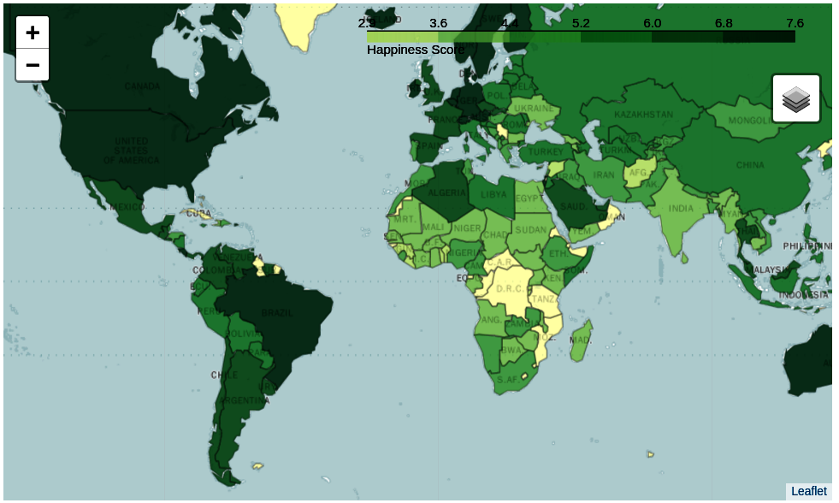
Data linkage issue
In World Happiness Index: United States
In GeoJSON file: United States of America
Fix: change names, e.g.,
happiness_data.at[12, 'Country'] = 'United States of America'

Slide 7




Shapely: geometric objects
Point: 2D or 3D
MultiPoint: collection of Point
LineString: sequence of Point
MultiLineString: multiple LineString
LinearRing: closed LineString
should not cross
Polygon: LinearRing as outer boundary, optionally multiple LinearRing as "holes"
should not touch in more than one point
MultiPolygon: multiple Polygon
should not touch in more than one point

Slide 8
Shapely: object examples
LineString
LinearRing
Polygon
line = LineString([(0.0, 0.0), (1.0, 1.0), (2.0, 0.5)])
outer = LinearRing([(3.0, 2.0), (3.0, 5.0), (6.0, 5.0),
(6.0, 2.0)])
inner1 = LinearRing([(3.5, 2.5), (3.5, 4.5), (4.5, 4.5),
(4.5, 2.5)])
inner2 = LinearRing([(5.0, 2.5), (5.0, 4.5), (5.5, 4.5), (5.5, 2.5)])
polygon = Polygon(outer, [inner1, inner2])

Slide 9
Shapely: predicates
a.within(b) ≡ b.contains(a)
a.intersects(b) ≡ not a.disjoint(b)
a.crosses(b)
a.almostequals(b, decimal=3)
a.is_valid
Shapely lets you create invalid objects
line.is_ring

Slide 10
Shapely: spatial analysis
a.intersection(b)
a.union(b)
a.difference(b)
a.symmetric_difference(b)
a.boundary: one dimension less
a.centroid: "mean" position
Set theoretic operations
a ≡ a.intersection(b).union(a.symmetric_difference(b))
a.symmetric_difference(b) ≡ a.difference(b).union(b.difference(a))
Note: use cascading_union for performance

Slide 11
Shapely: buffer
Point: 0D, LineString: 1D
buffer operation → 2D

Slide 12
Further reading
Fiona manual http://toblerity.org/fiona/index.html
Folium manual http://python-visualization.github.io/folium/docs-master/
Shapely manual https://shapely.readthedocs.io/en/latest/

