Slide 1
Essential C++ Numerics
Geert Jan Bex
(geertjan.bex@uhasselt.be)
License: this presentation is released under the Creative Commons, see http://creativecommons.org/publicdomain/zero/1.0/

Slide 2
Presentation based on: A tour of C++ Bjarne Stroustrup
Addison-Wesley, 2014

Slide 3
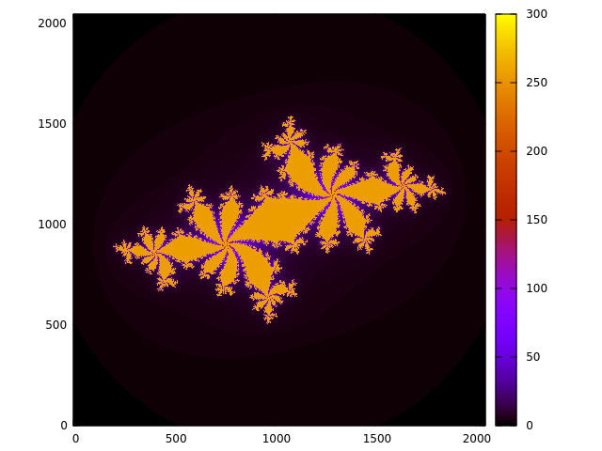
Complex numbers
#include <complex>
…
using namespace std;
…
const complex<double> c(-0.62772, - 0.42193);
for (double x = -1.8; x < 1.8; x += 0.001)
for (double y = -1.8; y < 1.8; y += 0.001) {
complex<double> z(x, y);
while (abs(z) < 2.0 && n++ < max_n)
z = z*z + c;
cout << x << " " << y << " " << n << endl;
}
(Overloaded) math functions
More efficient:
real(z)*real(z) + imag(z)*imag(z) < 4.0

Slide 4
Numerical limits
Integers
Floating point numbers
#include <limits>

Slide 5

Linear algebra
Several libraries
Eigen (http://eigen.tuxfamily.org/)
purely header files
trivial to install
Armadillo (http://arma.sourceforge.net/)
uses BLAS/Lapack
quite convenient
good performance
no distributed algorithms
…

Slide 6
Ordinary differential equations
Straightforward: Boost

Slide 7
What was left out/added?
Left out
Value arrays, see section on containers
Added
ODEs with Boost
Linear algebra with Armadillo

