Slide 1
Phishing Link Detection System
Machine Learning-Based Cybersecurity Solution for Detecting Malicious URLs
Phishing attacks continue to be one of the most common cyber threats, targeting individuals and organizations through deceptive websites and malicious links. This project presents an intelligent machine learning system designed to analyze URL characteristics and accurately identify phishing attempts before users interact with harmful websites.
Presented By – Group 5
Ziad Mamoun Awad Abu Zeid
Abdelrahman Hossam Youssef Mohamed
Malak Khaled Abou Elmagd Ali
Somia Rashad Ahmed Rashad

Slide 2

Problem Statement
Phishing attacks using deceptive URLs are increasing rapidly and have become a major cybersecurity challenge. These attacks aim to steal user credentials, financial information, and sensitive organizational data by tricking users into visiting fraudulent websites.
Traditional detection methods often struggle to keep pace with evolving phishing techniques. Therefore, there is a need for an automated and intelligent solution capable of identifying malicious URLs with high accuracy and reliability.
Develop a machine learning-based phishing detection system that can accurately distinguish legitimate URLs from phishing URLs while minimizing false positives and false negatives.

Slide 3
Dataset & Methodology
Dataset
Feature Extraction
Methodology
Dataset Size: 2,286 labeled URL samples
Legitimate URLs: 1,143
Phishing URLs: 1,143
Balanced dataset to prevent classification bias
The system extracts multiple URL-based features to identify suspicious patterns, including:
Data Collection and Preprocessing
URL Feature Extraction
Model Training
Performance Evaluation
Best Model Selection
URL Length
Number of Dots
Number of Digits
HTTPS Presence
Special Characters
Suspicious Keywords
Subdomain Count
Workflow
Dataset → Feature Extraction → Model Training → Model Evaluation → Best Model Selection → Deployment

Slide 4
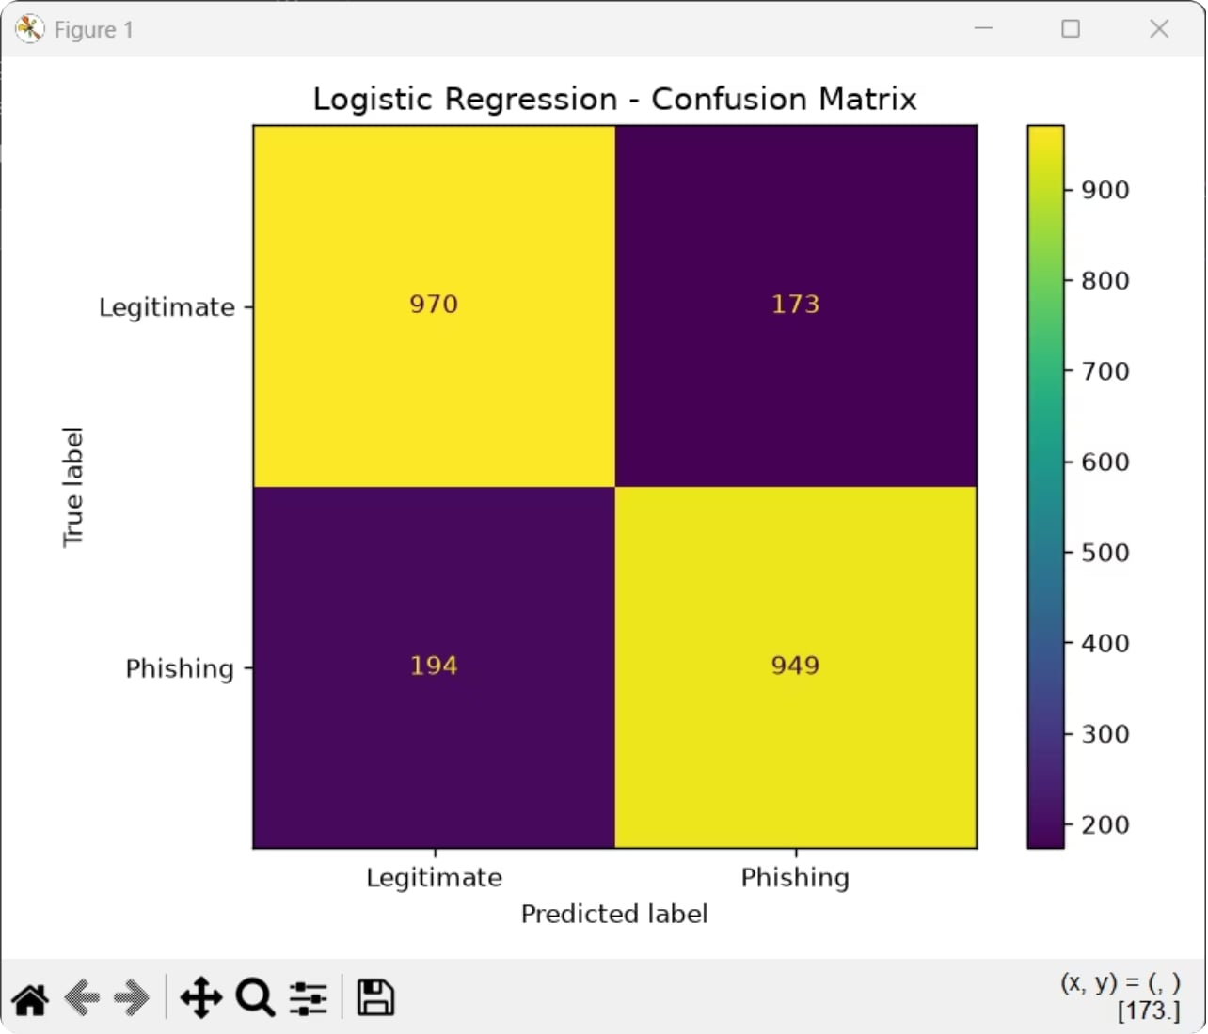
Logistic Regression
Performance: Train Acc 84.76% • Test Acc 83.95% • ROC AUC 92.88%
Fast linear baseline offering interpretable coefficients for URL-derived features. Good starting point for feature importance and quick inference in production.
Use case: low-latency screening and explainability for analyst review.

Slide 5
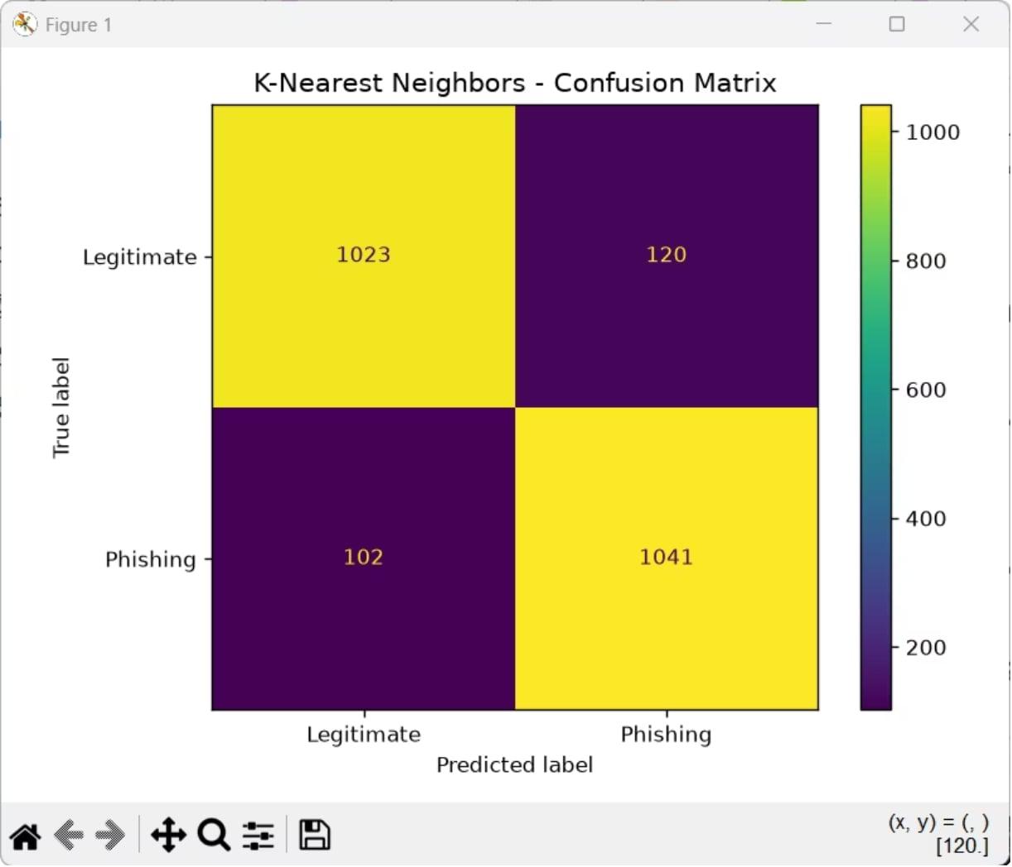
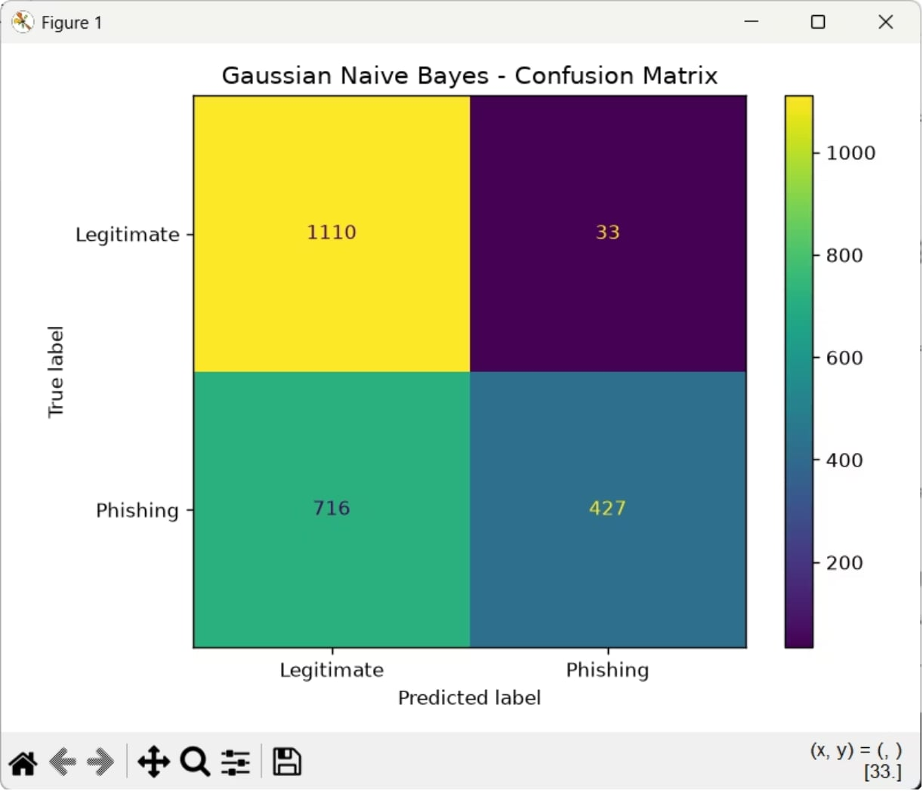
K-Nearest Neighbors (KNN)
Gaussian Naive Bayes
Performance: Train Acc 84.76% • Test Acc 83.95% • ROC AUC 92.88%
Distance-based classifier that labels URLs by proximity in feature space. Effective when feature scaling and relevant distance metrics are tuned.
Strengths: simplicity, non-parametric behavior. Weaknesses: inference cost at scale, sensitivity to noisy features.
Performance: Train Acc 84.76% • Test Acc 83.95% • ROC AUC 92.88%
Probabilistic baseline that assumes feature independence and Gaussian-distributed inputs. Often performs well on high-dimensional URL feature sets with fast training and inference.
Strengths: speed, simplicity, strong baseline performance. Weaknesses: independence assumption, reduced accuracy when feature correlations are important.
Placeholder: Confusion matrix screenshot (user to add).

Slide 6
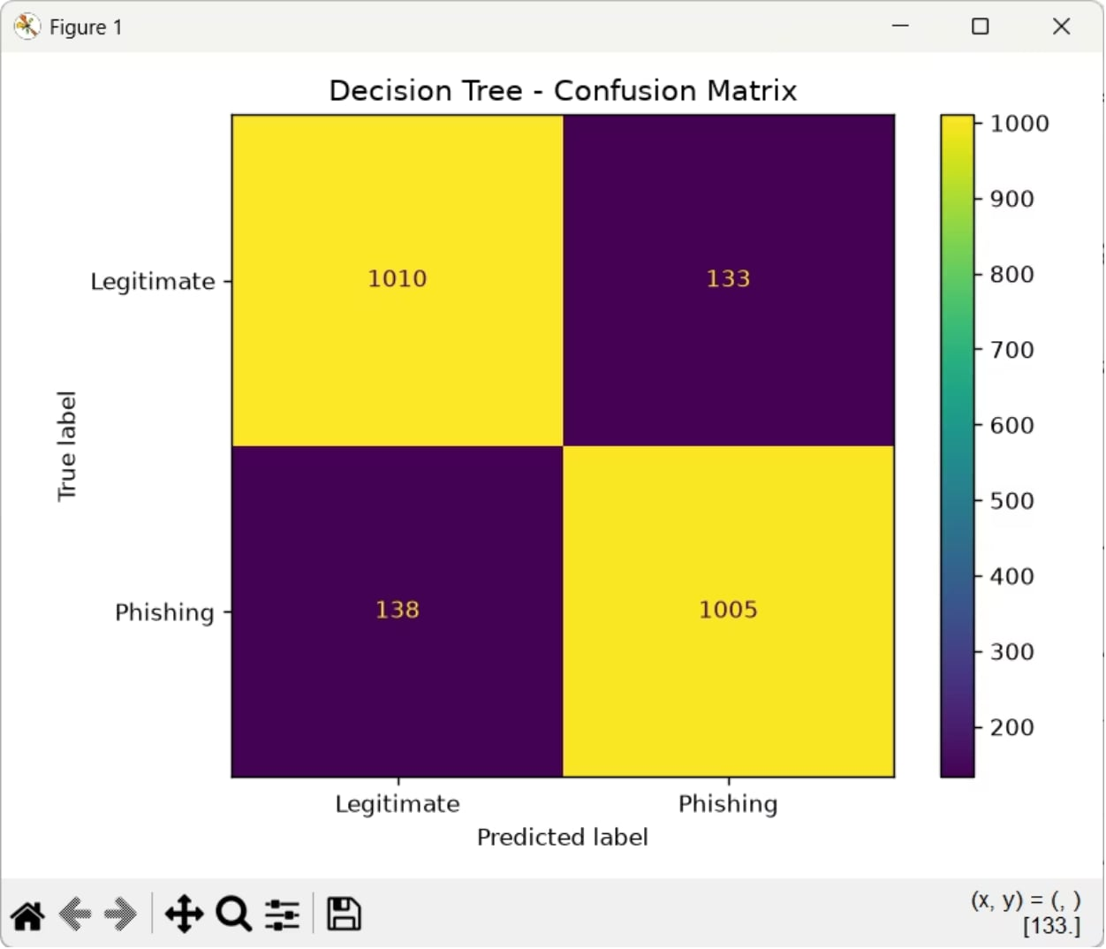
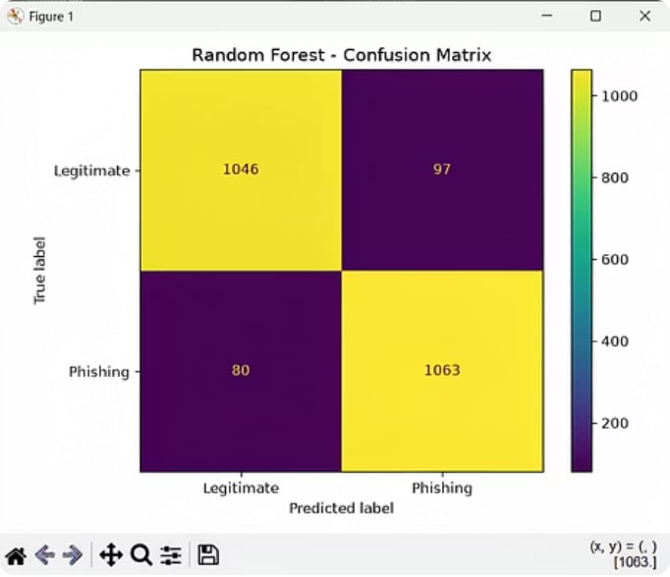
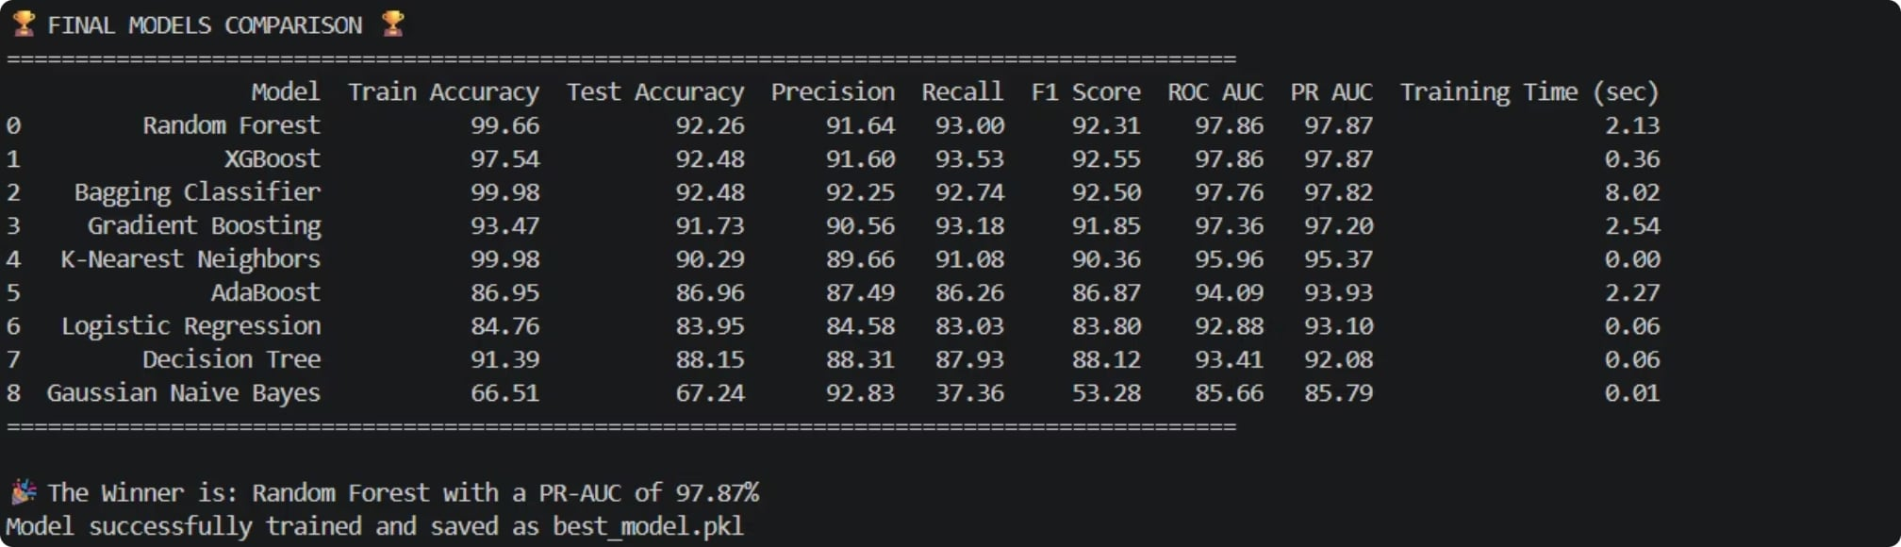
Decision Tree & Random Forest
Decision Tree: interpretable rules derived from URL features — useful for rule extraction and analyst debugging.
Random Forest: ensemble of trees that achieves the highest accuracy rates, improving robustness and reducing overfitting. It offers a strong baseline performance against phishing vectors.
Random Forest achieved the highest accuracy of 97.87% among all tested models, making it the optimal choice for our phishing detection system. Its superior performance in both precision and recall ensures reliable detection of malicious URLs while minimizing false positives.

Slide 7


Bagging Classifier & Gradient Boosting
Bagging Classifier: Test Accuracy 92.48% • ROC AUC 97.76%. High precision and recall observed — reliable at reducing both false negatives and false positives.
Gradient Boosting: Comparable top-tier performance (≥92% accuracy) with excellent class separation and calibration after tuning.
Recommendation: prioritize ensemble models (bagging/boosting) for production detection engine; retain simpler models for triage and interpretability.
Placeholder: Confusion matrices for Bagging and Gradient Boosting (user to add).

Slide 8


Boosting Algorithms
Boosting Models
XGBoost
Performance: Test Accuracy 92.48% • ROC AUC 97.86%
XGBoost is an advanced ensemble boosting algorithm that combines multiple weak learners to achieve high predictive accuracy. It demonstrated excellent phishing URL detection performance with strong precision, recall, and class separation.
High classification accuracy
Excellent generalization capability
Strong resistance to overfitting
Fast training and prediction
AdaBoost
Performance: Test Accuracy 86.96% • ROC AUC 94.09%
AdaBoost improves model performance by iteratively focusing on previously misclassified samples. It provides efficient boosting with relatively low computational cost and reliable phishing detection capability.
Lightweight boosting approach
Fast execution
Improved classification performance over basic models
Easy to implement and interpret
Recommendation
XGBoost outperformed AdaBoost across most evaluation metrics and ranked among the best-performing models in the phishing detection system. Its strong predictive power makes it a valuable candidate for real-world phishing detection applications.
Placeholder: Confusion matrices for XGBoost and AdaBoost (user to add).

Slide 9
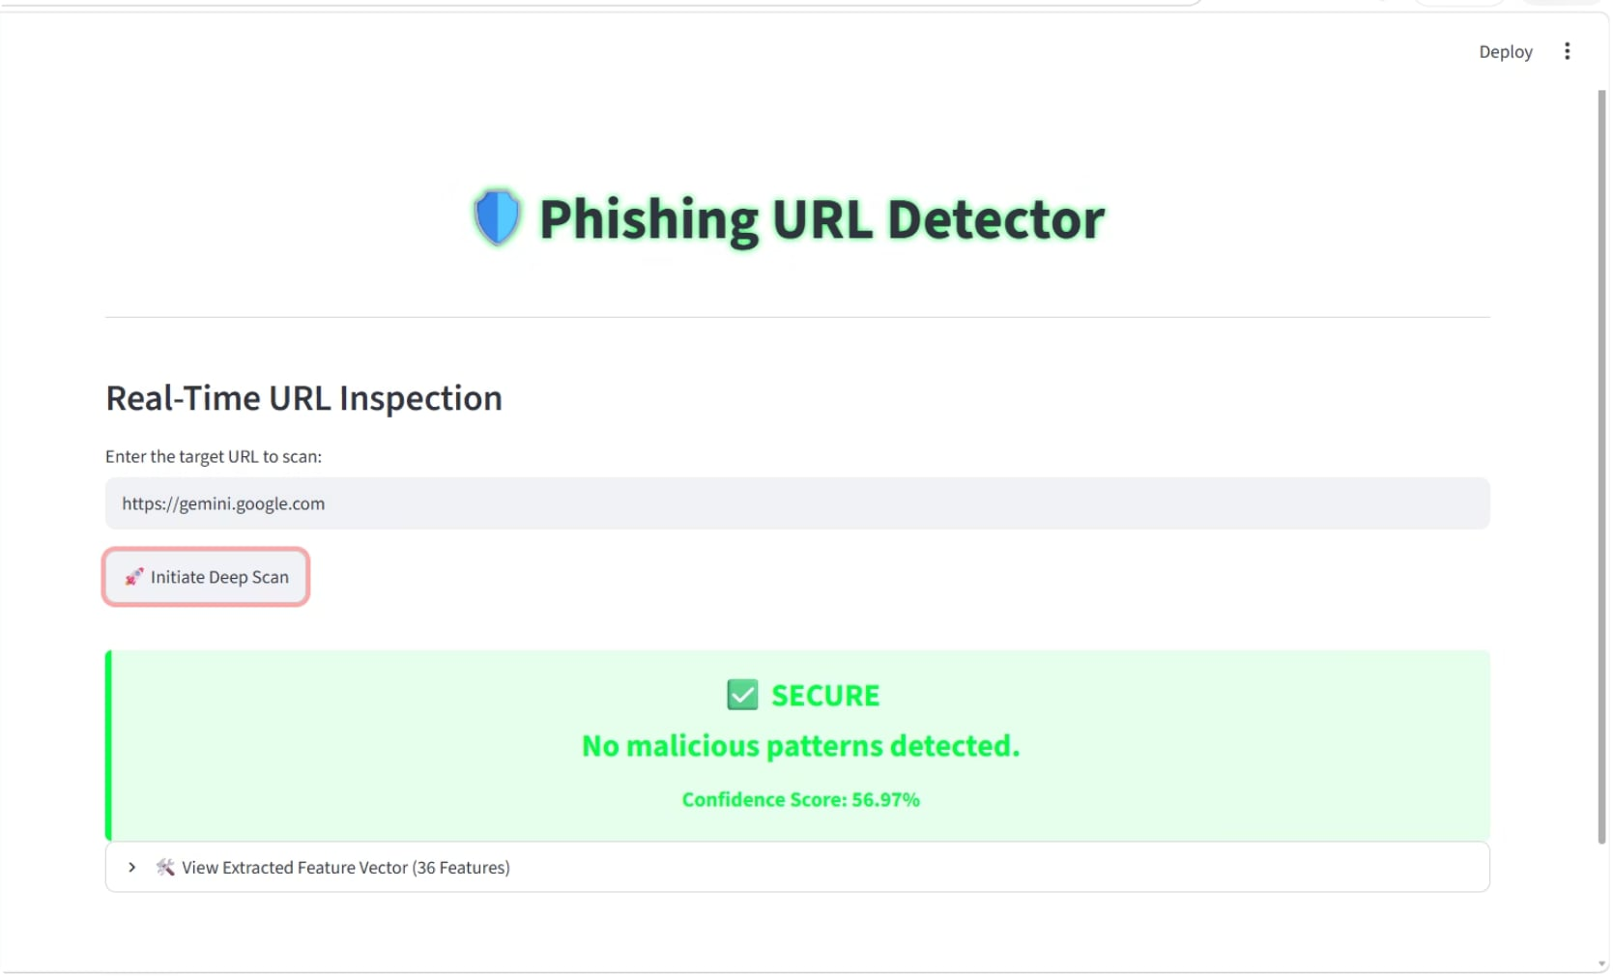
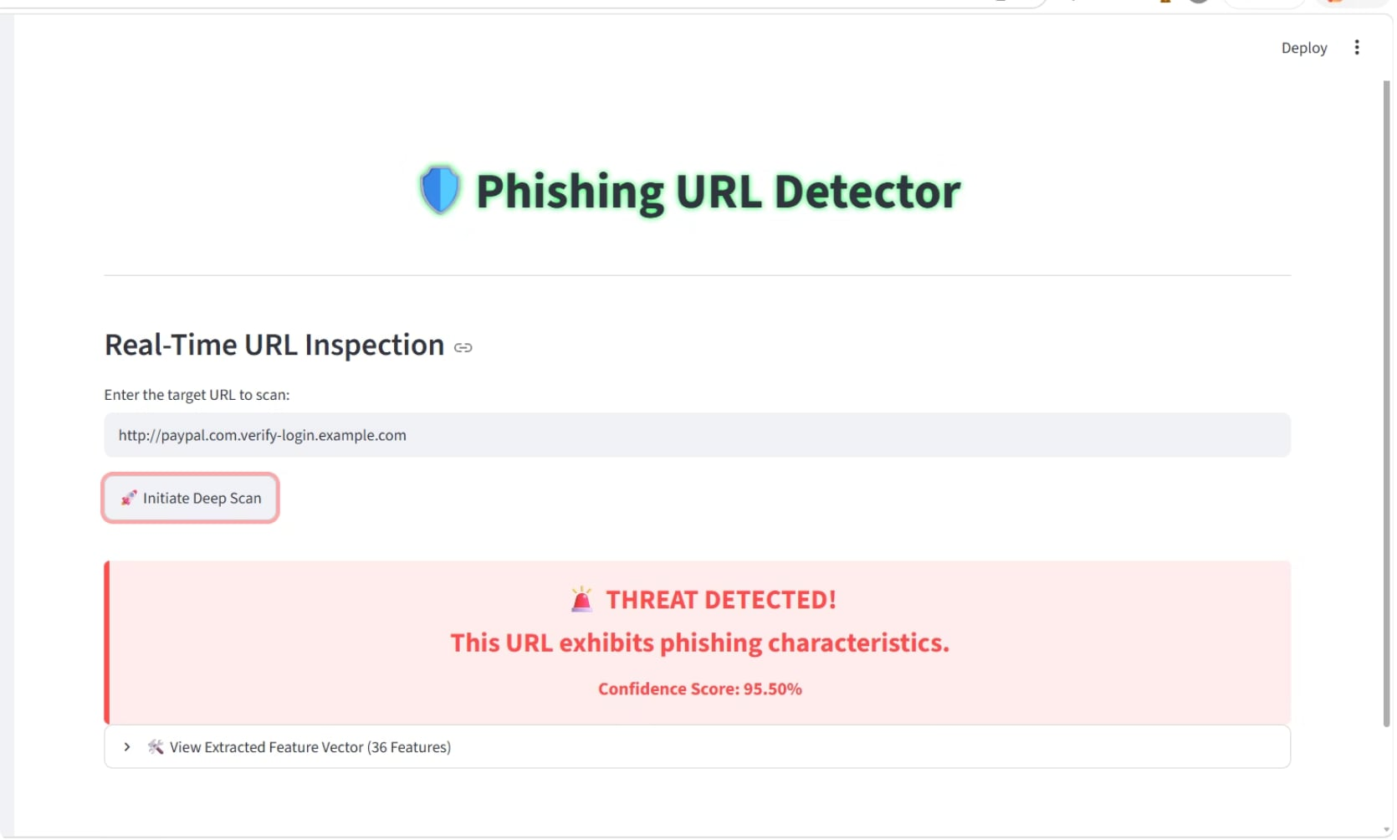

Deployment: Streamlit Front-End & Results UI
Enter a URL in the Streamlit interface to see a binary verdict, confidence score, and the key indicators behind the prediction.
SECURE
MALICIOUS
Safe / Secure Link
Unsafe / Malicious Link
Verdict: Secure
Confidence: High
Verdict: Malicious
Confidence: High
Green checkmark confirms low risk
Clean URL patterns and trusted signals
Positive feature indicators support the decision
Red X highlights elevated risk
Suspicious URL structure and warning signals
Negative indicators explain the alert
Use the same input field to compare both outcomes side by side during analyst review.

Slide 10
Conclusions & Next Steps
Multiple machine learning models were evaluated, including Logistic Regression, KNN, Gaussian Naive Bayes, Decision Tree, Random Forest, Bagging, AdaBoost, XGBoost, and Gradient Boosting. Based on the comparative analysis, Random Forest achieved the best overall performance and was selected as the final deployment model.
Operational plan: integrate ensemble detector into real-time pipeline; use lightweight models for pre-filtering.
Immediate next steps: add your screenshots (confusion matrices, Streamlit UI), run adversarial testing, and deploy monitoring for drift and false-positive trends.
Key metrics to monitor post-deployment: precision, recall, ROC AUC, false positive rate, throughput latency, and model calibration.

