Slide 1



Slide 2

Who am I?
Abd Alhakim Hawaf Software Tester Shifting from Mechanical Engineering
ISTQB® (CTFL | CTFL-AT)
Information Technology Institute (ITI) Trainee – Ministry Of Communications and Information Technology (MCIT)
CAIRO, NEW CAPITAL NOV -2023 – MAR-2024

Slide 3
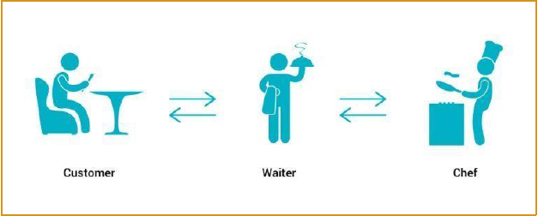

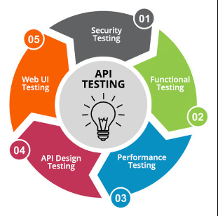

What Is an API
API
(Application Programming Interface) enables
communication and data exchange between two
separate software systems. A software system
implementing an API contains functions/sub routines
which can be executed by another software system
API Testing
Make sure that they are functional
Performance & speed testing
Security

Slide 4

What is My Project
Fake Store API Testing
Rest API
E-commerce
Shopping website prototype

Slide 5




Methodology Of Testing
1-Rest APIs Tools:-
Manual Testing Using
Automation Testing Using

Slide 6
Methodology Of Testing
2-Used Methods:-
Create/Read/Update/Delete (CRUD Operations)

Slide 7

Methodology Of Testing
3-Functional Testing:-
HTTP status codes
Response time
Data accuracy
Status Code
200+ means the request has succeeded.
300+ means the request is redirected to another URL
400+ means an error that originates from the client has occurred
500+ means an error that originates from the server has occurred

Slide 8
Demonstration
PostMan Code
PostMan Video
GitHub:
Video
https://github.com/AbdAlhakimHawaf/FakeStoreAPI_ITI.git
1
2
3
4
RestAssured Code
RestAssured Video
GitHub:
Video
https://github.com/AbdAlhakimHawaf/FakeStoreAPI_ITI.git

