Slide 1

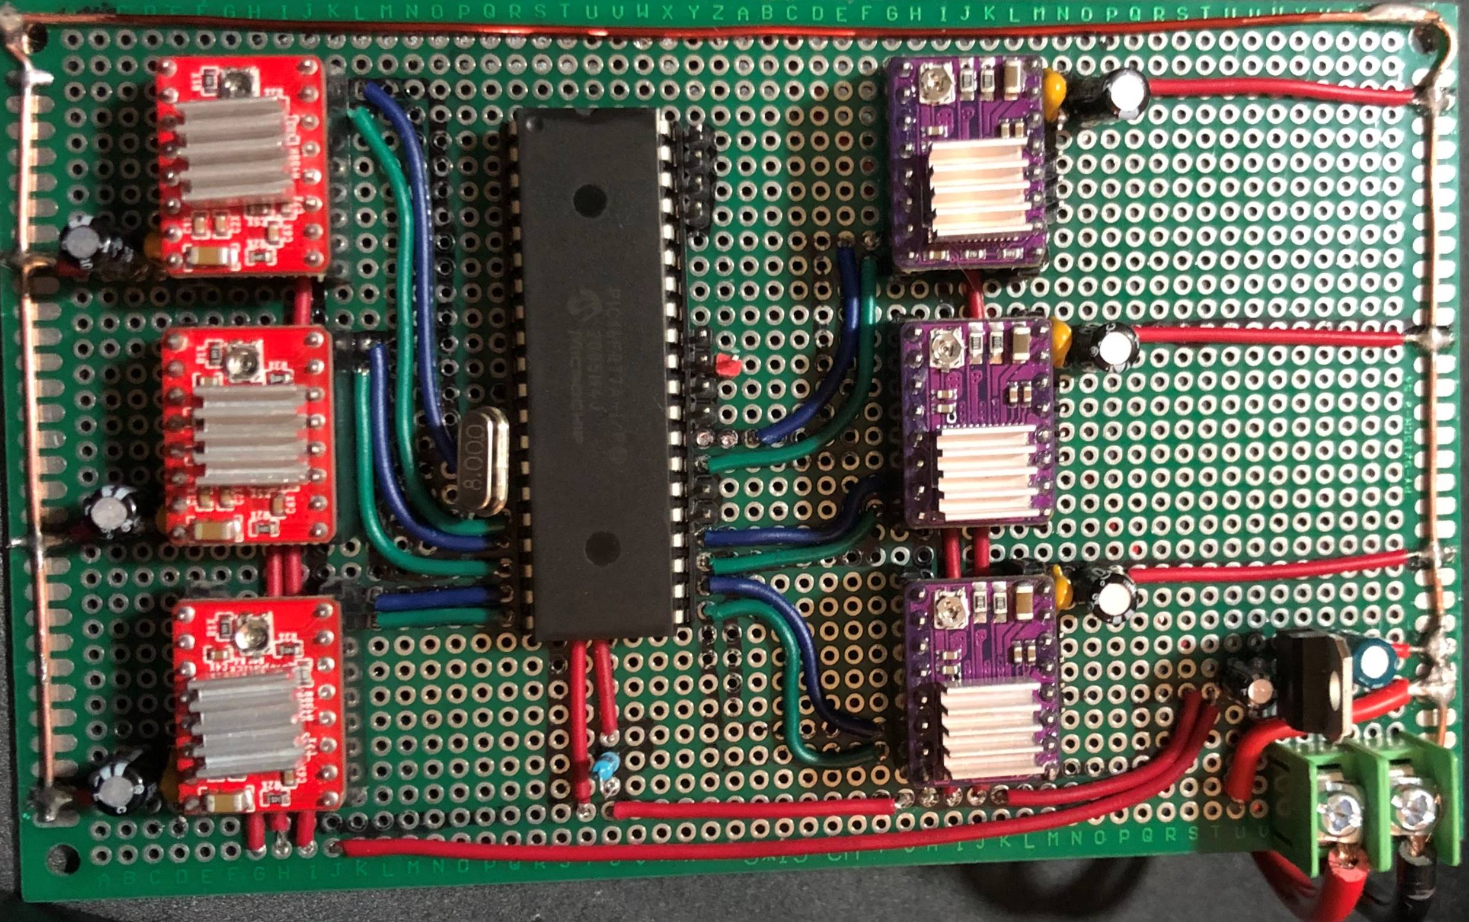
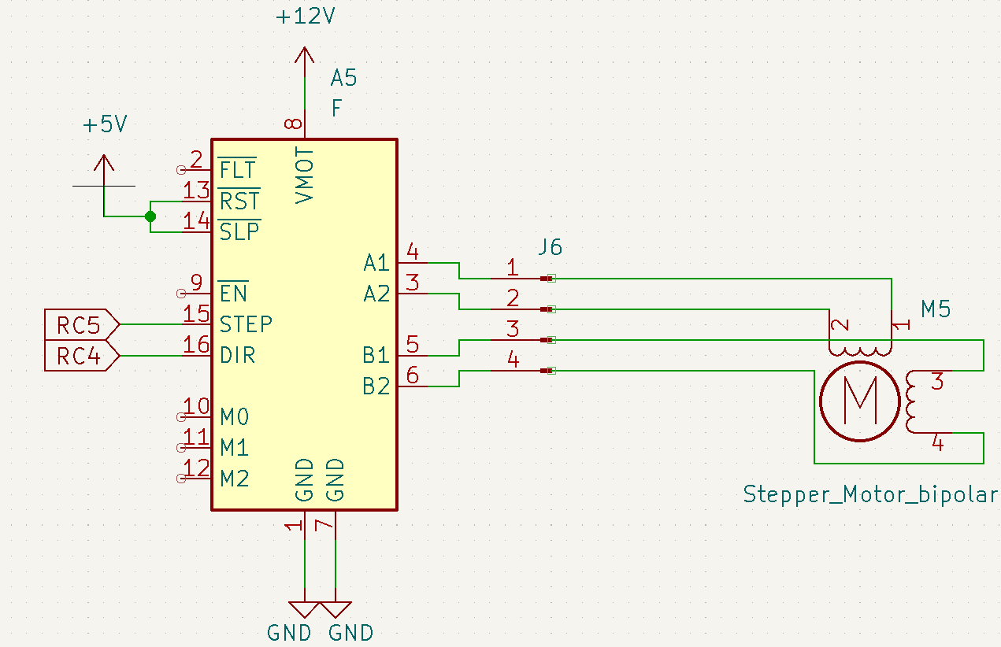
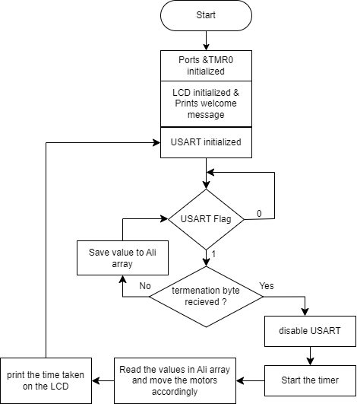
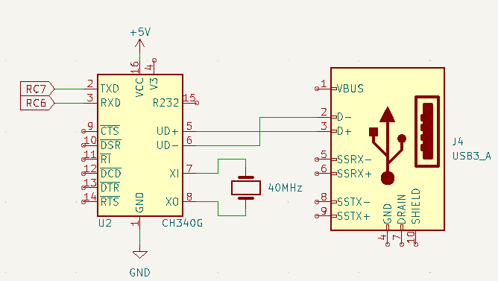
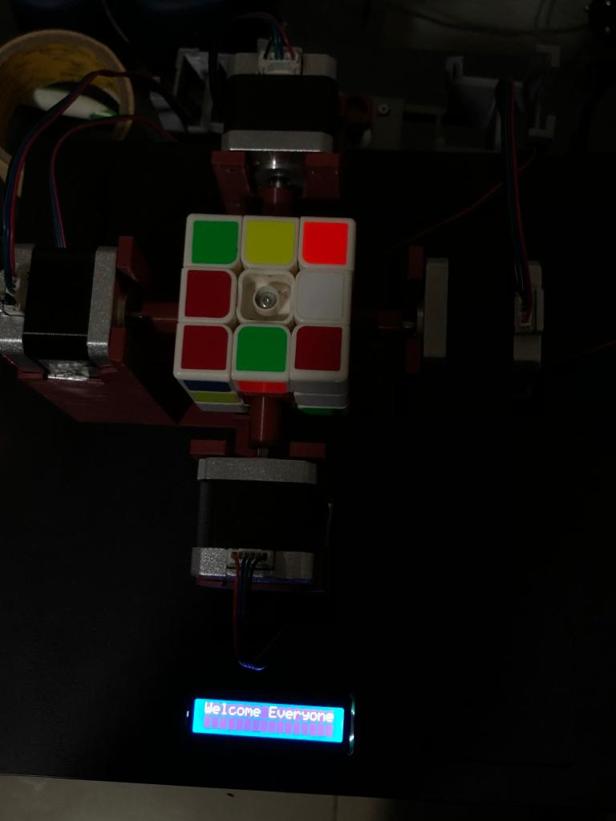
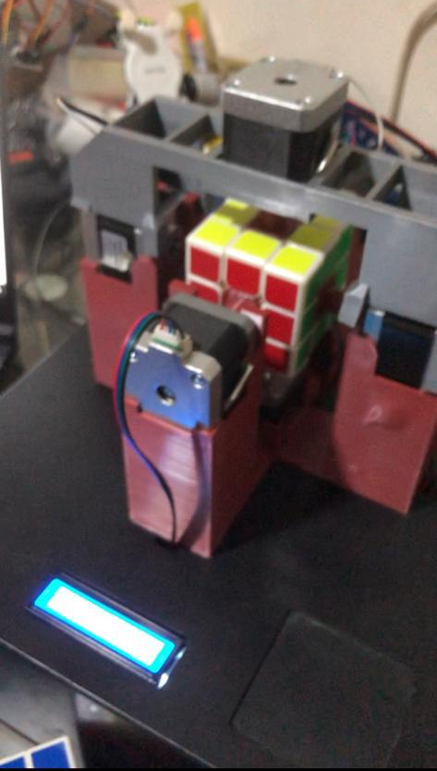
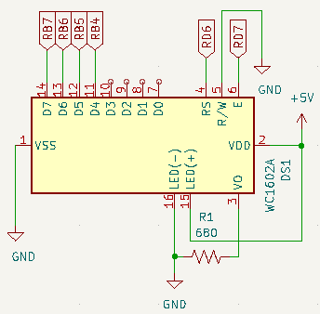
Qußot
A. AlJundi, O. Natsheh, and Z. Hamarneh
Supervisor: Dr. Belal Sababha
Embedded Systems Final Design Project, Fall 2022
King Abdullah II School of Engineering
Princess Sumaya University for Technology
Introduction
Our Project is a Rubik’s cube solver or as we like to call it Qußot, which is made of six stepper motors, an LCD screen, a serial communication gate , and a highly efficient code. We used a software called Cube Explorer that requires the cube to be scanned then it gives you the solving algorithm to solve the cube.
Figure 4: Circuit Diagram
\
Figure 5: Software flowchart
Results
(a) (b)
Figure 6: (a) Before, (b) After
Amazingly the time difference between the two pictures is 1.74 as shown on the LCD screen in the video.
Design
We used 6 drivers for six motors one on each face of the cube, here’s a schematic for one of the motors
Figure 1: A4988 Driver, Nema 17 stepper motor.
Using the stepper motor driver, you can control the direction and precisely defined increment in the shaft’s rotational position:
You can control the direction by sending a zero for counterclockwise or a one for clockwise to pin 16 (DIR).
A rising edge would cause a 1.8-degree rotation in the shaft, since we need a 90-degree rotations the code gives you 50 rising edge.
The solving algorithm is sent to the PIC using serial communication.
Figure 2: USB to serial chip CH340G
The sent message contains on of letters (F, B, L, R, U, D) each refers to one of the six faces of the cube, also if the needed move is counterclockwise a prime is sent next to the letter.
We used TMR0 for two main functions, generating the precise needed time delay to generate the steps to move the motor, and as a timer to calculate how much time it took to solve it
Then the calculated time taken is printed out on the LCD screen
Figure 3: LCD Screen
Conclusion
Qußot is a simple but elegant ‘robot’, the hardware design is flawless, and the software makes it magical.
The project is surely a hard one, and it took a lot of effort and hard work, but we are proud to say that after researching about it, our Qußot is the fastest in the middle east.

