Slide 1

Crisis Communication Effectiveness on
Social Media During COVID-19 Pandemic
Rebound Periods
01.04.02 Applied Mathematics and Computer Science
Student: Abdallah Essa, Group J4233
Scientific Supervisor:
Sergey V. Kovalchuk, Candidate of Technical Sciences, Associate Professor

Slide 2
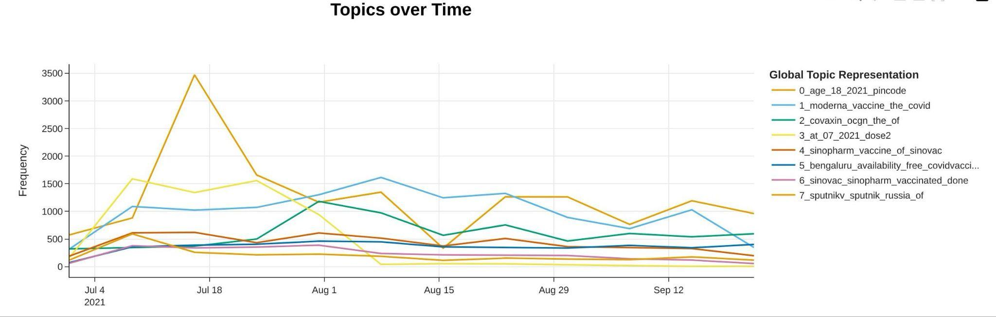
Statement of the Problem
During COVID-19 pandemic rebound periods:
- Public health communicators must reach people fast
- Social media is the main channel
- But: which messages actually get engagement?
Research gap:
- Most studies use only ONE method (sentiment)
- Most studies skip the Delta rebound (July-Sept 2021)
We need a multi-method study of crisis
communication during pandemic rebounds.

Slide 3
Purpose and Objectives
Research Purpose:
Identify which content features predict tweet engagement during the COVID-19 Delta rebound.
Objectives:
1. Build a corpus of vaccine tweets (July-September 2021)
2. Apply two sentiment models (VADER and Twitter-RoBERTa)
3. Identify topics using BERTopic
4. Test theory with regression models (Negative Binomial and ZINB)

Slide 4
Review of Similar Research
Three main studies on COVID-19 vaccine tweets:
[1] Lyu et al. (2021)
• 1.5M tweets, topic modeling
• Limitation: ends before Delta rebound
[2] Yousefinaghani et al. (2021)
• 4.5M tweets, sentiment analysis only
• Limitation: single sentiment tool
[3] Xu et al. (2022)
• Sentiment analysis through Dec 2021
• Limitation: no theoretical framework
Research gap:
No multi-method study during the Delta rebound with a theoretical model.

Slide 5
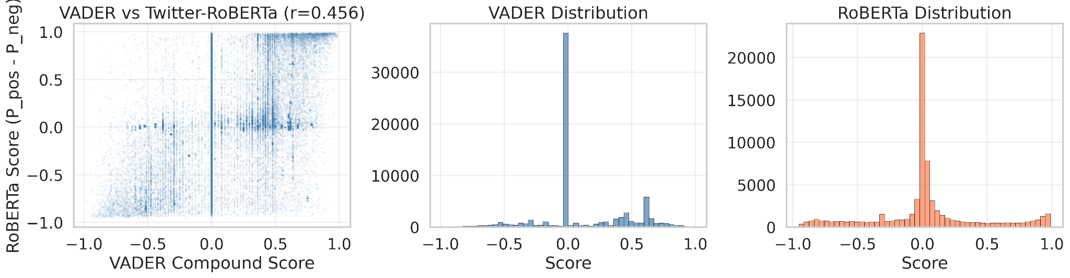
Research Methods and Tools
Data:
71,845 unique tweets (Kaggle dataset)
Period: July-September 2021
Tools: Python, Hugging Face, statsmodels
Methods:
- Sentiment: VADER + Twitter-RoBERTa
- Topics: BERTopic (19 final topics)
- Stats: Negative Binomial + ZINB
- Medical NER: vaccines + side effects

Slide 6
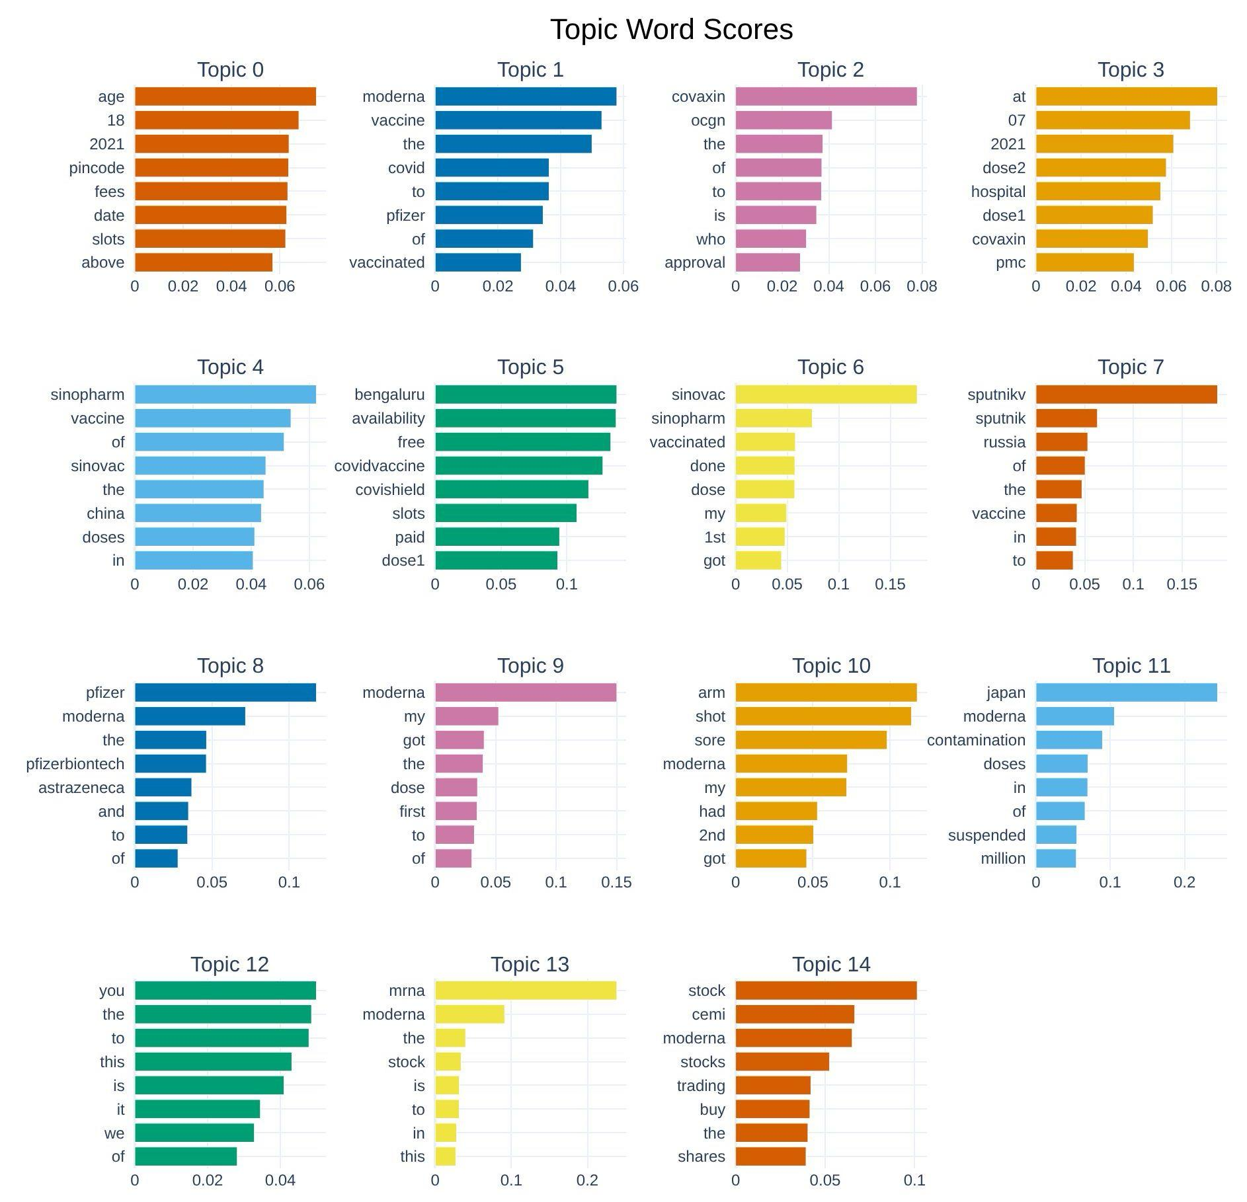
The Solution Flow
Step 1: Data Collection
72,847 raw tweets → 71,845 unique tweets
(after Delta rebound filter + deduplication)
Step 2: Feature Engineering
• Sentiment (VADER, RoBERTa)
• Dialogic markers (?, #, @)
• Media richness (URL presence)
• Vaccine brands + side effects
Step 3: Topic Modeling (BERTopic)
105 topics → 19 final topics
Top: Moderna, Covaxin, Pfizer, Sinopharm
Step 4: Statistical Modeling
3 models compared:
Baseline NB → Upgraded NB → Final ZINB
AIC improvement: 4,348 points

Slide 7
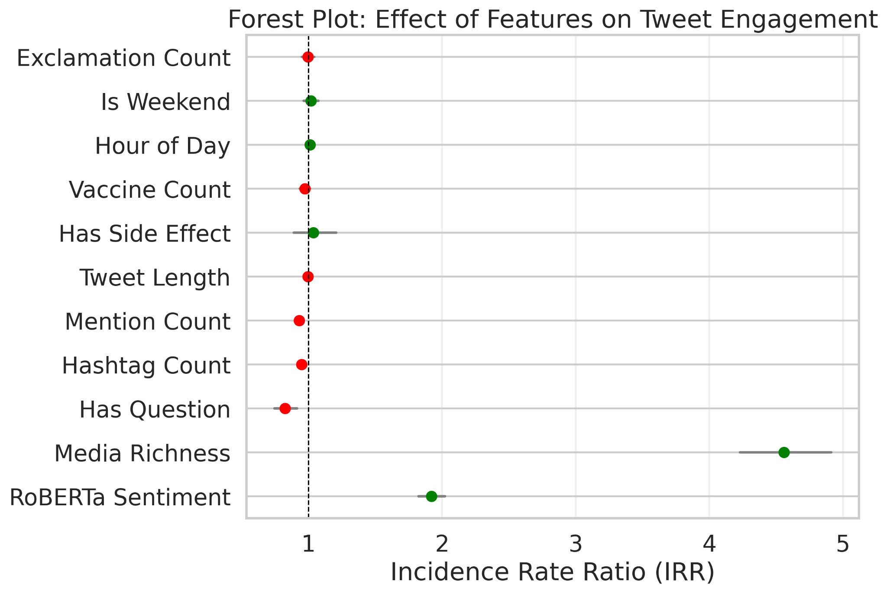
Key Results:
Three main findings:
- Media Richness: IRR = 4.56
Tweets with URLs get 4.6× more engagement
(strongest predictor)
- Dialogic Markers: All NEGATIVE
• Questions: -32% engagement
• Hashtags: -13% per hashtag
• Mentions: -12% per mention
- Sentiment: IRR = 1.91 (RoBERTa)
Positive sentiment increases engagement
(smaller effect than media richness)
Code: github.com/AbdAllAh950/
covid-crisis-communication-analysis

Slide 8
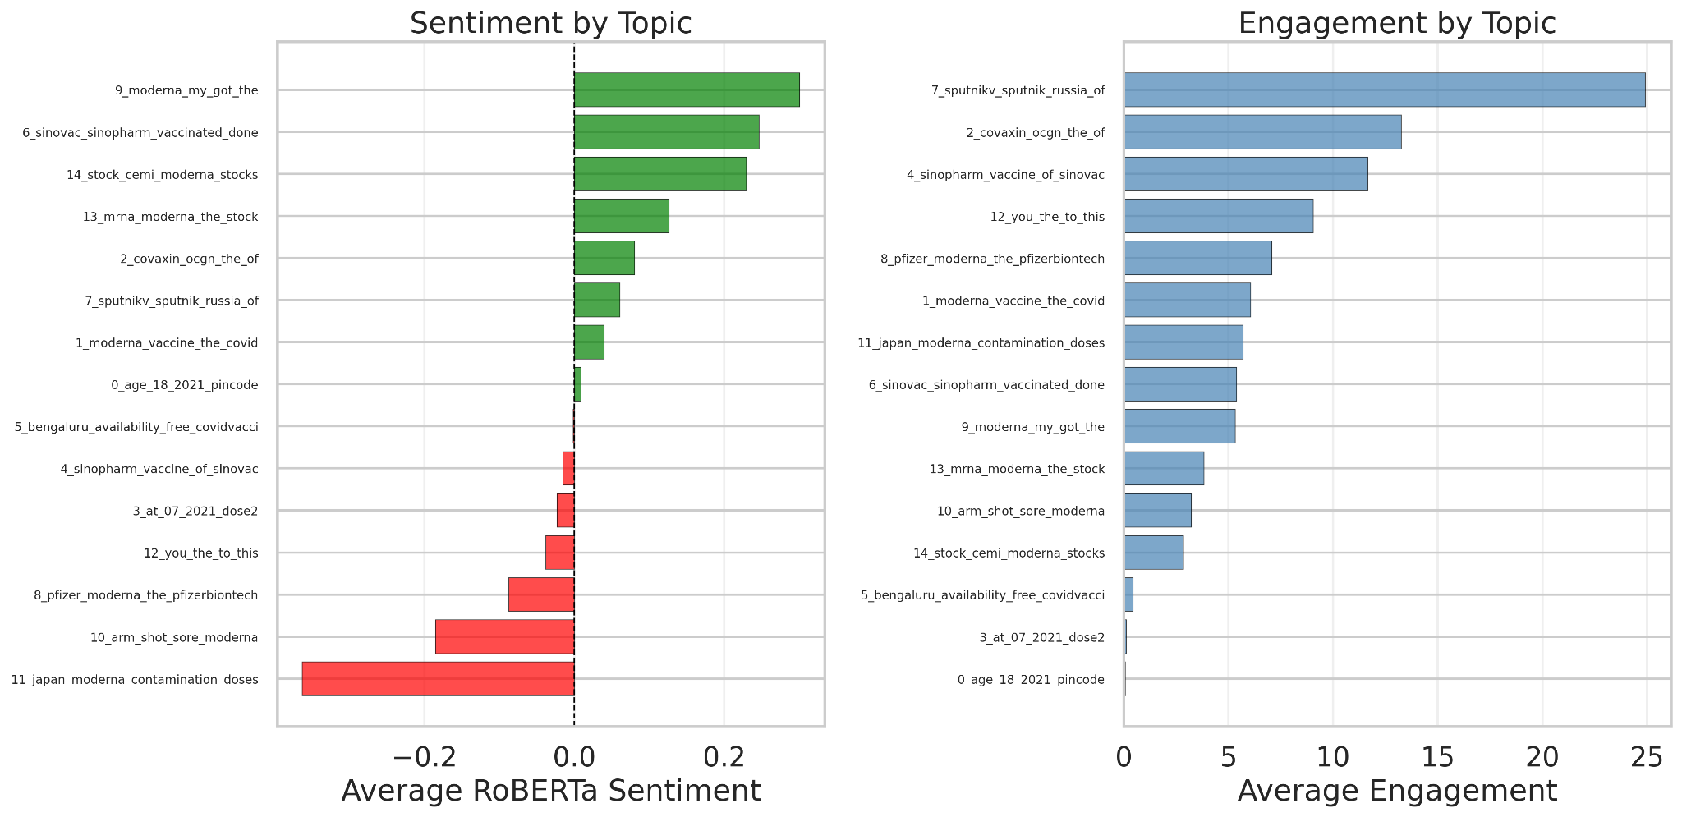
Conclusion
Three contributions:
- Theoretical:
• Supports Media Richness Theory
• Challenges Dialogic Communication Theory
- Methodological:
• Multi-method pipeline
• Reproducible code on GitHub
- Practical:
Health communicators should use rich content
(URLs, images) during crisis rebounds.
Future work:
Extend to full COVID-19 archive (2020-2023)
in upcoming PhD research at ITMO.

Slide 9

THANK YOU FOR YOUR TIME!

