Slide 1




Syria FireWatch
Predicting dangerous fire days from daily weather on the Syrian coast (Latakia & Tartus)
Group 1
Climate Challenge: Climate Risks and Natural Hazards (Wildfire)
Team members:yousef algazali -Amjad Shykhani -Bayan Alhindaoui
AbdAlrhman QarahBolad -Mahmoud Mawed-Razan Rai Albalha

Slide 2
Climate Problem & Research Question
The problem
Wildfire risk along the Syrian coast may increase during periods of high temperature, low humidity, strong winds, and low rainfall.
However, the relationship between these weather conditions and actual fire activity has not been clearly measured for the region.
We combine satellite fire detections with daily weather data from Latakia and Tartus to find the conditions behind fire events and how fire activity changes over time.
Main research question
Which weather conditions are most associated with satellite-detected fire days, and have high risk wildfire days increased over time?

Slide 3
Dataset
NASA FIRMS Active Fire Detections
NASA POWER Daily Weather
• fire_count — fire detections/day
• max_frp — maximum Fire Radiative Power (MW)
• fire_day_any — 1 if any fire detected
• fire_day_major — 1 if ≥3 detections OR max FRP ≥10 MW
• t2m_max — maximum temperature (°C)
• rh2m — relative humidity (%)
• ws2m — wind speed (m/s)
• prectotcorr — precipitation (mm)
Derived: dry_days · rh2m_3d · t2m_max_3d · rain_7d
Scope: Latakia–Tartus coastal region · fire season May–October · 18,459 fire-season records · 2012–2026

Slide 4
Python Approach
Feature engineering (pandas)
Honest time-based evaluation
• t2m_max, rh2m, ws2m, prectotcorr
• dry_days, 3-day humidity/temp, 7-day rain
• season_sin, season_cos
• latitude + longitude
Fire columns are outcomes only — never inputs (no leakage)
• Train: 2012–2019 (10,304 rows)
• Validation: 2020–2021 (2,576 rows)
• Test: 2022–2026 (5,579 rows)
Models: Hot & dry rule · Placebo · Logistic Regression · Random Forest · Weather-only RF
Metrics: ROC-AUC · PR-AUC · lift vs random · precision · recall · F1 | Risk thresholds are chosen on validation data only

Slide 5
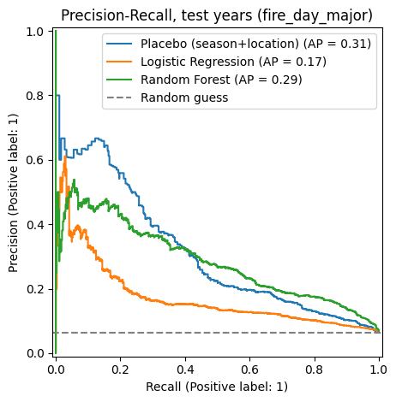
Model Results & Risk Levels
Observed major-fire rate by predicted risk level
Risk | Days | Fire days | Fire rate | Share
Low | 3,917 | 71 | 1.8% | 20%
Moderate | 754 | 78 | 10.3% | 22%
High | 908 | 212 | 23.3% | 59%
Key finding: observed major-fire rate rises from 1.8% (Low) to 10.3% (Moderate) to 23.3% (High).
Risk thresholds: Moderate ≥ 0.37 · High ≥ 0.60
Important: on this test set, the season + location placebo had higher PR-AUC than the weather-based Random Forest (0.313 vs 0.286).

Slide 6
Interactive Syria FireWatch
Prototype UI: enter one day of weather and location → receive a risk score, risk level, and practical advice.
Enter weather
Model output
Date: 2025-08-10
Grid cell: 35.5_36.250
HIGH FIRE RISK
Temperature: 37 °C
Humidity: 40 %
Wind: 2.5 m/s
Rain: 0 mm
Risk score: 0.90
Dry days: 45
7-day rain: 0 mm
High danger. Consider alerting local fire services and restricting open burning.
CHECK FIRE RISK
The notebook also supports testing a historical day and comparing predicted risk with the observed fire outcome.

Slide 7
Limitations & Next Steps
Limitations
Next steps
Satellite detections can miss small fires or fires hidden by clouds
The output is a ranking score, not a true probability
Correlated inputs (e.g. daily vs 3-day temperature) share importance credit
Valid for the fire season (May–October) only
Trained on observed weather; live use needs forecast data
Add vegetation / fuel load and land-cover data
Calibrate scores into real probabilities
Extend beyond the coast to other Syrian regions
Connect a daily forecast feed for live risk alerts
Validate against civil-defence fire records
Thank you

