Slide 1
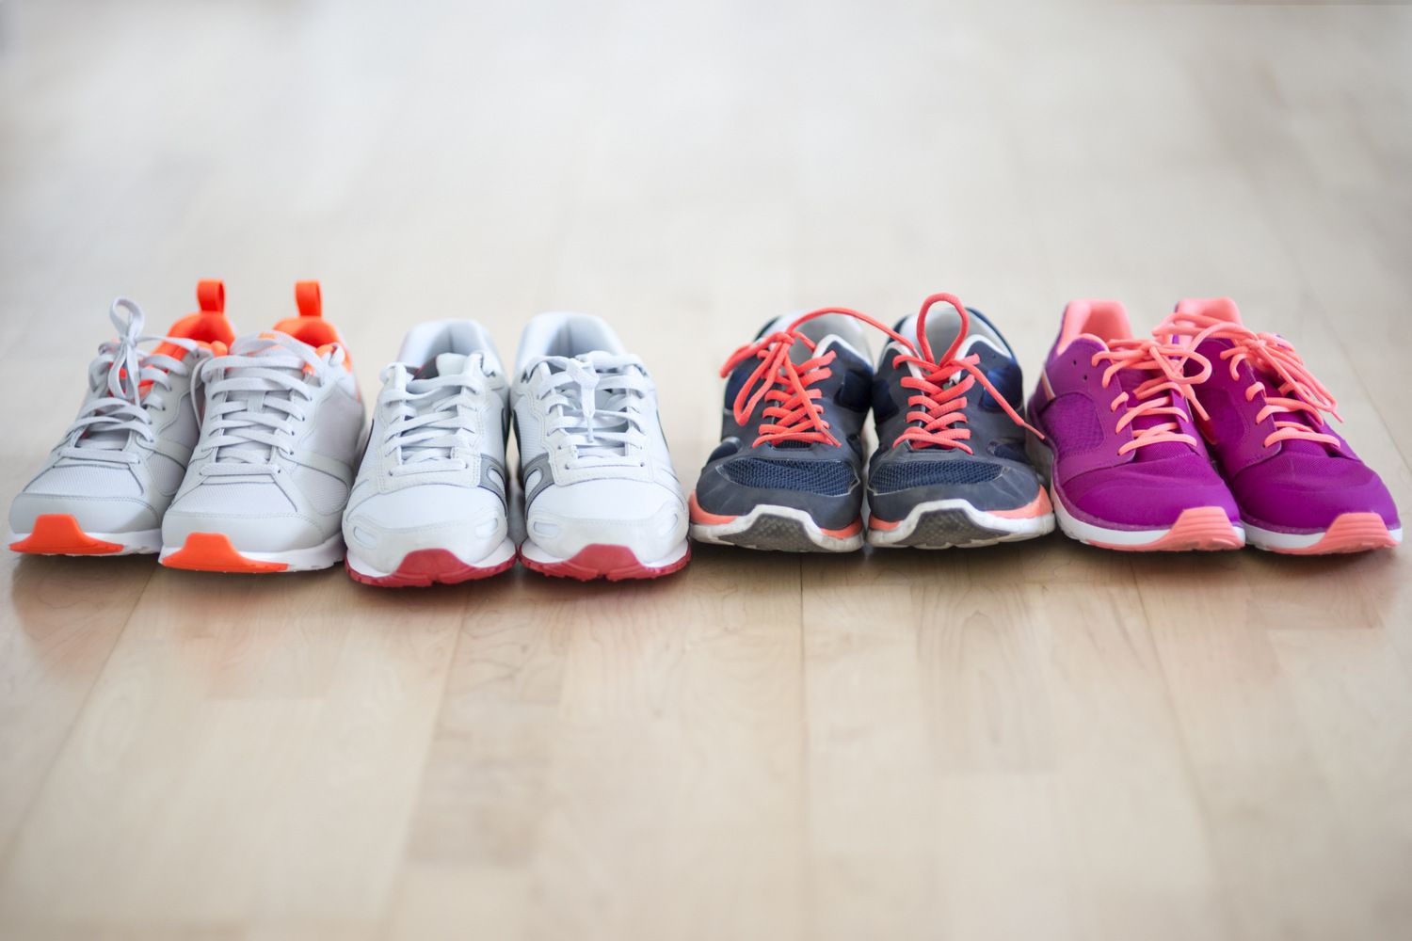


Optimizing Online Sports Retail Revenue

Slide 2

What is the goal of this analysis?
We aim to increase the company's revenues by deep dive into the data and explore it to get ideas to improve revenues.
So, First question I have asked my self when I saw the data is:
Which sports brands generate the most revenue and how much stock does it occupy?

Slide 3
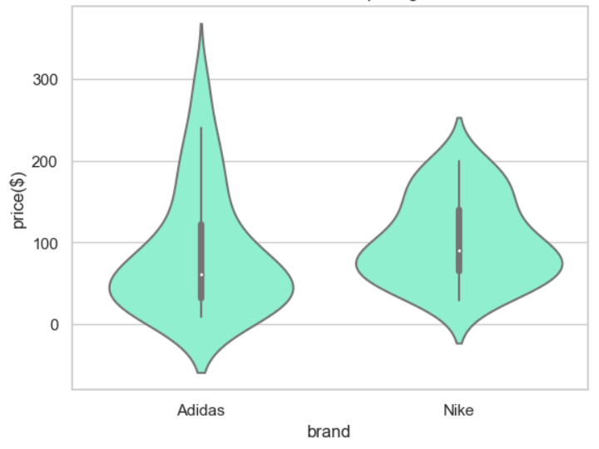
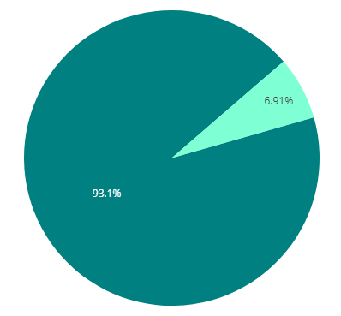

Adidas VS Nike
Adidas VS Nike products pricing
Total number of products for each brand

Slide 4
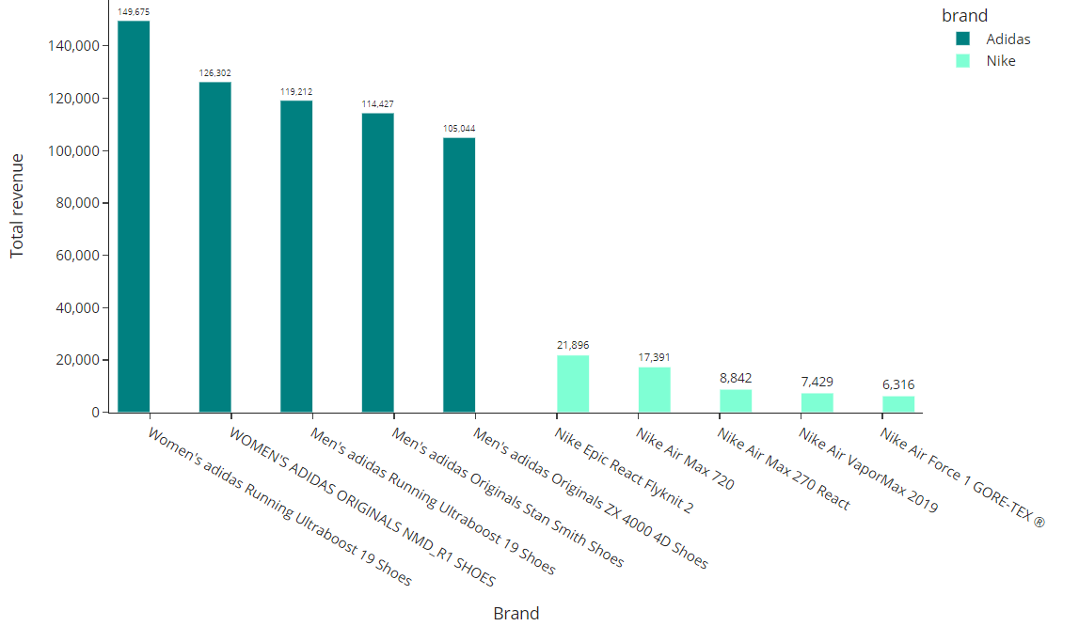
TOP 5 profitable products from each brand

Slide 5
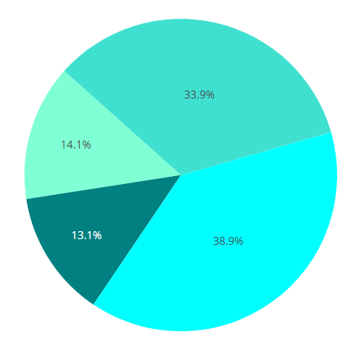
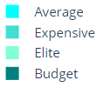
Products percentage for each category

Slide 6
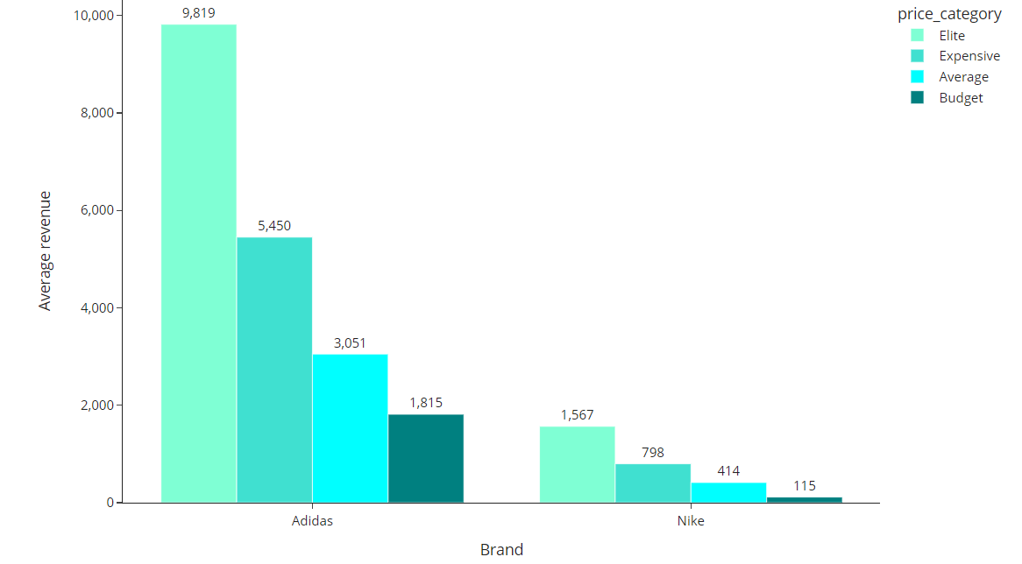
Average revenue for each brand and price category

Slide 7
Adidas products outperform Nike in total revenue across all price categories.
"Elite" Adidas products priced at $129 or more generate the most revenue.
Suggested strategies to increase revenue:
Increase the proportion of Adidas products priced at $129 or more.
Remove all Nike products except for products that have revenue of 5700$ or above to create space for more Adidas items and potentially boost revenue.

Slide 8
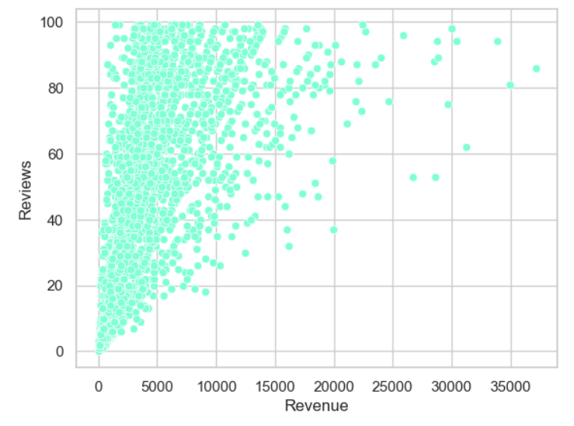
Relationship between reviews and revenue
Interestingly, there is a strong positive correlation between revenue and reviews.
This means, if we can get more reviews on the company's website, it may increase sales of those items with a larger number of reviews.

Slide 9
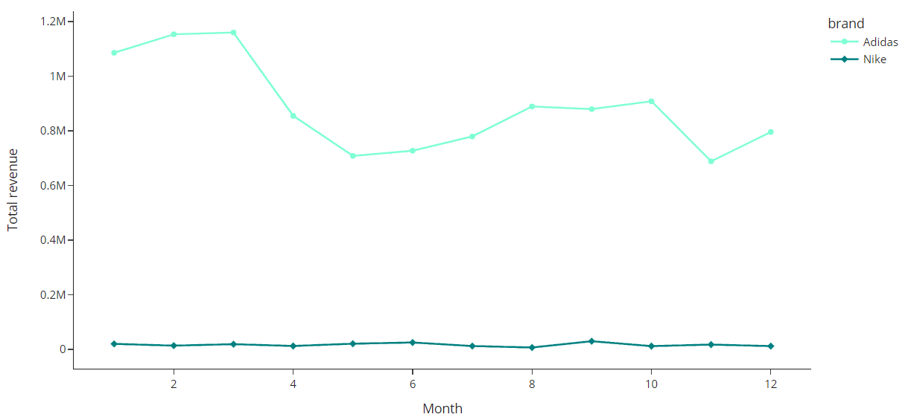
Total revenue per month over the year

Slide 10
Revenues peak in the first quarter of the year but decline in subsequent quarters.
To investigate this trend, we need to explore whether special factors, such as promotional offers or discounts, in the first quarter contribute to the higher revenue and analyse their impact on overall revenue patterns.

Slide 11
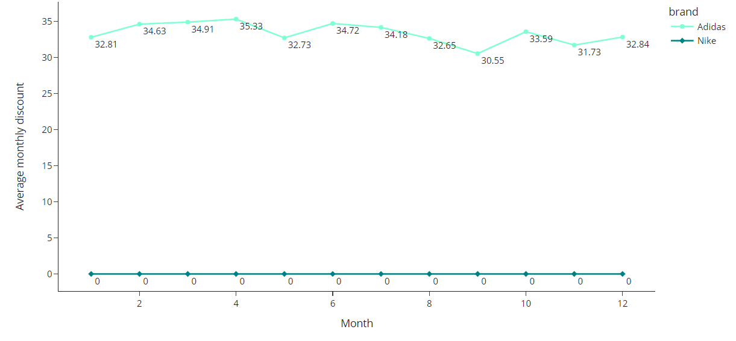
Average monthly discount over the year

Slide 12
It seems like discount is almost the same for the whole year and it has no effect on revenue.
The company must run an experiment to discover what makes the first quarter of the year has the best revenue and focus on the results to make use of it for the rest of the year.

Slide 13
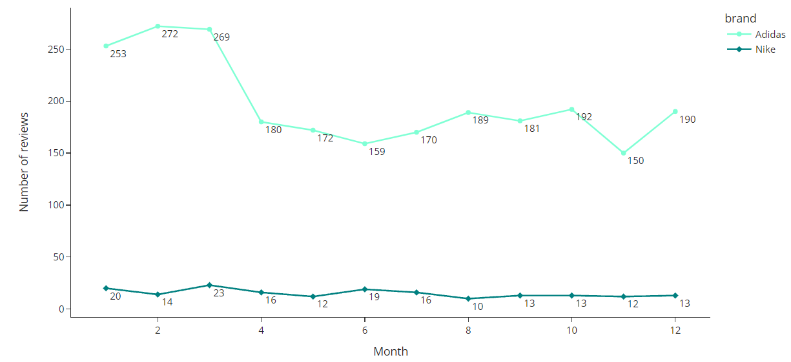
Monthly reviews over the year

Slide 14
Looks like product reviews are highest in the first quarter of the calendar year, so there is scope to run experiments aiming to increase the volume of reviews in the other nine months!

Slide 15
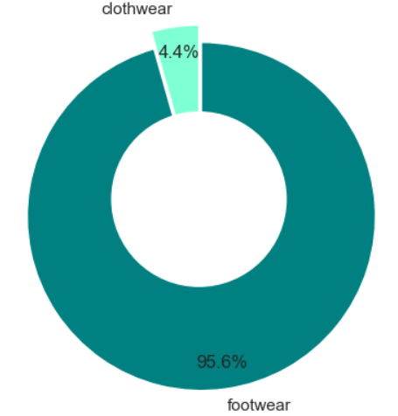
Revenue generated by different products
Footwear products generate 95.6% of the total revenue and occupy 92% of company stock.
Clothing products generate 4.4% of total revenue but occupy 8% of company stock.
Recommendation: Make all the company stock of footwear products only.

Slide 16
Conclusion
Increase the proportion of Adidas products priced at $129 or more.
Remove all Nike products except for products that have total revenue of 5700$ or above to create space for more Adidas items.
Run experiments aiming to increase the volume of reviews for the last nine months of the year.
Try to reduce the amount of discount offered on Adidas products and monitor sales volume to see if it remains stable.
Make all the company stock of footwear products only.

Slide 17



Thank you
Contact information
https://www.linkedin.com/in/omar-ahmed-6597061ba/
https://t.me/AbdElghany_505
omar.ahmed.oa.431@gmail.com

