Slide 1
N-puzzle

Slide 2
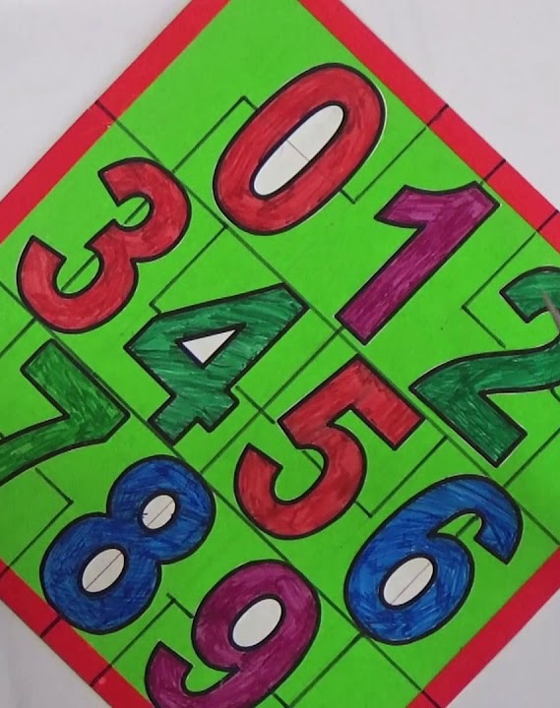
N-Puzzle Solver (for sizes: 8, 15, and 24) using a Best-First Search algorithm
20210561 | عبدالله مصطفي محمود الشامي
20211070 | يوسف حاتم محمود احمد
20211059 | يوسف احمد كامل تهامي
20211067 | يوسف جابر فتحي صادق
20210005 | ابراهيم اسامه حسن محمد عمران
20210737 | محمد احمد محمد عبدالمجيد

Slide 3
Introduction
Heuristic search and the idea of a priority queue are both used in the best first search. This search algorithm follows a particular rule. The purpose is to take the shortest route possible from the starting point to the destination. When determining the shortest route in a network between a particular starting node and a goal node, the best First Search algorithm in artificial intelligence is utilized. As the distance from the starting node increases, the algorithm expands the graph nodes until it reaches the destination node.

Slide 4
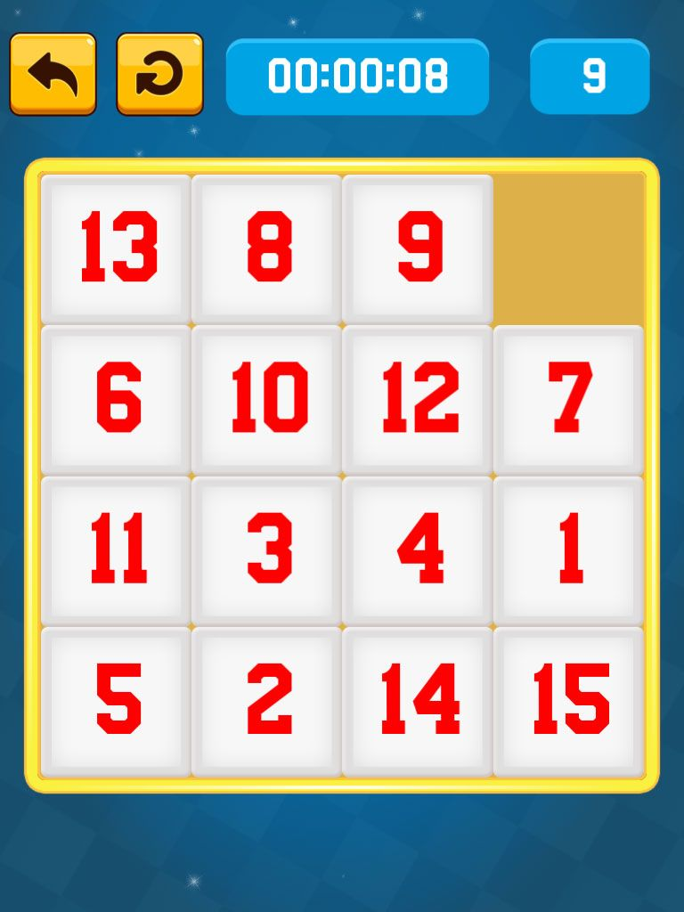
priority queue
A priority queue is a data structure that stores elements with associated priorities and allows for efficient retrieval of the element with the highest (or lowest) priority. Unlike a regular queue, where elements are removed in the order they are added, a priority queue dequeues elements based on their priority. Key operations of a priority queue typically include:
Insertion: Adding an element with an associated priority to the priority queue.
Deletion: Removing the element with the highest (or lowest) priority from the priority queue.
Peek/Top: Viewing the element with the highest (or lowest) priority without removing it.
Update: Modifying the priority of an existing element.
Priority queues can be implemented using various data structures, such as heaps, binary search trees, or arrays. The choice of implementation depends on the specific requirements and performance characteristics needed for a particular application.
One of the most common implementations is using a binary heap, which is a complete binary tree that satisfies the heap property (either min-heap or max-heap). In a min-heap, the parent node has a priority less than or equal to the priorities of its children, while in a max-heap, the parent node has a priority greater than or equal to the priorities of its children

Slide 5
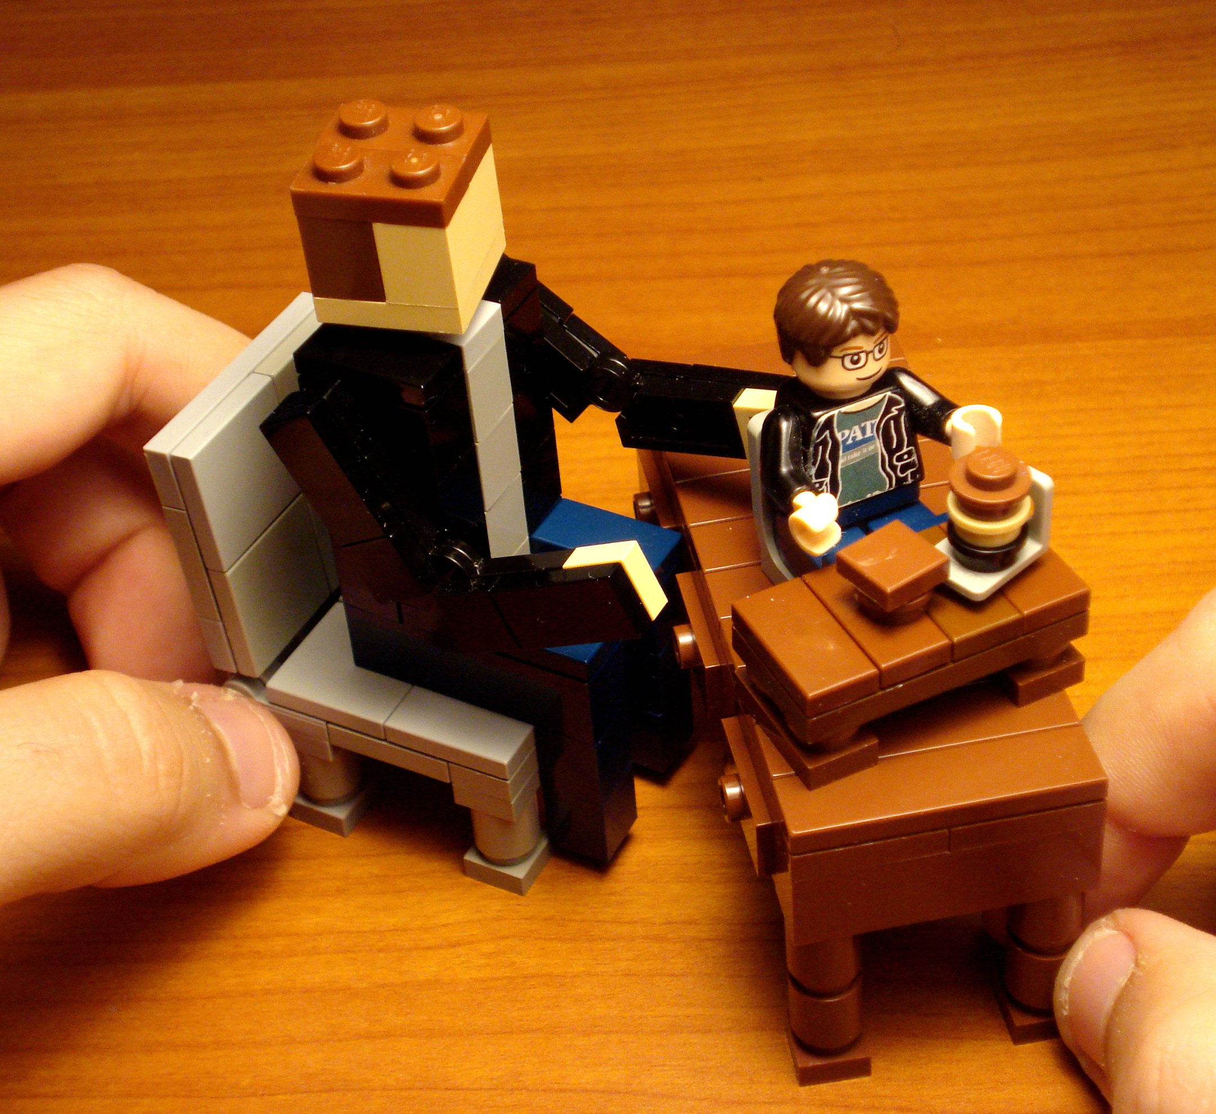
Project idea
The n puzzle is a classical problem for modelling algorithms involving heuristics. Commonly
used heuristics for this problem include counting the number of misplaced tiles and finding the sum of the taxicab distances between each block and its position in the goal configuration.
N-Puzzle consists of N tiles where N can be 8, 15, 24 and so on. The puzzle is divided into √(N+1) rows and √(N+1) columns eg. 15-Puzzle will have 4 rows and 4 columns, an 8-Puzzle will have 3 rows and 3 columns and so on. The puzzle consists of one empty space where the tiles can be moved
An instance of the n-puzzle game consists of a board holding n^2-1 distinct movable tiles, plus an empty space. The tiles are numbers from the set 1,..,n^2-1. For any such board, the empty space may be legally swapped with any tile horizontally or vertically adjacent to it. In this assignment, the blank space is going to be represented with the number 0. Given an initial state of the board, the combinatorial search problem is to find a sequence of moves that transitions this state to the goal state; that is, the configuration with all tiles arranged in ascending order 0,1,… ,n^2−1. The search space is the set of all possible states reachable from the initial state. The blank space may be swapped with a component in one of the four directions {‘Up’, ‘Down’, ‘Left’, ‘Right’}, one move at a time. The cost of moving from one configuration of the board to another is the same and equal to one. Thus, the total cost of path is equal to the number of moves made from the initial state to the goal state.

Slide 6

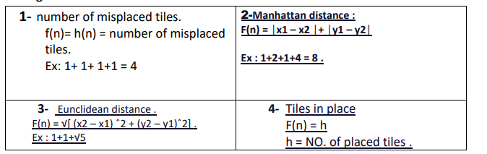
Main Functionalities:
The main function in this problem is to rearrange the tiles to their original positions, as in Goal State
. The initial state must be compared with the goal state, and then heuristic ways should be devised to solve this problem in the simplest possible time and cost.
In this problem, each operation costs 1, and the process is a step up, down, right, or left (only if possible), in addition to not repeating the previous step in order to move away from infinite loops
In the n-puzzle problem, the solution will be done by the best search algorithm through 4 basic heuristic functions.

Slide 7
There is a lot of paper in this task here is a few:
1) Pedagogical Possibilities for the N-Puzzle Problem:
Abstract:
In this paper we present work on a project funded by the National Science Foundation with a goal of unifying the artificial intelligence (AI) course around the theme of machine learning. Our work involves the development and testing of an adaptable framework for the presentation of core AI topics that emphasizes the relationship between AI and computer science. Several hands-on laboratory projects that can be closely integrated into an introductory AI course have been developed. We present an overview of one of the projects and describe the associated curricular materials that have been developed. The project uses machine learning as a theme to unify core AI topics in the context of the N-puzzle game. Games provide a rich framework to introduce students to search fundamentals and other core AI concepts. The paper presents several pedagogical possibilities for the N-puzzle game, the rich challenge it offers, and summarizes our experiences using it

Slide 8
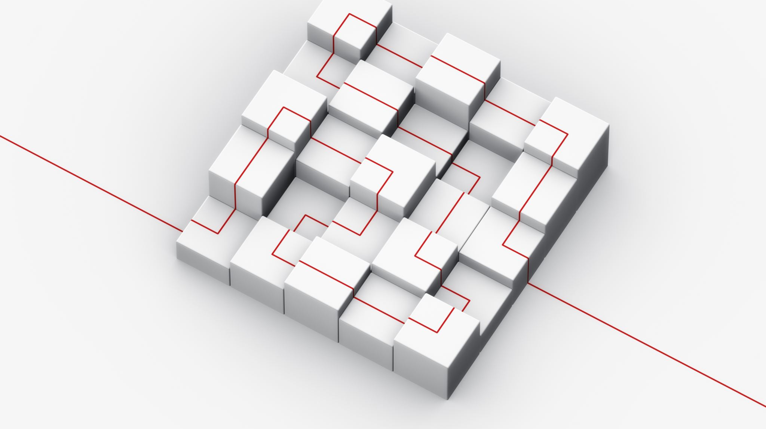
There is a lot of paper in this task here is a few:
2)Experimental Comparison of Uninformed and Heuristic AI Algorithms for N Puzzle Solution:
Abstract:
This paper compares the performance of popular AI techniques, namely the Breadth First Search, Depth First Search, A* Search, Greedy Best First Search and the Hill Climbing Search in approaching the solution of a N-Puzzle of size 8, on a 3x3 matrix board. It looks at the complexity of each algorithm as it tries to approaches the solution in order to evaluate the operation of each technique and identify the better functioning one in various cases. The N Puzzle is used as the test scenario and an application was created to implement each of the algorithms to extract results. The paper also depicts the extent each algorithm goes through while processing the solution and hence helps to clarify the specific cases in which a technique may be preferred over another.

Slide 9
3) 15-Puzzle Problem Solving with the Artificial Bee Colony Algorithm Based on Pattern Database:
Abstract:
The N-puzzle problem is one of the most classical problems in mathematics. Since the number of states in the N-puzzle is equal to the factorial of the number of tiles, traditional algorithms can only provide solutions for small-scale ones, such as 8-puzzle. Various uninformed and informed search algorithms have been applied to solve the N-puzzle, and their performances have been evaluated. Apart from traditional methods, artificial intelligence algorithms are also used for solutions. This paper introduces a new approach based on a meta-heuristic algorithm with a solving of the 15-puzzle problem. Generally, only Manhattan distance is used as the heuristic function, while in this study, a linear conflict function is used to increase the effectiveness of the heuristic function. Besides, the puzzle was divided into subsets named pattern database, and solutions were obtained for the subsets separately with the artificial bee colony (ABC) algorithm. The proposed approach reveals that the ABC algorithm is very successful in solving the 15-puzzle problem
There is a lot of paper in this task here is a few:

Slide 10
4) Evaluating Search Algorithms for Solving n-Puzzle:
Abstract:
Artificial game playing has gathered significant attention in past few decades. Several games are used to evaluate various algorithm. n-puzzle is a classical problem in computer science in evaluating search heuristics which is a central problem in artificial game playing and artificial intelligence in general. In this paper we formulate n-puzzle as an undirected graph problem and evaluate search algorithms with various heuristics. We find out relation between a random puzzle state and its time complexity and also provide evidence that finding a shortest path to an n-puzzle is an NP-Hard problem.
There is a lot of paper in this task here is a few:

Slide 11
5) An N-Puzzle Solver Using Tissue P System with Evolutional Symport/Antiport Rules and Cell Division:
Abstract:
An N-puzzle is a sliding blocks game that takes place on a grid with tiles each numbered from 1 to N. Many strategies like branch and bound and iterative deepening are exist in the literature to find the solution of the puzzle. But, here, a different membrane computing algorithm also called P systems, motivated from the structure and working of the living cell has been used to obtain the solution. A variation of P system, called tissue P system with evolutional symport/antiport (TPSESA) rules, is used to solve the puzzle. It has been proved that the power of computation of TPSESA rules with membrane division is universal Turing computable. In this paper, a concept of dynamic membrane division is also considered so that it completely simulates the behavior of a living cell. On the basis of experiments performed on a sample of different instances, the proposed algorithm is very efficient and reliable. As far as the author is concerned, this is the first time, an N-Puzzle problem is solved using the framework of membrane computing.
There is a lot of paper in this task here is a few:

Slide 12
What is Best First Search?
Details of the algorithm(s)/approach(es) that will be used
Best-first search is a class of search algorithms, which explore a graph by expanding the most promising node chosen according to a specified rule.
Judea Pearl described the best-first search as estimating the promise of node n by a "heuristic evaluation function {\display style f(n)} which, in general, may depend on the description of n, the description of the goal, the information gathered by the search up to that point, and most importantly, on any extra knowledge about the problem domain."
Some authors have used "best-first search" to refer specifically to a search with a heuristic that attempts to predict how close the end of a path is to a solution (or, goal), so that paths which are judged to be closer to a solution (or, goal) are extended first. This specific type of search is called greedy best-first search or pure heuristic search.
Efficient selection of the current best candidate for extension is typically implemented using a priority queue

Slide 13
NOTE
Details of the algorithm(s)/approach(es) that will be used
The A* search algorithm is an example of a best-first search algorithm, as is B*. Best-first algorithms are often used for path finding in combinatorial search. Neither A* nor B* is a greedy best-first search, as they incorporate the distance from the start in addition to estimated distances to the goal.

Slide 14
Advantages and Disadvantages of Best First Search:
Advantages:
Can switch between BFS and DFS, thus gaining the advantages of both.
More efficient when compared to DFS.
The solution will definitely found out by BFS If there is some solution.
BFS will never get trapped in a blind alley, which means unwanted nodes.
If there is more than one solution then it will find a solution with minimal steps.
Disadvantages:
1. Chances of getting stuck in a loop are higher.
2. Memory Constraints As it stores all the nodes of the present level to go for the next level.
3. If a solution is far away then it consumes time.

Slide 15
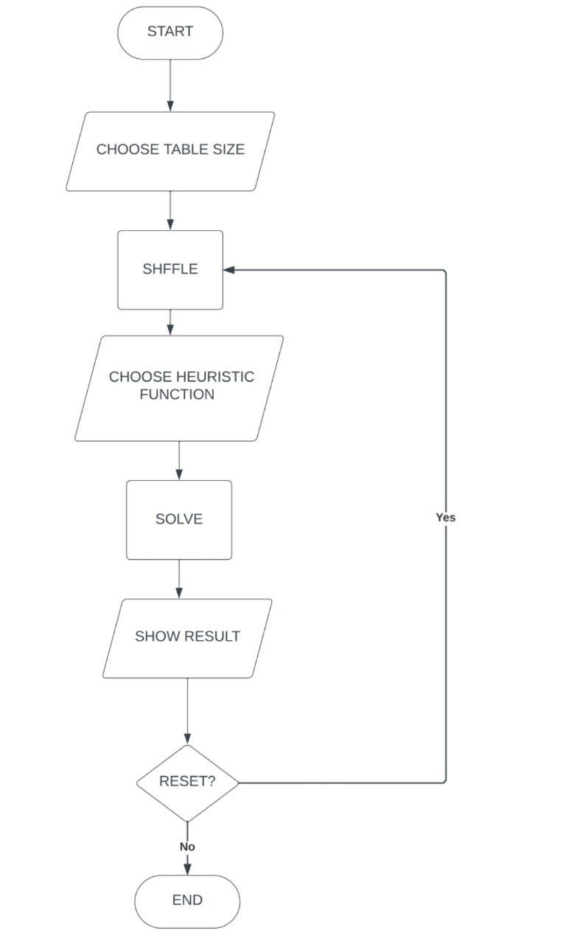
In the following this is flow chart of “Best-first search”

Slide 16
In the following this is flow chart of “Best-first search
1-create a priority queue 2-insert the initial state in the queue 3-calculate heuristic distance for child states 4-select the state with lowest heuristic distance 5- if the state is the goal state solution is found; else repeat process 3 until the end

Slide 17
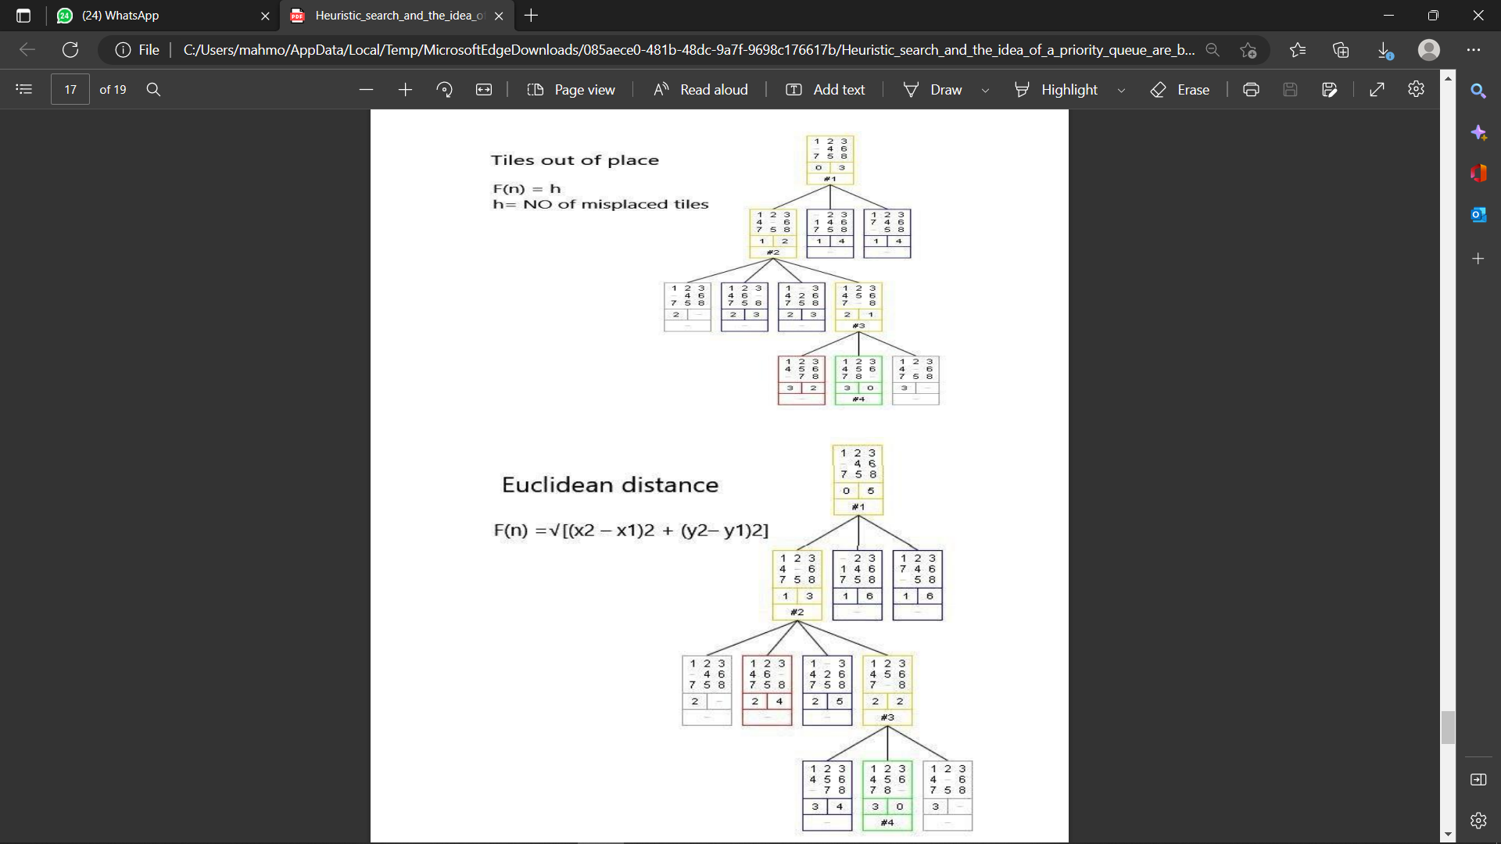
The block diagram for all heuristic function :

Slide 18
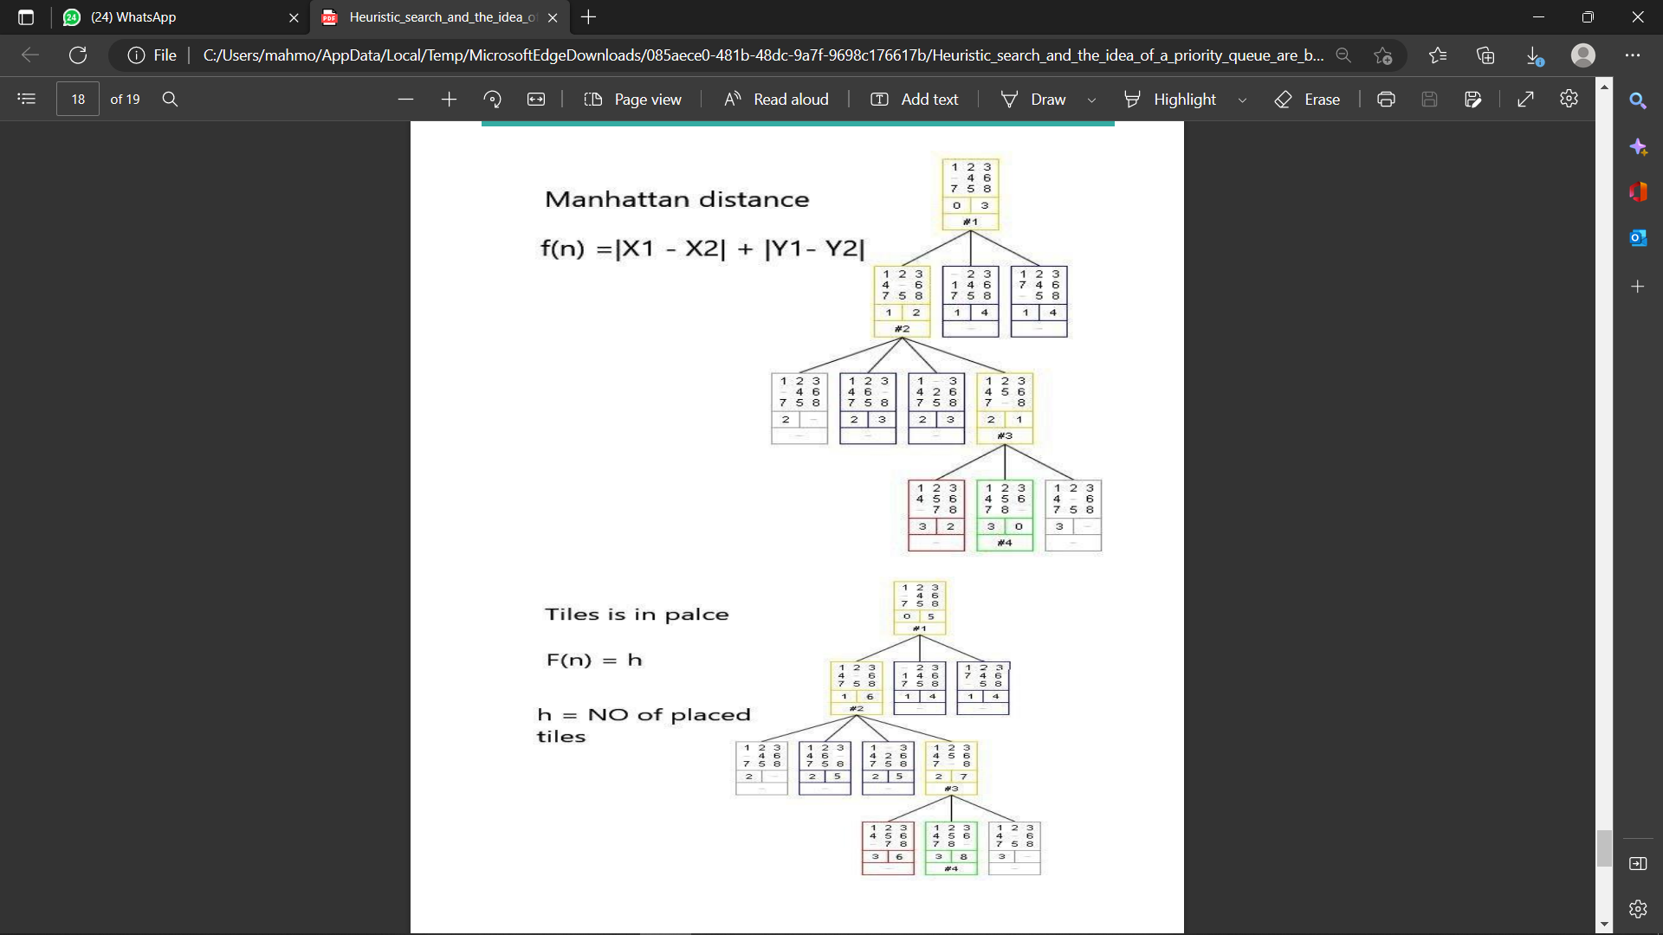
The block diagram for all heuristic function :

Slide 19
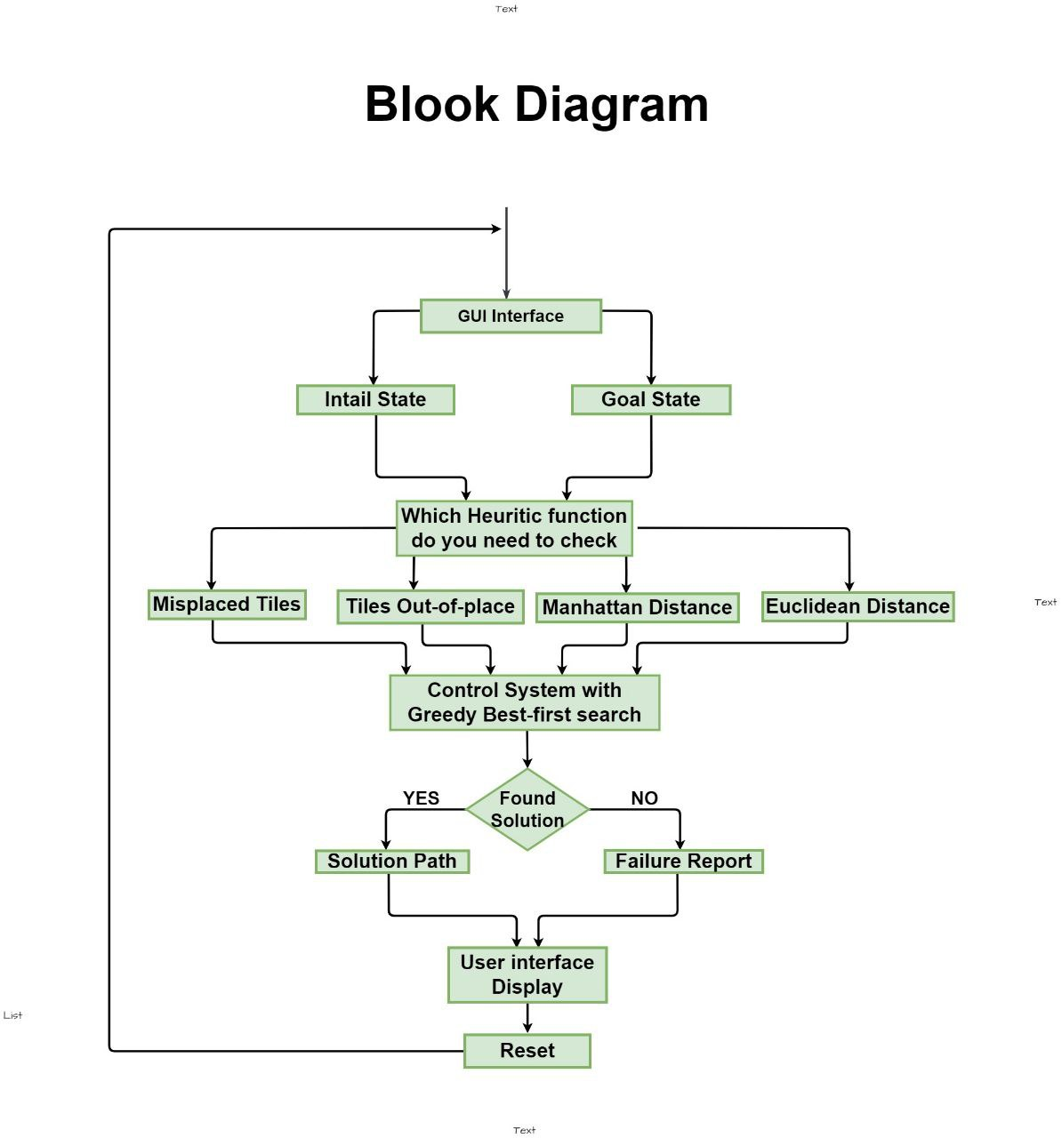
The block diagram of the system:

Slide 20
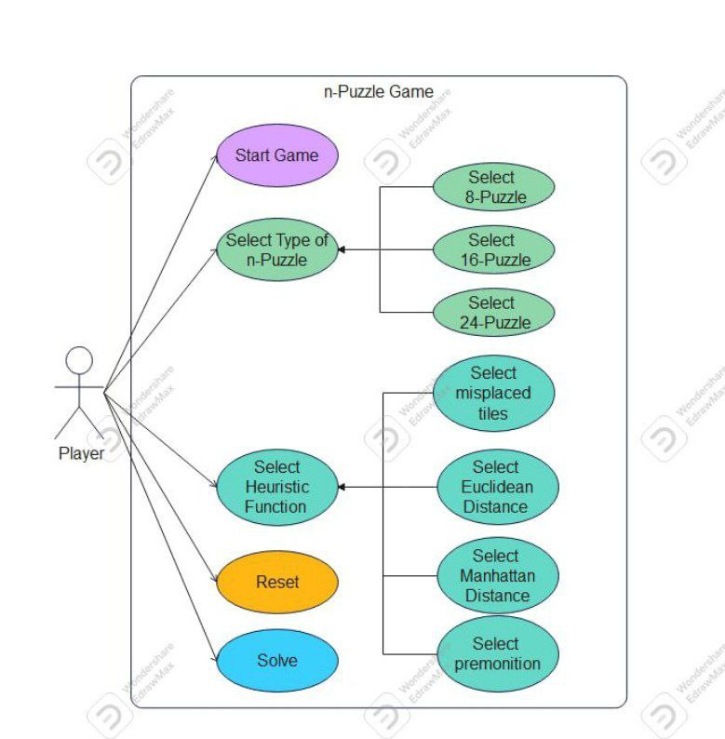
Use case- diagram which represent the future /function from the user’s point of view:

Slide 21

Thank you

