Slide 1






AAPL-SEC-FINANCIAL-FACTS-AND-FILING
langs : EDA With Python
VisitMy Portfolio

Slide 2

Ingoude Company
INTRODUCTION
"Raw financial data is messy. It contains missing values, illogical entries, duplicate reports, and extreme outliers."
This pipeline solves that problem. It automatically detects whether your data is Stock Prices or Company Financials, then applies the right cleaning strategy for each.

Slide 3

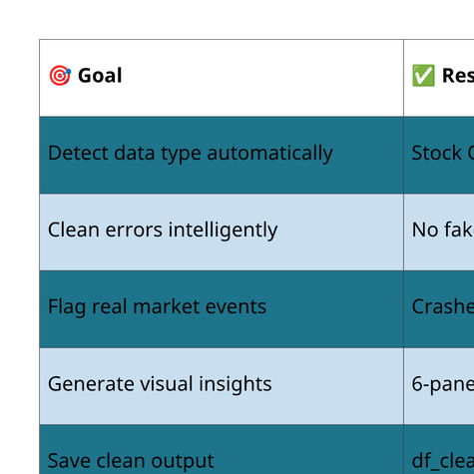
Ingoude Company
PROJECT BACKGROUND

Slide 4


Ingoude Company
PROJECT GOALS & OBJECTIVES
Step 1 — Load & Detect
Step 2 — Clean the Data
  Read the CSV file
  Show shape, types, missing %, duplicates
  Auto-detect: Stock or SEC data
Stock Mode
  If prices are missing, we fill them forward from the last known value.
  If volume is missing, we replace it with the median.
  If High is lower than Low, that row is deleted.
  If there's a volume spike, we flag it — but keep it.
  If there's a price crash, we flag it — but keep it.

Slide 5
Ingoude Company
PROJECT GOALS & OBJECTIVES
Step 2 — Clean the Data(con)
Step 3 — Statistics
  🏛️ SEC Mode
  If there are duplicate filings, we keep only the latest one.
  If there are conflicting values, we trust the restatement.
  If Q4 is missing, we calculate it (Full Year minus Q1+Q2+Q3).
  If the revenue tag changed over time, we unify it into one column.
  Calculate: Mean, Median, Std, Skew, Kurtosis
  Explain shape in plain English
    "Right-skewed with heavy tails"

Slide 6
Ingoude Company
PROJECT GOALS & OBJECTIVES
Step 4 — Visualize
Step 5 — Output
  One figure, six panels:
  Histogram — Main variable
  Histogram — Secondary variable
  Box plot — Secondary variable
  Box plot — Returns / Growth
  Time series — Main variable
  Time series — Secondary variable
  Save cleaned_data.csv
  Print final shape + first 5 rows

Slide 7

Ingoude Company
PROJECT LINKS
Github
https://github.com/Abdalla820/AAPL-SEC-Financial-Facts-and-Filing
Kaggle Dataset
https://www.kaggle.com/datasets/blixture/apple-stocks

Slide 8



Abdalla Mohamed
THANK YOU
FOR YOUR ATTENTION
abdallamohamed8354@gmail.com
Portfolio
+021205479856

