Slide 1


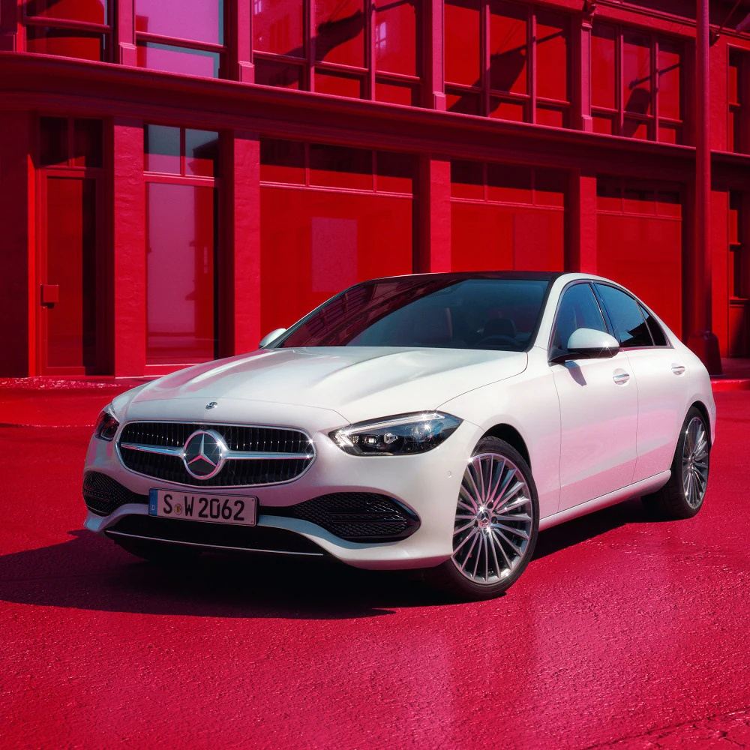
MERCEDES-BENZ
Global sales performance, 2019–2023
presented by
Abdalla Mohamed

Slide 2



02 THE PROBLEM
Why this project?
Scale
25+ models sold across 20+ countries
Scatter
Data spread across years, regions and channels
Blind spots
Hard to see what is working and what is not
The need
A single view for fast business decisions

Slide 3
03 THE SOLUTION
An interactive Power BI dashboard
01
02
03
04
Tracks
Compares
Analyzes
Shows
Revenue, units and growth
Car models
Regions and countries
Trends over time

Slide 4
04 THE Data
What I used
SOURCE | DESCRIPTION
Mercedes Sales Data | 5 years of sales (2019–2023)
Car Images | Model photos
Country Flags | Region and country metadata
About 1,500+ records, 25+ models, 20+ countries

Slide 5





Total revenue
05 KEY NUMBERS
$200M+
HEADLINE KPIS
Units sold
1,500+
Time-Period
2019–23
Car models
25+
20+
Countries

Slide 6
06 KEY FINDINGS
What the data told us
Top models
AMG GT and S-Class lead revenue
Top regions
North America and Europe
Growth
2023 was the strongest year
Channels
Wholesale dominates sales
EVs rising
EQB, EQA and EQE growing fast

Slide 7
07 RECOMMENDATIONS
What Mercedes should do
PRIORITY | ACTION
Focus | Push top models harder in marketing
Expand | Target underperforming regions
Electrify | Promote the EV lineup more aggressively
Optimize | Balance Wholesale vs. Dealership

Slide 8


Project Links
Github
https://github.com/Abdalla820/Mercedes-Benz-Sales-2019-2023
Dataset
https://github.com/prince-pastakiya/Mercedes-Benz-Sales-Data-Analysis

Slide 9
THANK YOU
linkedin.com/in/abdalla-mohamed-farouk
presented by
Abdalla Mohamed

