Slide 1




linkedin.com/in/abdalla-mohamed-farouk
Online Retail II —
Customer Analytics Pipeline
Lang & Tools :
Python , power Bi
Presented By:
Abdalla Mohamed

Slide 2

About Project
Pyhon
A simple Python pipeline that cleans the Online Retail II dataset and produces customer segments and retention analysis.
What It Does :
  Load the raw dataset (CSV or Excel).
  Clean it — remove duplicates, missing customers, cancellations, returns, and non-product items.
  Score each customer with RFM (Recency, Frequency, Monetary).
  Segment customers into groups like Champions, Loyal, At Risk, Hibernating.
  Cluster customers with K-Means (optional).
  Analyze cohorts — monthly retention by first-purchase month.
  Export three CSV files.

Slide 3
About Project
Page 2: RFM Analysis
RFM scores every customer on three things:
Recency — how recently they bought
Frequency — how often they buy
Monetary — how much they spend
Each gets a score from 1 to 5.
Customers are grouped into 10 segments:
  Champions
  Loyal Customers
  Potential Loyalists
  New Customers
  Promising
  Need Attention
  About to Sleep
  At Risk
  Can't Lose Them
  Hibernating
Revenue by segment:
Champions: 49.32% Loyal Customers: 25.72%
At Risk: 7.24% Hibernating: 5.9%
Potential Loyalists: 5.78% Others: 1.76%
Power Bi
Page 1: Overview
Shows the main business numbers.
Key metrics:
Average Order Value: 475.16
Total Customers: 4K
Total Sales: 9M
Total Orders: 18K
Also shows:
Customers by segment
Revenue by segment
Average order value by country

Slide 4
About Project
Power Bi
Page 3: Cohort Trends
Shows how many customers come back after their first purchase.
Retention drops fast:
Month 1: 100%
Month 2: about 2.4%
Month 12: less than 1%
Sales by first purchase quarter:
Qtr 4: 55.42%
Qtr 1: 26.49%
Qtr 3: 11.8%
Qtr 2: about 6%
Yearly retention:
2010: 5.43
2011: 26.19
Total: 31.63
Page 4: Geospatial
Shows where customers are around the world.
  United Kingdom has the most customers and sales
  Other markets: Ireland, Germany, France, Netherlands
  Many more countries with small numbers
Charts on this page:
  World map of customers and sales
  Revenue share by country (donut chart)
  Customers and average order value by country (bar chart)

Slide 5
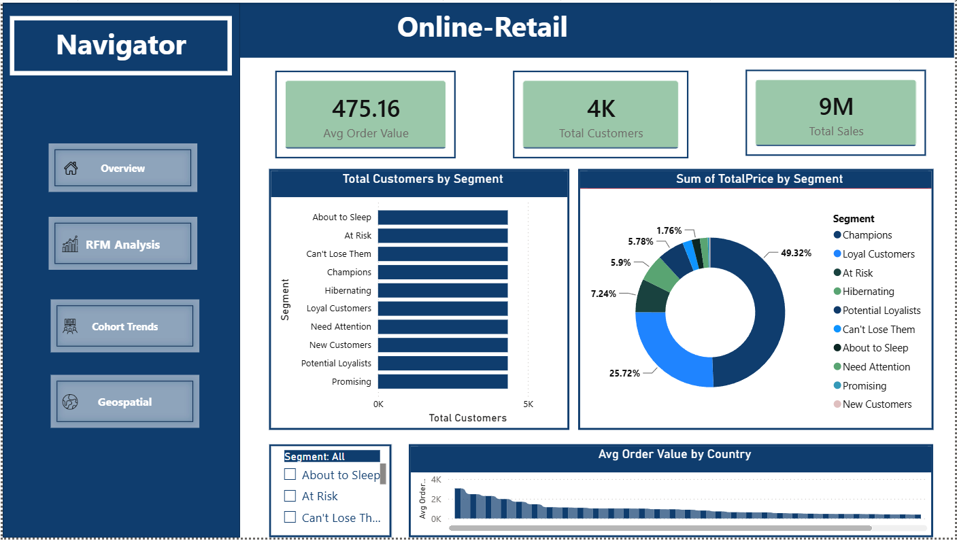
Overview

Slide 6
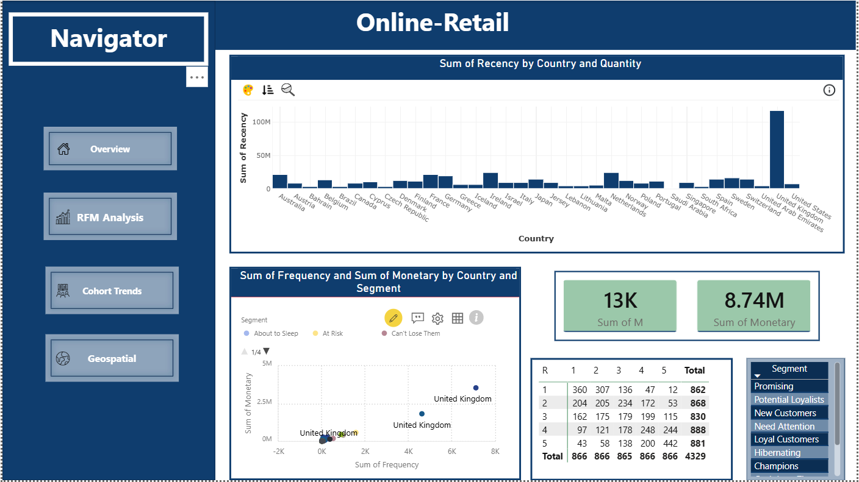
RFM Analysis

Slide 7
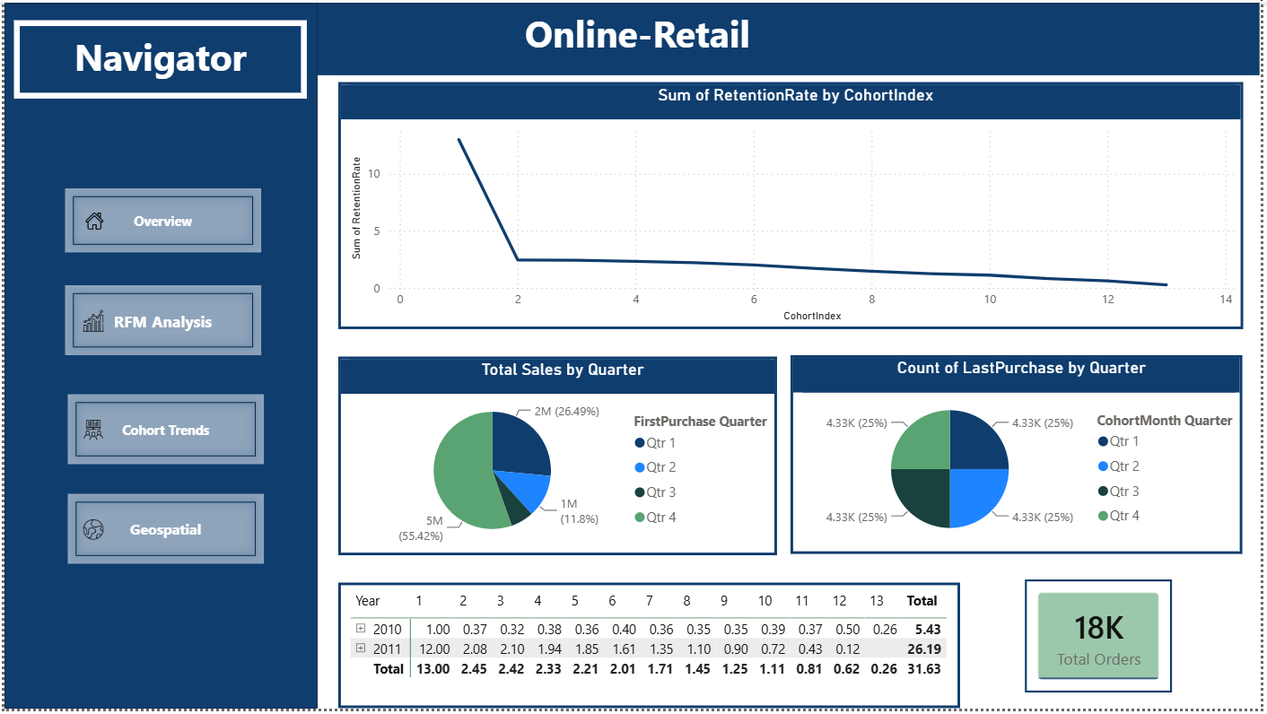
Cohort Trends

Slide 8
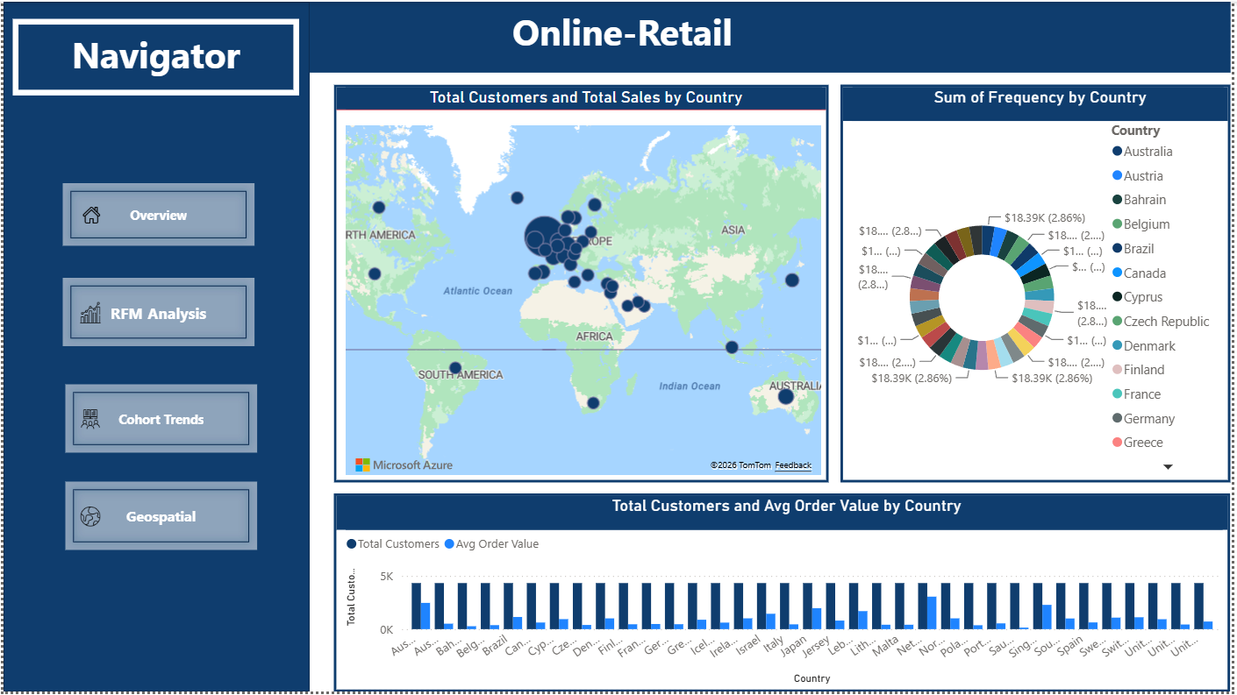
Geospatial

Slide 9

Project Links
Github
https://github.com/Abdalla820/Online_Retail
Kaggle Dataset
https://www.kaggle.com/datasets/tunguz/online-retail-ii

Slide 10

Thank You
So Much
  abdallamohamed8354@gmail.com
  +021205479856
linkedin.com/in/abdalla-mohamed-farouk

