Slide 1
Merceds-Benz Sales
2019-2023
view

Slide 2
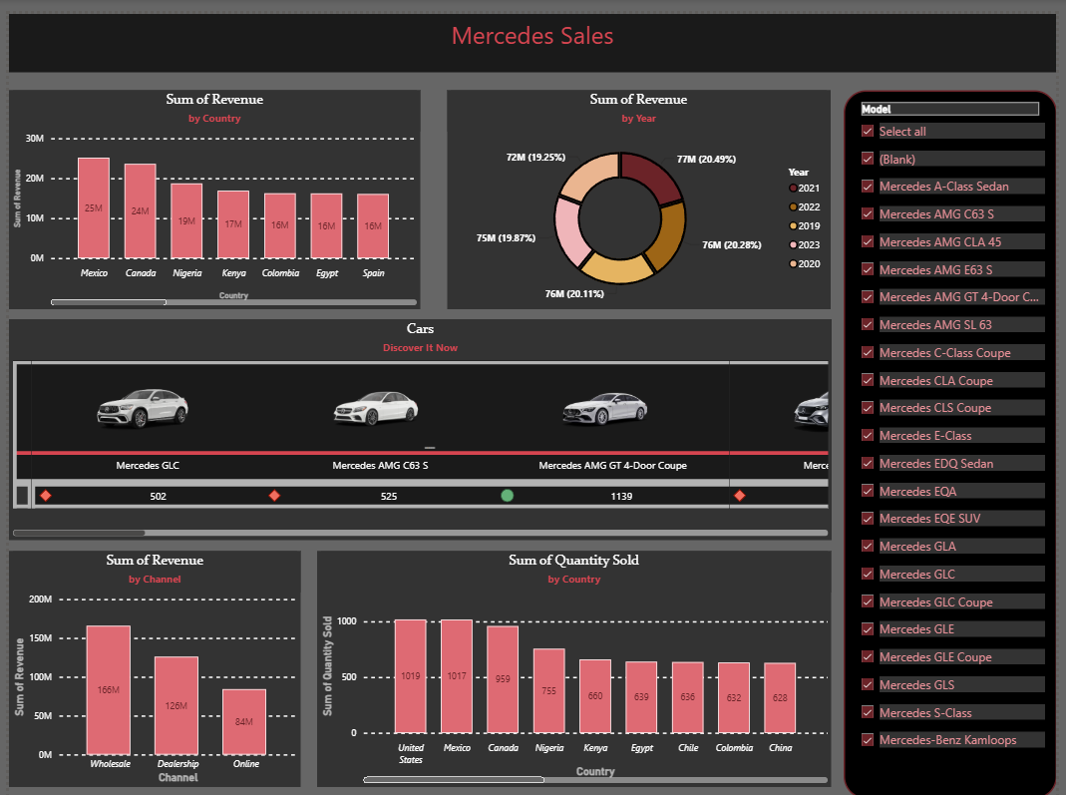

Slide 3
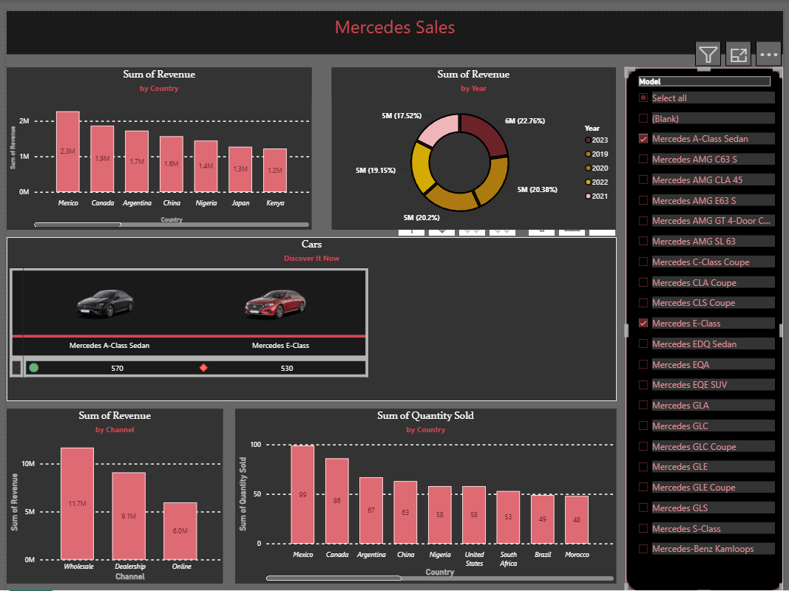

Slide 4
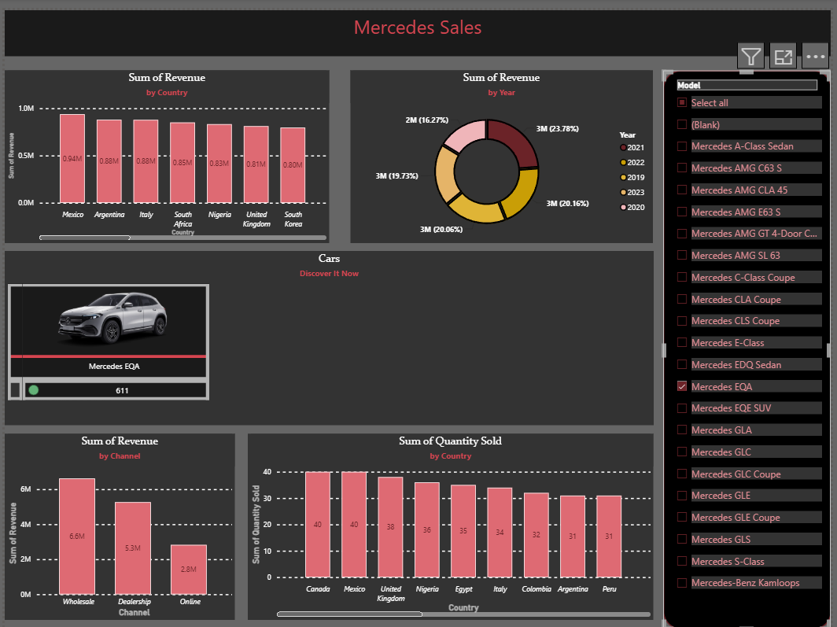

Slide 5
