Slide 1
SOW1 - SOW2 secure communication
Cybersecurity requirement review: feature, workflow, SIQs and test approach
Mekra Vision Controller - SOW2 rear and trailer camera

Slide 2
The feature in one page
SOW1
Bosch camera head with Samsung S5K3B6SA imager. Holds its own key pair in OTP.
SOW2
ECU with Ambarella CV22FS. Holds the Samsung root public key in OTP and a hardware TRNG.
Goal
SOW2 authenticates SOW1, then protects every frame (AES-CMAC tag) and every command.
Scope: CS testing, system and software. 55 requirements: 25 concept (CS_CONCEPT) and 30 technical (TECH_CS_CONCEPT). SOW2 verifies; SOW1 only responds.

Slide 3
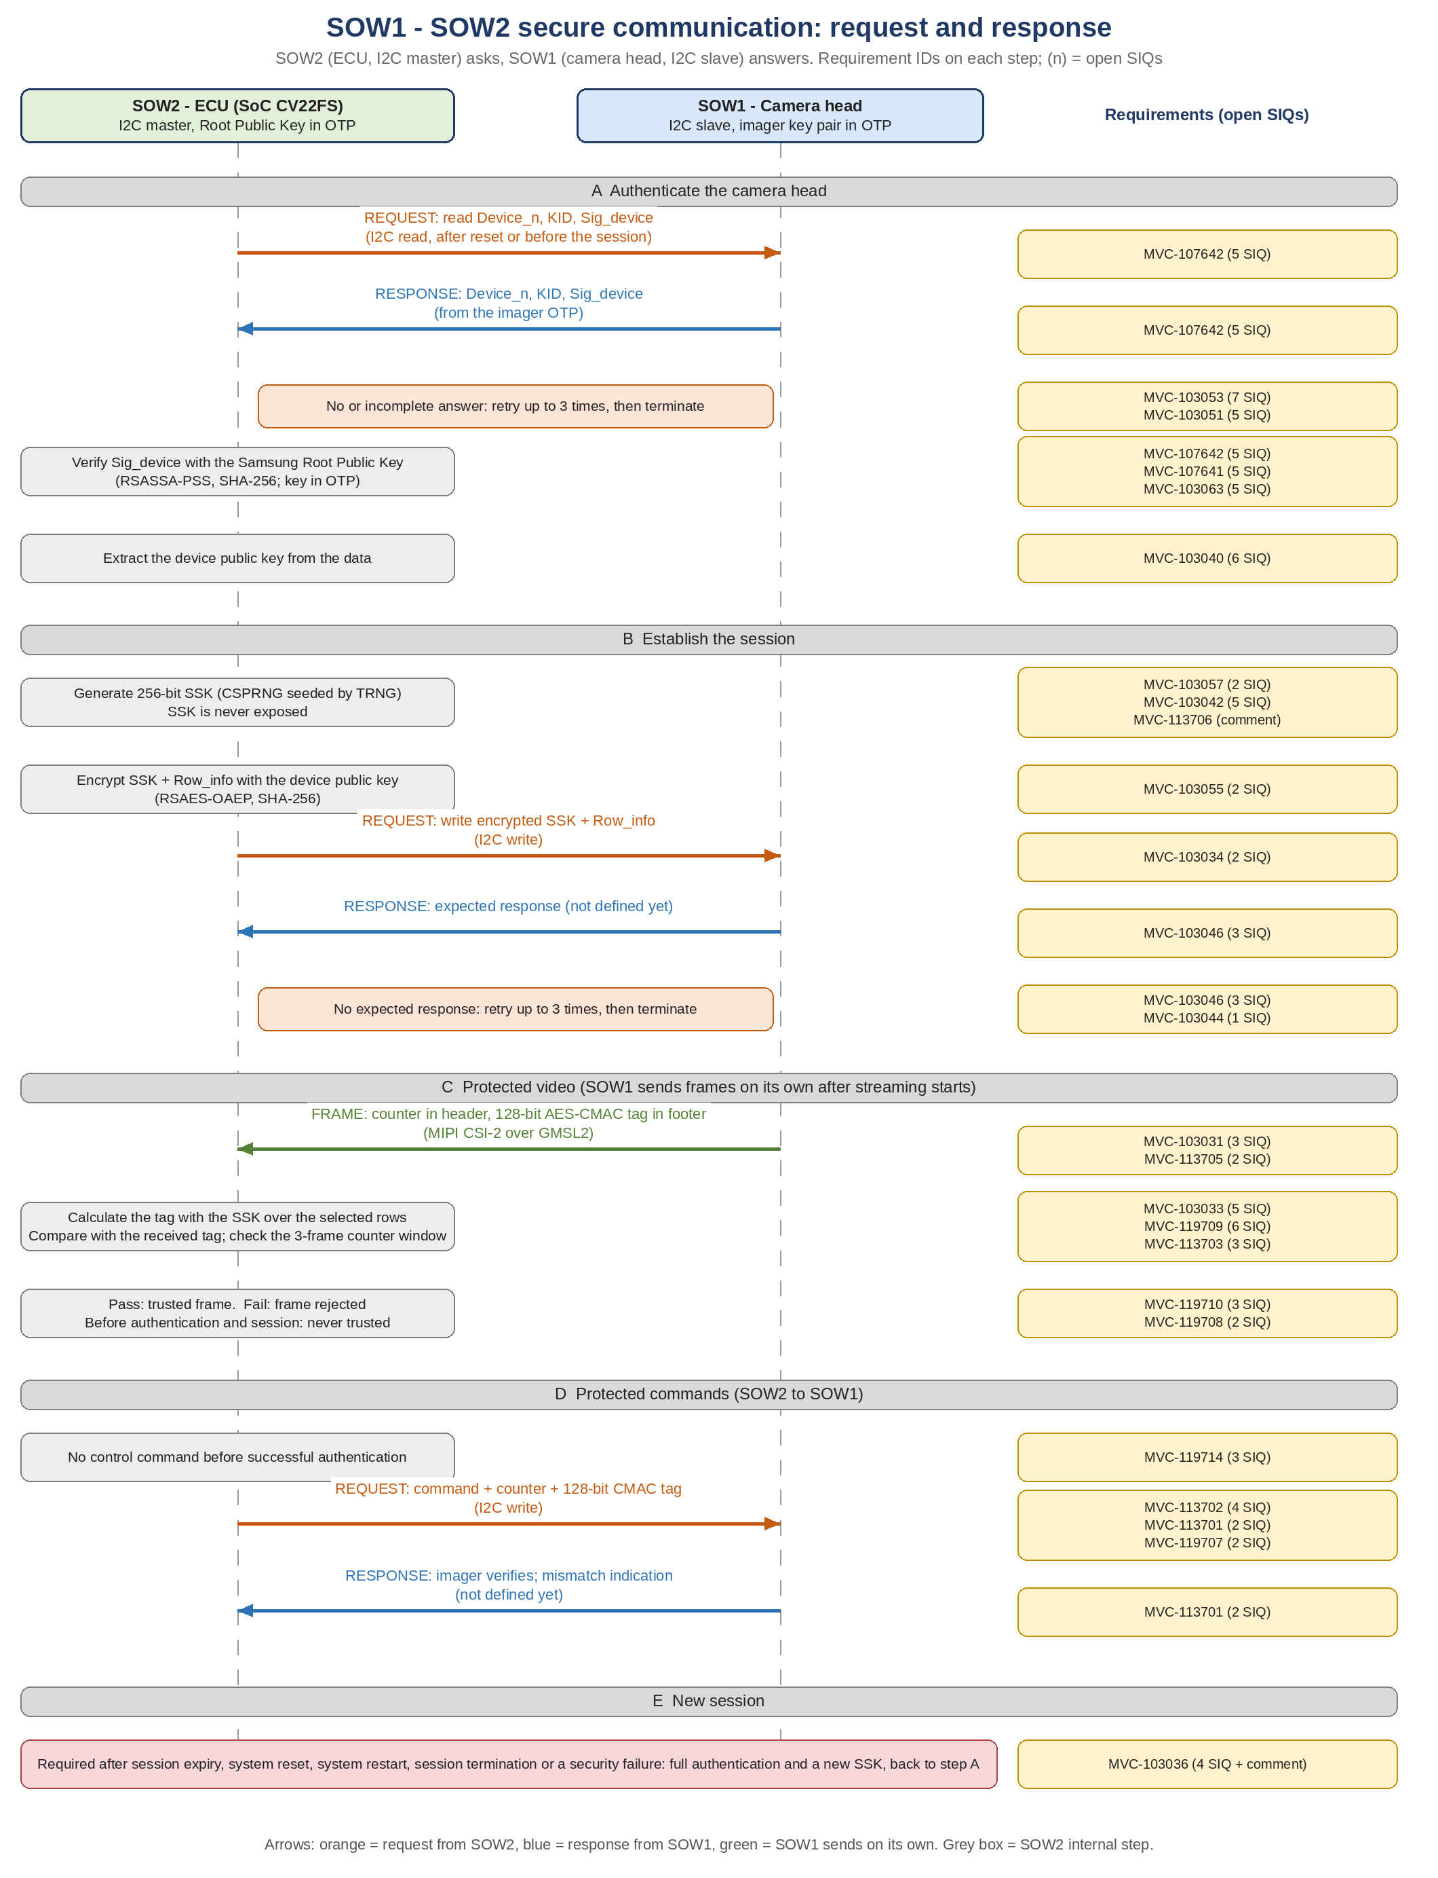
Message flow: request and response

Slide 4
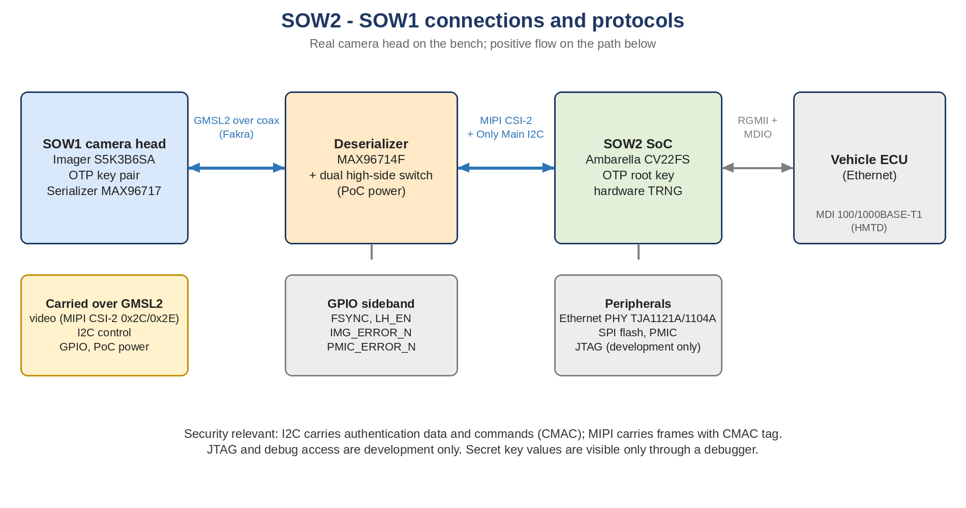
Connections and protocols

Slide 5
Keys and data
Item | Where | Used for
Samsung root key pair | Public key in SOW2 OTP | Verify the imager signature
Device key pair (per imager) | Private in SOW1 OTP, public read over I2C | Sign Device_n; decrypt SSK
SSK (256-bit session key) | SOW2 DRAM, imager | AES-CMAC on frames and commands
KID | Read from imager | Selects scheme and hash (SRS)
Row_info | Sent with SSK | Imager frame configuration
Interface spec (Bosch v1.0): the first 17 frames carry no tag; each imager has its own key pair.

Slide 6
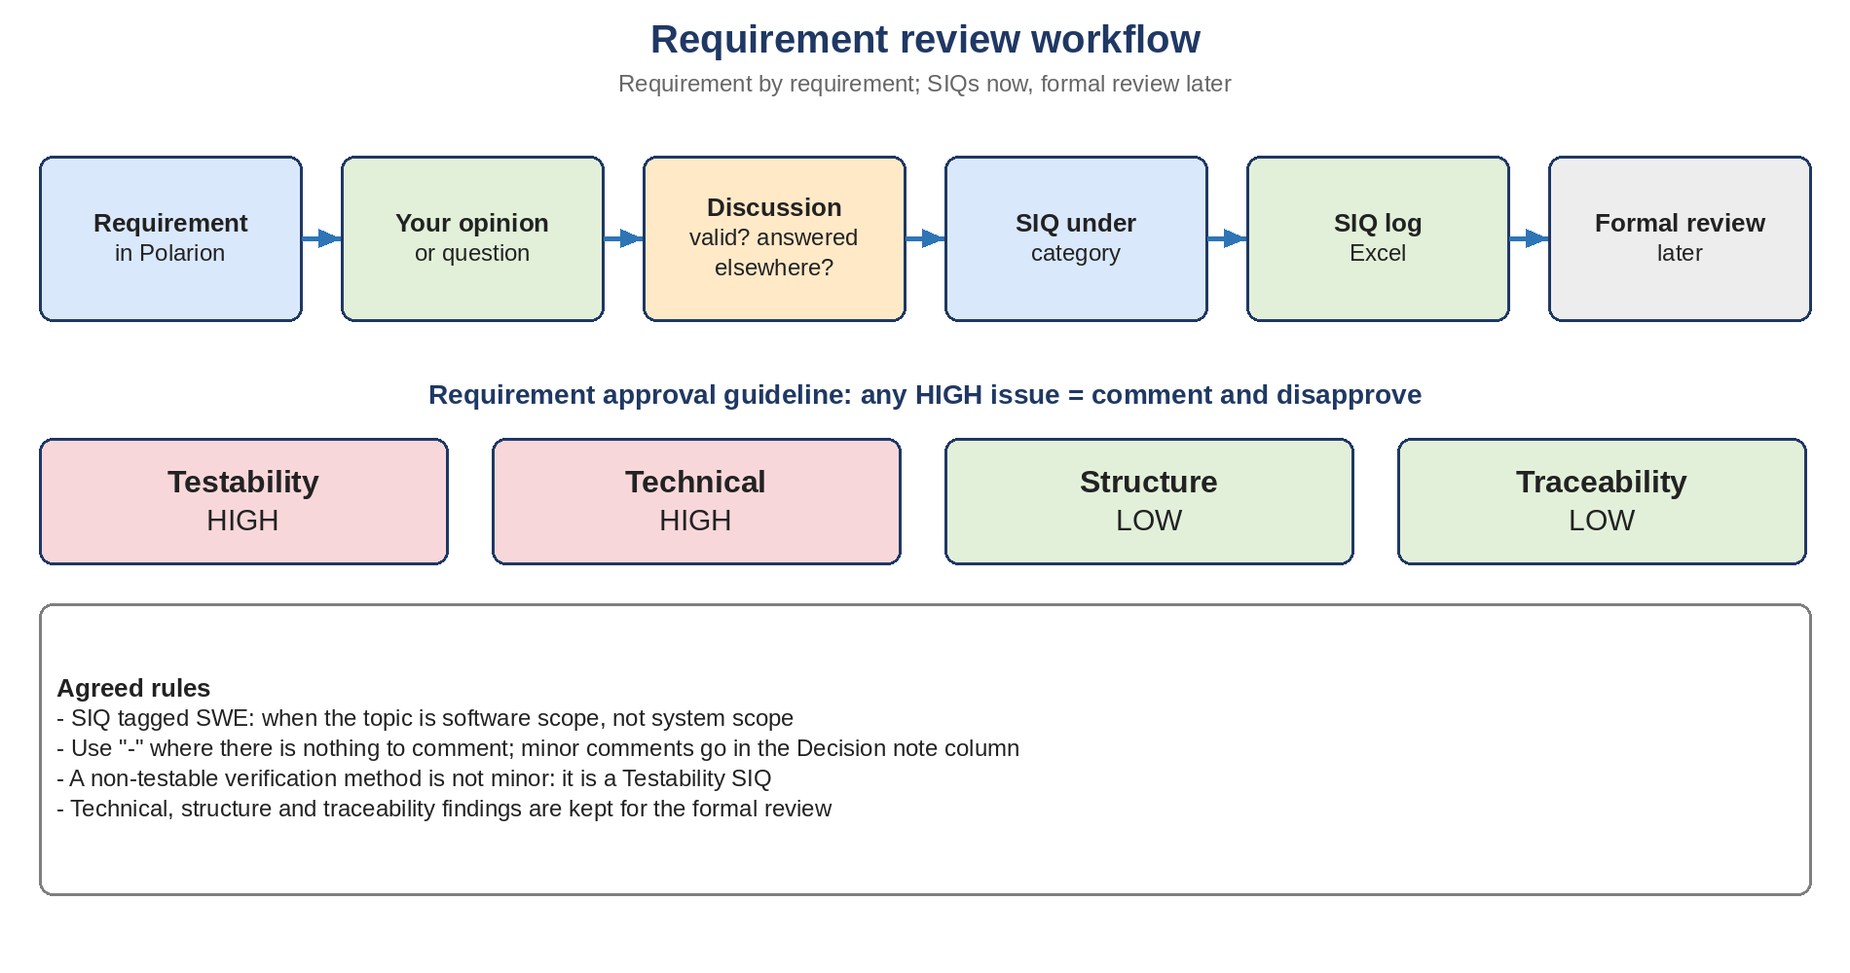
Review workflow

Slide 7
Main findings so far
Retry conflict
Retry requirement vs attempts count; SRS MVC-108124 says terminate
Frame counter
64-bit in header, 16-bit register: wraps in about 18 min at 60 fps
First 17 frames
No tag; requirements do not say so
Tag position
CMAC byte position not documented
KID meaning
SRS: selects scheme and hash; unclear in concept
Verification
Several methods not testable as written
OTP
Root key: programmed once or per flash?
Single or many keys
One imager key pair each; not stated in requirements

Slide 8
SIQ status: 87 SIQs, 25 of 25 concept requirements reviewed
Requirement | Topic | SIQs | Status
MVC-119709 | Verify frame tag | 5 | agreed
MVC-107641 | RSASSA-PSS with SHA-256 | 5 | agreed, SIQ-4 to rework
MVC-103063 | Root key in OTP | 5 | agreed
MVC-107642 | Authenticate imager | 5 | proposed, SIQ-4/5 to rework
MVC-103053 | Retry authentication | 7 | agreed
MVC-103051 | Terminate authentication | 5 | proposed
MVC-103040 | Extract device public key | 6 | agreed
MVC-103057 | Generate 256-bit SSK | 2 + minor | agreed
MVC-103042 | CSPRNG and TRNG | 5 | decided
MVC-103055 | Encrypt SSK and Row_info | 5 | proposed

Slide 9
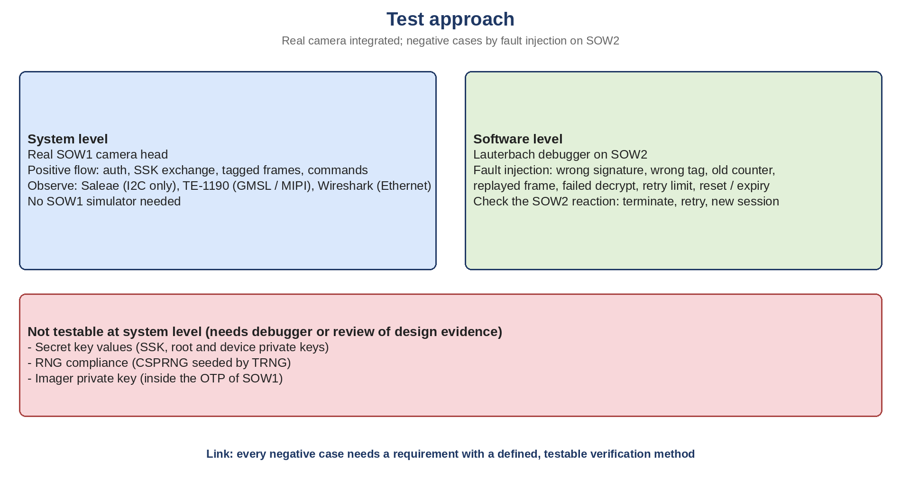
Test approach

Slide 10
Next steps
Decide SIQ-2 wording for MVC-103042
Rework 107642 SIQ-4/5 and 107641 SIQ-4 (real camera, fault injection)
Write the agreed SIQs into the SIQ log Excel
Continue: 119710, 103033, 103031, 113705, 113703, 119708, 103046, 103044, 103036, 119714, 113706, 113702, 113701, 119707
Then the 30 technical requirements; then the formal review

