Slide 1
JoTouch
AI-Driven Prosthetic Hand
TEAM: Issa · Mohammad ·Abdallah
SUPERVISOR: Dr. Mohammad Khrisat
Al-Balqa Applied University
Notes:
Open. JoTouch — an AI-driven anthropomorphic prosthetic hand, graduation project at Al-Balqa Applied University. Team of three, seven-month build. This is a Phase 1 catch-up: the digital twin is complete and running.

Slide 2
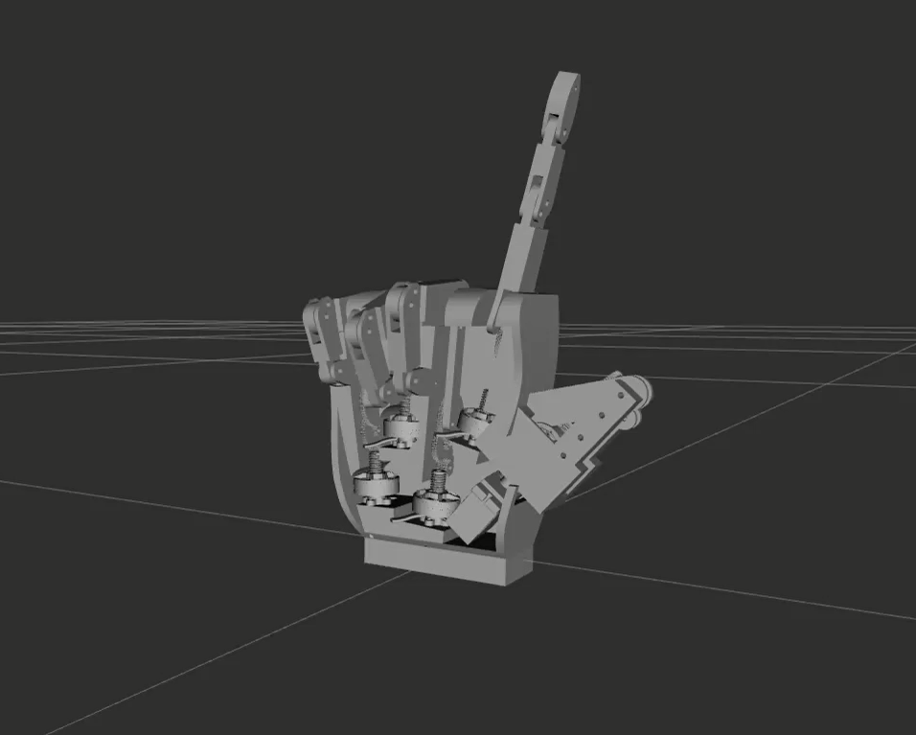
OVERVIEW
02 / 22
The What
Anthropomorphic prosthetic hand
AI-driven via Force Myography
ROS 2 + custom firmware
↳ RViz · one → two → three → four → five
Notes:
What JoTouch is in one breath: an anthropomorphic hand driven by AI from forearm muscle signals — Force Myography — running on ROS 2 with custom firmware. Seven-month graduation scope. The loop on the right is the live RViz simulation cycling gestures.

Slide 3
01
SECTION 01 · PHASE 1 COMPLETE
Mechanical
Mechanical Design · URDF
Notes:
Section one. This is the half of Phase 1 about the physical machine — the mechanical design, the CAD, and turning that CAD into a simulatable URDF model. All complete.

Slide 4
PHASE 1 · MECHANICAL
04 / 22
1 Motor → 3 Joints per finger
Master–slave kinematics — MCP drives, PIP & DIP follow via four-bar linkage
F1404 BLDC
MCP
45 mm proximal
PIP
27 mm middle
DIP
18 mm distal
90°
100°
70°
FOUR-BAR LINKAGE · ANATOMICAL COUPLING
ONE motor per finger drives the MCP — PIP & DIP follow. No per-joint actuators.
5
motors, not 15
Notes:
This is the key architectural decision. One motor drives the MCP of each finger; the PIP and DIP joints follow mechanically through a four-bar linkage — anatomical coupling at 90, 100, and 70 degrees at full curl. So three joints per finger move from a single actuator. Five motors instead of fifteen, while keeping a natural curl.

Slide 5
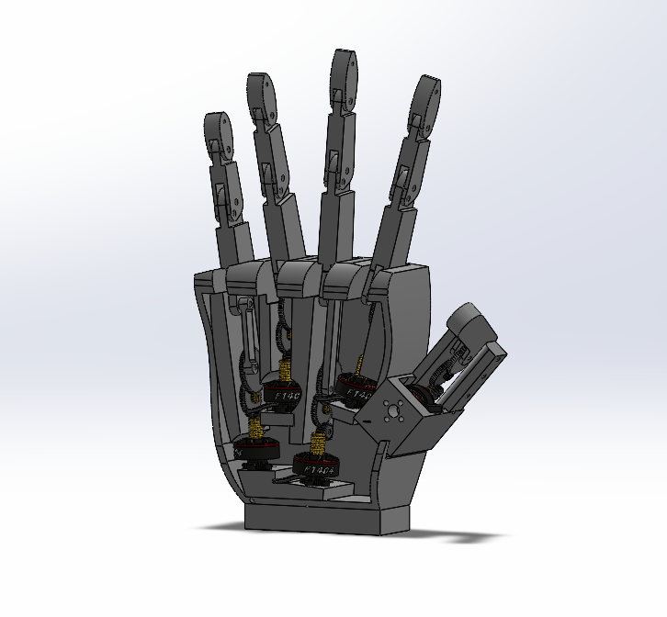
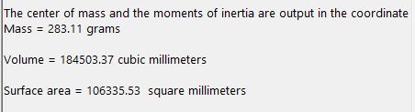
PHASE 1 · MECHANICAL
05 / 22
CAD & Constraints
Total mass
290 g
Phalanges (Fibonacci)
45 / 27 / 18 mm
Construction
PA12 nylon
Gear train
brass + POM
Reduction / finger
400 : 1
Notes:
The CAD locks the physical constraints. Total hand mass is 290 grams measured in CAD. Phalange lengths follow a Fibonacci progression — 45, 27, 18 millimeters. Printed in PA12 nylon, with a brass and Delrin gear train running a 400-to-1 reduction per finger. Seven actuated degrees of freedom.

Slide 6
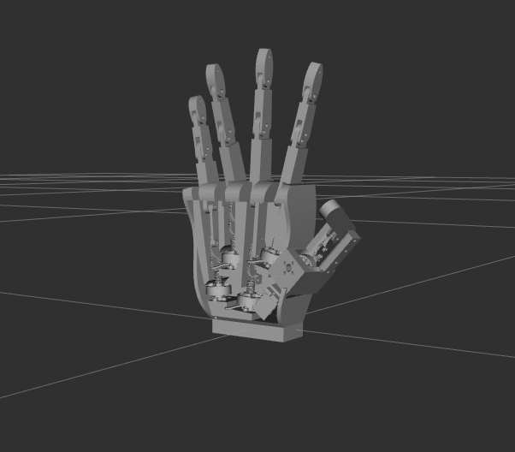
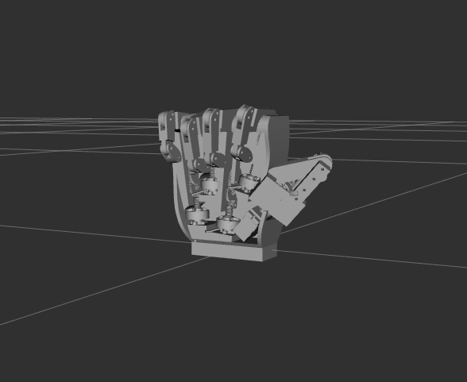
PHASE 1 · MECHANICAL
06 / 22
CAD to URDF
→
→
SOURCE
EXPORT + SCRIPT
SIMULATION
SolidWorks
SW2URDF
ROS 2 · RViz
16
links
14
joints
8
mimic relationships
Notes:
Getting from CAD to a simulatable model. We export from SolidWorks with SW2URDF, then run custom Python post-processing — flipping joint axes, fixing mesh paths, and injecting the mimic joints that encode the coupling. The result: 16 links, 14 joints, and 8 mimic relationships, all driving the digital twin.

Slide 7
02
SECTION 02 · HARDWARE
Electrical
Split compute · 8-channel FMG sensor array

Slide 8
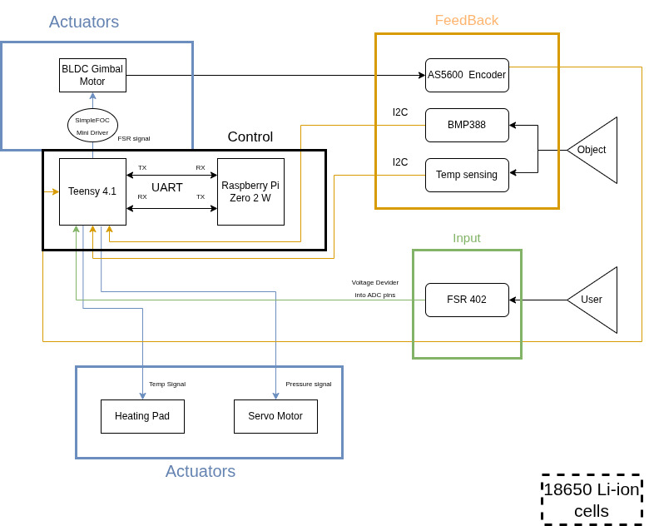
System Architecture
08 / 22

Slide 9
ARCHITECTURE
09 / 22
Brain & Spine
Split compute · ROS 2 Jazzy on Ubuntu 24.04
BRAIN
SPINE
Raspberry Pi Zero 2 W
Teensy 4.1
micro-ROS
◂ ──────── ▸
Real-time motor control
ML inference
USB serial
600 MHz · ample headroom SimpleFOC · closed loop
TensorFlow Lite
Notes:
The compute is split into a brain and a spine. The Raspberry Pi Zero 2 W is the brain — it runs ML inference. The Teensy 4.1 is the spine — hard real-time motor control at 600 MHz. They talk over micro-ROS on a USB serial link. This split keeps inference latency off the control loop.

Slide 10
04 · CODING THE TEENSY & RASPBERRY PI
IN PROGRESS
Two controllers, one real-time loop
Teensy 4.1 real-time control (C++)
Raspberry Pi AI prediction (Python)
Reads the sensors
Runs the AI model
captures the muscle signal
classifies gesture + regresses joint angles
Runs the on-board mapping
Sends commands when confident
base weights from our data, updated per patient
acts only above the confidence target
Drives the motors
Handles online training
moves the joints smoothly + proportional
updates each patient's weights
Reads the encoders
Coordinates the two units
feeds back true motion for control & training
high-level brain to the Teensy's spine
How they talk to each other
Teensy
sensor + encoder stream →
Raspberry Pi
predicts intent
Teensy
← target motion commands
Goal: smooth, real-time response end-to-end · commands sent only when the model is confident.
coded
to wire up
JoTouch — Technical Brief · Sensing, Control & AI
10 / 22

Slide 11
Technical Specifications
11 / 22
Performance Targets
System Specifications
Degrees of Freedom
Multi-Degree of Freedom
Processing
Teensy 4.1 + RPi Zero 2 W
Control Latency
< 100ms target
Communication
UART / micro-ROS
Intent Accuracy
> 90% target
Power
2S 18650 Li-ion (7.4V)
Operating Time
8+ hours daily use
Sensing
FMG , BMP388 + Temp Input
Weight Target
< 700g
Framework
ROS 2 + TensorFlow Lite
Sensory Feedback System
Pressure sensors on fingertips → Servo-driven rubber band on residual limb | Temperature sensors → Heating pad feedback

Slide 12
01 · WHERE WE READ THE SIGNAL
PLANNED
8 sensors over the forearm muscles
S1
Sensor → muscle → what it controls
S8
S2
S1
Brachioradialis (BR) — wrist side movement + partial flexion
forearm
cross-section
S2
Ext. Carpi Radialis (ECR) — wrist extension + radial (toward thumb)
S7
S3
S3
Extensor Digitorum (ED) — opens fingers 2–5 — opens the hand
S4
Ext. Carpi Ulnaris (ECU) — wrist extension + ulnar (toward little)
S5
Flexor Carpi Ulnaris (FCU) — wrist flexion + ulnar deviation
S6
S4
S6
Flexor Digit. Superficialis (FDS) — flex middle / ring / little — grip
S5
S7
FDS (index region) — flex index finger — pinch / precision
Flexors — close
Extensors — open
8-sensor ring · proximal forearm
S8
Flexor Carpi Radialis + FPL — wrist flexion + thumb — pinch
Reading the right signal
Sensors sit over the muscle bellies on the proximal forearm — about 5–6 cm below the elbow — where the FMG signal is strongest. Flexor muscles on the palm side close the fingers and wrist; extensor muscles on the back open them. Eight evenly-spaced sensors give full-circle coverage, and the model learns the natural overlap between neighbouring muscles (crosstalk) on its own — no muscle has to be isolated perfectly.
JoTouch — Technical Brief · Sensing, Control & AI
12 / 22

Slide 13
03
SECTION 03 · PHASE 1 COMPLETE
ROS 2 Pipeline & Software
7 packages · synthetic FMG → brain → kinematics → RViz
Notes:
Section two — the software half of Phase 1. Seven ROS 2 packages built from scratch form the pipeline that drives the digital twin, end to end.

Slide 14
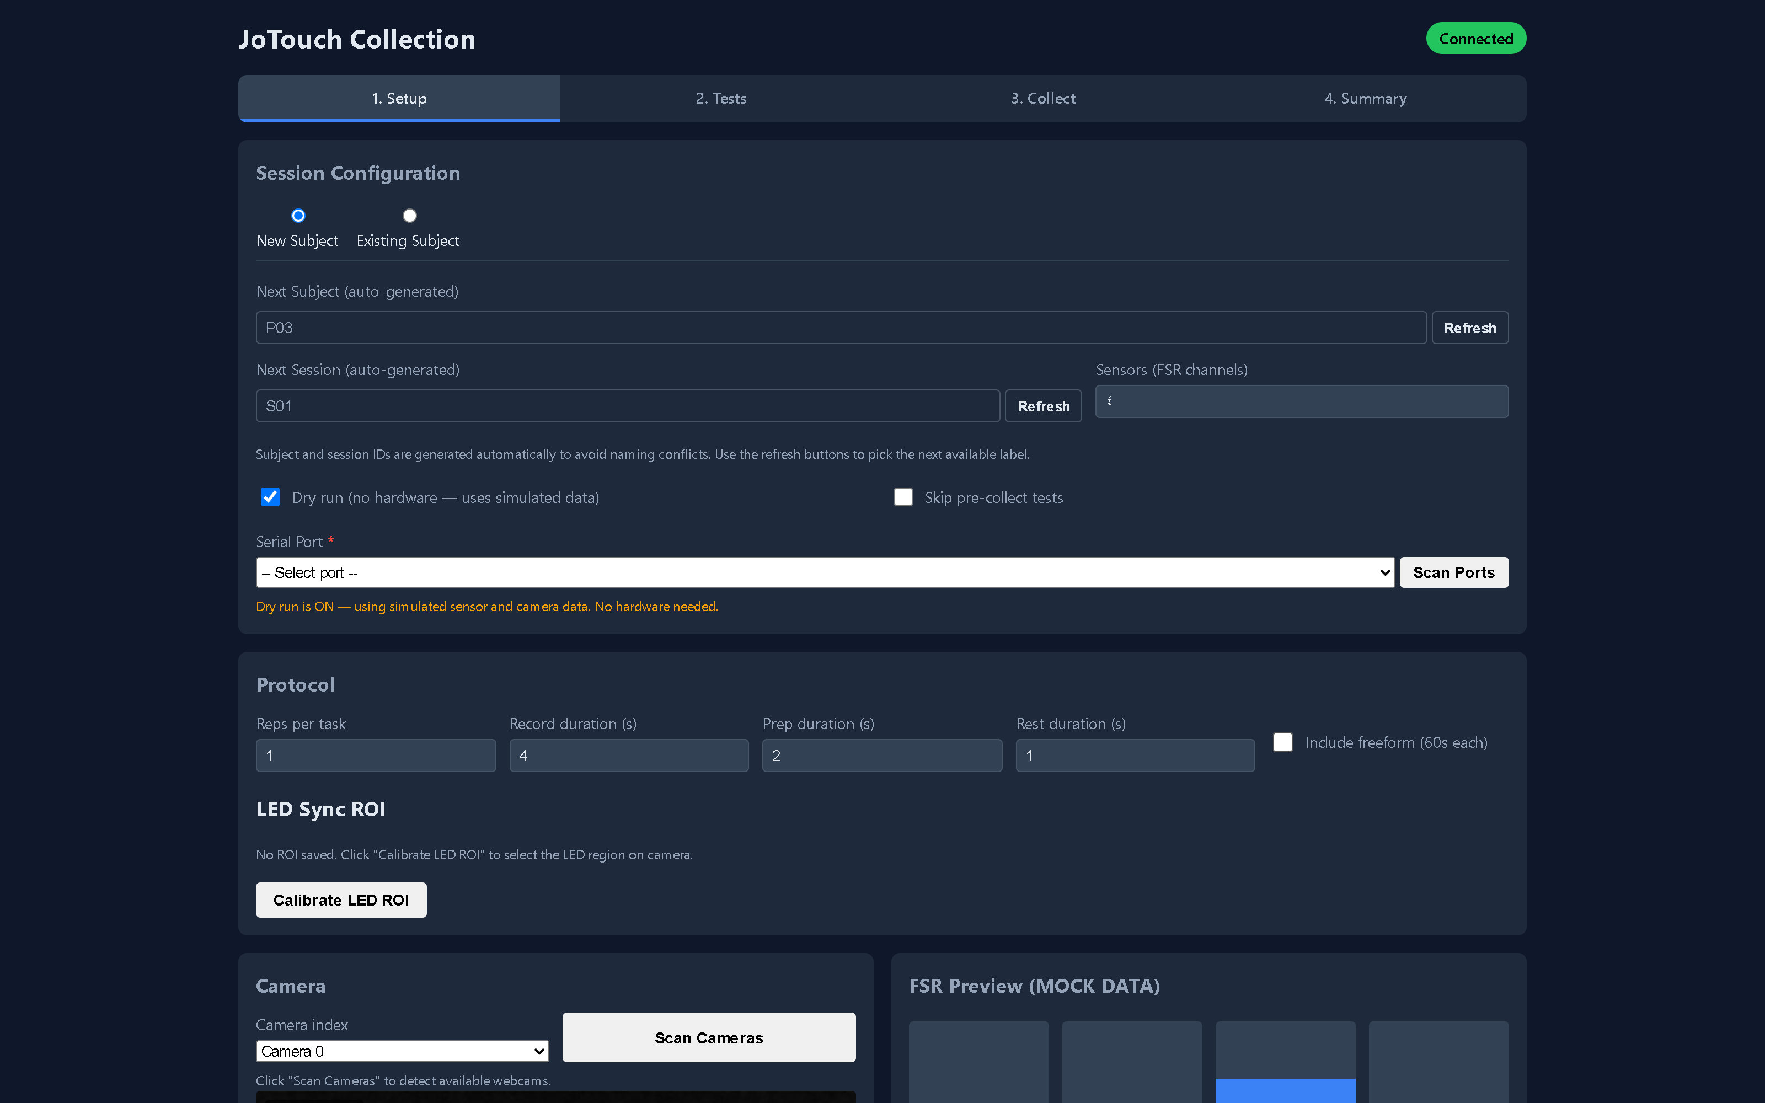
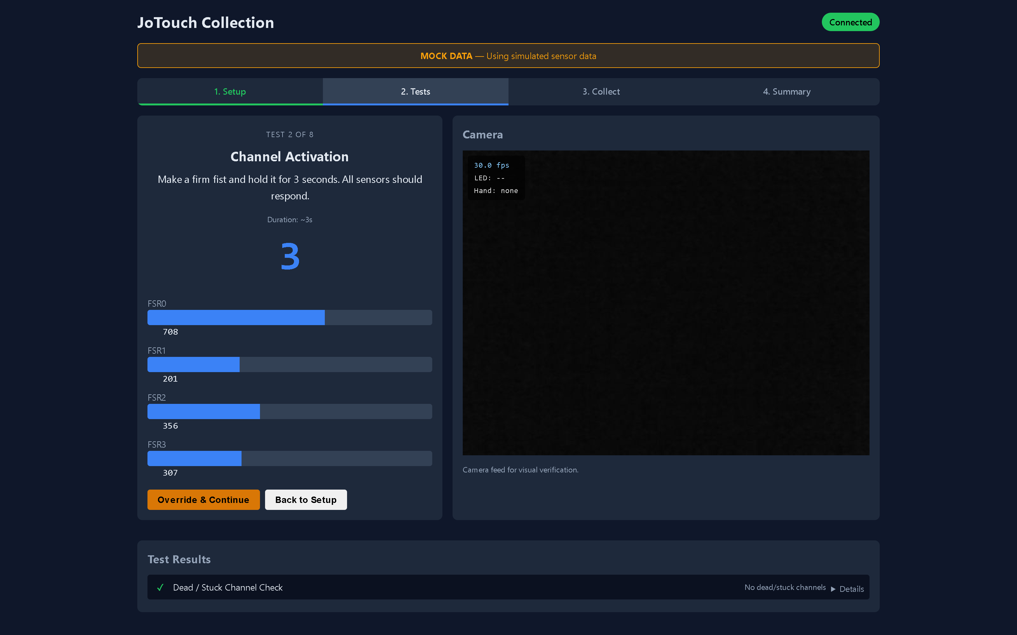
SOFTWARE · COLLECTION UI
14 / 22
FMG Data Collection Workbench
Browser operator console — Setup → Tests → Collect → Summary
01 SETUP — session IDs, protocol, LED sync ROI, live FSR preview
02 TESTS — 8 mandatory pre-collection checks with live cueing

Slide 15
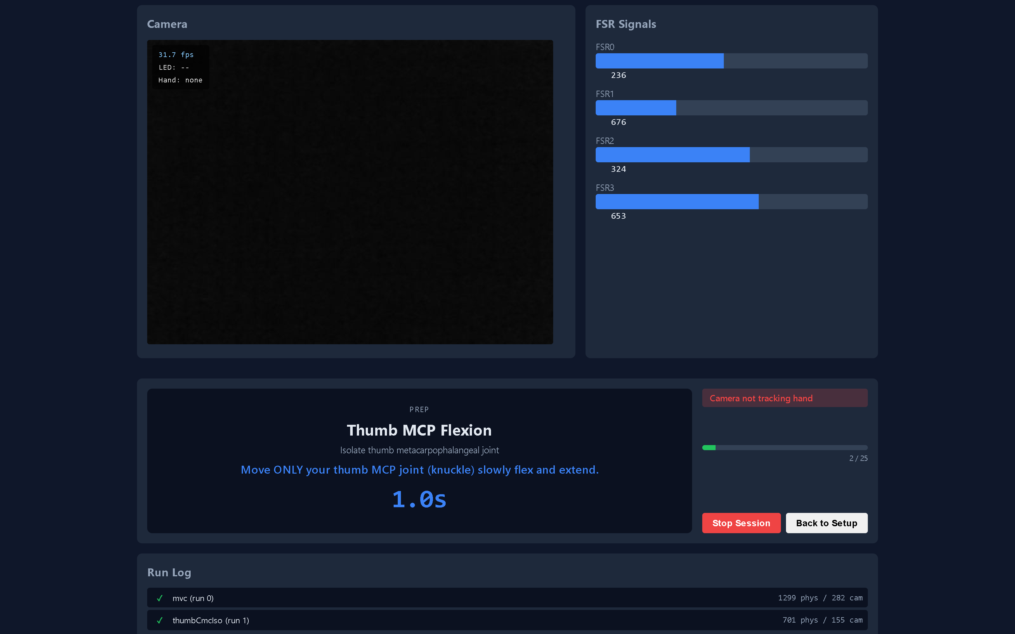
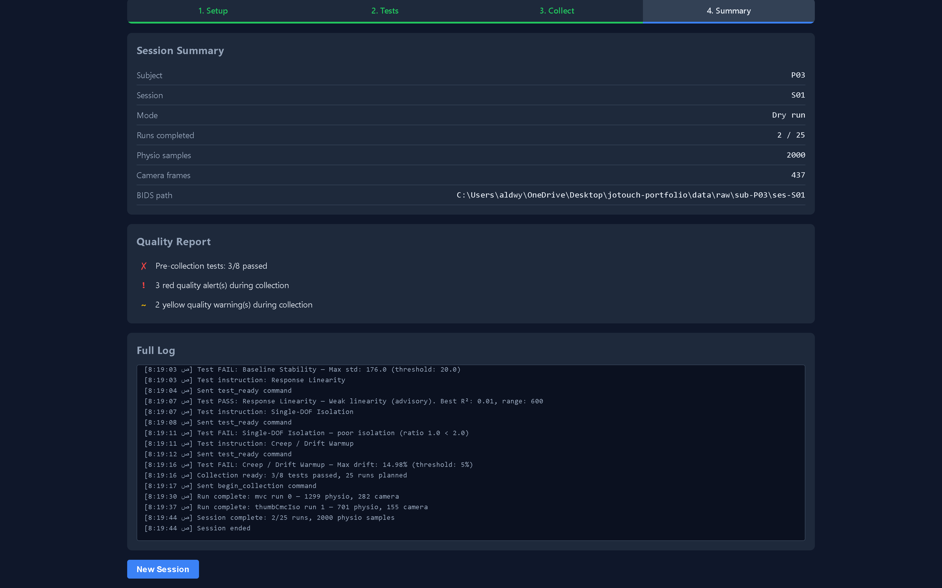
SOFTWARE · COLLECTION UI
15 / 22
Collecting a Session
Cue-driven recording, real-time quality gating, BIDS-structured output
03 COLLECT — cue card, camera, FSR signals, run log
04 SUMMARY — run tally, quality report, full session log

Slide 16
02 · AI MODEL
BENCHMARKED
JoTouchModel — classification and regression
Not just classification: the model predicts which gesture (classification) and the exact joint angles (regression) → proportional, natural control.
How the model reads the signal
Why these choices
Windowed FMG input
Why classification + regression
a short slice of sensor history
Classification picks the intended gesture; regression outputs the exact joint angles. Together they give smooth, proportional motion instead of fixed on/off grips.
MobileNetV2 blocks
extract features from the signal
Why MobileNetV2
TCN (temporal conv.)
Lightweight and efficient — built for edge devices — so it runs on the Raspberry Pi within our power and latency budget, with far fewer parameters than a full CNN.
model how the signal evolves in time
Regularised shared layer
robust, compact representation
Why a TCN (not an RNN/LSTM)
Convolutions over time capture the muscle pattern as it unfolds, run fast in parallel, and avoid the unstable gradients of recurrent nets — better for real-time control.
Two heads — Classification + Regression
gesture + continuous joint angles
Why on-device + confidence gating
Local inference removes network delay and protects privacy; the hand acts only when the model is confident, keeping motion safe and stable.
JoTouch — Technical Brief · Sensing, Control & AI
16 / 22

Slide 17
03 · ONLINE PER-PATIENT TRAINING
PLANNED
The hand learns each patient over time
Sensor → motor weights
① Initial fixed weights trained on our dataset
② Per-patient updated online for each user over time
How we get the signals
The personalisation loop
Input — intent
1 · Use / calibrate
FMG in · encoder angles out
2 · Learn online
refine on this patient's data
The forearm FMG sensors capture what the patient is trying to do.
Output — ground truth
The motor encoders report the real joint positions, giving a matched (intent → motion) pair every moment — no extra lab equipment.
once target accuracy is met
Supervised calibration
4 · Update weights
push refined weights to Teensy
3 · Accuracy check
does it reach our target?
In a guided session the patient performs prescribed movements, so the collected pairs are trustworthy labels for learning.
Why online, per-patient
Anatomy and muscle activation differ per person and drift over time, so a fixed model degrades. Encoders supply ground truth continuously, letting the system keep improving itself.
JoTouch — Technical Brief · Sensing, Control & AI
17 / 22

Slide 18
05 · TRAINING DATA & RESULTS
OPEN DATA
Trained and tested on open-source FMG datasets
To be precise: we have not run our own human trials yet. JoTouchModel was trained end-to-end on three published open-source FMG datasets — 37,500 windows — and scored on a 15% test set it never saw while training.
The three datasets
Accuracy on the untouched test set
Zenodo MDPI FMG · 17 subjects
Dataset
Test accuracy
Latency
Epochs
Zakia & Menon, MDPI Data 2022 · 5 stage motions
12,500 windows · 8 channels × 20 steps (200 ms)
Zenodo (5 motions)
86.78%
3.57 ms
13
Exoskelebox (6 gestures)
70.92%
3.07 ms
40
Exoskelebox FMG benchmark · 20 subjects
arXiv:2007.14918 · 6 gestures × 3 wrist orientations
15,000 windows · 8 forearm FSR @ ~100 Hz
PLoS ONE (4 grasps)
42.61%
2.06 ms
12
One model, small enough for the hand itself
PLoS ONE 2025 FMG · 27 participants
65.8 K parameters · 257 KB · 2–3.6 ms per window on a plain CPU. The window is 200 ms and refreshes every 50 ms, so prediction uses only a few percent of the time we have — the latency budget is not the bottleneck.
Young et al., e0321319 · 4 grasps × 5 load levels
10,000 windows · 8 channels @ 100 Hz
How these numbers were produced
The data is public and cited, so anyone can reproduce this. One model per dataset — the label sets mean different things, so merging them into a single classifier would be dishonest. Identical pipeline for all three: AdamW + OneCycleLR + gradient clipping + early stopping (patience 8), up to 40 epochs, batch 64, lr 0.001, split 70% train / 15% validation / 15% untouched test.
JoTouch — Technical Brief · Sensing, Control & AI
18 / 22

Slide 19
06 · HOW WELL IT GENERALISES
HONEST LIMITS
The same subject vs. an unseen subject
The limit we do not hide: accuracy measured on a subject the model has never seen is far lower than accuracy on the subjects it trained on. We tested this on purpose, with leave-one-subject-out cross-validation.
Identical training, two ways of splitting the data
Why — and what we do about it
Same subjects (random split)
Unseen subject (leave-one-subject-out)
Why the drop happens
Zenodo
96.8%
FMG reads the muscle bulging under the skin. Forearm size, fat layer, band tightness and the exact rotation of the band differ from person to person, so the same gesture produces a different 8-channel pattern on a new arm.
17 subjects · 5 classes · chance 20%
35.4% ±9.6
Exoskelebox
64.5%
20 subjects · 6 classes · chance 17%
21.2% ±2.7
Why this is not a dead end
This is exactly the case for per-patient training (slide 3). The motor encoders supply ground truth for free, so the hand calibrates on its own user instead of depending on a stranger's forearm.
PLoS ONE
50.6%
27 subjects · 4 classes · chance 25%
29.4% ±1.5
Both bars come from the identical 12-epoch protocol on identical data — only the split differs.
Regression too: R² 0.85 → 0.03 on an unseen subject (Zenodo).
What we claim — and what we do not
We claim a real-time model that learns an individual subject's FMG signal well on published open data, and runs inside the hand's time and power budget. We do not claim a plug-and-play model that works on an unseen arm out of the box — no published FMG model does — and we have not yet collected data from our own patients. The per-patient calibration step is where that happens, and it is the engineering answer to this limit, not a workaround for it.
JoTouch — Technical Brief · Sensing, Control & AI
19 / 22

Slide 20
PHASE 1 · SOFTWARE
20 / 22
ROS 2 Dataflow
INPUT
COMPUTE
OUTPUT
/jotouch_fmg
/jotouch/fmg
/jotouch_brain
/jotouch/joint_command
/jotouch_kinematics
synthetic FMG @ 200 Hz
───▸
ML inference · dummy model
───▸
7 DOF → 14 joint angles
/joint_states
▼
/jotouch_spine_sim
/robot_state_pub
/tf
RViz
fake Teensy · 1st-order lag
forward kinematics → /tf
───▸
3D visualization
Notes:
The live dataflow. Synthetic FMG at 200 hertz feeds the brain node — currently a dummy linear model. The brain emits 7 joint curls; kinematics expands those to 14 joint angles using the master-slave coupling. From there it splits: the spine simulator stands in for the Teensy, and robot-state-publisher drives RViz. Input, compute, output — color-coded.

Slide 21
PHASE 1 · SOFTWARE
21 / 22
Tools & Stack
ROS 2 Jazzy
Python 3.12
C++
PlatformIO
MIDDLEWARE
ROS 2 NODES
TEENSY FIRMWARE
BUILD / FLASH
SimpleFOC
micro-ROS
TF Lite Micro
Obsidian
FIELD-ORIENTED CTRL
BRAIN ↔ SPINE
DEPLOY TARGET
DOCUMENTATION
Notes:
The toolchain. ROS 2 Jazzy on the software side, Python for the nodes, C++ on the Teensy through PlatformIO, SimpleFOC for field-oriented motor control, micro-ROS bridging the spine, TensorFlow Lite Micro as the deployment target for the model, and Obsidian holding all the project documentation.

Slide 22
JOTOUCH //
PHASE 1 · COMPLETE
Questions?
Kinematics · ROS 2 stack · the road to hardware
TEAMIssa · Abdullah · Mohammad
SUPERVISORDr. Mohammad Khrisat
Al-Balqa Applied University · 2026
Notes:
That's Phase 1 — complete and validated. Happy to go deeper on the kinematics, the ROS 2 stack, or the road to hardware. Thank you. Questions?

