Slide 1
JoTouch
Continuous-Control Prosthetic Hand with Sensory Feedback
Jordan-built, region-ready
KAFD Research & Innovation Fund | February 2026

Slide 2
The Problem
$15K-50K
High Demand, not Obtainable for most
Cost of advanced prosthetics
✗
Conventional myoelectric control is mostly discrete: select a grip, then execute.
✗
EMG sensors are affected by sweat, noise, and skin impedance, alongside being expensive.
✗
Meaningful tactile/proprioceptive feedback is still limited in most commercial systems
✗
Complex systems are harder to maintain: a small fault can require expert diagnostics and assembly-level replacement.

Slide 3
Our Solution: JoTouch
Digital Nervous System
Natural Control
Grip velocity and aperture are proportional to detected muscle effort
A distributed 'Brain-Spine' architecture using ROS 2 that mimics the biological nervous system
“Human” Feel
Temperature and pressure feedback to residual limb
→ Force Myography (FMG) sensing
Affordable
→ ML-powered intent prediction
Fraction of commercial prosthetic costs
→ Real-time sensory feedback
Durable
Silicone-protected, modular replaceable parts
→ Modular, light-weight, repairable design
Scalable
ROS 2 framework adapts to different limb types

Slide 4
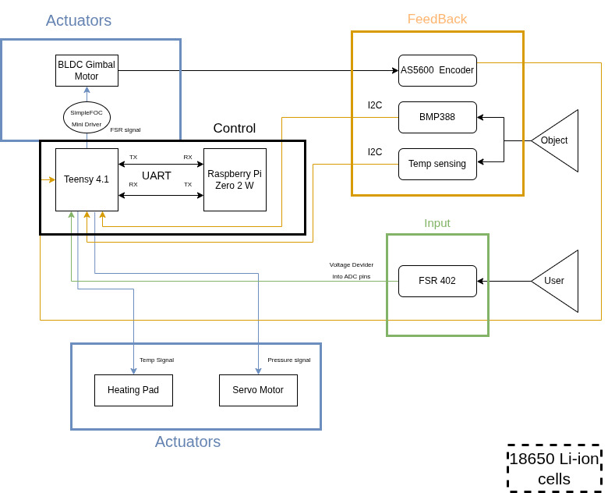
System Architecture

Slide 5
Technical Specifications
Performance Targets
System Specifications
Degrees of Freedom
Multi-Degree of Freedom
Processing
Teensy 4.1 + RPi Zero 2 W
Control Latency
< 100ms target
Communication
UART / micro-ROS
Intent Accuracy
> 90% target
Power
2S 18650 Li-ion (7.4V)
Operating Time
8+ hours daily use
Sensing
FMG , BMP388 + Temp Input
Weight Target
< 700g
Framework
ROS 2 + TensorFlow Lite
Sensory Feedback System
Pressure sensors on fingertips → Servo-driven rubber band on residual limb | Temperature sensors → Heating pad feedback

Slide 6
Development Methodology
1
2
3
4
5
Digital Twin & Simulation
Data Collection & Assembly
AI Training & Optimization
Embedded Deployment
Clinical Validation
Establish micro-ROS bridge, build virtual model in RViz/MoveIt, validate algorithms risk-free
Fabricate mechanical structure, integrate FMG sensors, develop data recorder node
Train ML models (regression/neural networks), tune PID controllers for fluid motion
Quantize AI model, flash to RP PI with TensorFlow Lite, standalone operation
Test latency (<100ms), accuracy (>90%), comfort, and easy to use

Slide 7
Key Innovations
A
FMG over EMG
B
Regression ML Control
C
Brain-Spine Architecture
Noise-resistant, no gels, reliable long-term use
Continuous proportional control, not discrete gestures (Classifiers)
Decoupled processing with micro-ROS for safety reflexes
D
Digital Twin
E
Sensory Feedback
F
Modular Design
Train in simulation, deploy safely to hardware
Temperature + pressure sensing with feedback to the user
Replace broken parts. A combination of high-strength polymers and a silicone skin to maintain the safety of the internal components

Slide 8
Market Potential & Scalability
Individual Users
Why Jordan?
Affordable prosthetics for amputees who can't access expensive commercial solutions
✓ Limited local prosthetic development companies
Healthcare Partners
Partnerships with healthcare providers for coverage programs
✓ High import costs make foreign solutions unaffordable
MENA Expansion
✓ Strategic location for MENA market access
Huge underserved market in developing regions with limited access
✓ Growing medical technology ecosystem
Product Variations
ROS 2 framework enables rapid adaptation for different limb types
✓ First-mover advantage in affordable bionics
Competitive Edge: Quality of advanced prosthetics at a fraction of the cost

Slide 9
Project Timeline (7 Months)
M1
M2
M3
M4
M5
M6
M7
Phase 1: Simulation & Digital Twin
Phase 2: Hardware Assembly
Phase 3: Data Collection
Phase 4: AI Training
Phase 5: Embedded Deployment
Phase 6: Integration & Testing
Phase 7: Clinical Validation
Key Milestones:
◆ M2: Working simulation demo
◆ M4: First hardware prototype
◆ M5: Trained ML model
◆ M7: Clinical-ready prototype

Slide 10
Proposed Budget
Category / Item
Qty
Cost (JOD)
Processing Units
Budget Distribution
Teensy 4.1
1
Raspberry Pi Zero 2 W
1
Motor System
BLDC Gimbal Motors
7
Motor System:
SimpleFOC Mini Drivers
7
AS5600 Encoders
7
Sensors
Fabrication:
FSR 402 (FMG)
8
BMP388 Pressure
5
DS18B20 Temperature
5
Sensors:
TCA9548A
2
Power & Misc
18650 Cells + BMS
1 set
Power & Misc:
Voltage Regulators
2
Subtotal:
Wiring & Connectors
-
Fabrication
Contingency (15%):
Processing:
3D Printing / Materials
-
PCB Fabrication
-
Silicone Skin
-
TOTAL:

Slide 11
The Team
Issa Abdullah — Team Lead
Mohammed Al Khateeb
Abdullah Al Thwieb
System Integration
Planning, milestones, and team coordination
ROS2 architecture & integration
Mechanical design & prototyping
Research & Benchmarking
Literature tracking & state-of-the-art updates
Requirements + user needs synthesis
Performance benchmarking & evaluation metrics
Algorithms & Software
ML intent decoding (regression)
Data pipeline, testing & tooling
Embedded/ROS2 software support
Faculty Advisor: Dr. Mohammad Khrisat | Department of Mechatronics Engineering, BAU
.

Slide 12
Thank You
Questions & Discussion
Contact: [issaterawi132@gmail.com] | AlBalqa Applied University
JoTouch | KAFD Research & Innovation Fund | February 2026

