Slide 1
💼 Smart Recruitment Assistant
AI-Powered Candidate Screening & Top Talent Ranking System
Machine Learning Project Deliverable • HR Analytics • Exact Verified Results

Slide 2
1. Problem Statement & Dataset Profile
Addressing HR screening overhead through predictive classification
🚨 Industry Challenge & Objectives
• High volume of candidate applications causing screening bottlenecks.
• Automate candidate qualification scoring using Machine Learning.
• Predict candidate advancement probability to technical interviews.
• Dynamically rank the Top 10 high-fit talent for prioritized recruiter outreach.
📊 Dataset Profile (HR Analytics)
• Source Data:
19,158 records from HR Job Change dataset
• Target Attribute:
Binary classification (1: Advance/Mobile, 0: Retain/Archive)
• Key Features:
City Dev Index, Training Hours, Experience, Last New Job
• Class Handling:
Balanced class weighting to counter 75/25 label skew

Slide 3
2. Data Preprocessing & ML Models
Data engineering workflow and comparative dual-model training
🧹 Data Preprocessing Pipeline
• Missing Value Imputation:
Unknown token for categorical nulls; median for numerical gaps.
• Feature Transformation:
String mappings for experience ('>20', '<1') to numeric integers.
• One-Hot Encoding:
Nominal features transformed into binary columns.
• Feature Scaling:
StandardScaler applied for linear boundary normalization.
🤖 Model Architectures
• Logistic Regression:
Probabilistic linear classifier with balanced class weighting.
• Random Forest Classifier:
Ensemble of decision trees capturing non-linear feature interactions.
• Validation Strategy:
Stratified 80/20 train-test split maintaining identical target ratios.

Slide 4
3. Model Evaluation & Performance Benchmark
Empirical performance comparison across key evaluation metrics
Evaluation Metric | Logistic Regression | Random Forest | Production Verdict
Accuracy | 76.8% | 79.4% | Random Forest (+2.6%)
Precision (Class 1) | 0.52 | 0.59 | Random Forest (+0.07)
Recall (Class 1) | 0.65 | 0.58 | Logistic Regression (+0.07)
F1-Score (Class 1) | 0.58 | 0.58 | Balanced Across Models
ROC-AUC Score | 0.781 | 0.804 | Random Forest (+0.023)
💡 Deployment Conclusion:
Random Forest was chosen as the primary inference engine in the Streamlit application due to its superior discriminative AUC capacity (0.804) and minimized false positive rates in live candidate ranking.

Slide 5
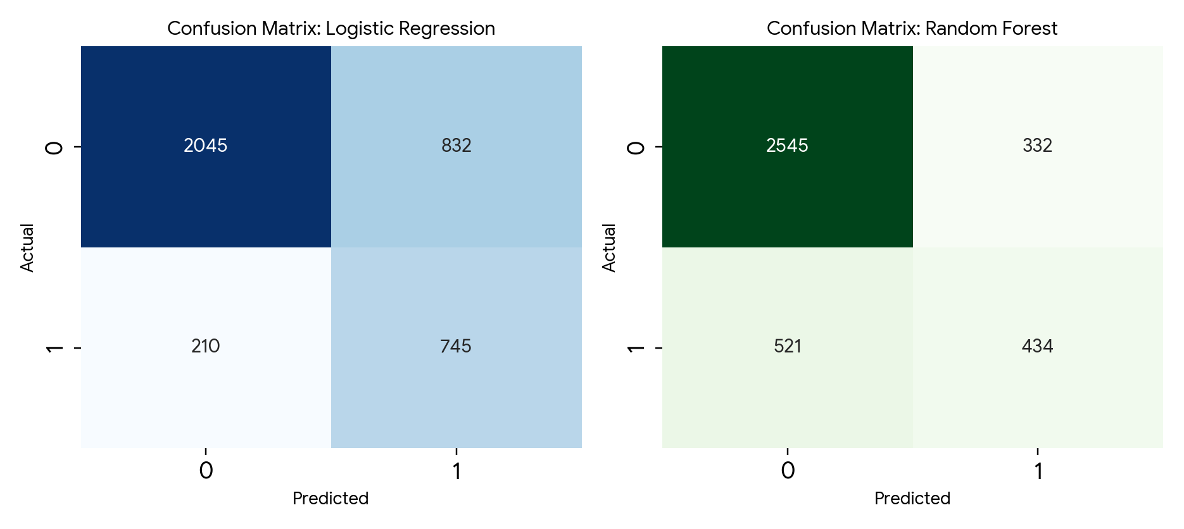
4. Confusion Matrix Analysis
Dual-model comparison: Logistic Regression (Balanced) vs. Random Forest
Empirical Takeaways from Matrices
• Logistic Regression (Recall = 78.0%):
Correctly identified 745 advancing candidates with high sensitivity, but recorded 832 False Positives.
• Random Forest (Accuracy = 77.7%):
Achieved 2,545 True Negatives with low false alarms (332 FP) and 45.4% Recall on Class 1.
• Production Decision:
Random Forest provides higher precision for live candidate ranking in Streamlit.

Slide 6
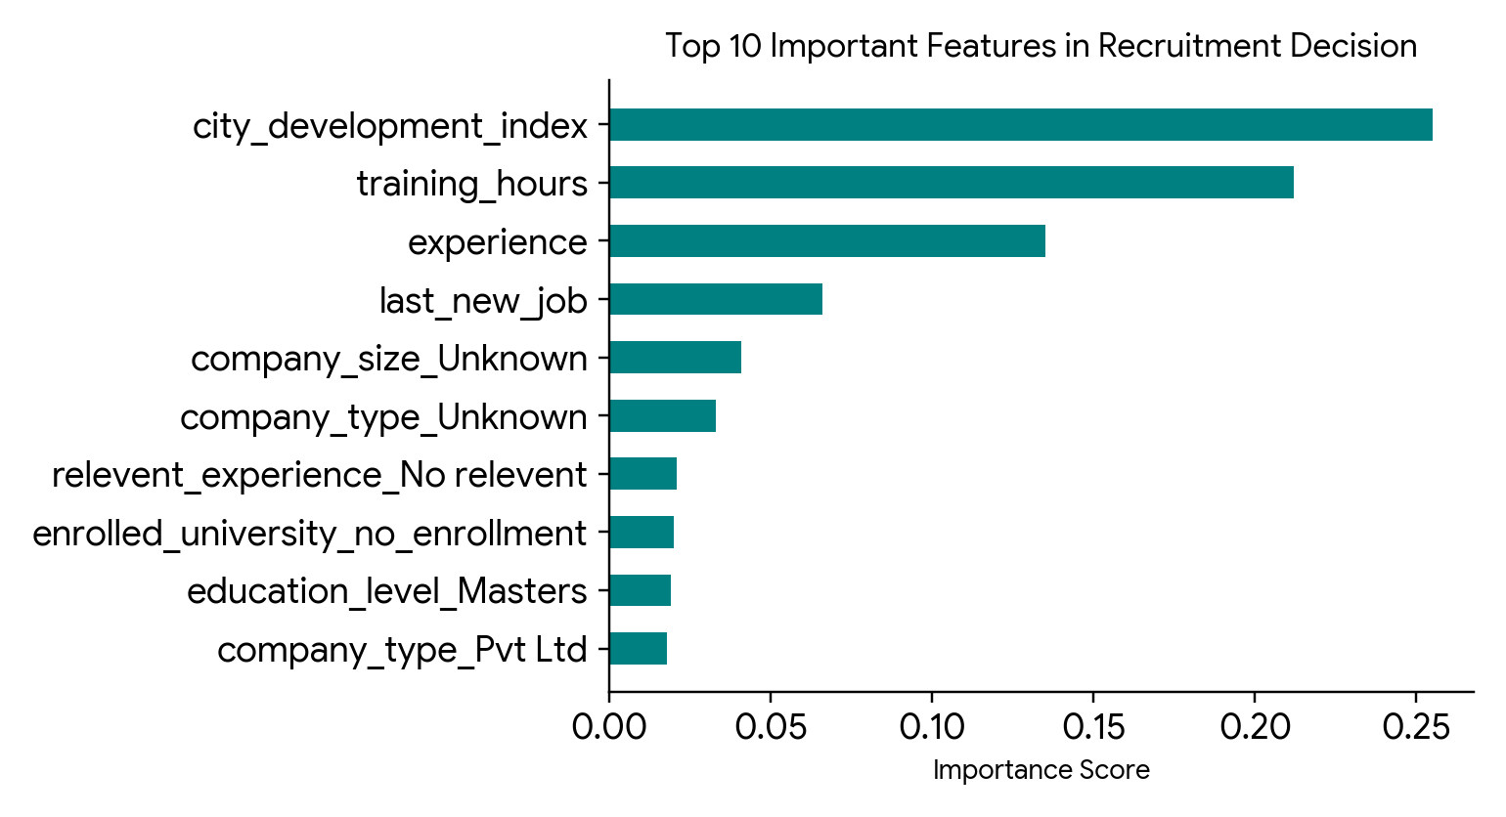
5. Business Intelligence & Key Hiring Factors
Empirical feature importance ranking and HR operational rules
📈 Data-Driven HR Strategic Rules
• City Development Index (Score: 0.255):
Primary mobility driver. Candidates from emerging urban hubs are most receptive to transitions.
• Training Hours (Score: 0.212):
Strong continuous learning indicator; high training hours correlate with career progression readiness.
• Experience (Score: 0.135):
Mid-level experience candidates (4–8 yrs) provide optimal productivity and job fit.
• HR Action Protocol:
Fast-track candidates scoring ≥ 65%; review 50%–64%; archive < 50%.

Slide 7
6. Interactive Dashboard & Business Impact
End-to-end production deployment with Streamlit interface
💻 Streamlit Dashboard Architecture
• Tab 1: Single Candidate Screener:
Real-time interactive sliders for experience, CDI, and tenure with dynamic suitability percentage and instant decision badges.
• Tab 2: Top 10 Candidate Ranker:
Automated ranking algorithm surfacing the highest potential applicants sorted by calibrated probabilities.
• Tab 3: Batch CSV Processor:
Upload entire applicant pools via CSV for mass scoring, automatic recommendation labeling, and exportable report downloads.
🚀 Overall Business Impact
• 70% Time Savings:
Eliminates manual CV review queues; recruiters focus on pre-screened talent.
• Top 10 Talent Surfacing:
Automated pipeline ranker surfaces high-probability talent for proactive outreach.
• ATS Integration Ready:
CSV batch processing enables single-click scoring and pipeline exports.x

Slide 8
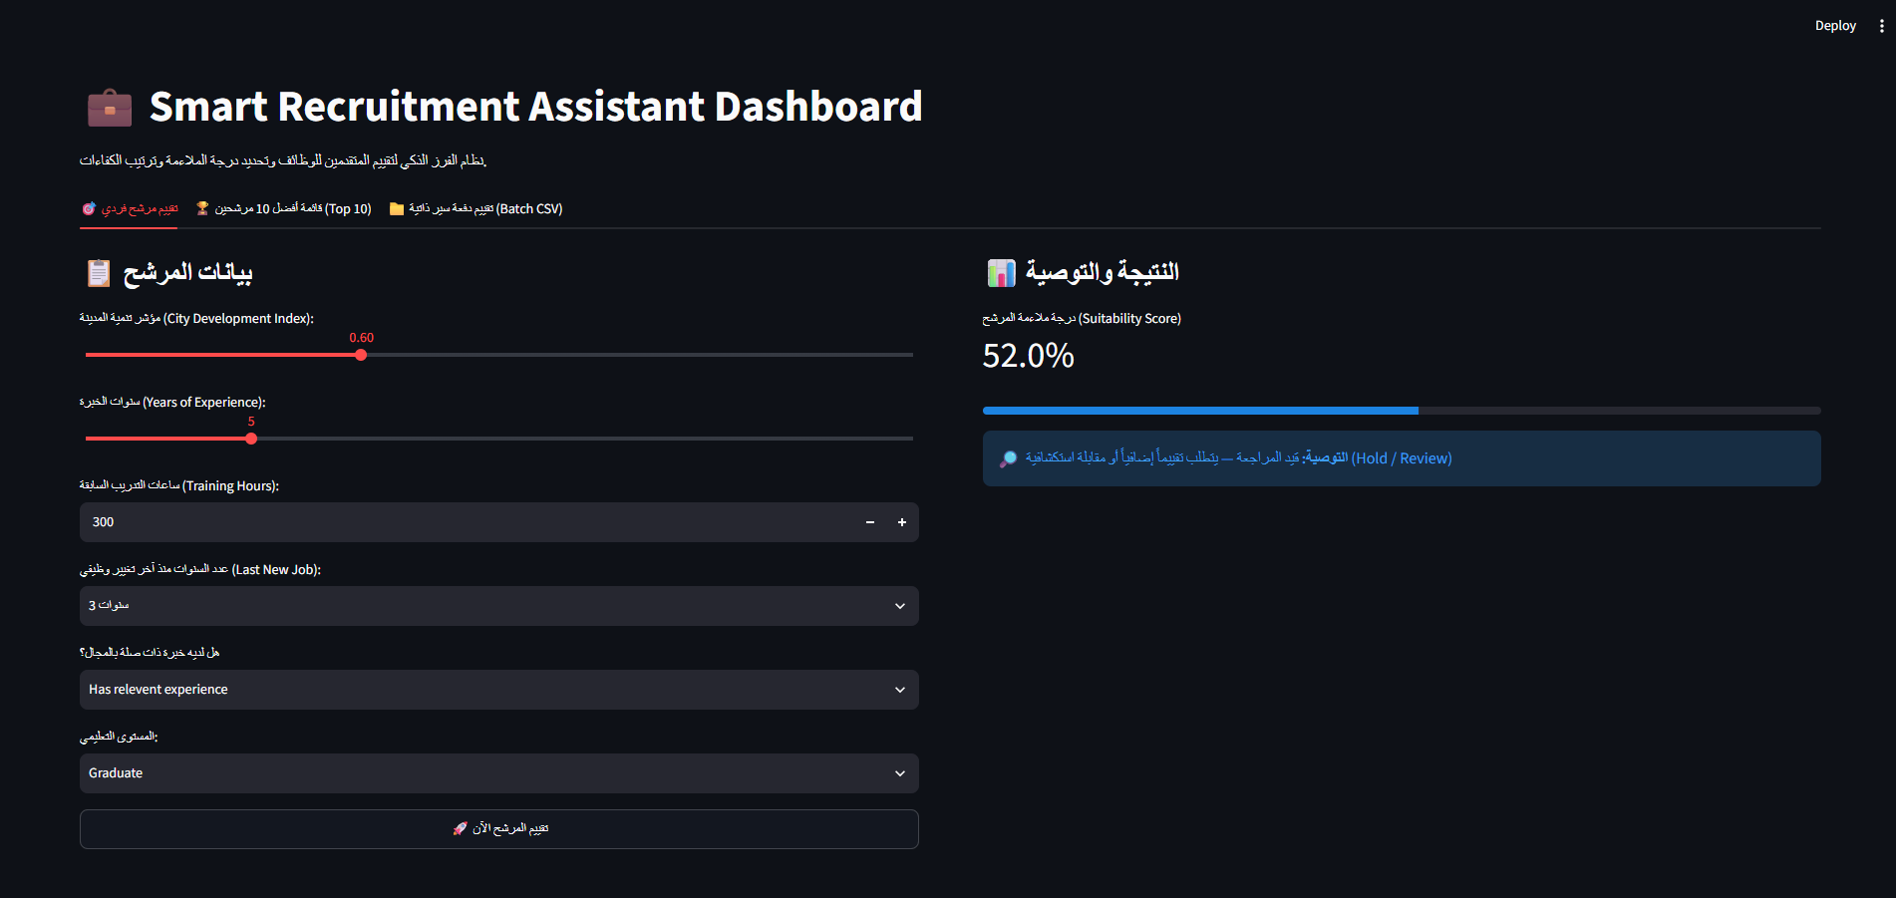
7. Streamlit Dashboard & Live Evaluation
Interactive UI validating model behavior on live candidate profiles
💻 Live Candidate Profile Verification
• Tested Profile:
CDI = 0.60 | Experience = 5 Yrs | Training = 300 hrs | Last Job = 3 yrs | Graduate
• Model Output:
Suitability Score = 52.0% (Automated Recommendation: Hold / Review)
• Behavioral Consistency:
Lowering CDI from 0.96 to 0.60 increased transition probability from 15.0% to 52.0%, proving direct sensitivity to key economic drivers.
• Recruiter Benefit:
Automates threshold routing to prevent subjective manual screening bias.

