Slide 1
GPU Architectures
Prof. Onur Mutlu
ETH Zürich
Spring 2023
11 May 2023

Slide 2
GPUs are SIMD Engines Underneath
The instruction pipeline operates like an SIMD pipeline (e.g., an array processor)
However, the programming is done using threads, NOT SIMD instructions
Let us distinguish between
Programming Model (Software) vs.
Execution Model (Hardware)

Slide 3
Programming Model vs. Hardware Execution Model
Programming Model refers to how the programmer expresses the code
E.g., Sequential (von Neumann), Data Parallel (SIMD), Dataflow,
Multi-threaded (MIMD, SPMD), …
Execution Model refers to how the hardware executes the code underneath
E.g., Out-of-order execution, Vector processor, Array processor,
Dataflow processor, Multiprocessor, Multithreaded processor, …
Execution Model can be very different from the Programming Model
E.g., von Neumann model implemented by an OoO processor
E.g., SPMD model implemented by a SIMD processor (a GPU)

Slide 4
How Can You Exploit Parallelism Here?
for (i=0; i < N; i++)
Scalar Sequential Code
C[i] = A[i] + B[i];
load
Iter. 1
load
Let’s examine three programming options to exploit instruction-level parallelism present in this sequential code:
add
store
load
1. Sequential (SISD)
Iter. 2
load
add
2. Data-Parallel (SIMD)
store
3. Multithreaded (MIMD/SPMD)

Slide 5
Prog. Model 1: Sequential (SISD)
for (i=0; i < N; i++)
C[i] = A[i] + B[i];
Can be executed on a:
Scalar Sequential Code
load
Pipelined processor
Out-of-order execution processor
Iter. 1
load
add
Independent instructions executed when ready
Different iterations are present in the instruction window and can execute in parallel in multiple functional units
In other words, the loop is dynamically unrolled by the hardware
store
load
Iter. 2
load
add
Superscalar or VLIW processor
Can fetch and execute multiple instructions per cycle
store

Slide 6
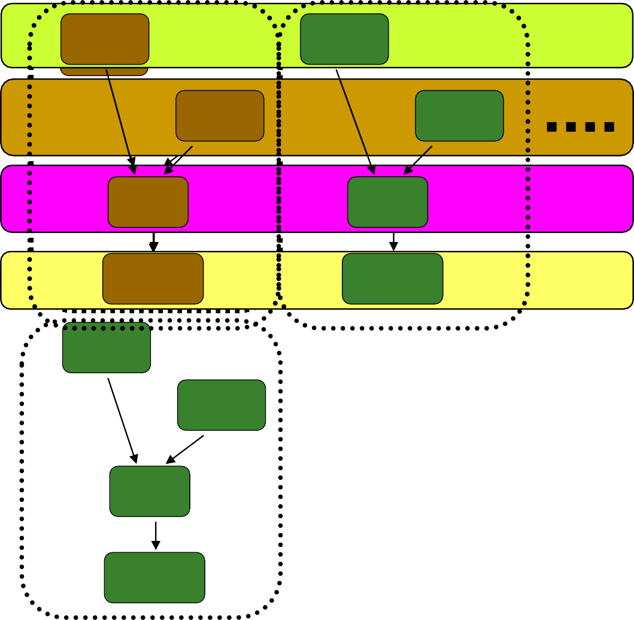
Prog. Model 2: Data Parallel (SIMD)
for (i=0; i < N; i++)
C[i] = A[i] + B[i];
Scalar Sequential Code
load
Vector Instruction
Vectorized Code
VLD A → V1
VLD B → V2
VADD V1 + V2 → V3
VST V3 → C
load
Iter. 1
l_{l}o_{o}a_{a}d_{d}
load
add
add
ssttoorree
store
Ite^{l}rº.^{ad} 1
Iter. 2
load
Realization: Each iteration is independent
Iter. 2
Idea: Programmer or compiler generates a SIMD instruction to execute the same instruction from all iterations across different data
add
store
Best executed by a SIMD processor (vector, array)

Slide 7
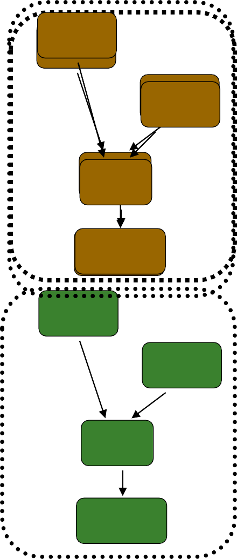

Prog. Model 3: Multithreaded
for (i=0; i < N; i++)
C[i] = A[i] + B[i];
Scalar Sequential Code
load
load
Iter. 1
l_{l}o_{o}a_{a}d_{d}
load
add
add
ssttoorree
store
Ite^{l}rº.^{ad} 1
Iter. 2
load
Realization: Each iteration is independent
Iter. 2
Idea: Programmer or compiler generates a thread to execute each iteration. Each thread does the same thing (but on different data)
add
store
Can be executed on a MIMD machine

Slide 8
Prog. Model 3: Multithreaded
for (i=0; i < N; i++)
C[i] = A[i] + B[i];
load
load
load
load
add
add
store
store
Iter. 1
Iter. 2
Realization: Each iteration is independent
This particular model is also called:
SPMD: Single Program Multiple Data
Idea: Programmer or compiler generates a thread to execute each iteration. Each thread does the same thing (but on different data)
Can be executed on a SIMT machine Single Instruction Multiple Thread
Can be executed on a SIMD machine
8
Can be executed on a MIMD machine

Slide 9
A GPU is a SIMD (SIMT) Machine
Except it is not programmed using SIMD instructions
It is programmed using threads (SPMD programming model)
Each thread executes the same code but operates a different piece of data
Each thread has its own context (i.e., can be treated/restarted/executed independently)
A set of threads executing the same instruction are dynamically grouped into a warp by the hardware
A warp is essentially a SIMD operation formed by hardware!

Slide 10
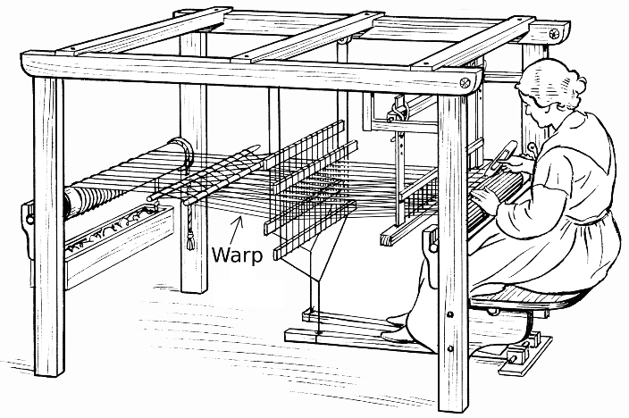
Warp Terminology
Source: Wikipedia

Slide 11
SPMD on SIMT Machine
for (i=0; i < N; i++)
C[i] = A[i] + B[i];
load
load
Warp 0 at PC X
load
load
Warp 0 at PC X+1
add
add
Warp 0 at PC X+2
store
store
Warp 0 at PC X+3
Iter. 1
Iter. 2
Warp: A set of threads that execute the same instruction (i.e., at the same PC)
Realization: Each iteration is independent
This particular model is also called:
SPMD: Single Program Multiple Data
Idea: Programmer or compiler generates a thread to execute each iteration. Each thread does the same thing (but on different data)
A GPU executes it using the SIMT model: Single Instruction Multiple Thread
Can be executed on a SIMD machine
11
Can be executed on a MIMD machine

Slide 12
SIMD vs. SIMT Execution Model
SIMD: A single sequential instruction stream of SIMD instructions → each instruction specifies multiple data inputs
[VLD, VLD, VADD, VST], VLEN
SIMT: Multiple instruction streams of scalar instructions →
threads grouped dynamically into warps
[LD, LD, ADD, ST], NumThreads
Two Major SIMT Advantages:
Can treat each thread separately → i.e., can execute each thread independently (on any type of scalar pipeline) → MIMD processing
Can group threads into warps flexibly → i.e., can group threads that are supposed to truly execute the same instruction → dynamically obtain and maximize benefits of SIMD processing

Slide 13
Fine-Grained Multithreading of Warps
for (i=0; i < N; i++)
C[i] = A[i] + B[i];
Assume a warp consists of 32 threads
If you have 32K iterations, and 1 iteration/thread → 1K warps
Warps can be interleaved on the same pipeline → Fine grained multithreading of warps
load
load
Warp 10 at PC X
load
load
add
add
Warp 20 at PC X+2
store
store
Iter. 32020*32
Iter. 21303*32 + 1

Slide 14
Fine-Grained Multithreading (FGMT) of Warps
for (i=0; i < N; i++)
C[i] = A[i] + B[i];
Assume a warp consists of 32 threads
If you have 32K iterations, and 1 iteration/thread → 1K warps
Warps can be interleaved on the same pipeline → Fine grained multithreading of warps
load
load
Warp 3 at PC X
Iterations 96-127
load
load
Warp 2 at PC X+1
Iterations 64-95
add
add
Warp 1 at PC X+2
Iterations 32-63
store
store
Warp 0 at PC X+3
Iterations 0-31
All threads in a warp are independent of each other
→ They be executed seamlessly in a fine-grained multithreaded pipeline

Slide 15

Fine-Grained Multithreading: Basic Idea
CLK
CLK
CLK
Control
RegWriteD
RegWriteE
RegWriteM
RegWriteW
Unit
MemtoRegD
MemtoRegE
MemtoRegM
MemtoRegW
MemWriteD
MemWriteE
MemWriteM
31:26 _{Op}
BranchD
BranchE
BranchM
PCSrcM
ALUControlD
ALUControlE_{2:0}
^{5:0} Funct
ALUSrcD
ALUSrcE
RegDstD
RegDstE
ALUOutW
CLK
CLK
CLK
CLK
0
PC'
PCF
A RD
Instruction Memory
InstrD
25:21
A1
WE3 _{RD1}
SrcAE
ZeroM
WE
0
1
ALU
ALUOutM
A RD
Data
ReadDataW
1
20:16
A2 RD2
A3
_{WD3} Register
0
SrcBE
1
WriteDataM
Memory
WD
File
WriteDataE
20:16
RtE
0
WriteRegE
WriteRegM
WriteRegW
15:11
RdE
1
4:0
4:0
4:0
+
15:0
Sign Extend
SignImmE
<<2
4
+
PCBranchM
PCPlus4F
PCPlus4D
PCPlus4E
ResultW
Each pipeline stage has an instruction from a different, completely-independent thread
We need a PC and a register file for each thread + muxes and control

Slide 16

Warps and Warp-Level FGMT
Warp: A set of threads that execute the same instruction (on different data elements) → SIMT (Nvidia-speak)
All threads run the same code
Warp: The threads that run lengthwise in a woven fabric …
Thread Warp 3
Thread Warp 8
Thread Warp
Common PC
Scalar Thread W | Scalar Thread X | Scalar Thread Y
Scalar Thread Z
Thread Warp 7
SIMD Pipeline
Lindholm et al., "NVIDIA Tesla: A Unified Graphics and Computing Architecture," IEEE Micro 2008.

Slide 17
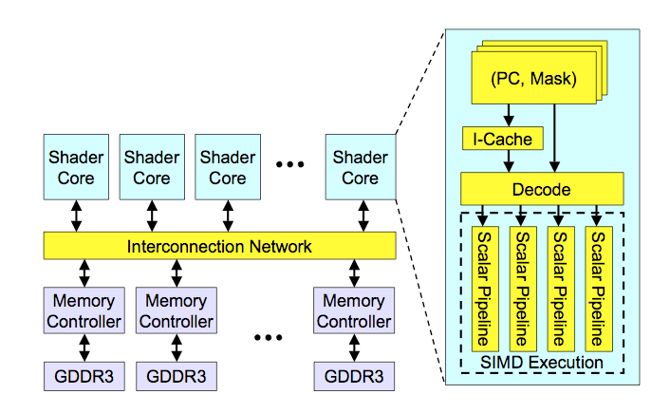
High-Level View of a GPU
Lindholm et al., "NVIDIA Tesla: A Unified Graphics and Computing Architecture," IEEE Micro 2008.

Slide 18
Latency Hiding via Warp-Level FGMT
Warp: A set of threads that execute the same instruction (on different data elements)
Thread Warp 3
Warps available for scheduling
Thread Warp 8
Fine-grained multithreading
One instruction per thread in pipeline at a time (No interlocking)
Interleave warp execution to hide latencies
Register values of all threads stay
in register file
FGMT enables simple pipeline & long latency tolerance
Thread Warp 7
SIMD Pipeline
I-Fetch
Decode
RF
RF
RF
Warps accessing memory hierarchy Miss?
ALU
ALU
ALU
D-Cache
Thread Warp 1
All Hit?
Data
Thread Warp 2
Writeback
Thread Warp 6
Millions of threads operating on the
same large image/video
Slide credit: Tor Aamodt
18

Slide 19
Recall: Vector Instruction Execution
VADD A,B → C
Execution using one pipelined functional unit
Execution using four pipelined functional units
A[6] | B[6] | A[24] | B[24] | A[25] | B[25] | A[26] | B[26] | A[27] | B[27]
A[5] | B[5] | A[20] | B[20] | A[21] | B[21] | A[22] | B[22] | A[23] | B[23]
A[4] | B[4] | A[16] | B[16] | A[17] | B[17] | A[18] | B[18] | A[19] | B[19]
A[3] | B[3] | A[12] | B[12] | A[13] | B[13] | A[14] | B[14] | A[15] | B[15]
C[2]
C[8]
C[9]
C[10]
C[11]
C[1]
C[4]
C[5]
C[6]
C[7]
Time
Time
C[0]
C[0]
C[1]
C[2]
C[3]
Space
Slide credit: Krste Asanovic

Slide 20
Warp Execution (Recall the Previous Slide)
32-thread warp executing ADD A[tid],B[tid] → C[tid]
Execution using one pipelined functional unit
Execution using four pipelined functional units
A[6] | B[6] | A[24] | B[24] | A[25] | B[25] | A[26] | B[26] | A[27] | B[27]
A[5] | B[5] | A[20] | B[20] | A[21] | B[21] | A[22] | B[22] | A[23] | B[23]
A[4] | B[4] | A[16] | B[16] | A[17] | B[17] | A[18] | B[18] | A[19] | B[19]
A[3] | B[3] | A[12] | B[12] | A[13] | B[13] | A[14] | B[14] | A[15] | B[15]
C[2]
C[8]
C[9]
C[10]
C[11]
C[1]
C[4]
C[5]
C[6]
C[7]
Time
Time
C[0]
C[0]
C[1]
C[2]
C[3]
Space
Slide credit: Krste Asanovic

Slide 21
Recall: Vector Unit Structure
Functional Unit
Partitioned
Vector
Registers
Elements 0, 4, 8, …
Elements 1, 5, 9, …
Elements 2, 6, 10,
…
Elements 3, 7, 11,
…
Lane
Memory Subsystem
Slide credit: Krste Asanovic

Slide 22
GPU SIMD Execution Unit Structure
Functional Unit
Registers for each Thread
Registers for thread IDs 1, 5, 9, …
Registers for thread IDs 2, 6, 10, …
Registers for thread IDs 3, 7, 11, …
Registers for thread IDs 0, 4, 8, …
Lane
Memory Subsystem
Slide credit: Krste Asanovic

Slide 23
SIMT Memory Access (Loads and Stores)
Same instruction in different threads uses thread id to index and access different data elements
Let’s assume N=16, 4 threads per warp → 4 warps
Threads
0 | 1 | 2 | 3 | 4 | 5 | 6 | 7 | 8 | 9 | 10 | 11 | 12 | 13 | 14 | 15
+
0 | 1 | 2 | 3 | 4 | 5 | 6 | 7 | 8 | 9 | 10 | 11 | 12 | 13 | 14 | 15
Data elements
+
+
+
+
Warp 0 Warp 1 Warp 2 Warp 3
For maximum performance, memory should provide enough bandwidth
(i.e., elements per cycle throughput to match computation unit throughput)
Slide credit: Hyesoon Kim
25

Slide 24








Warps not Exposed to GPU Programmers
CPU threads and GPU kernels
Sequential or modestly parallel sections on CPU
Massively parallel sections on GPU: Blocks of threads
Serial Code (host)
Parallel Kernel (device)
KernelA<<<nBlk, nThr>>>(args);
. . .
Serial Code (host)
Parallel Kernel (device)
KernelB<<<nBlk, nThr>>>(args);
. . .
Slide credit: Hwu & Kirk
26

Slide 25


Sample GPU SIMT Code (Simplified)
CPU code
for (ii = 0; ii < 100000; ++ii) {
C[ii] = A[ii] + B[ii];
}
CUDA code
// there are 100000 threads
global void KernelFunction(…) {
int tid = blockDim.x * blockIdx.x + threadIdx.x; int varA = aa[tid];
int varB = bb[tid]; C[tid] = varA + varB;
}
Slide credit: Hyesoon Kim

Slide 26
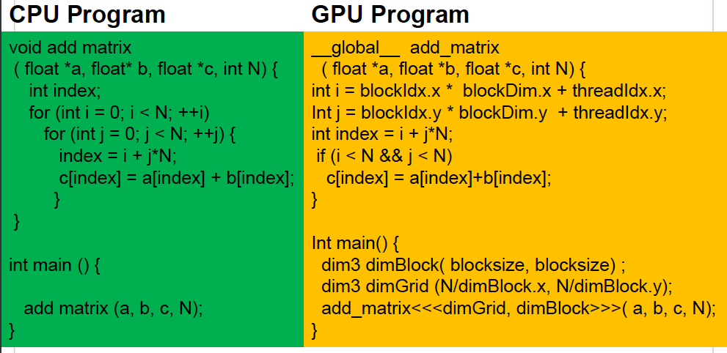
Sample GPU Program (Less Simplified)
Slide credit: Hyesoon Kim

Slide 27


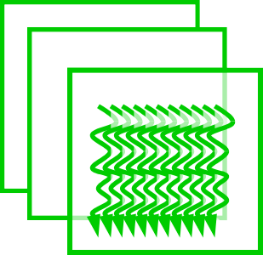
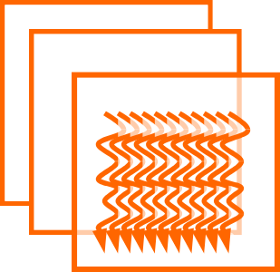

From Blocks to Warps
GPU core: A SIMD pipeline
Streaming Processor (SP)
Many such SIMD Processors
Streaming Multiprocessor (SM)
Blocks are divided into warps
SIMD/SIMT unit (32 threads)
Block 0’s warps
…
t0 t1 t2 … t31
Block 1’s warps
…
t0 t1 t2 … t31
Block 2’s warps
…
t0 t1 t2 … t31
…
…
…
NVIDIA Fermi architecture

Slide 28
Warp-based SIMD vs. Traditional SIMD
Traditional SIMD contains a single thread
Sequential instruction execution; lock-step operations in a SIMD instruction
Programming model is SIMD (no extra threads) → SW needs to know
vector length
ISA contains vector/SIMD instructions
Warp-based SIMD consists of multiple scalar threads executing in a
SIMD manner (i.e., same instruction executed by all threads)
Does not have to be lock step
Each thread can be treated individually (i.e., placed in a different warp)
→ programming model not SIMD
SW does not need to know vector length
Enables multithreading and flexible dynamic grouping of threads
ISA is scalar → SIMD operations can be formed dynamically
Essentially, it is SPMD programming model implemented on SIMD
hardware

Slide 29
SPMD
Single procedure/program, multiple data
This is a programming model rather than computer organization
Each processing element executes the same procedure, except on different data elements
Procedures can synchronize at certain points in program, e.g. barriers
Essentially, multiple instruction streams execute the same program
Each program/procedure 1) works on different data, 2) can execute a different control-flow path, at run-time
Many scientific applications are programmed this way and run on MIMD
hardware (multiprocessors)
Modern GPUs programmed in a similar way on a SIMD hardware

Slide 30
SIMD vs. SIMT Execution Model
SIMD: A single sequential instruction stream of SIMD instructions → each instruction specifies multiple data inputs
[VLD, VLD, VADD, VST], VLEN
SIMT: Multiple instruction streams of scalar instructions →
threads grouped dynamically into warps
[LD, LD, ADD, ST], NumThreads
Two Major SIMT Advantages:
Can treat each thread separately → i.e., can execute each thread independently on any type of scalar pipeline → MIMD processing
Can group threads into warps flexibly → i.e., can group threads that are supposed to truly execute the same instruction → dynamically obtain and maximize benefits of SIMD processing

Slide 31
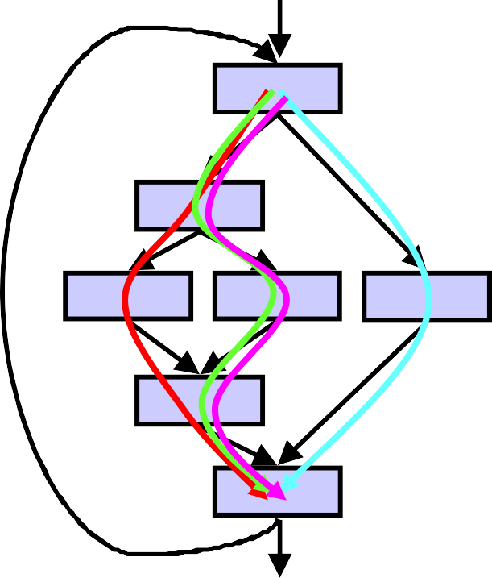
Threads Can Take Different Paths in Warp-based SIMD
Each thread can have conditional control flow instructions
Threads can execute different control flow paths
A
B
Thread Warp | Common PC
Thread 1 | Thread 2 | Thread 3 | Thread 4
C
D
F
E
G
Slide credit: Tor Aamodt

Slide 32
Control Flow Problem in GPUs/SIMT
A GPU uses a SIMD pipeline to save area on control logic
Groups scalar threads into warps
Branch
Branch
Path A
Path A
Branch divergence occurs when threads inside warps branch to different execution paths
Path B
Path B
This is the same as conditional/predicated/masked execution. Recall the Vector Mask and Masked Vector Operations
Slide credit: Tor Aamodt

Slide 33
Remember: Each Thread Is Independent
Two Major SIMT Advantages:
Can treat each thread separately → i.e., can execute each thread independently on any type of scalar pipeline → MIMD processing
Can group threads into warps flexibly → i.e., can group threads that are supposed to truly execute the same instruction → dynamically obtain and maximize benefits of SIMD processing
If we have many threads
We can find individual threads that are at the same PC
And, group them together into a single warp dynamically
This reduces “divergence” → improves SIMD utilization
SIMD utilization: fraction of SIMD lanes executing a useful operation (i.e., executing an active thread)

Slide 34
Dynamic Warp Formation/Merging
Idea: Dynamically merge threads executing the same instruction, i.e., at the same PC (after branch divergence)
Form new warps from warps that are waiting
Enough threads branching to each path enables the creation of full new warps
Warp X Warp Y
Warp Z

Slide 35
Dynamic Warp Formation/Merging
Idea: Dynamically merge threads executing the same instruction, i.e., at the same PC (after branch divergence)
Branch
Branch
Path A
Path B
Path A
Fung et al., “Dynamic Warp Formation and Scheduling for Efficient GPU Control Flow,” MICRO 2007.

Slide 36

Dynamic Warp Formation Example
_{A} x/1111
y/1111
Legend
A A
Execution of Warp x Execution of Warp y
at Basic Block A at Basic Block A
D
A new warp created from scalar threads of both Warp x and y executing at Basic Block D
_{B} x/1110
y/0011
_{C} x/1000 _{D} x/0110
y/0010 y/0001
_{F} x/0001
y/1100
_{E} x/1110
y/0011
_{G} x/1111
y/1111
A A B B C C D D E E F F G G A A
Baseline
Time
Dynamic Warp Formation
A A B B
C D
E E
F
G G A A
Time
Slide credit: Tor Aamodt
38

Slide 37

Large Warps and Two-Level Warp Scheduling
Two main reasons for GPU resources be underutilized
Branch divergence
Long latency operations
Long-latency load
Core All Warps Compute
All Warps Compute
Memory System
Req Warp 0
Req Warp 1
Req Warp 15
Round Robin Scheduling, 16 total warps
time
Narasiman et al., “Improving GPU Performance via Large Warps and Two-Level Warp
Scheduling,” MICRO 2011.
40

Slide 38
Two-Level Scheduling of Warps
Scheduling smaller warp groups reduces stalls due to long latency operations
Core All Warps Compute
All Warps Compute
Memory
System
Req Warp 0
Req Warp 1
Req Warp 15
Round Robin Scheduling, 16 total warps
time
Group 0 Group 1 Group 0 Group 1
Core Compute Compute Compute Compute
Saved Cycles
Req Warp 0
Req Warp 1
Memory System
Req Warp 7
Req Warp 8
Req Warp 9
Req Warp 15
time
Two Level Round Robin Scheduling, 2 fetch groups, 8 warps each
Narasiman et al., “Improving GPU Performance via Large Warps and Two-Level Warp Scheduling,” MICRO 2011.

Slide 39
Why Ai boost GPUs Era
Massive linear‑algebra workloads – every training step is just huge GEMMs and convolutions; GPUs already had thousands of FP/INT lanes built for graphics.
Data & model sizes exploded – GPT‑2 (2019) ≈ 110 M params → GPT‑4‑class (2023) ≈ 1.8 T params; FLOP demand grew 2‑3 × per year, far faster than CPU cores.
Energy / $ efficiency – H100 delivers ≈ 1.5 PFLOP FP16 per board at ~700 W; a CPU cluster needs 10× the racks (and power) for the same math [megware](see pdf).
CUDA / ROCm software moat – mature kernels, automatic kernel fusion, graph compilers (TensorRT, TVM, XLA) let researchers stay productive while hardware evolves.

Slide 40
Self Attention in LLM and Transformer
Core op: Q × Kᵀ → Softmax → (result) × V; three dense GEMMs dominate the FLOPs.
Parallel axes everywhere – batch B, heads h, sequence length N, hidden dim d → ideal for 2‑D/3‑D thread‑block tiling.
Sequence‑length bottleneck: O(N²) compute & memory; GPUs hide that with huge SRAM tiles + warp‑specialized kernels (FlashAttention, xFormers).
Hopper’s Transformer Engine automatically chooses FP8/FP16 and kicks in fused‑QKV kernels.

Slide 41
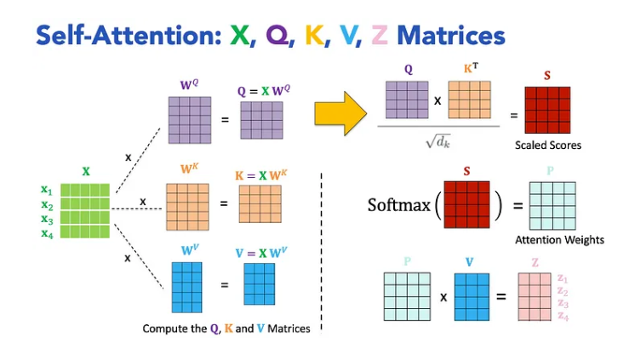
Self Attention in LLM and Transformer
Self-Attention and Transformer Network Architecture | by LM Po | Medium

Slide 42
Self Attention in LLM and Transformer
A query represents what you’re looking for.
Keys represent identifiers or tags associated with pieces of information (documents, words, etc.).
Values represent the actual content or information that you want to retrieve.

Slide 43
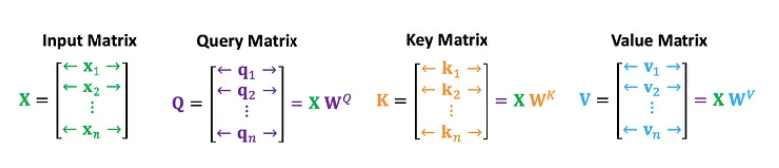
Step by step computations
Compute the Query, Key, and Value Matrices: First, we transform each token of our sentence into three different vectors Q, K, and V. This is done by multiplying the input embeddings with learned weight matrices.

Slide 44
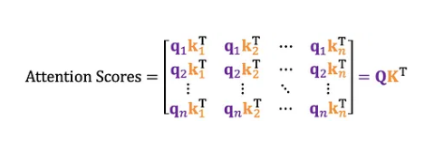
Step by step computations
Calculate Attention Scores: Next, we calculate how much each word should pay attention to every other word by taking the dot product of the Query and Key matrices.

Slide 45
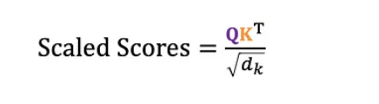
Step by step computations
Scaling the Scores: To mitigate the problem of large variance in high-dimensional matrices, the dot products are scaled by the square root of the dimensionality of Key vectors (√dₖ).

Slide 46
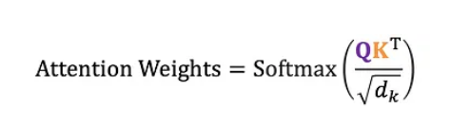
Step by step computations
Apply the Softmax Function: The scaled scores are passed through a softmax function to normalize the values between 0 and 1.

Slide 47
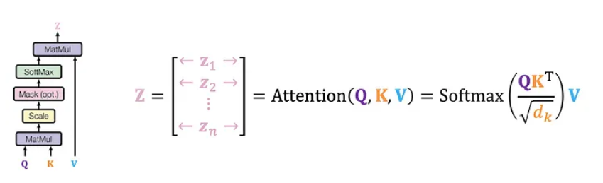
Step by step computations
Weight the Values: The attention weights are used to compute a weighted sum of the value matrix, resulting in the final output of the self-attention mechanism.

Slide 48
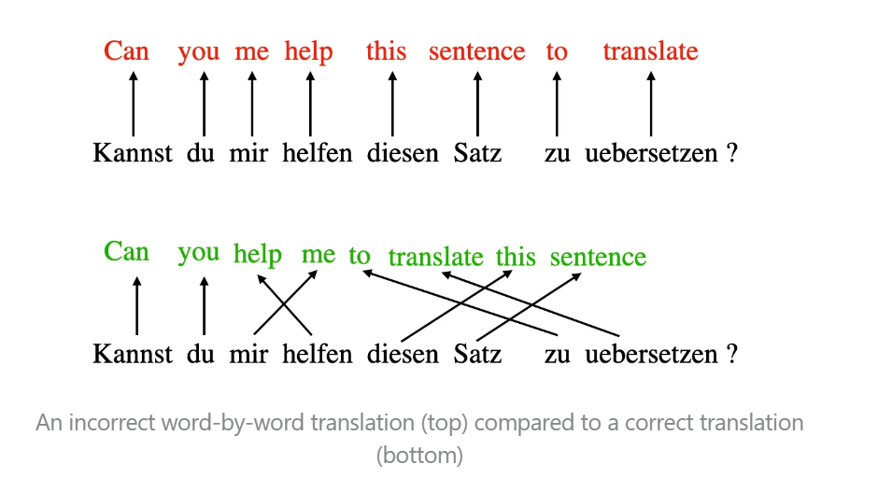
Example

Slide 49
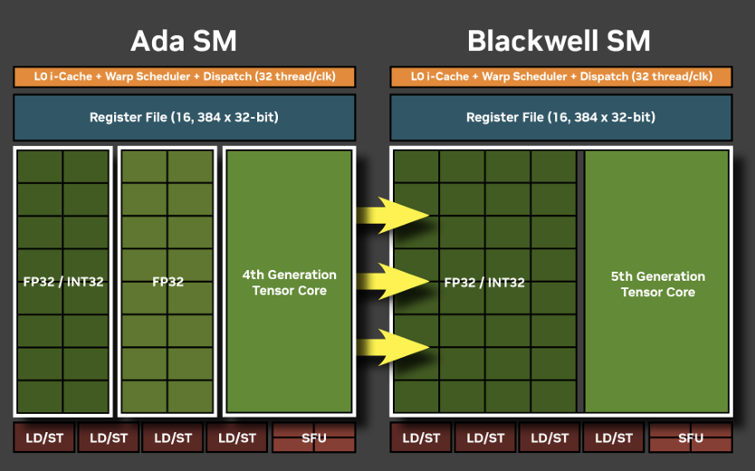
Tensor Core Architecture

Slide 50
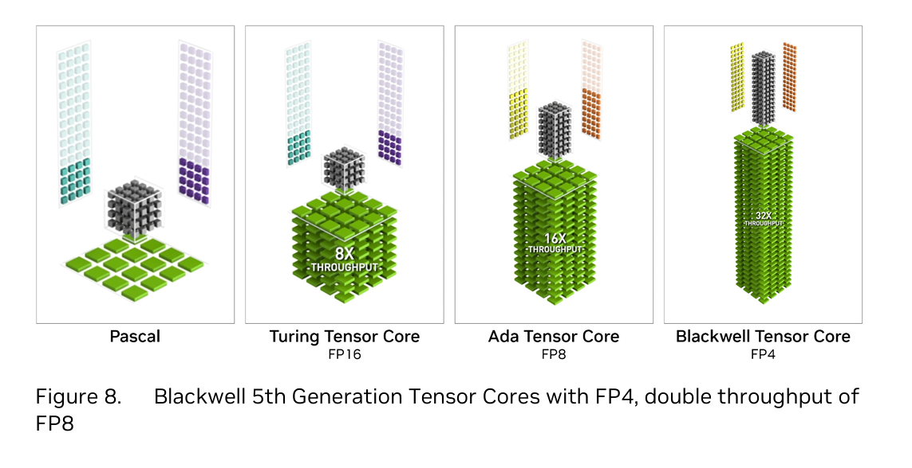
Tensor Core Architecture

Slide 51
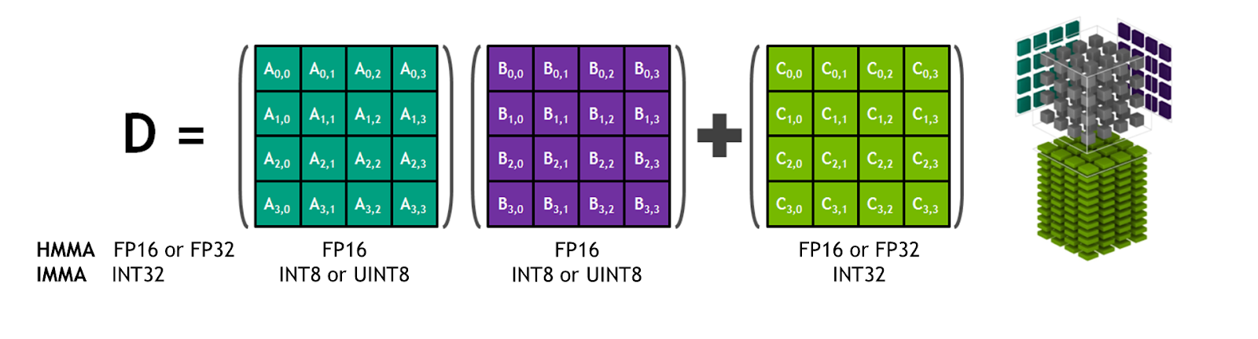
MMA(Matrix Multiply Accumulate ) Unit

Slide 52
MMA(Matrix Multiply Accumulate ) Unit
Systolic Array Concept
A systolic array is a grid (or network) of simple processing elements that rhythmically pass data between each other in a way that mimics the pumping of blood (hence “systolic”). It’s like a conveyor belt where each element performs a small computation and then passes the intermediate result along.

Slide 53
MMA(Matrix Multiply Accumulate ) Unit
How It Works:
Data Flow: Each processing element in the array performs a multiply-accumulate (or a simpler operation) and sends the output to the next neighbor. This creates a “wave” of operations that moves across the array.
Pipelining: The structure is highly pipelined, which means that while one part of the array is doing multiplication, another may be adding the previous results, thus achieving parallelism and high throughput.
Data Reuse: Since data is passed from one processing element to the next, there's less need to move data back and forth from slower memory, which reduces latency and improves overall efficiency.

