Slide 1

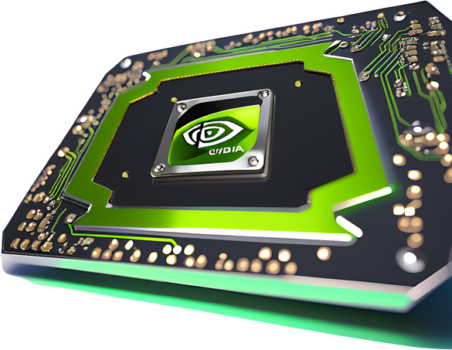

INTRODUCTION
TO CUDA

Slide 2
History & Background
NVIDIA launched CUDA with the G80 GPU, enabling developers to directly write parallel code in C/C++(2007).

Slide 3
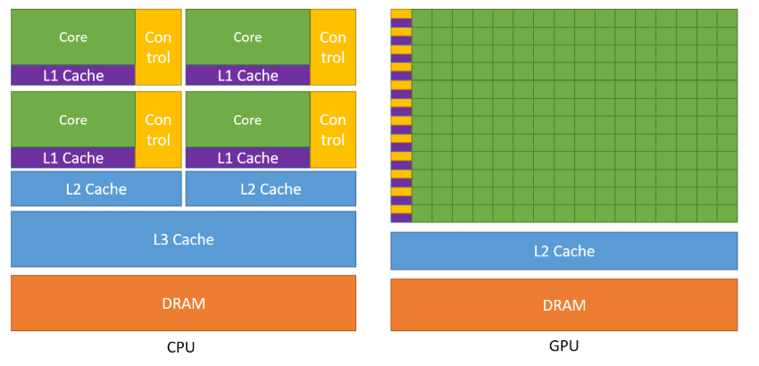
Architectural Evolution
Tesla (2006–2008) – First CUDA-capable GPUs
Fermi (2010) – Introduced cache hierarchy and improved double precision
Kepler (2012) – Enhanced energy efficiency
Maxwell (2014) – Improved performance per watt
Pascal (2016) – NVLink, Unified Memory enhancements
Volta (2017) – Tensor Cores for AI workloads
Turing (2018) – RT Cores for ray tracing
Ampere (2020) – Enhanced Tensor
& RT Cores, next-gen HPC performance

Slide 4
Course Overview
What is GPU computing?
CUDA programming giude
CPU vs GPU vs NPU architecture

Slide 5
CUDA Architecture
GPU hardware model (SMs, warps, threads)
SIMT execution model
Host (CPU) vs. Device (GPU)
Kernel functions and launch configuration
Basic CUDA syntax: __global__, <<< >>>
Hello world from GPU

Slide 6
Hello from GPU
__global__ void helloFromGPU() {
if (threadIdx.x == 0 && blockIdx.x == 0) {
printf("Hello World from GPU!\n");
}
}
int main() {
// Launch the kernel (1 block, 1 thread)
helloFromGPU<<<1, 1>>>();
// Check for any errors during kernel launch
cudaError_t err = cudaGetLastError();
if (err != cudaSuccess) {
std::cerr << "Kernel launch error: "
<< cudaGetErrorString(err) << std::endl;
return 1;
}
// Wait for GPU to finish, ensures the kernel's printf completes
cudaDeviceSynchronize();
// Print from the CPU
std::cout << "Hello from CPU!" << std::endl;
return 0;
}

