Slide 1

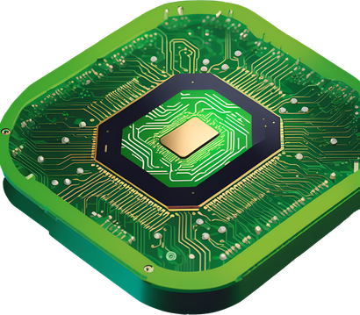
X-PURA
Improving Deep Learning Performance: Strategies for Enhancing Tensor Cores and Neural Processing Units
PRESENTED BY
Abdallah Awad, Ali Al-Saed, Osama Hamdan
Instructor: Dr.Aymen Hroub
PAGE 01

Slide 2

X-PURA
Introduction to the Problem
- NPUs face two main issues:
1. Inefficiency in FP16 multiplication within Tensor Cores.
2. Bottlenecks caused by limited vector lengths in SoftMax
operations during transformer computations.
- These challenges hinder performance scalability and latency reduction in AI workloads.
Problem Definition
Relevance
Optimizing these areas is crucial for handling advanced neural network tasks like transformers.
PAGE 02

Slide 3

X-PURA
Key Goals
- Develop an advanced FP16 multiplier using the Karatsuba algorithm to reduce computational complexity.
- Enhance the vector unit architecture by increasing its length to improve parallel processing.
- Optimize NPUs to balance performance with resource and energy efficiency.
Research Objectives
Expected Outcomes
-Achieve higher throughput and lower execution times for AI workloads.
- Provide scalable solutions adaptable to future AI models.
PAGE 03

Slide 4
X-PURA
Contributions
CORE CONTRIBUTIONS
- Development of a novel FP16 multiplier leveraging the Karatsuba algorithm for reduced computational complexity.
- Extension of vector unit length from 512 to 1024 bits for improved parallelism in SoftMax.
- Comprehensive performance evaluations comparing the proposed solutions to classical methods.
IMPACT
- Enables NPUs to efficiently handle transformer models and large-scale neural networks.
- Provides a foundation for energy-efficient, high-performance AI accelerators.
PAGE 04

Slide 5
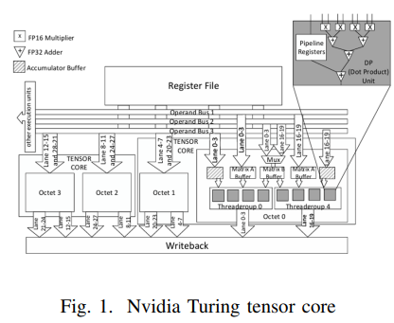
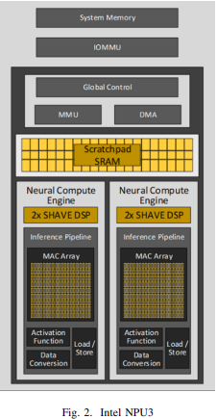
X-PURA
Major Related Works
Existing Innovations
NVIDIA TENSOR CORES
INTEL NPUS
GAPS IDENTIFIED
Efficient mixed-precision computation with FP16 multipliers and FP32 accumulators.
Focus on flexibility and programmability, targeting AI-specific operations like SoftMax.
Limited scalability and inefficiencies in vectorization for AI accelerators.
PAGE 05

Slide 6
X-PURA
Proposed Solution
Karatsuba Algorithm
Vector Length Expansion
- A divide-and-conquer method that splits numbers into smaller components for efficient multiplication.
- Reduces computational complexity to Θ(n^1.585), enabling faster FP16 multiplications.
- Extending vector length from 512 to 1024 bits allows simultaneous processing of more data.
- Mitigates performance bottlenecks in SoftMax operations common in transformer models.
PAGE 06

Slide 7
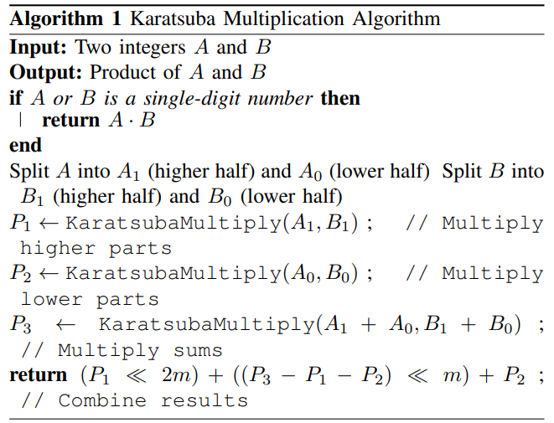
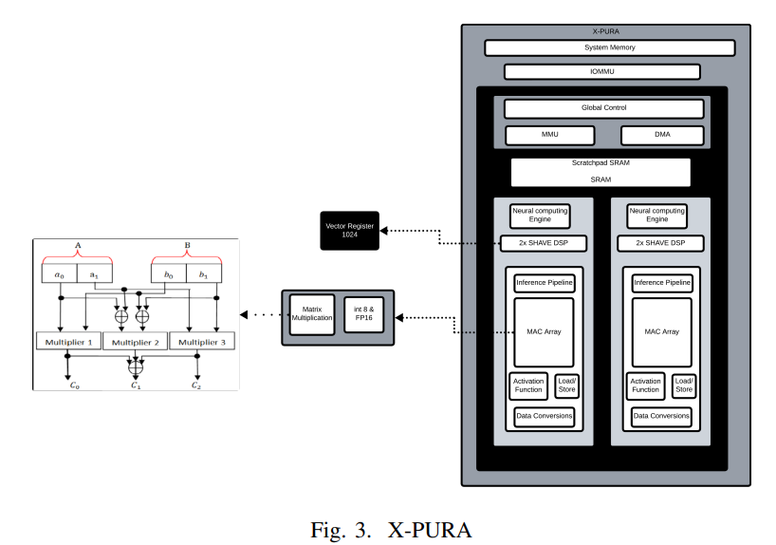

X-PURA
PAGE 07

Slide 8

X-PURA
Methodology
IMPLEMENTATION APPROACH
- Modify Tensor Core design to include the Karatsuba multiplier for FP16 operations.
- Expand vector unit length while maintaining compatibility with existing NPU architectures.
EVALUATION FRAMEWORK
- Compare execution times and throughput of the Karatsuba algorithm versus classical multiplication methods.
- Assess vector unit performance across different lengths (e.g., 512, 1024, 2048 bits).
- Use metrics such as execution time, throughput, and resource utilization to validate improvements.
PAGE 08

Slide 9

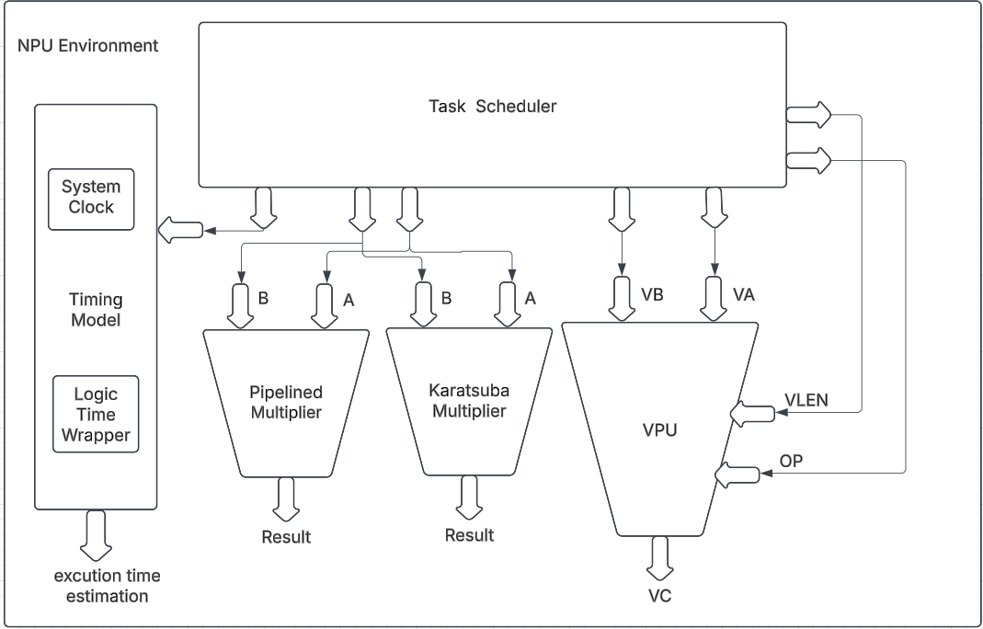



X-PURA SIMULATOR

Slide 10
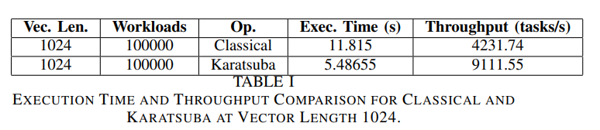
X-PURA
Snapshot from Results
PAGE 09

Slide 11
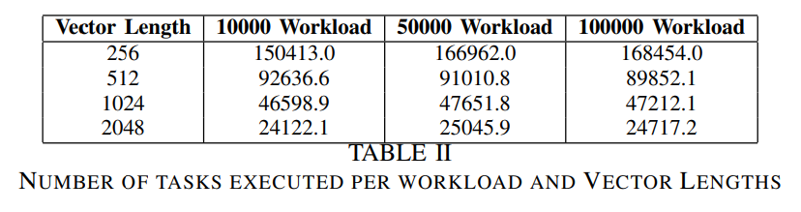
X-PURA
Snapshot from Results
PAGE 09

Slide 12

X-PURA
Experimental Results
Karatsuba Algorithm
Key Observations
- Execution time reduced by approximately 2x compared to classical methods.
- Achieved a throughput of 9111.55 tasks/second versus 4231.74 tasks/second for classical multiplication.
- Increased vector lengths reduce the number of tasks needed to complete workloads, improving efficiency.
- Karatsuba multiplier shows significant scalability and resource savings.
Vector Length Impact
- Optimal performance observed with a 2048-vector length, offering the lowest execution time.
- 1024-vector length provides a balance between efficiency and hardware resource requirements.
PAGE 10

Slide 13
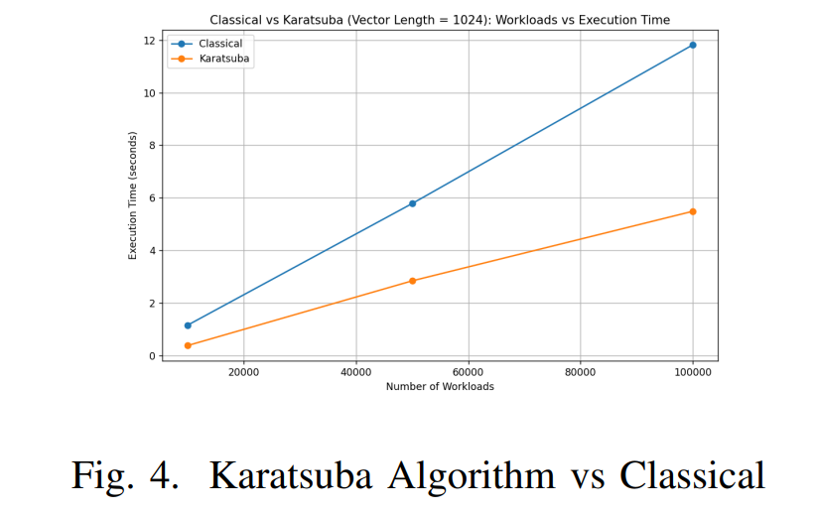
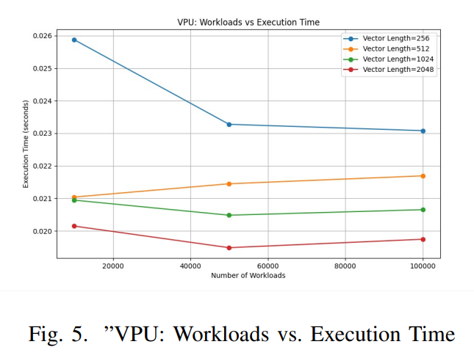
X-PURA
Results and Plots
PAGE 11

Slide 14


X-PURA
Analysis, Discussions, and Comparisons
PERFORMANCE COMPARISONS
CHALLENGES IDENTIFIED
- Proposed solutions outperform existing methods in terms of execution time, throughput, and task efficiency.
- Demonstrated scalability for large-scale AI workloads.
- Increased vector length requires more hardware resources, leading to potential trade-offs in area and power consumption.
- Adapting the Karatsuba algorithm to hardware introduces design complexity.
STATE-OF-THE-ART BENCHMARKS
- Outperforms NVIDIA Tensor Cores and Intel NPUs in SoftMax and matrix multiplication tasks.
PAGE 12

Slide 15
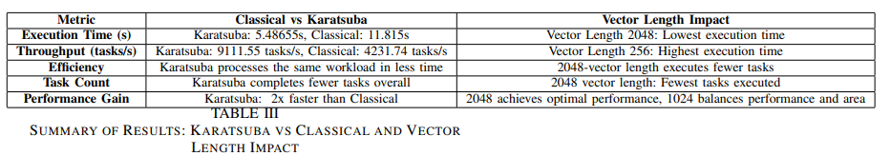
X-PURA
Conclusion and Future Work
SUMMARY OF ACHIEVEMENTS
FUTURE DIRECTIONS
- Combined use of the Karatsuba algorithm and vector length expansion enhances NPU performance.
- Improved computational efficiency and throughput for AI applications.
- Explore energy-efficient designs for mobile and edge devices.
- Investigate scalability for more complex neural networks and larger datasets.
- Incorporate additional algorithms for further optimization.
PAGE 14

Slide 16
X-PURA
Thank
You!
PAGE 15

