Slide 1



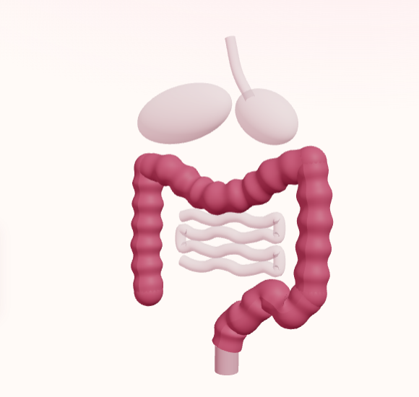
Faculty of Nursing for Girls, Al-Azhar University
كُليّة التمريض للبنات بالقاهرة
Medical-Surgical Nursing Department
قسم التمريض الباطني والجراحي
Al-Azhar University
جامعة الأزهر الشريف
COLON CANCER
Nursing College Presentation
A Comprehensive Clinical Seminar on Colorectal Oncology, Surgical Interventions & Advanced Nursing Care Plans.
UNDER SUPERVISION
Prof. Dr. Heba Abdel-Azem
Professor of Medical Surgical Nursing Department
Dr. Eman Abel-Maqsoud
Demonstrator of Medical Surgical Nursing Department
Academic Year 2026 / 2027
3D Digestive Oncology Model

Slide 2
Faculty of Nursing for Girls, Al-Azhar University
كُليّة التمريض للبنات بالقاهرة
Medical-Surgical Nursing Department
قسم التمريض الباطني والجراحي
Al-Azhar University
جامعة الأزهر الشريف
PRESENTATION TEAM
Presentation Team
إعداد طالبات كلية التمريض • الفرقة الدراسية
Faculty of Nursing for Girls • Al-Azhar University • Medical-Surgical Nursing Department
1
Hager Hany
Nursing Student • Al-Azhar University
2
Hager Saeed
Nursing Student • Al-Azhar University
3
Hager Mostafa
Nursing Student • Al-Azhar University
4
Haidy Mahmoud
Nursing Student • Al-Azhar University
5
Norhan Badawy
Nursing Student • Al-Azhar University
6
Hager Ahmed
Nursing Student • Al-Azhar University
Clinical seminar prepared under the academic curriculum of the Medical-Surgical Nursing Department, Faculty of Nursing for Girls, Al-Azhar University.

Slide 3
Faculty of Nursing for Girls, Al-Azhar University
كُليّة التمريض للبنات بالقاهرة
Medical-Surgical Nursing Department
قسم التمريض الباطني والجراحي
Al-Azhar University
جامعة الأزهر الشريف
EDUCATIONAL FRAMEWORK
GOAL
The goal of this assignment is to provide nursing students with a comprehensive understanding of colon cancer, including its anatomy, pathophysiology, risk factors, clinical manifestations, diagnosis, and management, in order to enhance their ability to deliver safe, evidence-based nursing care to patients with colon cancer.
Medical-Surgical Nursing
Clinical Competency Standards
Delivering holistic, evidence-based care tailored to oncology patients undergoing colorectal surgical and medical interventions.
✓ Anatomical & Pathophysiological Mastery
✓ Evidence-Based Diagnostic Assessment
✓ Multimodal Oncologic Management
✓ Patient-Centered Nursing Process & Care Plans

Slide 4
Faculty of Nursing for Girls, Al-Azhar University
كُليّة التمريض للبنات بالقاهرة
Medical-Surgical Nursing Department
قسم التمريض الباطني والجراحي
Al-Azhar University
جامعة الأزهر الشريف
EDUCATIONAL FRAMEWORK
OBJECTIVES
By the end of this assignment, the student will be able to:
1
Define colon cancer and describe the anatomy and physiology of the colon.
2
Explain the pathophysiology, causes, and risk factors of colon cancer.
3
Identify the types, signs and symptoms, and complications of colon cancer.
4
Discuss the diagnostic tests, staging, and prognosis of colon cancer.
5
Outline the medical and surgical management and the preventive measures of colon cancer.
6
Describe the role of the nurse in caring for patients with colon cancer before and after surgery.
7
Apply the nursing process to a patient with colon cancer.

Slide 5
Faculty of Nursing for Girls, Al-Azhar University
كُليّة التمريض للبنات بالقاهرة
Medical-Surgical Nursing Department
قسم التمريض الباطني والجراحي
Al-Azhar University
جامعة الأزهر الشريف
AGENDA
Presentation Outlines
01 Cover
08 Pathophysiology
15 Prognosis
02 Goals
09 Risk Factors
16 Management and Treatment
03 Objectives
10 Causes
17 Prevention
04 Outlines
11 Types
18 Nursing Role
05 Introduction
12 Signs and Symptoms
19 Nursing Process
06 Definition
13 Complications
20 Summary
07 Anatomy and Physiology
14 Diagnostic Tests
21 References

Slide 6
Faculty of Nursing for Girls, Al-Azhar University
كُليّة التمريض للبنات بالقاهرة
Medical-Surgical Nursing Department
قسم التمريض الباطني والجراحي
Al-Azhar University
جامعة الأزهر الشريف
INTRODUCTION
Introduction
Colon cancer is a major cancer of the digestive system.
It starts when colon lining cells grow abnormally and uncontrollably.
Often begins as small polyps that may turn cancerous over several years.
Digestive System & Colonic Lining

Slide 7
Faculty of Nursing for Girls, Al-Azhar University
كُليّة التمريض للبنات بالقاهرة
Medical-Surgical Nursing Department
قسم التمريض الباطني والجراحي
Al-Azhar University
جامعة الأزهر الشريف
INTRODUCTION
Introduction: Risk Factors
Risk factors
• Older age
• Family history
• Inherited genetic conditions
• Inflammatory bowel disease
• Smoking
• Lifestyle
It can also occur without any known risk factors.

Slide 8
Faculty of Nursing for Girls, Al-Azhar University
كُليّة التمريض للبنات بالقاهرة
Medical-Surgical Nursing Department
قسم التمريض الباطني والجراحي
Al-Azhar University
جامعة الأزهر الشريف
DEFINITION
Definition
1
A malignant disease of the colon, the longest part of the large intestine.
2
Abnormal cells divide uncontrollably and form a malignant tumor.
3
Most cases are adenocarcinomas, arising from glandular cells lining the colon.

Slide 9
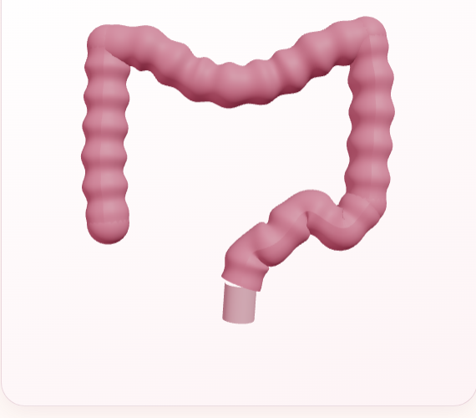
Faculty of Nursing for Girls, Al-Azhar University
كُليّة التمريض للبنات بالقاهرة
Medical-Surgical Nursing Department
قسم التمريض الباطني والجراحي
Al-Azhar University
جامعة الأزهر الشريف
ANATOMY AND PHYSIOLOGY
Anatomy of the Colon
The colon is the main part of the large intestine.
It is approximately 1.5 meters long.
Its main functions are absorbing water and electrolytes and forming solid stool.
The colon has four main sections.
3D Colon Anatomy Model

Slide 10
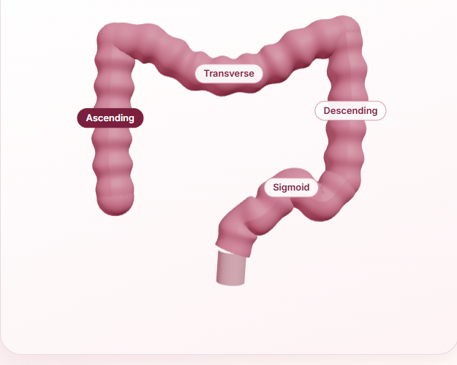
Faculty of Nursing for Girls, Al-Azhar University
كُليّة التمريض للبنات بالقاهرة
Medical-Surgical Nursing Department
قسم التمريض الباطني والجراحي
Al-Azhar University
جامعة الأزهر الشريف
ANATOMY AND PHYSIOLOGY
The Four Sections of the Colon
Ascending Colon
Located on the right side; carries contents upward.
Transverse Colon
Extends across the upper abdomen from right to left.
Descending Colon
Runs downward along the left side.
Sigmoid Colon
S-shaped section connecting the descending colon to the rectum.
Interactive 3D Anatomical Segmentation

Slide 11
Faculty of Nursing for Girls, Al-Azhar University
كُليّة التمريض للبنات بالقاهرة
Medical-Surgical Nursing Department
قسم التمريض الباطني والجراحي
Al-Azhar University
جامعة الأزهر الشريف
PATHOPHYSIOLOGY
Pathophysiology
Key Genetic Drivers:
APC
KRAS
p53
Genetic mutations (APC, KRAS, p53).
Abnormal cells develop into polyps then cancer.
DNA repair defects cause uncontrolled cell growth.

Slide 12

Faculty of Nursing for Girls, Al-Azhar University
كُليّة التمريض للبنات بالقاهرة
Medical-Surgical Nursing Department
قسم التمريض الباطني والجراحي
Al-Azhar University
جامعة الأزهر الشريف
PATHOPHYSIOLOGY
Pathophysiology: From Normal Cells to Cancer
Step 1: Normal colon cells
Step 2: Abnormal cellular changes
Step 3: Polyp formation
Step 4: Cancer development
3D Cellular Lattice Progression

Slide 13
Faculty of Nursing for Girls, Al-Azhar University
كُليّة التمريض للبنات بالقاهرة
Medical-Surgical Nursing Department
قسم التمريض الباطني والجراحي
Al-Azhar University
جامعة الأزهر الشريف
RISK FACTORS
Risk Factors
Age over 50
Family history
Obesity
Smoking and alcohol
Red and processed meat
Physical inactivity
Diabetes
Note: Age over 50 is listed here, while the Prevention slides note screening begins at age 45.

Slide 14
Faculty of Nursing for Girls, Al-Azhar University
كُليّة التمريض للبنات بالقاهرة
Medical-Surgical Nursing Department
قسم التمريض الباطني والجراحي
Al-Azhar University
جامعة الأزهر الشريف
CAUSES
Causes
• Genetic mutations
• Hereditary syndromes
• Family history
• Chronic intestinal inflammation
• Unhealthy lifestyle

Slide 15
Faculty of Nursing for Girls, Al-Azhar University
كُليّة التمريض للبنات بالقاهرة
Medical-Surgical Nursing Department
قسم التمريض الباطني والجراحي
Al-Azhar University
جامعة الأزهر الشريف
TYPES
Types of Cancer in the Colon and Rectum
95%
Adenocarcinoma
The most common type (about 95%), develops in mucus-producing cells lining the colon and rectum.

Slide 16
Faculty of Nursing for Girls, Al-Azhar University
كُليّة التمريض للبنات بالقاهرة
Medical-Surgical Nursing Department
قسم التمريض الباطني والجراحي
Al-Azhar University
جامعة الأزهر الشريف
TYPES
Types: Other Cancers of the Colon and Rectum
Carcinoid Tumors
Develop from hormone-producing cells in the intestine.
Gastrointestinal Stromal Tumors (GISTs)
Develop from specialized cells in the digestive tract wall.
Lymphomas
Cancers that develop from immune system cells and may affect the colon and rectum.
Sarcomas
Rare cancers that develop in muscles, blood vessels, or connective tissues of the intestinal wall.

Slide 17
Faculty of Nursing for Girls, Al-Azhar University
كُليّة التمريض للبنات بالقاهرة
Medical-Surgical Nursing Department
قسم التمريض الباطني والجراحي
Al-Azhar University
جامعة الأزهر الشريف
SIGNS AND SYMPTOMS
Signs and Symptoms of Colon Cancer
RECTUM
Blood in Stool
Blood may appear in the stool or as rectal bleeding.
LOWER
Change in Stool Appearance
Changes in stool color, including dark or black stools.
BODY
Fatigue and Weakness
May result from chronic bleeding and iron-deficiency anemia.

Slide 18
Faculty of Nursing for Girls, Al-Azhar University
كُليّة التمريض للبنات بالقاهرة
Medical-Surgical Nursing Department
قسم التمريض الباطني والجراحي
Al-Azhar University
جامعة الأزهر الشريف
SIGNS AND SYMPTOMS
Signs and Symptoms: Continued
BODY
Unexplained Weight Loss
Sudden weight loss without an obvious reason.
ABDOMEN
Abdominal Bloating and Bowel Changes
Persistent bloating or feeling that the bowel has not completely emptied.
NONE
No Symptoms
Some patients may have no symptoms, especially in early stages.

Slide 19
Faculty of Nursing for Girls, Al-Azhar University
كُليّة التمريض للبنات بالقاهرة
Medical-Surgical Nursing Department
قسم التمريض الباطني والجراحي
Al-Azhar University
جامعة الأزهر الشريف
COMPLICATIONS
Complications of Colon Cancer
Bowel Obstruction
Gastrointestinal Bleeding
Tumor growth blocks the intestine, causing abdominal pain, swelling, nausea, and vomiting.
Tumor bleeding may cause anemia, fatigue, and bloody or black stools.

Slide 20
Faculty of Nursing for Girls, Al-Azhar University
كُليّة التمريض للبنات بالقاهرة
Medical-Surgical Nursing Department
قسم التمريض الباطني والجراحي
Al-Azhar University
جامعة الأزهر الشريف
COMPLICATIONS
Complications: Continued
Perforation
Metastasis
A hole in the intestinal wall can lead to peritonitis and serious infection.
Cancer spreads to nearby lymph nodes or distant organs, especially the liver and lungs.

Slide 21
Faculty of Nursing for Girls, Al-Azhar University
كُليّة التمريض للبنات بالقاهرة
Medical-Surgical Nursing Department
قسم التمريض الباطني والجراحي
Al-Azhar University
جامعة الأزهر الشريف
COMPLICATIONS
Complications: Continued
Malnutrition and Weight Loss
Emotional and Psychological Impact
Reduced food intake and treatment side effects may cause weight loss and nutritional deficiencies.
Cancer diagnosis and treatment may cause anxiety, stress, and depression.

Slide 22
Faculty of Nursing for Girls, Al-Azhar University
كُليّة التمريض للبنات بالقاهرة
Medical-Surgical Nursing Department
قسم التمريض الباطني والجراحي
Al-Azhar University
جامعة الأزهر الشريف
DIAGNOSTIC TESTS
Clinical Examination
The doctor asks about symptoms and medical history.
1
Examines the abdomen and may perform a digital rectal examination.
2

Slide 23
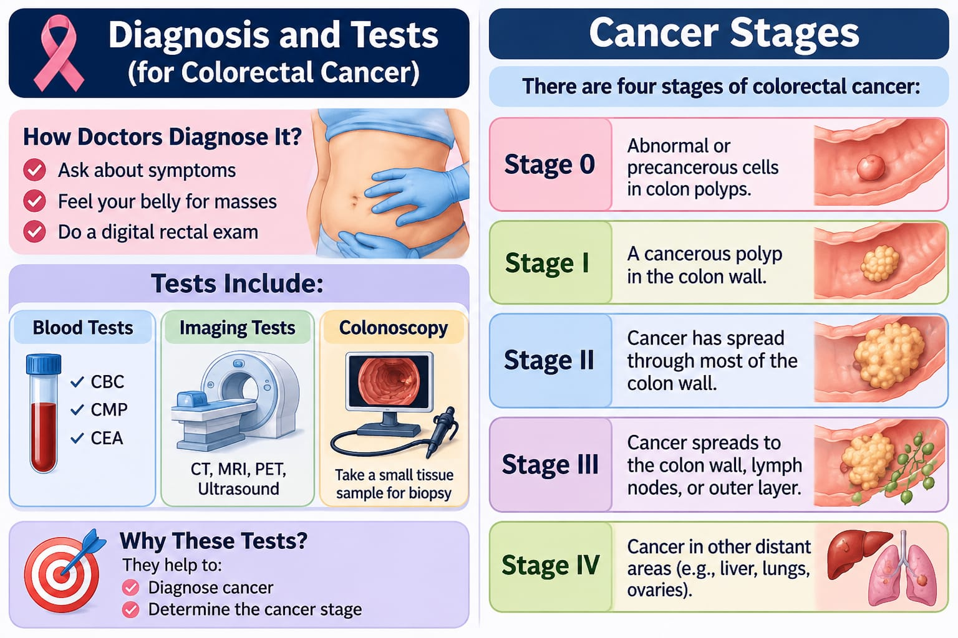
Faculty of Nursing for Girls, Al-Azhar University
كُليّة التمريض للبنات بالقاهرة
Medical-Surgical Nursing Department
قسم التمريض الباطني والجراحي
Al-Azhar University
جامعة الأزهر الشريف
DIAGNOSTIC TESTS
Diagnostic Tests
Blood Tests
CBC, CMP and CEA.
Imaging Tests
CT scan, MRI, PET scan and abdominal ultrasound.
Colonoscopy
Allows the doctor to examine the colon and take a biopsy for laboratory examination.
Clinical Diagnostic & Staging Infographic

Slide 24
Faculty of Nursing for Girls, Al-Azhar University
كُليّة التمريض للبنات بالقاهرة
Medical-Surgical Nursing Department
قسم التمريض الباطني والجراحي
Al-Azhar University
جامعة الأزهر الشريف
DIAGNOSTIC TESTS
Why These Tests?
These tests help doctors diagnose cancer and determine its stage.

Slide 25
Faculty of Nursing for Girls, Al-Azhar University
كُليّة التمريض للبنات بالقاهرة
Medical-Surgical Nursing Department
قسم التمريض الباطني والجراحي
Al-Azhar University
جامعة الأزهر الشريف
DIAGNOSTIC TESTS
Stages of Colon Cancer
0
Stage 0
Abnormal or precancerous cells.
I
Stage I
Cancer is in the colon wall.
II
Stage II
Cancer spreads deeper through the colon wall.
TNM Staging System Reference

Slide 26
Faculty of Nursing for Girls, Al-Azhar University
كُليّة التمريض للبنات بالقاهرة
Medical-Surgical Nursing Department
قسم التمريض الباطني والجراحي
Al-Azhar University
جامعة الأزهر الشريف
DIAGNOSTIC TESTS
Stages of Colon Cancer: Continued
III
Stage III
Cancer spreads to nearby lymph nodes.
IV
Stage IV
Cancer spreads to distant organs such as the liver or lungs.
TNM Staging System Reference

Slide 27
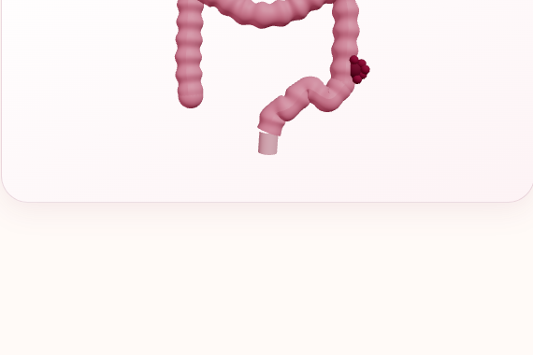
Faculty of Nursing for Girls, Al-Azhar University
كُليّة التمريض للبنات بالقاهرة
Medical-Surgical Nursing Department
قسم التمريض الباطني والجراحي
Al-Azhar University
جامعة الأزهر الشريف
PROGNOSIS
Outlook of Colon Cancer
The outlook depends on the cancer stage, patient's general health, and response to treatment.
Early diagnosis and treatment improve the chances of recovery.
Treatment may include surgery, chemotherapy, and radiation therapy.
3D Colon Tumor Visualization

Slide 28
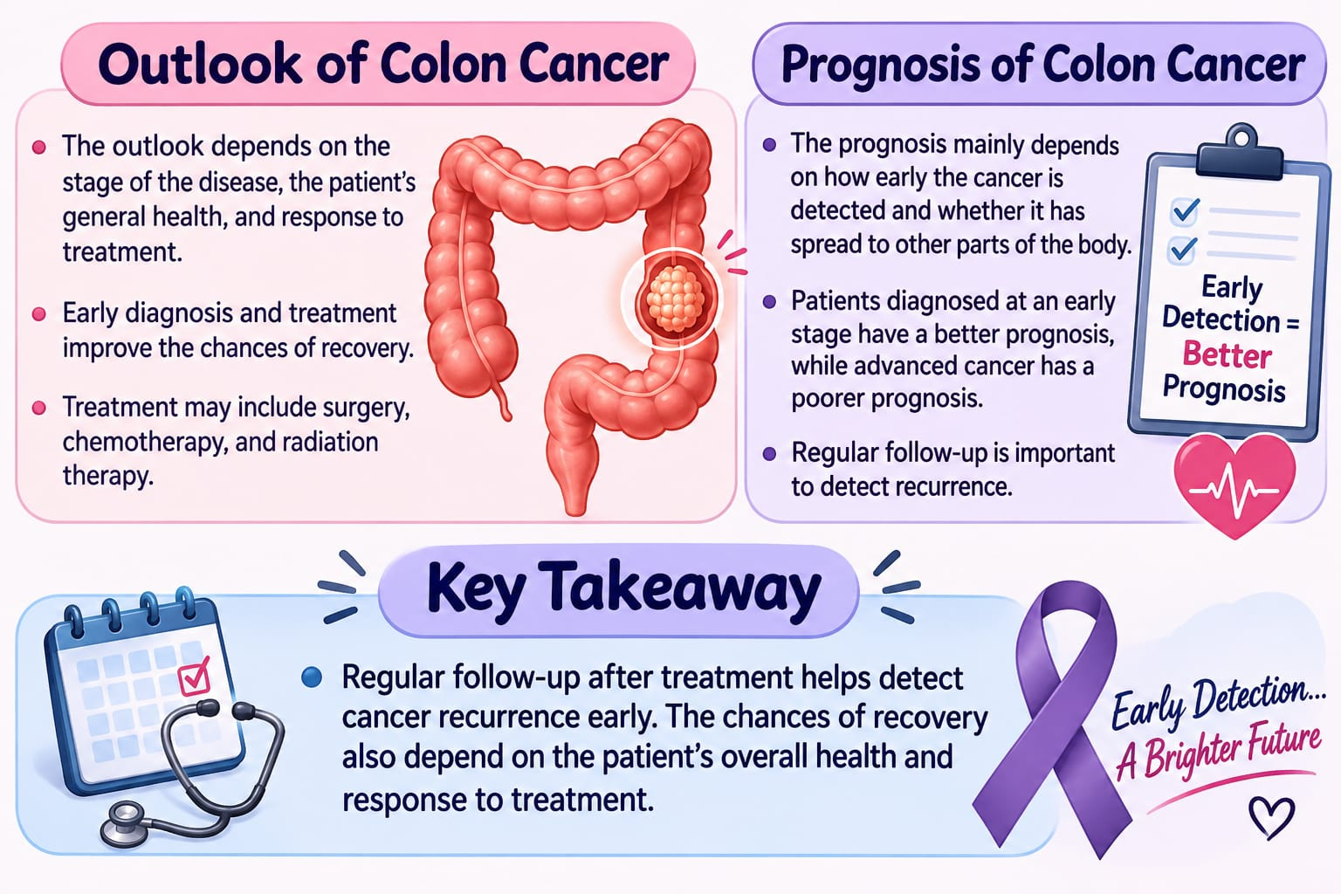
Faculty of Nursing for Girls, Al-Azhar University
كُليّة التمريض للبنات بالقاهرة
Medical-Surgical Nursing Department
قسم التمريض الباطني والجراحي
Al-Azhar University
جامعة الأزهر الشريف
PROGNOSIS
Prognosis of Colon Cancer
Prognosis depends on how early cancer is detected and whether it has spread.
Early-stage cancer has a better prognosis, while advanced cancer has a poorer prognosis.
Regular follow-up after treatment helps detect recurrence early.
Prognosis & Survival Infographic
Key takeaway: Regular follow-up after treatment helps detect cancer recurrence early. The chances of recovery also depend on the patient's overall health and response to treatment.

Slide 29
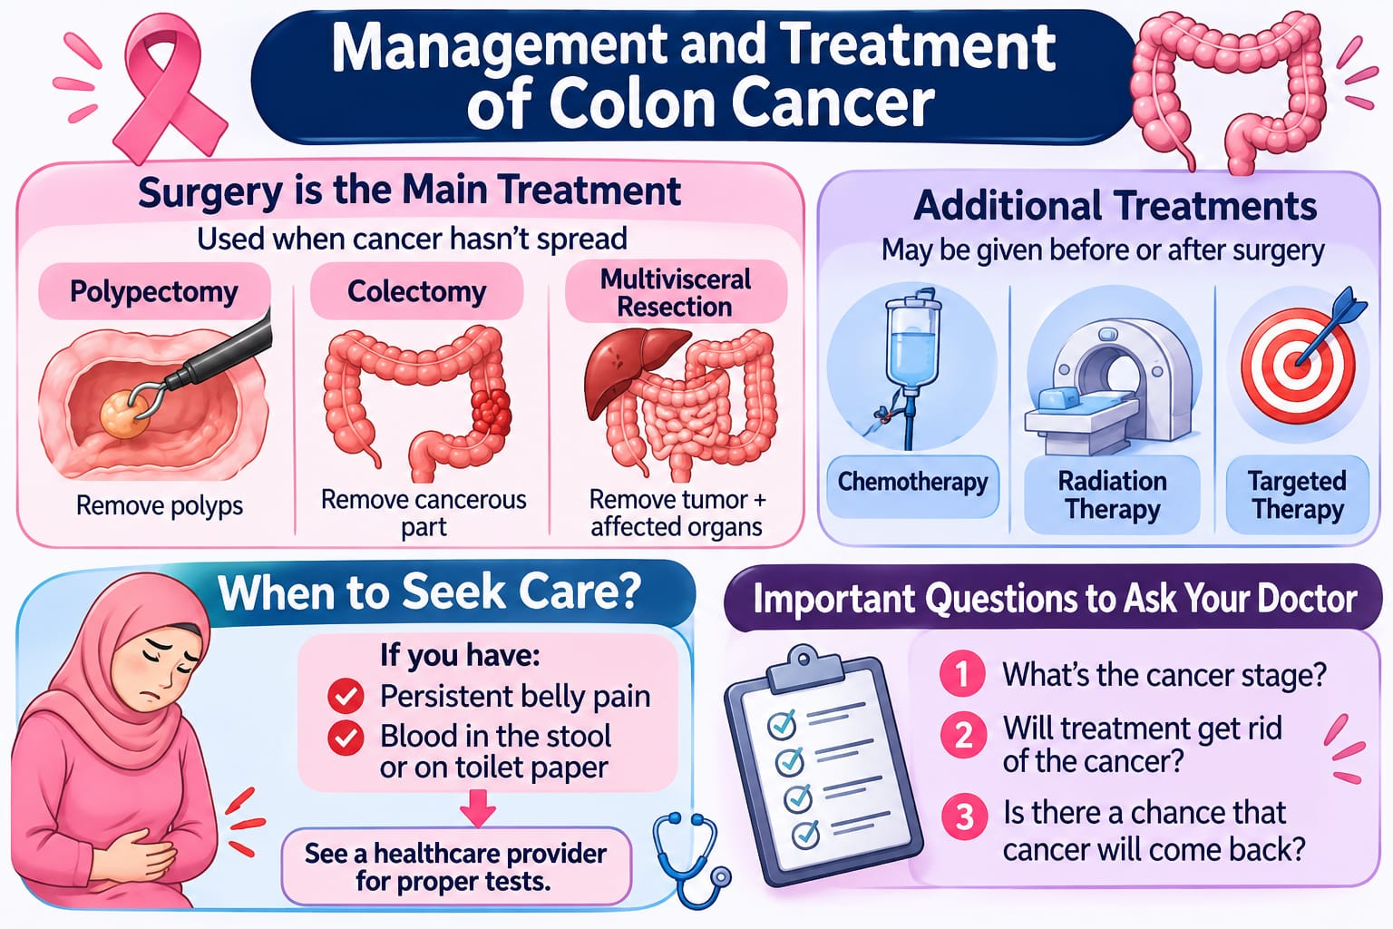
Faculty of Nursing for Girls, Al-Azhar University
كُليّة التمريض للبنات بالقاهرة
Medical-Surgical Nursing Department
قسم التمريض الباطني والجراحي
Al-Azhar University
جامعة الأزهر الشريف
MANAGEMENT AND TREATMENT
Management and Treatment
Surgery is the main treatment for colon cancer that hasn't spread.
Polypectomy
Removal of cancerous or precancerous polyps.
Colectomy
Removal of the affected part of the colon.
Multivisceral Resection
Removal of the tumor and nearby affected organs.
Surgical Interventions Overview

Slide 30
Faculty of Nursing for Girls, Al-Azhar University
كُليّة التمريض للبنات بالقاهرة
Medical-Surgical Nursing Department
قسم التمريض الباطني والجراحي
Al-Azhar University
جامعة الأزهر الشريف
MANAGEMENT AND TREATMENT
Additional Treatment and When to Seek Medical Care
Chemotherapy, radiation therapy and targeted therapy may be used before or after surgery.
Chemotherapy
Radiation therapy
Targeted therapy
When to Seek Medical Care
Consult a doctor if you have persistent abdominal pain or blood in your stool, as these symptoms may have different causes and require medical evaluation.

Slide 31
Faculty of Nursing for Girls, Al-Azhar University
كُليّة التمريض للبنات بالقاهرة
Medical-Surgical Nursing Department
قسم التمريض الباطني والجراحي
Al-Azhar University
جامعة الأزهر الشريف
MANAGEMENT AND TREATMENT
Important Questions
?
What is the cancer stage?
?
Can treatment eliminate the cancer?
?
Can the cancer return?

Slide 32
Faculty of Nursing for Girls, Al-Azhar University
كُليّة التمريض للبنات بالقاهرة
Medical-Surgical Nursing Department
قسم التمريض الباطني والجراحي
Al-Azhar University
جامعة الأزهر الشريف
PREVENTION
Prevention: Screening & Early Detection
✓
Regular screening is one of the most powerful tools for preventing colorectal cancer
✓
It takes 10 to 15 years for polyps to turn into cancer, screening allows removal before they develop
✓
Start screening at age 45 (or earlier if strong family history/genetic risk)

Slide 33
Faculty of Nursing for Girls, Al-Azhar University
كُليّة التمريض للبنات بالقاهرة
Medical-Surgical Nursing Department
قسم التمريض الباطني والجراحي
Al-Azhar University
جامعة الأزهر الشريف
PREVENTION
Lifestyle & Risk Reduction
Healthy Weight
Maintaining healthy weight lowers risk
Physical Activity
Regular moderate to vigorous activity lowers risk of polyps and cancer
Diet
Eat more vegetables, fruits, and whole grains. Limit red meats and processed meats.
Avoid Alcohol & Smoking
Quitting reduces colorectal cancer risk

Slide 34
Faculty of Nursing for Girls, Al-Azhar University
كُليّة التمريض للبنات بالقاهرة
Medical-Surgical Nursing Department
قسم التمريض الباطني والجراحي
Al-Azhar University
جامعة الأزهر الشريف
PREVENTION
Supplements & Medical Factors
Vitamins & Minerals
Folic acid, Vitamin D, Calcium, and Magnesium may help lower risk
NSAIDs (Aspirin)
May lower risk, but not recommended for prevention due to stomach bleeding
Hormone Therapy
May reduce risk in women, but carries other health risks

Slide 35
Faculty of Nursing for Girls, Al-Azhar University
كُليّة التمريض للبنات بالقاهرة
Medical-Surgical Nursing Department
قسم التمريض الباطني والجراحي
Al-Azhar University
جامعة الأزهر الشريف
NURSING ROLE
Nursing Role: Assessment & Pre-Operative Care
Phase: Assessment and pre-operative care
Comprehensive Assessment: Changes in bowel habits, blood in stool, unexplained anemia, abdominal discomfort, nutritional status, family history
Bowel Preparation: Laxatives, enemas, or oral bowel cleansers
Patient Education & Psychological Support: Explain procedure, address fears and anxiety
Stoma Site Marking: Mark optimal site with ostomy specialist (WOCN)

Slide 36
Faculty of Nursing for Girls, Al-Azhar University
كُليّة التمريض للبنات بالقاهرة
Medical-Surgical Nursing Department
قسم التمريض الباطني والجراحي
Al-Azhar University
جامعة الأزهر الشريف
NURSING ROLE
Post-Operative Nursing Care
Phase: Post-operative care
Monitoring: Vital signs, abdominal pain, bowel sounds, return of intestinal function
Stoma Care: Stoma should be pink/red and moist, teach pouch change and skin protection
Prevent Complications: Pain medication, early ambulation, deep breathing to prevent DVT

Slide 37
Faculty of Nursing for Girls, Al-Azhar University
كُليّة التمريض للبنات بالقاهرة
Medical-Surgical Nursing Department
قسم التمريض الباطني والجراحي
Al-Azhar University
جامعة الأزهر الشريف
NURSING ROLE
Managing Treatment Side Effects
Phase: Treatment side effects
Chemotherapy & Radiation Support: Manage nausea, vomiting, fatigue, diarrhea with medications and fluids to prevent dehydration
Infection & Lab Monitoring: Monitor WBCs and platelets for infection and bleeding risks

Slide 38
Faculty of Nursing for Girls, Al-Azhar University
كُليّة التمريض للبنات بالقاهرة
Medical-Surgical Nursing Department
قسم التمريض الباطني والجراحي
Al-Azhar University
جامعة الأزهر الشريف
NURSING ROLE
Psychological & Rehabilitation Support
Phase: Psychological and rehabilitation support
Body Image & Coping: Help patient adapt to bodily changes with colostomy
Holistic Support: Continuous emotional support for patient and family

Slide 39
Faculty of Nursing for Girls, Al-Azhar University
كُليّة التمريض للبنات بالقاهرة
Medical-Surgical Nursing Department
قسم التمريض الباطني والجراحي
Al-Azhar University
جامعة الأزهر الشريف
NURSING PROCESS
Nursing Care Plan: Fatigue
ACTUAL NURSING CARE PLAN
Fatigue related to decreased oxygen carrying capacity secondary to anemia as evidenced by
Subjective Data:
Patient states feeling tired, weak, and dizzy.
Objective Data:
Pallor of skin, low Hb/Hct levels, and decreased activity tolerance.
Short-Term Goal
Patient will report decreased fatigue within 24–48 hours.
Long-Term Goal
Patient will perform daily activities with minimal fatigue and demonstrate improved activity tolerance.

Slide 40
Faculty of Nursing for Girls, Al-Azhar University
كُليّة التمريض للبنات بالقاهرة
Medical-Surgical Nursing Department
قسم التمريض الباطني والجراحي
Al-Azhar University
جامعة الأزهر الشريف
NURSING PROCESS
Fatigue: Interventions & Rationales
Nursing Interventions | Scientific & Evidence-Based Rationales
Assess fatigue level, monitor vital signs regularly. | To determine fatigue severity, evaluate anemia, and detect abnormalities early.
Provide adequate rest periods and assist with daily activities as needed. | To conserve energy and prevent excessive exhaustion.
Encourage iron-rich foods, administer prescribed iron supplements. | To support hemoglobin production, correct iron deficiency.

Slide 41
Faculty of Nursing for Girls, Al-Azhar University
كُليّة التمريض للبنات بالقاهرة
Medical-Surgical Nursing Department
قسم التمريض الباطني والجراحي
Al-Azhar University
جامعة الأزهر الشريف
NURSING PROCESS
Nursing Care Plan: Abdominal Pain
ACTUAL NURSING CARE PLAN
Persistent abdominal pain related to tumor growth and intestinal changes secondary to colon cancer.
Subjective Data:
“I have abdominal pain.”
Objective Data:
Abdominal tenderness on palpation.
Short-Term Goal
Patient will report reduced abdominal pain within 24–48 hours.
Long-Term Goal
Patient will maintain pain control.

Slide 42
Faculty of Nursing for Girls, Al-Azhar University
كُليّة التمريض للبنات بالقاهرة
Medical-Surgical Nursing Department
قسم التمريض الباطني والجراحي
Al-Azhar University
جامعة الأزهر الشريف
NURSING PROCESS
Abdominal Pain: Interventions & Rationales
Nursing Interventions | Scientific & Evidence-Based Rationales
Assess the patient's pain level, location, characteristics and vital signs. | To determine the severity and pattern of pain, and to detect changes.
Administer prescribed analgesics. | To relieve pain, reduce muscle tension, and improve patient comfort.
Educate the patient to eat small, frequent, low-fiber meals. | To prevent stomach overloading, minimize bowel irritation, and allow early medical intervention.

Slide 43
Faculty of Nursing for Girls, Al-Azhar University
كُليّة التمريض للبنات بالقاهرة
Medical-Surgical Nursing Department
قسم التمريض الباطني والجراحي
Al-Azhar University
جامعة الأزهر الشريف
NURSING PROCESS
Nursing Care Plan: Risk for Dysfunctional Gastrointestinal Motility
POTENTIAL NURSING CARE PLAN
Risk for Dysfunctional Gastrointestinal Motility related to the presence of a colon tumor mass and potential narrowing of the intestinal lumen.
Goal
Patient will maintain stable gastrointestinal function.

Slide 44
Faculty of Nursing for Girls, Al-Azhar University
كُليّة التمريض للبنات بالقاهرة
Medical-Surgical Nursing Department
قسم التمريض الباطني والجراحي
Al-Azhar University
جامعة الأزهر الشريف
NURSING PROCESS
Gastrointestinal Motility: Interventions & Rationales
Nursing Interventions | Scientific & Evidence-Based Rationales
Auscultate bowel sounds in all 4 quadrants every 4 hours. | To detect early signs of bowel obstruction.
Encourage progressive ambulation and physical activity as tolerated. | To stimulate peristalsis and enhance natural GI motility.
Maintain adequate hydration via oral fluids or prescribed IV routes. | To prevent constipation and ease stool passage.

Slide 45
Faculty of Nursing for Girls, Al-Azhar University
كُليّة التمريض للبنات بالقاهرة
Medical-Surgical Nursing Department
قسم التمريض الباطني والجراحي
Al-Azhar University
جامعة الأزهر الشريف
SUMMARY
Summary
SUMMARY
Academic section scheduled in course curriculum.
Content preserved pending upcoming clinical symposium update.

Slide 46
Faculty of Nursing for Girls, Al-Azhar University
كُليّة التمريض للبنات بالقاهرة
Medical-Surgical Nursing Department
قسم التمريض الباطني والجراحي
Al-Azhar University
جامعة الأزهر الشريف
REFERENCES
References
REFERENCES
Academic section scheduled in course curriculum.
Content preserved pending upcoming clinical symposium update.

