Slide 1
Household Electricity
By Supercaliprobablisticexpialidocious.

Slide 2
Introduction
This research project investigates individual household electricity consumption patterns using probability theory and statistical inference methods. to comprehensively characterize consumption patterns.

Slide 3


Our team
Abdulrahman Jalal
Kit Kat

Slide 4
Dataset Overview
Source: UCI Machine Learning Repository
Contributors: Georges Hebrail & Alice Berard (2012)
Location: Single household in Sceaux, France (≈7 km from Paris)
Time period: December 2006 – November 2010 (47 months)
Sampling rate: One-minute intervals
Size: 2,075,259 observations
Variables: 9 household measurement variables

Slide 5

The main variables we used.
Date time
Global Active Power
Calendar date of measurement.
Day, Hour, Week type and Season Type was induced from the date time.
Household total active power, minute averaged. The main factor used in all of our research questions.

Slide 6
Research Questions
01
02
03
04
05
Distribution Characterization
Day-Type Effects
(Weekday vs Weekend)
Seasonal Effects
Predictability and Linear Relationships
Independence of Categorical Variables

Slide 7
01
Distribution Characterization
Which probability distribution (Normal, Lognormal, Gamma, Weibull) best characterizes household electricity consumption?

Slide 8
Tests Used
Shapiro-Wilk Test
Anderson-Darling Test
Kolmogorov-Smirnov (KS) Test
Checks how well data fits a chosen distribution by measuring the maximum difference between the data’s CDF and the theoretical CDF.
Checks normality by seeing how closely the data match a normal distribution. Works best for small to moderate samples.
Measures how well data match a distribution, especially at the extremes.

Slide 9
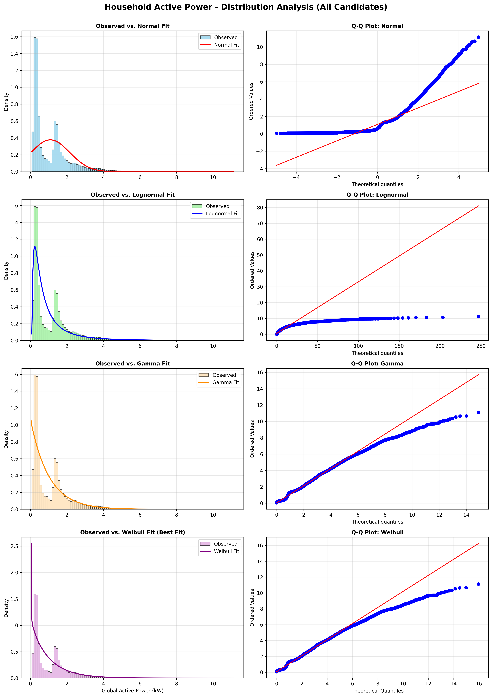
Distribution Characterization Visually

Slide 10
KS Test Results
Distribution | KS Statistic
Weibull | 0.124161
Gamma | 0.133175
Lognormal | 0.133026
Normal | 0.181861

Slide 11
Normal Fit Tests
Shapiro-Wilk Test
Anderson-Darling Test
Test Statistic (W): 0.796745
Data are NOT normally distributed
Test Statistic (A²): 117,259.223836
Critical Value (α=0.05): 0.787
Normal distribution does not fit (test exceeds critical value)

Slide 12
02
Day-Type Effects
Is consumption significantly different on weekends versus weekdays?

Slide 13
Tests Used
Welch's Two-Sample t-Test
Compares the means of two independent groups without assuming equal variances.

Slide 14
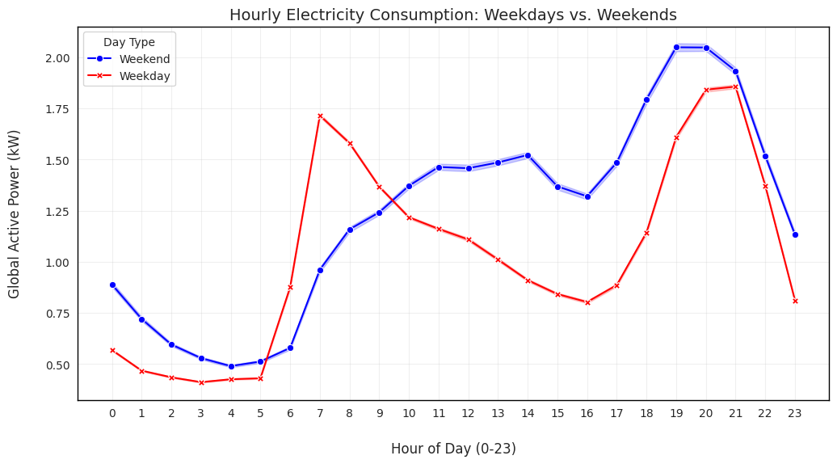
Hourly Electricity Consumption: Weekdays vs. Weekends
Weekdays show a sharp morning peak around 7–8 AM, followed by a midday dip and a smaller evening rise.
Weekends have a smoother profile with higher daytime and evening consumption, peaking around 7–9 PM.
Overall, weekend usage is consistently higher than weekday usage during the day and evening, reflecting different household routines.

Slide 15
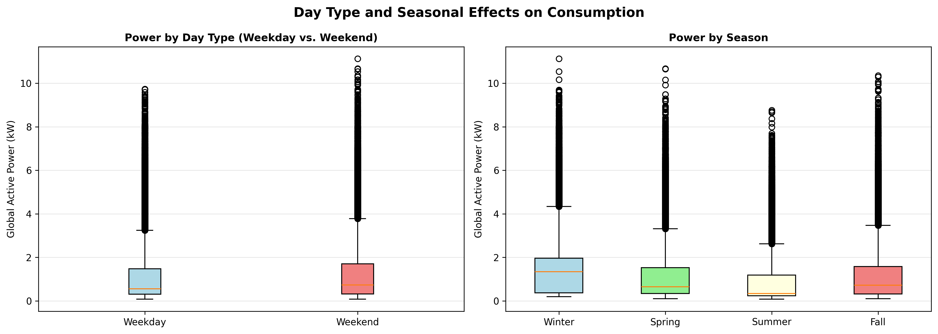
Weekday vs Weekend
The median Global Active Power is higher during the weekends than the weekdays.

Slide 16
Analysis Results
Statistic | Weekday | Weekend
Count (n) | 1,470,428 | 578,852
Mean | 1.0355 kW | 1.2342 kW
t-statistic: 111.5779
p-value: < 0.000001 (effectively zero)
The difference is highly statistically significant and not due to random chance.

Slide 17
03
Seasonal Effects
Do seasonal variations significantly affect consumption patterns?

Slide 18
Tests Used
One-Way ANOVA
Tukey HSD Post-Hoc Test
Compares the means of three or more groups to see if at least one group is significantly different.
Focuses on overall differences, not which specific groups differ.
Identifies which specific groups differ after ANOVA finds a significant difference.
Controls for multiple comparisons to avoid false positives.

Slide 19
Seasons Visualization
Global active power varies across seasons. Winter show higher median and more extreme values, while Summer has the lowest median power consumption.

Slide 20
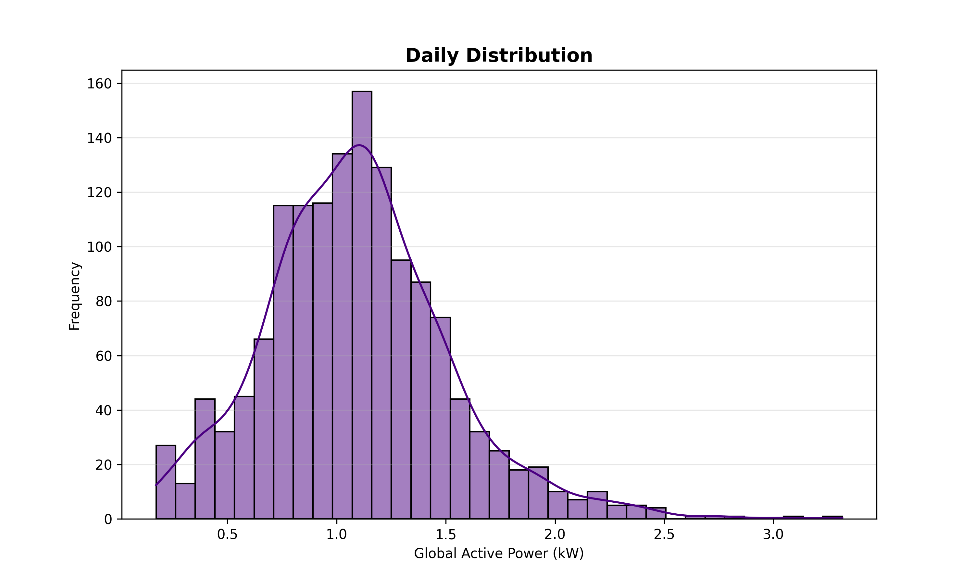
There’s a catch!
Data is not normally distributed as we have discussed earlier. So, two things were done on the data so ANOVA could be used:
Data was averaged by day instead of by minute which resulted in a more normal distribution
For each season a sample of 300 was taken to make sure they are equal for the Tukey’s HSD test.

Slide 21
One Way ANOVA Result
Source | SS | DF | F-Stat | Fc
Between Seasons | 75 | 3 | 213.45 | 2.605
Within Seasons | 140.1 | 1196.0
Seasonal means differ significantly

Slide 22
Tukey HSD Post-Hoc Result
HSD = 0.0056
Comparison | Mean Difference | HSD | Significant?
Winter - Spring | 0.3124 kW | >HSD | Yes
Winter - Summer | 0.7046 kW | >HSD | Yes
Winter - Fall | 0.3084 kW | >HSD | Yes
Spring - Summer | 0.3922 kW | >HSD | Yes
Fall - Spring | 0.004 kW | <HSD | No
Fall - Summer | 0.107 kW | >HSD | Yes

Slide 23
04
Predictability and Linear Relationships
Can we accurately predict consumption from electrical variables?

Slide 24
Tests Used
Simple regression
Multiple regression
Predicts a response using a single predictor.
Uses two or more predictors to explain variation in the response.

Slide 25
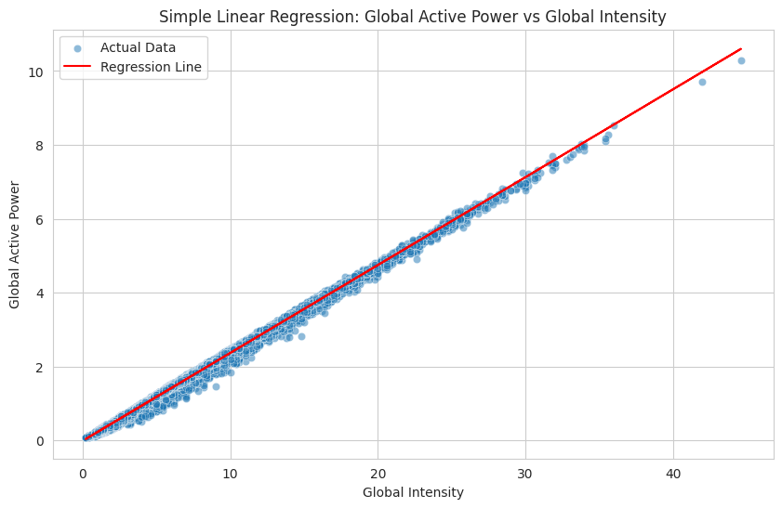
Single Regression Visualization
There’s a very high correlation between Global Active Power and Global Intensity, which means that Global Intensity is strong predictor of consumption.

Slide 26
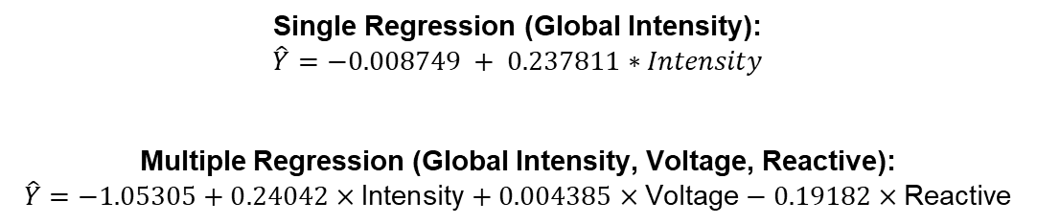
Induced Formulas
Single Regression (Global Intensity):
$$\hat{Y}=−0.008749 + 0.237811∗Intensity$$
Multiple Regression (Global Intensity, Voltage, Reactive):
$$\hat{Y}=−1.05305+0.24042×\text{Intensity}+0.004385×\text{Voltage}−0.19182×\text{Reactive}$$

Slide 27
05
Independence of Categorical Variables
Are categorical variables (hour, day type, season) independent of consumption levels?

Slide 28
Tests Used
Chi-Square Test for Independence
A statistical test used to determine whether two categorical variables are independent or related, by comparing observed frequencies with expected frequencies.

Slide 29
Independance Test
Season × Consumption Level
Week Type × Consumption Level
χ² = 153738.85
Degrees of freedom = 6
Season and Consumption are associated.
χ² = 8536
Degrees of freedom = 2
Week Type and consumption are associated
Hour × Consumption Level
χ² = 410365.5963
Degrees of freedom = 46
Hour and consumption are associated

Slide 30
Thanks!
Do you have any questions?
Please keep this slide for attribution

