Slide 1
ASTRONOVA
WEBSITE

Slide 2
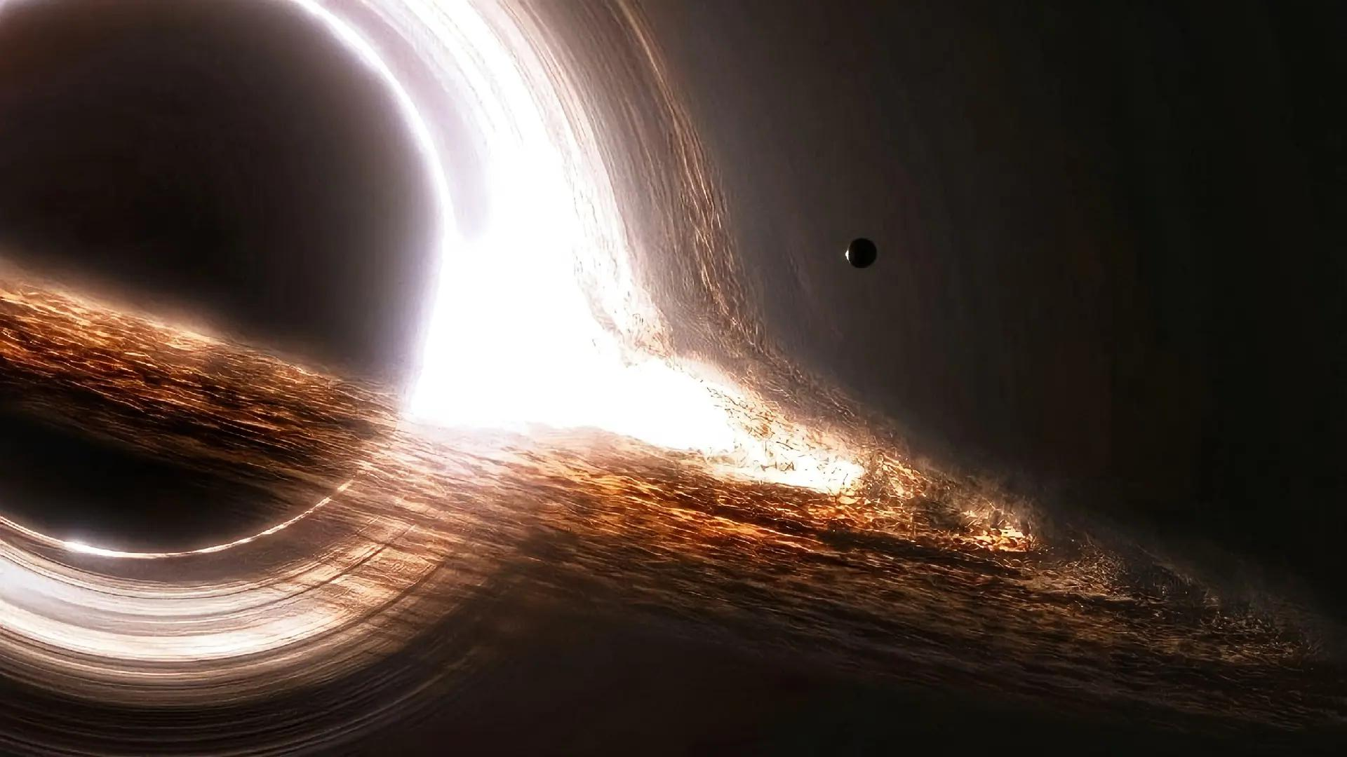
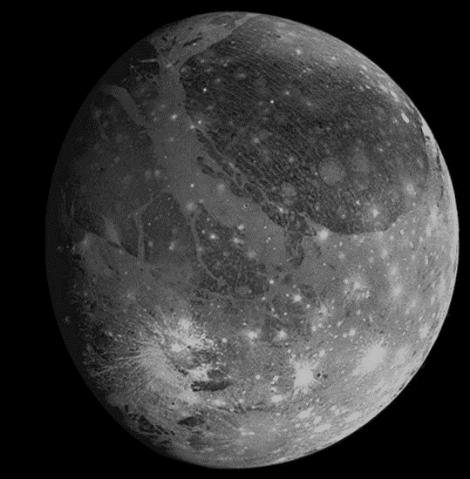
EXOPLANETS
YES !
Did you now anything about Exoplanets ?
What do you think you know about exoplanets or space ?
Any thing !

Slide 3
WHAT A PROPLEM !!
Why don’t people know much about exoplanets ?
The information available is often complex or not intended for the general public
The lack of educational platform that offer simple and understand contant for everyone

Slide 4
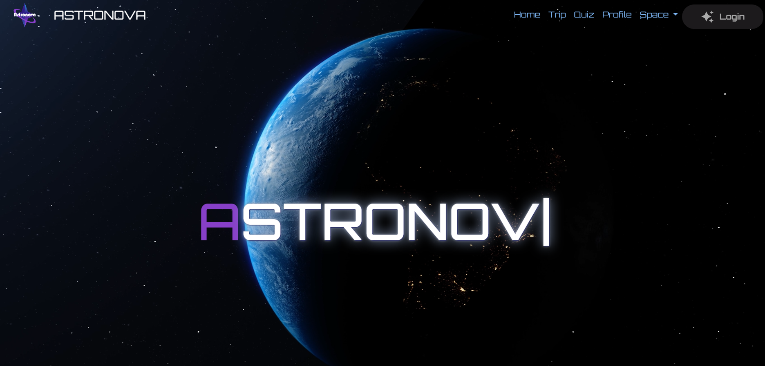
SO …
To address the lack of knowledge about exoplanets, we present a comprehensive and interactive website designed to simplify astronomical information. It offers a rich database of exoplanets, along with interactive features and educational resources, making space exploration accessible to everyone.

Slide 5
What a features ?
We offer key features such as general information on four main topics:
Solar System
Exoplanets
Black holes
Space explorers and their missions, highlighting their discoveries of phenomena and other planets.
Exoplanets
General information about exoplanets
The most significant exoplanets discovered
Along with images of their appearances and the phenomena occurring on them.

Slide 6
And not only that …
We also offer additional features
including a page to test your knowledge about space,
as well as the ability to view key space missions, rockets, and spacecraft.

Slide 7

Future updates
Further development of the 3D simulation feature will enhance user interaction, allowing for immersive exploration of exoplanets and celestial phenomena.
We are introducing the idea of augmented reality (AR) for a live view of space and planets, providing users with an immersive experience to explore the universe in real-time.
Additionally, we will increase the amount of information and educational videos, along with the idea of offering rewards for users who achieve high scores in quizzes

