Slide 1
Crop Yield Prediction and Agricultural Analytics System
A machine Learning approach to climate and pesticide drivers in global Agriculture
Predictive Modeling & insights Dashboard

Slide 2
Introduction
This project focuses on developing a data-driven agricultural analytics system that predicts crop yield using historical environmental and agricultural data from 1961 to 2016. The system integrates multiple datasets, including crop yield, rainfall, temperature, and pesticide usage, to analyze how climatic and agricultural factors influence crop productivity over time.
The project applies data preprocessing, feature engineering, and supervised machine learning techniques to build a regression model capable of predicting crop yield based on environmental conditions and agricultural inputs. Additional engineered features such as climatic factors and rolling yield averages are incorporated to improve predictive performance and analytical depth.
The final processed dataset is visualized using Tableau dashboards to provide interactive insights into agricultural trends, climate impact, and country-level crop performance. The project demonstrates an end-to-end workflow covering data cleaning, integration, machine learning, and visualization using Python and Tableau.

Slide 3
Project Justification
Agriculture is highly affected by environmental conditions such as rainfall and temperature, as well as agricultural inputs like pesticide usage. Understanding how these factors influence crop yield is important for improving food production, resource management, and agricultural planning.
Traditional agricultural analysis often relies on historical observation without predictive capabilities. This project addresses that limitation by applying machine learning techniques to historical agricultural data in order to identify patterns and generate predictive insights.
The project is justified because it demonstrates how data science and machine learning can support agricultural decision-making by:
Identifying relationships between climate variables and crop productivity
predicting future yield outcomes based on environmental conditions
analyzing long-term agricultural trends and providing visual insights through interactive dashboards.
In addition, the project serves as a practical application of data analytics, feature engineering, supervised learning, and data visualization techniques within a real-world business and agricultural context.

Slide 4
Datasets
yield.csv
pesticide.csv
rainfall.csv
temp.csv
Source:
https://www.kaggle.com/code/kushagranull/crop-yield-prediction/input

Slide 5
Pre-Processing & Pipeline
Cleaning
Handling missing values and ensuring alignment across merged datasets.
Scaling
StandardScaler applied to pesticide usage, rainfall and temperature to prevent weight bias.
Encoding
One-Hot Encoding for categorical features (Crop Type, Country).

Slide 6
Features
Output
Country
Year
Crop
Pesticide_Usage
Avg_temperature
Average_rainfall_mm_per_year
climate_factor
yield_lag
rolling_avg_yield
Yield

Slide 7
Libraries
Pandas
Matplotlib.pyplot
seaborn
Sklearn
sklearn.compose – ColumnTransformer
sklearn.preprocessing -- StandardScaler, OneHotEncoder
sklearn.linear_model – LinearRegression
sklearn.ensemble – RandomForestRegressor
sklearn.model_selection train_test_split

Slide 8
Data Splitting For ML
Train Data –1990 to 2008
Test Data --2009 to2013

Slide 9
Machine Learning Models(MLM)
Linear Regression Model (Baseline) r^2 score =93.82
Random Forest Regressor (RFR) r^2 score=95.05 (Capture non-linear patterns)
Random Forest Regressor(without engineered features)(RFRW) r^2 score=93.11 (Capture real-world Agronomy effect)

Slide 10
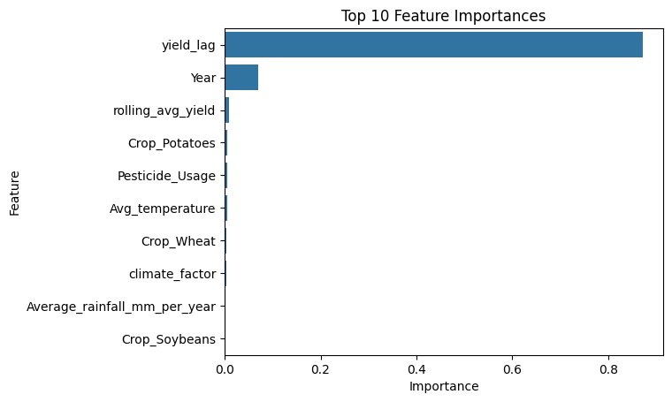
Feature Importance(RFR)
The RFR model relied heavily on lag yield to make predictions( the “momentum effect”)
While the model having a high r^2 score of 95.05% , this historical dominance masked the casual interactions of climatic and other features in predicting yield.

Slide 11
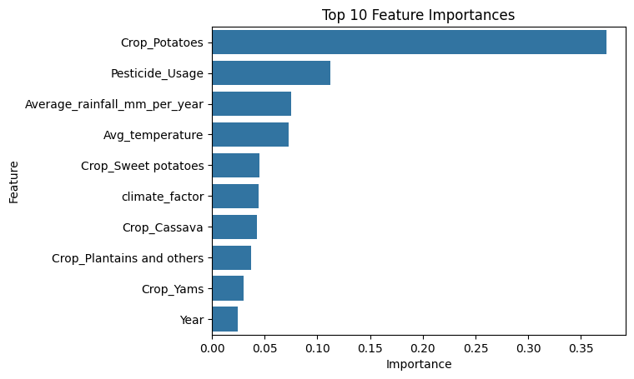
Feature Importance(RFRW)
RFRW model was forced to learn from scratch .
Although the accuracy reduced to 93.11% resulting feature importances that perfectly mirror real-world agronomy.
Heavier crop types such as potatoes led the race with 37.40%, sweet potatoes with 4.49%, cassava with 4.26%
Pesticide usage took 2nd spot with 11.21%

Slide 12
Tableau Visualization
10 countries with different climatic conditions was selected for tableau Visualization
Tableau-Dashboard

Slide 13
Core Findings
1.Crop Type Dictates the Baseline, but Tech Input Drives the Scaling
The Tableau Evidence:The "Country-Crop-Yield" breakdown highlights that certain crop types (like potatoes and sweet potatoes) maintain massive, heavy physical yield weights per hectare compared to grains like wheat, regardless of which country they are grown in.
The ML Validation: The feature importance graph shows Crop such as Potatoes leading the entire race with 37.40% of the model's predictive importance, closely followed by pesticide usage.
The Combined Finding: This reveals that biology sets the anchor, but technology drives the efficiency. Crop type acts as the primary scalar weight, while pesticide usage acts as a direct proxy for modernized, intensive farming infrastructure that insulates a country's yields from environmental fluctuations.

Slide 14
Core Findings Cont...
2. The Core Sufficiency of Environmental & Technological Inputs
The Tableau Evidence: The dashboard shows that while climatic baselines (temperature and rainfall) remain remarkably stable over the observed years, crop yields across countries like Braziland India show dynamic, distinct paths.
The ML Validation: When we stripped away historical lag shortcuts in the RFRW model, the model still achieved a spectacular R^2 score of 93.11% using climate, crop types and pesticide inputs.
The Combined Finding: This proves a major conceptual point: We do not need complex historical context to predict agricultural success. Environmental and biological factors combined with human technological inputs are highly sufficient on their own to explain over 93% of global crop yield variance.

Slide 15
Limitations & Future Work
Our pure environmental model (RFRW) captures 93.11% of global yield variance.
Data Limitations: Unmeasured factors such as soil degradation metrics, specific fertilizer NPK compositions, and localized micro-climate anomalies are not captured in the current global datasets.
Future Work : Integrating localized soil-health profiles to ascertain if soil properties can influence predictability accuracy .

Slide 16
Thank You!
Questions & Discussion

