Slide 1
Al Ain University research output
1,338 papers · 558 authors · 184 on the faculty roster
Nothing is counted unless the paper itself prints an AAU address. Generated 2026-09-07.

Slide 2
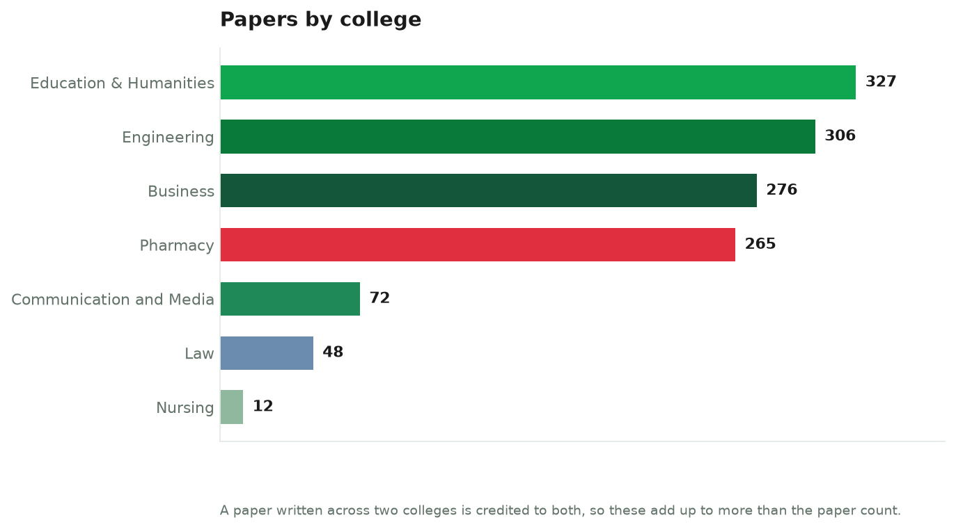

Slide 3
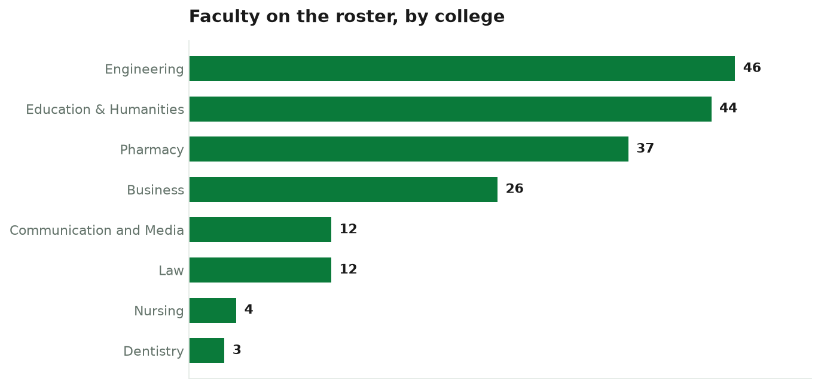

Slide 4


Slide 5
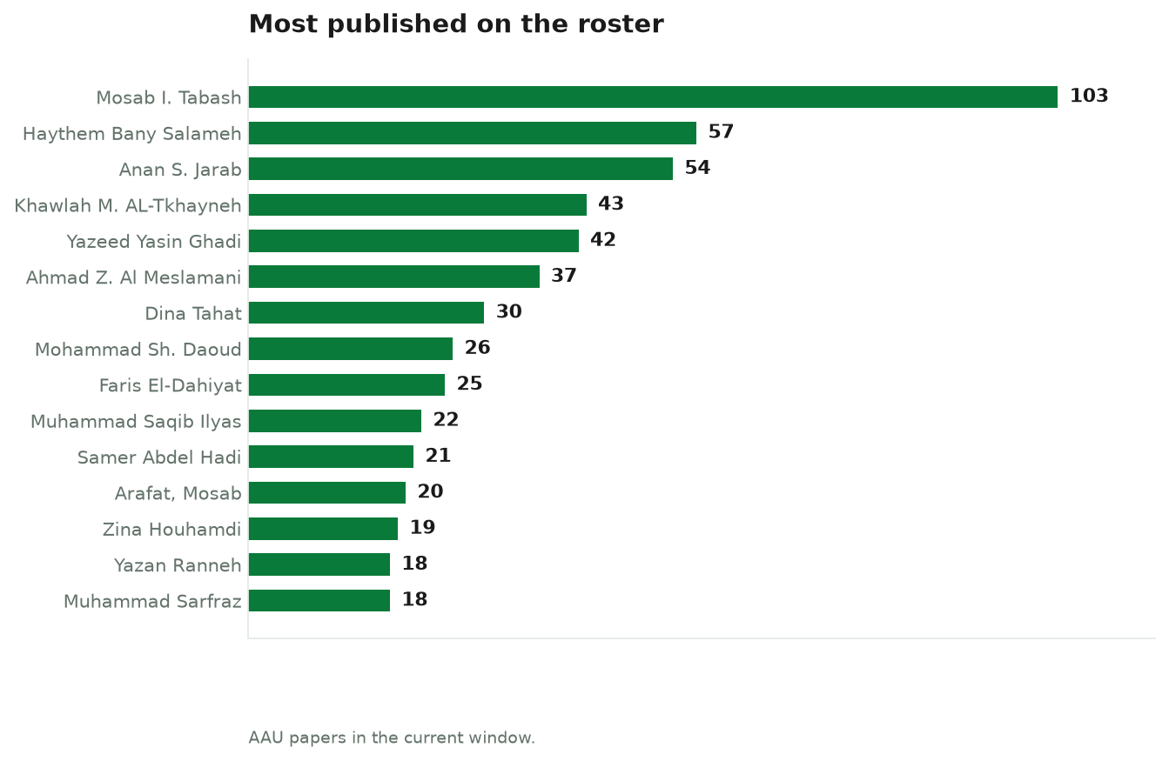

Slide 6
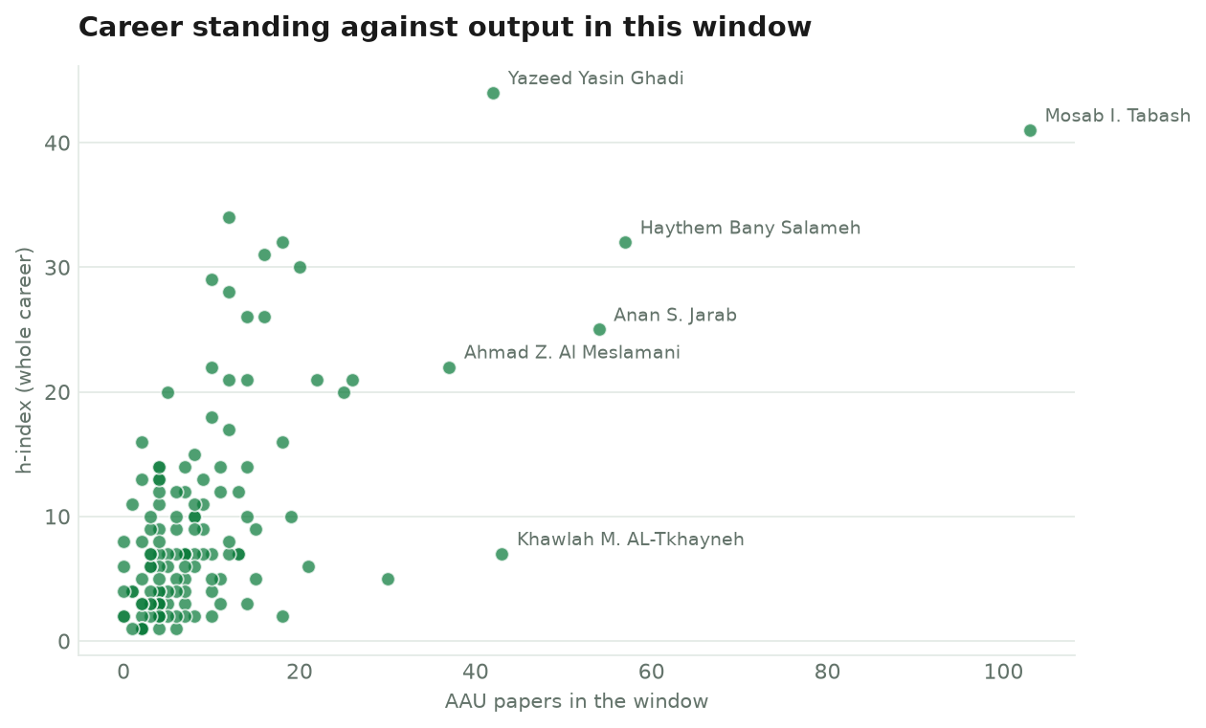

Slide 7
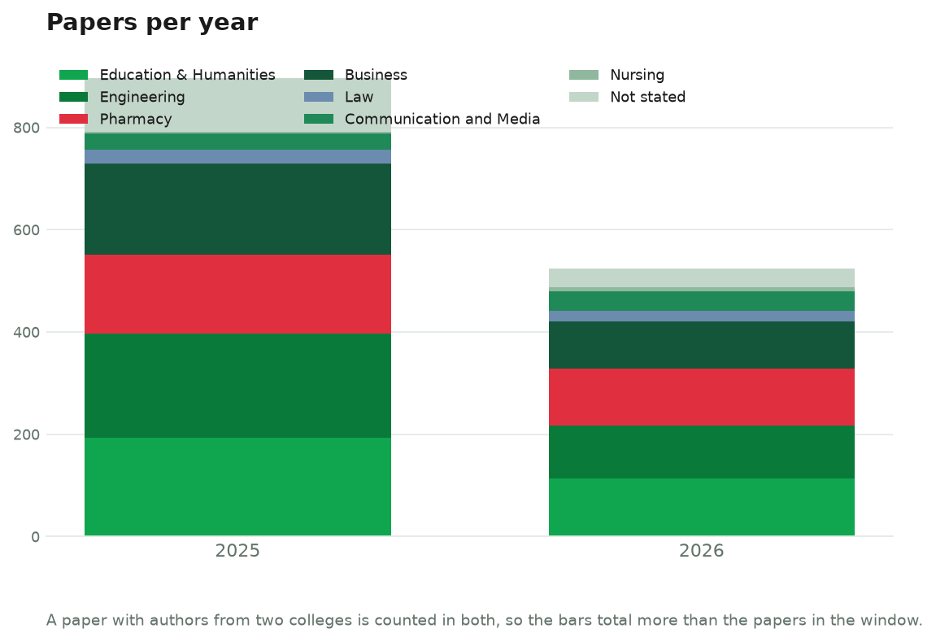

Slide 8
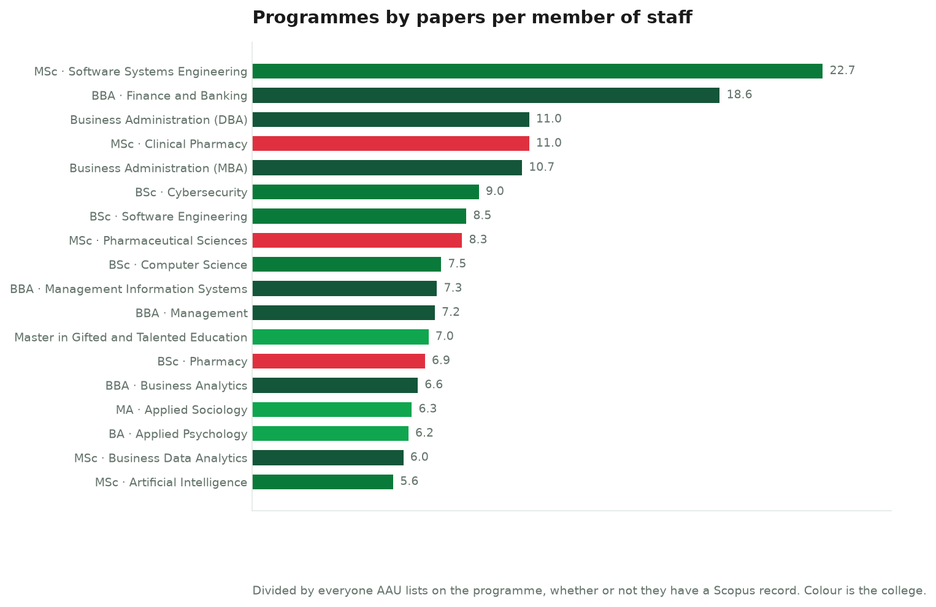

Slide 9
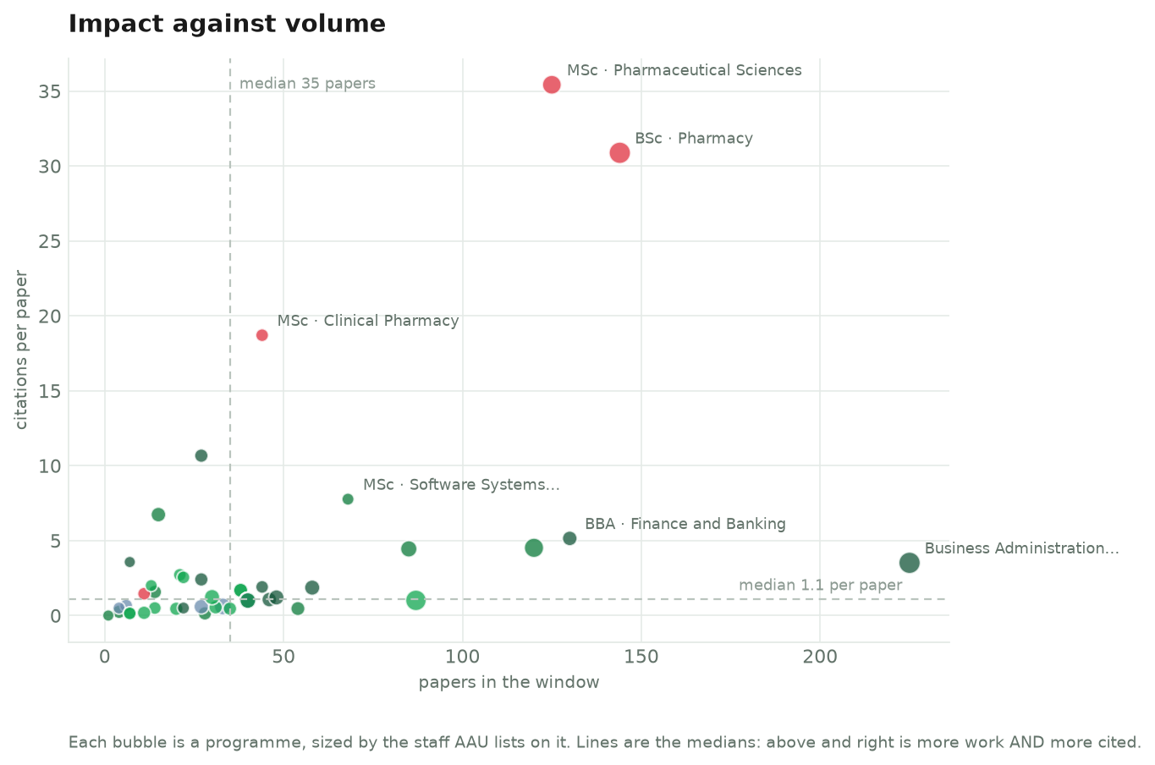

Slide 10
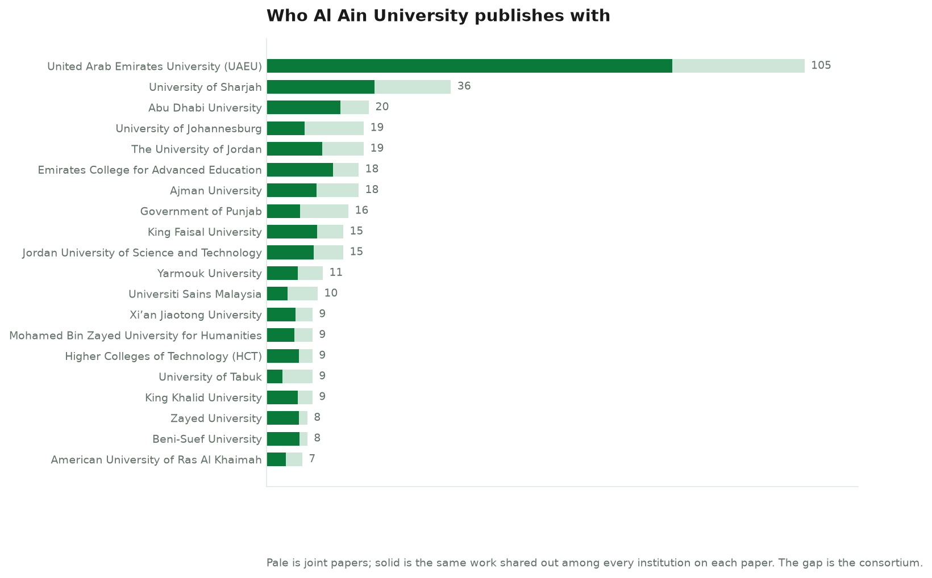

Slide 11
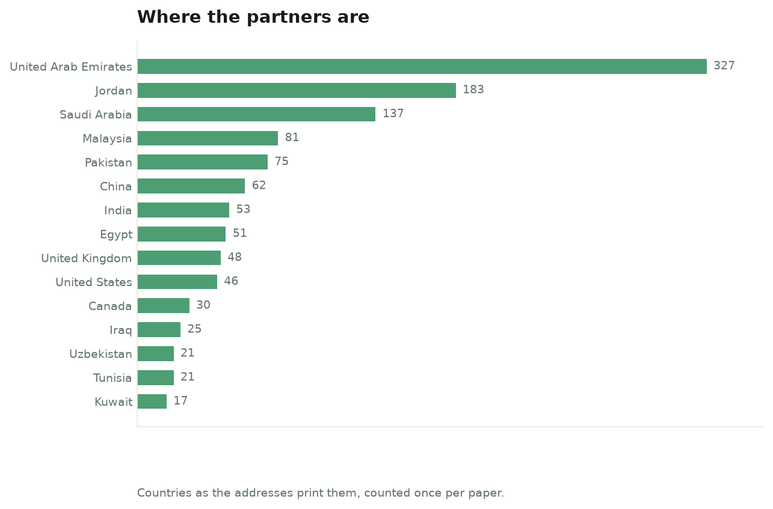

Slide 12
