Slide 1
Design and Analysis of Algorithms
Introduction

Slide 2
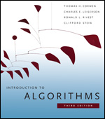
Class Policy
Grading
Introduction to Algorithms,
Thomas H. Cormen, Charles E. Leiserson, Ronald L. Rivest and Clifford Stein

Slide 3

Homework Submission
Submit all homeworks using the
e-learning system
http://elearning.just.edu.jo/

Slide 4
Why Study Algorithms?
Necessary in any computer programming problem
  Improve algorithm efficiency: run faster, process more data, do something that would otherwise be impossible
  Solve problems of significantly large size
  Technology only improves things by a constant factor
Compare algorithms
Algorithms as a field of study
  Learn about a standard set of algorithms
  New discoveries arise
  Numerous application areas
Learn techniques of algorithm design and analysis
Introduction

Slide 5
Applications
Multimedia
  CD player, DVD, MP3, JPG, DivX, HDTV
Internet
  Packet routing, data retrieval (Google)
Communication
  Cell-phones, e-commerce
Computers
  Circuit layout, file systems
Science
  Human genome
Transportation
  Airline crew scheduling, ARAMEX and DHL deliveries
Introduction

Slide 6

Roadmap
Different problems
  Searching
  Sorting
  Graph problems
Different design paradigms
  Incremental
  Divide-and-conquer
  Greedy algorithms
Introduction

Slide 7
Algorithm
Design
Methods / ideas / tricks for developing (fast !) algo.
Analysis
Abstract / mathematical computation of algorithms (without actually implementing them)
Mathematical is needed:
  To formally specify the problem
  Analysis of correctness
  Analysis of efficiency (time, memory use,…)

Slide 8

Analyzing Algorithms
Predict the amount of resources required:
  memory: how much space is needed?
  computational time: how fast the algorithm runs?
FACT: running time grows with the size of the input
Input size (number of elements in the input)
  Size of an array, polynomial degree, # of elements in a matrix, # of bits in the binary representation of the input, vertices and edges in a graph
Def: Running time = the number of primitive operations (steps) executed before termination
  Arithmetic operations (+, -, *), data movement, control, decision making (if, while), comparison
Introduction

Slide 9
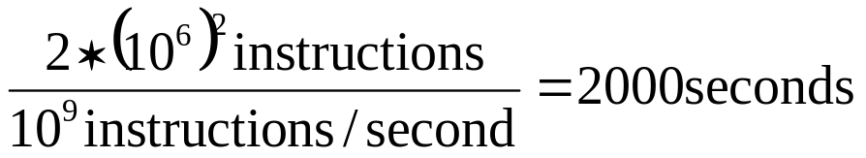
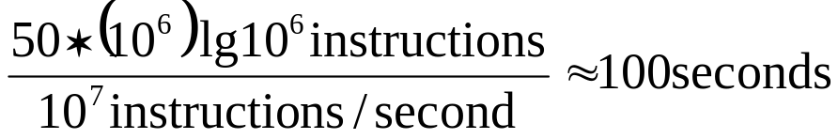
Algorithm Efficiency vs. Speed
E.g.: Sorting n numbers
Friend’s computer = 10⁹ instructions/second
Friend’s algorithm = 2n² instructions
Your computer = 10⁷ instructions/second
Your algorithm = 50nlgn instructions
Your friend =
You =
Sort 10⁶ numbers!
2000/100 = 20 times better!!
Introduction

