Slide 1

CY-431 Software Security
Introduction
Instructed and edited by:
Dr. Heba Alawneh
Author: Mathias Payer
CS-412 Software Security

Slide 2
Course outline
Secure software lifecycle Security policies
Attack vectors
Defense strategies: mitigations and testing Case studies: browser/web/mobile security
Course Homepage: https://nebelwelt.net/teaching/19-412-SoSe/
CS-412 Software Security

Slide 3
Why should you care?
Security impacts everybody’s day-to-day life Security impacts your day-to-day life
User: make safe decisions
Developer: design and build secure systems Researcher: identify flaws, propose mitigations
CS-412 Software Security

Slide 4
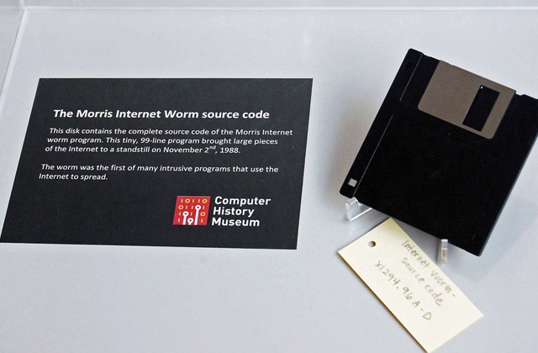
Morris Worm
Figur
3:e
CS-412 Software Security

Slide 5
Morris Worm: What it did
Brought down most of the internet in 2nd November, 1988
Buffer overflow in fingerd, injected shellcode and commands. Debug mode in sendmail to execute arbitrary commands.
Dictionary attack with frequently used usernames/passwords.
Buggy worm: the routine that detected if a system was already infected was faulty and the worm kept reinfecting the same machines until they died.
Reverse engineering of the worm
CS-412 Software Security

Slide 6
C and C++ are unsafe. Humans too.
Kostya Serebryany, Making C/C++ safer
Lots of scary bugs with scary names and logos C and C++ are neither memory nor type safe
Root causes: read/write out-of-bounds (OOB) or after-free (UAF), integer overflow, type confusion, . . .
Consequences: (remote) code execution, information leak, privilege escalation, safety/reliability issues, . . .
CS-412 Software Security
Notes:
Hardware memory tagging is a technique used to improve the security and reliability of software systems by adding metadata, or "tags," to memory regions. This metadata allows for more fine-grained tracking of how memory is accessed and used, helping to detect and prevent certain classes of vulnerabilities, such as buffer overflows and use-after-free bugs.

Slide 7
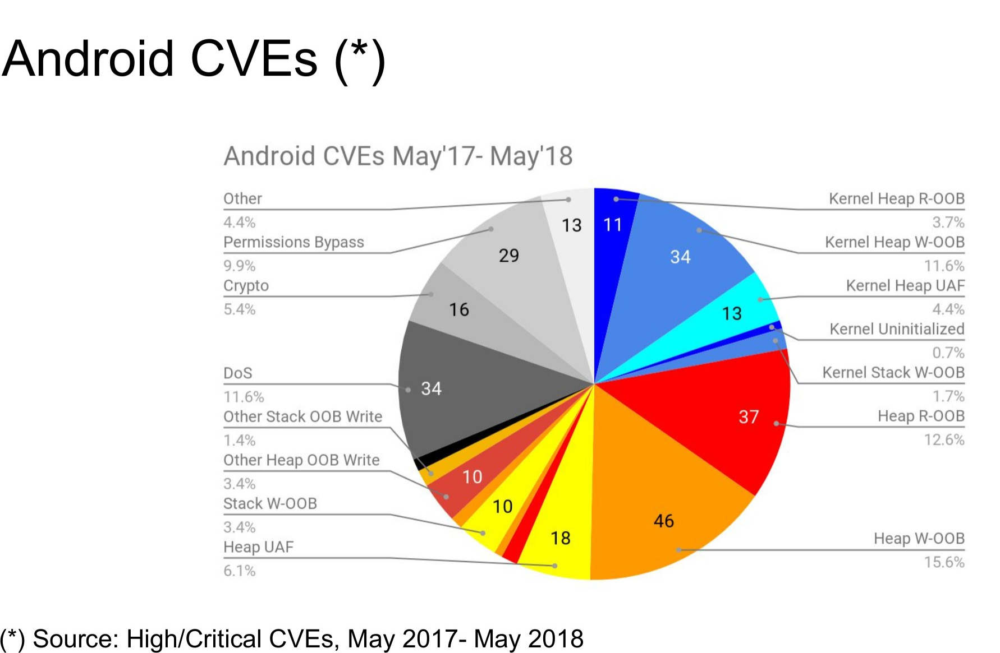
Android
Figure 4: Android Common Vulnerabilities and Exposures (CVEs)
CS-412 Software Security

Slide 8
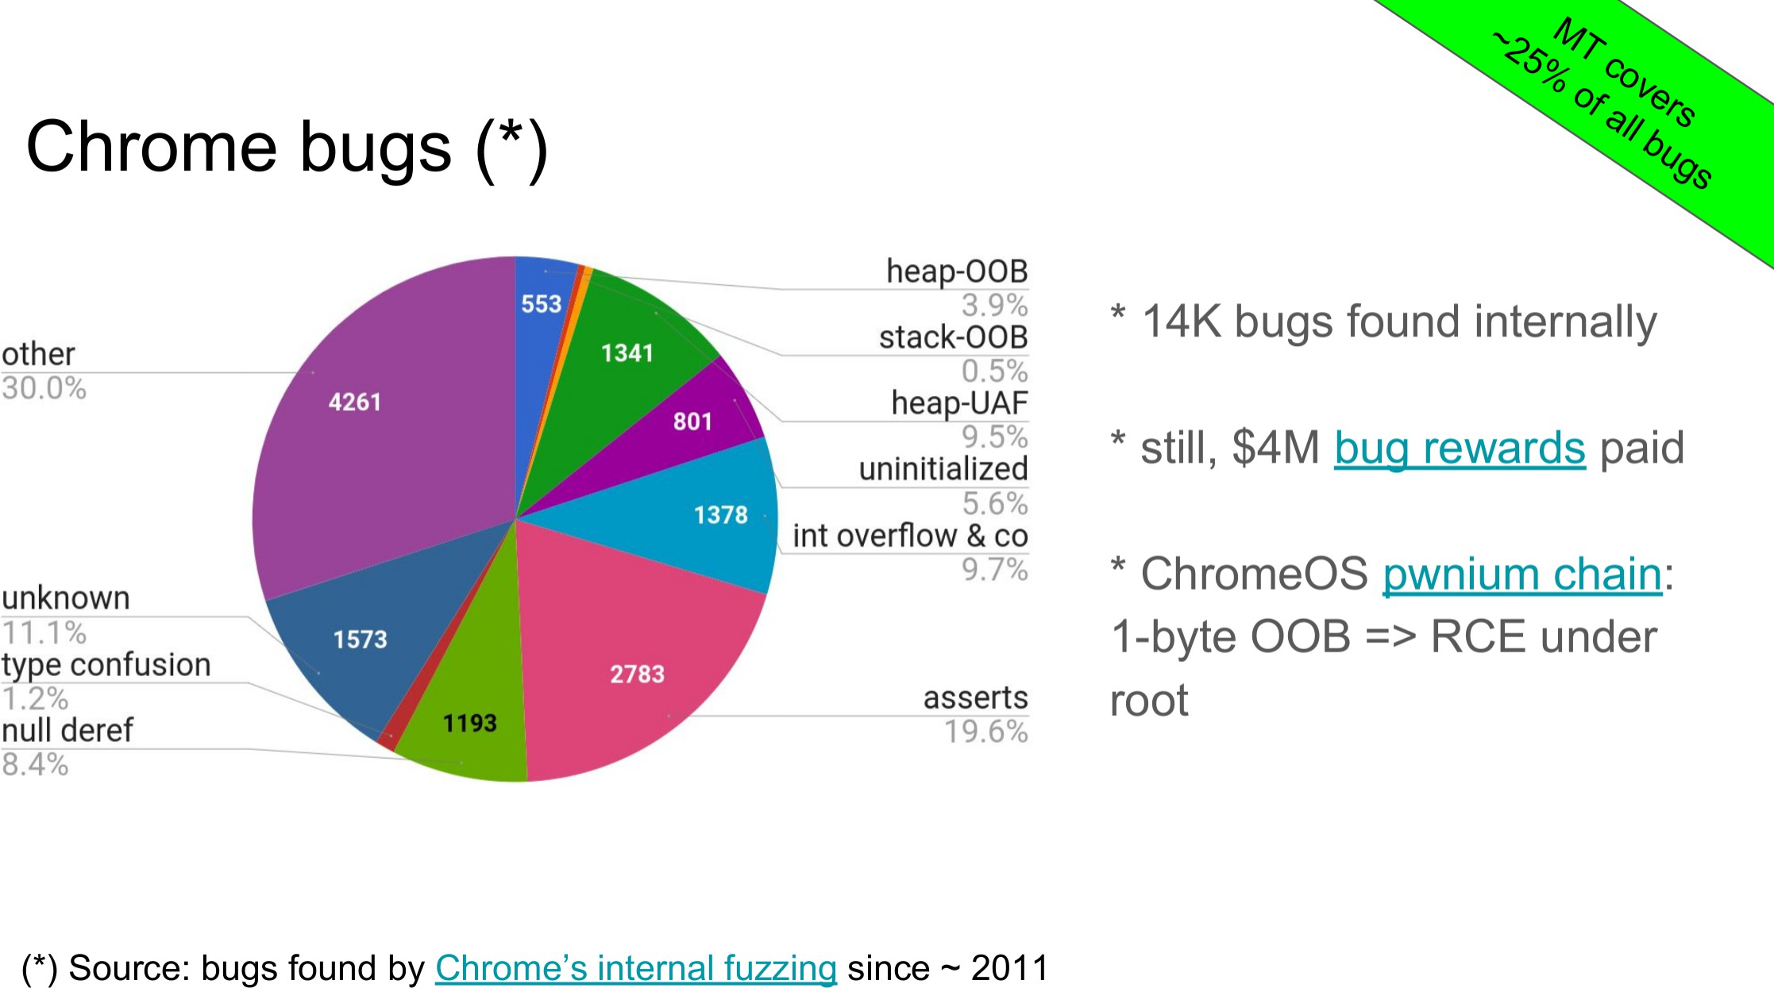
Google Chrome
Figure 5:
CS-412 Software Security
Notes:
HEAP OOB: out of bound
HEAP UAF: Use-After-Free

Slide 9
Low-level software is highly complex
Low-level languages (C/C++) trade type safety and memory safety for performance
Google Chrome: 76 MLoC Gnome: 9 MLoC
Xorg: 1 MLoC
glibc: 2 MLoC
Linux kernel: 17 MLoC
CS-412 Software Security
Notes:
Xorg: X Window System

Slide 10
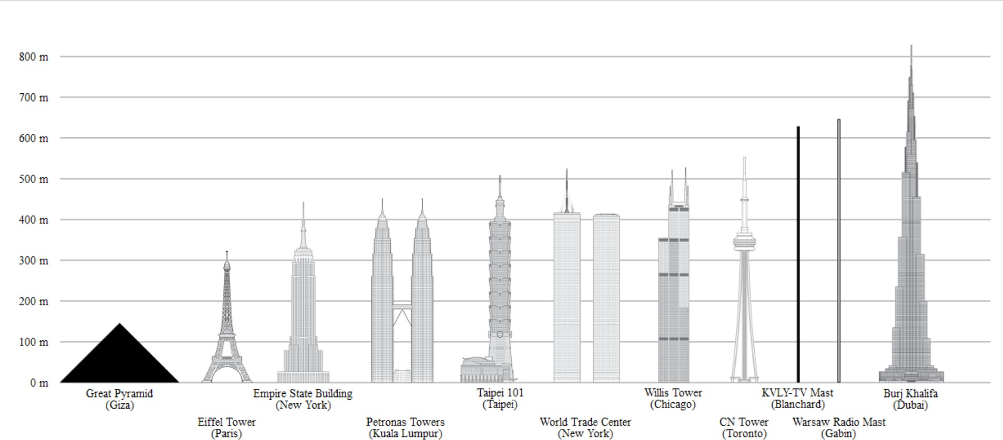
Software complexity (1/2)
Figure 6:
CS-412 Software Security

Slide 11
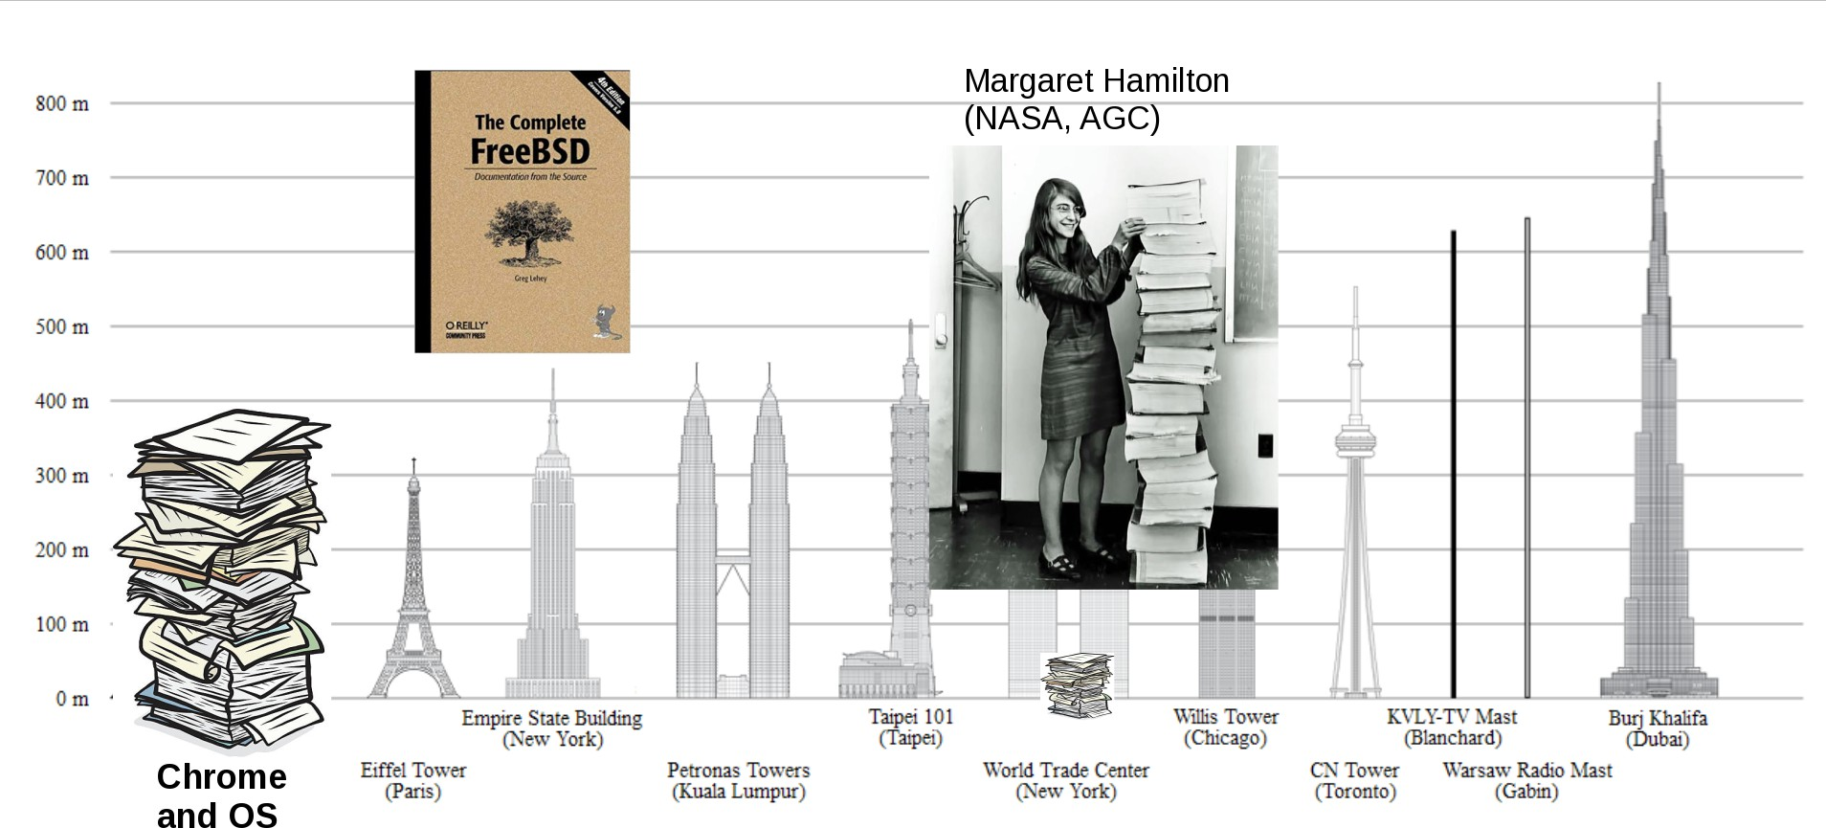
Software complexity (2/2)
Figure 7:
~100 mLoC, 27 lines/page, 0.1mm/page equals roughly 370m
CS-412 Software Security

Slide 12
Software Engineering versus Security
Software engineering aims for
Dependability: producing fault-free software Productivity: deliver on time, within budget Usability: satisfy a client’s needs Maintainability: extensible when needs change
Software engineering combines aspects of PL, networking, project management, economics, etc.
Security is secondary and often limited to testing.
CS-412 Software Security

Slide 13
Definition: Security
Security is the application and enforcement of policies through mechanisms over data and resources.
Policies specify what we want to enforce
Mechanisms specify how we enforce the policy (i.e., an implementation/instance of a policy).
CS-412 Software Security

Slide 14
Security best practices
Always lock your screen (on mobile/desktop) Unique password for each service
Two-factor authentication
Encrypt your transport layer (TLS) Encrypt your messages (GPG) Encrypt your filesystem (DM-Crypt) Disable password login on SSH
Open (unkown) executables/documents in an isolated environment
CS-412 Software Security

Slide 15
Definition: Software Security
Software Security is the area of Computer Science that focuses on (i) testing, (ii) evaluating, (iii) improving, (iv) enforcing, and (v) proving the security of software.
CS-412 Software Security

Slide 16
Why is software security difficult?
Human factor (programmer, software architect, . . . ) Concept of weakest link
Performance Usability
Lack of resources (time, money)
CS-412 Software Security

Slide 17
Software security best practices?
Properly design software
Clear documentation (design and implementation) Leverage frameworks (don’t reimplement functionality) Code reviews
Add rigorous security tests to unit tests
Formal verification for components that can be verified (protocols, small pieces of software)
Red team software Offer bug bounties
CS-412 Software Security

Slide 18
Definition: Software Bug
A software bug is an error, flaw, failure, or fault in a computer program or system that causes it to produce an incorrect or unexpected result, or to behave in unintended ways. Bugs arise from mistakes made by people in either a program’s source code or its design, in frameworks and operating systems, and by compilers.
Source: Wikipedia
CS-412 Software Security

Slide 19
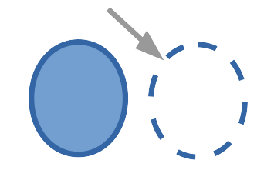
Common bugs: spatial memory safety violation
void vuln() { char buf[12];
char *ptr = buf[11];
*ptr++ = 10;
*ptr = 42;
}
Figure 8:
CS-412 Software Security

Slide 20
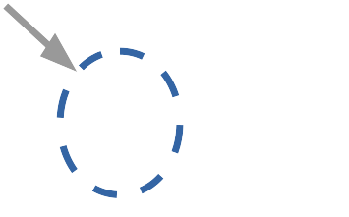
Common bugs: temporal memory safety violation
void vuln(char *buf) { free(buf);
buf[12] = 42;
}
Figure 9:
CS-412 Software Security

Slide 21
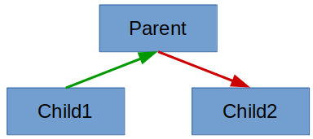
Common bugs: type confusion
class Base {};
class Greeter : Base {};
class Exec : Base {};
Greeter *g = new Greeter();
Base *b = static_cast<Base*>(g);
Exec *e = static_cast<Exec*>(b);
...
Figure 10:
CS-412 Software Security

Slide 22
Definition: Software Vulnerability
A vulnerability is a software weakness that allows an attacker to exploit a software bug. A vulnerability requires three key components (i) system is susceptible to flaw, (ii) adversary has access to the flaw (e.g., through information flow), and (iii) adversary has capability to exploit the flaw.
CS-412 Software Security

Slide 23
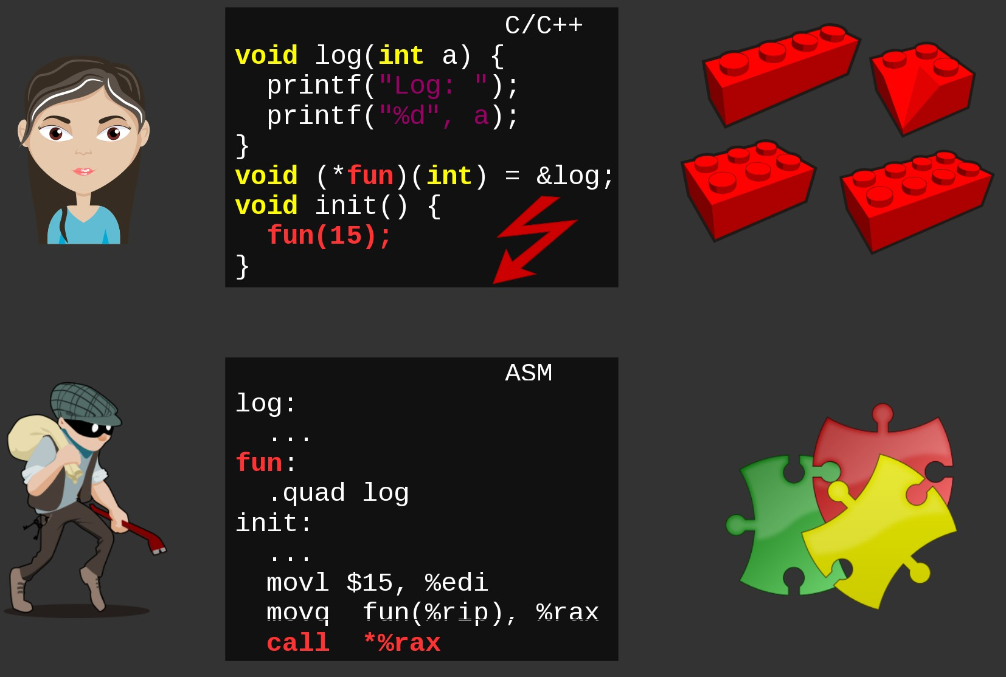
Problem: broken abstractions
Figure 11:
CS-412 Software Security

Slide 24
Course goals
Software running on current systems is exploited by attackers despite many deployed defense mechanisms and best practices for developing new software.
Goal: understand state-of-the-art software attacks/defenses across all layers of abstraction: from programming languages, compilers, runtime systems to the CPU, ISA, and operating system.
CS-412 Software Security

Slide 25
Learning outcomes
Understand causes of common weaknesses. Identify security threats, risks, and attack vector. Reason how such problems can be avoided.
Evaluate and assess current security best practices and defense mechanisms for current systems.
Become aware of limitations of existing defense mechanisms and how to avoid them.
Identify security problems in source code and binaries, assess the associated risks, and reason about severity and exploitability.
Assess the security of given source code.
CS-412 Software Security

Slide 26
Syllabus: Basics
Secure software lifecycle: Design; Implementation; Testing; Updates and patching
Basic security principles: Threat model; Confidentiality, Integrity, Availability; Least privileges; Privilege separation; Privileged execution; Process abstraction; Containers; Capabilities
Reverse engineering: From source to binary; Process memory layout; Assembly programming; Binary format (ELF)
CS-412 Software Security

Slide 27
Syllabus: Policies and Attacks
Security policies: Compartmentalization; Isolation; Memory safety; Type safety
Bug, a violation of a security policy: Arbitrary read; Arbitrary write; Buffer overflow; Format string bug; TOCTTOU
Attack vectors: Confused deputy; Control-flow hijacking; Code injection; Code reuse; Information leakage;
CS-412 Software Security

Slide 28
Syllabus: Defenses
Mitigations: Address Space Layout Randomization; Data Execution Prevention; Stack canaries; Shadow stacks; Control-Flow Integrity; Sandboxing; Software-based fault isolation
Testing: Test-driven development; Beta testing; Unit tests; Static analysis; Fuzz testing; Symbolic execution; Formal verification
Sanitizer: Address Sanitizer; Valgrind memory checker; Undefined Behavior Sanitizer; Type Sanitization (HexType)
CS-412 Software Security

Slide 29
Syllabus: Case studies
Browser security: Browser security model; Adversarial computation; Protecting JIT code; Browser testing
Web security: Web frameworks; Command injection; Cross-site scripting; SQL injection
Mobile security: Android market; Permission model; Update mechanism
CS-412 Software Security

Slide 30
Course material
Slides/homepage: https://nebelwelt.net/teaching/19-412-SoSe/ Text book: Mathias Payer, Software Security: Principles, Policies, and Protection
Moodle for discussions Complementing books
Trent Jaeger, Operating System Security
Remzi H. Arpaci-Dusseau and Andrea C. Arpaci-Dusseau. Operating Systems: Three Easy Pieces
Labs and exercises
CS-412 Software Security

Slide 31
Text book: SS3P
Software Security: Principles, Policies, and Protection
Software and System Security Principles
Secure Software Life Cycle
Memory and Type
Safety Defense Strategies
Attack Vectors
Case Studies: Mobile and Web
CS-412 Software Security

Slide 32
SS3P: Software and System Security Principles Basic security properties
Assessing the security of a system Confidentiality, Integrity, and Availability Isolation, Least Privilege, Compartmentalization Threat Modeling
CS-412 Software Security

Slide 33
Secure Software Life Cycle
Integration of security into design
Continuously assess security during implementation Testing of software projects to vet security issues Continuously track of security properties Continuous project security management
CS-412 Software Security

Slide 34
Grading
First Exam: 25%
Second Exam: 25%
Course Work (Assignments + Quizzes): 20%
Final Exam: 40%
CS-412 Software Security

Slide 35
Academic Integrity
All work that you submit in this course must be your own. Unauthorized group efforts are considered academic dishonesty. You are allowed to discuss the problem with your peers but you may not copy or reuse any part of an existing solution.
We will use automatic tools to compare your solution to those of other current and past students. The risk of getting caught is too high!
CS-412 Software Security

Slide 36
Summary
Software Security is the area of Computer Science that focuses on (i) testing, (ii) evaluating, (iii) improving, (iv) enforcing, and (v) proving the security of software.
Learn to identify common security threats, risks, and attack vectors for software systems.
Assess current security best practices and defense mechanisms for current software systems.
Design and evaluate secure software. Have fun!
CS-412 Software Security

