Slide 1

CS412 Software Security
Basic Principles
Edited by: Dr. Heba Alawneh
Author:
Prof. Mathias Payer
EPFL, Spring 2019
CS412 Software Security

Slide 2
Allow intended use of software, prevent unintended use that may cause harm.
Software Security
CS412 Software Security

Slide 3
Security principles
Confidentiality: an attacker cannot recover protected data Integrity: an attacker cannot modify protected data Availability: an attacker cannot stop/hinder computation
Accountability/non-repudiation may be used as fourth fundamental concept. It prevents denial of message transmission or receipt.
CS412 Software Security

Slide 4
Security analysis
Given a software system, is it secure?
. . . it depends
What is the attack surface?
What are the assets? (How profitable is an attack?) What are the goals? (What drives an attacker?)
CS412 Software Security

Slide 5
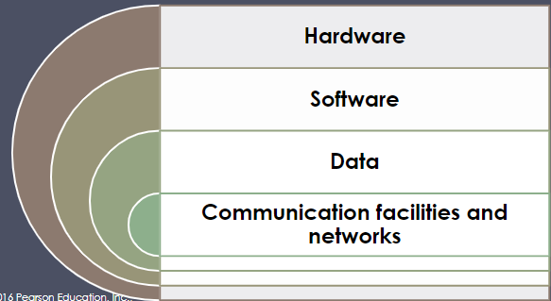
Assets of a Computer System
CS412 Software Security

Slide 6
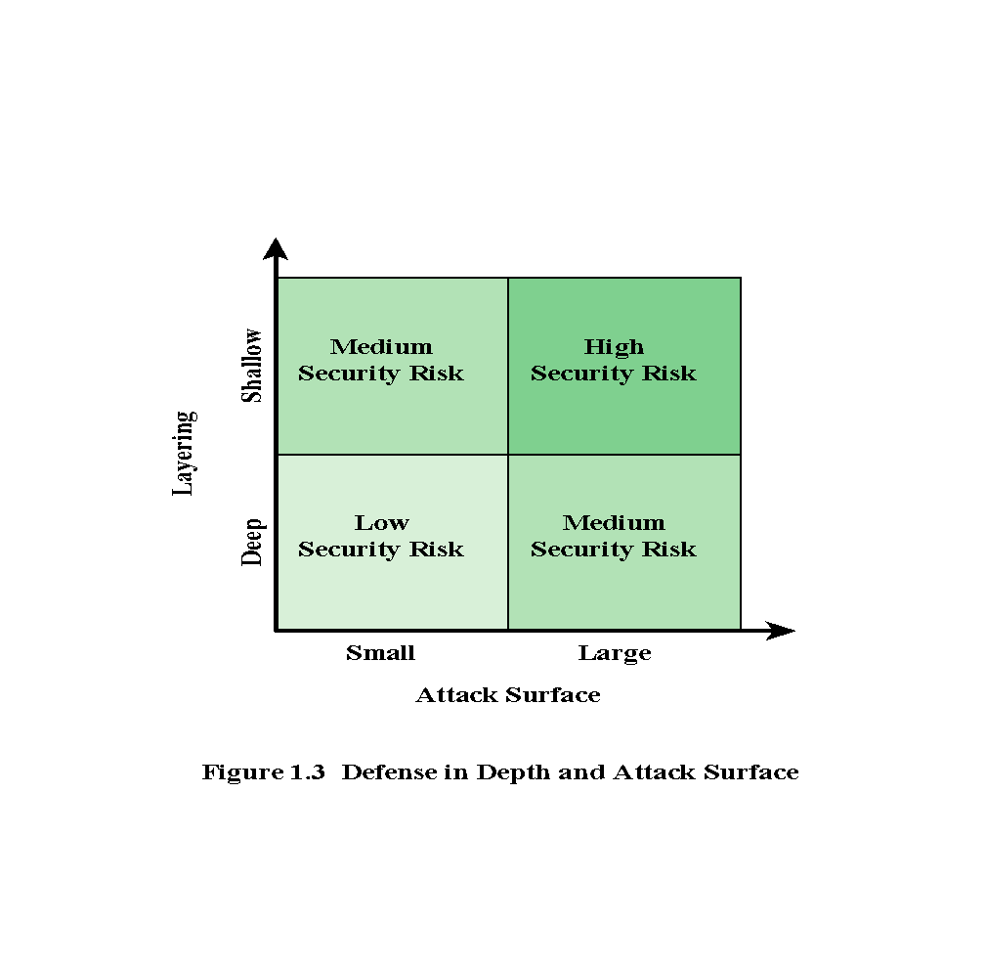
Attack Surface
Network Attack Surface
Software Attack Surface
Human Attack Surface
CS412 Software Security

Slide 7
Attacks and Defenses Attack (threat) models
A class of attacks that you want to stop
What is the attacker’s capability? What is impact of an attack?
What attacks are out-of-scope?
Defenses address a certain attack/threat model.
General: e.g., stop memory corruptions
Very specific: e.g., stop overwriting a return address
CS412 Software Security

Slide 8
Threat model
The threat model defines the abilities and resources of the attacker. Threat models enable structured reasoning about the attack surface.
Awareness of entry points (and associated threats) Look at systems from an attacker’s perspective
Decompose application: identify structure Determine and rank threats
Determine counter measures and mitigation
Reading material: https://www.owasp.org/index.php/ Application_Threat_Modeling
CS412 Software Security

Slide 9
Threat model: safe
Assume you want to protect your valuables by locking them in a safe.
In trust land, you don’t need to lock your safe. An attacker may pick your lock.
An attacker may use a torch to open your safe.
An attacker may use advanced technology (x-ray) to open it. An attacker may get access (or copy) your key.
CS412 Software Security

Slide 10
Threat model: operating systems
Malicious extension: inject an attacker-controlled driver into the OS;
Bootkit: compromise the boot process (BIOS, boot sectors); Memory corruption: software bugs such as spatial and temporal memory safety errors or hardware bugs such as rowhammer; Data leakage: the OS accidentally returns confidential data (e.g., randomization secrets);
Concurrency bugs: unsynchronized reads across privilege levels result in TOCTTOU (time of check to time of use) bugs; Side channels: indirect data leaks through shared resources such as hardware (e.g., caches), speculation (Spectre or Meltdown), or software (page deduplication);
Resource depletion and deadlocks: stop legitimate computation by exhausting or blocking access to resources
CS412 Software Security

Slide 12
Cost of security
There is no free lunch, security incurs overhead. Security is. . .
expensive to develop,
may have performance overhead, may be inconvenient to users.
CS412 Software Security

Slide 13
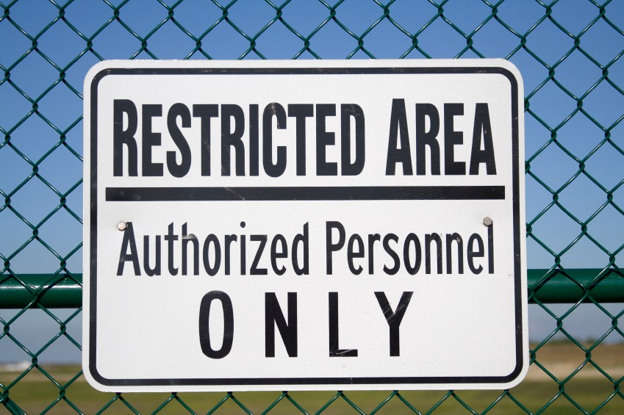
Fundamental security mechanisms
Isolation Least privilege
Fault compartments Trust and correctness
Figure 1
CS412 Software Security

Slide 14
Isolation
Isolate two components from each other. One component cannot access data/code of the other component except through a well-defined API.
CS412 Software Security

Slide 15
Least privilege
The principle of least privilege ensures that a component has the least privileges needed to function.
Any privilege that is further removed from the component removes some functionality.
Any additional privilege is not needed to run the component according to the specification.
Note that this property constrains an attacker in the privileges that can be obtained.
CS412 Software Security

Slide 16
Fault compartments
Separate individual components into smallest functional entity possible. General idea: contain faults to individual components. Allows abstraction and permission checks at boundaries.
Note that this property builds on least privilege and isolation. Both properties are most effective in combination: many small components that are running and interacting with least privileges.
CS412 Software Security

Slide 17
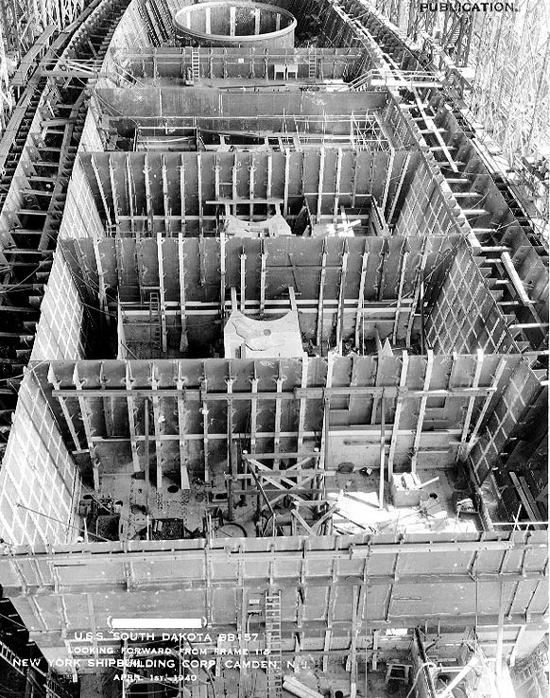
Fault compartments
Figure 2
CS412 Software Security

Slide 18
Trust and correctness
Specific components are assumed to be trusted or correct according to a specification.
Formal verification ensures that a component correctly implements a given specification and can therefore be trusted. Note that this property is an ideal property that cannot generally be achieved.
CS412 Software Security

Slide 19
CS412 Software Security

Slide 20
Hardware and software abstractions
Operating System (OS) abstractions Hardware abstractions
CS412 Software Security

Slide 21
Operating System (OS) abstraction Provides process abstraction
Well-defined API to access hardware resources Enforces mutual exclusion to resources Enforces access permissions for resources Restrictions based on user/group/ACL Restricts attacker
CS412 Software Security

Slide 22
OS process isolation
Memory protection: protect the memory (code and data such as heap, stack, or globals) of one process from other processes Address space: working memory of one process
Today’s system implement address spaces (virtual memory) through page tables with the help of an Memory Management Unit (MMU)
CS412 Software Security

Slide 23
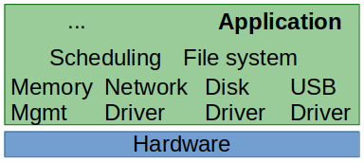
OS designs: single domain (1/4)
A single layer, no isolation or compartmentalization
All code runs in the same domain: the application can directly call into operating system drivers
High performance, often used in embedded systems
Figure 3
CS412 Software Security

Slide 24
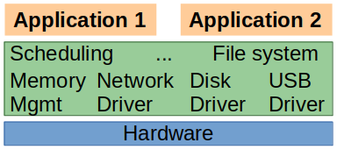
OS design: monolithic (2/4)
Two layers: the operating system and applications The OS manages resources and orchestrates access
Applications are unprivileged, must request access from the OS Linux fully and Windows mostly follows this approach for performance (isolating individual components is expensive)
Figure 4
CS412 Software Security

Slide 25
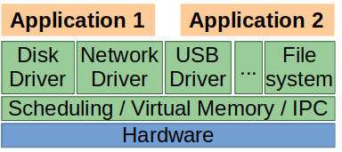
OS design: micro-kernel (3/4)
Many layers: each component is a separate process Only essential parts are privileged
Process abstraction (address spaces) Process management (scheduling) Process communication (IPC)
Applications request access from different OS processes
Figure 5
CS412 Software Security

Slide 26
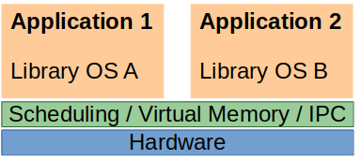
OS design: library os (4/4)
Few thin layers; flat structure
Micro-kernel exposes bare OS services
Each application brings all necessary OS components
Figure 6
CS412 Software Security

Slide 27
Hardware abstraction
Virtual memory through MMU/OS
Only OS has access to raw physical memory DMA for trusted devices
ISA enforces privilege abstraction (ring 0/3 on x86)
Hardware abstractions are fundamental for performance
CS412 Software Security

Slide 28
Access control
Authentication: Who are you (what you know, have, or are)?
Authorization: Who has access to object?
Audit/Provenance: I’ll check what you did.
CS412 Software Security

Slide 29
Authentication: who are you?
There are three fundamental types of identification:
What you know: username / password What you are: biometrics
What you have: second factor / smartcard
How do you authenticate a remote entity?
Kerberos: capabilities and tokens.
CS412 Software Security

Slide 30
Authorization: Information flow control
An important question when handling shared resources is who can access what information.
These access policies are called access control models. Access control models were originally developed by the US military
Users with different clearance levels on a single system Data was shared across different levels of clearance Therefore the name “multi-level security”
CS412 Software Security

Slide 31
Authorization: Types of access control
Mandatory Access Control (MAC): Rule and lattice-based policy
Discretionary Access Control (DAC): Object owners specify policy
Role-Based Access Control (RBAC): Policy defined in terms of roles (sets of permissions), individuals are assigned roles, roles are authorized for tasks.
CS412 Software Security

Slide 32
MAC
Centrally controlled
One entity controls what permissions are given Users cannot change policy themselves Examples: Bell/LaPadula and Biba
CS412 Software Security

Slide 33
Bell and LaPadula
Multi level security model that enforces information flow control All security levels are monotonically ordered, files have clearance level
A given clearance allows reading files of lower or equal clearance and writing files of equal or higher clearance. Summary: read-down, write-up
Bell/LaPadula enforces confidentiality
CS412 Software Security

Slide 34
Biba
Multi level security model that enforces information flow control All security levels are monotonically ordered, files have integrity level
A given clearance allows reading files of higher or equal clearance and writing files of lower or equal clearance. Summary: read-up, write-down
Biba enforces integrity
CS412 Software Security

Slide 35
DAC
MAC is complex and requires central control, empower the user!
User has authority over resources she owns
User determines permissions for her data if other users want to access it
For example: Unix permissions
CS412 Software Security

Slide 36
RBAC
Access permission is broken into sets of roles. Users get assigned specific roles Administration privileges may be a role.
CS412 Software Security

Slide 37
Different security models
Access control lists (static) Capabilities (static)
Bell-LaPadula (state machine) Information flow (flow dependent)
CS412 Software Security

Slide 38
Access control matrix
Provide access rights for subjects to objects.
foo bar baz
user rwx rw rw group rx r r
other rx r
Used, e.g., for Unix/Linux file systems or Android/iOS/Java security model for privileged APIs.
Introduced by Butler Lampson in 1971 http://research.microsoft.com/en-us/um/people/ blampson/08-Protection/Acrobat.pdf.
CS412 Software Security

Slide 39
Summary and conclusion
Software security goal: allow intended use of software, prevent unintended use that may cause harm.
Three principles: Confidentiality, Integrity, Availability. Security of a system depends on its threat model.
Isolation, least privilege, fault compartments, and trust as concepts.
Security relies on abstractions to reduce complexity. Reading assignment: Butler Lampson, Protection http://doi.acm.org/10.1145/775265.775268
CS412 Software Security

