Slide 1
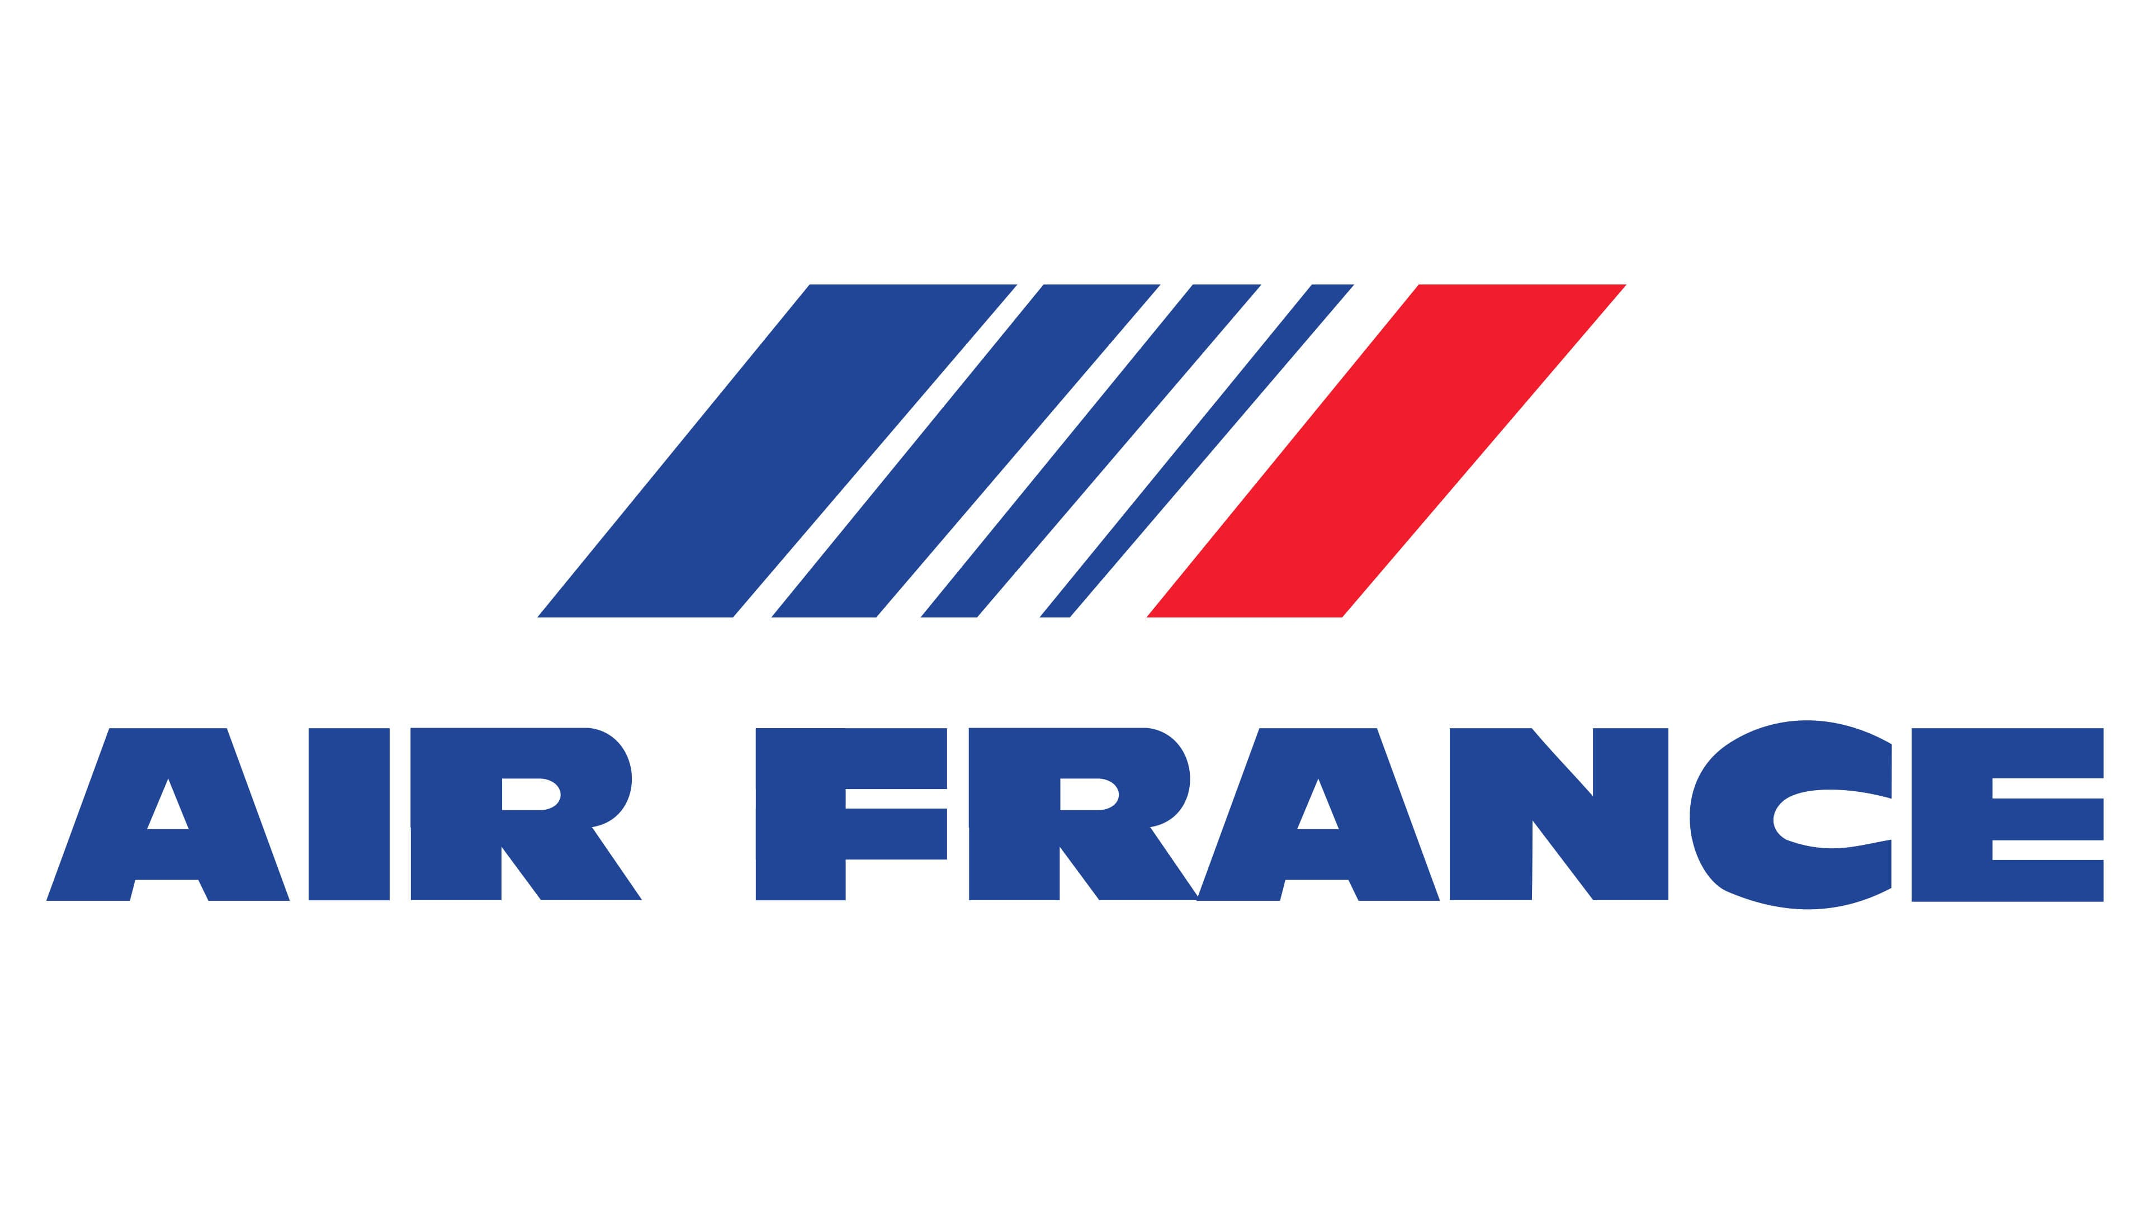
Air France Internet Marketing
Team 7
Abdallah Bazzan
Abdul Salam
Lwazilwenkosi Khanye
Chandrasekhar

Slide 2
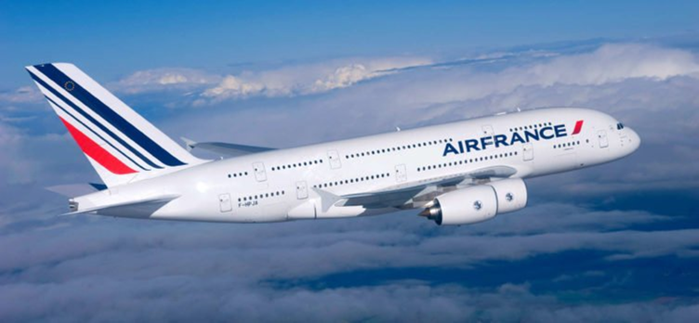
Objectives
Increase the International market share which is currently at 8%
Increase Campaign Efficiency to drive more bookings
Keep Cost of Clicks Low
Increase Net Income
Reach Large Customer Segments
Maximize ROA and Bookings

Slide 3
Most Important KPIs
ROA (Return on Advertising)
Conversion Rate
Income per Booking
Total Cost Per booking

Slide 4
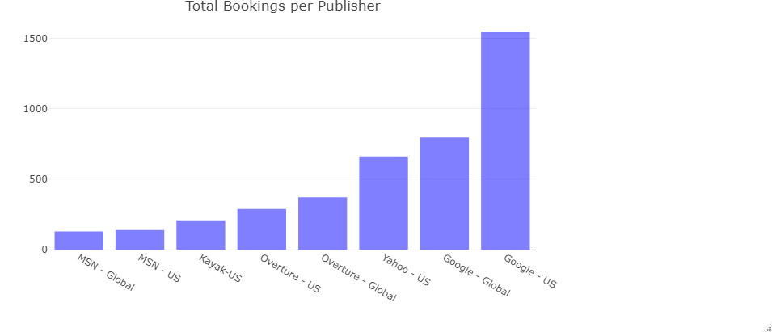
Total Booking per Publisher
Google – US with the highest number of bookings
Yahoo – US has a good number of bookings
MSN – US has lowest number of bookings
Let's compare results with the Cost per booking for each publisher

Slide 5
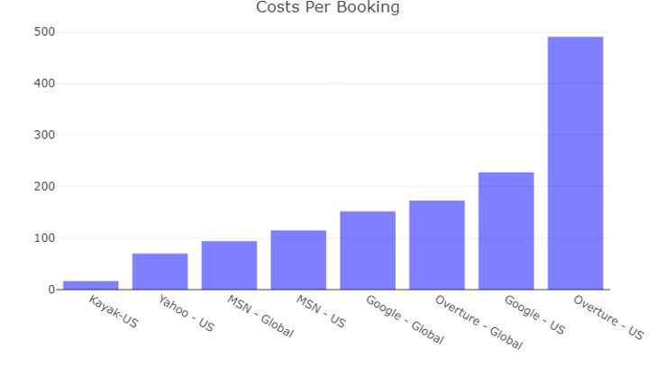
Cost Per Booking
Overture with the highest cost
Yahoo's cost is low compared to the number of bookings we had before
Google – US cost is relatively higher than MSN and Yahoo
Let's dive into the ROA per each publisher

Slide 6
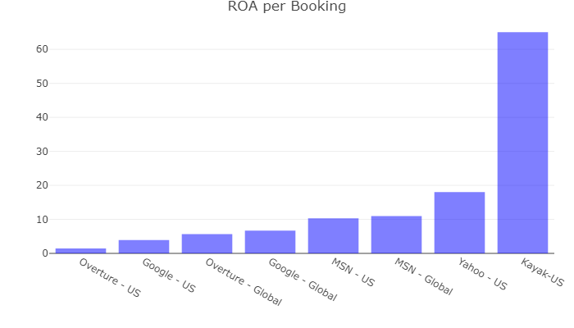
ROA per Booking
Kayak has the highest ROA, so it is definitely worth considering it within our Campaign
Yahoo – US has the highest ROA between the SEMs
Google – US has lower ROA
What could be the best tailored campaign ?

Slide 7
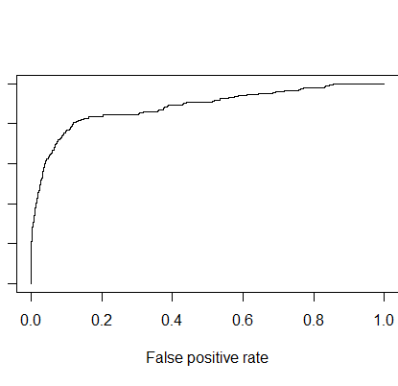
Logistic Regression on Total Volume of Bookings
After normalization, it showed the highest positive impact to be is the Number of Clicks
Therefore, Best approach is to maximize clicks and minimize the avg cost per click
According to this criteria, Yahoo is the most recommended SEM

Slide 8
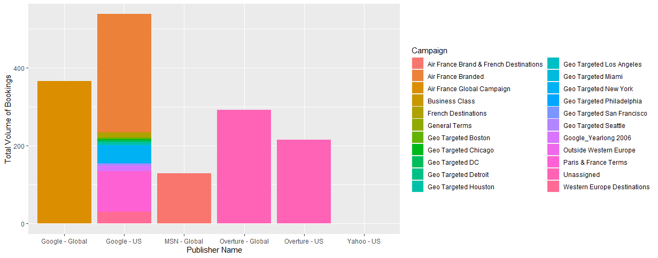
Campaign vs Bookings

Slide 9
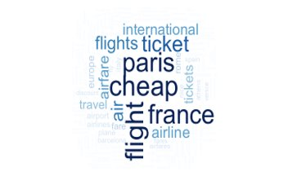
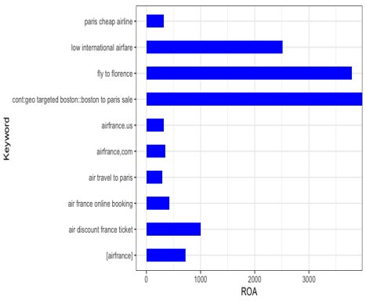
Keywords Analysis
Top 10 keywords based on the ROA
The association is strong with destinations such France and Italy
Paris, France and Cheap are the most associated words

Slide 10
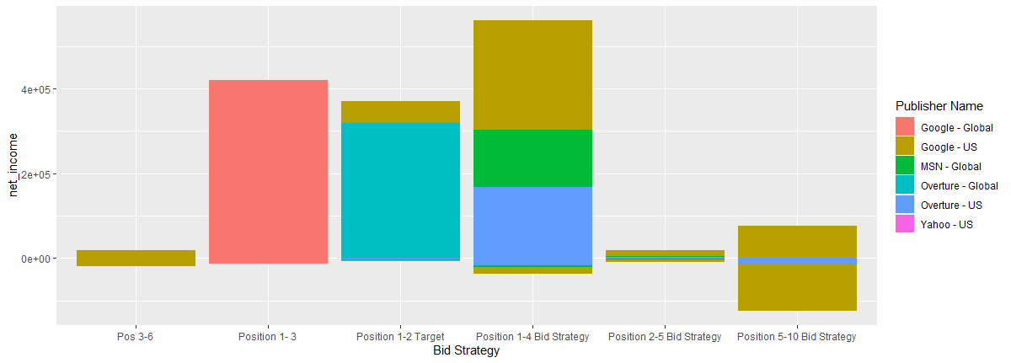
Best Bid Strategies to consider

Slide 11
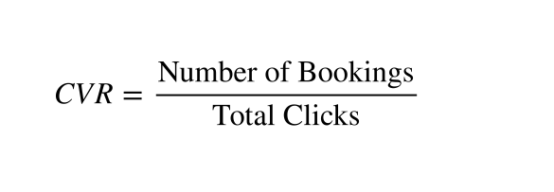
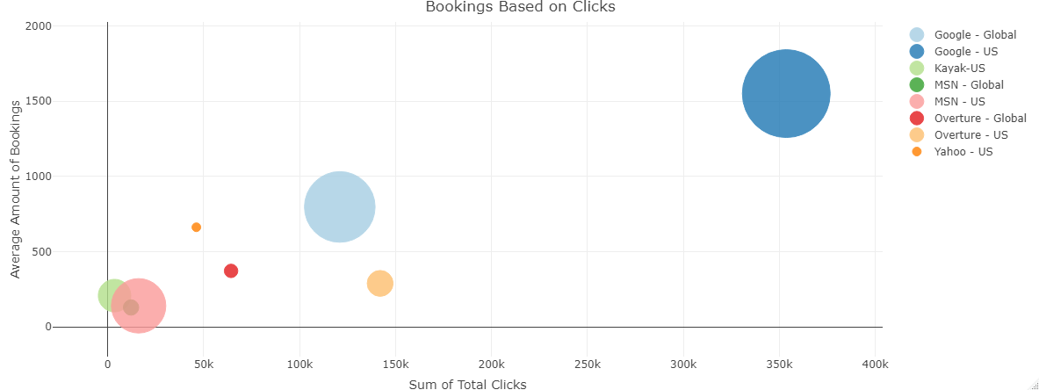
Bookings Vs Clicks
Google - US has the highest has conv. Rate of 0.42%
Yahoo – US has high bookings compared to the number of clicks with low cost with conv rate of 1.5%
Conversion rate for Yahoo is higher than that of Google – US.

Slide 12
Business Recommendation
Three different scenarios to get the best tailored campaign
The best scenario is one that permits us to maximize our return on investment. To do this, a big share of the funds should be spent on the search engine with the highest return on advertisement (ROA) which is Yahoo – US
Also, taking into consideration the popularity and high bookings of Google – US, it is better to give a share of the marketing campaign to Google - US
Kayak is a new SEM with very high potential and high ROA, therefore we recommend giving it a share of the marketing expense in our campaign.
Scenarios | Net Income
Actual Scenario | 4.14
Uniform Strategy Scenario | 6.16
Highest ROA Scenario | 13.67

Slide 13
Key Takeaways
Maximizing campaign efficiency takes into account the top keywords for the search engine as well as the KPIs discussed
Air France best strategy is one that tailors each SEM taking into consideration firstly the ROA and then the volume of bookings
Increasing campaign performance is achieved by maintaining the high number of clicks while lower the average cost per click to increase the number of bookings
Marketing Campaign gives a share for the SEM with the highest ROA which is Yahoo – US and a share for Google – US for having the highest volume of bookings and a big share in Kayak which has high ROA and high future potential

Slide 14
THANK YOU

